Slide 1



PWC_CustomerRetention
View in Power BI
Last data refresh:
4/6/2023 12:29:08 AM UTC
Downloaded at:
4/6/2023 12:49:26 AM UTC

Slide 2
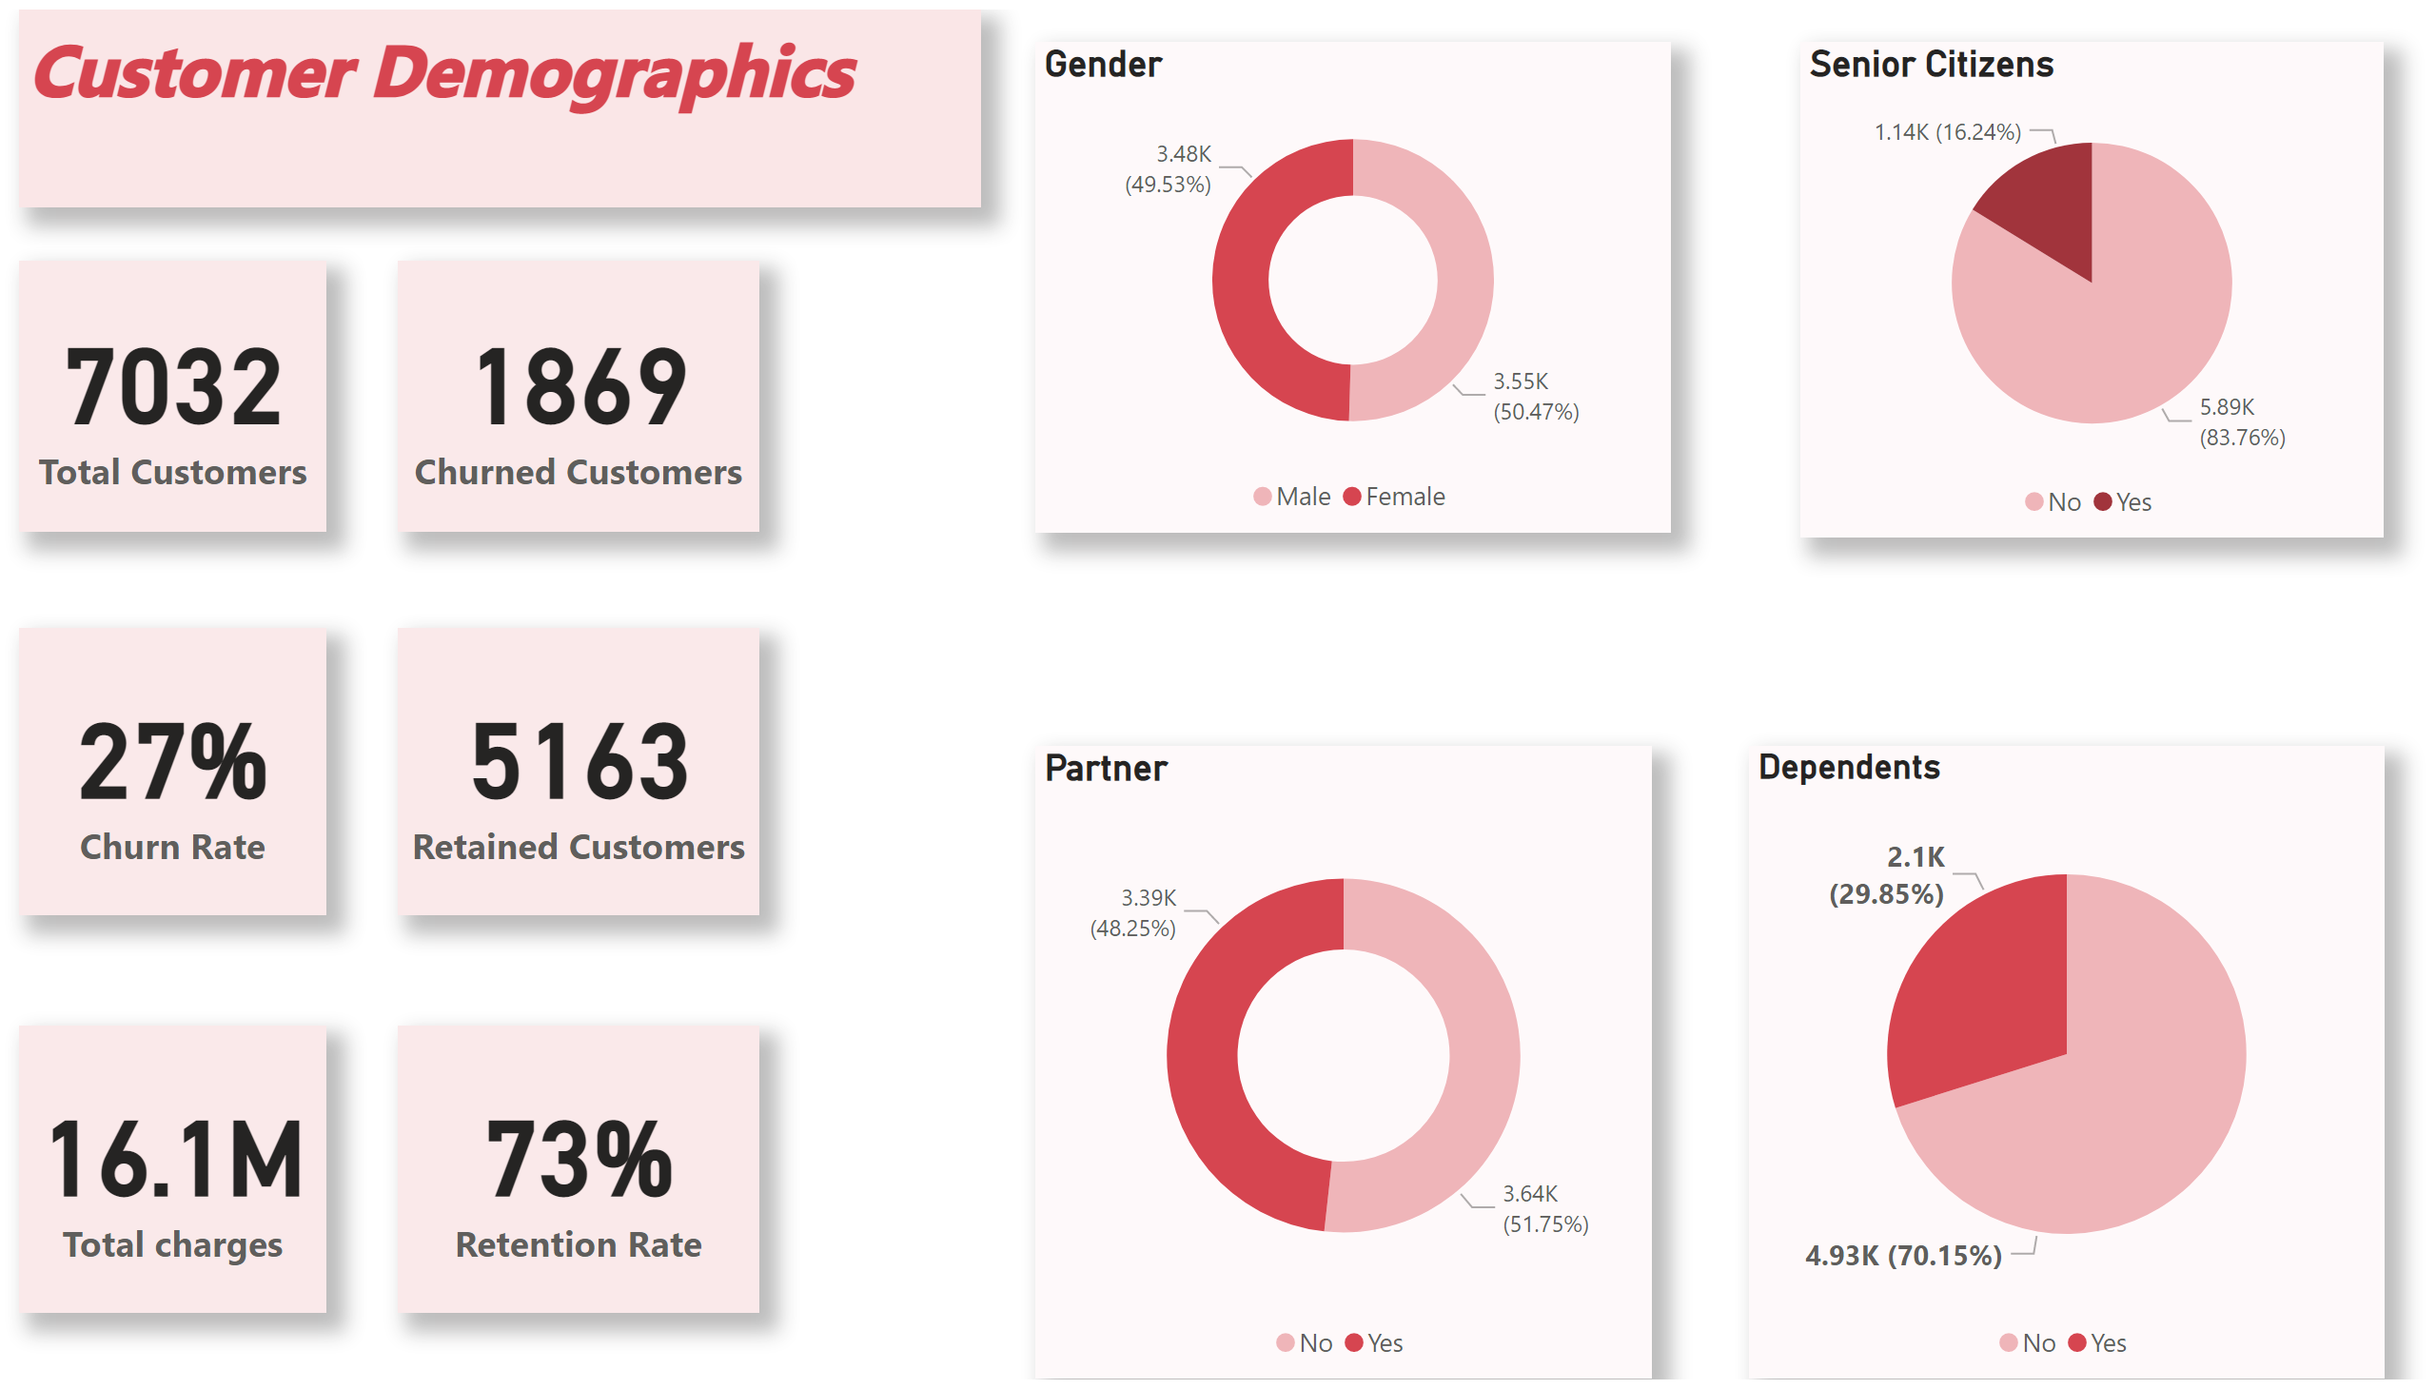
Customer Demographics
Notes:
textbox
No alt text provided
card
No alt text provided
card
No alt text provided
card
No alt text provided
Gender
No alt text provided
Partner
No alt text provided
Senior Citizens
No alt text provided
Dependents
No alt text provided
card
No alt text provided
card
No alt text provided
card
No alt text provided

Slide 3
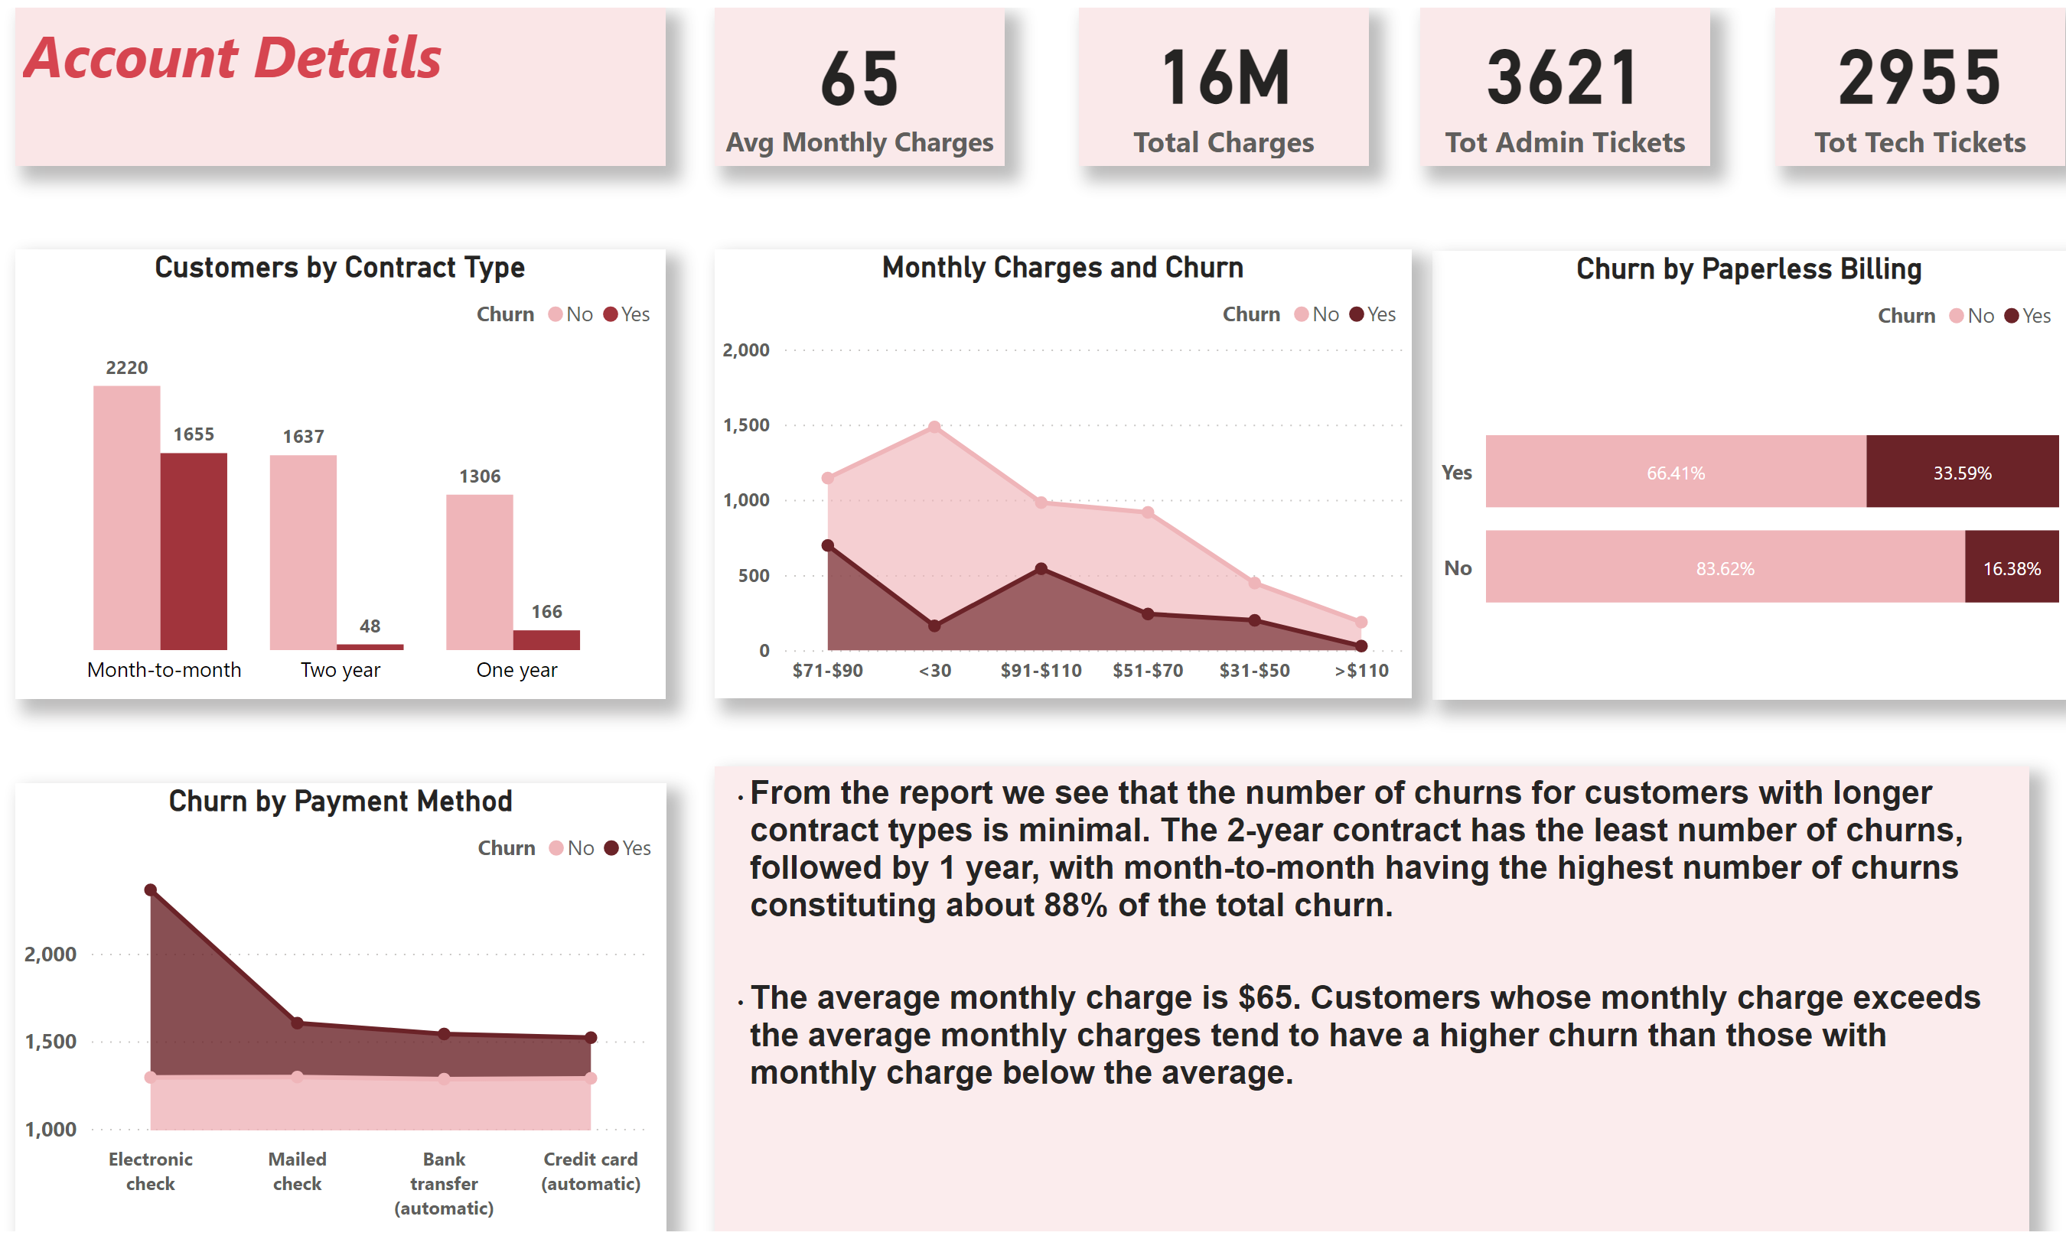
Account Details
Notes:
textbox
No alt text provided
Customers by Contract Type
No alt text provided
Churn by Payment Method
No alt text provided
Churn by Paperless Billing
No alt text provided
card
No alt text provided
card
No alt text provided
card
No alt text provided
card
No alt text provided
Monthly Charges and Churn
No alt text provided
textbox
No alt text provided

Slide 4
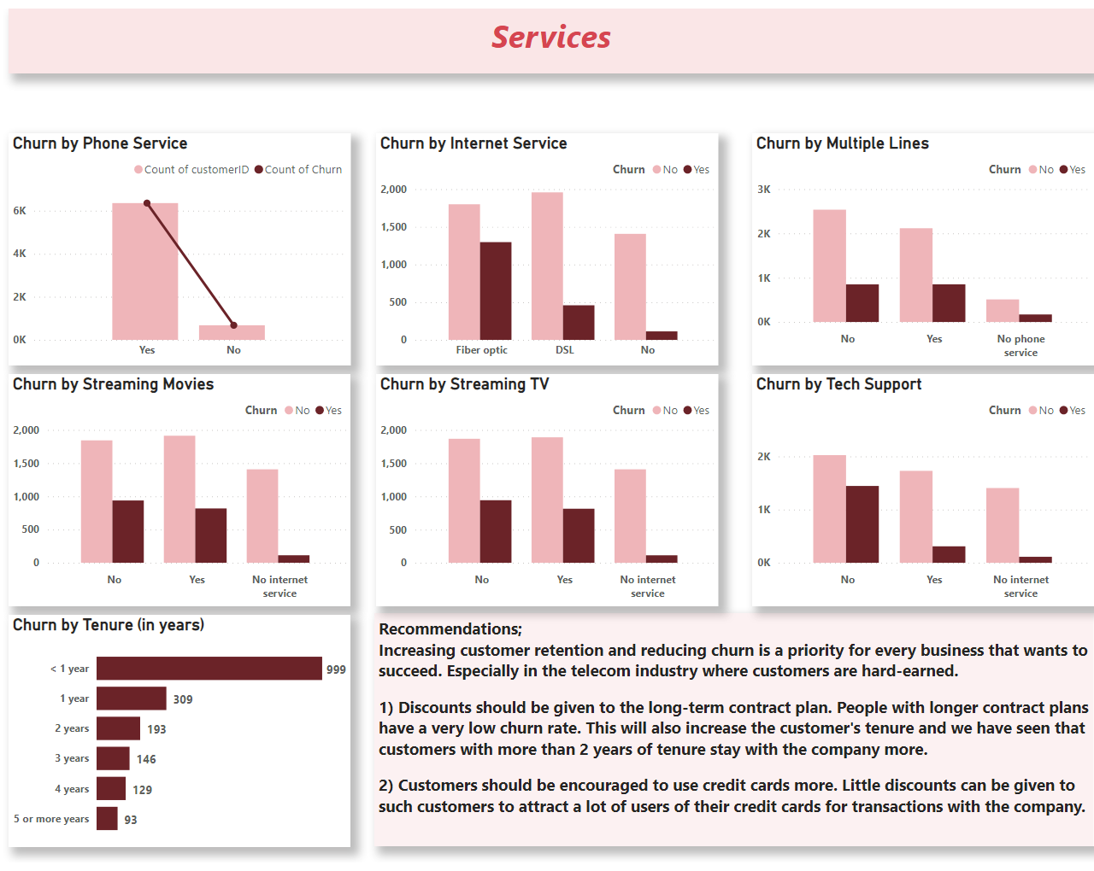
Services
Notes:
textbox
No alt text provided
Churn by Phone Service
No alt text provided
Churn by Internet Service
No alt text provided
Churn by Multiple Lines
No alt text provided
Churn by Streaming Movies
No alt text provided
Churn by Streaming TV
No alt text provided
Churn by Tech Support
No alt text provided
Churn by Tenure (in years)
No alt text provided
textbox
No alt text provided

