Slide 1
Our company vs 3rd Party Carriers

Slide 2
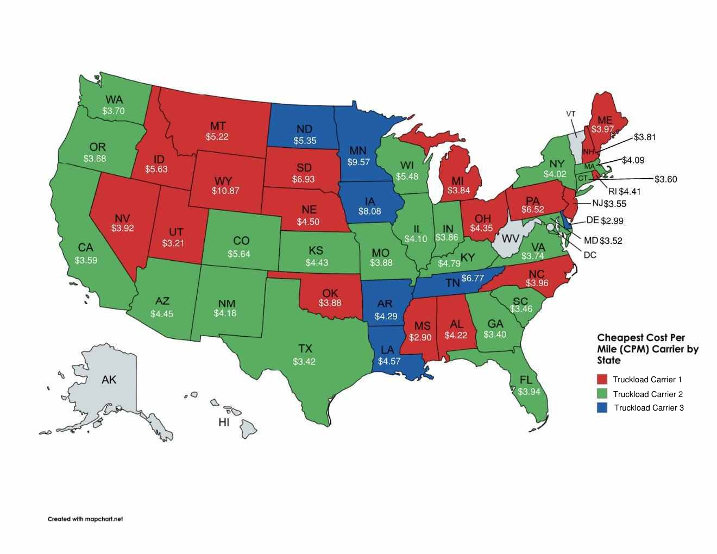
Approach for Analysis Determined cost per mile (CPM) for each of the truckload carriers

Slide 3
Approach for Analysis Assumptions Made New incurred cost vs current 3rd party model

Slide 4
Approach for Analysis Assumptions Made
Driver pay: $0.55 per mile
Employee benefits calculated at 30% of yearly estimated pay
Unemployment taxes calculated at 1.16% of employee’s salary
Work comp insurance is calculated at $8.00 per $100 of payroll (MN rate for Motor Freight Carrier Driver)
General commercial insurance was obtained through our insurance company using a ballpark figure provide by them
Vehicle tabs used 2023 cost
Fuel tax used 2023 cost
$4.02 Diesel price per gallon (2024 average)
Driver averages 110,000 miles per year
132 deliveries based off of 2023 data
52 mph overall average
All order data used was both delivery only and installations (pulled all orders that we used TL carriers on)

Slide 5
Cost Implications For company vs. Third-Party model
Company cost per mile (leasing equipment): $3.14 – all inclusive
Truckload Carrier 1 cost per mile: $4.23
Truckload Carrier 2 cost per mile: $4.39
Truckload Carrier 3 cost per mile: $4.99
Miles per year per driver: 110,000
Potential savings/year: $239,800/year (would reduce our cost & our customers price, but margin performance would stay the same)
Will require calculation of lower margin charged to customer
*Return pallet/dunnage removal cost elimination would all be additional savings not included
Average dunnage cost removal is $800 per order ($105,600 per year)
Average return pallet savings of $2,086 per delivery ($275,352 per year)
Multi-Stop Opportunities
Employing our own drivers is significantly more cost-effective than relying on third-party carriers

Slide 6
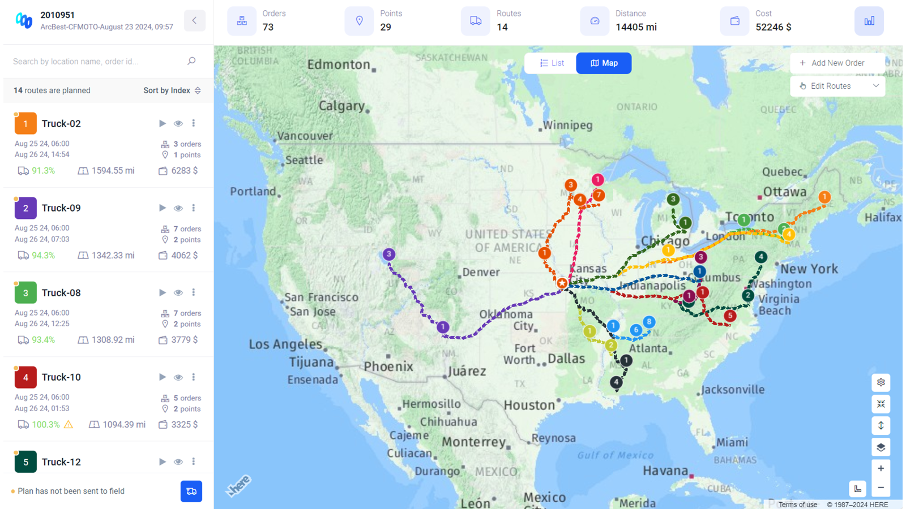
Use Case Combination of multiple ltl shipments
Example of a tool others in the industry use
Partner carrier currently using an optimization tool to combine multiple LTL shipments into one TL
17% cost savings compared to LTL pricing
One way (not including back haul potential)
Currently partnering with Arcbest to understand use of tool and potential implementation of backhaul

Slide 7
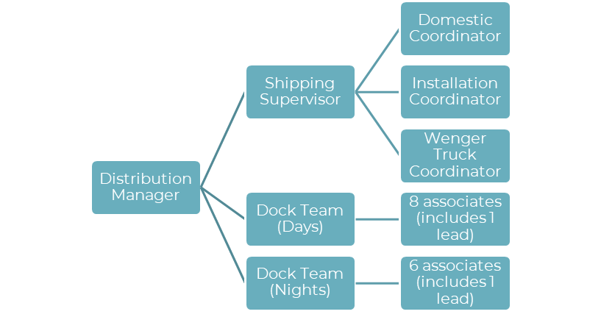
Shipping supervisor Proposal Currently, all distribution staff report directly to the distribution manager, this includes 17 associates (in various roles) across two shifts.
Current State
Proposed Future State (addition of Shipping Supervisor)
Distribution Manager
Domestic Coordinator
Installation Coordinator
Dock Team (Days)
6 associates (includes 1 lead)
International Coordinator
Dock Team (Nights)
8 associates (includes 1 lead)

Slide 8
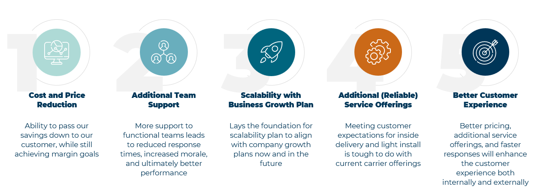
Business case our company is committed to delighting our customers through continuous improvement

Slide 9
THANK YOU
Brandon Albers

