Slide 1
Cost optimization for installation operations

Slide 2
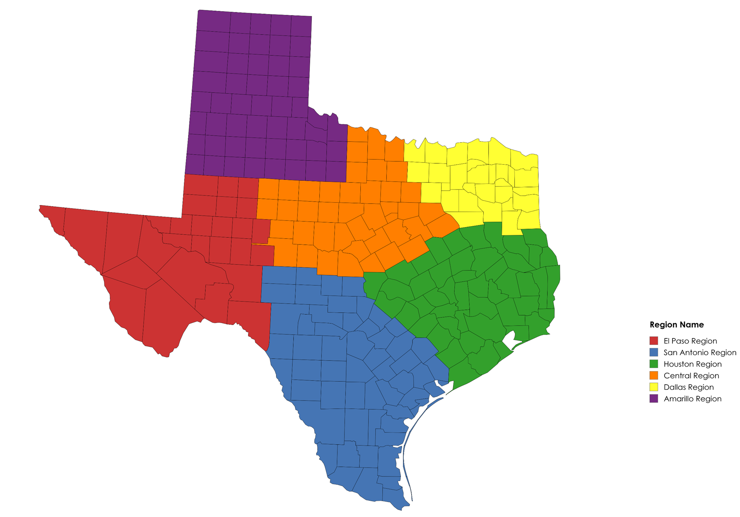
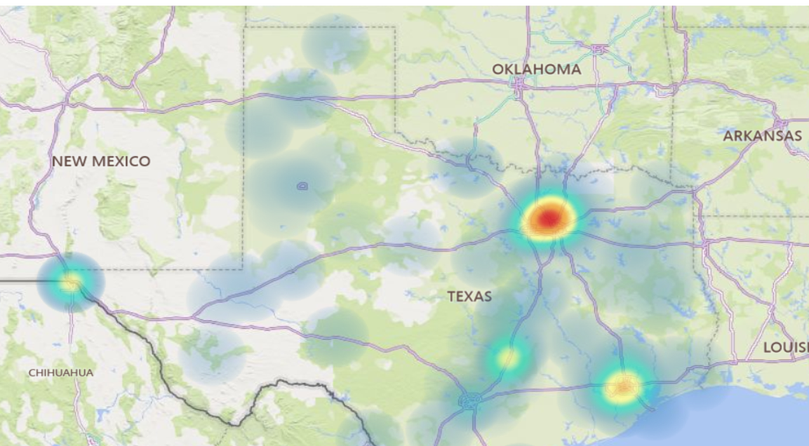
Approach for Analysis Using Heatmap data to determine regions best suited for new installer.

Slide 3
Approach for Analysis Assumptions Made

Slide 4
Approach for Analysis Assumptions Made
Overall
Every crew uses 4 people
Each crew members gets their own hotel
Install length of 2 days + 1 travel day (3 hotels)
Travel Expenses
Travel from City 1 – 3rd Party 1 at $21/hr | Travel from City 2 – 3rd Party 2 at $17/hr
Travel for our company based off of living location assumed in assumptions
Used 2023 data for # of installs per region
Hourly Rate Savings
3rd Party 1 $42/hr | 3rd Party 2 $38/hr | Our Company $30/hr
Maine Union Rate $38.95 total package ($29.27 hourly | $9.68 fringe)
Employee Benefits
Benefit calculations based off of 2,080 hours per year @ hourly rate * 30%
Assumed at 40 hours/week (both office and installer)
I have NOT factored in unemployment taxes
Depreciation
Van purchase price depreciated over 5 years
Misc Expenses
Our Installer $60 per day per diem
$100 per install for consumables for Our Installer (anchors, etc)
Cell phone stipend $80 per month
No new Fastfield licenses needed
Additional Head Count
2 new office staff needed - $60,000 per year each
Operating Expenses
$200 factored in per year to account for future computer costs
Yearly insurance/registration cost for new vehicles NOT factored in
Difference in Overhead allocation between how we calculate 3rd parties vs our Installers is NOT factored in.
Not factoring in any office/storage warehouse leasing that would be needed
Capital Expenses
Purchase price of latest van used - $75,000
Initial tool invest for installer - $1,500
New laptops and printers - $800 for computer, $200 for printer

Slide 5
Cost Implications of Company vs. Third-Party Services Cost Per Install – 3rd Party 1 $6,832, 3rd party 2 $7,626, Our company $7,990

Slide 6
What’s Next? Focus on Where we are going, not where we have been
Background:
Significant bonds were passed in AREA 1 several years ago.
These bonds impacted our margins from 2021 to 2023, leading to constrained profitability.
Our Company’s historical approach has been reactive.
Future State:
Transition to a proactive strategy to anticipate and respond to future bond activity.
Align Sales and Installations teams more closely with bond timing and quoting activity to avoid unexpected resource shortfalls and improve capacity planning.
Action Steps:
Collaborate more effectively with Sales to stay informed on future bonds and assess their impact on our business operations.
We missed the opportunity to reposition crews AREA 1, which affected our ability to manage the increased volume effectively.
It is critical that we establish a system for early identification of bond approvals to prepare for future demand and adapt operational strategies for sustained success.

Slide 7
THANK YOU
Brandon Albers

