Slide 1
Final Presentation
Law + AI

Slide 2
Introduction

Slide 3
Problem Statement
The US Stock market is the largest in the world and there is an increasing need to protect it from the malicious activities.
Our goal is to increase the detection capabilities by incorporating AI to have better surveillance coverage so that any suspicious activities can be flagged quickly.

Slide 4
Demo 1.0

Slide 5
Dataset
Organization - Amazon
Sample years - 2013,2014, and 2015
Features - Volume (# Transactions) per day, start day stock price, end day stock price
Source - Yahoo Finance

Slide 6
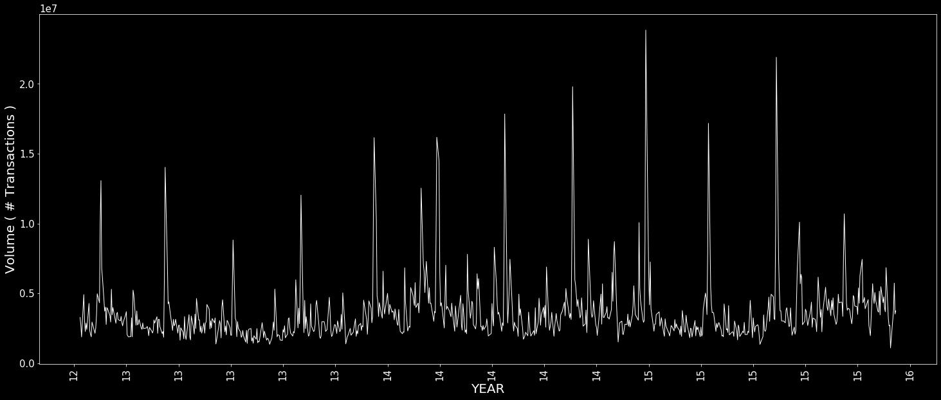
Volume (# Transactions) Analysis
Analyze each day’s # transactions.
Create a threshold.
Identify the peaks (very high transactions)

Slide 7
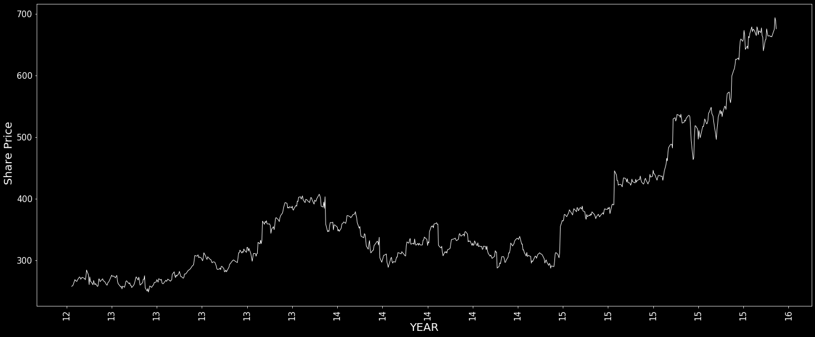
Stock Price Fluctuations
Analyze the stock price fluctuations for the identified high transaction days.
If stock prices fluctuate more than a threshold, highlight them.

Slide 8
Demo 2.0

Slide 9
Future Work

Slide 10
Questions?

