Slide 1
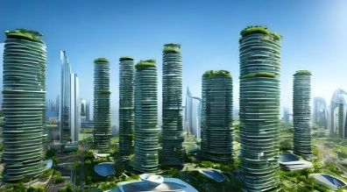
Swanse Science
NASA in Your Neighborhood
How does the climate affect our mood?
Paula Bartolomé Mora
Alberto San Segundo Gonzalo
Pablo Ruiz Giles
Miguel Varas Heredia
Notes:
https://stock.adobe.com/es/images/sustainable-green-city-with-futuristic-office-building-and-architecture-sublime-image-generative-ai/573586317

Slide 2



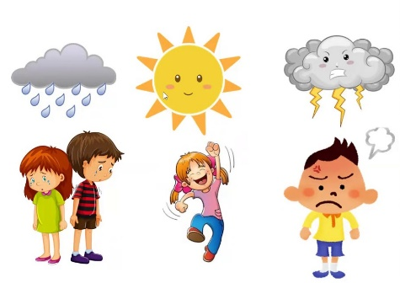
1. How does the climate affect our mood?
We combine climate with emotions
.
.
.
.
.
Temperature
Humidity
Air Quality
Notes:
Today, one out of every four people suffers or will suffer from a mental disorder at some point in their life. Only in Spain, nearly 3 million people have been actually diagnosed with depression, making it the most prevalent mental illness.
Today, we are more aware of mental health than ever before, but have you ever thought of how the climate affects our mood?
We are Swanse Science and our challenge, "NASA in our neighborhood" began with this question. The main goal was to discover how we could connect the environment with people to improve the quality of life in our town.
After studying resources and data from NASA's satellites, we had the idea that we could correlate parameters such as temperature, air quality or humidity with emotions and moods, such as happiness, anger or sadness.
All of this led us to create Bubble.
https://www.youtube.com/watch?v=-IAabA25rq4
https://graffica.info/quien-diseno-el-logo-de-la-nasa/

Slide 3

2. Bubble

Slide 4
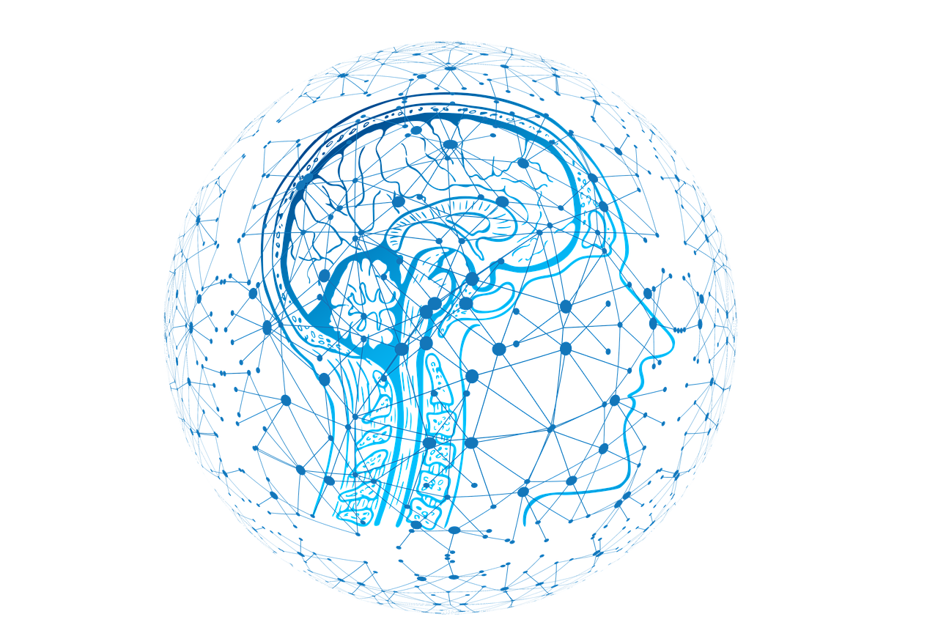
3. Artificial intelligence algorithm
Inputs
User preferences
Client’s mood reflected in the hormone levels of each emotion
Climate parameters
Output
The best climate + personalized activities for user
Notes:
Bubble is an application that uses an artificial intelligence algorithm that has several inputs:
User preferences
Client's mood reflected in the hormone levels of each emotion
Climate state
Knowing that, it challenges you with a combination of the optimal location with a personalized activities for the user. In addition, it has the option to connect with other people in your town so you can do these challenges together and become part of a community that shares your interests.
https://puradata.com.ar/como-impactan-los-avances-tecnologicos-en-el-cerebro-humano/

Slide 5
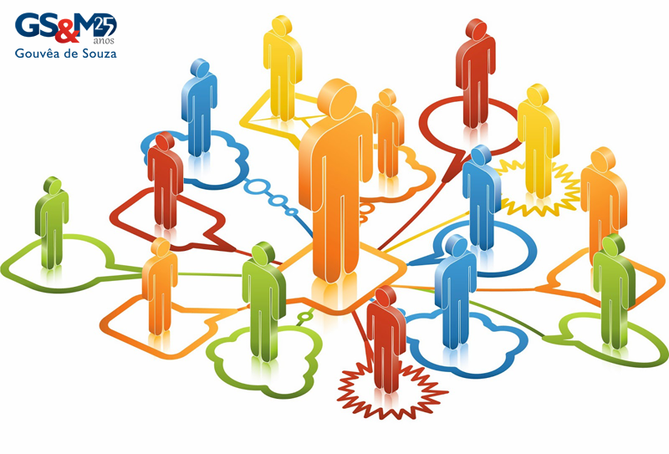
4. Heterotopia
An enviroment in a enviroment
Creation of communities
Become part of a comunity
Notes:
This is where the name comes from, related to the concept of heterotopia - "an environment in a environments".
Each "bubble" in the application represents a heterotopia in which users can experience and interact in a unique way.
https://mercadoeconsumo.com.br/16/07/2014/artigos/o-consumidor-em-1o-lugar/

Slide 6
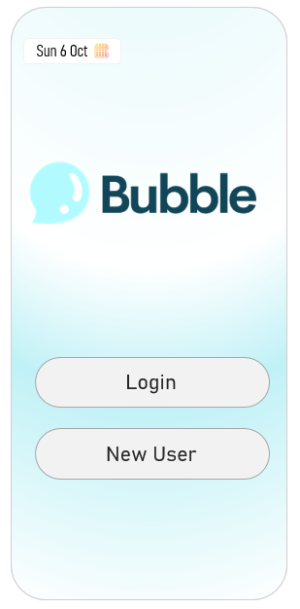
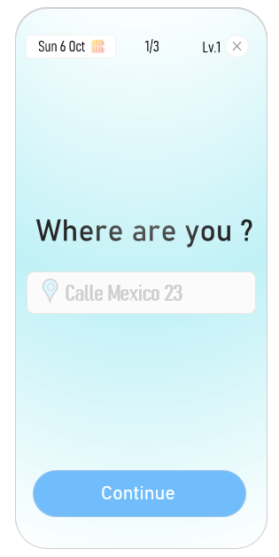
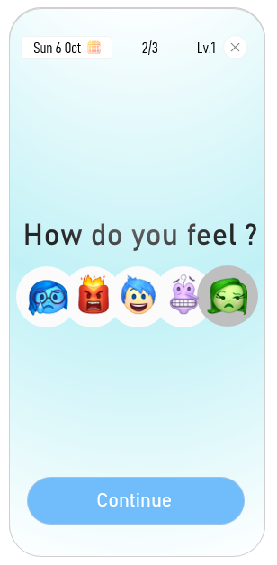
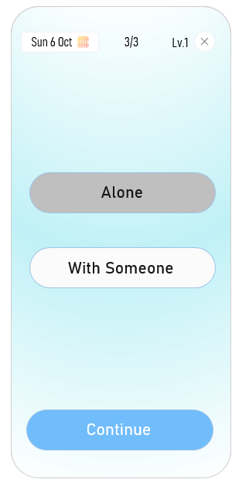
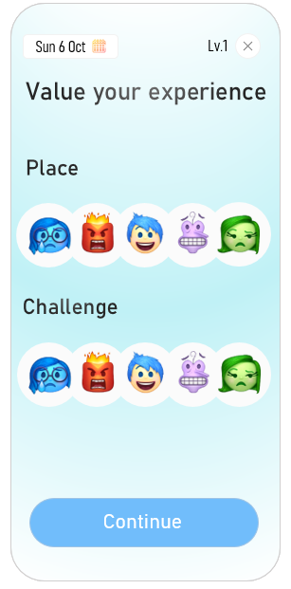
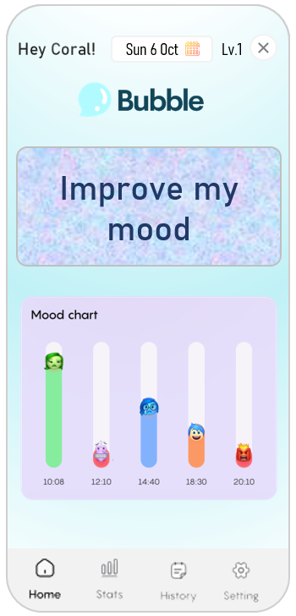
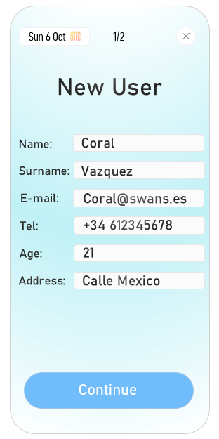
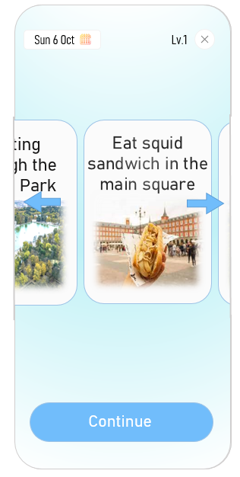
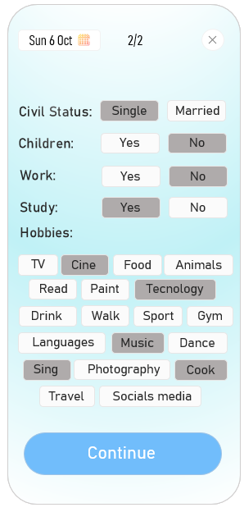
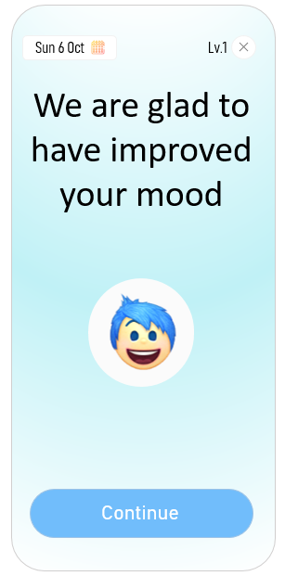
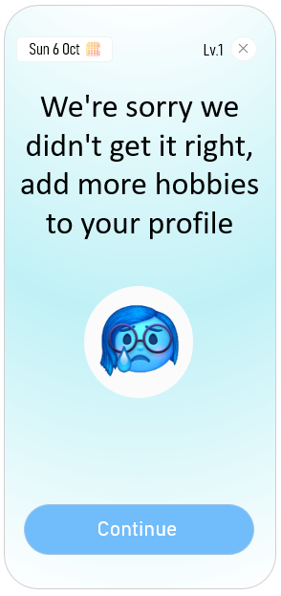
5. App
3 questions
Feedback
The best challenges
Notes:
So How it works?
At the start of the application you have two options login or register. When a new user arrives, they will have to enter their personal information and favorite hobbies so that the app can characterize the user with a unique experience. It is necessary to mention that stakeholders are every user that has a mobile phone.
On the main screen, each user can view their stats, history and most importantly, they will have the option to improve their mood.
By selecting this option, the user will be asked three questions:
Your current location, so that the app can see the climatic characteristics of your environment and recommend a better place according to your preferences.
How do you feel, to determine an activity that will reduce your elevated hormone levels and increase the hormones you need to feel better.
And if you want to do the activity alone or with someone else.
With all this, the app will suggest a list of the best actions for each user in order to improve their mood taking into account the specific activity and the location with the best climatic conditions.
Finally, when the user chooses the activity and performs it, the user will give feedback to the app to improve and train the algorithm, so that the user feels the need to use it and take care of the environment for more unique experiences. So, if you are ready to improve your mood and discover new exciting challenges, just download Bubble and start feeling better with just one click.
https://es.hoteles.com/go/spain/el-retiro-park-madrid?pos=HCOM_ES&locale=es_ES
https://arrabalmadrid.es/los-mejores-bocadillos-de-calamares-en-la-plaza-mayor-de-madrid/
https://www.pinterest.es/pin/530510031082999758/
https://www.figma.com/file/kyrep70Wq5sj0BZFIzz6K0/MoodBook---Mood-Tracking-App-(Community)?type=design&node-id=1-2&mode=design&t=S237yNivmbVcOIQg-0

Slide 7
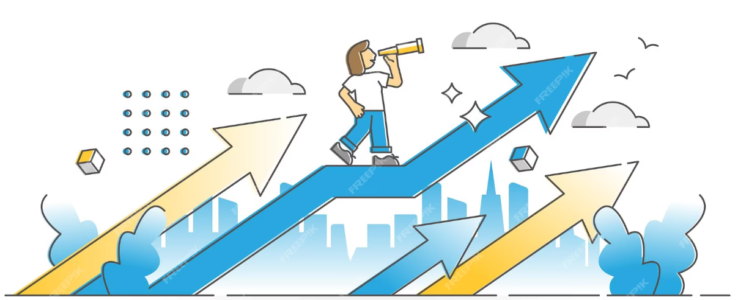
6. Future Cases
Profesional use for psychologies
Mental health improvement
Suicides rates reduction
Continue the research about the impact of climate in people’s emotions
Notes:
https://www.freepik.es/vector-premium/oportunidad-viendo-como-vista-futuro-concepto-esquema-progreso-crecimiento-carrera-femenina-exitosa-o-desarrollo-empresarial-mejora-ilustracion-vector-flecha-direccion-ascendente-adelante_20648377.htm

