Slide 1
Course Staff
Lecturer: Adam Ghandar
aghandar@sustech.edu.cn
Tutor: 赵耀(ZHAO Yao)老师
zhaoy6@sustech.edu.cn
Course structure
Lectures
Labs

Slide 2
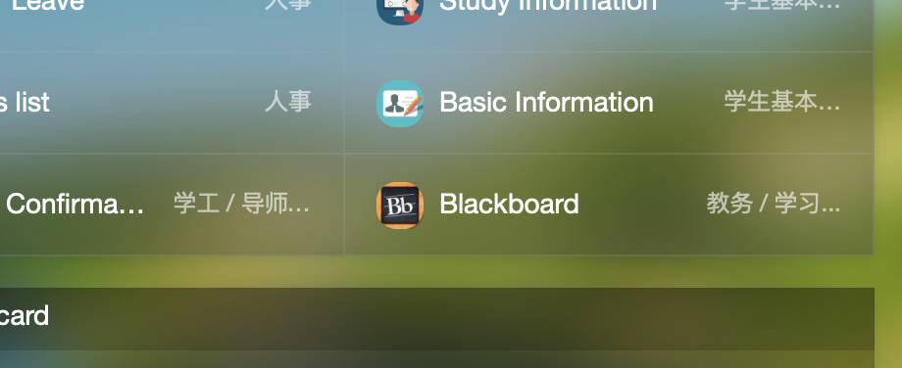
Course website
“Blackboard”
http://bb.sustech.edu.cn or via Ehall http://ehall.sustech.edu.cn/new/index.html

Slide 3
Assessment
Participation: 10%
Project 20% (release in approx. week 6)
Presentation 10% (about project)
Pracs: 10% (1 mark for each completed successfully up to a max of 10)
Assignments 10% (2 assignments)
Mid term 10%
Final exam 30%

Slide 4
Exam
Open Book and unlimited notes
Electronic devices forbidden

Slide 5
Grades
Your marks can be checked online
Any queries should be directed to the Lecturer via email clearly stating your student id the assignment and question
Extensions or requests for special consideration should where possible be supported by documentation and submitted in advance
Participation will be graded by looking at your posts in the forum and attendance

Slide 6
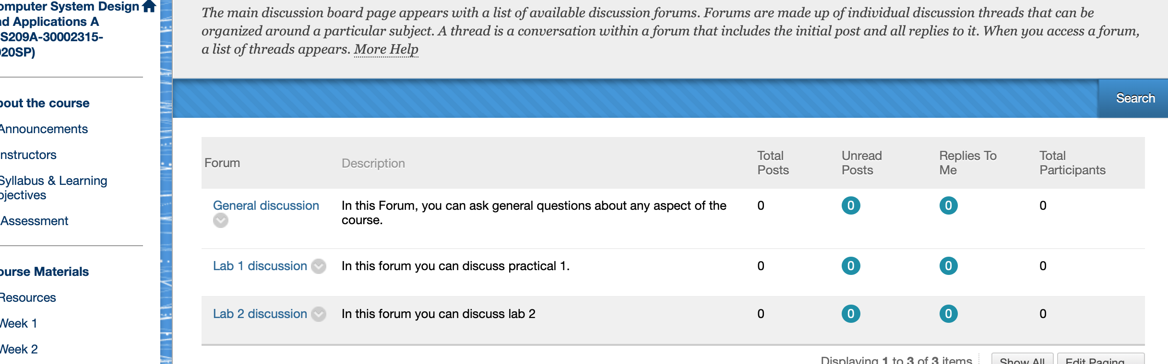
Online Course Forums
All questions and discussion about the course work can be undertaken here

Slide 7
Course Objectives
This course aims to provide a deeper understanding of programming and new topics in computer application system design, especially data processing, GUI implementations, stream processing, program evaluation, regexp application and other advanced programming topics & skills useful for scientific & engineering students. You will learn how to use java programming to develop software that can solve practical problems.

Slide 8

Outcomes
On completion of this course, students should be able to:
Understand design principles and good practices in software application design.
Apply programming concepts from object-oriented programming.
Use Java to solve real world problems effectively and efficiently.

Slide 9
Topics Covered
Information Systems
Data and IO
Design paradigms, OOP, practical programming in Java
Collections and generic types
Advanced programming techniques (nested classes, anonymous classes, inheritance and polymorphism, Streams, regex, reflection and more)
Graphical User Interfaces (GUI) with JavaFX
Client server applications
Multithreading
Data persistence including databases
Java Virtual Machine (JVM)
Testing and test driven development

Slide 10

Text A
Textbook A:
Robert Sedgewick & Kevin Wayne:
Computer Science: An
Interdisciplinary
Approach
2016 Addison-Wesley Professional,
Pearson

Slide 11
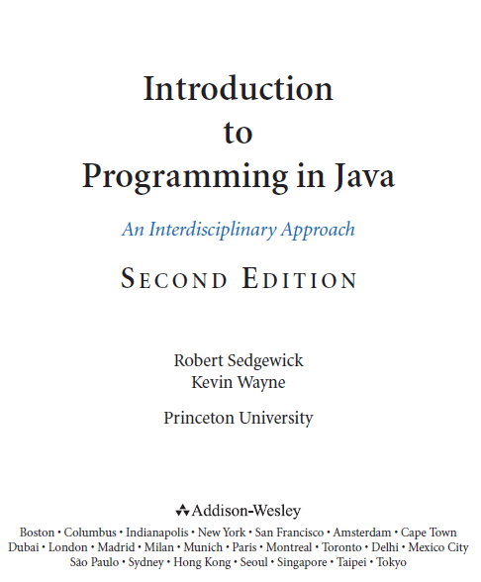
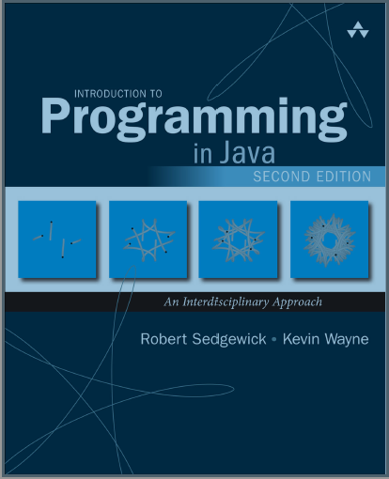
Alternative Short Version (first part of the previous book)
Notes:
The way of the program (programming language, program, debug, first program...)
Variables and types (variables, assignments, operators...)
Void methods (floating-point, classes and methods, parameters...)
Conditionals and recursion (modulus operator, conditions, recursion...)
GridWorld: Part 1 (College Board AP Computer Science Case Study)
Value methods (return values, overloading...)
Iteration and loops (multiple assignment, while...)
Strings and things (characters, traversal, String...)
Mutable objects (packages, instance variables, Objects...)
GridWorld: Part 2 (College Board AP Computer Science Case Study)
Create your own objects (class, constructors...)
Arrays (accessing elements, arrays and objects...)
Arragys of Objects (Card objects, arrays of cards...)
Objects of Arrays (Deck class, shuffing, sorting...)
Object-oriented programming (object methods and class methods, inheritance...)
GridWorld: Part 3 (College Board AP Computer Science Case Study)

Slide 12
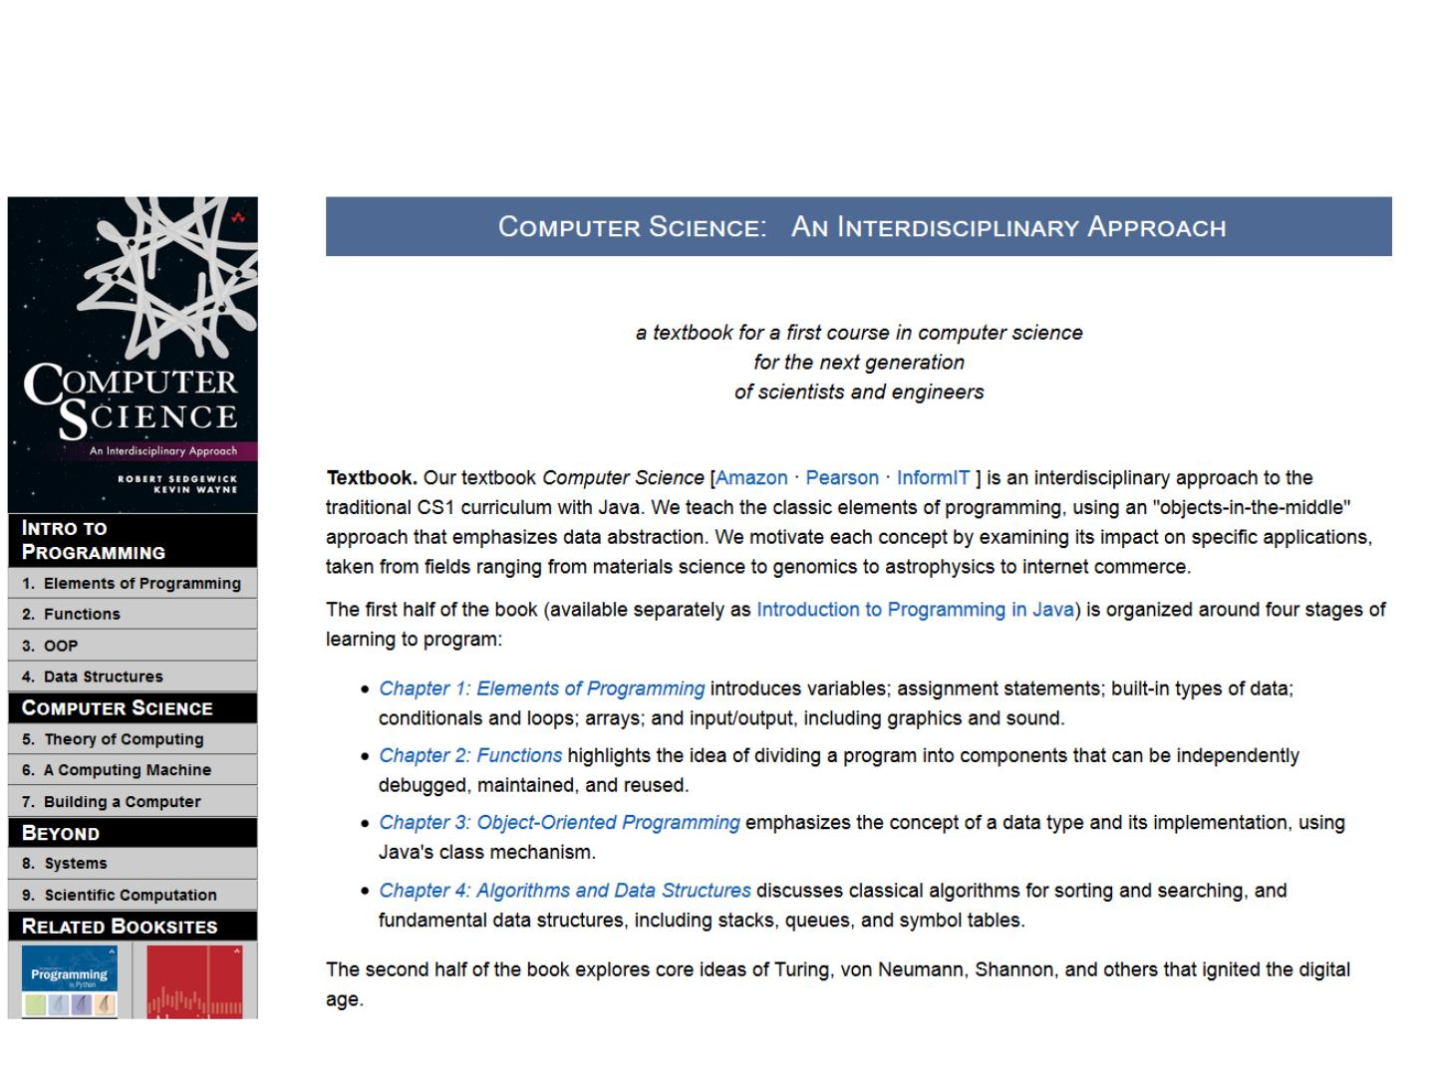
Website for the textbook
http://introcs.cs.princeton.edu/java/
You can refer to the code and slides here

Slide 13
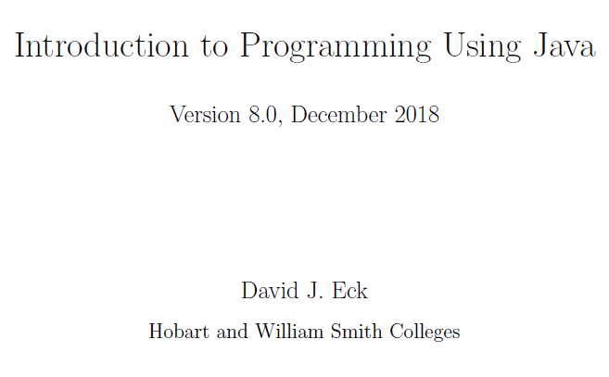
Text B
 It is an online book (Thanks David J. Eck from Hobart and William Smith Colleges):
http://math.hws.edu/javanotes8/

Slide 14
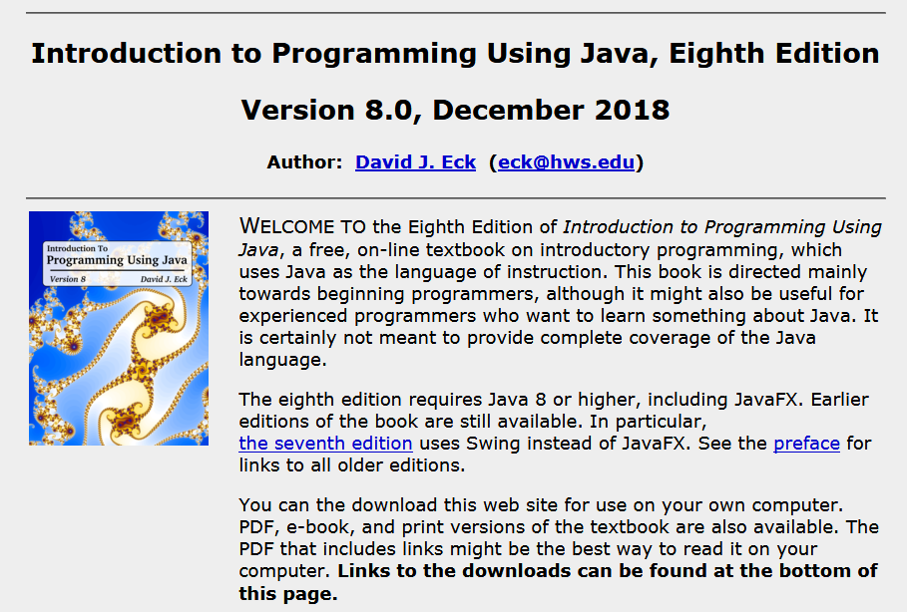

Slide 15
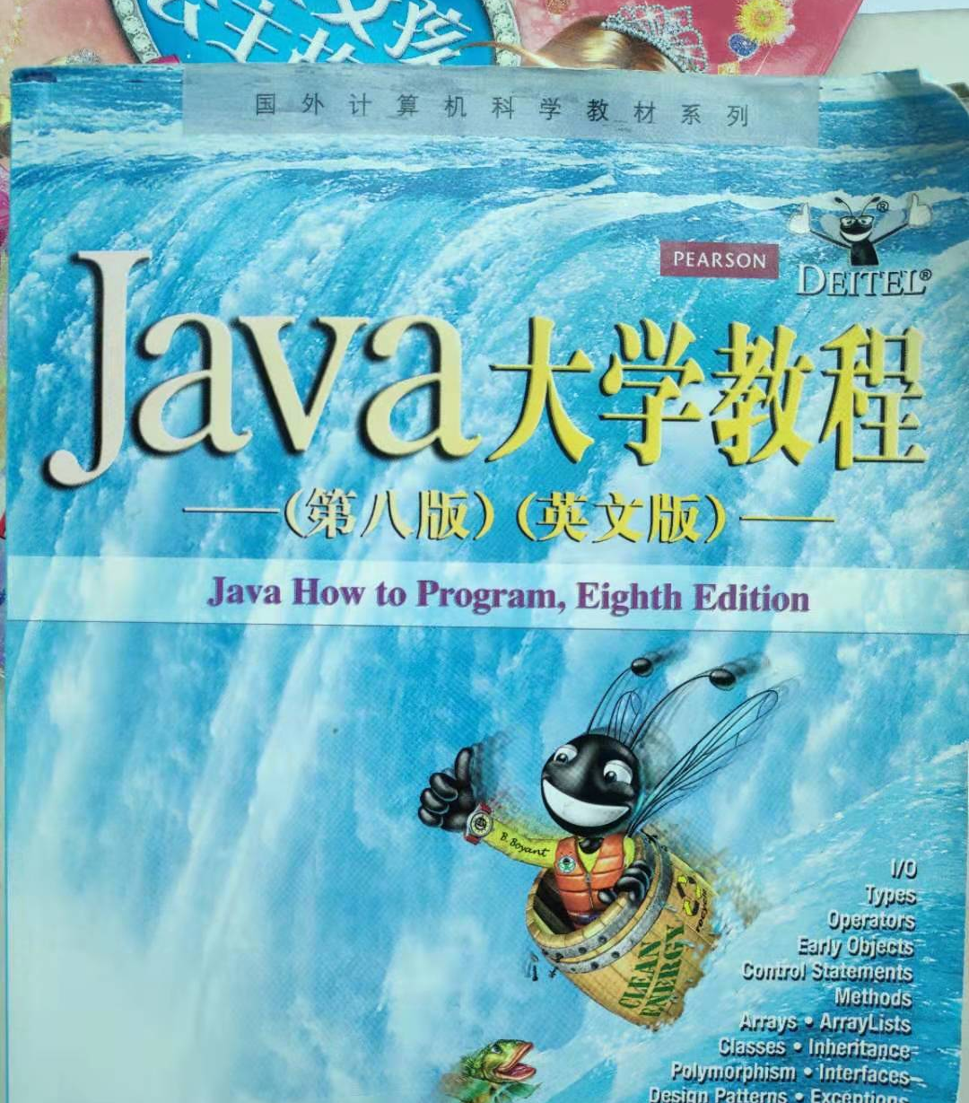
Java How to Program (any edition)

Slide 16
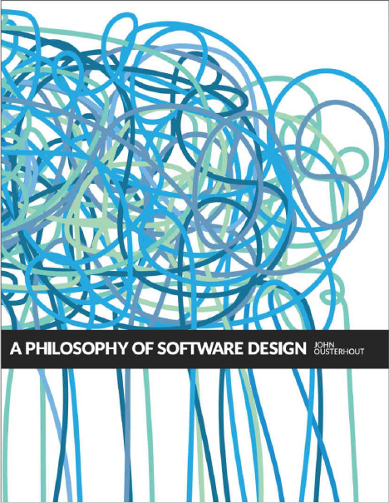
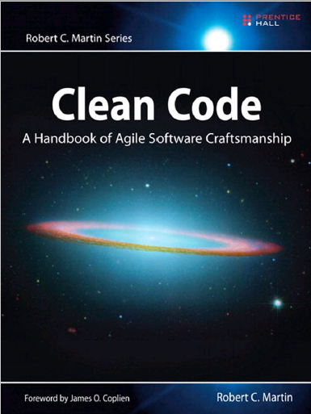
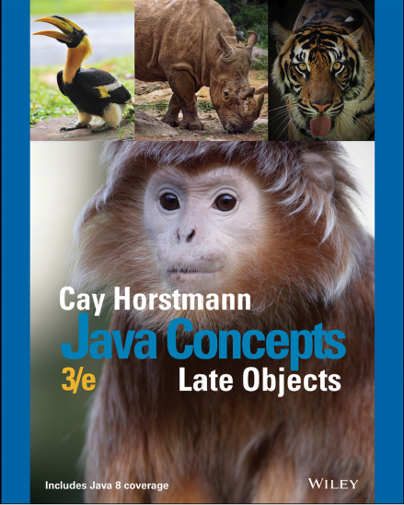
Additional reading about programming and computing to assist your development as a computing professional…
There are others that we may mention during this course…

Slide 17
References:
Cay Horstmann. Java Concepts, Late Objects, 3e, Wiley 2018
Robert C. Martin. Clean Code: A Handbook of Agile Software Craftsmanship. Prentice Hall, Pearson, 2009
John Ousterhout. A Philosophy of Software Design. Yaknyam Press, 2018

Slide 18
Important
Most ideas will be covered in class but some details might be skipped. These details are covered in the required reading.
Assignments and project should be done individually although group discussions are allowed
Any dishonest behaviour and cheating in assignments will be dealt with severely
If you get an idea for a solution from others or online you must acknowledge the source in your submission

Slide 19
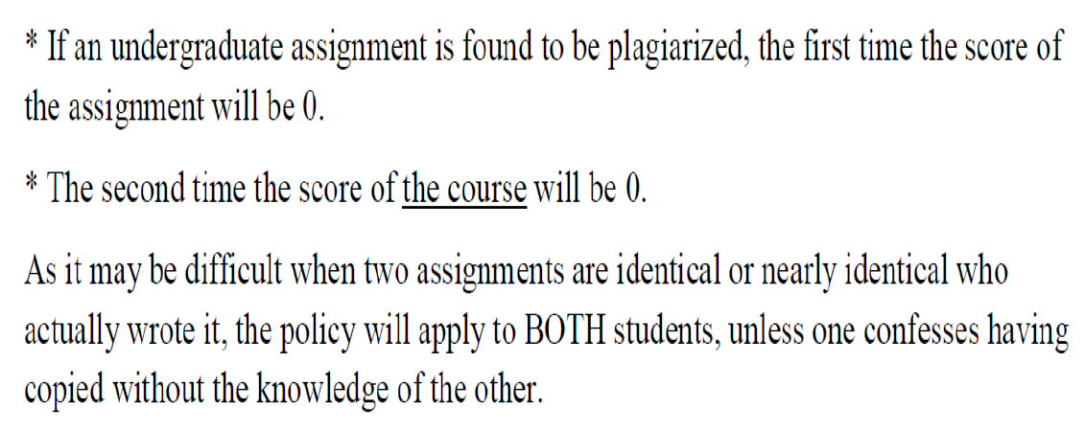
Plagiarism Policy

Slide 20
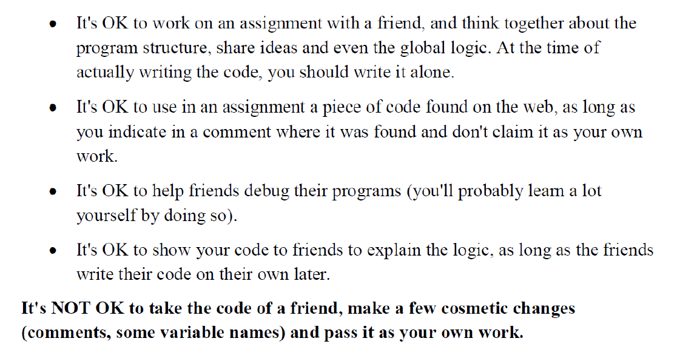
What is okay and what is not okay?

Slide 21
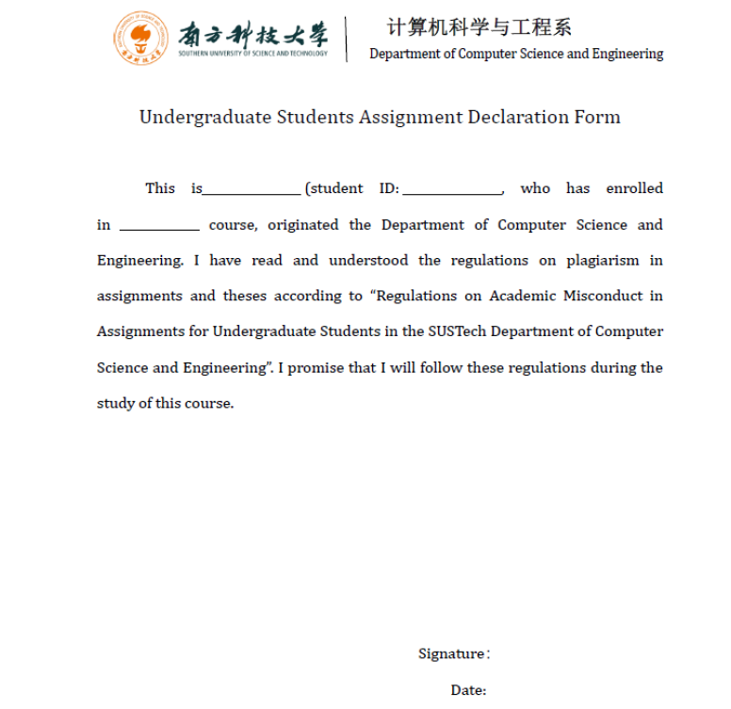
What is okay and what is not okay?

Slide 22
Important message
If you are having trouble to understand something as a question in class.
The lecture slides and other materials are in progress. If you have a suggestion please email. Your classmates and future students will thank you.

Slide 23
What will I learn in this course?
Design principles and good software design
Programming concepts and OO programming
Using Java to solve real world problems efficiently
Compared with introduction programming courses we will cover methodologies and patterns that are useful in large scale problem solving
Some background from CS102A and CS102B is assumed

