Slide 1
Midterm solution
曾歆勋 张诗奇

Slide 2
P1. CPU Scheduling
Time
HRRN
FIFO/FCFS
RR
SJF
Priority
A
1
A
A
A
A
A
B
2
A
A
A
A
B
3
A
A
B
A
A
C
4
A
A
A
A
C
D
5
B
B
C
B
C
6
C
C
A
C
D
7
C
C
D
C
D
8
D
D
C
D
D
9
D
D
D
D
A
10
D
D
D
D
A
Avg.Turn
-
4.5
4.5
4.75
4.5
4.25
around Time

Slide 3
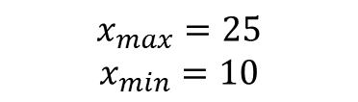
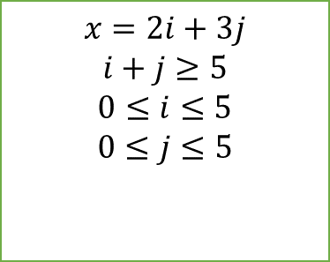
P2. Multithreading
Thread A | Thread B
for (i=0; i<5; i++) { x = x + 2; } | for (j=0; j<5; j++) { x = x + 3; }
a1. load r0, x \\ x=0
a2. addi r0, 2
a3. store r0, x \\ r0=2
b1. load r1, x \\ x=0
b2. addi r1, 3
b3. store r1, x \\ r1=3
execute order:
a1
b1
a2
b2
a3
b3
x value
0
0
0
0
2
3
execute order:
a1
b1
b2
a2
b3
a3
x value
0
0
0
0
3
2
$$x=2i+3j$$
$$i+j≥5$$
$$0≤i≤5$$
$$0≤j≤5$$
(a)
(b)
$$x_{max}=25$$
$$x_{min}=10$$

Slide 4

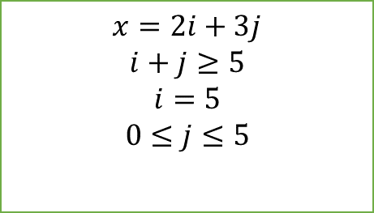
P2. Multithreading
Thread A | Thread B
for (i=0; i<5; i++) { x = x + 2; } | for (j=0; j<5; j++) { x = x + 3; }
atomic
a1. load r0, x \\ x=0
a2. addi r0, 2
a3. store r0, x \\ r0=2
b1. load r1, x \\ x=0
b2. addi r1, 3
b3. store r1, x \\ r1=3
execute order:
a1
b1
b2
b3
a2
a3
x value
0
0
0
3
3
2
execute order:
a1
a2
b1
b2
b3
a3
x value
0
0
0
0
3
2
$$x=2i+3j$$
$$i+j≥5$$
$$i=5$$
$$0≤j≤5$$
$x=${10,13,16,19,22,25}
(c)

Slide 5
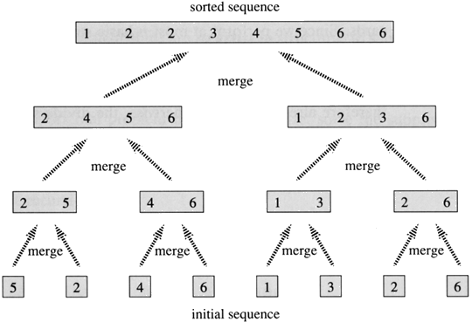
P2. Multithreading
(d) In both condition: TCB, including register value, PC, stack pointers, etc. In different process: PCB, file-descriptor table, etc.
(e)
Same task, different data
different independent task
CPU
IO

Slide 6
P3. System call
File-descriptor table
0 | STDIN
1
2 | STDERR
File-descriptor table
0 | STDIN
1
2 | STDERR
dup2(old_fd, new_fd)
Copy old_fd to new_fd
dup(old_fd)
Copy old_fd
test.txt
test.txt
STDOUT
STDOUT
3 test.txt
3 test.txt
4 STDOUT
Standard out | test.txt
Standard out | test.txt
Starting main
cs302 SUSTech, in child
Starting main
cs302 SUSTech, in parent
Ending main: 0
cs302 SUSTech, in child
Ending main: 123
cs302 SUSTech, in parent
Ending main: 0
Ending main: 123

Slide 7
P3. System call
(c)
getppid()
signal(SIGTEST, orange)
apple()
waitpid(pid) or wait(NULL) or wait(0)
(f)
OS does not trust user’s stack, user’s stack may cause unpredictable error. So OS always enter a kernel-allocated stack before entering kernel.
Schedule frequently happens, if every thread has a unique kernel stack, they can easily switch between running and ready state. Otherwise kernel stack has to save and restore in every switching.
(d)、(e)
Try yourself

Slide 8
P4. (a)
Parallelism refers to techniques to make programs faster by performing several computations at the same time. This requires hardware with multiple processing units.
Concurrency refers to techniques that make programs more usable. Concurrency can be implemented and is used a lot on single processing units.

Slide 9
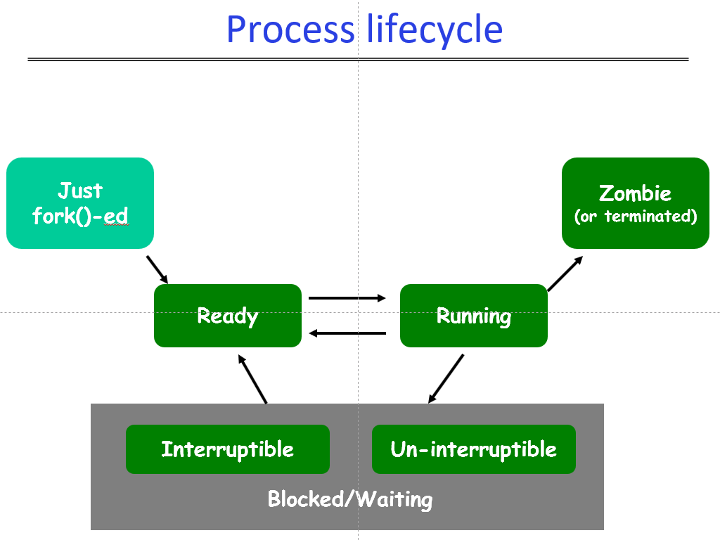
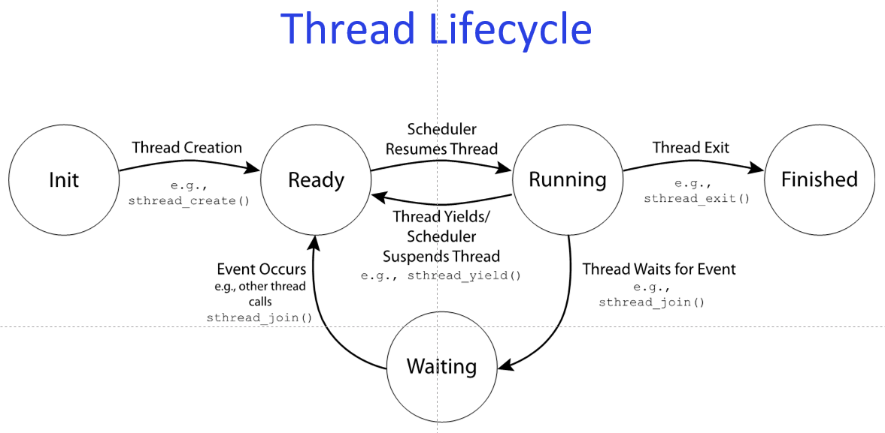
P4. (b)

Slide 10
P4. (b)
BASIS FOR COMPARISON | PROCESS | THREAD
Basic | Program in execution. | Part of process.
Memory sharing | Completely isolated and do not share memory. | Shares memory with each other.
Resource consumption | More | Less
Time required for creation | More | Less
Context switching time | Takes more time. | Consumes less time.

Slide 11
P4. (c)
fork()
create a new process.
copy all user-space data to new process, e.g. PC, code, data and cache.
copy parent’s PCB to new process.
update some information in PCB, e.g. PID, parent, running time and return value.

Slide 12
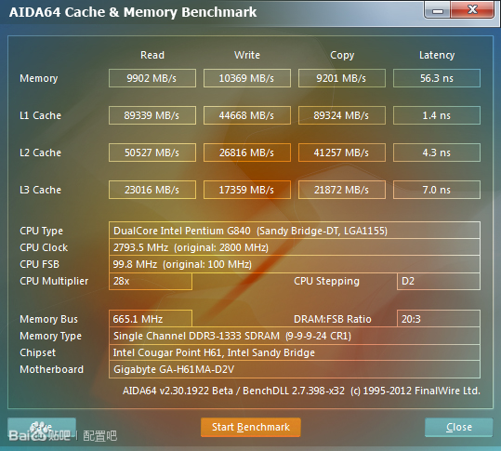
P4. (d)
register | 1 cycle
l1 cache | 1ns
l2 cache | 4ns
memory | 100ns
disk | 100,000ns
faster is smaller, more expensive
bigger is slower, but cheaper

Slide 13
P4. (e)
Real time is wall clock time - time from start to finish of the call.
User time is the CPU time spent on codes in user-space memory
Sys time is the CPU time spent on codes in kernel-space memory
real < user+sys: On a multi-processor machine, a multi-threaded process.
real > user+sys: wait(), sleep(), I/O operation

