Slide 1
CS302 Operating System Lab 3 Process2
HUANG Bo, ZENG Xinxun, ZHANG Shiqi

Slide 2
Outline
Recap Exercise on Lecture
Lab2 report review
Linux process organization

Slide 3
Exercise on Lecture : fork() + exec()
Try the code fork_exec.c see what happens

Slide 4
Exercise on Lecture : fork() + exec() + wait()
Try the code fork_exec2.c see what happens

Slide 5
Exercise on Lecture : fork() detail
All process info can be seen in /proc:
Compile and run fork_detail.c
Try cpid and ppid on “less /proc/pid/status”
int getMemory(){ //Note: this value is in MB! FILE* file = fopen("/proc/self/status", "r"); int result = -1; char line[128]; while (fgets(line, 128, file) != NULL){ if (strncmp(line, "VmSize:", 6) == 0){ result = parseLine(line); break; } } fclose(file); return result/1024; }

Slide 6
Exercise on Lecture : Write to same file
How can parent and child process write to same file?
Compile and run share_file_fwrite.c
Compile and run share_file_write.c

Slide 7
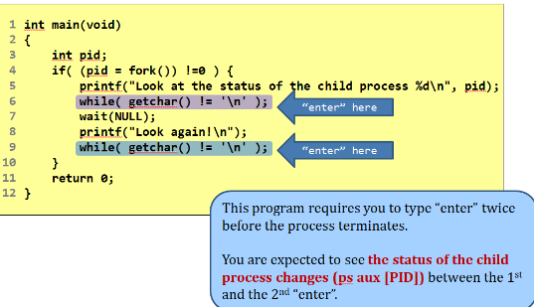
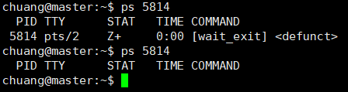
Exercise on Lecture : Zombie
Compile and run wait_exit.c
Look the status of the child process

Slide 8
Lab2 report review
How to realize inter-process communication
Pipe, named pipe(FIFO)
Message queue
Signal
Semaphore
Shared memory
Socket
What’s different between PIPE, FIFO and MQ?

Slide 9
Pipe vs FIFO
PIPE | FIFO
PIPE is un-named IPC object | FIFO is named IPC object
PIPE doesn’t exist in the filesystem, vanish after program exit or one of end closed. | FIFO exists in the filesystem. Even the program exit, FIFO file remain till system reboot.
PIPE can only communicate among the related process (parent and child, sibling). | FIFO can be used for unrelated process. Even not in a local computer (in network).
PIPE is often used between two processes. | FIFO is often used in multiple processes communicating.
PIPE no control over ownership and permission. | FIFO, as a file, need to control ownership and permission.

Slide 10
FIFO demonstration
Try mkfifo myfifo
Try file myfifo
Try echo hello > myfifo
Try cat myfifo (in another terminal)

Slide 11
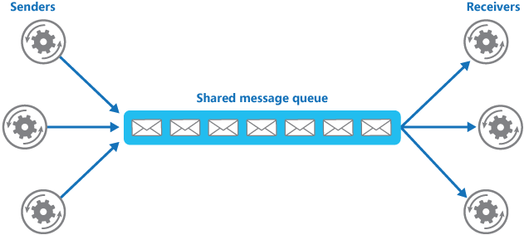
What is Message queue
Message queue is a component provides an asynchronous communications protocol, letting that multiple senders and receivers can interact asynchronously but in correct order .
POSIX MQ
RabbitMQ
RocketMQ
WEIXINMQ

Slide 12
FIFO vs Message queue
FIFO | MQ
Synchronous | Asynchronous
Only bytes steam | User define struct
Unconditionally read | Selectively read
Both local and remote | Both local and remote *
In memory, cannot recover | Can be in memory and hard disk *
Content can be read only once | Content can be read until be removed *
The * means POSIX MQ does not provide these characters, but other MQ can do that.

Slide 13
MQ demonstration
Try the code mq_write.c and mq_read.c see what happens
Try multiple writer and reader see what happens.

Slide 14
Lab2 report review
How to realize inter-process connection
Parent process
fork
fork
Child process
exec ls
write
read
Child process
exec more
Pipe
Copy pipe write to stdout
Copy pipe read to stdin

Slide 15
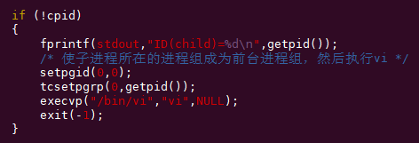
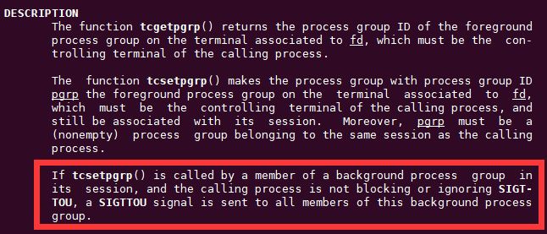
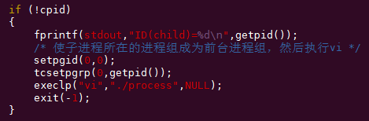
Lab2 report review
process.c, debug and analysis
1. Why cannot open vi?
2. Why parent process will be suspended?

Slide 16
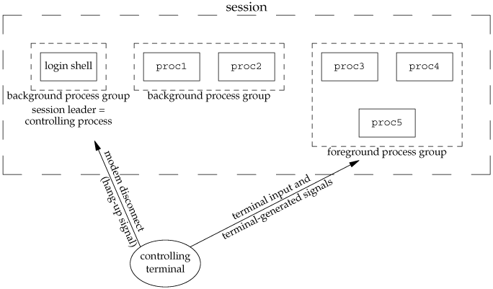
Linux process organization
Process Group
Session
Controlling Terminal
Job Control

Slide 17
Process Groups
A process group is a collection of (related) processes.
It usually associated with the same job that can receive signals from the same terminal.
Each group has a process group ID.
Each group has a group leader who pid = pgid
www.cs.fsu.edu/~xyuan/cop5570/lect7_session.ppt

Slide 18
Process Groups
To get the group ID of a process:
pid_t getpgrp(void): return the pgpid of calling process
pid_t getpgid(pid_t pid): return the pgpid of given process
getpgid(0) is equivalent to getpgrp()
A signal can be sent to the whole group of processes.
int killpg(int pgrp, int sig);
If pgrp is 0, killpg() sends sig to process group of calling process
www.cs.fsu.edu/~xyuan/cop5570/lect7_session.ppt

Slide 19
Process Groups
To set the group ID:
pid_t setpgid(pid_t pid, pid_t pgid)
Set the process group ID of pid to pgid
If the two arguments are equal, the process with pid becomes a process group leader.
pid_t setpgrp(void)
Set the group ID of calling process to its process ID
Equavalent to
A process can set group ID of itself or its children
www.cs.fsu.edu/~xyuan/cop5570/lect7_session.ppt

Slide 20
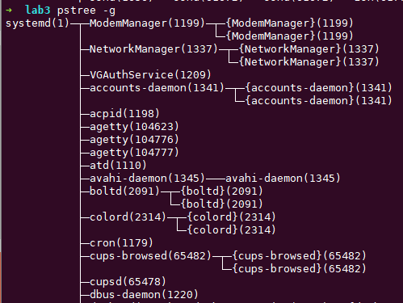
pstree command
the pstree command displays a tree of processes.
Try “man pstree” to see the options
pstree –g: show process group id
pstree –g | grep process

Slide 21
Controlling Terminal
The controlling terminal is a terminal that
controls processes by sending signals to them
provide I/O operation
Two types of controlling terminals:
regular terminal devices
Ctrl-Alt-F1 to F7(TTY1-TTY6 and exit)
pseudo-terminal devices (e.g. terminal, Xshell)
Use ‘ps’ command, there are pts/* in TTY column
www.cs.fsu.edu/~xyuan/cop5570/lect7_session.ppt

Slide 22
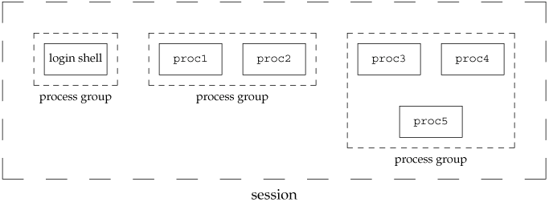
Sessions
Sessions
A session is one or more process groups
login shell is the first process that executes under our user ID
A new session begins after login
A session terminate after logout(close terminal or type exit)
http://poincare.matf.bg.ac.rs/~ivana/courses/ps/sistemi_knjige/pomocno/apue/APUE/0201433079/ch09lev1sec5.html

Slide 23
Sessions
To establish a new session:
pid setsid(void);
Calling process become the session leader
Calling process become a new group leader of a new group
Calling process has no controlling terminal (break up the old one)
Each login shell is a session. When a shell is created, a terminal must be setup.
www.cs.fsu.edu/~xyuan/cop5570/lect7_session.ppt

Slide 24
Sessions and Controlling Terminal
A session can have zero or a single controlling terminal
The session leader that establishes the connection to the control terminal is called the controlling process.
www.cs.fsu.edu/~xyuan/cop5570/lect7_session.ppt

Slide 25
Sessions and Process Group
A session contains several process groups
One foreground process group
Many background process groups
Input
Only foreground group
Terminals’ interrupt signals are only sent to the processes in the foreground group.
Output
Typically shared
www.cs.fsu.edu/~xyuan/cop5570/lect7_session.ppt

Slide 26
Process and Job
Process: an execution of certain program with its own address space
Jobs: processes which are started by a shell
You can Ctrl+C, Ctrl+Z, bg, fg…

Slide 27
Job Control
Allows to start multiple jobs from a single terminal and control which job can access the terminal.
Foreground jobs can access terminal.
Background jobs may not:
When a background job try to read, SIGTTIN signal is sent.
When a background job try to change its mode, SIGTTOU signal is sent.

