Slide 1
CS302 Operating System Lab 5 Mutual Exclusion
Xinxun Zeng, Shiqi Zhang, Dongping Zhang

Slide 2
Race Condition
The outcome of an execution depends on a particular order in which the shared resource is accessed.
A simple example: The too much milk problem

Slide 3
The too much milk problem
Description:
Mom and Dad are all used to checking the fridge when they arrive home. If milk run out, he or she will leave home to buy milk. The fridge is small in your home that only one bottle of milk can be put in it at a time. Mom and Dad always arrive home at different time.

Slide 4
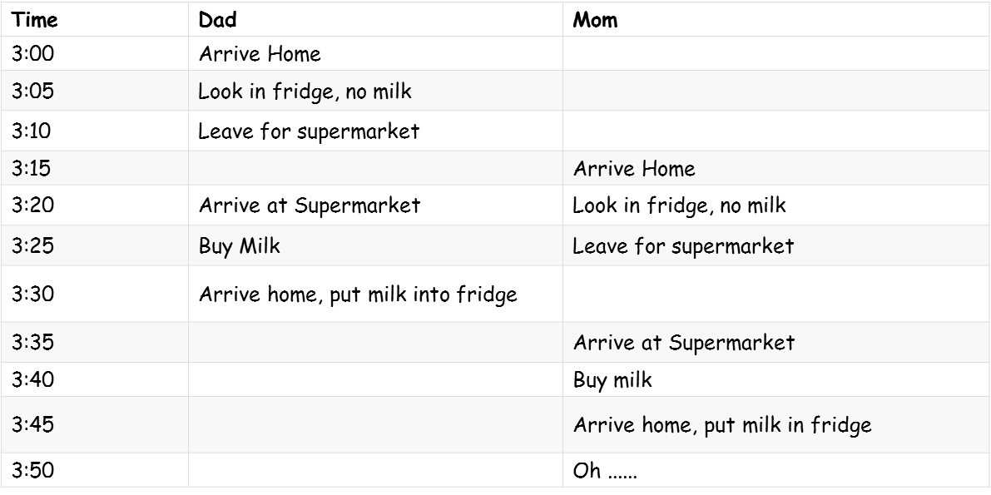
The too much milk problem

Slide 5
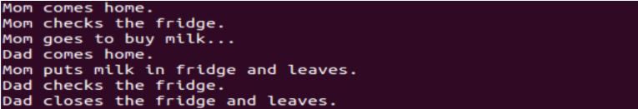
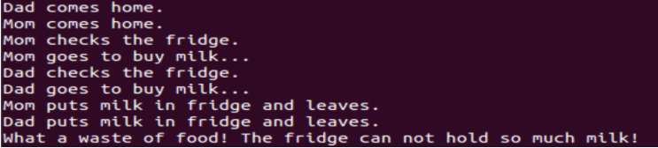
The too much milk problem
Compile and run like this:
gcc milk.c -o milk
./milk
Result:
http://www.cse.cuhk.edu.hk/~ericlo/teaching/os/lab/7-IPC2/race_con.html
Notes:
the result of these two programs depends on
the order in which the fridge is accessed.
This is an example of race condition.

Slide 6
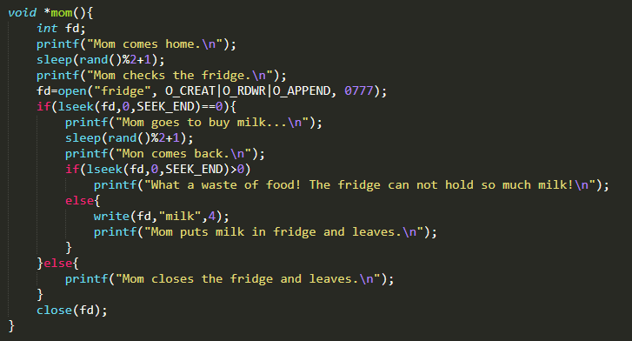
The too much milk problem
mom
http://www.cse.cuhk.edu.hk/~ericlo/teaching/os/lab/7-IPC2/race_con.html
Notes:
write(int fd, const void *buf, size_t count): count bytes
lseek():
repositions the file offset of the open file fd to the argument offset=0
according to the directive whence=SEEK_END
SEEK_END:
The file offset is set to the size of the file plus offset bytes.
lseek() returns:
The resulting offset location as measured in bytes from the beginning of the file

Slide 7
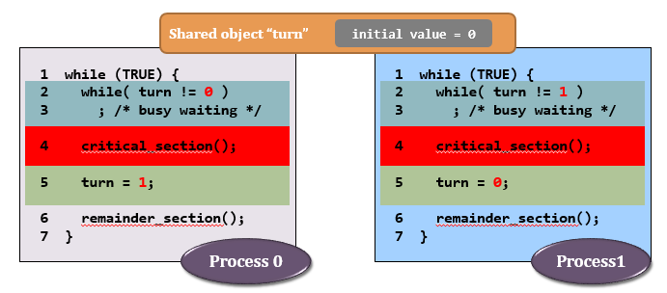
Busy Waiting
Loop on yet another shared object turn to detect the status of other processes
Example: spin_lock

Slide 8
Practice
How to fix the too much milk problem by busy waiting?
(Hint: you could use pthread_spin_lock)

Slide 9
Pthread_spin_lock API
int pthread_spin_init (pthread_spinlock_t *, int);
int pthread_spin_lock(pthread_spinlock_t *)
int pthread_spin_unlock(pthread_spinlock_t *)

Slide 10
Sleep Waiting
During waiting, the CPU would work on other task and no CPU are wasted.
E.g. Mutex Lock, Semaphore

Slide 11
Practice
How to fix the too much milk problem by spin-based waiting?
(Hint: use pthread_mutex_lock)

Slide 12
Pthread_mutex_lock API
int pthread_mutex_lock(pthread_mutex_t *)
int pthread_mutex_unlock(pthread_mutex_t *)

Slide 13
Spin_lock vs Mutex
Is mutex always better than spin_lock?
Not exactly. Why?
lock
i++
unlock
lock
…
…
…
…
…
unlock

Slide 14
Better way
Mom see the fridge is empty.
Mom leave a note and then go buy milk.
Dad open the fridge and see the note.
Dad just go away.
new API:
int pthread_mutex_trylock (pthread_mutex_t *)
int pthread_spin_trylock (pthread_spinlock_t *)

Slide 15
Semaphores
Semaphore is a variable that has an integer value
Initialize: a nonnegative integer value
semWait (P): decreases the semaphore value. the value becomes negative, then the process executing the semWait is blocked.
semSignal (V): increases semaphore value. If the resulting value is less than or equal to zero, then a process is blocked by a semWait operation, if any, is unblocked.

Slide 16
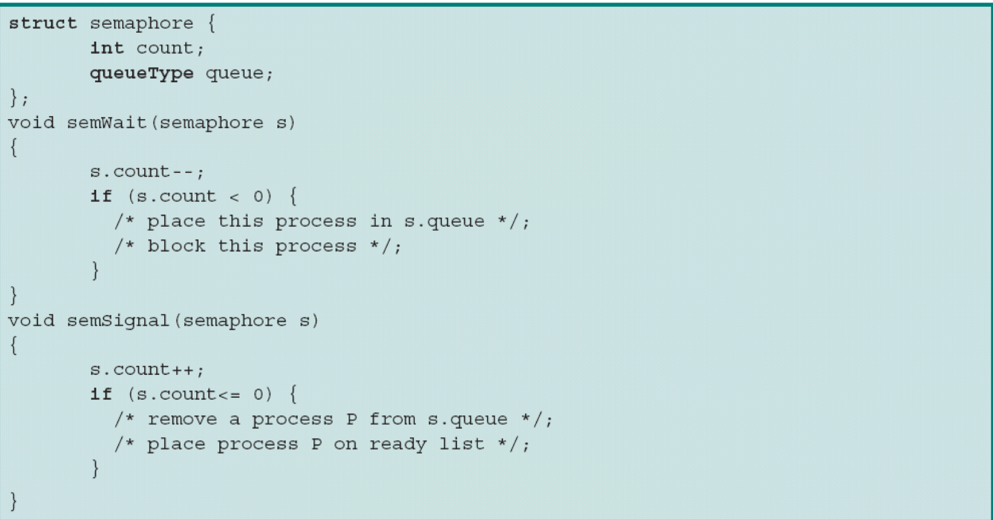
Semaphores

Slide 17
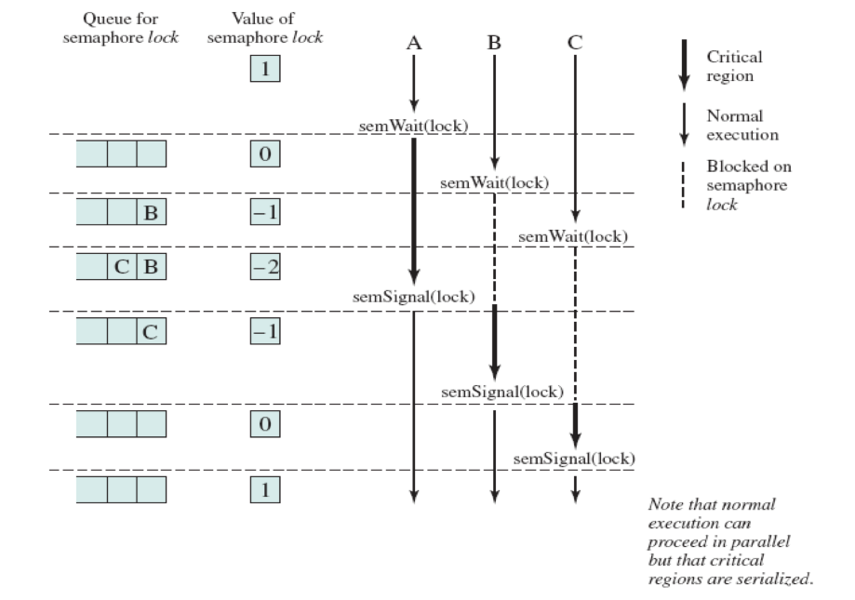
Mutual Exclusion using Semaphores

Slide 18
Semaphore API in Linux
Function | Description
sem_open | Opens/creates a named semaphore for use by a process
sem_wait | lock a semaphore
sem_post | unlock a semaphore
sem_close | Deallocates the specified named semaphore
sem_unlink | Removes a specified named semaphore
sem_getvalue | get semaphore value
semaphore.c shows how to use these functions to create, operate and remove named semaphore.
compile semaphore.c like this:
gcc semaphore.c -pthread -o semaphore
http://www.cse.cuhk.edu.hk/~ericlo/teaching/os/lab/7-IPC2/race_con.html

Slide 19
Practice
Remember the milk problem.
What if the fridge has space to store 2 bottles of milk?
Besides mom and dad, you are the third people will buy milk.
How to handle the too much milk problem by semaphore ?

Slide 20
Mutex vs Semaphore
Is binary semaphore equals to mutex?
Not exactly.
Mutex is more about resource protection.
Semaphore is more about resource assignment.
Mutex can only be unlock by container.
Semaphore can be assigned by anyone, including caller itself.
Mutex lock will be released, if the holder is terminate.
Semaphore will not add up, if the holder is terminate.

Slide 21
Your home has new problem
Your family buy a new big fridge, which can put in 100 bottles of milk.
Dad and you always take milk but never buy.
Mom is very frequently checking the fridge is empty or not.
If fridge is empty, she will go buy milk. Otherwise do nothing.
while (1){
lock
int num=check_fridge()
if(num>0)
take milk
unlock
} Dad and you
while (1){
lock
int num=check_fridge()
if(num==0)
go buy milk
unlock
} Mom

Slide 22
Condition variable
used to wait for a particular condition to become true.
Cond = a condition + a mutex
When we need condition variable?
when If/else is unbalance

Slide 23
Pthread_cond API
int pthread_cond_wait (pthread_cond_t *, pthread_mutex_t *);
release lock, put thread to sleep until condition is signaled;
when thread wakes up again, re-acquire lock before returning
int pthread_cond_signal (pthread_cond_t *);
Wake up at least one of the threads that are blocked on the specified condition variable.
If more than one thread is blocked on a condition variable, the scheduling policy shall determine the order in which threads are unblocked.

Slide 24
Solution
while (1){
lock//lock mutex
while(check_fridge()>0)
cond_wait //wait for cond_signal, unlock mutex
go buy milk
unlock
} Brother
Try to realize it
while (1){
lock
int num=check_fridge()
if(num>0)
take milk
else cond_signal
unlock
} Mon and you
while (1){
lock//lock mutex
while(check_fridge()>0)
cond_wait //wait for cond_signal and unlock mutex
go buy milk
unlock
} Dad

Slide 25
Three typical problem
Producers and Consumers
Readers and Writers
Dining philosopher(Not in this lab)

Slide 26
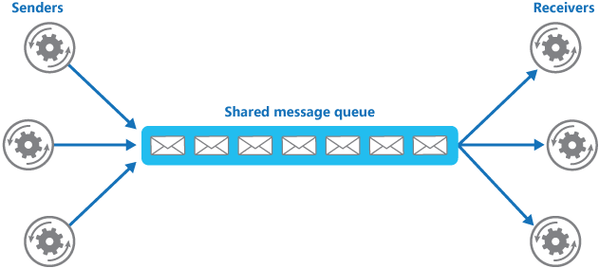
Producers and Consumers

Slide 27
Producers and Consumers
There is a queue, has a fixed size n.
Producer can produce when queue is not full
Consumer can consume when queue is not empty
At any time, only one person can access the queue
How?

Slide 28
Readers-Writers Problem
There is a data area shared among a number of processes.
Data area: a file, a block of main memory, a bank of processor registers and etc.
The conditions that must be satisfied are as follows:
Any number of readers can simultaneously read the file
Only one writer at a time may write to the file
If a writer is writing to the file, no reader can read it

Slide 29
Scenarios:
When new reader coming,
If no reader and writer, then new reader can read.
If writer is waiting and other readers are reading, then new reader can read.
If writer is writing, then new reader waits.
When new writer coming,
If no reader, then new writer can write.
If reader is reading, then new writer waits.
If writer is writing, then new writer waits.

Slide 30
Assignment: Readers-Writers Problem
Please complete the report
Please complete ”read.h” and “write.h”, and You should implement according to the output format in "output_sample.txt“
Check the blackboard for deadline

