Slide 1
Memory management
Huang Bo, Zeng Xinxun, Zhang Shiqi

Slide 2
OUTLINE
Contiguous Memory Allocation
Uniprogramming
Multiprogramming
Non-Contiguous Memory Allocation
Segmentation
Paging

Slide 3
Uniprogramming
Physical memory
OS
P

Slide 4
Uniprogramming
Physical memory
Pros
No translation & protection
App can access larger physical address
Simple
OS
P

Slide 5
Uniprogramming
Physical memory
OS
Cons
Not efficient
Not powerful
P

Slide 6
Multiprogramming
What if we want to run multiple processes?
Each process has the same memory size
OS
P1
How to manage each block?
P2
P5
fixed-sized
partitions
P3
P4

Slide 7
Multiprogramming
What if we want to run multiple processes?
Each process has the same memory size
OS
All
Free
P1
m1
P2
P5
m2
fixed-sized
partitions
P3
m3
m4

Slide 8
Multiprogramming
What if we want to run multiple processes?
Each process has different memory size
OS
P1
P5
P2
variable
partitions
P3
P6
P4

Slide 9
Multiprogramming
What if we want to run multiple processes?
Each process has different memory size
OS
P1
P5
P6
variable
partitions
P3
P6
P6

Slide 10
Fragmentation
P1
P1
External Fragmentation
Internal Fragmentation
P2

Slide 11
Multiprogramming
For Multiprogramming, we need to consider fragmentation problem.
There are several strategies:
First fit
Best fit
Worst fit
All
Free
All
Free
P
m1
m1
m2

Slide 12
Multiprogramming
For Multiprogramming, we need to consider fragmentation problem.
There are several strategies:
First fit
Best fit
Worst fit
All
Free
All
Free
All
Free
m1
P
m2
return
slice
m3
m4

Slide 13
Multiprogramming
For Multiprogramming, we need to solve fragmentation problem.
There are several strategies :
First fit
Best fit
Worst fit
best-fit
worst-fit
All
Free
All
Free
All
Free
m1
m1
m1
Which is better?
P
m2
m2
m2
m3
m2
m3
m3
m4
m4
P
m4
m4

Slide 14
Multiprogramming
Another allocation structure——Buddy System
256KB
128KB
128KB
64KB
64KB
32KB
32KB
Assume we have 4GB memory,
How many times to search for a free block?

Slide 15
Question
Q: How to avoid or reduce fragmentation?
Defragmentation
OS
Noncontiguous allocation
Segmentation
Paging
P1
P2
P3

Slide 16
Segmentation
Mem
OS
Seg1
Stack
Seg2
Seg3
Heap
Seg4
Seg5
BSS
Data
Code

Slide 17
Question
Q: How to know which segment is stored in which physical address?

Slide 18
Segmentation
Pros.
Make data more “logical”, easy to share
We can do much better on “protection”
Reduce fragmentation
Cons.
Segment size is not fixed, more complicated
One process need allocate memory many times
Fragmentation is smaller but still a problem

Slide 19
Paging
Q: What’s the idea of Paging?

Slide 20
Paging
Mem
OS
Seg3
page1
page1
page2
page2
page3
page3
page4
page4
page5
page5
page6
page6

Slide 21
question
Q: How to know which page is stored in which physical address?

Slide 22
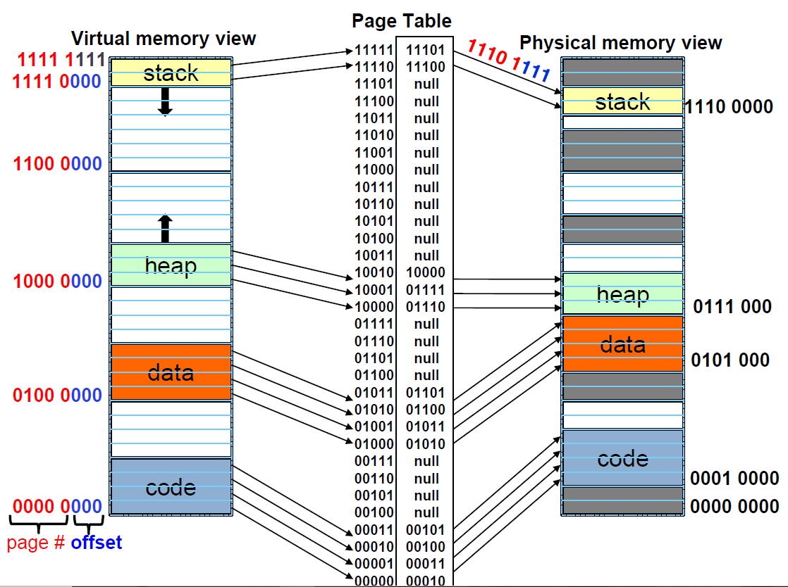
Paging
The idea like database. We need a extra space for “Page Table”, and we also need a “index” to speed up the searching.

Slide 23
Paging
Pros.
Simple to implement
Reduce external fragmentation
Demand paging technique (learn latter)
Cons.
Page table requires extra memory space
Internal fragmentation problem

Slide 24
Lab requirement
Complete the code, so that it can realize basic memory allocation (basic). Please notice, the program may have some bugs, you are also required to fix it. (be care of input/output buffer)
You can try to add buddy system/ segmentation /paging to this program, which will give you 20 bonus points.
read OS_Lab8_Memory_Guide.pdf for detail.

