Slide 1
Caching and page replacement
Zhang Shiqi, Zeng Xinxun, Huang Bo

Slide 2
Overview
Caching Strategy
Direct-mapped cache
Set-associative cache
Full-associative cache
Paging Replacement
FIFO
MIN
LRU
Clock
Second-chance list

Slide 3
What is cache
A repository for copies that can be accessed more quickly than the original.
Make frequent case fast and infrequent case less dominant.
Why is caching useful?
Temporal locality
Spatial Locality

Slide 4
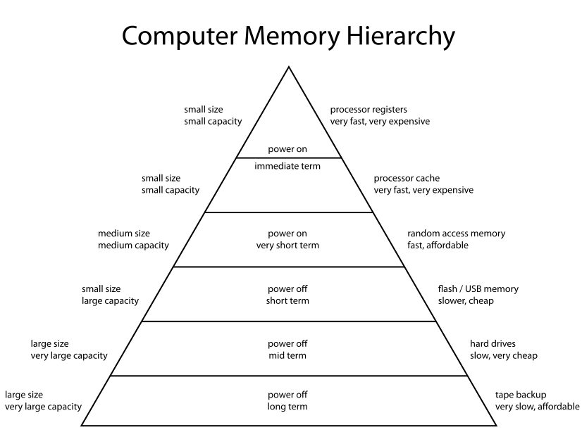
Caching
Pictures from wiki

Slide 5
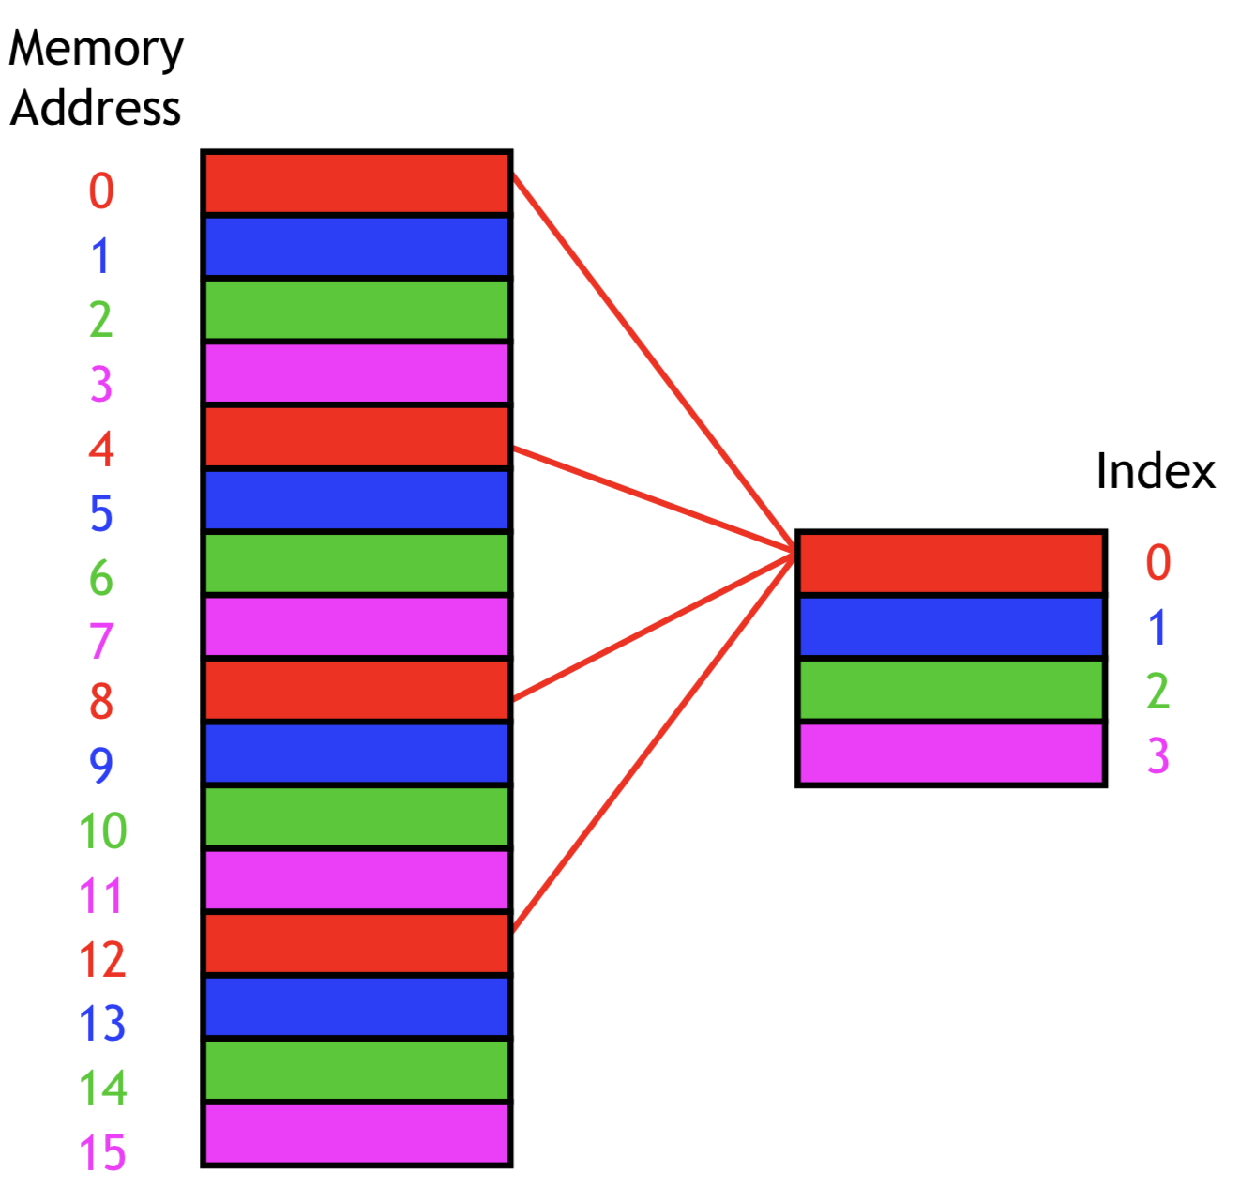
Direct mapped cache
A direct-mapped cache is the simplest approach:
each main memory address maps to exactly one cache block.
How to compute this mapping?
https://courses.cs.washington.edu/courses/cse378/09wi/lectures/lec15.pdf

Slide 6
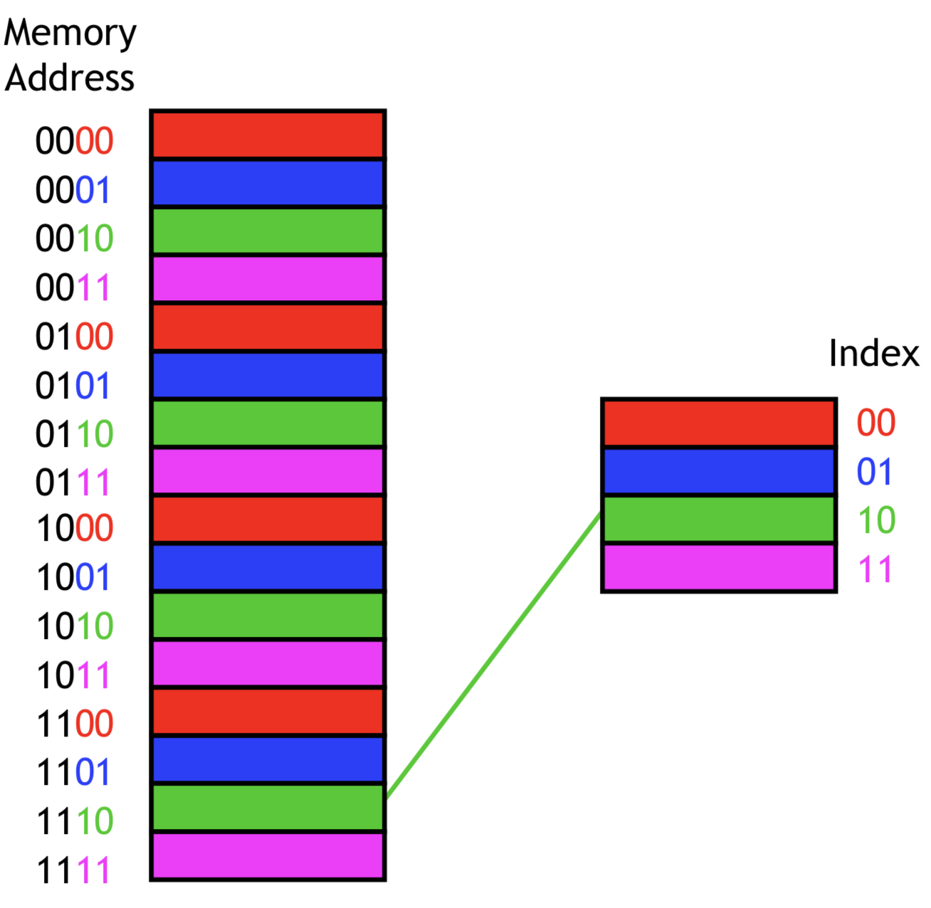
Mapping
Use k least-significant bits to mapping
k: determined by cache size
https://courses.cs.washington.edu/courses/cse378/09wi/lectures/lec15.pdf

Slide 7
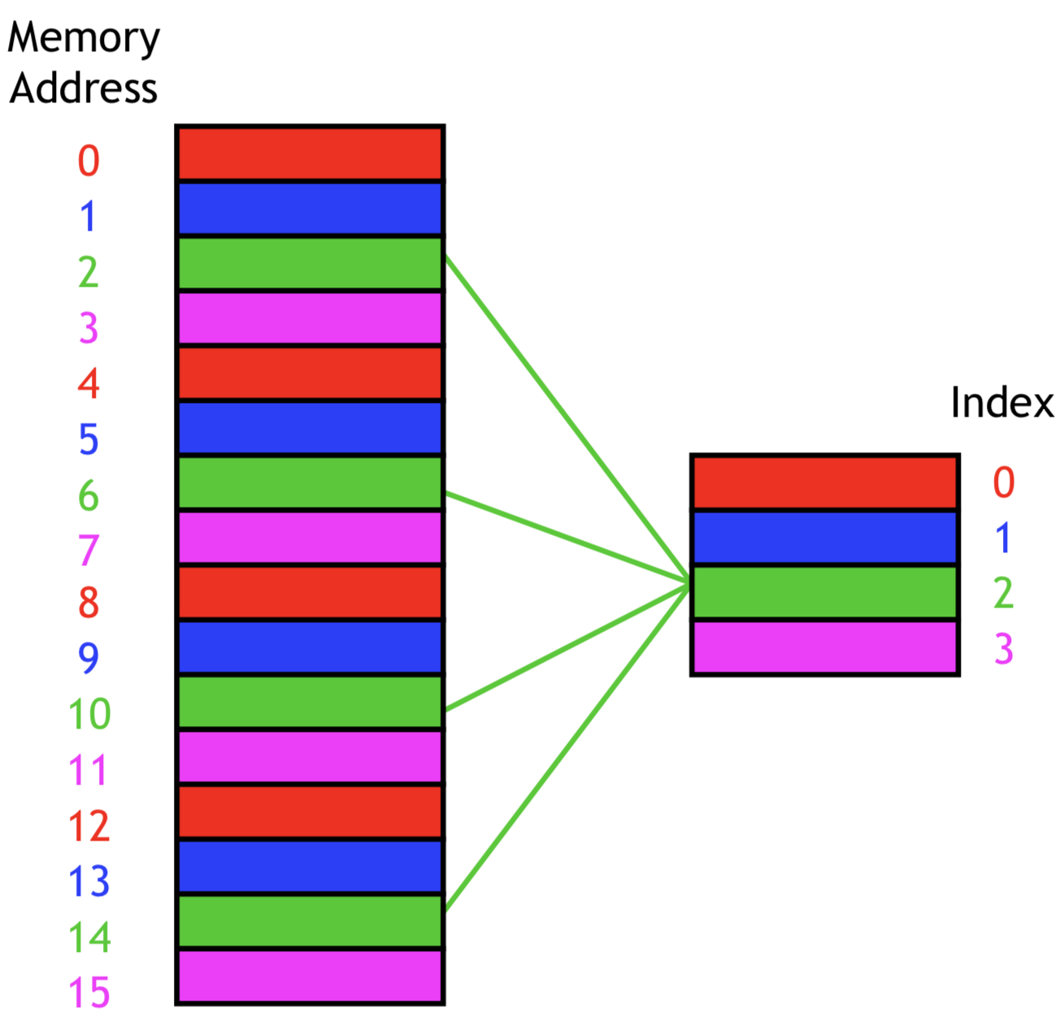
Question
How to DISTINGUISH the correct data?
https://courses.cs.washington.edu/courses/cse378/09wi/lectures/lec15.pdf
Notes:
Now we can store memory data into cache, but memory data from different address may map to same cache line.

Slide 8
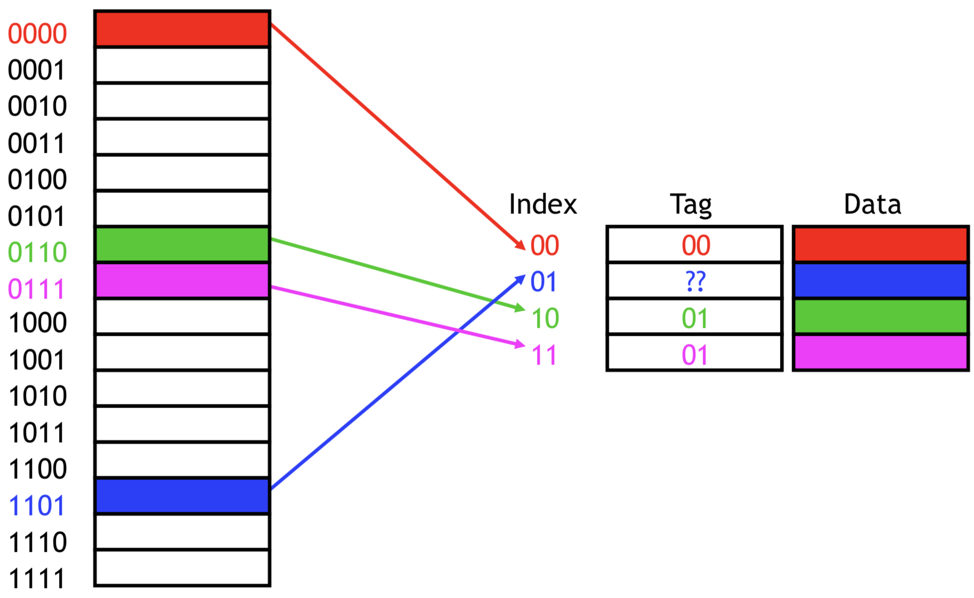
Tag field
Use register to distinguish between different memory locations
https://courses.cs.washington.edu/courses/cse378/09wi/lectures/lec15.pdf

Slide 9
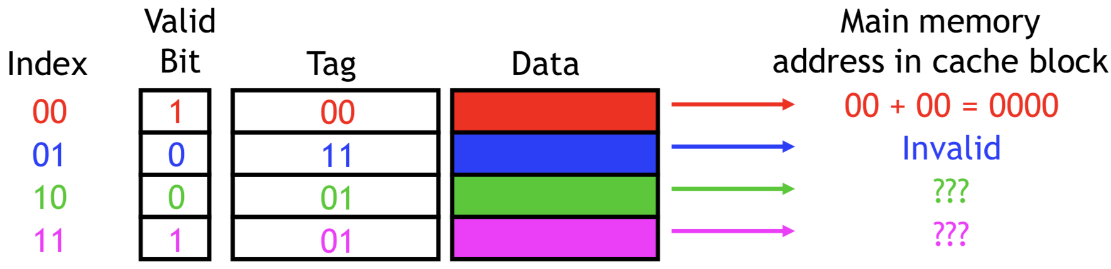
Valid bit
When the system is initialized, all the valid bits are set to 0
When data is loaded into a particular cache block, the corresponding valid bit is set to 1.
https://courses.cs.washington.edu/courses/cse378/09wi/lectures/lec15.pdf

Slide 10
question
For a 32-bit system, 9 least significant bits are used for cache index and other bits are used for tag field. Each cache data contains one byte.
What is the total size of cache?

Slide 11
question
Currently, each cache block only contains one byte from one memory location. What is the problem?
We don’t consider Spatial Locality
How to solve it?
Enlarge block size that can contains data from continuous memory location
Notes:
How to solve it?

Slide 12
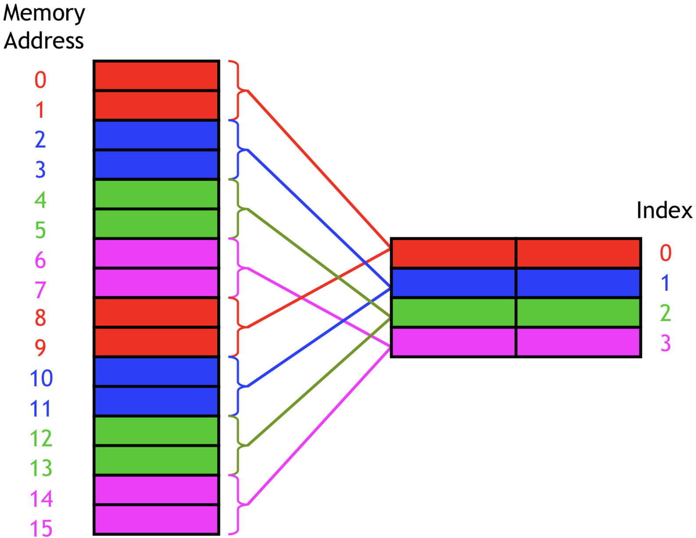
Enlarge block size
https://courses.cs.washington.edu/courses/cse378/09wi/lectures/lec15.pdf

Slide 13
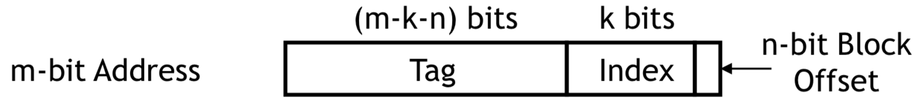
Direct mapped cache
For a m-bit system
Each cache line contain 2^{n} bytes.
Using k bits to identify each cache line.
Tag field is the most (m-k-n) bits

Slide 14
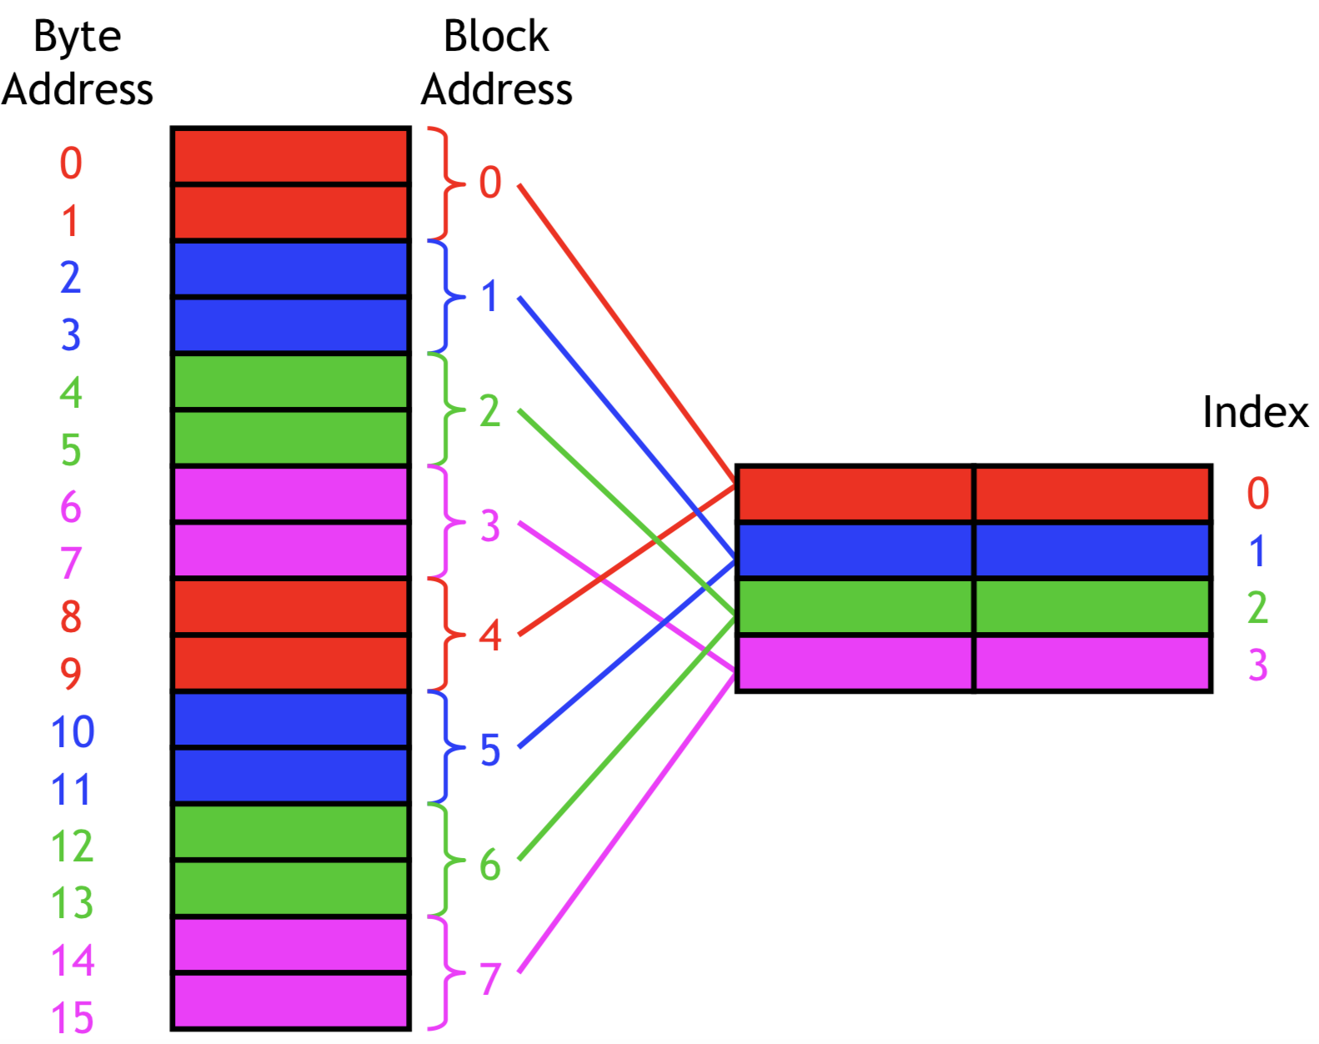
Direct mapped cache
https://courses.cs.washington.edu/courses/cse378/09wi/lectures/lec15.pdf

Slide 15
Disadvantage
All address with the same least significant k bits will mapped to same place
Eg. 4000403X, 5032803X
May cause a lot of conflict

Slide 16
Set Associative cache
How to avoid conflict?
We store many of them!
We have N-direct mapped caches(N-way)

Slide 17
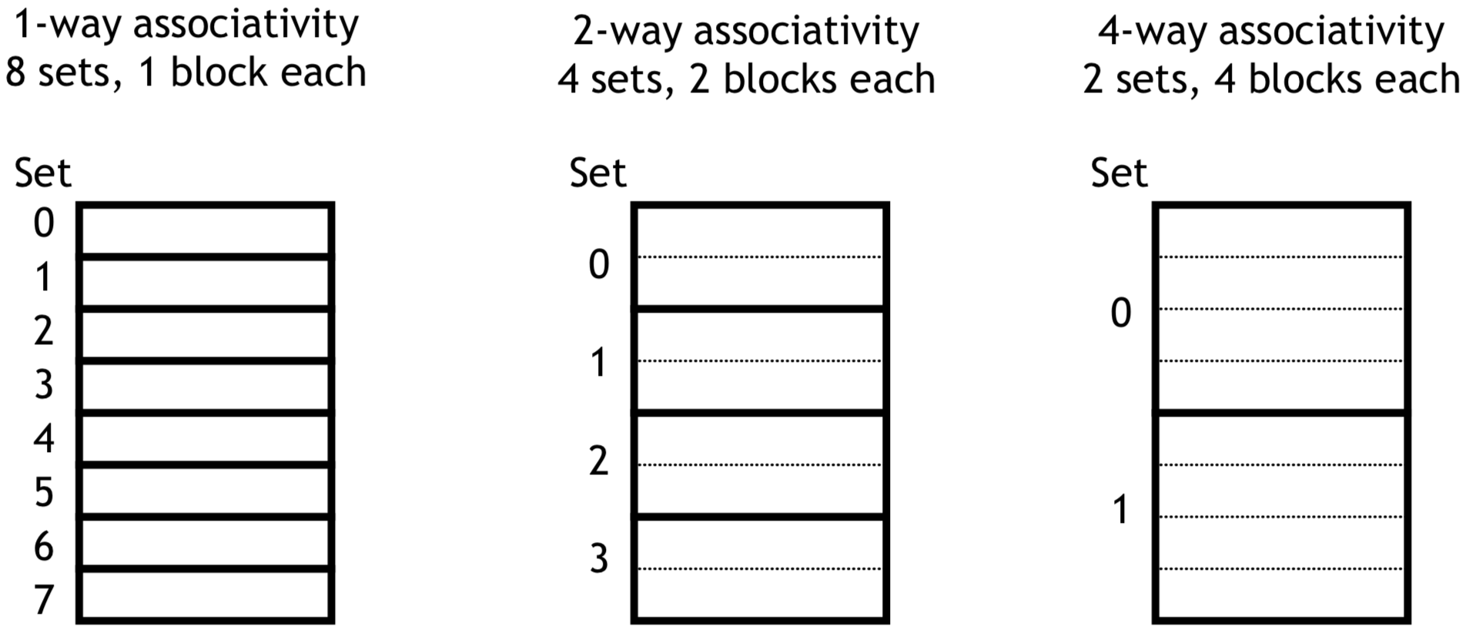
Set Associative cache
The cache is divided into groups of blocks, called sets.
If each set has n blocks, the cache is an n-way associative cache
https://courses.cs.washington.edu/courses/cse378/09wi/lectures/lec15.pdf
Notes:
How to find the cache
First use set index and find the set,
scan all block in this set until find the block with given tag
Then use the byte offset to direct to final position

Slide 18
Set Associative cache
Pros
Improve the spatial utilizations
Reduce miss rate
Cons
Traverse every way in a set, lower speed
More complicate hardware support

Slide 19
Fully associative cache
We don’t use cache index. We can use cache tag to distinguish them.
Only one set in set associative cache

Slide 20
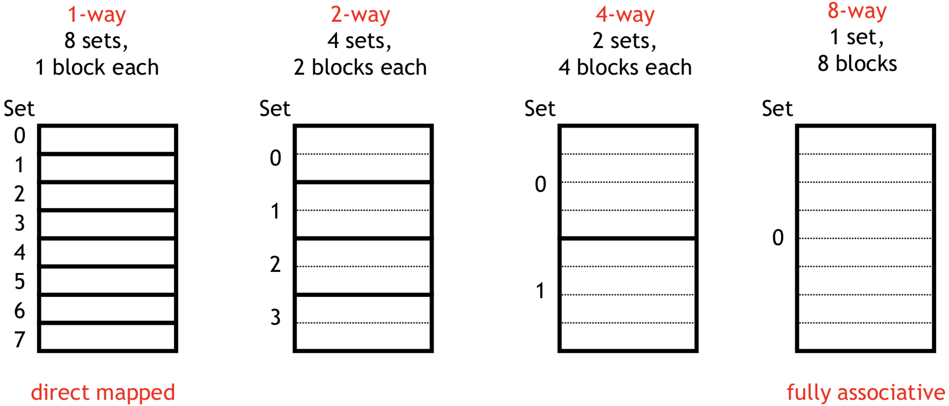
More general view
https://courses.cs.washington.edu/courses/cse378/09wi/lectures/lec15.pdf
Notes:
1-way set associative cache is the same as a direct-mapped cache.
If a cache has 2k blocks, a 2k-way set associative cache would be the same as a fully-associative cache.

Slide 21
question
How to do replacement in a set?
Can we use FIFO, LRU?
Notes:
LRU,FIFO and MIN are design for reduce miss.
Assume no miss happens, the operation of algorithms will make the total overhead 10 times slower.
Despite they do reduce the miss ratio, but still not wise here.

Slide 22
Page replacement
Why we need page replacement?
To support demand paging
Why we need demand paging?
Increase multiprogramming degree
virtual memory

Slide 23
Page replacement
Random
FIFO
Min
LRU
Clock
Second-Chance List

Slide 24
fifo
Using a fixed-size queue to maintain the page.
When there comes a new query:
1) If it exists, return the result. (Hit)
2) If it doesn’t exist. (Miss)
if the queue is full, pop
push back

Slide 25
Min
We replace the one won’t be used for longest time.
Min gives us the minimum number of faults.
When there comes a new query:
1) If it exists, return the result. (Hit)
2) If it doesn’t exist. (Miss)
if the ? is full, find the one
replace it

Slide 26
MIn
Q. Can you prove that Min algorithm gives the minimum number of faults?

Slide 27
LRU
Replace the least recent used one.
When there comes a new query:
1) If it exists(Hit)
update the data structure
return the result.
2) If it doesn’t exist. (Miss)
if the ? is full, find the one
replace it
update the data structure

Slide 28
LRU
Q: How to implement?
Counter
Timestamp
Double-Linked-List
Q: What’s the problem?
Additional operation for every hit, 10 times slower.

Slide 29
CLOCK
0
-1
1
5
0
-1
0
-1
0
3
0
4
0
-1
0
-1
1
1
0
7
0
-1
1
2

Slide 30
second-chance
FIFO
LRU
NEW
OLD

