Slide 1



Process-Memory-Tracker
CS302 project2
11811702 张湲
11811522 张韶丰
11811405 高圣迪
2021/05/30

Slide 2
Outline
Introduction
Implementation
Demonstration
Result Analysis
Future direction

Slide 3
Introduction
This project has realized a memory leak detector for C/C++ programs which runs on Linux operating systems. It mainly realizes three functions
Real time statistics system process memory usage
Detect the allocation and release of memory and file handle in a process
Detects whether there is a memory leak in a process

Slide 4
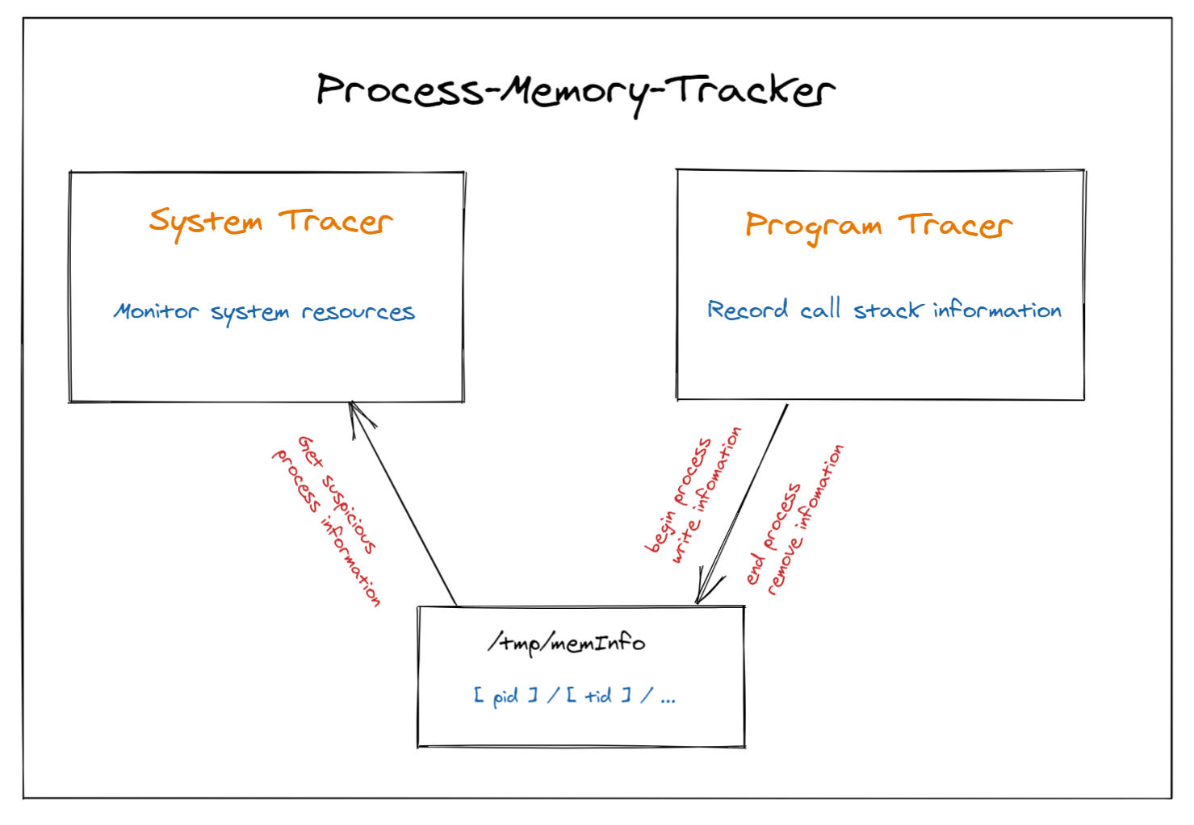
Structure

Slide 5
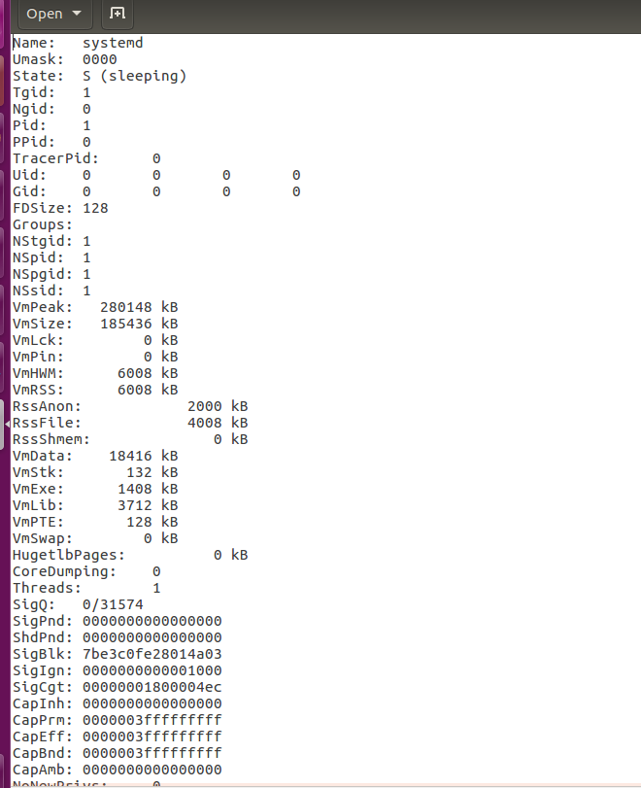
Implementation：task1
The program will read the status information of each process in proc/pid/status, and get the memory usage of all processes, and display the information of all processes to the user, and can sort according to the virtual memory usage of the process.

Slide 6
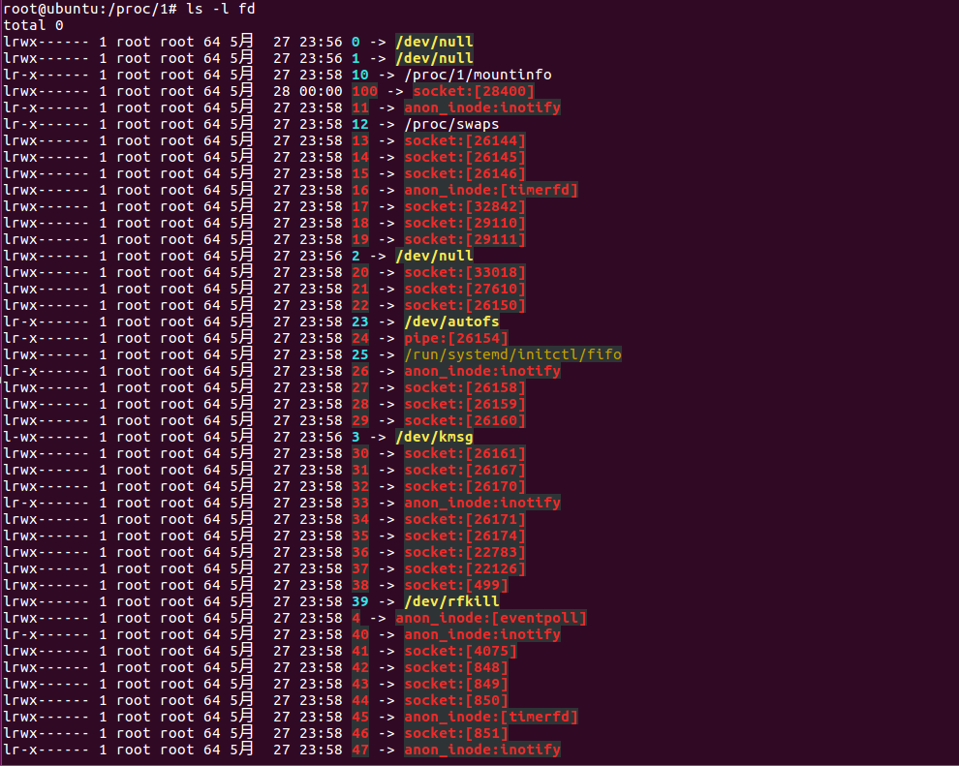
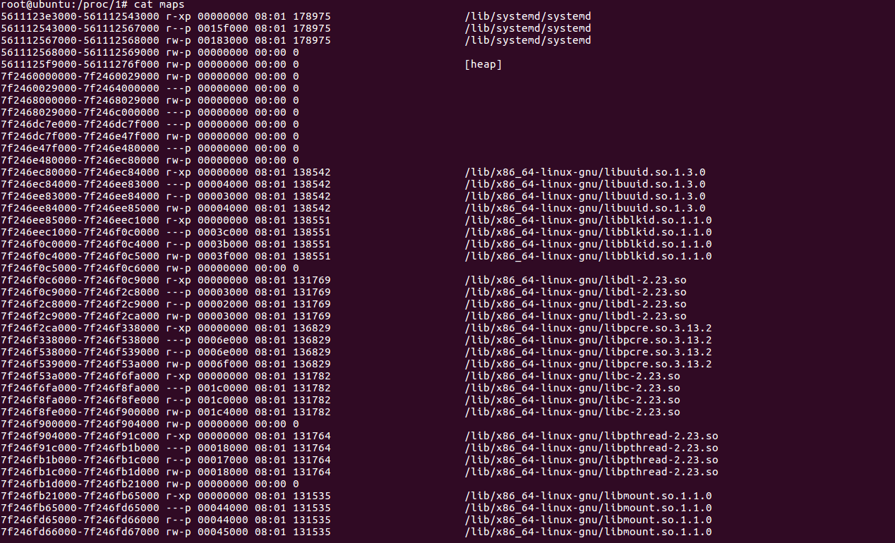
Implementation：task2
In order to get the file handle and the memory usage of the process in real time, C++ is used to execute the ls -l proc/pid/fd and cat proc/pid/ maps command and store the returned result in vector <string> to get the file handle and the memory usage of the process.

Slide 7
Implementation：task3
Monitor the allocation and release of code memory and file handle
gcc wrap: malloc, free, new, delete, fopen, freopen and fclose.
operator overloading: new[] and delete[]
Get the location of the calling function
backtrace, addr2line
Call information storage and maintenance
hashmap
pthread_once, mutex, lock_guard
Catch abnormal signals
signal
Interact with the process detection program
/tmp/memTracer/[pid]/[tid]

Slide 8
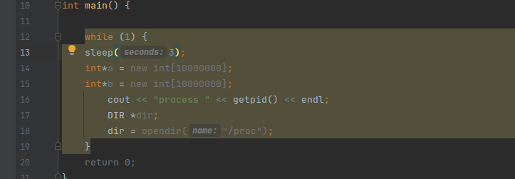
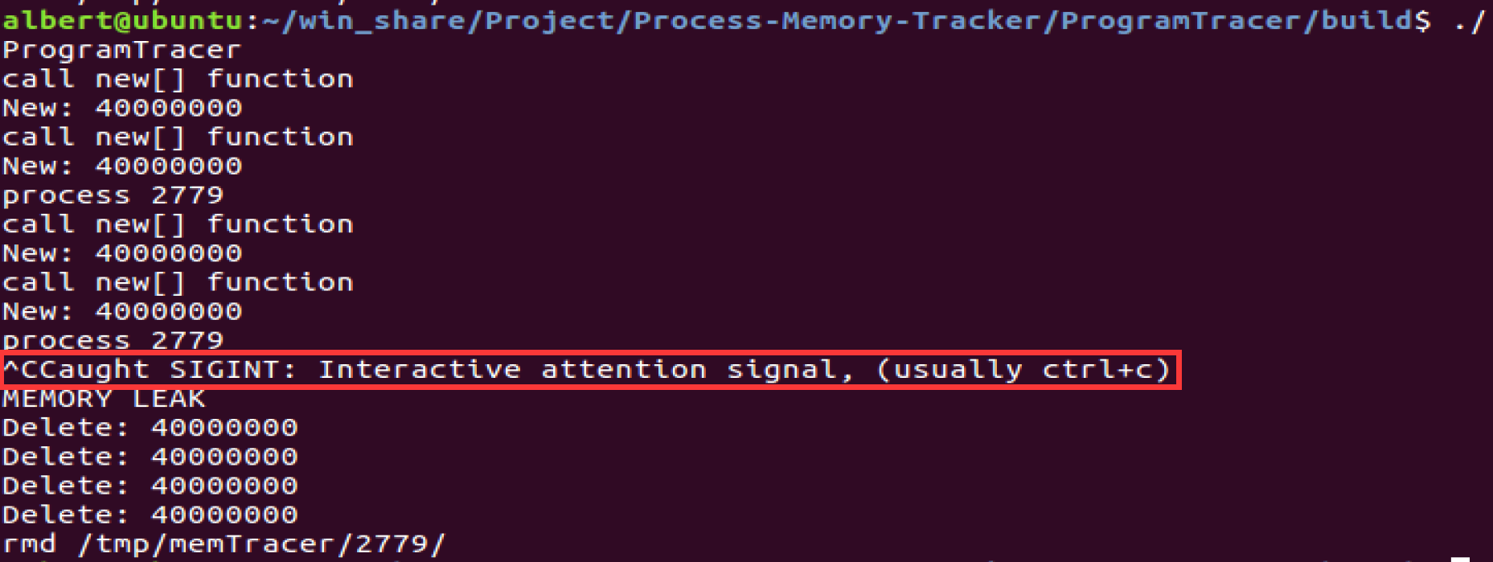
Exception Catch and Automatic Release

Slide 9
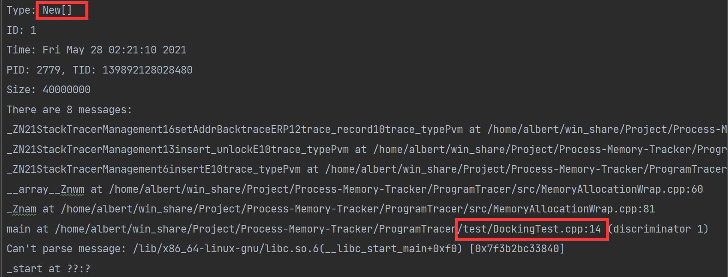
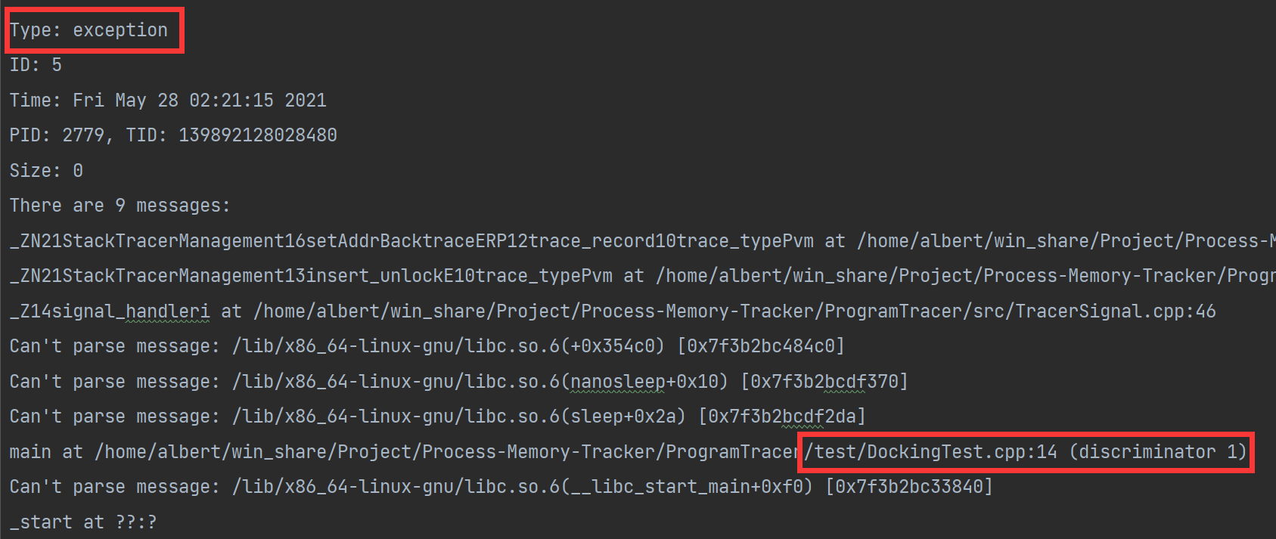
Output

Slide 10
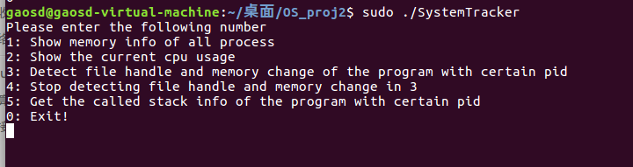
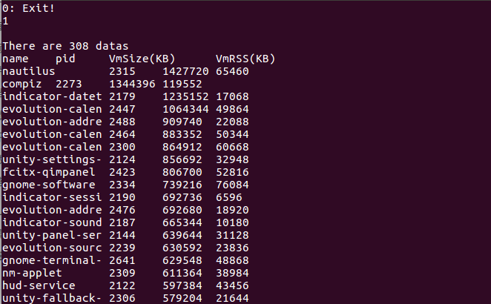

Demonstration

Slide 11
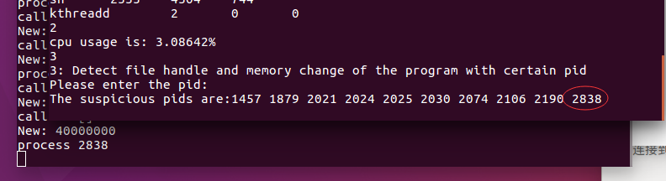
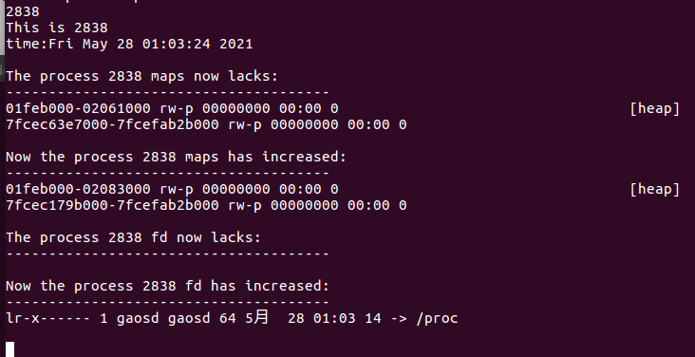
Demonstration

Slide 12
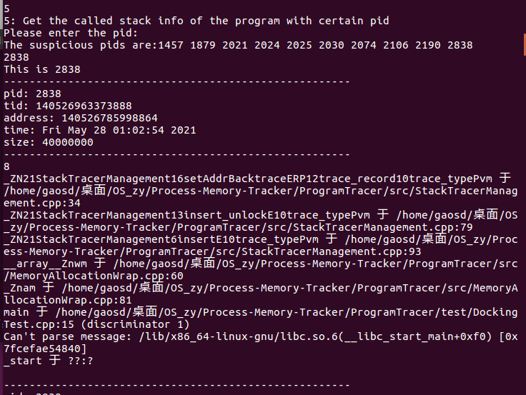
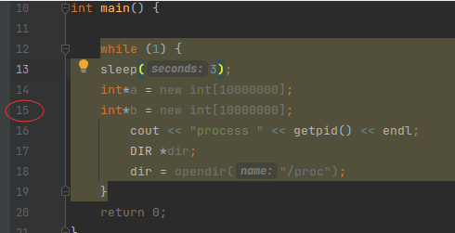
Demonstration

Slide 13
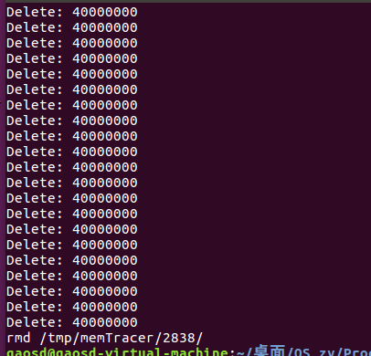
Demonstration

Slide 14
Result Analysis
The memory leak detector is aimed at C/C++ programs. The detector could compatible with most Linux operating systems and has high portability. Support OS including Ubuntu, Centos.
The detector does not significantly affect the performance of the running program when it detects memory leaks.
The detector can make real-time statistics on the memory usage of the system process and its threads. Sort and display the memory statistics in real time.
The detector can detect the allocation and release of memory and file handles in a process or thread.
The detector can count the process memory allocation and release, and analyze whether there is a memory leak. If there is a memory leak, the detector can analyze and obtain the code that may have a memory leak.

Slide 15
Future direction
Since addr2line can only resolve static link addresses, it will be wrong for dynamic link library address resolution. In the future, we can try to parse the file line number of the dynamic library based on the offset address.
At present, the algorithm of detecting memory leak is relatively simple. We will optimize it as much as possible in the future to make it more efficient.

Slide 16
Division of labor
张韶丰: Finish the program detection part. Implement program memory detection and record the location of memory leaks.
高圣迪: Realize the algorithm of memory leak detection, integrate the code, and realize the real-time display of process memory
张湲：Realize the detection of specific process memory and file handle, realize the calculation of CPU usage

Slide 17
THANK YOU
Q&A

