Slide 1


Abt-FKT-DNC09-DCOM Workshop
AUTOSAR Diagnostic Communication Manager – Dcm Training
CDG-SMT/ESB3
Chassis Systems Control
Internal | CDG-SMT/ESB3 Simone Kriso | 10.12.2012 | © Robert Bosch GmbH 2007. All rights reserved, also regarding any disposal, exploitation, reproduction, editing, distribution, as well as in the event of applications for industrial property rights.

Slide 2

Agenda
Autosar Dcm Training
Overview: SW Context
Features
Design Aspects
Static View
Dynamic View
Interfaces
Roadmap / Deliveries / Support
Chassis Systems Control
Internal | CDG-SMT/ESB3 Simone Kriso | 10.12.2012 | © Robert Bosch GmbH 2007. All rights reserved, also regarding any disposal, exploitation, reproduction, editing, distribution, as well as in the event of applications for industrial property rights.

Slide 3
Agenda
Autosar Dcm Training
Overview: SW Context
Features
Design Aspects
Static View
Dynamic View
Interfaces
Roadmap / Deliveries / Support
Chassis Systems Control
Internal | CDG-SMT/ESB3 Simone Kriso | 10.12.2012 | © Robert Bosch GmbH 2007. All rights reserved, also regarding any disposal, exploitation, reproduction, editing, distribution, as well as in the event of applications for industrial property rights.

Slide 4
AUTOSAR Architecture with Dcm
Autosar Dcm Training
Application
Software
Component
Application
Software
Component
nn
Actuator
Software
Component
Sensor
Software
Component
AUTOSAR Software
AUTOSAR Interface
AUTOSAR Interface
AUTOSAR Interface
..............
AUTOSAR Interface
AUTOSAR Runtime Environment (RTE)
Communication
Services
AUTOSAR COM
Dcm
Diagnostic Com.
Manager
<Bus specific>
State Manager
Generic NM Interface
<Bus specific>
NM
IPDU Multiplexer
PDU Router
<Bus specific> Transport Protocol
Communication Hardware Abstraction
Communication Drivers
Chassis Systems Control
Internal | CDG-SMT/ESB3 Simone Kriso | 10.12.2012 | © Robert Bosch GmbH 2007. All rights reserved, also regarding any disposal, exploitation, reproduction, editing, distribution, as well as in the event of applications for industrial property rights.

Slide 5
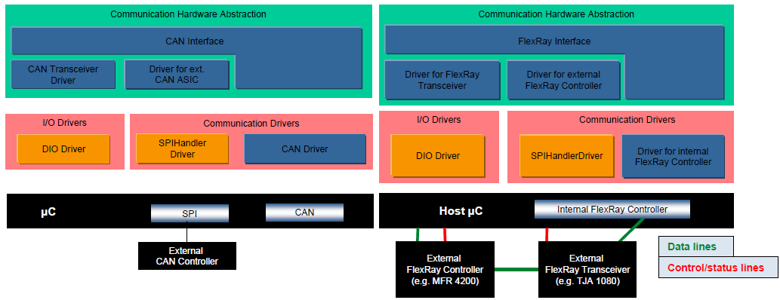
Autosar Dcm Training
Application
ComM
DiagAdapt (DGS)
Appl
DCOM
RTE
BswM
Dem
Dcm
IoHwAb
PduR
Nvm
SchM(RTE)
CanTp
J1939Tp
FrArTp /
FrTp AR3.1
FrIsoTp /
FrTp AR4.0
OEM
FrTp
Chassis Systems Control
Internal | CDG-SMT/ESB3 Simone Kriso | 10.12.2012 | © Robert Bosch GmbH 2007. All rights reserved, also regarding any disposal, exploitation, reproduction, editing, distribution, as well as in the event of applications for industrial property rights.

Slide 6
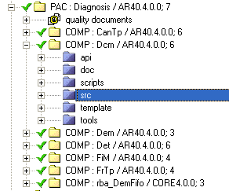
Overview: Definition of Dcm
Autosar Dcm Training
Role of Dcm
Ensures diagnostic data flow and manages the diagnostic states (diagnostic sessions and security states)
Supports UDS (ISO 14229-1) and OBD (ISO 15031-5) with protocol layer and service layer
Is independent from the network (CAN, FlexRay,..)
Usage of Dcm
All services run on the protocol layer
In the service layer, Dcm provides standard diagnostic service implementations
Dcm is part of the Diagnosis Package within the CUBAS Stack and configured by
the BCT configuration tool that generates required configuration .c/.h files
and configuration files which have to be adapted manually, *appl*.c/h
Chassis Systems Control
Internal | CDG-SMT/ESB3 Simone Kriso | 10.12.2012 | © Robert Bosch GmbH 2007. All rights reserved, also regarding any disposal, exploitation, reproduction, editing, distribution, as well as in the event of applications for industrial property rights.

Slide 7
Agenda
Autosar Dcm Training
Overview: SW Context
Features
Design Aspects
Static View
Dynamic View
Interfaces
Roadmap / Deliveries / Support
Chassis Systems Control
Internal | CDG-SMT/ESB3 Simone Kriso | 10.12.2012 | © Robert Bosch GmbH 2007. All rights reserved, also regarding any disposal, exploitation, reproduction, editing, distribution, as well as in the event of applications for industrial property rights.

Slide 8
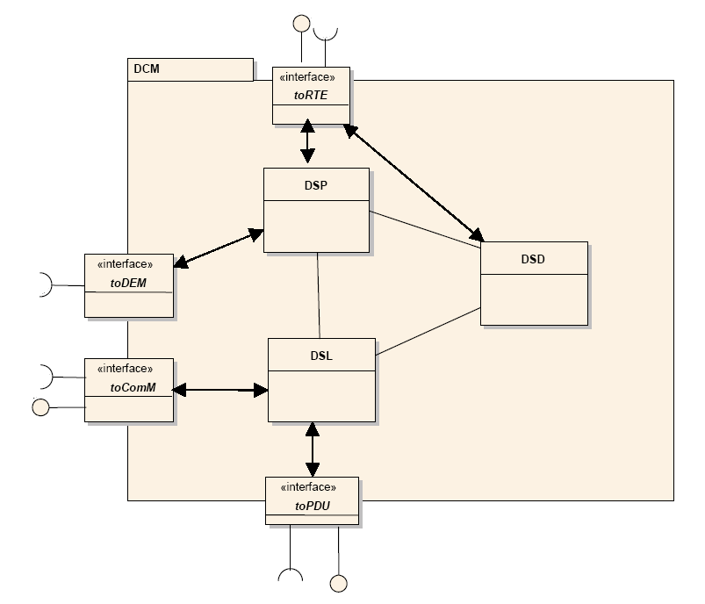
Dcm Features: Architecture Overview
Autosar Dcm Training
Dcm internally consists of 3 functional blocks:
Diagnostic Session Layer DSL
This part is responsible to receive the request, start the protocol, monitor the timings (P2max, S3max etc) and transmit the response.
Diagnostic Service Dispatcher DSD
This part Dcm will verify the diagnostic data partially (verification of SID, allowed session and security). DSD will call the service interpreter function.
Diagnostic Service Processing DSP
This part of Dcm contains the implemented standard services (for UDS and OBD).
Due to optimization reasons, DSL and DSD are
clubbed in the CUBAS Dcm and form the FC
DslDsd
Chassis Systems Control
Internal | CDG-SMT/ESB3 Simone Kriso | 10.12.2012 | © Robert Bosch GmbH 2007. All rights reserved, also regarding any disposal, exploitation, reproduction, editing, distribution, as well as in the event of applications for industrial property rights.

Slide 9
Dcm Features: Diagnostic Session Layer DSL
Autosar Dcm Training
Request Handling
Forward requests from PDU Router to DSD
Concurrent functional “TesterPresent” (“keep alive logic”)
Response Handling
Forward responses from DSD to PDU Router
Guarantee response timing to tester by ResponsePending transmission
Support of periodic transmission and ResponseOnEvent (ROE) transmission
Support of “Paged Buffer” concept for long responses
Security Level Handling
Manage security level
Session State Handling
Manage session state
Keep track of active non-default sessions (S3max timeout supervision)
Informs depending modules on session change (in AR40.5.0.0 via BswM)
Diagnostic Protocol Handling
Handling of different diagnostic protocols (e.g. UDS, OBD)
Communication Mode Handling
Handling of communication requirements (Full- / Silent- / No Communication)
Indicating of active / inactive diagnostic
Enable / Disable all kinds of transmissions
Chassis Systems Control
Internal | CDG-SMT/ESB3 Simone Kriso | 10.12.2012 | © Robert Bosch GmbH 2007. All rights reserved, also regarding any disposal, exploitation, reproduction, editing, distribution, as well as in the event of applications for industrial property rights.

Slide 10
Dcm Features: Diag. Service Dispatcher DSD
Autosar Dcm Training
Service Dispatching
Support check of diagnostic service identifier (SID) / subfunction and adaptation of the diagnostic message
Distribution of diagnostic message to service interpreter (DSP or diagnostic application)
Service Verification
Verification functionality (session, security level, permission of application)
Response Assembling
Assemble positive or negative response
Suppression of responses
Handling of „suppressPosRspMsgIndicationBit“
suppression of negative responses for Functional Request { ISO 14229 requirement: Negative response messages with negative response codes of SNS (serviceNotSupported), SFNS (subFunctionNotSupported) and ROOR (requestOutOfRange) shall never be transmitted when functional addressing was used for the request message }
Initiate transmission
Chassis Systems Control
Internal | CDG-SMT/ESB3 Simone Kriso | 10.12.2012 | © Robert Bosch GmbH 2007. All rights reserved, also regarding any disposal, exploitation, reproduction, editing, distribution, as well as in the event of applications for industrial property rights.

Slide 11
Dcm Features: Diag. Service Processing DSP
Autosar Dcm Training
Diagnostic service interpreter:
Analyze the received request message
Check format and whether the addressed sub-function is supported
Acquire data or execute the required function call on the Dem, SWC’s or other BSW modules
Assemble the response
According to AUTOSAR AR 4.0, Dcm implements several OBD and UDS services.
Emissions-Related Diagnostic Services
AUTOSAR Dcm portfolio:
All OBD services are specified in ISO 15031-5, beside OBD mode 0x05 (which is not relevant in powertrain area)
CUBAS Dcm provides all OBD services, as specified in AUTOSAR R4.0, with the AUTOSAR interfaces (-> interface to Dem, RTE / BSW,..)
Chassis Systems Control
Internal | CDG-SMT/ESB3 Simone Kriso | 10.12.2012 | © Robert Bosch GmbH 2007. All rights reserved, also regarding any disposal, exploitation, reproduction, editing, distribution, as well as in the event of applications for industrial property rights.

Slide 12
Dcm Features: Diag. Service Processing DSP
Autosar Dcm Training
Unified Diagnostic Services in AUTOSAR 4.0
Error memory interface:
ClearDiagnosticInformation (service 0x14)
ReadDTCInformation (service 0x19) (some subfunctions are missing in CUBAS Dcm R4.0)
ControlDTCSetting (service 0x85)
Diagnostic communication and security:
DiagnosticSessionControl (service 0x10)
TesterPresent (service 0x3E)
SecurityAccess (service 0x27)
ECU State Handling
EcuReset (0x11)
Communication Handling
CommunicationControl (0x28)
Event Handling
Response on Event (0x86)
Chassis Systems Control
Internal | CDG-SMT/ESB3 Simone Kriso | 10.12.2012 | © Robert Bosch GmbH 2007. All rights reserved, also regarding any disposal, exploitation, reproduction, editing, distribution, as well as in the event of applications for industrial property rights.

Slide 13
Dcm Features: Diag. Service Processing DSP
Autosar Dcm Training
Additional Unified Diagnostic Services in AUTOSAR 4.0
Data Handling
ReadDataByIdentifier (0x22)
DynamicallyDefineDataIdentifier (0x2C)
WriteDataByIdentifier (0x2E)
Actuator and Routine Handling
InputOuputControlByIdentifier (0x2F)
RoutineControl (0x31)
Services which are currently not supported (as on 15th Oct 2012):
AccessTimingParameter (0x83)
SecuredDataTransmission (0x84)
LinkControl (0x87)
ReadMemoryByAddress (0x23) (scheduled for AR40.5.0.0)
ReadScalingDataByIdentifier (0x24)
ReadDataByPeriodicIdentifier (0x2A) (scheduled for AR40.5.0.0)
WriteMemoryByAddress (0x3D) (scheduled for AR40.5.0.0)
RequestDownload (0x34)
RequestUpload (0x35)
TransferData (0x36)
RequestTransferExit (0x37)
Chassis Systems Control
Internal | CDG-SMT/ESB3 Simone Kriso | 10.12.2012 | © Robert Bosch GmbH 2007. All rights reserved, also regarding any disposal, exploitation, reproduction, editing, distribution, as well as in the event of applications for industrial property rights.

Slide 14
Dcm Features
Autosar Dcm Training
SW-C (via RTE) / other BSW
Dependencies to
other modules
Dcm
Dem
Dlt
NvM
IoHwAb
BswM
PduR
ComM
Chassis Systems Control
Internal | CDG-SMT/ESB3 Simone Kriso | 10.12.2012 | © Robert Bosch GmbH 2007. All rights reserved, also regarding any disposal, exploitation, reproduction, editing, distribution, as well as in the event of applications for industrial property rights.

Slide 15
Overview changes AR3.1 – AR4.0.2 (1/4)
Autosar Dcm Training
DSL/DSD
New PduR Interface
New ComM interface (available with AR40.5.0.0)
Receive cancellation
Interaction with BswM (session, reset, communication control handling)
Bootloader interaction for flash programming
Manufacturer and supplier indication (according to new ISO design)
Subfunction configuration now in DSD service table
Chassis Systems Control
Internal | CDG-SMT/ESB3 Simone Kriso | 10.12.2012 | © Robert Bosch GmbH 2007. All rights reserved, also regarding any disposal, exploitation, reproduction, editing, distribution, as well as in the event of applications for industrial property rights.

Slide 16
Overview changes AR3.1 – AR4.0.2 (2/4)
Autosar Dcm Training
OBD
Mode 1 / 9: signal interface
Mode 1: availabilty PIDS, Support information, fill byte handling
Mode 1: harmonized SW-C interface with UDS and Dem
Mode 2: re-design: now on Dcm side (instead of Dem)
Mode 6: re-design: to be ISO conform
Chassis Systems Control
Internal | CDG-SMT/ESB3 Simone Kriso | 10.12.2012 | © Robert Bosch GmbH 2007. All rights reserved, also regarding any disposal, exploitation, reproduction, editing, distribution, as well as in the event of applications for industrial property rights.

Slide 17
Overview changes AR3.1 – AR4.0.2 (3/4)
Autosar Dcm Training
UDS
RDBI / WDBI / IOCBI: signal interface instead of DID interface
WDBI: interface to NvRam (with AR40.5.0.0)
RDBI: interface to IoHwAb / NvRam (only NvM with AR40.5.0.0)
IOCBI: inerface to IoHwAb
RDBI / WDBI: sender/receiver interface support
RDBI: harmonized SW-C interface with OBD and DEM
RDBI: interface of OBD configuration to be used for the OBD DIDs
IOCBI: re-design + packed Ids (MaskRecord)
RC: using IN / OUT parameters
RDBI / WDBI / IOCBI / RC: endianess conversion
Chassis Systems Control
Internal | CDG-SMT/ESB3 Simone Kriso | 10.12.2012 | © Robert Bosch GmbH 2007. All rights reserved, also regarding any disposal, exploitation, reproduction, editing, distribution, as well as in the event of applications for industrial property rights.

Slide 18
Overview changes AR3.1 – AR4.0.2 (4/4)
Autosar Dcm Training
UDS
Dem interface: some corrections (buffersize ptr in Dem_GetFreezeFrameDataByDTC() / Dem_GetExtendedDataRecordByDTC(), Dem_SetDTCFilterForRecords to be replaced with Dem_SetFreezeFrameRecordFilter, ..)
DSC: session configuration per protocol (not yet supported in CUBAS Dcm)
Interaction with BswM (session (-> DSC), reset (-> ER), communication control (-> CC) handling)
port interface: status information (OpStatus) to service application
New services: memory access (Read/WriteMemoryByAddress come with AR40.5.0.0)
Chassis Systems Control
Internal | CDG-SMT/ESB3 Simone Kriso | 10.12.2012 | © Robert Bosch GmbH 2007. All rights reserved, also regarding any disposal, exploitation, reproduction, editing, distribution, as well as in the event of applications for industrial property rights.

Slide 19
Useful Links
Autosar Dcm Training
DCM SWS AUTOSAR R4.0 Rev 2:
file://si8256\autosar$\SVN3-COPY\22_Releases\40_Release4.0R0002\01_Standard\AUTOSAR_SWS_DiagnosticCommunicationManager.pdf
DCM SWS AUTOSAR R3.1 Rev 4:
file://si8256\autosar$\SVN3-COPY\22_Releases\31_Release3.1R0004\01_Standard\AUTOSAR_SWS_DCM.pdf
Chassis Systems Control
Internal | CDG-SMT/ESB3 Simone Kriso | 10.12.2012 | © Robert Bosch GmbH 2007. All rights reserved, also regarding any disposal, exploitation, reproduction, editing, distribution, as well as in the event of applications for industrial property rights.

Slide 20
Autosar Dcm Training
- BREAK -
Chassis Systems Control
Internal | CDG-SMT/ESB3 Simone Kriso | 10.12.2012 | © Robert Bosch GmbH 2007. All rights reserved, also regarding any disposal, exploitation, reproduction, editing, distribution, as well as in the event of applications for industrial property rights.

Slide 21
Agenda
Autosar Dcm Training
Overview: SW Context
Features
Design Aspects
Static View
Dynamic View
Interfaces
Roadmap / Deliveries / Support
Chassis Systems Control
Internal | CDG-SMT/ESB3 Simone Kriso | 10.12.2012 | © Robert Bosch GmbH 2007. All rights reserved, also regarding any disposal, exploitation, reproduction, editing, distribution, as well as in the event of applications for industrial property rights.

Slide 22
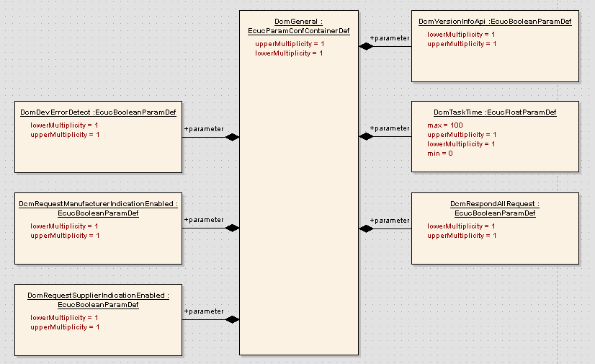
Static Design Aspects: General DCM settings
Autosar Dcm Training
Period of processing DCM MainFunction
enable / disable the request manufacturer indication callback
enable / disable the request supplier indication callback
Chassis Systems Control
Internal | CDG-SMT/ESB3 Simone Kriso | 10.12.2012 | © Robert Bosch GmbH 2007. All rights reserved, also regarding any disposal, exploitation, reproduction, editing, distribution, as well as in the event of applications for industrial property rights.

Slide 23
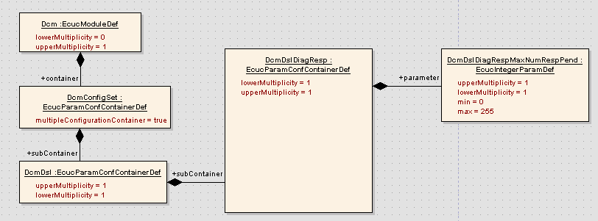
Static Design Aspects:ResponsePending Config
Autosar Dcm Training
Maximum number of negative responses with NRC 0x78
.
Chassis Systems Control
Internal | CDG-SMT/ESB3 Simone Kriso | 10.12.2012 | © Robert Bosch GmbH 2007. All rights reserved, also regarding any disposal, exploitation, reproduction, editing, distribution, as well as in the event of applications for industrial property rights.

Slide 24
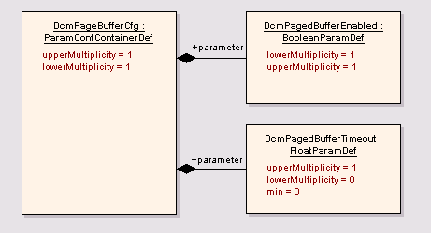
Static Design Aspects: PagedBuffer Config
Autosar Dcm Training
enable / disable the Page buffer mechanism
Chassis Systems Control
Internal | CDG-SMT/ESB3 Simone Kriso | 10.12.2012 | © Robert Bosch GmbH 2007. All rights reserved, also regarding any disposal, exploitation, reproduction, editing, distribution, as well as in the event of applications for industrial property rights.

Slide 25
Static Design Aspects: Config. Architecture
Autosar Dcm Training
Chassis Systems Control
Internal | CDG-SMT/ESB3 Simone Kriso | 10.12.2012 | © Robert Bosch GmbH 2007. All rights reserved, also regarding any disposal, exploitation, reproduction, editing, distribution, as well as in the event of applications for industrial property rights.

Slide 26
Static Design Aspects: Protocols
Autosar Dcm Training
Role of Protocols
Protocols can be used to implement different sets of services in the same ECU. This means that DCM supports multiple diagnostic applications.
Examples of protocols are:
UDS on CAN
UDS on FlexRay
UDS on InternetProtocol
OBD on CAN
For each protocol,
a separate service table can be assigned
a priority is configured. The level of priority is relevant at protocol preemption (e.g. OBD suspends enhanced diagnosis with UDS)
the Rx buffer is assigned (holding the request data)
The Tx buffer is assigned (holding the response data)
Chassis Systems Control
Internal | CDG-SMT/ESB3 Simone Kriso | 10.12.2012 | © Robert Bosch GmbH 2007. All rights reserved, also regarding any disposal, exploitation, reproduction, editing, distribution, as well as in the event of applications for industrial property rights.

Slide 27
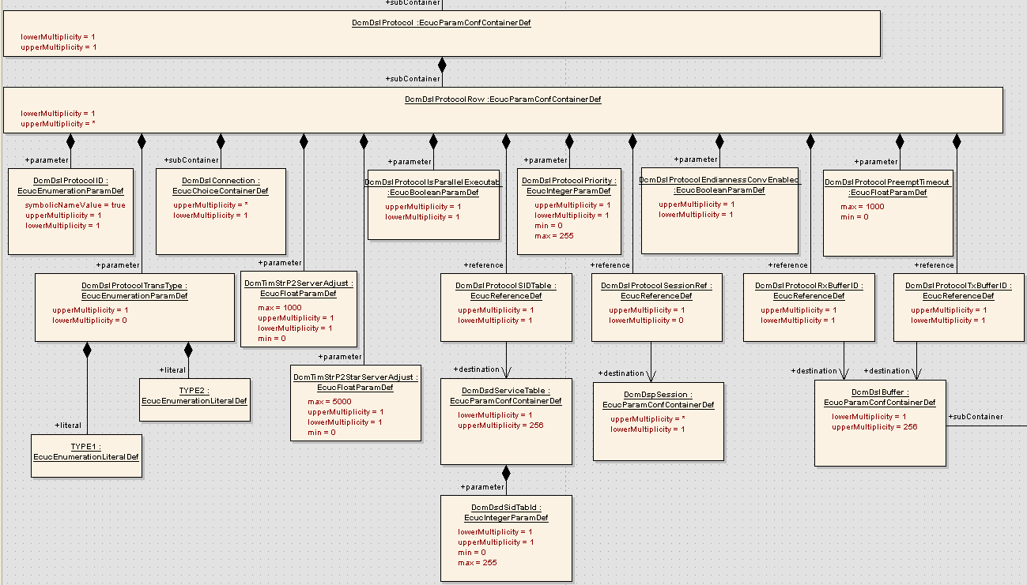
Static Design Aspects: Protocols
Autosar Dcm Training
Protocol name
Reference to service table
Rx and Tx
Buffer configuration
Reference to connection
Protocol Priority
Chassis Systems Control
Internal | CDG-SMT/ESB3 Simone Kriso | 10.12.2012 | © Robert Bosch GmbH 2007. All rights reserved, also regarding any disposal, exploitation, reproduction, editing, distribution, as well as in the event of applications for industrial property rights.

Slide 28
Static Design Aspects: Connections
Autosar Dcm Training
Role of Connections
Connections are used to define
which incoming PDU-IDs belong to which protocol,
if a PDU-ID is associated with functional or physical addressing,
which outgoing PDU-ID has to be used for the responses of a protocol
Typically only one connection per protocol is sufficient.
More connections per protocol are required in case multiple tester addresses have to
be supported (e.g. for extended addressing on CAN)
Chassis Systems Control
Internal | CDG-SMT/ESB3 Simone Kriso | 10.12.2012 | © Robert Bosch GmbH 2007. All rights reserved, also regarding any disposal, exploitation, reproduction, editing, distribution, as well as in the event of applications for industrial property rights.

Slide 29
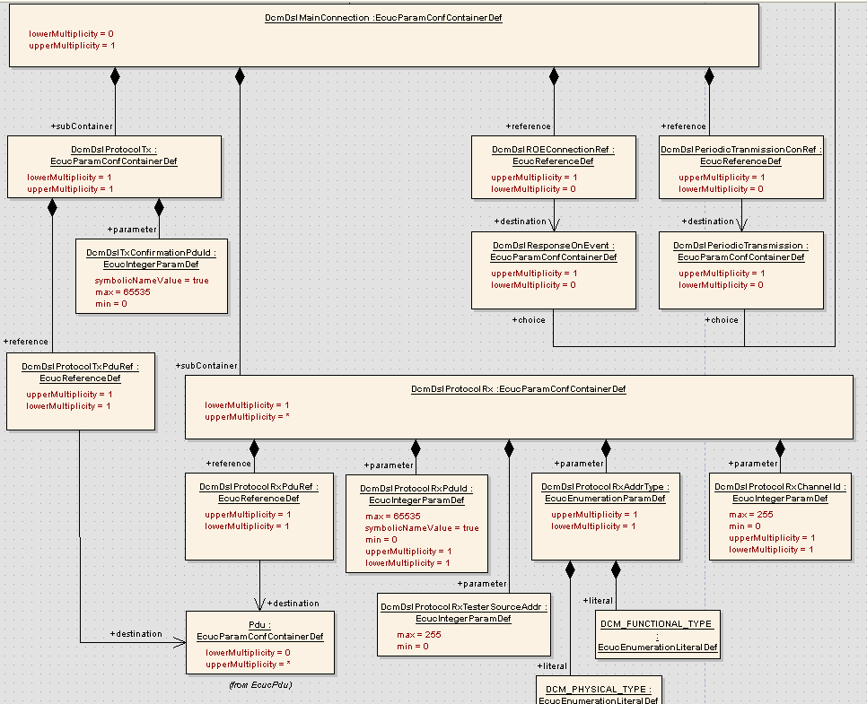
Static Design Aspects: Connections
Autosar Dcm Training
Tx PDU ID
Rx PDU IDs
Addressing type (phys / func)
Chassis Systems Control
Internal | CDG-SMT/ESB3 Simone Kriso | 10.12.2012 | © Robert Bosch GmbH 2007. All rights reserved, also regarding any disposal, exploitation, reproduction, editing, distribution, as well as in the event of applications for industrial property rights.

Slide 30
Static Design Aspects: Buffers
Autosar Dcm Training
Role of Buffers
For each protocol, there is configuration of Rx and Tx buffer.
Each buffer is associated with a particular buffer size.
RxBuffer and TxBuffer of the same protocol can share the same buffer.
RxBuffer and TxBuffer of different protocols having same priorities can also share the same buffer.
TxBuffer of different protocols (of different priorities) can also be shared provided if the same buffer is not used as RxBuffer for any of the protocols.
Sharing of Rx buffer is allowed only in case these protocols having the same prio.
Chassis Systems Control
Internal | CDG-SMT/ESB3 Simone Kriso | 10.12.2012 | © Robert Bosch GmbH 2007. All rights reserved, also regarding any disposal, exploitation, reproduction, editing, distribution, as well as in the event of applications for industrial property rights.

Slide 31
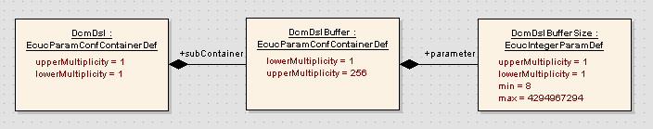
Static Design Aspects: Buffers
Autosar Dcm Training
Chassis Systems Control
Internal | CDG-SMT/ESB3 Simone Kriso | 10.12.2012 | © Robert Bosch GmbH 2007. All rights reserved, also regarding any disposal, exploitation, reproduction, editing, distribution, as well as in the event of applications for industrial property rights.

Slide 32
Static Design Aspects: Service Tables
Autosar Dcm Training
Role of Service Tables
In a service table the collection of supported services is given with the selection of the according Service IDs (SIDs)
Per service
The function pointer to the service interpreter
The function pointer to the service interpreter init
The sessions in which the service is allowed to run
The security levels in which the service is allowed to run
Several service tables can be configured
Each protocol references the used service table
Chassis Systems Control
Internal | CDG-SMT/ESB3 Simone Kriso | 10.12.2012 | © Robert Bosch GmbH 2007. All rights reserved, also regarding any disposal, exploitation, reproduction, editing, distribution, as well as in the event of applications for industrial property rights.

Slide 33
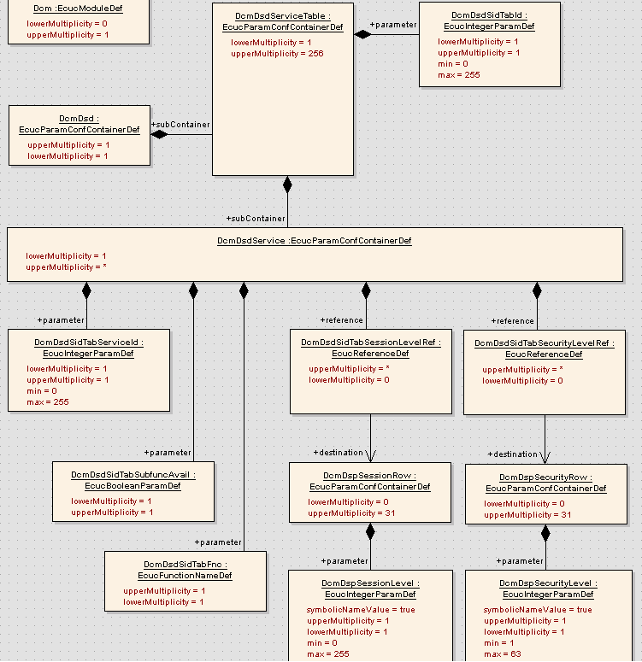
Static Design Aspects: Service Tables
Autosar Dcm Training
ID of Service Table
Allowed sessions
SID
Allowed security levels
Service with Subfunction?
FunctionPtr of ServiceInterpreter
Chassis Systems Control
Internal | CDG-SMT/ESB3 Simone Kriso | 10.12.2012 | © Robert Bosch GmbH 2007. All rights reserved, also regarding any disposal, exploitation, reproduction, editing, distribution, as well as in the event of applications for industrial property rights.

Slide 34
Training Step 2
Autosar Dcm Training
Chassis Systems Control
Internal | CDG-SMT/ESB3 Simone Kriso | 10.12.2012 | © Robert Bosch GmbH 2007. All rights reserved, also regarding any disposal, exploitation, reproduction, editing, distribution, as well as in the event of applications for industrial property rights.

Slide 35
Static Design Aspects: Session Configuration
Autosar Dcm Training
Role of Sessions
A diagnostic session enables a specific set of diagnostic services and/or functionality in the server(s).
Only one diagnostic session is active at time
Service DiagnosticSessionControl enables the session transition triggered by the tester
Examples of Sessions are
Default Session
Programming Session (-> Jump to Bootloader)
ExtendedDiagnosticSession
Chassis Systems Control
Internal | CDG-SMT/ESB3 Simone Kriso | 10.12.2012 | © Robert Bosch GmbH 2007. All rights reserved, also regarding any disposal, exploitation, reproduction, editing, distribution, as well as in the event of applications for industrial property rights.

Slide 36
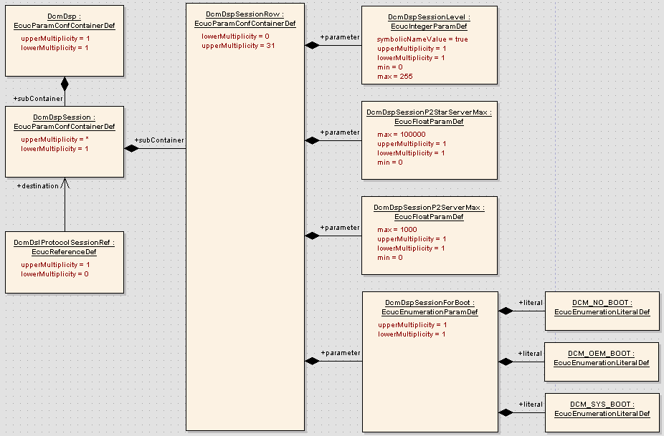
Static Design Aspects: Session Configuration
Autosar Dcm Training
SessionLevel
P2*ServerMax
P2ServerMax
JumpToBoot
Chassis Systems Control
Internal | CDG-SMT/ESB3 Simone Kriso | 10.12.2012 | © Robert Bosch GmbH 2007. All rights reserved, also regarding any disposal, exploitation, reproduction, editing, distribution, as well as in the event of applications for industrial property rights.

Slide 37
Static Design Aspects: Security Access Config
Autosar Dcm Training
Role of Security Access
Access protection for security, emission or safety reasons
Diagnostic services / subfunctions
Data
Routines
Memory ranges
Seed and key mechanism is used within the service SecurityAccess
Only one security level is active at time
Chassis Systems Control
Internal | CDG-SMT/ESB3 Simone Kriso | 10.12.2012 | © Robert Bosch GmbH 2007. All rights reserved, also regarding any disposal, exploitation, reproduction, editing, distribution, as well as in the event of applications for industrial property rights.

Slide 38
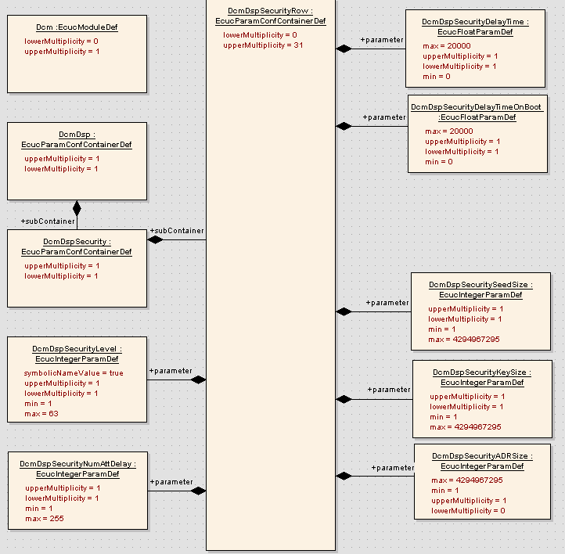
Static Design Aspects: Security Access Config
Autosar Dcm Training
Delay time after failed security access
Start delay timer on power on
SecurityLevel
Size of the Seed
Size of the Key
Number of failed security accesses after which the delay time is activated
Size of SecurityAccessDataRecord
Chassis Systems Control
Internal | CDG-SMT/ESB3 Simone Kriso | 10.12.2012 | © Robert Bosch GmbH 2007. All rights reserved, also regarding any disposal, exploitation, reproduction, editing, distribution, as well as in the event of applications for industrial property rights.

Slide 39
Training Step 3
Autosar Dcm Training
Chassis Systems Control
Internal | CDG-SMT/ESB3 Simone Kriso | 10.12.2012 | © Robert Bosch GmbH 2007. All rights reserved, also regarding any disposal, exploitation, reproduction, editing, distribution, as well as in the event of applications for industrial property rights.

Slide 40
Static Design Aspects: Data ID Configuration
Autosar Dcm Training
Role of Data ID (DID) configuration
Exits for the services
ReadDataByIdentifier (RDBI)
WriteDataByIdentifier (WDBI)
InputOutputControlByIdenitier (IOCBI)
Chassis Systems Control
Internal | CDG-SMT/ESB3 Simone Kriso | 10.12.2012 | © Robert Bosch GmbH 2007. All rights reserved, also regarding any disposal, exploitation, reproduction, editing, distribution, as well as in the event of applications for industrial property rights.

Slide 41
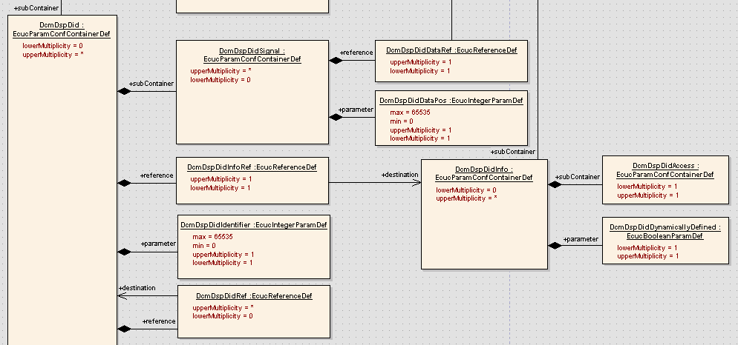
Static Design Aspects: Data ID Config (1/3)
Autosar Dcm Training
Allowed sessions / security levels
DID Signal
DID used for DDDI service
DID
Chassis Systems Control
Internal | CDG-SMT/ESB3 Simone Kriso | 10.12.2012 | © Robert Bosch GmbH 2007. All rights reserved, also regarding any disposal, exploitation, reproduction, editing, distribution, as well as in the event of applications for industrial property rights.

Slide 42
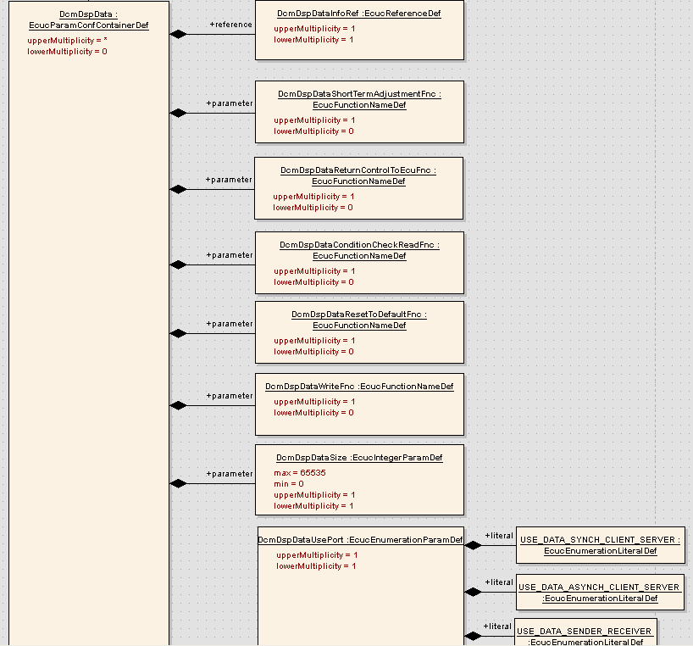
Static Design Aspects: Data ID Config (2/3)
Autosar Dcm Training
Per DID DataElement
IOCBI: Fnc for ShortTermAdjustment
IOCBI: Fnc for Return Control to ECU
RDBI: Fnc to check the condition
IOCBI: Fnc for ResetToDefault
WDBI: Fnc to write the data
RDBI/WDBI: Size of the DID element
Kind of interface (RTE, FNC, NvM)
Chassis Systems Control
Internal | CDG-SMT/ESB3 Simone Kriso | 10.12.2012 | © Robert Bosch GmbH 2007. All rights reserved, also regarding any disposal, exploitation, reproduction, editing, distribution, as well as in the event of applications for industrial property rights.

Slide 43
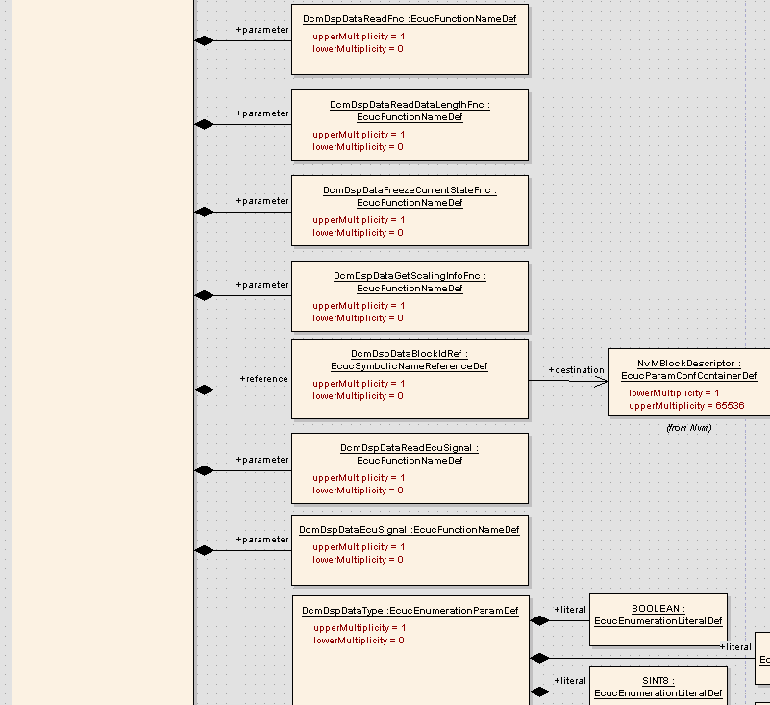
Static Design Aspects: Data ID Config (3/3)
Autosar Dcm Training
Per DID DataElement
RDBI: Fnc to read the data
IOCBI: Fnc for FreezeCurrentState
RDBI: Fnc to get the length (variable length configured)
RDBI / WDBI: Reference to NvM Block
DataType
Chassis Systems Control
Internal | CDG-SMT/ESB3 Simone Kriso | 10.12.2012 | © Robert Bosch GmbH 2007. All rights reserved, also regarding any disposal, exploitation, reproduction, editing, distribution, as well as in the event of applications for industrial property rights.

Slide 44
Static Design Aspects: Routine ID Configuration
Autosar Dcm Training
Role of Routine ID (RID) configuration
Exists for the services
RoutineControl (RC)
Chassis Systems Control
Internal | CDG-SMT/ESB3 Simone Kriso | 10.12.2012 | © Robert Bosch GmbH 2007. All rights reserved, also regarding any disposal, exploitation, reproduction, editing, distribution, as well as in the event of applications for industrial property rights.

Slide 45
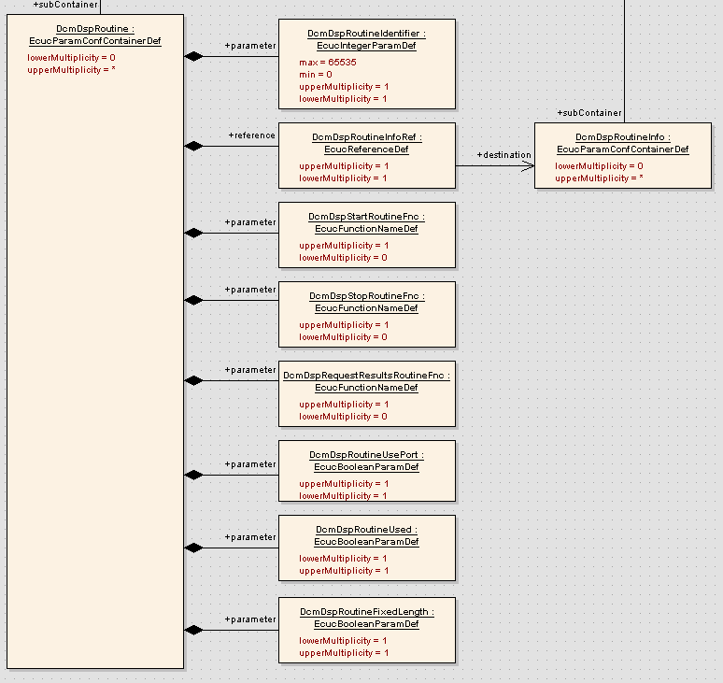
Static Design Aspects: RoutineID Config (1/2)
Autosar Dcm Training
RID
FNC of StartRoutine
FNC of StopRoutine
FNC of RequestRoutine
Results
RTE or FNC to be used
Chassis Systems Control
Internal | CDG-SMT/ESB3 Simone Kriso | 10.12.2012 | © Robert Bosch GmbH 2007. All rights reserved, also regarding any disposal, exploitation, reproduction, editing, distribution, as well as in the event of applications for industrial property rights.

Slide 46
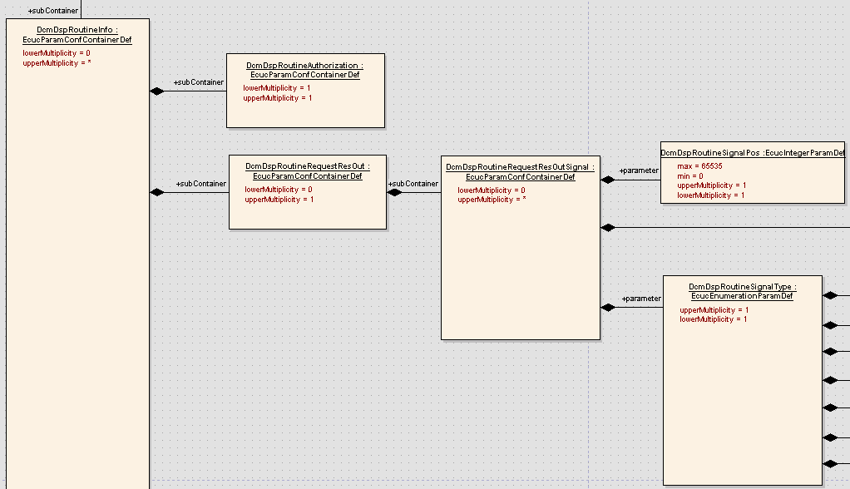
Static Design Aspects: RoutineID Config (2/2)
Autosar Dcm Training
Allowed sessions / security levels
RoutineID Parameters of e.g. RequestRoutineResults
Chassis Systems Control
Internal | CDG-SMT/ESB3 Simone Kriso | 10.12.2012 | © Robert Bosch GmbH 2007. All rights reserved, also regarding any disposal, exploitation, reproduction, editing, distribution, as well as in the event of applications for industrial property rights.

Slide 47
Static Design Aspects: Configuration Details
Autosar Dcm Training
Configuration details of Autosar parameters and containers can be found in chapter 10 of DCM SWS AR 4.0 for the AUTOSAR configuration containers and configuration parameters
Vendor specific configuration parameters which are BOSCH specific parameters are described in the SWS for BSW SW Module Dcm Extension (DOORS)
Both the above documents are analysed and the requirements are updated accordingly in DOORS. Please find the same:
SWS for Dcm: doors://ABT-DOORS.de.bosch.com:36677/?version=2&prodID=0&urn=urn:telelogic::1-3a1288eb3f4712b8-M-00056a0d
SWS for Dcm Ext: doors://ABT-DOORS.de.bosch.com:36677/?version=2&prodID=0&urn=urn:telelogic::1-3a1288eb3f4712b8-M-00056a36
Chassis Systems Control
Internal | CDG-SMT/ESB3 Simone Kriso | 10.12.2012 | © Robert Bosch GmbH 2007. All rights reserved, also regarding any disposal, exploitation, reproduction, editing, distribution, as well as in the event of applications for industrial property rights.

Slide 48
Training Step 4
Autosar Dcm Training
Chassis Systems Control
Internal | CDG-SMT/ESB3 Simone Kriso | 10.12.2012 | © Robert Bosch GmbH 2007. All rights reserved, also regarding any disposal, exploitation, reproduction, editing, distribution, as well as in the event of applications for industrial property rights.

Slide 49
Agenda
Autosar Dcm Training
Overview: SW Context
Features
Design Aspects
Static View
Dynamic View
Interfaces
Roadmap / Deliveries / Support
Chassis Systems Control
Internal | CDG-SMT/ESB3 Simone Kriso | 10.12.2012 | © Robert Bosch GmbH 2007. All rights reserved, also regarding any disposal, exploitation, reproduction, editing, distribution, as well as in the event of applications for industrial property rights.

Slide 50
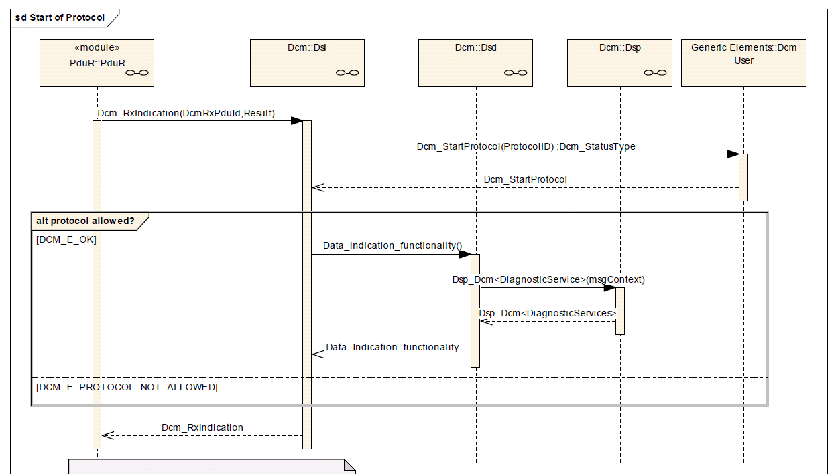
Dynamic Design Aspects: Protocol Start
Autosar Dcm Training
Chassis Systems Control
Internal | CDG-SMT/ESB3 Simone Kriso | 10.12.2012 | © Robert Bosch GmbH 2007. All rights reserved, also regarding any disposal, exploitation, reproduction, editing, distribution, as well as in the event of applications for industrial property rights.

Slide 51
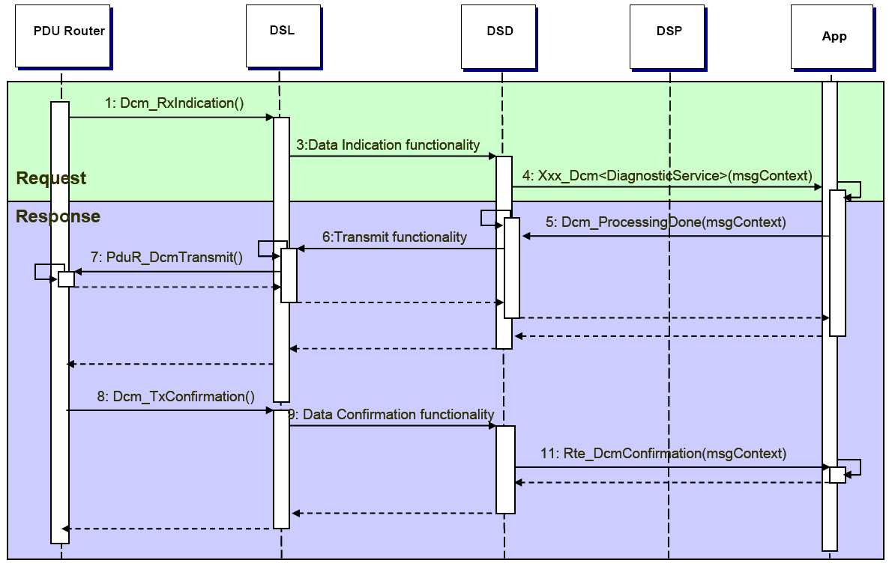
Dynamic Design Aspects: Request Handling (1/4)
Autosar Dcm Training
Request and Positive Response
Chassis Systems Control
Internal | CDG-SMT/ESB3 Simone Kriso | 10.12.2012 | © Robert Bosch GmbH 2007. All rights reserved, also regarding any disposal, exploitation, reproduction, editing, distribution, as well as in the event of applications for industrial property rights.

Slide 52
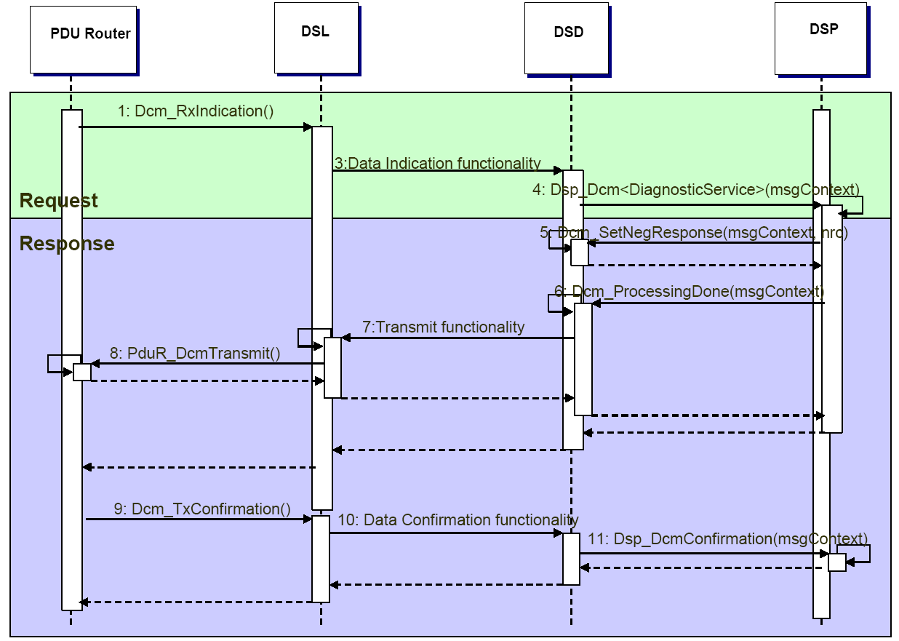
Dynamic Design Aspects: Request Handling (2/4)
Autosar Dcm Training
Request and Negative Response
Chassis Systems Control
Internal | CDG-SMT/ESB3 Simone Kriso | 10.12.2012 | © Robert Bosch GmbH 2007. All rights reserved, also regarding any disposal, exploitation, reproduction, editing, distribution, as well as in the event of applications for industrial property rights.

Slide 53
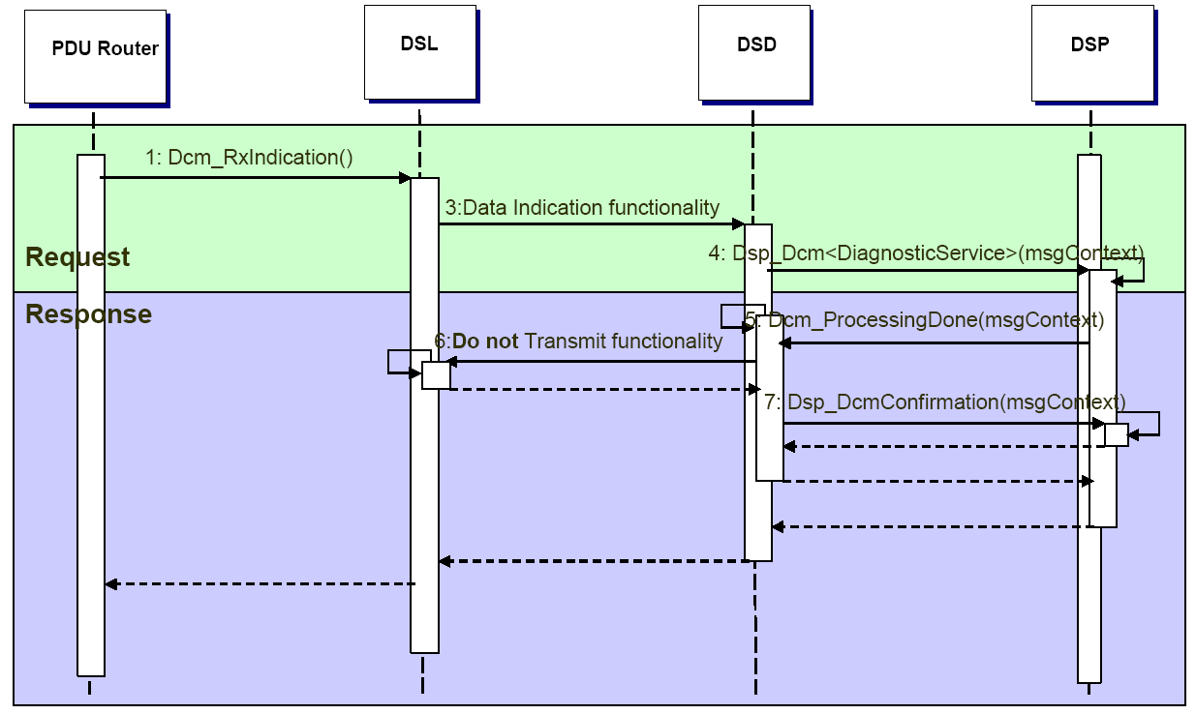
Dynamic Design Aspects: Request Handling (3/4)
Autosar Dcm Training
Request and no Response
Suppression due to suppressPosRspMsgIndicationBit set in request
Chassis Systems Control
Internal | CDG-SMT/ESB3 Simone Kriso | 10.12.2012 | © Robert Bosch GmbH 2007. All rights reserved, also regarding any disposal, exploitation, reproduction, editing, distribution, as well as in the event of applications for industrial property rights.

Slide 54
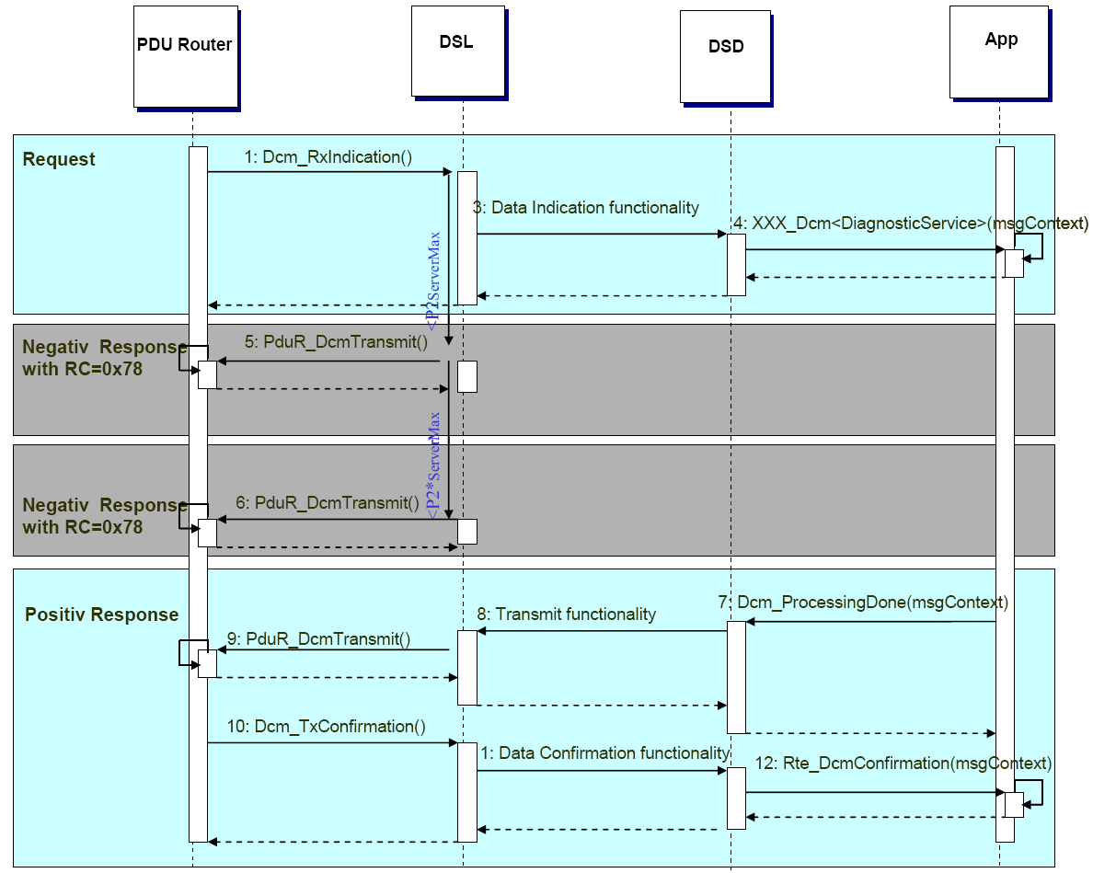
Dynamic Design Aspects: Request Handling (4/4)
Autosar Dcm Training
Request, ResponsePending and Positive Response
DSL triggers negative response with NRC 0x78 (ResponePending)
Chassis Systems Control
Internal | CDG-SMT/ESB3 Simone Kriso | 10.12.2012 | © Robert Bosch GmbH 2007. All rights reserved, also regarding any disposal, exploitation, reproduction, editing, distribution, as well as in the event of applications for industrial property rights.

Slide 55
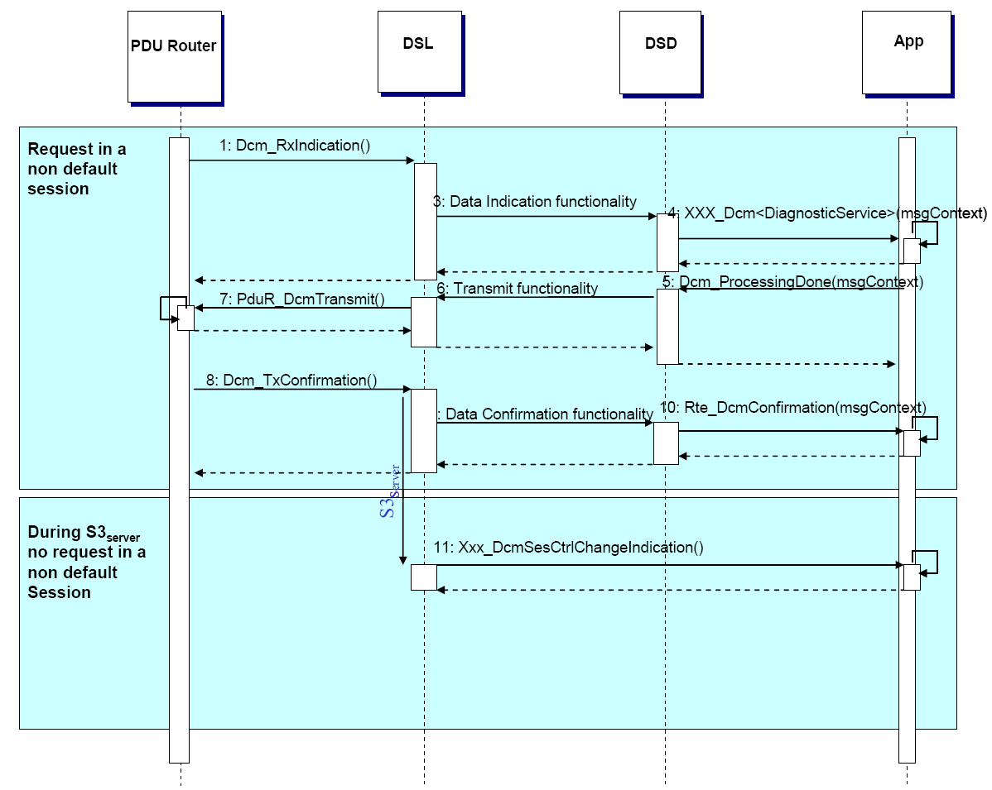
Dynamic Design Aspects: S3max Timeout
Autosar Dcm Training
On S3Server timeout, DCM changes to DefaultSession
Chassis Systems Control
Internal | CDG-SMT/ESB3 Simone Kriso | 10.12.2012 | © Robert Bosch GmbH 2007. All rights reserved, also regarding any disposal, exploitation, reproduction, editing, distribution, as well as in the event of applications for industrial property rights.

Slide 56
Agenda
Autosar Dcm Training
Overview: SW Context
Features
Design Aspects
Static View
Dynamic View
Interfaces
Roadmap / Deliveries / Support
Chassis Systems Control
Internal | CDG-SMT/ESB3 Simone Kriso | 10.12.2012 | © Robert Bosch GmbH 2007. All rights reserved, also regarding any disposal, exploitation, reproduction, editing, distribution, as well as in the event of applications for industrial property rights.

Slide 57
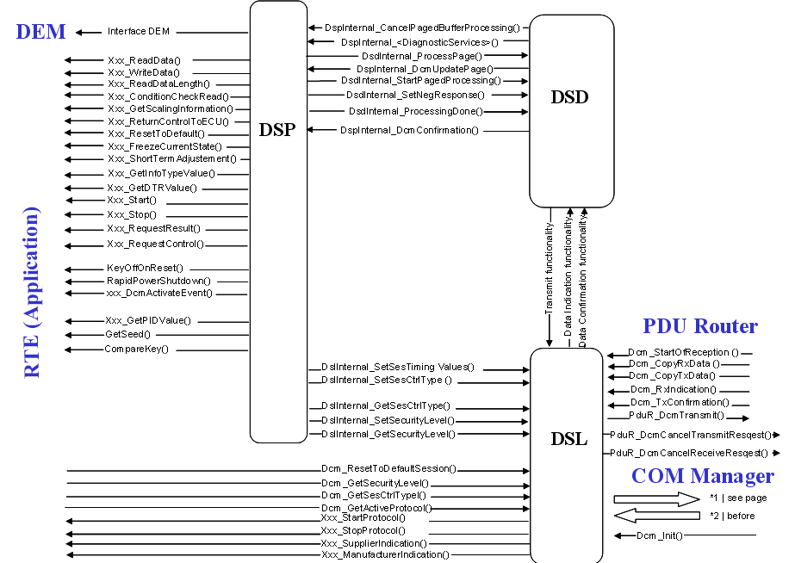
Interfaces: Overview
Autosar Dcm Training
Chassis Systems Control
Internal | CDG-SMT/ESB3 Simone Kriso | 10.12.2012 | © Robert Bosch GmbH 2007. All rights reserved, also regarding any disposal, exploitation, reproduction, editing, distribution, as well as in the event of applications for industrial property rights.

Slide 58
RTE Diagnostic Port Interface
Autosar Dcm Training
The RTE Diagnostic Port Interface is a set of interfaces to be implemented by each AUTOSAR software component (SW-C) that interacts with Dcm
DCM-DSL and DCM-DSD supports port interfaces (-> indication of protocol start / stop; service request indication)
DCM-DSP supports port interface
Retrieve, write and control data or functions for enhanced diagnosis
Security access
Session control
Retrieve and control functions for OBD diagnosis (PID, InfoType, TID)
CUBAS Dcm is also able to run without RTE
Chassis Systems Control
Internal | CDG-SMT/ESB3 Simone Kriso | 10.12.2012 | © Robert Bosch GmbH 2007. All rights reserved, also regarding any disposal, exploitation, reproduction, editing, distribution, as well as in the event of applications for industrial property rights.

Slide 59
Example of RTE communication
Autosar Dcm Training
Client-Server
SW_C1
Contains ECT Std_ReturnType ECT_ReadETC (uint8* ect) { *ect = calculation xxx; }
SW_C2
Contains VIN Std_ReturnType VIN_ReadVIN
(uint8* VIN) { *VIN = calculation xxx; }
RTE
DID 0x100
DID 0x120
Rte_Call_DataServices_ECT_ReadData()
Rte_Call_DataServices_VIN_ReadData()
DCM
Chassis Systems Control
Internal | CDG-SMT/ESB3 Simone Kriso | 10.12.2012 | © Robert Bosch GmbH 2007. All rights reserved, also regarding any disposal, exploitation, reproduction, editing, distribution, as well as in the event of applications for industrial property rights.

Slide 60
Interfaces: PDU Router (1/2)
Autosar Dcm Training
BufReq_ReturnType Dcm_StartOfReception(PduIdType DcmRxPduId, PduLengthType TpSduLength,PduLengthType* RxBufferSizePtr);
PduR informs Dcm about the start of a reception (e.g. FF / SF)
BufReq_ReturnType Dcm_CopyRxData(PduIdType DcmRxPduId, PduInfoType* PduInfoPtr, PduLengthType* RxBufferSizePtr);
Called at reception of a segment of a new tester request, Dcm is requested to copy the segment into the Dcm buffer
void Dcm_RxIndication (PduIdType DcmRxPduId, NotifResultType Result);
Once all the data is provided to Dcm, the indication function is called (using NotifResultType NTFRSLT_E_OK). Also, if an incoming transmission is aborted for some reason (timeout, ...), this function is called with NotifResultType NTFRSLT_E_NOT_OK.
Chassis Systems Control
Internal | CDG-SMT/ESB3 Simone Kriso | 10.12.2012 | © Robert Bosch GmbH 2007. All rights reserved, also regarding any disposal, exploitation, reproduction, editing, distribution, as well as in the event of applications for industrial property rights.

Slide 61
Interfaces: PDU Router (2/2)
Autosar Dcm Training
Std_ReturnType PduR_DcmTransmit (PduIdType, PduR_TxPduInfoPtr);
This function is called by Dcm to request the transfer of the response data over a transport layer.
BufReq_ReturnType Dcm_CopyTxData(PduIdType DcmTxPduId, PduInfoType* PduInfoPtr,RetryInfoType* RetryInfoPtr, PduLengthType* TxDataCntPtr);
By calling this function, PduR requests the Dcm to copy the Tx data into the TP buffer, after it has received a call to PduR_Transmit.
void Dcm_TxConfirmation (PduIdType DcmTxPduId, NotifResultType Result);
This function is called by PduR after the transmission of the response.
Chassis Systems Control
Internal | CDG-SMT/ESB3 Simone Kriso | 10.12.2012 | © Robert Bosch GmbH 2007. All rights reserved, also regarding any disposal, exploitation, reproduction, editing, distribution, as well as in the event of applications for industrial property rights.

Slide 62
Interfaces: Com Manager (1/2)
Autosar Dcm Training
void Dcm_ComM_NoComModeEntered(void);
All kind of transmissions (receive and transmit) shall be stopped immediately. This means that the ResponseOnEvent and PeriodicId and also the transmission of the normal communication (PduR_DcmTransmit) shall be disabled.
void Dcm_ComM_SilentComModeEntered(void);
All outgoing transmissions shall be stopped immediately. This means that the ResponseOnEvent and PeriodicId and also the transmission of the normal communication (PduR_DcmTransmit) shall be disabled.
void Dcm_ComM_FullComModeEntered(void);
All kind of transmissions shall be enabled immediately. This means that the ResponseOnEvent and PeriodicId and also the transmission of the normal communication (PduR_DcmTransmit) shall be enabled.
This is the default state after power-on.
Note: Dcm does not depend on these call-backs for deciding if a received message can be processed or if a transmit request can be placed to PduR for sending the response as it was a CUBAS-CCB decision to ignore these calls as most of the divisions within BOSCH currently does not have or support Com Manager. In future, when Com Manager is also part of CUBAS-BSW, this deviation would no longer exists
In AR40.5.0.0 update to the new ComM interface holding NetID info + mind the callbacks for the Dcm state machine
Chassis Systems Control
Internal | CDG-SMT/ESB3 Simone Kriso | 10.12.2012 | © Robert Bosch GmbH 2007. All rights reserved, also regarding any disposal, exploitation, reproduction, editing, distribution, as well as in the event of applications for industrial property rights.

Slide 63
Interfaces: Com Manager (2/2)
Autosar Dcm Training
void ComM_DCM_InactiveDiagnostic(void);
Indication of inactive diagnostic by the Dcm
void ComM_DCM_ActiveDiagnostic(void);
Indication of active diagnostic by the Dcm
In AR40.5.0.0 update to the new ComM interface holding NetID info
Chassis Systems Control
Internal | CDG-SMT/ESB3 Simone Kriso | 10.12.2012 | © Robert Bosch GmbH 2007. All rights reserved, also regarding any disposal, exploitation, reproduction, editing, distribution, as well as in the event of applications for industrial property rights.

Slide 64
Interfaces: Standard Service Interpreters
Autosar Dcm Training
Following functions have to be entered in the service table to use the standard
implementation of diagnostic services of DCM-DSP:
void Dcm_DcmDiagnosticSessionControl (Dcm_MsgContextType * pMsgContext);
void Dcm_Dsp_DscIni(void);
Service interpreter and init function of service 0x10.
void Dcm_DcmSecurityAccess (Dcm_MsgContextType * pMsgContext)
void Dcm_Dsp_SecaIni(void);
Service interpreter and init function of service 0x27.
void Dcm_DcmTesterPresent (Dcm_MsgContextType * pMsgContext);
Service interpreter function of service 0x3E.
Chassis Systems Control
Internal | CDG-SMT/ESB3 Simone Kriso | 10.12.2012 | © Robert Bosch GmbH 2007. All rights reserved, also regarding any disposal, exploitation, reproduction, editing, distribution, as well as in the event of applications for industrial property rights.

Slide 65
Interfaces: Diagnostic Service Interpreter
Autosar Dcm Training
Response Indication
void Dcm_SetNegResponse (const Dcm_MsgContextType *pMsgContext, Dcm_NegativeResponseCodeType ErrorCode);
Called by diagnostic service interpreter to indicate that a negative response shall be sent. To be followed by a call to Dcm_ProcessingDone().
void Dcm_ProcessingDone (const Dcm_MsgContextType *pMsgContext);
Called by diagnostic service interpreter to indicate that preparation of the response is completed.
Chassis Systems Control
Internal | CDG-SMT/ESB3 Simone Kriso | 10.12.2012 | © Robert Bosch GmbH 2007. All rights reserved, also regarding any disposal, exploitation, reproduction, editing, distribution, as well as in the event of applications for industrial property rights.

Slide 66
Interfaces: Message Context Type
Autosar Dcm Training
Message Context Concept
Access to the request and response buffers is provided by the AUTOSAR structure Dcm_MsgContextType.
The message context object is passed in the service interpreter function call.
Request Buffer Access (without SID): pMsgContext->reqData[] pMsgContext->reqDataLen
Response Buffer Access (without SID): pMsgContext->resData[] pMsgContext->resDataLen
Max. response buffer length: resMaxDataLen
Service ID (SID) value: idContext
msgAddInfo
Addressing type (phys / func)
SuppressPosResponse info
Source of request (tester request, RDPI, ROE)
typedef struct
{
Dcm_MsgType resData;
Dcm_MsgType reqData;
Dcm_MsgLenType resDataLen;
Dcm_MsgLenType reqDataLen;
Dcm_MsgLenType resMaxDataLen;
Dcm_IdContextType idContext;
PduIdType dcmRxPduId;
Dcm_MsgAddInfoType msgAddInfo;
} Dcm_MsgContextType;
Chassis Systems Control
Internal | CDG-SMT/ESB3 Simone Kriso | 10.12.2012 | © Robert Bosch GmbH 2007. All rights reserved, also regarding any disposal, exploitation, reproduction, editing, distribution, as well as in the event of applications for industrial property rights.

Slide 67
Interfaces: Diagnostic Application of DSL/DSD
Autosar Dcm Training
Callback Functions
Std_ReturnType DcmAppl_DcmIndication (uint8 SID, uint8* RequestData,
uint16 RequestLength);
Called by Dcm to indicate that a new diagnostic request was received. Can be used to filter incoming requests. (DcmRequestIndicationEnabled to be set to TRUE)
void DcmAppl_DcmConfirmation (Dcm_IdContextType idContext, PduIdType dcmRxPduId, Dcm_ConfirmationStatusType status);
Called by Dcm to indicate that the TX process is completed.
void DcmAppl_DcmSesCtrlChangeIndication(Dcm_SesCtrlType SesCtrlTypeOld, Dcm_SesCtrlType SesCtrlTypeNew);
Called by Dcm to indicate that a session change has occurred.
void DcmAppl_DcmConfirmation_DcmNegResp (Dcm_IdContextType idContext, PduIdType dcmRxPduId, Dcm_ConfirmationStatusType status);
Called by DCM to indicate that the TX process of a negative response, generated directly in DSL/DSD, is completed.
Chassis Systems Control
Internal | CDG-SMT/ESB3 Simone Kriso | 10.12.2012 | © Robert Bosch GmbH 2007. All rights reserved, also regarding any disposal, exploitation, reproduction, editing, distribution, as well as in the event of applications for industrial property rights.

Slide 68
Interfaces: Session
Autosar Dcm Training
Std_ReturnType Dcm_GetSesCtrlType (Dcm_SesCtrlType* SesCtrlType);
Reads the currently active diagnostic session level.
void Dcm_SetSesCtrlType (Dcm_SesCtrlType SesCtrlType);
Changes the currently active diagnostic session level. Results in a call to DcmAppl_DcmSesCtrlChangeIndication().
Chassis Systems Control
Internal | CDG-SMT/ESB3 Simone Kriso | 10.12.2012 | © Robert Bosch GmbH 2007. All rights reserved, also regarding any disposal, exploitation, reproduction, editing, distribution, as well as in the event of applications for industrial property rights.

Slide 69
Interfaces: Security Handling (1/3)
Autosar Dcm Training
Std_ReturnType Dcm_GetSecurityLevel (Dcm_SecLevelType* SecLevel);
Reads the currently active security level.
void Dcm_SetSecurityLevel ( Dcm_SecLevelType SecurityLevel);
Changes the currently active security level.
Chassis Systems Control
Internal | CDG-SMT/ESB3 Simone Kriso | 10.12.2012 | © Robert Bosch GmbH 2007. All rights reserved, also regarding any disposal, exploitation, reproduction, editing, distribution, as well as in the event of applications for industrial property rights.

Slide 70
Interfaces: Security Handling (2/3)
Autosar Dcm Training
Std_ReturnType DcmAppl_DcmGetSeed(Dcm_SecLevelType SecurityLevel, uint8 SeedLen, uint8 SecurityAccessDataLen, uint8* SecurityAccessDataRecord, uint8* Seed)
Application to provide the seed
Std_ReturnType DcmAppl_DcmCompareKey(Dcm_SecLevelType SecurityLevel, uint8 KeyLen, uint8 Key)
Application requested to compare the Key
Uint32 DcmAppl_DcmGetUpdatedDelayTime(uint8 SecurityLevel, uint8 Delaycount, uint32 DelayTime)
Enables the application to modify the delay time
Chassis Systems Control
Internal | CDG-SMT/ESB3 Simone Kriso | 10.12.2012 | © Robert Bosch GmbH 2007. All rights reserved, also regarding any disposal, exploitation, reproduction, editing, distribution, as well as in the event of applications for industrial property rights.

Slide 71
Interfaces: Security Handling (3/3)
Autosar Dcm Training
void DcmAppl_DcmSecaValidKey(uint8 SecTabIdx)
Indication of valid key
void DcmAppl_DcmSecaInvalidKey(uint8 SecTabIdx)
Indication of invalid key
void DcmAppl_StoreDelayCount(Dcm_SecLevelType SecurityLevel, uint8 DelayCount_u8)
Indication, that DelayCount has changed. This enables storages in NVRAM
Uint8 DcmAppl_GetUpdatedDelayCount(Dcm_SecLevelType SecurityLevel, uint8 DelayCount_u8)
Initialisation of DelayCount with the value from NVRAM
Chassis Systems Control
Internal | CDG-SMT/ESB3 Simone Kriso | 10.12.2012 | © Robert Bosch GmbH 2007. All rights reserved, also regarding any disposal, exploitation, reproduction, editing, distribution, as well as in the event of applications for industrial property rights.

Slide 72
Interfaces: Protocols
Autosar Dcm Training
Std_ReturnType Dcm_GetActiveProtocol(Dcm_ProtocolType *ActiveProtocol);
Reads the currently active protocol ID.
void Dcm_GetActiveServiceTable (uint8 *ActiveServiceTable);
Reads the currently active service table ID.
Std_ReturnType Dcm_SetActiveServiceTable(uint8 Sid_tableid_u8);
Activates new service table
Std_ReturnType DcmAppl_DcmStartProtocol (Dcm_ProtocolType ProtocolID);
DCM indicates, that a new protocol is started
Std_ReturnType DcmAppl_DcmStopProtocol (Dcm_ProtocolType ProtocolID);
DCM indicates, that a protocol is stopped due to preemption with a higher prior protocol
Chassis Systems Control
Internal | CDG-SMT/ESB3 Simone Kriso | 10.12.2012 | © Robert Bosch GmbH 2007. All rights reserved, also regarding any disposal, exploitation, reproduction, editing, distribution, as well as in the event of applications for industrial property rights.

Slide 73
Interfaces: AUTOSAR Deviations
Autosar Dcm Training
AUTOSAR 4.0 Compliance of CUBAS DCM
CUBAS DCM has some deviations to the AUTOSAR SWS 4.0 Rev 2.
Reasons for extensions are usually that Bosch needs are not covered by the AUTOSAR SWS. This leads to additional APIs or additional configuration parameters (= vendor specific parameters).
APIs that are available, stick to the AUTOSAR DCM SWS R4.0 Rev 2.
Chassis Systems Control
Internal | CDG-SMT/ESB3 Simone Kriso | 10.12.2012 | © Robert Bosch GmbH 2007. All rights reserved, also regarding any disposal, exploitation, reproduction, editing, distribution, as well as in the event of applications for industrial property rights.

Slide 74
Agenda
Autosar Dcm Training
Overview: SW Context
Features
Design Aspects
Static View
Dynamic View
Interfaces
Roadmap / Deliveries / Support
Chassis Systems Control
Internal | CDG-SMT/ESB3 Simone Kriso | 10.12.2012 | © Robert Bosch GmbH 2007. All rights reserved, also regarding any disposal, exploitation, reproduction, editing, distribution, as well as in the event of applications for industrial property rights.

Slide 75
Useful Links
Autosar Dcm Training
CUBAS Roadmap:
file://///bosch.com/dfsrb/DfsDE/DIV/CDG/Prj/CUBAS/01_CUBAS_ProjectMgmt/CUBAS-Intranet/Roadmap.htm
CUBAS DCM Deliveries:
file://///bosch.com/dfsrb/DfsDE/DIV/CDG/Prj/CUBAS/10_SystemStack/01_Diagnosis/Diagnosis-Intranet/Deliveries.htm
Support:
Is given upon email to "Support-BOX BSW Diagnosis"
Chassis Systems Control
Internal | CDG-SMT/ESB3 Simone Kriso | 10.12.2012 | © Robert Bosch GmbH 2007. All rights reserved, also regarding any disposal, exploitation, reproduction, editing, distribution, as well as in the event of applications for industrial property rights.

Slide 76
Autosar Dcm Training
- END -
Chassis Systems Control
Internal | CDG-SMT/ESB3 Simone Kriso | 10.12.2012 | © Robert Bosch GmbH 2007. All rights reserved, also regarding any disposal, exploitation, reproduction, editing, distribution, as well as in the event of applications for industrial property rights.

