Slide 1
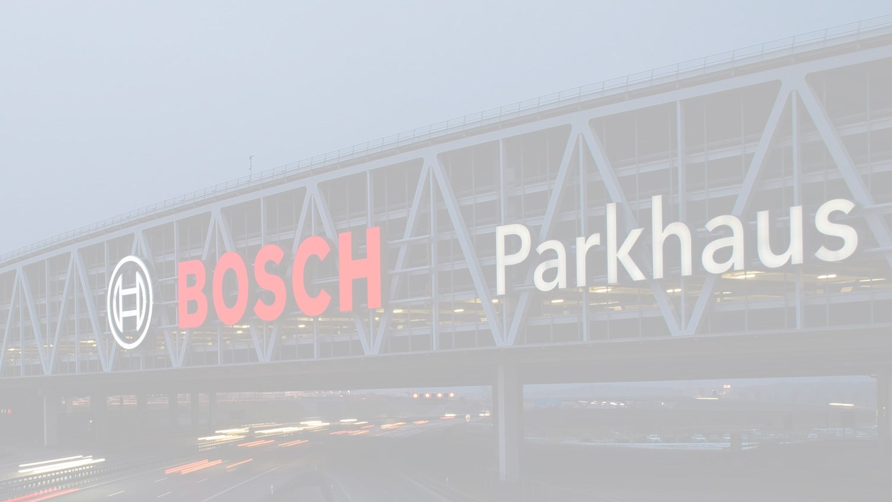
AUTOSAR ComStack & SIO Overview

Slide 2
Agenda
AUTOSAR Architecture
AUTOSAR Communication Stack
CAN Driver
CAN Interface
CAN Transport Protocol
PDU Router
COM
SIO Overview
2
Pham Vo Hoai Anh (RBVH/ESS1) | 4/29/2016
© Robert Bosch Engineering and Business Solutions Vietnam Company Limited 2016. All rights reserved, also regarding any disposal, exploitation, reproduction, editing, distribution, as well as in the event of applications for industrial property rights.

Slide 3
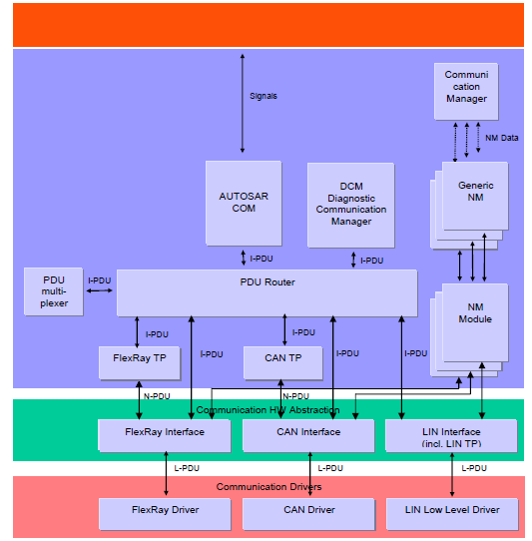
Overview
AUTOSAR Architecture
Application Layer
AUTOSAR Runtime Environment (RTE)
Provides services for application & BSW modules relating to communication.
Service Layer
Memory Services
Communication
Services
I/O Hardware Abstraction
Complex
Drivers
Interfaces for lower layer to upper layer. Also contains external driver
Onboard Device Abstraction
Memory Hardware Abstraction
Communication HW Abstraction
Microcontrollers Drivers
Memory Drivers
Communication Drivers
I/O Drivers
Contains internal driver – software module with direct access to uC
Microcontroller
Microcontroller
3
Pham Vo Hoai Anh (RBVH/ESS1) | 4/29/2016
© Robert Bosch Engineering and Business Solutions Vietnam Company Limited 2016. All rights reserved, also regarding any disposal, exploitation, reproduction, editing, distribution, as well as in the event of applications for industrial property rights.

Slide 4
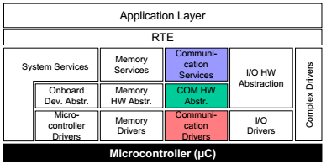
Communication Stack
AUTOSAR ComStack
ECU 1
Provides standardized access to the vehicle network system.
Software components can communicate with each other even if they are located on different ECUs
ECU 2
ECU n
Communication Bus
4
Pham Vo Hoai Anh (RBVH/ESS1) | 4/29/2016
© Robert Bosch Engineering and Business Solutions Vietnam Company Limited 2016. All rights reserved, also regarding any disposal, exploitation, reproduction, editing, distribution, as well as in the event of applications for industrial property rights.

Slide 5
Communication Stack
AUTOSAR ComStack
5
Pham Vo Hoai Anh (RBVH/ESS1) | 4/29/2016
© Robert Bosch Engineering and Business Solutions Vietnam Company Limited 2016. All rights reserved, also regarding any disposal, exploitation, reproduction, editing, distribution, as well as in the event of applications for industrial property rights.

Slide 6
Communication Stack
AUTOSAR ComStack
SDU - Service Data Unit: the data passed by an upper layer, with the request to transmit the data as well the data which is extracted after reception by the lower layer and passed to the upper layer.
PCI - Protocol Control Information: needed to pass a SDU from one instance of a specific protocol layer to another instance. Added by a protocol layer on the transmission side and is removed again on the receiving side.
PDU - Protocol Data Unit: contains SDU and PCI. On the transmission side the PDU is passed from the upper layer to the lower layer, which interprets this PDU as its SDU.
6
Pham Vo Hoai Anh (RBVH/ESS1) | 4/29/2016
© Robert Bosch Engineering and Business Solutions Vietnam Company Limited 2016. All rights reserved, also regarding any disposal, exploitation, reproduction, editing, distribution, as well as in the event of applications for industrial property rights.

Slide 7
CAN Driver
AUTOSAR ComStack
7
Pham Vo Hoai Anh (RBVH/ESS1) | 4/29/2016
© Robert Bosch Engineering and Business Solutions Vietnam Company Limited 2016. All rights reserved, also regarding any disposal, exploitation, reproduction, editing, distribution, as well as in the event of applications for industrial property rights.

Slide 8
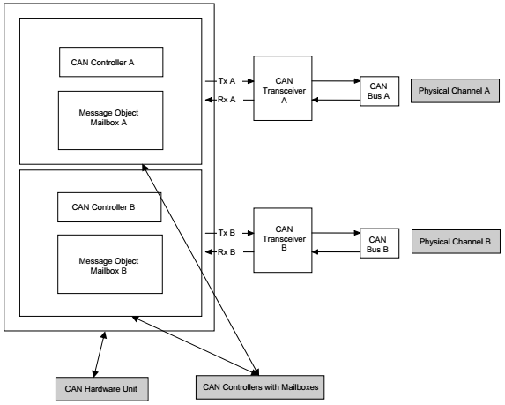
CAN Driver - Definitions
AUTOSAR ComStack
CAN Controller: serves exactly one physical channel.
CAN Hardware Unit: may consists of one or multiple CAN controllers and CAN RAM (Mailbox) areas.
CAN Hardware Object: a PDU buffer inside CAN RAM of CAN Hardware Unit/CAN Controller.
CAN Controller
Mailbox
CAN HW Obj
CAN HW Obj
CAN HW Obj
CAN Transceiver
CAN Network
8
Pham Vo Hoai Anh (RBVH/ESS1) | 4/29/2016
© Robert Bosch Engineering and Business Solutions Vietnam Company Limited 2016. All rights reserved, also regarding any disposal, exploitation, reproduction, editing, distribution, as well as in the event of applications for industrial property rights.

Slide 9
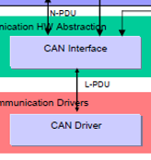
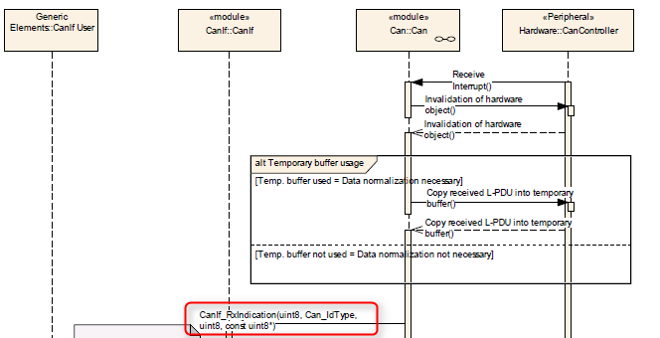
CAN Driver
AUTOSAR ComStack
Performs the hardware access and offers a hardware independent API to the upper layer
Only access CanIf from upper layer.
Provide service for initiating transmission.
Calls the callback functions of the CanIf module for notifying events, independently from the hardware
Provides services to control the behavior and state of the CAN controllers.
9
Pham Vo Hoai Anh (RBVH/ESS1) | 4/29/2016
© Robert Bosch Engineering and Business Solutions Vietnam Company Limited 2016. All rights reserved, also regarding any disposal, exploitation, reproduction, editing, distribution, as well as in the event of applications for industrial property rights.

Slide 10
CAN Interface
AUTOSAR ComStack
10
Pham Vo Hoai Anh (RBVH/ESS1) | 4/29/2016
© Robert Bosch Engineering and Business Solutions Vietnam Company Limited 2016. All rights reserved, also regarding any disposal, exploitation, reproduction, editing, distribution, as well as in the event of applications for industrial property rights.

Slide 11
CAN Interface - Definitions
AUTOSAR ComStack
HOH – Hardware Object Handle: represent an abstract reference to a CAN mailbox structure (contains CanId, DLC, Data). Be instantiated into HRH & HTH. Defined and provided by the CAN Driver.
HRH – Hardware Receive Handle: is a handle referencing a logical hardware transmit object of the CAN controller mailbox.
HTH – Hardware Transmit Handle: is a handle referencing a logical hardware receive object of the CAN controller mailbox.
11
Pham Vo Hoai Anh (RBVH/ESS1) | 4/29/2016
© Robert Bosch Engineering and Business Solutions Vietnam Company Limited 2016. All rights reserved, also regarding any disposal, exploitation, reproduction, editing, distribution, as well as in the event of applications for industrial property rights.

Slide 12
CAN Interface - Definitions
AUTOSAR ComStack
CanIf Rx L-PDU: L-PDU handle of which the direction is set to “lower to upper layer”.
CanIfRxBuffer: single element RAM buffer located in the CAN Interface module to store whole receive L-PDUs.
CanIf Tx L-PDU: L-PDU handle of which the direction is set to “upper to lower layer”.
CanIfTxBuffer: single element RAM buffer located in the CAN Interface module to store whole transmit L-PDUs.
12
Pham Vo Hoai Anh (RBVH/ESS1) | 4/29/2016
© Robert Bosch Engineering and Business Solutions Vietnam Company Limited 2016. All rights reserved, also regarding any disposal, exploitation, reproduction, editing, distribution, as well as in the event of applications for industrial property rights.

Slide 13
CAN Interface
AUTOSAR ComStack
Consists of all CAN hardware independent tasks belongs to the CAN communication device drivers of the corresponding ECU.
The application data buffers are located in the upper layer. The buffer location is passed by the CAN Interface from or to the CAN Driver during transmission and reception
Events detected and processed by the CAN Driver are forwarded to the CAN Interface.
DLC check for receive PDU.
13
Pham Vo Hoai Anh (RBVH/ESS1) | 4/29/2016
© Robert Bosch Engineering and Business Solutions Vietnam Company Limited 2016. All rights reserved, also regarding any disposal, exploitation, reproduction, editing, distribution, as well as in the event of applications for industrial property rights.

Slide 14
CAN Interface
AUTOSAR ComStack
Transmit data flow
Receive data flow
14
Pham Vo Hoai Anh (RBVH/ESS1) | 4/29/2016
© Robert Bosch Engineering and Business Solutions Vietnam Company Limited 2016. All rights reserved, also regarding any disposal, exploitation, reproduction, editing, distribution, as well as in the event of applications for industrial property rights.

Slide 15
CAN Transport Protocol
AUTOSAR ComStack
15
Pham Vo Hoai Anh (RBVH/ESS1) | 4/29/2016
© Robert Bosch Engineering and Business Solutions Vietnam Company Limited 2016. All rights reserved, also regarding any disposal, exploitation, reproduction, editing, distribution, as well as in the event of applications for industrial property rights.

Slide 16
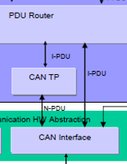
CAN Transport Protocol
AUTOSAR ComStack
Segment and reassemble CAN I-PDUs longer than 8 bytes for transferring diagnostic messages in a single CAN frame or in multiple CAN frames.
Event triggered so that CanTp can processes transfer of N-SDU (respectively L-SDU) coming from the PDU Router (respectively CAN Interface) directly.
16
Pham Vo Hoai Anh (RBVH/ESS1) | 4/29/2016
© Robert Bosch Engineering and Business Solutions Vietnam Company Limited 2016. All rights reserved, also regarding any disposal, exploitation, reproduction, editing, distribution, as well as in the event of applications for industrial property rights.

Slide 17
PDU Router
AUTOSAR ComStack
17
Pham Vo Hoai Anh (RBVH/ESS1) | 4/29/2016
© Robert Bosch Engineering and Business Solutions Vietnam Company Limited 2016. All rights reserved, also regarding any disposal, exploitation, reproduction, editing, distribution, as well as in the event of applications for industrial property rights.

Slide 18
PDU Router
AUTOSAR ComStack
Provides services for routing of I-PDUs:
Communication interface modules (e.g. LINIF, CANIF, and FlexRayIf)
Transport Protocol modules (e.g. CAN TP, FlexRay TP)
Diagnostic Communication Manager (DCM) and Transport Protocol modules
COM and Communication interface modules or I-PDU Multiplexer
I-PDU Multiplexer and communication interface modules
18
Pham Vo Hoai Anh (RBVH/ESS1) | 4/29/2016
© Robert Bosch Engineering and Business Solutions Vietnam Company Limited 2016. All rights reserved, also regarding any disposal, exploitation, reproduction, editing, distribution, as well as in the event of applications for industrial property rights.

Slide 19
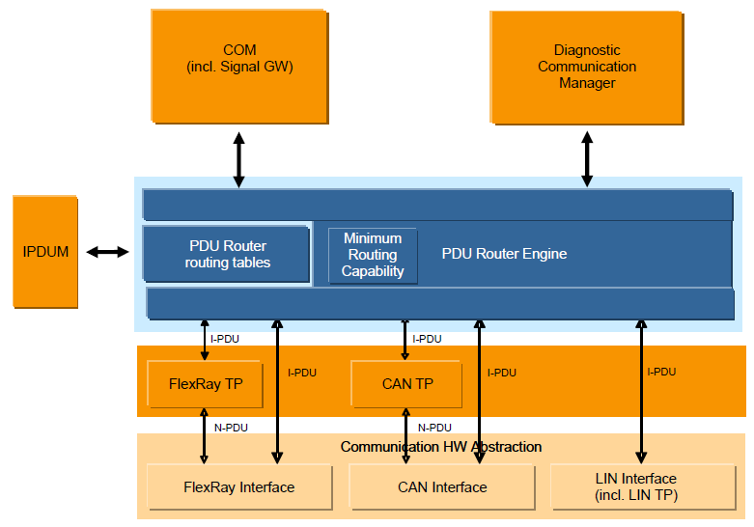
PDU Router
AUTOSAR ComStack
PDU Router routing tables: static routing tables describing the routing attributes for each PDU to be routed.
PDU Router Engine: actual code performing routing actions according to the PDU Router routing tables
Two ways of PDU transferring:
PDU Reception
PDU Transmission
Source path: COM → PDUR
Destination path: PDUR → CANIF
Source path: CANIF → PDUR
Destination path: PDUR → COM
19
Pham Vo Hoai Anh (RBVH/ESS1) | 4/29/2016
© Robert Bosch Engineering and Business Solutions Vietnam Company Limited 2016. All rights reserved, also regarding any disposal, exploitation, reproduction, editing, distribution, as well as in the event of applications for industrial property rights.

Slide 20
COM
AUTOSAR ComStack
RTE
20
Pham Vo Hoai Anh (RBVH/ESS1) | 4/29/2016
© Robert Bosch Engineering and Business Solutions Vietnam Company Limited 2016. All rights reserved, also regarding any disposal, exploitation, reproduction, editing, distribution, as well as in the event of applications for industrial property rights.

Slide 21
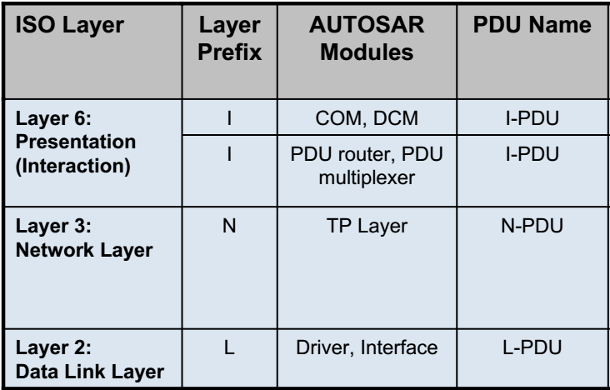
COM - Definitions
AUTOSAR ComStack
Signal
Signal: a unit of PDU which has 1 or more bit length. So called ‘Message’ in OSEK-COM.
Signal group: group of signals, be treated as an atomic unit.
I-PDU: PDU in interaction layer, consist of signals.
I-PDU group: an arbitrary collection of I-PDUs in the AUTOSAR COM module.
I-PDU Group
I-PDU
.
.
.
Payload
Signal group
21
Pham Vo Hoai Anh (RBVH/ESS1) | 4/29/2016
© Robert Bosch Engineering and Business Solutions Vietnam Company Limited 2016. All rights reserved, also regarding any disposal, exploitation, reproduction, editing, distribution, as well as in the event of applications for industrial property rights.

Slide 22
COM
AUTOSAR ComStack
RTE
Features:
Provision of signal oriented data interface from RTE and packing of signals to I-PDUs to be transmitted.
Unpacking of received I-PDUs and provision of received signals to RTE.
Routing of signals/signal groups from received I-PDUs into I-PDUs to become transmitted.
Communication transmission control (start/ stop of I-PDU groups).
Monitoring of receive signals (signals timeout) (*)
For CAN and LIN the maximum PDU length is 8 bytes.
Support endianess conversion.
22
Pham Vo Hoai Anh (RBVH/ESS1) | 4/29/2016
© Robert Bosch Engineering and Business Solutions Vietnam Company Limited 2016. All rights reserved, also regarding any disposal, exploitation, reproduction, editing, distribution, as well as in the event of applications for industrial property rights.

Slide 23
COM
AUTOSAR ComStack
Transmission interaction model
23
Pham Vo Hoai Anh (RBVH/ESS1) | 4/29/2016
© Robert Bosch Engineering and Business Solutions Vietnam Company Limited 2016. All rights reserved, also regarding any disposal, exploitation, reproduction, editing, distribution, as well as in the event of applications for industrial property rights.

Slide 24
COM
AUTOSAR ComStack
Reception interaction model
24
Pham Vo Hoai Anh (RBVH/ESS1) | 4/29/2016
© Robert Bosch Engineering and Business Solutions Vietnam Company Limited 2016. All rights reserved, also regarding any disposal, exploitation, reproduction, editing, distribution, as well as in the event of applications for industrial property rights.

Slide 25
AUTOSAR Architecture
MRR – VDB Architecture
Software Components – ACF, ACO, FUS….
Application Layer
VDB Runtime Environment (RTE)
AUTOSAR Runtime Environment (RTE)
FSI Software Components – NET, DIA, DAL….
OS
Service Layer
Memory Services
Communication
Services
I/O Hardware Abstraction
Complex
Drivers
Onboard Device Abstraction
Memory Hardware Abstraction
Communication HW Abstraction
Microcontrollers Drivers
Memory Drivers
Communication Drivers
I/O Drivers
Microcontroller
Microcontroller
25
Pham Vo Hoai Anh (RBVH/ESS1) | 4/29/2016
© Robert Bosch Engineering and Business Solutions Vietnam Company Limited 2016. All rights reserved, also regarding any disposal, exploitation, reproduction, editing, distribution, as well as in the event of applications for industrial property rights.

Slide 26
SIO Overview
Application
avi
CSP
SMI
SMO
Application
Layer
Netlib
SIO
hrz
Monitoring
Diagnostics
CSPL
Pdu mon
COM
XCP
dec
pgc
Interaction
Layer
I-PDU
I-PDUM
PDUR
DCM
ComM
NM
ISOTP15765 -2
Network Layer
N-PDU
<C> TP
<C> SM
CAN/FLEXRAY
<C IF >
Data link layer
L-PDU
C- Driver
C-Controller
26
Pham Vo Hoai Anh (RBVH/ESS1) | 4/29/2016
© Robert Bosch Engineering and Business Solutions Vietnam Company Limited 2016. All rights reserved, also regarding any disposal, exploitation, reproduction, editing, distribution, as well as in the event of applications for industrial property rights.

Slide 27
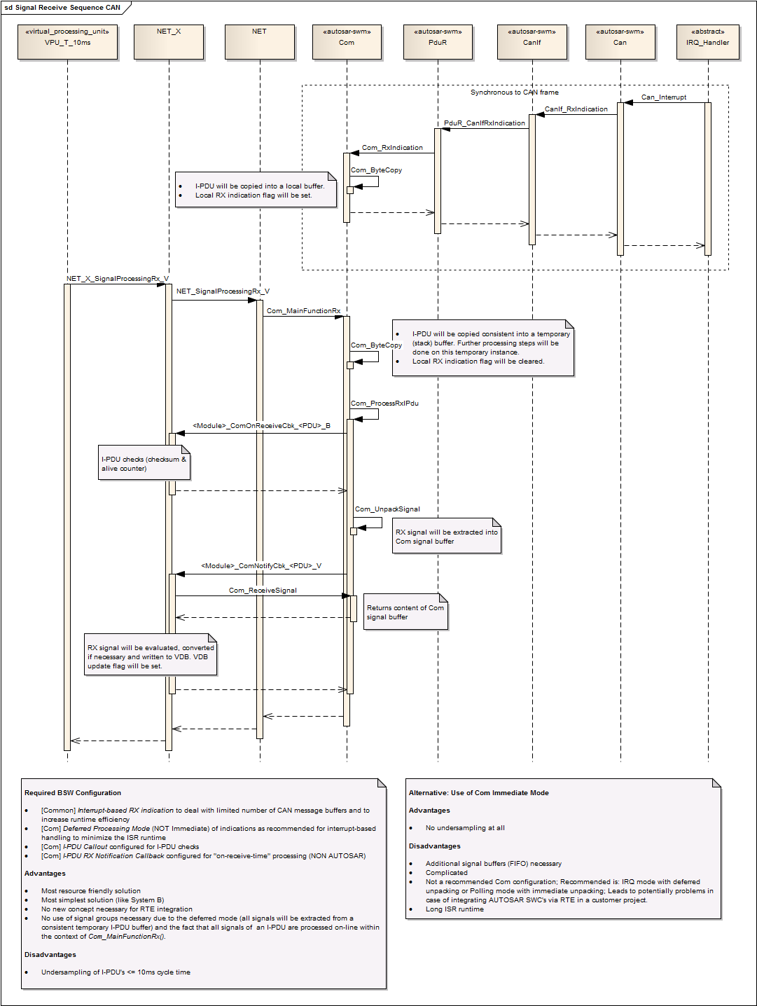
Flow of Rx Message
SIO Overview
27
Pham Vo Hoai Anh (RBVH/ESS1) | 4/29/2016
© Robert Bosch Engineering and Business Solutions Vietnam Company Limited 2016. All rights reserved, also regarding any disposal, exploitation, reproduction, editing, distribution, as well as in the event of applications for industrial property rights.

Slide 28
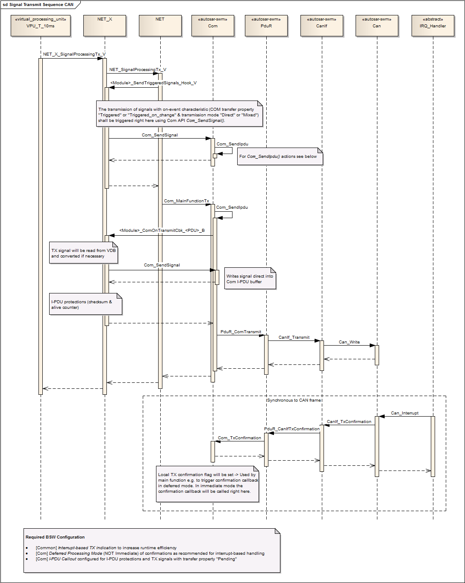
Flow of Tx Message
SIO Overview
28
Pham Vo Hoai Anh (RBVH/ESS1) | 4/29/2016
© Robert Bosch Engineering and Business Solutions Vietnam Company Limited 2016. All rights reserved, also regarding any disposal, exploitation, reproduction, editing, distribution, as well as in the event of applications for industrial property rights.

Slide 29
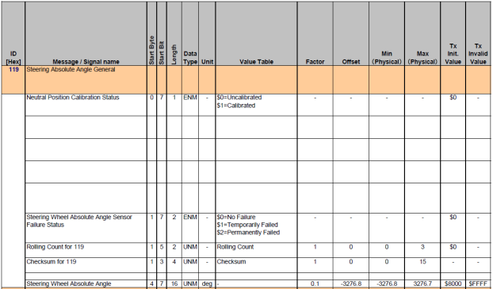
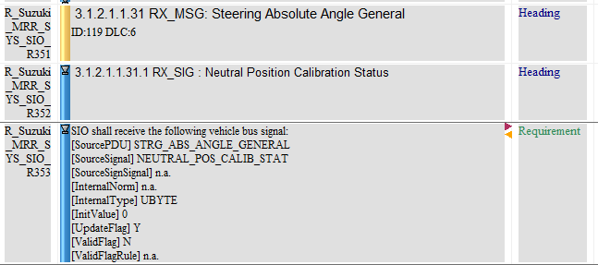
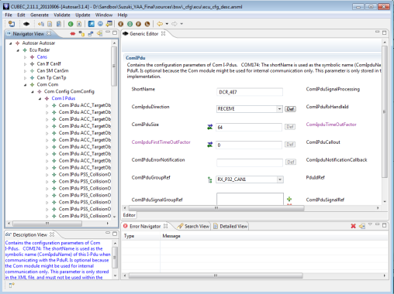
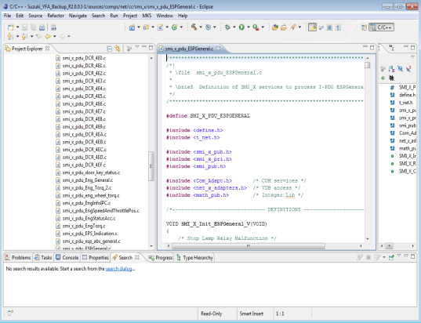
Working flow for adding new messages
SIO Overview
1. Requirement gathering
2. Update product requirement
3. CUBEC configuration
4. Coding
29
Pham Vo Hoai Anh (RBVH/ESS1) | 4/29/2016
© Robert Bosch Engineering and Business Solutions Vietnam Company Limited 2016. All rights reserved, also regarding any disposal, exploitation, reproduction, editing, distribution, as well as in the event of applications for industrial property rights.

Slide 30
Conversion
SIO Overview
Raw value to physical value
Physical value = Raw value * Bus factor + Offset
?
Ego velocity: min = -50km/h; max = 150km/h
Can signal: 10 bits
→ Appropriate Bus factor, Offset ?
30
Pham Vo Hoai Anh (RBVH/ESS1) | 4/29/2016
© Robert Bosch Engineering and Business Solutions Vietnam Company Limited 2016. All rights reserved, also regarding any disposal, exploitation, reproduction, editing, distribution, as well as in the event of applications for industrial property rights.

Slide 31
Conversion
SIO Overview
Physical value to VDB value
For RX message:
VDB value = (Physical value * Norm) * Conversion Factor
For TX message:
VDB value = (Physical value * Norm) / Conversion Factor
Ego velocity: min = -50km/h; max = 150km/h
VDB type: SWORD,
Conversion factor: 0.625 (miles/h)
→ Appropriate Norm ?
?
31
Pham Vo Hoai Anh (RBVH/ESS1) | 4/29/2016
© Robert Bosch Engineering and Business Solutions Vietnam Company Limited 2016. All rights reserved, also regarding any disposal, exploitation, reproduction, editing, distribution, as well as in the event of applications for industrial property rights.

