Slide 1

Controller Area Network
( CAN)
CAN
Boby Thomas
ECB – T1
ECB - T1

Slide 2
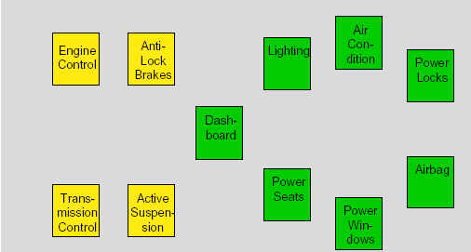
How it all began...
CAN
•The development of CAN began when more and more electronic
devices were implemented into modern motor vehicles. Examples of
such devices include engine management systems, active suspension,
ABS, gear control, lighting control, air conditioning, airbags and central
locking. All this means more safety and more comfort for the driver and
of course a reduction of fuel consumption and exhaust emissions.
ECB - T1

Slide 3
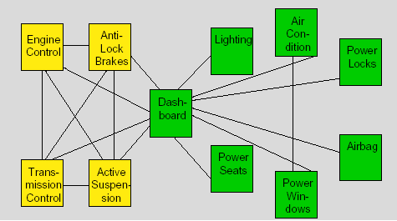
How it all began… (cont.)
CAN
•To improve the behavior of the vehicle even further, it was necessary
for the different control systems (and their sensors) to exchange information. This was usually done by discrete interconnection of the different systems (i.e. point to point wiring). The requirement for information exchange has then grown to such an extent that a cable network with a length of up to several miles and many connectors was required. This produced growing problems concerning material cost, production time and reliability.
ECB - T1

Slide 4
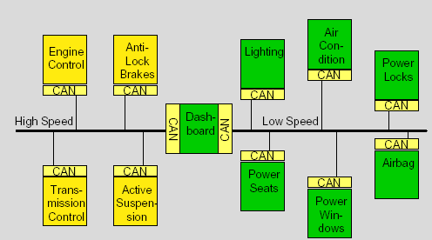
How it all began… (cont.)
CAN
•The solution to this problem was the connection of the control systems via a serial bus system. This bus had to fulfill some special requirements due to its usage in a vehicle.
•With the use of CAN, point-to-point wiring is replaced by one serial bus connecting all control systems. This is accomplished by adding some CAN-specific hardware to each control unit that provides the "rules" or the protocol for transmitting and receiving information via the bus.
ECB - T1

Slide 5
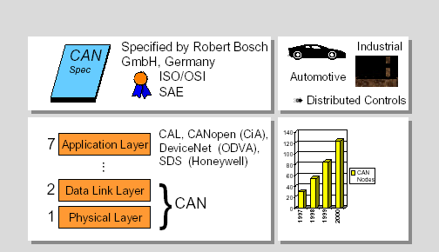
Overview
CAN
ECB - T1

Slide 6
Overview cont….
CAN
CAN or Controller Area Network is an advanced serial bus system that efficiently supports distributed control systems. It was initially developed for the use in motor vehicles by Robert Bosch GmbH, Germany, in the late 1980s, also holding the CAN license.
CAN is internationally standardized by the International Standardization Organization (ISO) and the Society of Automotive Engineers (SAE).
The CAN protocol uses the Data Link Layer and the Physical Layer in the ISO - OSI model. There are also a number of higher level protocols available for CAN.
CAN is most widely used in the automotive and industrial market segments. Typical applications for CAN are motor vehicles, utility vehicles, and industrial automation. Other applications for CAN are trains, medical equipment, building automation, household appliances, and office automation. Due to the high volume production in the automotive and industrial markets, low cost protocol devices are available.
ECB - T1

Slide 7
Overview cont….
CAN
5. Examples of vehicle bus systems, other than CAN, are A-BUS from Volkswagen, VAN or Vehicle Area Network, from Peugeot and Renault, and J1850 from Chrysler, General Motors and Ford.
6. CAN is clearly the leading vehicle bus protocol in Europe.
ECB - T1

Slide 8
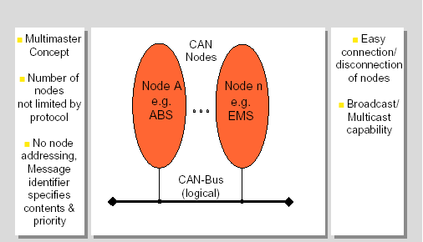
Basic Concepts
CAN
ECB - T1

Slide 9
Basic Concepts (cont.)
CAN
CAN is a multi-master bus with an open, linear structure with one logic bus line and equal nodes. The number of nodes is not limited by the protocol.
In the CAN protocol, the bus nodes do not have a specific address. Instead, the address information is contained in the identifiers of the transmitted messages, indicating the message content and the priority of the message.
The number of nodes may be changed dynamically without disturbing the communication of the other nodes.
Multicasting and Broadcasting is supported by CAN.
ECB - T1

Slide 10
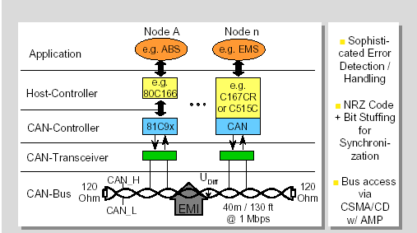
Basic Concepts (cont.)
CAN
ECB - T1

Slide 11
Basic Concepts (cont.)
CAN
CAN provides sophisticated error-detection and error handling mechanisms such as CRC check, and high immunity against electromagnetic interference. Erroneous messages are automatically retransmitted. Temporary errors are recovered. Permanent errors are followed by automatic switch-off of defective nodes. There is guaranteed system-wide data consistency.
The CAN protocol uses Non-Return-to-Zero or NRZ bit coding. For synchronization purposes, Bit Stuffing is used.
There is a high data transfer rate of 1000 kilobits per second at a maximum bus length of 40 meters or 130 feet when using a twisted wire pair which is the most common bus medium used for CAN. Message length is short with a maximum of 8 data bytes per message and there is a low latency between transmission request and start of transmission.
The bus access is handled via the advanced serial communications protocol Carrier Sense Multiple Access/Collision Detection with Non-Destructive Arbitration. This means that collision of messages is avoided by bitwise arbitration without loss of time.
ECB - T1

Slide 12
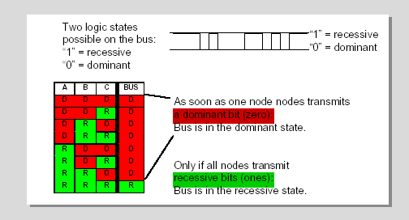
CAN Bus Characteristics - Wired-AND
CAN
ECB - T1

Slide 13
Basic Concepts (cont.)
CAN
There are two bus states, called "dominant" and "recessive".
The bus logic uses a "Wired-AND" mechanism, that is, "dominant bits" (equivalent to the logic level "Zero") overwrite the "recessive" bits (equivalent to the logic level "One" ).
ECB - T1

Slide 14
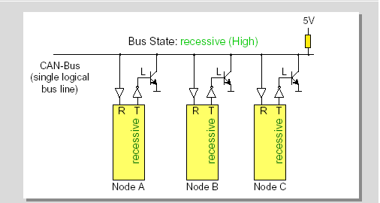
CAN Bus Characteristics - Wired-AND (cont.)
CAN
Only if all nodes transmit recessive bits (ones), the Bus is in the recessive state.
ECB - T1

Slide 15
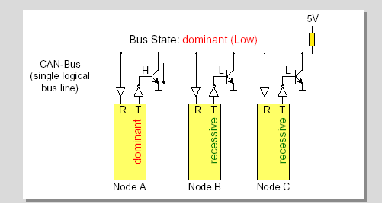
CAN Bus Characteristics - Wired-AND (cont.)
CAN
As soon as one node transmits a dominant bit (zero), the bus is in the dominant state.
ECB - T1

Slide 16
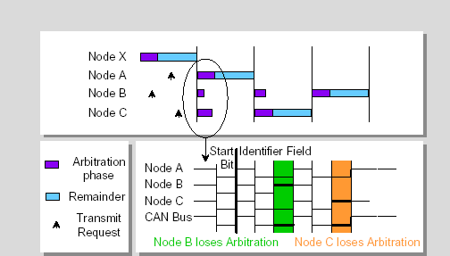
Bus Access and Arbitration: CSMA/CD w/ AMP
CAN
ECB - T1

Slide 17
Bus Access and Arbitration: CSMA/CD w/ AMP (cont.)
CAN
The CAN protocol handles bus accesses according to the concept called “Carrier Sense Multiple Access with Arbitration on Message Priority”. This arbitration concept avoids collisions of messages whose transmission was started by more than one node simultaneously and makes sure the most important message is sent first without time loss. In the picture above you see the trace of the transmit pins of three bus nodes called A, B and C, and the resulting bus state according to the wired-AND principle.
If two or more bus nodes start their transmission at the same time after having found the bus to be idle, collision of the messages is avoided by bitwise arbitration. Each node sends the bits of its message identifier and monitors the bus level.
ECB - T1

Slide 18
Bus Access and Arbitration: CSMA/CD w/ AMP (cont.)
CAN
3. At a certain time nodes A and C send a dominant identifier bit. Node B sends a recessive identifier bit but reads back a dominant one. Node B loses bus arbitration and switches to receive mode. Some bits later node C loses arbitration against node A. This means that the message identifier of node A has a lower binary value and therefore a higher priority than the messages of nodes B and C. In this way, the bus node with the highest priority message wins arbitration without losing time by having to repeat the message.
4. Nodes B and C automatically try to repeat their transmission once the bus returns to the idle state. Node B loses against node C, so the message of node C is transmitted next, followed by node B’s message.
5. It is not permitted for different nodes to send messages with the same identifier as arbitration could fail leading to collisions and errors.
ECB - T1

Slide 19
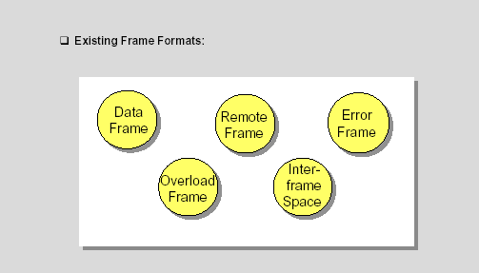
Frame Formats - Overview
CAN
ECB - T1

Slide 20
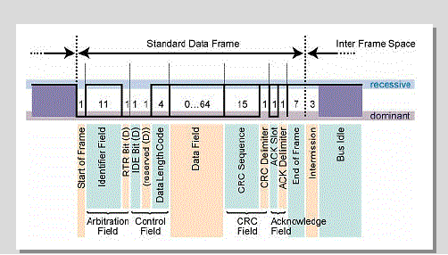
Frame Formats - Data Frame
CAN
ECB - T1

Slide 21
Frame Formats - Data Frame (cont.)
CAN
A "Data Frame" is generated by a CAN node when the node wishes to transmit data. The Standard CAN Data Frame is shown above. The frame begins with a dominant Start Of Frame bit for hard synchronization of all nodes.
The Start of Frame bit is followed by the Arbitration Field consisting of 12 bits: The 11-bit Identifier, which reflects the contents and priority of the message, and the Remote Transmission Request bit. The Remote transmission request bit is used to distinguish a Data Frame (RTR = dominant) from a Remote Frame (RTR = recessive).
The next field is the Control Field, consisting of 6 bits. The first bit of this field is called the IDE bit (Identifier Extension) and is at dominant state to specify that the frame is a Standard Frame. The following bit is reserved and defined as a dominant bit. The remaining 4 bits of the Control Field are the Data Length Code (DLC) and specify the number of bytes of data contained in the message (0 - 8 bytes).
ECB - T1

Slide 22
Frame Formats - Data Frame (cont.)
CAN
4. The data being sent follows in the Data Field which is of the length defined by the DLC above (0, 8, 16, ...., 56 or 64 bits).
5. The Cyclic Redundancy Field (CRC field) follows and is used to detect possible transmission errors. The CRC Field consists of a 15 bit CRC sequence, completed by the recessive CRC Delimiter bit.
6. The next field is the Acknowledge Field. During the ACK Slot bit the transmitting node sends out a recessive bit. Any node that has received an error free frame acknowledges the correct reception of the frame by sending back a dominant bit (regardless of whether the node is configured to accept that specific message or not). From this it can be seen that CAN belongs to the "in-bit-response" group of protocols. The recessive Acknowledge Delimiter completes the Acknowledge Slot and may not be overwritten by a dominant bit.
7. Seven recessive bits (End of Frame) end the Data Frame.
ECB - T1

Slide 23
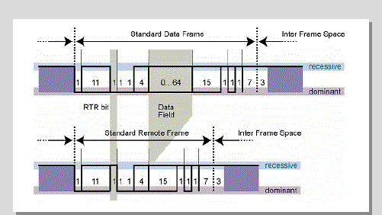
Frame Formats - Remote Frame
CAN
ECB - T1

Slide 24
Frame Formats - Remote Frame (cont.)
CAN
Generally data transmission is performed on an autonomous basis with the data source node (e.g. a sensor) sending out a Data Frame. It is also possible, however, for a destination node to request the data from the source by sending a Remote Frame.
There are 2 differences between a Data Frame and a Remote Frame. Firstly the RTR-bit is transmitted as a dominant bit in the Data Frame and secondly in the Remote Frame there is no Data Field. In the very unlikely event of a Data Frame and a Remote Frame with the same identifier being transmitted at the same time, the Data Frame wins arbitration due to the dominant RTR bit following the identifier. In this way, the node that transmitted the Remote Frame receives the desired data immediately.
ECB - T1

Slide 25
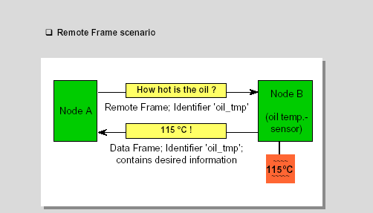
Frame Formats - Remote Frame (cont.)
CAN
ECB - T1

Slide 26
Frame Formats - Remote Frame (cont.)
CAN
If a node wishes to request the data from the source, it sends a Remote Frame with an identifier that matches the identifier of the required Data Frame. The appropriate data source node will then send a Data Frame as a response to this remote request.
ECB - T1

Slide 27
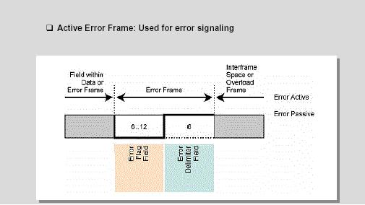
Frame Formats - Error Frame
CAN
ECB - T1

Slide 28
Frame Formats - Error Frame (cont.)
CAN
An Error Frame is generated by any node that detects a bus error. The Error Frame consists of 2 fields, an Error Flag field followed by an Error Delimiter field. The Error Delimiter consists of 8 recessive bits and allows the bus nodes to restart bus communications cleanly after an error. There are, however, two forms of Error Flag fields. The form of the Error Flag field depends on the “error status” of the node that detects the error.
If an “error-active” node detects a bus error then the node interrupts transmission of the current message by generating an “active error flag”. The “active error flag” is composed of six consecutive dominant bits. This bit sequence actively violates the bit stuffing rule. All other stations recognize the resulting bit stuffing error and in turn generate Error Frames themselves. The Error Flag field therefore consists of between six and twelve consecutive dominant bits (generated by one or more nodes). The Error Delimiter field completes the Error Frame. After completion of the Error Frame bus activity returns to normal and the interrupted node attempts to resend the aborted message.
ECB - T1

Slide 29
Frame Formats - Error Frame (cont.)
CAN
3. If an “error passive” node detects a bus error then the node transmits an “passive Error Flag” followed, again, by the Error Delimiter field. The “passive Error Flag” consists of six consecutive recessive bits, and therefore the Error Frame (for an “error passive” node) consists of 14 recessive bits (i.e. no dominant bits). From this it follows that, unless the bus error is detected by the node that is actually transmitting (i.e. is the bus master), the transmission of an Error Frame by an “error passive” node will not affect any other node on the network. If the bus master node generates an “error passive flag” then this may cause other nodes to generate error frames due to the resulting bit stuffing violation.
ECB - T1

Slide 30
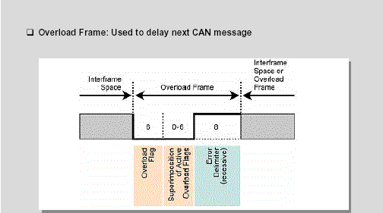
Frame Formats - Overload Frame
CAN
ECB - T1

Slide 31
Frame Formats - Overload Frame (cont.)
CAN
An Overload Frame has the same format as an “active” Error Frame. An Overload Frame, however can only be generated during Interframe Space. This is the way then an Overload Frame can be differentiated from an Error Frame (an Error Frame is sent during the transmission of a message). The Overload Frame consists of 2 fields, an Overload Flag followed by an Overload Delimiter. The Overload Flag consists of six dominant bits followed by Overload Flags generated by other nodes (as for “active error flag”, again giving a maximum of twelve dominant bits). The Overload Delimiter consists of eight recessive bits. An Overload Frame can be generated by a node if due to internal conditions the node is not yet able to start reception of the next message. A node may generate a maximum of 2 sequential Overload Frames to delay the start of the next message.
ECB - T1

Slide 32
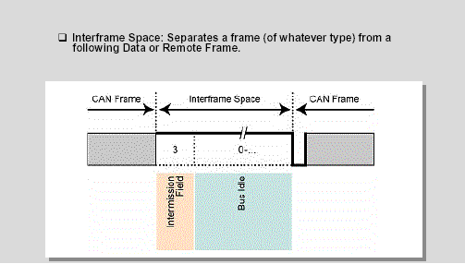
Frame Formats - Interframe Space
CAN
ECB - T1

Slide 33
Frame Formats - Interframe Space (cont.)
CAN
Interframe Space separates a preceeding frame (of whatever type) from a following Data or Remote Frame. Interframe space is composed of at least 3 recessive bits, these bits are termed the Intermission. This time is provided to allow nodes time for internal processing before the start of the next message frame. After the Intermission, for error active CAN nodes the bus line remains in the recessive state (Bus Idle) until the next transmission starts.
The Interframe Space has a slightly different format for error passive CAN nodes which were the transmitter of the previous message. In this case, these nodes have to wait another eight recessive bits called Suspend Transmission before the bus turns into bus idle for them after Intermission and they are allowed to send again. Due to this mechanism error active nodes have the chance to transmit their messages before the error passive nodes are allowed to start a transmission.
ECB - T1

Slide 34
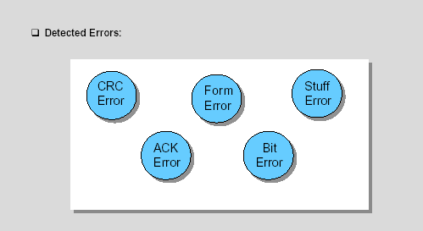
Error Detection - Overview
CAN
The CAN protocol provides sophisticated error detection mechanisms discussed in the following slides.
ECB - T1

Slide 35
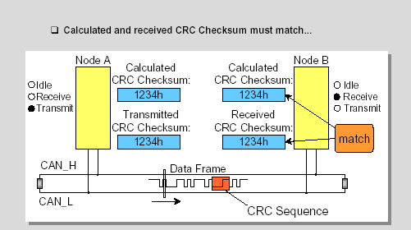
Error Detection - Cyclic Redundancy Check
CAN
ECB - T1

Slide 36
Error Detection - Cyclic Redundancy Check (cont.)
CAN
With the Cyclic Redundancy Check, the transmitter calculates a check sum for the bit sequence from the start of frame bit until the end of the Data Field.
This CRC sequence is transmitted in the CRC Field of the CAN frame.
The receiving node also calculates the CRC sequence using the same formula and performs a comparison to the received sequence.
ECB - T1

Slide 37
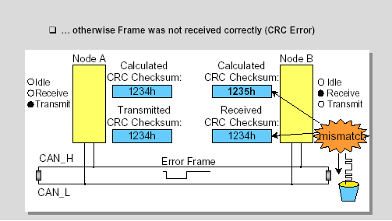
Error Detection - Cyclic Redundancy Check (cont.)
CAN
ECB - T1

Slide 38
Error Detection - Cyclic Redundancy Check (cont.)
CAN
If node B detects a mismatch between the calculated and the received CRC sequence , then a CRC error has occurred.
Node B discards the message and transmits an Error Frame to request retransmission of the garbled frame.
ECB - T1

Slide 39
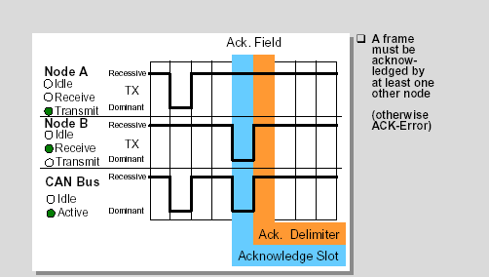
Error Detection - Acknowledge
CAN
ECB - T1

Slide 40
Error Detection – Acknowledge (cont.)
CAN
With the Acknowledge Check the transmitter checks in the Acknowledge Field of a message to determine if the Acknowledge Slot, which is sent out as a recessive bit, contains a dominant bit.
If this is the case, at least one other node, (here node B) has received the frame correctly.
If not, an Acknowledge Error has occured and the message has to be repeated. No Error Frame is generated, though.
ECB - T1

Slide 41
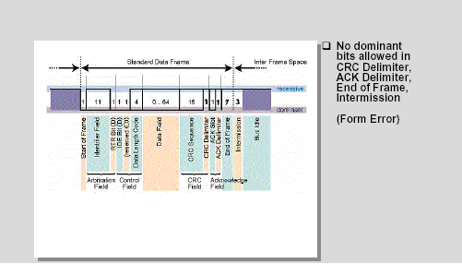
Error Detection - Frame Check
CAN
ECB - T1

Slide 42
Error Detection - Frame Check (cont.)
CAN
Another error detection mechanism is the Frame Check. If a transmitter detects a dominant bit in one of the four segments:
CRC Delimiter,
Acknowledge Delimiter,
End of Frame or
Interframe Space
then a Form Error has occurred and an Error Frame is generated. The message will then be repeated.
ECB - T1

Slide 43
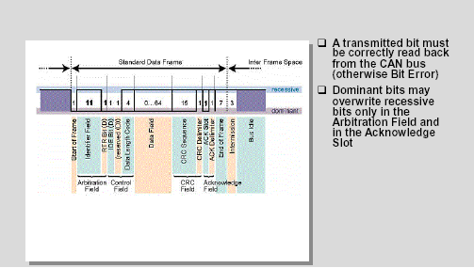
Error Detection - Bit Monitoring
CAN
ECB - T1

Slide 44
Error Detection - Bit Monitoring (cont.)
CAN
All nodes perform Bit Monitoring: A Bit Error occurs if a transmitter sends a dominant bit but detects a recessive bit on the bus line or, sends a recessive bit but detects a dominant bit on the bus line.
An Error Frame is generated and the message is repeated.
When a dominant bit is detected instead of a recessive bit, no error occurs during the Arbitration Field or the Acknowledge Slot because these fields must be able to be overwritten by a dominant bit in order to achieve arbitration and acknowledge functionality.
ECB - T1

Slide 45
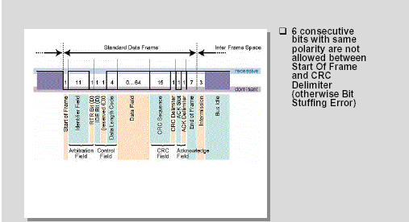
Error Detection - Bit Stuffing Check
CAN
ECB - T1

Slide 46
Error Detection - Bit Stuffing Check (cont.)
CAN
If six consecutive bits with the same polarity are detected between Start of Frame and the CRC Delimiter, the bit stuffing rule has been violated.
A stuff error occurs and an Error Frame is generated. The message is then repeated.
ECB - T1

Slide 47
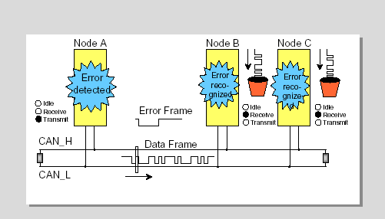
Error Handling
CAN
ECB - T1

Slide 48
Error Handling (cont.)
CAN
Detected errors are made public to all other nodes via Error Frames.
The transmission of the erroneous message is aborted and the frame is repeated as soon as possible.
ECB - T1

Slide 49
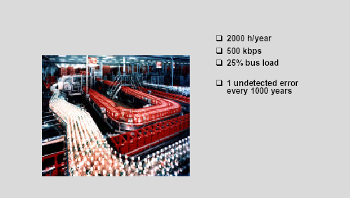
Undetected Errors - an example
CAN
ECB - T1

Slide 50
Undetected Errors - an example (cont.)
CAN
To understand the error detection capabilities of CAN, imagine a vehicle equipped with CAN running 2000 hours per year at a CAN bus speed of 500 kbps with 25% bus load.
This will result in 1 undetected error every 1000 years.
ECB - T1

Slide 51
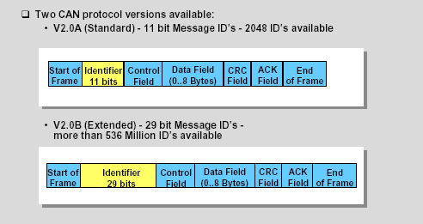
CAN Protocol Versions
CAN
ECB - T1

Slide 52
CAN Protocol Versions (cont.)
CAN
The original CAN specifications (Versions 1.0, 1.2 and 2.0A) specify an 11 bit message identifier. This is known as "Standard CAN".
Those Data Frames and Remote Frames, which contain an 11-bit identifier are therefore called Standard Frames.
With these frames, 211 (=2048) different messages can be identified (identifiers 0-2047).
However, the 16 messages with the lowest priority (2032-2047) are reserved.
Specification V2.0A has since been updated (to version 2.0B) to remove this possible message number limitation and meet the SAE J1939 standard for the use of CAN in trucks.
ECB - T1

Slide 53
CAN Protocol Versions (cont.)
CAN
6. Version 2.0B CAN is referred to as "Extended CAN".
7. Extended Frames, according to CAN specification V2.0 part B, contain a 29-bit identifier which allows 229 (over 536 Million) message identifiers.
8. The 29-bit identifier is made up of the 11-bit identifier ("Base ID") and the 18-bit Extended Identifier ("ID Extension").
9. CAN specification Version 2.0B still allows message identifier lengths of 11 bits to be used.
ECB - T1

Slide 54
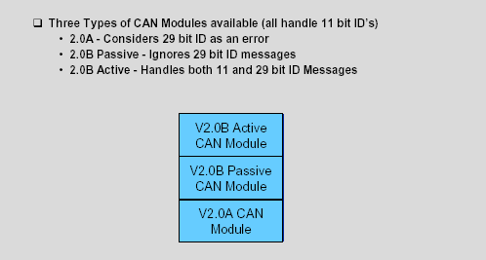
CAN Protocol Versions (cont.)
CAN
ECB - T1

Slide 55
CAN Protocol Versions (cont.)
CAN
There are three different types of CAN modules available.
2.0A - Considers 29 bit ID as an error
2.0B Passive - Ignores 29 bit ID messages
2.0B Active - Handles both 11 and 29 bit ID Messages
ECB - T1

Slide 56
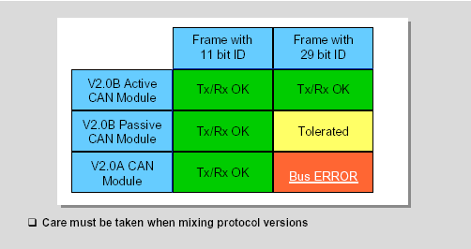
CAN Protocol Versions (cont.)
CAN
ECB - T1

Slide 57
CAN Protocol Versions (cont.)
CAN
CAN modules specified after CAN V2.0 part A are only able to transmit and receive Standard Frames according to the Standard CAN protocol.
Messages using the 29-bit identifier sent to a Standard CAN module cause errors.
If a device is specified after CAN V2.0 part B, there's one more distinction. Modules named "V2.0B Passive" can only transmit and receive Standard Frames but tolerate Extended Frames without generating Error Frames.
"V2.0B Active" devices are able to transmit and receive both Standard and Extended Frames.
Siemens offers V2.0B Active and V2.0B Passive devices.
ECB - T1

Slide 58
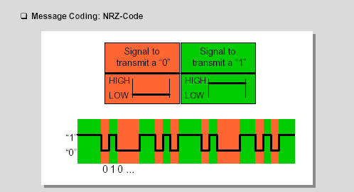
Message Coding
CAN
ECB - T1

Slide 59
Message Coding (cont.)
CAN
The CAN protocol uses Non-Return-to-Zero or NRZ bit coding. This means that the signal is constant for one whole bit time and only one time segment is needed to represent one bit.
Usually, but not always, a "zero" corresponds to a dominant bit, placing the bus in the dominant state, and a "one" corresponds to a recessive bit, placing the bus in the recessive state.
ECB - T1

Slide 60
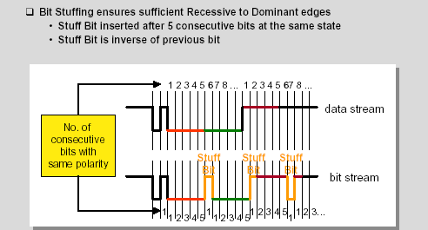
Bit Stuffing
CAN
ECB - T1

Slide 61
Bit Stuffing (cont.)
CAN
One characteristic of Non-Return-to-Zero code is that the signal provides no edges that can be used for resynchronization when transmitting a large number of consecutive bits with the same polarity.
Therefore Bit stuffing is used to ensure synchronization of all bus nodes.
This means that during the transmission of a message, a maximum of five consecutive bits may have the same polarity.
Whenever five consecutive bits of the same polarity have been transmitted, the transmitter will insert one additional bit of the opposite polarity into the bit stream before transmitting further bits.
The receiver also checks the number of bits with the same polarity and removes the stuff bits again from the bit stream. This is called "destuffing".
ECB - T1

Slide 62
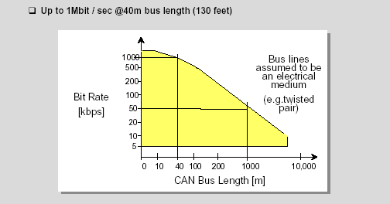
Relation between Baud Rate and Bus Length
CAN
ECB - T1

Slide 63
Relation between Baud Rate and Bus Length (cont.)
CAN
The maximum CAN bus speed is 1 MBaud, which can be achieved with a bus length of up to 40 meters when using a twisted wire pair.
For bus lengths longer than 40 meters the bus speed must be reduced.
A 1000 meter bus can still be realised with a 50 KBaud bus speed.
For a bus length above 1000 meters special drivers should be used.
ECB - T1

Slide 64
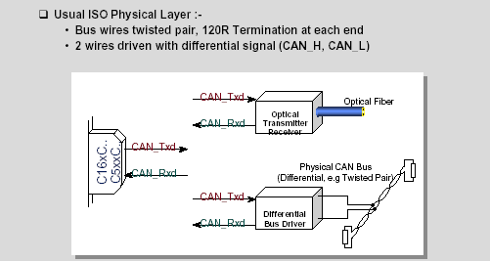
ISO Physical Layer
CAN
ECB - T1

Slide 65
ISO Physical Layer (cont.)
CAN
For the CAN bus line, a medium must be chosen that is able to transmit the two possible bit states “dominant” and “recessive”. One of the most common and cheapest ways is to use a twisted wire pair. The bus lines are then called "CAN_H" and "CAN_L". The two bus lines CAN_H and CAN_L are driven by the nodes with a differential signal. The twisted wire pair is terminated by terminating resistors at each end of the bus line, typically 120 Ohms.
But also an optical medium would be possible for CAN. In this case, the recessive state would be represented by the signal “light off”, the dominant state by the signal “light on”.
ECB - T1

Slide 66
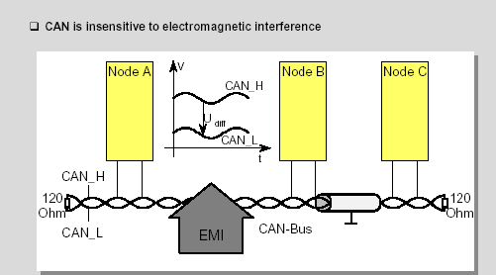
CAN and EMI
CAN
ECB - T1

Slide 67
CAN and EMI (cont.)
CAN
Due to the differential nature of transmission CAN is insensitive to electromagnetic interference, because both bus lines are affected in the same way which leaves the differential signal unaffected.
To reduce the sensitivity against electromagnetic interference even more, the bus lines can additionally be shielded. This also reduces the electromagnetic emission of the bus itself, especially at high baudrates.
ECB - T1

Slide 68
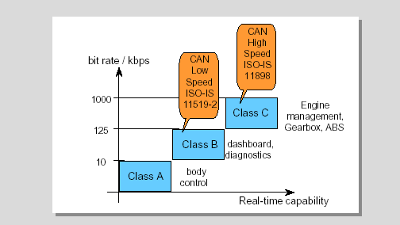
Standardization Issues
CAN
ECB - T1

Slide 69
Standardization Issues (cont.)
CAN
Vehicle bus system applications can be separated in three different categories according to their real-time capabilities.
Class A for a low speed bus with bit rates up to 10 kbps, e.g for body control applications,
Class B for a low speed bus with bit rates from 10 kbps to 125 kbps, e.g. for dashboard and diagnostics,
Class C for a high speed bus with bit rates from 125 kbps to 1 Mbps for real time applications like engine management, Gearbox, ABS etc.
For the use of CAN in vehicles two standards have been defined for the bus interface:
CAN High Speed according to ISO-IS 11898 for bit rates between 125 kbps and 1 Mbps
CAN Low Speed according to ISO-IS 11519-2 for bit rates up to 125 kbps
ECB - T1

Slide 70
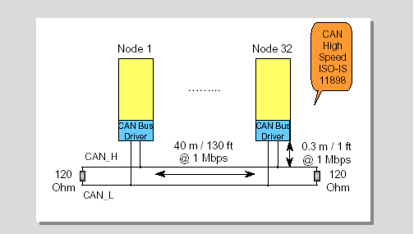
Physical Layer according to ISO-IS 11898
CAN
ECB - T1

Slide 71
Physical Layer according to ISO-IS 11898 (cont.)
CAN
This is the structure of a Controller Area Network according to ISO-IS 11898. The bus lines may be up to 40 m (130 ft) long at the maximum speed of 1 Mbaud and are terminated by termination resistors of 120 Ohms. The bus lines may be longer when decreasing the baud rate. Up to 30 nodes can be connected with CAN drivers according to this standard. For the connection of more nodes, stronger drivers or repeaters have to be used. To avoid reflexions the connection from the bus lines to the nodes should not exceed 0.3 m (1 ft) at 1 Mbps.
ECB - T1

Slide 72
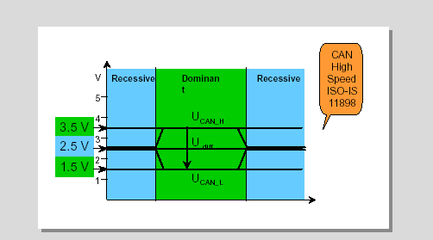
Bus Levels according to ISO-IS 11898
CAN
ECB - T1

Slide 73
Bus Levels according to ISO-IS 11898 (cont.)
CAN
These are the bus levels according to ISO-IS 11898. A recessive bit is represented by both CAN bus lines driven to a level of about 2.5 V so that the differential voltage between CAN_H and CAN_L is around 0 V.
A dominant bit is represented by CAN_H going to about 3.5 V and CAN_L going to about 1.5 V. This results in a differential voltage for a dominant bit of about 2V.
ECB - T1

Slide 74
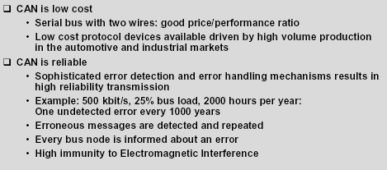
User Benefits
CAN
ECB - T1

Slide 75
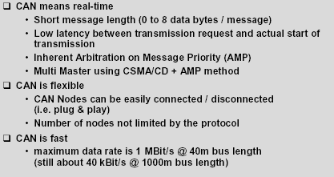
User Benefits (cont.)
CAN
ECB - T1

Slide 76
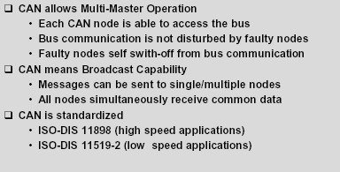
User Benefits (cont.)
CAN
ECB - T1

Slide 77
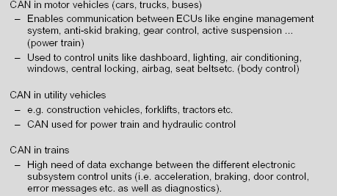
Application Examples
CAN
ECB - T1

Slide 78
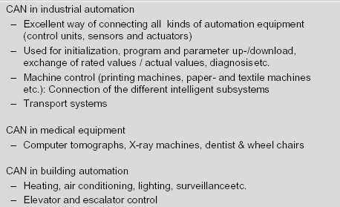
Application Examples (cont.)
CAN
ECB - T1

Slide 79
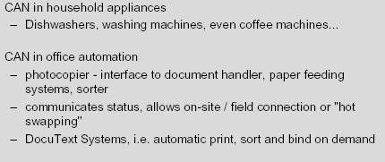
Application Examples (cont.)
CAN
ECB - T1

