Slide 1
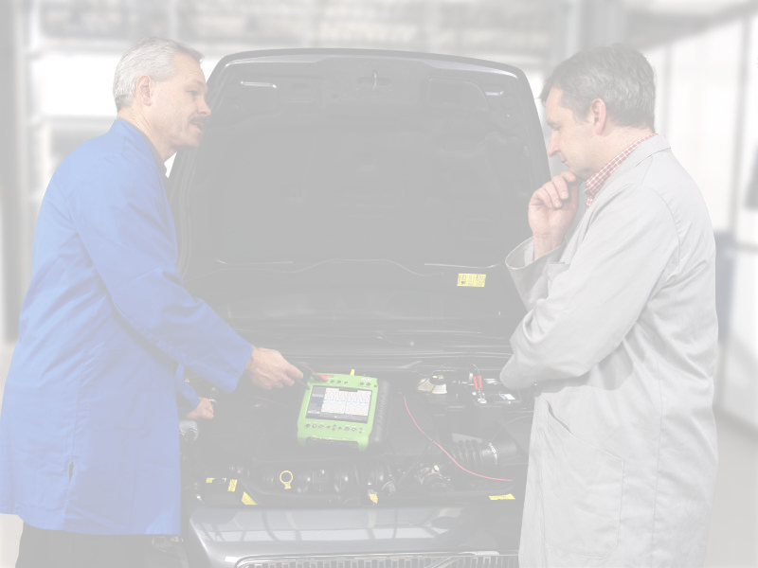

DCM Overview – part1
Overview of Diagnostic Communication
Chassis Systems Control
Internal | RBEI/EAR1 | 10.12.2012 | © Robert Bosch GmbH 2007. All rights reserved, also regarding any disposal, exploitation, reproduction, editing, distribution, as well as in the event of applications for industrial property rights.

Slide 2

Diagnosis Overview
Agenda
General Diagnostics Concepts
Need for Diagnostics and Basics of Diagnostics
Diagnostics Protocols
Diagnostics Terminology
Addressing in Diagnostics
Diagnostics Timing Parameters
Response Handling
Chassis Systems Control
Internal | RBIN/EDP2 | 10.12.2012 | © Robert Bosch GmbH 2007. All rights reserved, also regarding any disposal, exploitation, reproduction, editing, distribution, as well as in the event of applications for industrial property rights.

Slide 3
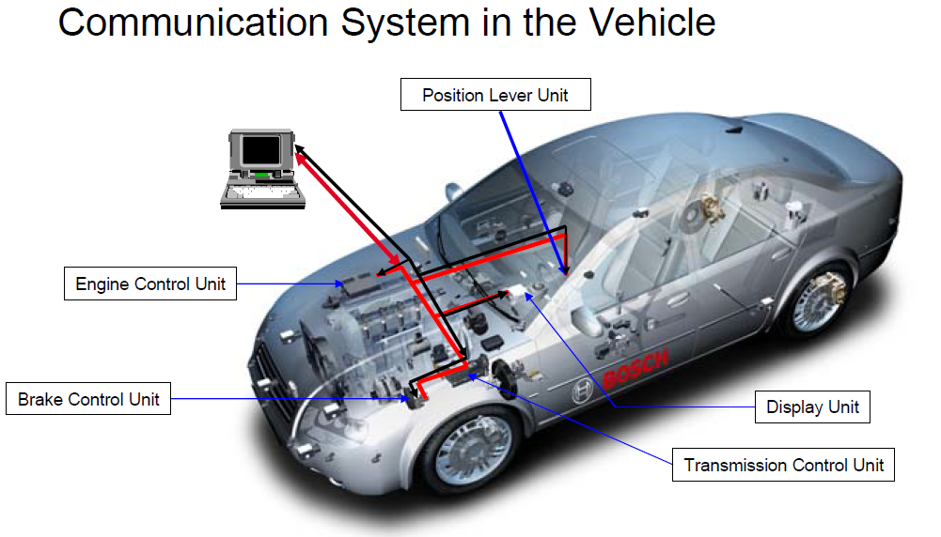

Diagnosis Oveview
Chassis Systems Control
Internal | CDG-SMT/ESB3 Simone Kriso | 10.12.2012 | © Robert Bosch GmbH 2007. All rights reserved, also regarding any disposal, exploitation, reproduction, editing, distribution, as well as in the event of applications for industrial property rights.

Slide 4
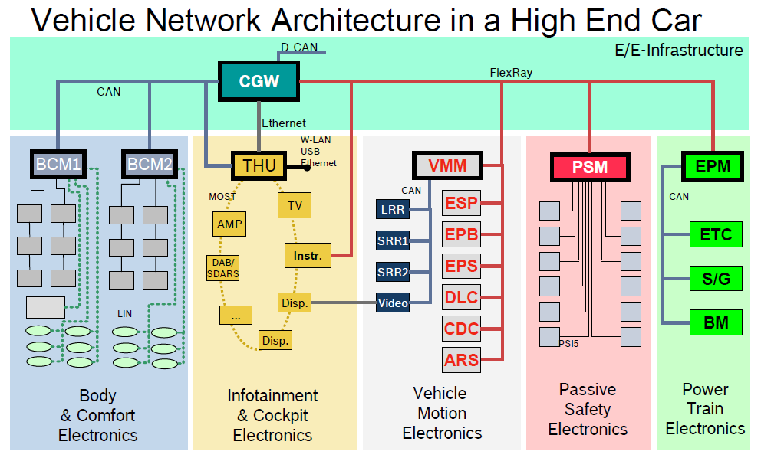
Diagnosis Overview
Chassis Systems Control
Internal | CDG-SMT/ESB3 Simone Kriso | 10.12.2012 | © Robert Bosch GmbH 2007. All rights reserved, also regarding any disposal, exploitation, reproduction, editing, distribution, as well as in the event of applications for industrial property rights.

Slide 5
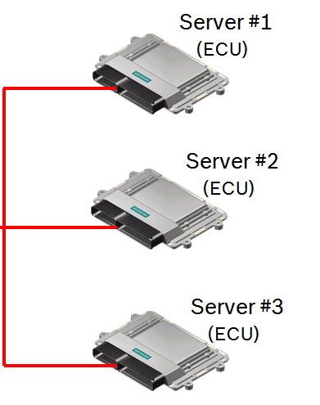
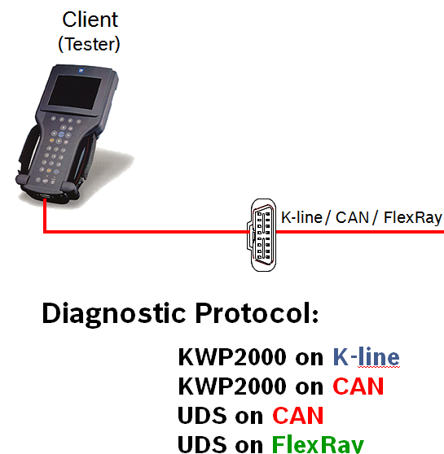
Diagnosis Overview
Communication in Automobiles:
In-Vehicle Communication is achieved through various means by using different protocols like Communication Manager (COM) etc
Tester Communication could be used for Diagnostics, Application/Calibration, Measurement, Flash Programming
Chassis Systems Control
Internal | RBIN/EDP2 | 10.12.2012 | © Robert Bosch GmbH 2007. All rights reserved, also regarding any disposal, exploitation, reproduction, editing, distribution, as well as in the event of applications for industrial property rights.

Slide 6
Videos
Need For Diagnostics https://www.youtube.com/watch?v=Afame2v9hog
Tester https://www.youtube.com/watch?v=GegBklNmJqc
OBD tester https://www.youtube.com/watch?v=TFoe-IkUVbw
Emission check https://www.youtube.com/watch?v=AZ7iVLi4IJc
Diagnosis Overview
Chassis Systems Control
Internal | CDG-SMT/ESB3 Simone Kriso | 10.12.2012 | © Robert Bosch GmbH 2007. All rights reserved, also regarding any disposal, exploitation, reproduction, editing, distribution, as well as in the event of applications for industrial property rights.

Slide 7
Diagnosis Overview - Need for Diagnostics
Evolution of Complex engine control system with increased no. of components
( Sensors, Actuators etc..) requires increased electronic monitoring
It would be cumbersome and difficult to identify faults and rectify it based
on manual methods of fault identification.
Errors are stored in ECU and reported to tester. These have to be erased
through tester once the fault is fixed.
To monitor operating condition at different engine/ vehicle speeds and simulate operation of the various actuators at different operating conditions
Chassis Systems Control
Internal | RBIN/EDP2 | 10.12.2012 | © Robert Bosch GmbH 2007. All rights reserved, also regarding any disposal, exploitation, reproduction, editing, distribution, as well as in the event of applications for industrial property rights.

Slide 8
Diagnosis Overview - Basics of Diagnostics
Diagnostics is fundamentally
Interchange of status information between ECU and tester
Reading / Writing into memory of ECU
Interface with other programs in the ECU
Uses / Users
Service engineers in workshop
Research/System engineers for feedback / post mortem
Developers during development and Application Tryout
Chassis Systems Control
Internal | RBIN/EDP2 | 10.12.2012 | © Robert Bosch GmbH 2007. All rights reserved, also regarding any disposal, exploitation, reproduction, editing, distribution, as well as in the event of applications for industrial property rights.

Slide 9
Basics of Diagnostics
Typical Tester functions
Identification of the system (Ex: Vehicle Identification Number)
Reading of error memory stored in ECU
Erasing errors from ECU memory after necessary rectification.
Monitoring different operating conditions (sensor values etc..)
Actuator testing etc
Chassis Systems Control
Internal | RBIN/EDP2 | 10.12.2012 | © Robert Bosch GmbH 2007. All rights reserved, also regarding any disposal, exploitation, reproduction, editing, distribution, as well as in the event of applications for industrial property rights.

Slide 10
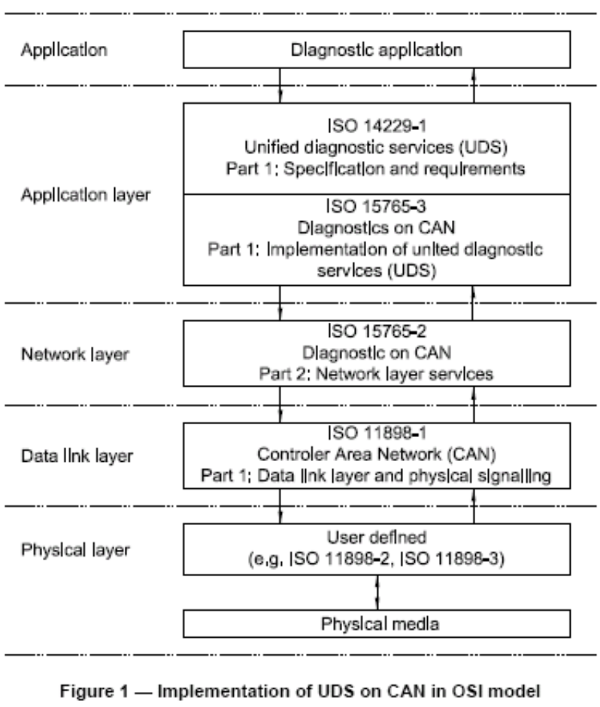
Diagnosis Overview - Diagnostics Protocols
Major Communication Protocols in Vehicle Diagnostics
Unified Diagnostic Services (ISO 14229)
  Deals with the implementation specifications of ISO 14229 Services over CAN
On Board Diagnostics (ISO 15031)
  Specially for Emission related Diagnostics
  Uses CAN or UART as medium for communication with Tester and ECU
Key Word Protocol 2000 (ISO 14230)
  Usage is intended for K-Line, but could be used over CAN as well
DCM
Chassis Systems Control
Internal | RBIN/EDP2 | 10.12.2012 | © Robert Bosch GmbH 2007. All rights reserved, also regarding any disposal, exploitation, reproduction, editing, distribution, as well as in the event of applications for industrial property rights.

Slide 11
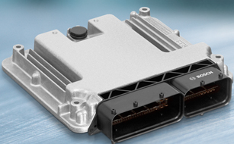
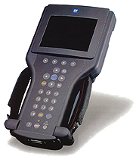
Addressing in Diagnostics
Physical addressing shall always be a dedicated message to a server implemented in one ECU. When physical addressing is used, the communication is a point-to-point communication between the client and the server.
Functional addressing is used by the client if it does not know the physical address of the server that shall respond to a service request or if the server is implemented as a distributed server in several ECUs. When functional addressing is used, the communication is a broadcast communication from the client to a server implemented in one or more ECUs.
6F1 11 02 3E 00
6F1 DF 02 3E 00
Engine ECU
Phys address 0x11
Func address 0xDF
ECU1
Tester
Airbag ECU
Phys address 0x12
Func address 0xDF
ECU2
Chassis Systems Control
Internal | RBIN/EDP2 | 10.12.2012 | © Robert Bosch GmbH 2007. All rights reserved, also regarding any disposal, exploitation, reproduction, editing, distribution, as well as in the event of applications for industrial property rights.

Slide 12
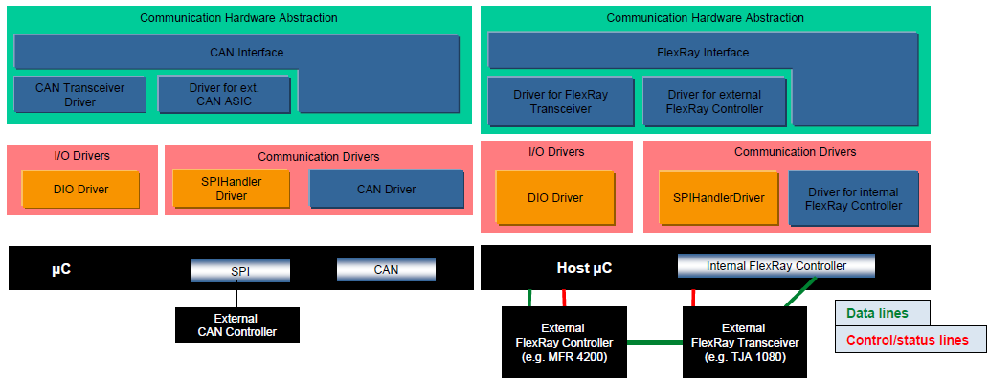
Diagnosis Overview
Application
ComM
DiagAdapt (DGS)
Appl
DCOM
RTE
BswM
Dem
Dcm
IoHwAb
PduR
Nvm
SchM(RTE)
CanTp
J1939Tp
FrArTp /
FrTp AR3.1
FrIsoTp /
FrTp AR4.0
OEM
FrTp
Chassis Systems Control
Internal | CDG-SMT/ESB3 Simone Kriso | 10.12.2012 | © Robert Bosch GmbH 2007. All rights reserved, also regarding any disposal, exploitation, reproduction, editing, distribution, as well as in the event of applications for industrial property rights.

Slide 13
Autosar Dcm Training
Application
SF
Data
Dcm
SID
SF
Data
CanTpPdu to DcmPdu
Mapping
PduR
CanTp
PCI
Data
CANID to CanTpPdu
Mapping
Can/CanIf
CANID
Data
Chassis Systems Control
Internal | CDG-SMT/ESB3 Simone Kriso | 10.12.2012 | © Robert Bosch GmbH 2007. All rights reserved, also regarding any disposal, exploitation, reproduction, editing, distribution, as well as in the event of applications for industrial property rights.

Slide 14
DIAGNOSTIC COMMUNICATION - NETWORK LAYER
N-PDU FORMAT
CAN data field
8 bytes data
N_AI
N_PCI
N_Data
N_AI Address Information
N_PCI Protocol Control Information
N_Data Databytes for application
Chassis Systems Control
Internal | RBEI/EAR1 | 10.12.2012 | © Robert Bosch GmbH 2007. All rights reserved, also regarding any disposal, exploitation, reproduction, editing, distribution, as well as in the event of applications for industrial property rights.

Slide 15
Service Primitives defined by ISO 15765-2
Diagnosis Overview
N_USData.request (Address Information, MessageData, Length)
N_USData.confirm (Address Information, N_Result)
N_USData_FF.indication (Address Information, Length)
N_USData.indication (Address Information, MessageData, Length, N_Result)
N_ChangeParameter.request (Address Information, Parameter, Parameter_Value)
N_ChangeParameter.confirm (Address Information, Parameter, Result_ChangeParameter)
Transport and Network layer as defined by ISO 15765-2
Data Link Layer and Physical Layer
Chassis Systems Control
Internal | CDG-SMT/ESB3 Daniel Hahn | 10.12.2012 | © Robert Bosch GmbH 2007. All rights reserved, also regarding any disposal, exploitation, reproduction, editing, distribution, as well as in the event of applications for industrial property rights.

Slide 16
Service Primitives defined by ISO 15765-2
Diagnosis Overview
Session Layer and Above
Transport and Network layer as defined by ISO 15765-2
L_Data.confirm ( <Identifier>, <TransferStatus> )
L_Data.request ( <Identifier>, <DLC>, <Data>)
L_Data.indication ( <Identifier>, <DLC>, <Data> )
Chassis Systems Control
Internal | CDG-SMT/ESB3 Daniel Hahn | 10.12.2012 | © Robert Bosch GmbH 2007. All rights reserved, also regarding any disposal, exploitation, reproduction, editing, distribution, as well as in the event of applications for industrial property rights.

Slide 17
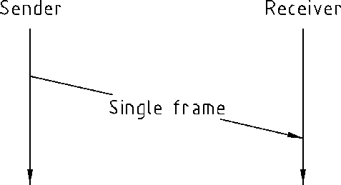
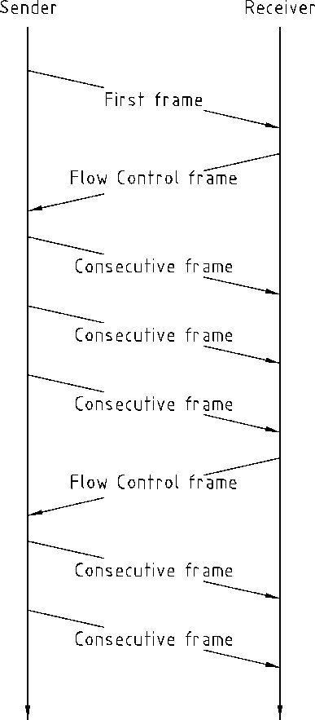
ISO 15765 – Segmented Message Transmission
Diagnosis Overview
Un-Segmented message transmission
Segmented message transmission
Unsegmented Transmission
Single Frame (SF)
Segmented Transmission
Sender starts with First Frame (FF)
Receiver confirms with Flow Control (FC)
Sender sends remaining transmission data with Consecutive Frames (CF)
Chassis Systems Control
Internal | RBEI/EAR2 - Ramachandran V | 10.12.2012 | © Robert Bosch GmbH 2007. All rights reserved, also regarding any disposal, exploitation, reproduction, editing, distribution, as well as in the event of applications for industrial property rights.

Slide 18
Frames at the Network layer
byte#1 byte#2 byte#3 . . . byte#8
Single Frame
0000
SF_DL
DATA 1
. . .
DATA 7
First Frame
0001
FF_DL
FF_DL
DATA 1
. . .
DATA 6
Consecutive Frame
0010
SN
DATA 1
. . .
DATA 7
Flow Control
0011
FS
BS
STmin
SF_DL single frame data length
FS flow status
FF_DL first frame data length
BS block size
SN sequence number
STmin min. separation time
Chassis Systems Control
Internal | RBEI/EAR1 | 10.12.2012 | © Robert Bosch GmbH 2007. All rights reserved, also regarding any disposal, exploitation, reproduction, editing, distribution, as well as in the event of applications for industrial property rights.

Slide 19
USDT - Segmented Data Transfer
first frame (FF)
flow control (FC#1)
(e.g. blocksize = 3)
consecutive frame (CF#1)
consecutive frame (CF#2)
consecutive frame (CF#3)
Sender
Receiver
flow control (FC#2)
consecutive frame (CF#4)
:
Chassis Systems Control
Internal | RBIN/EDP2 | 10.12.2012 | © Robert Bosch GmbH 2007. All rights reserved, also regarding any disposal, exploitation, reproduction, editing, distribution, as well as in the event of applications for industrial property rights.

Slide 20
Example : COMMUNICATION AT THE NETWORK LAYER LEVEL
application message
application message
3D
14
48
00
01
00
FirstFrame
3D
14
48
00
01
00
10 16 3D 14 48 00 01 00
FlowControl
30 02 05 AA AA AA AA AA
blocksize = 2
STmin = 5ms
0F
01
02
03
04
05
06
0F
01
02
03
04
05
06
ConsecutiveFrame
21 0F 01 02 03 04 05 06
ConsecutiveFrame
22 07 08 09 0A 0B 0C 0D
07
08
09
0A
0B
0C
0D
Sender
Tester
Receiver
ECU
07
08
09
0A
0B
0C
0D
FlowControl
30 00 05 AA AA AA AA AA
blocksize = 0
STmin = 5ms
last ConsecutiveFrame
23 0E 0F AA AA AA AA AA
0E
0F
0E
0F
Chassis Systems Control
all byte values in hex
Internal | RBEI/EAR1 | 10.12.2012 | © Robert Bosch GmbH 2007. All rights reserved, also regarding any disposal, exploitation, reproduction, editing, distribution, as well as in the event of applications for industrial property rights.

Slide 21
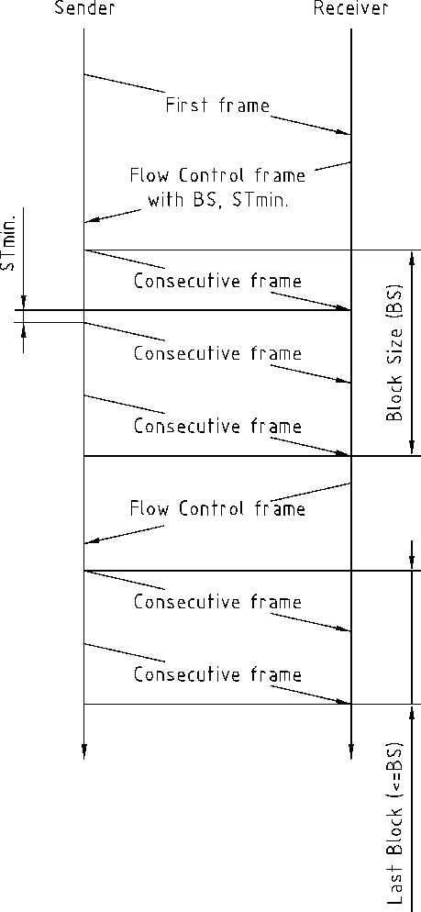
ISO 15765 – STmin, BS
Diagnosis Overview
Flow Control Parameter
Minimum Separation Time (STmin)
Minimum Time the sender shall wait between 2 CFs
Block Size (BS)
Maximum number of CFs the receiver allows the sender to send in one block, before waiting for the next CF.
BS = 0 (infinite)
All Consecutive Frames (CF) will be send without any further Flow Control frames
Chassis Systems Control
Internal | RBEI/EAR2 - Ramachandran V | 10.12.2012 | © Robert Bosch GmbH 2007. All rights reserved, also regarding any disposal, exploitation, reproduction, editing, distribution, as well as in the event of applications for industrial property rights.

Slide 22
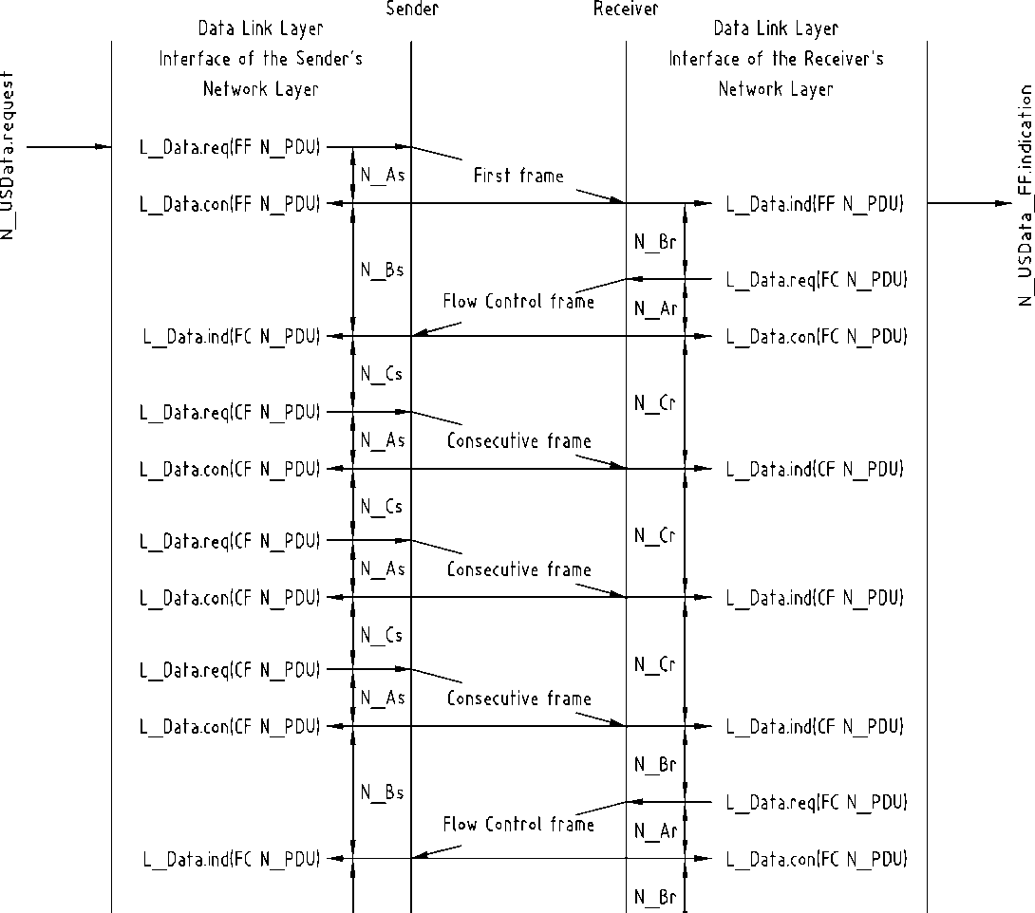
ISO 15765 – Timing-Parameter
Diagnosis Overview
Timing Parameter
As/Ar
Time for transmission of the CAN frame
Bs
Time until reception of the next Flow Control Frame
Br
Time until transmission of the next Flow Control Frame
Cs
Time until transmission of the next Consecutive Frame
Cr
Time until reception of the next Consecutive Frame
FF
FC
CF
CF
CF
FC
Chassis Systems Control
Internal | RBEI/EAR2 - Ramachandran V | 10.12.2012 | © Robert Bosch GmbH 2007. All rights reserved, also regarding any disposal, exploitation, reproduction, editing, distribution, as well as in the event of applications for industrial property rights.

Slide 23
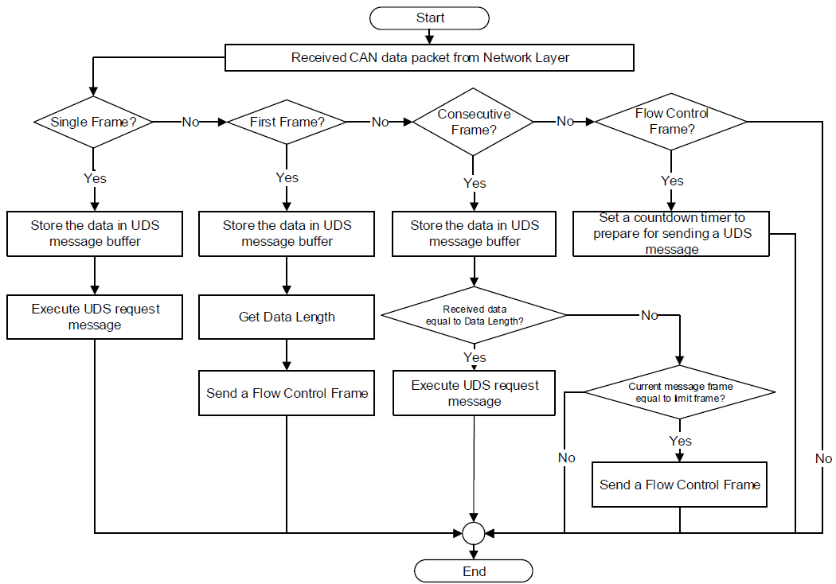
Autosar Dcm Training
Chassis Systems Control
Internal | CDG-SMT/ESB3 Simone Kriso | 10.12.2012 | © Robert Bosch GmbH 2007. All rights reserved, also regarding any disposal, exploitation, reproduction, editing, distribution, as well as in the event of applications for industrial property rights.

Slide 24
enhanced diagnostic services
vehicle application
???
SV security access
Error Management
Reprogramming
Actuator Tests
project specific configuration
e.g.
addresstable, identifier, data, etc.
generic services with
project specific configurations
e.g.
-WriteMemoryByAddress
-ReadMemoryByAddress
-ReadDataByIdentifier
exclusive project specific services
e.g.
-InputOutputControl
-RoutineControl
exclusive generic services
e.g.
-TesterPresent
-TransferData
generic service interface
b a s i c c o m m u n i c a t i o n l a y e r
Chassis Systems Control
Internal | RBIN/EDP2 | 10.12.2012 | © Robert Bosch GmbH 2007. All rights reserved, also regarding any disposal, exploitation, reproduction, editing, distribution, as well as in the event of applications for industrial property rights.

Slide 25
Contents
Request
Tester
ECU(s)
Request Message (1 - 4095 bytes)
SID
Data
#1
Data
#2
Data
#3
Data
#4
Data #5
Data #6
Data
#7
. . .
Data #4094
Example
readMemoryByAddress Request
23h
14h
00h
3Fh
FDh
DCh
0Ah
Chassis Systems Control
Internal | RBIN/EDP2 | 10.12.2012 | © Robert Bosch GmbH 2007. All rights reserved, also regarding any disposal, exploitation, reproduction, editing, distribution, as well as in the event of applications for industrial property rights.

Slide 26
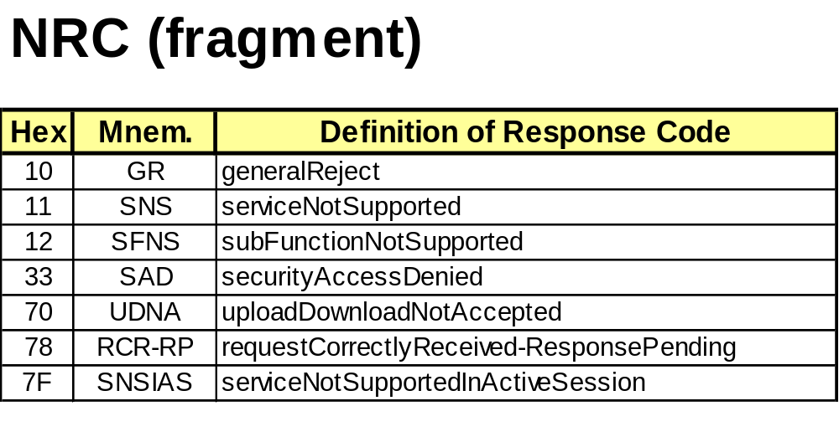
negative Response
Tester
ECU(s)
data (3 bytes)
SID
NR $7F
Data1
Req.SID
Data2
NRC
Chassis Systems Control
Internal | RBIN/EDP2 | 10.12.2012 | © Robert Bosch GmbH 2007. All rights reserved, also regarding any disposal, exploitation, reproduction, editing, distribution, as well as in the event of applications for industrial property rights.

Slide 27
UDS on CAN addressing
physical addressing
(point to point)
Tester
(Client)
CAN
ECU
physical Request CAN-ID: 7E0h
physical Response CAN-ID: 7E8h
Chassis Systems Control
Internal | RBIN/EDP2 | 10.12.2012 | © Robert Bosch GmbH 2007. All rights reserved, also regarding any disposal, exploitation, reproduction, editing, distribution, as well as in the event of applications for industrial property rights.

Slide 28
UDS on CAN addressing modes
functional addressing
(point to multipoint)
Tester
(Client)
CAN
ECU 1
physical Request CAN-ID: 7E0h
physical Response CAN-ID: 7E8h
functional Request CAN-ID: 7DFh
ECU 2
physical Request CAN-ID: 7E1h
physical Response CAN-ID: 7E9h functional Request CAN-ID: 7DFh
ECU 3
physical Request CAN-ID: 7E2h
physical Response CAN-ID: 7EAh
functional Request CAN-ID: 7DFh
Chassis Systems Control
Internal | RBIN/EDP2 | 10.12.2012 | © Robert Bosch GmbH 2007. All rights reserved, also regarding any disposal, exploitation, reproduction, editing, distribution, as well as in the event of applications for industrial property rights.

Slide 29
Inter message timing
S3can_client
S3can_server
N_USData.req
FF
N_USDataFF.ind
Request
FC
CF
last CF
N_USData.con
N_USData.ind
P2can_client
P2can_server
FF
N_USData.req
N_USDataFF.ind
FC
Response
CF
last CF
N_USData.ind
N_USData.con
S3can_client
S3can_server
Chassis Systems Control
Internal | RBIN/EDP2 | 10.12.2012 | © Robert Bosch GmbH 2007. All rights reserved, also regarding any disposal, exploitation, reproduction, editing, distribution, as well as in the event of applications for industrial property rights.

Slide 30
Request / Response Handling
S3
Tester:
Request Message
P2
ECU #1:
Response Message
P2
ECU #2:
Response Message
only possible if functional addresssing
S3
Tester:
Request Message
Chassis Systems Control
Internal | RBIN/EDP2 | 10.12.2012 | © Robert Bosch GmbH 2007. All rights reserved, also regarding any disposal, exploitation, reproduction, editing, distribution, as well as in the event of applications for industrial property rights.

Slide 31
negative Response NRC=78h handling
TESTER
ECU
Request
P2_{CAN}
_{e.g. 50ms}
negative Response (NRC=78h)
P2*_{CAN}
_{e.g. 5000ms}
negative Response (NRC=78h)
P2*_{CAN}
_{e.g. 5000ms}
final negative Response (NRC != 78h)
final positive Response
Chassis Systems Control
Internal | RBIN/EDP2 | 10.12.2012 | © Robert Bosch GmbH 2007. All rights reserved, also regarding any disposal, exploitation, reproduction, editing, distribution, as well as in the event of applications for industrial property rights.

Slide 32
APPLICATION LAYER TIMING PARAMETERS- P2, P2*
TESTER
ECU
REQUEST
Request
FF indication
Confirmation
Indication
P2 CAN_Server
Neg Resp NRC 0x78
Request
The maximum time before which the ECU should start sending the response message after successful reception of the request
Indication
Confirmation
P2* CAN_Server
Enhanced timeout for the tester to wait after the reception of a negative response message with response code 0x78
Response
Request
FF indication
Indication
Confirmation
Chassis Systems Control
Internal | RBEI/EAR1 | 10.12.2012 | © Robert Bosch GmbH 2007. All rights reserved, also regarding any disposal, exploitation, reproduction, editing, distribution, as well as in the event of applications for industrial property rights.

Slide 33
SESSION LAYER TIMING PARAMETERS- S3 Server
TESTER
DSC REQUEST
ECU
Request
Confirmation
Indication
P2 CAN_Server
DSC RESPONSE
Indication
Confirmation
S3 Client
Request
S3 Server
FF Indication
Indication
Confirmation
P2 CAN_Server
Time for the server to keep a diagnostic session other than the default Session active while not receiving any diagnostic request message.
FF indication
Response
Request
Indication
Confirmation
S3 Client
Tester Present request
S3 Server
Confirmation
Maximum time between physically transmitted request messages to a single server
Indication
P2 CAN_Server
S3 Client Timeout
Tester Present response
Request
Indication
Confirmation
Chassis Systems Control
Internal | RBEI/EAR1 | 10.12.2012 | © Robert Bosch GmbH 2007. All rights reserved, also regarding any disposal, exploitation, reproduction, editing, distribution, as well as in the event of applications for industrial property rights.

Slide 34
Request with SuppressPositiveResponseMessage
Sub-
function
Data #1
Data #2
Data #3
...
Data #n
SID
1/0 XXX XXXX
sub-function paramenter value
possible range: 00h to 7Fh (127d)
SuppressPositiveResponseMessageIndicationBit
1 = suppress positive response message
0 = positive response message is required
- valid for all Services with Sub-Function
- negative Response will be send independent of SPRMIB
Chassis Systems Control
Internal | RBIN/EDP2 | 10.12.2012 | © Robert Bosch GmbH 2007. All rights reserved, also regarding any disposal, exploitation, reproduction, editing, distribution, as well as in the event of applications for industrial property rights.

Slide 35
data interpretation order
SID supported ?
no
yes
negative response
NRC 11h SNS
SID supported in active session ?
no
yes
negative response
NRC 7Fh SNSIAS
SID security access ok ?
no
yes
negative response
NRC 33h SAD
is the length of the service
with Sub-Function at least 2d ?
(SID+subFunction = 2d)
no
negative response
NRC 13h IMLOIF
yes
Sub-Function supported ?
no
yes
negative response
NRC 12h SFNS
Sub-Function supported in active session ?
no
yes
negative response
NRC 7Eh SFNSIAS
Sub-Function security access ok ?
no
additional
for services with sub-Function
negative response
NRC 33h SAD
Chassis Systems Control
Internal | RBIN/EDP2 | 10.12.2012 | © Robert Bosch GmbH 2007. All rights reserved, also regarding any disposal, exploitation, reproduction, editing, distribution, as well as in the event of applications for industrial property rights.

Slide 36
Terminology of Diagnostics
Protocol
Session
Security
Service Table
Service
Connection
Service Identifier
Negative Response Code
Positive Response
Negative Response
Single Frame Response
Multiple Frame Response
Protocol is a set of rules which will define the process of how reception and transmission should work, restriction on the timings, set of the services supported etc
A diagnostic session enables a specific set of diagnostic services and/or functionality in the ECU. It furthermore enables a protocol depending data set of timing parameters applicable for the started session.
The purpose of this is to provide a means to access data and/or diagnostic services, which have restricted access for security, emissions, or safety reasons
Service table is a set of services (functions) supported / configured for a protocol. Only one service table will be assigned for any protocol. Ex: service table for UDS protocol will contain the services defined according to ISO14229
Diagnostic Service is an instruction, which is requested by a tester and carried out by the ECU.
A connection in diagnostics is a medium by which the tester and an ECU communication happens.
A unique service Identifier will be assigned to a service defined by the protocol. Service Id is fixed by the protocol Ex: 0x3E is the Service ID for Tester Present service
If the ECU is not able to carry out a tester request, it sends a response telegram with a NRC. The NRC gives the tester information about the reason for rejection
If the request from the tester is performed successfully by the diagnostics application in server positive response will be sent.
If the request from the tester is not fulfilled by the service, negative response will be returned with a suitable negative response code.
If the response sent from diagnostic layer can be accommodated in a single CAN frame (8 bytes), single frame response will be sent. Otherwise multiple frames will be sent to tester
Chassis Systems Control
Internal | RBIN/EDP2 | 10.12.2012 | © Robert Bosch GmbH 2007. All rights reserved, also regarding any disposal, exploitation, reproduction, editing, distribution, as well as in the event of applications for industrial property rights.

Slide 37
Autosar Dcm Training
?
Chassis Systems Control
Internal | CDG-SMT/ESB3 Simone Kriso | 10.12.2012 | © Robert Bosch GmbH 2007. All rights reserved, also regarding any disposal, exploitation, reproduction, editing, distribution, as well as in the event of applications for industrial property rights.

