Slide 1
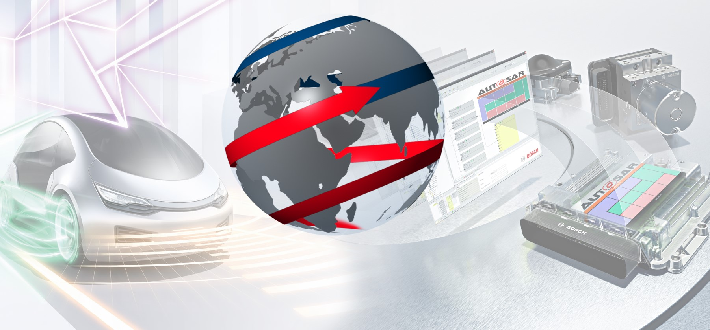
Dem - Event Memory - Training
CDG-SMT - The Solutions Network -
1
Internal | Cross Divisional Group - Software, Methods and Tools | CDG-SMT/ESE3 | 2017.10.23
© Robert Bosch GmbH 2017. All rights reserved, also regarding any disposal, exploitation, reproduction, editing, distribution, as well as in the event of applications for industrial property rights.

Slide 2
Agenda
DEM - Event Memory
Introduction
Storage of Event Related Data
Freeze Frames and Extended Data
Event Combination, Priority & Displacement
Aging and Occurrence Counter
Immediate Storage & NVM Blocks
Mirror & Shadow Memory
Interfaces to DCM
2
Internal | Cross Divisional Group - Software, Methods and Tools | CDG-SMT/ESE3 | 2017.10.23
© Robert Bosch GmbH 2017. All rights reserved, also regarding any disposal, exploitation, reproduction, editing, distribution, as well as in the event of applications for industrial property rights.

Slide 3
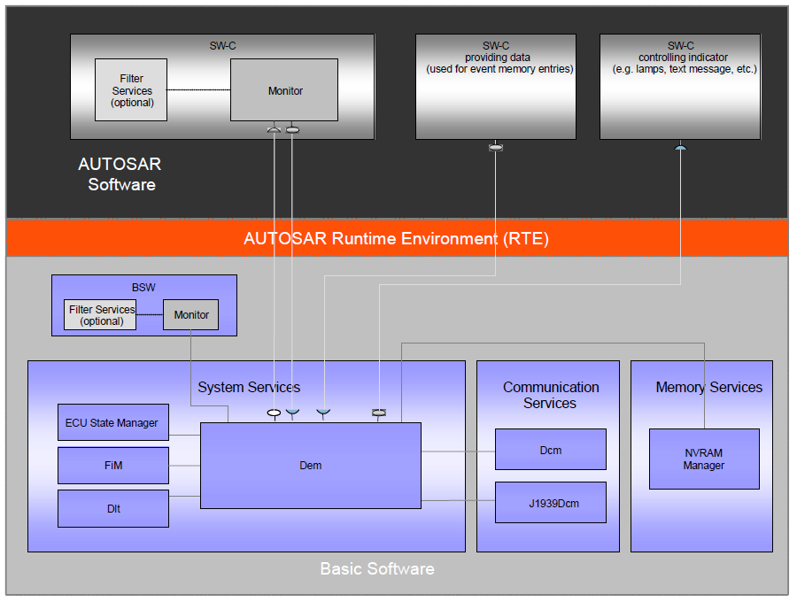
Interfaces to AUTOSAR modules
DEM - Event Memory
3
Internal | Cross Divisional Group - Software, Methods and Tools | CDG-SMT/ESE3 | 2017.10.23
© Robert Bosch GmbH 2017. All rights reserved, also regarding any disposal, exploitation, reproduction, editing, distribution, as well as in the event of applications for industrial property rights.

Slide 4
Scope
DEM - Event Memory
CUBAS Dem is implementing AUTOSAR Specification R4.2 Rev 2”
CUBAS Dem based on AUTOSAR R4.0 Rev 2 available (Status Freezed)
Few features & interfaces are already adopted to R4.3 Rev1
CUBAS Dem has additional Bosch specific extensions
DEM R4.2 Rev 2
Bosch
Features
DEM
Rev 4.x
4
Internal | Cross Divisional Group - Software, Methods and Tools | CDG-SMT/ESE3 | 2017.10.23
© Robert Bosch GmbH 2017. All rights reserved, also regarding any disposal, exploitation, reproduction, editing, distribution, as well as in the event of applications for industrial property rights.

Slide 5
Introduction: Failure Memories in DEM
DEM - Event Memory
DEM is supporting failure memories to store event related data based on Customer, CARB and Bosch requirements.
Customer
OBD
Bosch
Event Memory Customer
Stores Event Related Data based on Customer Requirements
OBD Memory
Stores Event Related Data based on CARB Requirements
Bosch Failure Memory
Stores Event Related Data based on Bosch Requirements
mandatory
optional
optional
5
Internal | Cross Divisional Group - Software, Methods and Tools | CDG-SMT/ESE3 | 2017.10.23
© Robert Bosch GmbH 2017. All rights reserved, also regarding any disposal, exploitation, reproduction, editing, distribution, as well as in the event of applications for industrial property rights.

Slide 6
Introduction: Event Memory (Customer)
DEM - Event Memory
The component Diagnostic Event Manager (DEM) is responsible for processing and storing of diagnostic events and event related data (e.g. environmental data).
DEM provides fault information to the Diagnostic Communication Manager (DCM) (e.g. read stored DTCs from the event memory).
DEM is supporting several Event Memories (Primary, 1 UserDefined and Mirror Memory), but the specific event memory processing is not defined for UserDefined and Mirror Memory.
The ´Event Memory´ is defined as a set of event records. The event record includes event status and the event related data.
Monitorings
Diagnostic
Event Manager
Diagnostic Communication Manager
Triggers Event
Stores Event Related Data in Event Memory
Stores Event Status
Reads Event Related Data
Reads Event Status
6
Internal | Cross Divisional Group - Software, Methods and Tools | CDG-SMT/ESE3 | 2017.10.23
© Robert Bosch GmbH 2017. All rights reserved, also regarding any disposal, exploitation, reproduction, editing, distribution, as well as in the event of applications for industrial property rights.

Slide 7
ISO 14229-1 Terms
DEM - Event Memory
Test Pass Criteria Specific conditions that define whether a system is working properly within normal, acceptable operating ranges (e.g. no failures exist and the diagnosed system is classified as “OK”)
Test Failure Criteria Specific failure conditions that define whether a system has failed. (e.g. failures exist and the diagnosed system is classified as “NOT OK”)
Confirmed Failure Criteria Specific failure conditions that define whether the system is definitively problematic (confirmed), ensuring storage of the DTC record in long-term memory
Occurrence Counter Counter recording the number of occurrences a DTC test is reporting a unique test failure (Test Passed → Test Failed)
Aging A process to determine if a confirmed DTC can be cleared from long-term memory. (e.g. after a configured number of failure-free cycles)
7
Internal | Cross Divisional Group - Software, Methods and Tools | CDG-SMT/ESE3 | 2017.10.23
© Robert Bosch GmbH 2017. All rights reserved, also regarding any disposal, exploitation, reproduction, editing, distribution, as well as in the event of applications for industrial property rights.

Slide 8
Event Memory (1)
DEM - Event Memory
Event Memory
Primary
Mirror (optional)
Loc 1
Loc 2
Loc 2
UserDefined (optional)
Loc 1
Loc i
Loc j
Loc 1
Loc 2
Loc k
Permanent
(OBD)
Event Memory An event memory consists of several event memory entries. (Primary, UserDefined and Mirror Memory)
Event Memory Location The event memory entry is a single storage container for a single event and its event related data.
Event Related Data Event related data are additional data items (e.g. sensor values or time stamp/mileage) which are stored with an event in an event memory. ISO 14229 defines two types of event related data: freeze frames (snapshot records) and extended data.
Memory Location
Freeze Frames
FF 1
Data 1
FF 1
Data n
General
Event-Id
Time -Id
Fault Counter
Aging & Occ Counter
Extended Data
Ext Data 1
Ext Data n
FF 2
Data 1
FF 2
Data n
OBD FF Data 1
OBD FF Data n
OBD Freeze Frame
8
Internal | Cross Divisional Group - Software, Methods and Tools | CDG-SMT/ESE3 | 2017.10.23
© Robert Bosch GmbH 2017. All rights reserved, also regarding any disposal, exploitation, reproduction, editing, distribution, as well as in the event of applications for industrial property rights.

Slide 9
Event Memory (2)
DEM - Event Memory
Definition and use of the different Event Memory Types (Primary, UserDefined and Mirror) is OEM specific.
The Diagnostic Communication Manager (DCM) is implementing the UDS protocol. (ISO 14229)
CUBAS Dem implements Primary, 1 UserDefined and Mirror memory based on a single Event Memory object with multiple instances sharing all methods and configuration data.
Each event can be mapped to Primary or UserDefined Memory, but not to both
9
Internal | Cross Divisional Group - Software, Methods and Tools | CDG-SMT/ESE3 | 2017.10.23
© Robert Bosch GmbH 2017. All rights reserved, also regarding any disposal, exploitation, reproduction, editing, distribution, as well as in the event of applications for industrial property rights.

Slide 10
Event/Fault Confirmation
DEM - Event Memory
Event Debouncing A diagnostic event is debounced in case of repeated detection of PRE-PASSED or PRE-FAILED by service Dem_SetEventStatus considering a fault detection counter. (affects Fault Detection Counter)
Event Qualification A diagnostic event is qualified in case PASSED and FAILED are reported by Dem_SetEventStatus. (affects Fault Detection Counter andTestFailed /TestNotComplete/PendingDTC - Flag)
Event Confirmation A diagnostic event is confirmed in case of repeated detection of this qualified event over failure cycles considering a fault confirmation counter. (affects Fault Confirmation Counter and ConfirmedDtc - Flag)
Event Debouncing (PRE-FAILED, PRE-PASSED)
Event Qualification
(FAILED, PASSED) (FDC-Counter > Threshold)
Event /Fault Confirmation
(Conf.-Counter > Threshold)
10
Internal | Cross Divisional Group - Software, Methods and Tools | CDG-SMT/ESE3 | 2017.10.23
© Robert Bosch GmbH 2017. All rights reserved, also regarding any disposal, exploitation, reproduction, editing, distribution, as well as in the event of applications for industrial property rights.

Slide 11
Synchronous Storage of Event Related Data (1)
DEM - Event Memory
Call SetEventStatus
Enter Event in EvBuff
Process Cyclic Main Function
Enter Event in EvMem
Store Debug Data in EvBuf
Aquires & Stores Freeze Frame Data in EvBuf
Aquires & Stores Extended Data in EvBuf
Process Dependency/Graph (optional)
Dispatch & Distribute Event to all event memories
Get free or already existing memory location to store DTC/event
On FF-Capture Write Freeze Frame to FF - Records in EvMem
On ED-Capture Write/Update Extended Data in EvMem
Debug Data are optionally passed as parameters
Remark: Configuration option asynchronous storage not yet fully supported
Synchronous to caller
Asynchronous to caller
11
Internal | Cross Divisional Group - Software, Methods and Tools | CDG-SMT/ESE3 | 2017.10.23
© Robert Bosch GmbH 2017. All rights reserved, also regarding any disposal, exploitation, reproduction, editing, distribution, as well as in the event of applications for industrial property rights.

Slide 12
Storage of Event Related Data (2)
DEM - Event Memory
Monitoring
Dem_SetEventStatus (opt. DebugData)
Ext. SR Data Elements
External Variable Read
Acquire
Event Buffer
EventId
Debug Data
Freeze Frame
Extended Data
Acquire
Ext. CS Data Elements
External Read Function (callback in BSW or RTE port)
Capture Trigger
Calculate
Event Memory
Event-Id
Aging-,Occurrence-Counter
Freeze Frame Records (0 .. n)
Extended Data (0 .. 1)
Internal Data Elements
DebugData
AgingCounter
OccurrenceCounter
OverflowIndicator
FDCs
EventStatusByte
…
Update
DCM
e.g.Dem_GetExtendedDataRecordbyDTC
12
Internal | Cross Divisional Group - Software, Methods and Tools | CDG-SMT/ESE3 | 2017.10.23
© Robert Bosch GmbH 2017. All rights reserved, also regarding any disposal, exploitation, reproduction, editing, distribution, as well as in the event of applications for industrial property rights.

Slide 13
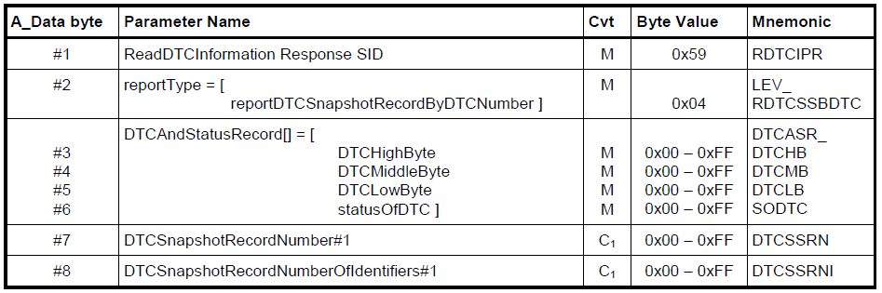
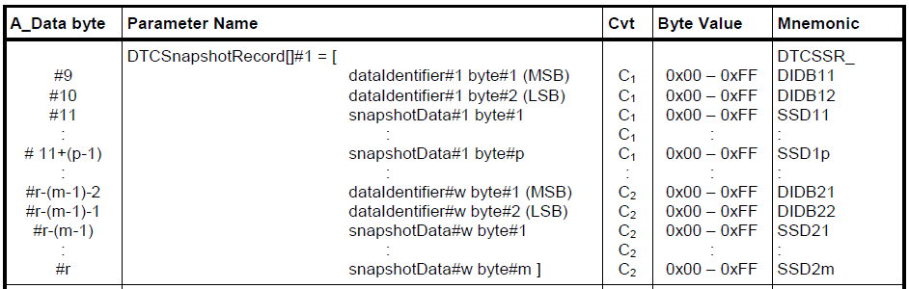
Freeze Frame (1) – ISO-14229
DEM - Event Memory
13
Internal | Cross Divisional Group - Software, Methods and Tools | CDG-SMT/ESE3 | 2017.10.23
© Robert Bosch GmbH 2017. All rights reserved, also regarding any disposal, exploitation, reproduction, editing, distribution, as well as in the event of applications for industrial property rights.

Slide 14
Freeze Frame (2)
DEM - Event Memory
Freeze Frames are the same as SnapShotRecords in ISO 14229
The content of the DTC Snapshots is not defined by ISO 14229
A Freeze Frame is defined as a record of DIDs (Data Identifiers).
AUTOSAR Dem is supporting up to 255 Freeze Frames Classes with up to 255 DIDs
Each DTC has a reference to exact one Freeze Frame Class
Each DTC can have up to n Freeze Frames
Freeze Frames are stored when the Trigger Condition is fulfilled ⎯ TriggerOnFailed ⎯ TriggerOnPending ⎯ TriggerOnConfirmed ⎯ TriggerOnFdcThreshold
14
Internal | Cross Divisional Group - Software, Methods and Tools | CDG-SMT/ESE3 | 2017.10.23
© Robert Bosch GmbH 2017. All rights reserved, also regarding any disposal, exploitation, reproduction, editing, distribution, as well as in the event of applications for industrial property rights.

Slide 15
Freeze Frame (3)
DEM - Event Memory
2 Types of Freeze Frame Record Numeration (Calculated /Configured)
Calculated Freeze Frames
Set of Freeze Frames with identical Trigger for all Records
Freeze Frame Record 1 is the first Freeze Frame
The Freeze Frame Record n is the most recent Freeze Frame and will be updated/overwritten in case additional Freeze Frames needs to be stored for this event
Configured Freeze frames (not yet supported)
Set of Freeze Frames with individual triggers and update behavior per Record
n case of configured Freeze Frame Record Numeration the Record Number can be assigned by configuration (instead of auto-calculation)
Freeze Frames are stored when the Trigger Condition is fulfilled TriggerOnFailed, TriggerOnPending, TriggerOnConfirmed, TriggerOnFdcThreshold
15
Internal | Cross Divisional Group - Software, Methods and Tools | CDG-SMT/ESE3 | 2017.10.23
© Robert Bosch GmbH 2017. All rights reserved, also regarding any disposal, exploitation, reproduction, editing, distribution, as well as in the event of applications for industrial property rights.

Slide 16
Freeze Frame (4) – Calculated Record Numbers
DEM - Event Memory
DemFreezeFrameClass
ref(s) to DemDidClass
DemDidClass
DidIdentifier
DemDataElementClass
ref(s) to DemDataElementClass
DemExternalCSDataElementClass
has DemExternalCSDataElementClass or DemInternalDataElementClass or DemExternalSRDataElement
size
DemInternalDataElementClass
size
ReadFunction or RTE-Port
AgingCounter, OccurrenceCounter, OverflowInd, Debug0, Debug1, FDC
DemMaxNumberFreezeFrameRecords
DemDtcAttributes
Optional ref to DemFreezeFrameClass
DemExternalSRDataElementClass
DataElementType (Boolean, uint8, uint16, …)
DemDataElementEndianess (Opaque, Big Endian, Little Endian)
16
Internal | Cross Divisional Group - Software, Methods and Tools | CDG-SMT/ESE3 | 2017.10.23
© Robert Bosch GmbH 2017. All rights reserved, also regarding any disposal, exploitation, reproduction, editing, distribution, as well as in the event of applications for industrial property rights.

Slide 17
Freeze Frame (5) – Configured Record Numbers
DEM - Event Memory
DemFreezeFrameRecNumClass
ref(s) to DemFreezeFrameRecordClass
DemFreezeFrameRecordClass
DemFreezeFrameRecordTrigger (TestFailed, Pending, Confirmed, FDC-Threshold) → NOT YET SUPPORTED MUST BE CONFIGURD IDENTICAL DemFreezeFrameRecordUpdate (Yes / No) → NOT YET SUPPORTED
DemDtcAttributes
Optional ref to DemFreezeFrameRecNumClass
DemFreezeFrameRecordNumber
Optional ref to DemFreezeFrameClass
DemFreezeFrameClass
ref(s) to DemDidClass
17
Internal | Cross Divisional Group - Software, Methods and Tools | CDG-SMT/ESE3 | 2017.10.23
© Robert Bosch GmbH 2017. All rights reserved, also regarding any disposal, exploitation, reproduction, editing, distribution, as well as in the event of applications for industrial property rights.

Slide 18
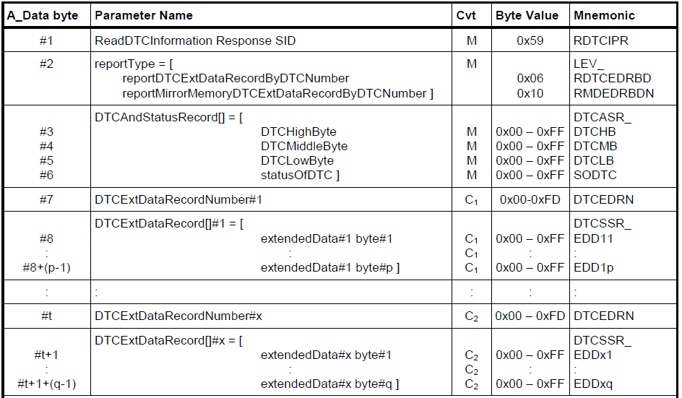
Extended Data (1) – ISO - 14229
DEM - Event Memory
18
Internal | Cross Divisional Group - Software, Methods and Tools | CDG-SMT/ESE3 | 2017.10.23
© Robert Bosch GmbH 2017. All rights reserved, also regarding any disposal, exploitation, reproduction, editing, distribution, as well as in the event of applications for industrial property rights.

Slide 19
Extended Data (2)
DEM - Event Memory
Extended Data is defined as a set of data records
The content of the DTC Extended Data is not defined by ISO 14229 DTC. A typical use of DTC Extended Data is to store dynamic data associated with the DTC, e.g.: ⎯ DTC occurrence counter ⎯ DTC aging counter
AUTOSAR Dem is supporting up to 255 Extended Data Classes with up to 253 Extended Data Records.
Each DTC/Event has a reference to exact one Extended Data Class
Extended Data Records are stored when the Trigger Condition is fulfilled ⎯ TriggerOnFailed ⎯ TriggerOnPending ⎯ TriggerOnConfirmed ⎯ TriggerOnMirror ⎯ TriggerOnPassed ⎯ TriggerOnFdcThreshold
19
Internal | Cross Divisional Group - Software, Methods and Tools | CDG-SMT/ESE3 | 2017.10.23
© Robert Bosch GmbH 2017. All rights reserved, also regarding any disposal, exploitation, reproduction, editing, distribution, as well as in the event of applications for industrial property rights.

Slide 20
Extended Data (3)
DEM - Event Memory
DemDtcAttributes
ref(s) to DemExtendedDataRecordClass
DemExtendedDataRecordClass
ExtendedDataRecordNumber
ExtendedDataRecordUpdate (Yes/No)
DemDataElementClass
ref(s) to DemDataElementClass
DemExternalCSDataElementClass
has DemExternalCSDataElementClass or DemInternalDataElementClass or DemExternalSRDataElement
size
DemInternalDataElementClass
size
ReadFunction or RTE-Port
AgingCounter, OccurrenceCounter, OverflowInd, Debug0, Debug1
Optional ref to DemExtendedDataClass
DemExtendedDataClass
ExtendedDataRecordTrigger
DemExternalSRDataElementClass
DataElementType (Boolean, uint8, uint16, …)
DemDataElementEndianess (Opaque, Big Endian, Little Endian)
20
Internal | Cross Divisional Group - Software, Methods and Tools | CDG-SMT/ESE3 | 2017.10.23
© Robert Bosch GmbH 2017. All rights reserved, also regarding any disposal, exploitation, reproduction, editing, distribution, as well as in the event of applications for industrial property rights.

Slide 21
Event Combination
DEM - Event Memory
Event combination defines the ability of the Dem module to map several events to one specific DTC. This is called n:1 mapping
If Event Combination is disabled each event is mapped to exact one DTC. This is called 1:1 mapping
Dem is supporting two types of event combination Combined type 1 (On Storage) Event related data are stored in one event memory location for all events of the DTC (only one entry per DTC) Combined type 2 (On Retrieval) Event related data are stored in one event memory location for each event (several entries per DTC, only one entry per event)
In case of event combination event related event configuration parameter needs to be identical (DemMaxNumberFreezeFrameRecords , DemAgingCycleCounterThreshold, …)
EventMemory Type 1
Event 1,3 (Dtc1)
Event 2 (Dtc2)
EventMemory Type 2
Event 1 (Dtc1)
Event 2 (Dtc2)
Empty
Event 3 (Dtc1)
Empty
Empty
21
Internal | Cross Divisional Group - Software, Methods and Tools | CDG-SMT/ESE3 | 2017.10.23
© Robert Bosch GmbH 2017. All rights reserved, also regarding any disposal, exploitation, reproduction, editing, distribution, as well as in the event of applications for industrial property rights.

Slide 22
Event Priority
DEM - Event Memory
Event priority is defining the importance of an event. It is used to determine which fault entries may be removed from the event memory in case the number of stored events exceeds the maximum number of memory entries. (event memory is full)
A priority value of 1 is indicating the highest priority. Larger priority values are defining lower importance.
Hint: Failure Entries are priorized versus OnFdcThreshold Entries
22
Internal | Cross Divisional Group - Software, Methods and Tools | CDG-SMT/ESE3 | 2017.10.23
© Robert Bosch GmbH 2017. All rights reserved, also regarding any disposal, exploitation, reproduction, editing, distribution, as well as in the event of applications for industrial property rights.

Slide 23
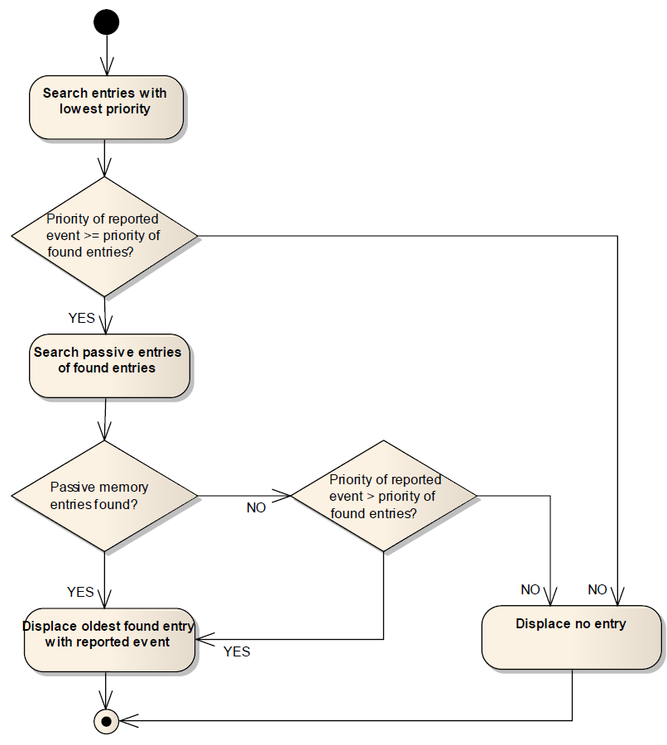
Event Displacement
DEM - Event Memory
In case an event gets qualified as failed (TestFailed changes from 0 to 1) and the event memory is full, the Dem may need to displace existing entries in the event memory entry.
Event displacement means that the most insignificant, already existing event memory entry is replaced by a new event.
If event displacement is enabled Dem is considering the following sequence of displacement criteria : 1. Priority (high/low) 2. Test Failed Status (active/passive) 3. Occurrence (new/old)
Dem module is displacing lowest prioritized passive and old events preferably.
23
Internal | Cross Divisional Group - Software, Methods and Tools | CDG-SMT/ESE3 | 2017.10.23
© Robert Bosch GmbH 2017. All rights reserved, also regarding any disposal, exploitation, reproduction, editing, distribution, as well as in the event of applications for industrial property rights.

Slide 24
Aging / Aging Counter (1)
DEM - Event Memory
DEM supports to remove an event from the event memory, if its fault conditions are not fulfilled for a certain period of time (aging cycles). This process is called as “aging”.
The Aging Counter is counting the number of aging cycles until an event/DTC is removed from event memory
Dem is providing an aging counter per event memory entry
DEM is initializing the aging counter with 0 if a event is entered in the event memory
Dem provides the configuration parameter DemAgingCycleCounterThreshold per event defining the number of passed aging cycles to delete the event in case DemAgingAllowed is configured.
Aging Cycle Counter is an Up-Counter counting Passed (TC,TF = 0) or Not-Failed (TF = 0) Aging-Cycles (→ DemAgingCounterType )
Aging Cycle Counter Range is 0 … DemAgingCycleCounterThreshold (max. 255)
The Aging Counter is mapped to the Internal Data Element DEM_AGINGCTR
The vendor-specific configuration parameter DemAgingCounterType allows to disable the Aging Counter in order to optimize resources
24
Internal | Cross Divisional Group - Software, Methods and Tools | CDG-SMT/ESE3 | 2017.10.23
© Robert Bosch GmbH 2017. All rights reserved, also regarding any disposal, exploitation, reproduction, editing, distribution, as well as in the event of applications for industrial property rights.

Slide 25
Occurrence Counter
DEM - Event Memory
DEM is providing an occurrence counter per event memory entry.
DEM is initializing the occurrence counter with 1 if a event is entered in the event memory
DEM is incrementing the occurrence counter by 1 if the related event is already stored in the event memory and the TestFailed Flag changes from 0 to 1. (PASSED → FAILED)
In case the configuration parameter DemOccurrenceCounterProcessing is configured as DEM_PROCESS_OCCCTR_CDTC, DEM is only incrementing the occurrence counter if the fault confirmation has been successfully finished (ConfirmedDTC Flag is 1)
Occurrence Counter Range is 1 … 255
DEM is not incrementing the occurrence counter anymore, if the counter has reached its maximum value
The Occurrence Counter is mapped to the Internal Data Element DEM_OCCCTR
The vendor-specific configuration parameter DemOccurrenceCounterType allows to disable the Occurrence Counter in order to optimize resources
25
Internal | Cross Divisional Group - Software, Methods and Tools | CDG-SMT/ESE3 | 2017.10.23
© Robert Bosch GmbH 2017. All rights reserved, also regarding any disposal, exploitation, reproduction, editing, distribution, as well as in the event of applications for industrial property rights.

Slide 26
NVM Blocks (1)
DEM - Event Memory
DEM needs several non-volatile Data Blocks.
Each Event Memory Location of the Event Memory is stored in an separate Non-Volatile Block in order to support immediate writing requirements.
The number of configured non-volatile blocks in DemNvRamBlockIds is the sum of the sizes of primary, userdefined and mirror memory. (Each block has the same size!)
Several non-volatile data blocks may lead to inconsistencies in case that not all changed non-volatile data blocks are safely written. This might occur e.g. in an under-voltage situation. DEM is therefore performing data plausibility checks to detect and resolve conflicting data.
EvMem
Prim, User, ..
Location n
Location 1
…
Status Byte
Permanent Memory
Location 1
Location 4
Disturbance Memory
…
DEM NVM Data Blocks
History Status Byte
Generic Data
Bosch Failure Memory
Event Indicator
26
Internal | Cross Divisional Group - Software, Methods and Tools | CDG-SMT/ESE3 | 2017.10.23
© Robert Bosch GmbH 2017. All rights reserved, also regarding any disposal, exploitation, reproduction, editing, distribution, as well as in the event of applications for industrial property rights.

Slide 27
NVM Blocks (2)
DEM - Event Memory
DemNvRamBlockId
Short Name
DemNvRamBlockRef
DemGeneral
Has DemNvRamBlockId (1 ..n)
 | Event Memory Location | Generic Data
# Use of Indexed DemNvBlocks | yes, number of locations/indices: Primary + UserDefined + Mirror (first index is zero) | no
Dem/DemGeneral/DemNvBlockId
# ShortName | DEM_NVM_ID_EVMEM_LOC_<index> | DEM_NVM_ID_DEM_GENERIC_NV_DATA
NvM/NvMBlockDescriptor
# NvMRamBlockDataAddress | - | -
# NvMNvBlockLength | number of Bytes needs to match sizeof(Dem_EvMemEventMemoryType) | number of Bytes needs to match sizeof(Dem_GenericNvDataType)
# NvMBlockUseSyncMechanism | true | true
# NvMReadRamBlockFromNvCallback | Dem_EvMemNvmReadRamBlockFromNvCallback<index> | Dem_GenericNVDataReadRamBlockFromNvCallback
# NvMWriteRamBlockToNvCallback | Dem_EvMemNvmWriteRamBlockToNvCallback<index> | Dem_GenericNVDataWriteRamBlockToNvCallback
27
Internal | Cross Divisional Group - Software, Methods and Tools | CDG-SMT/ESE3 | 2017.10.23
© Robert Bosch GmbH 2017. All rights reserved, also regarding any disposal, exploitation, reproduction, editing, distribution, as well as in the event of applications for industrial property rights.

Slide 28
Immediate Storage (1)
DEM - Event Memory
DEM supports writing of non volatile data (e.g. event memory) after shutdown as standard
DEM also supports immediate writing of event memory data on DTC configuration
DEM supports to limit the number of non volatile accesses in case of immediate storage.
The limit applies to all DTCs with Immediate Storage.
Cleared data will be written immediate
Reported DTC has Immediate NV Storage configured ?
Immediate Storage Limit configured ?
DTC Occurrence Counter < Limit ?
Any DTC has immediate storage configured ?
DTC is cleared ?
No: No Immediate Storage
Yes: Immediate Storage
No: No Immediate Storage
No: Immediate Storage
No: No Immediate Storage
Yes: Immediate Storage
28
Internal | Cross Divisional Group - Software, Methods and Tools | CDG-SMT/ESE3 | 2017.10.23
© Robert Bosch GmbH 2017. All rights reserved, also regarding any disposal, exploitation, reproduction, editing, distribution, as well as in the event of applications for industrial property rights.

Slide 29
Immediate Storage (2)
DEM - Event Memory
DemDTCAttributes
DemImmediateNvStorageLimit
DemImmediateNvStorage
DemGeneral
DemGeneralRB
DemOccurrenceCounterType
29
Internal | Cross Divisional Group - Software, Methods and Tools | CDG-SMT/ESE3 | 2017.10.23
© Robert Bosch GmbH 2017. All rights reserved, also regarding any disposal, exploitation, reproduction, editing, distribution, as well as in the event of applications for industrial property rights.

Slide 30
Mirror Memory
DEM - Event Memory
The Dem is able to support additional Event Memories (e.g. Mirror Memory), but the specific event memory processing is not defined in detail in the AUTOSAR specification
In CUBAS Dem the Mirror Memory is an instance of the Event Memory. The entry is triggered by the configuration switch DemMirrorMemoryType. The available options are: - “Store in Mirror Memory On Failed “ - “Store in Mirror Memory On Clear”
The entry in MIRROR Memory is a physical copy of the original entry in Primary or UserDefined Memory.
Only Events with EventDestination MIRROR will be stored in MIRROR Memory!
EventDestination = PRIMARY/SEC
On Clear
EventDestination = MIRROR
On Clear
Primary/Sec Memory
- Entry 1
- Entry 2
On Failed
Mirror Memory
- Entry 1
- Entry 2
On Failed
30
Internal | Cross Divisional Group - Software, Methods and Tools | CDG-SMT/ESE3 | 2017.10.23
© Robert Bosch GmbH 2017. All rights reserved, also regarding any disposal, exploitation, reproduction, editing, distribution, as well as in the event of applications for industrial property rights.

Slide 31
Shadow Memory
DEM - Event Memory
Shadow Memory is a resource optimized legacy implementation of a Mirror Memory.
The basic concept is that deleted entries in the event memory are marked as “virtual deleted”. Via this tag the deleted entries are still “available” as “shadow entries” in the original memory without additional NVM resources and NVM write cycles.
Shadow Memory is enabled by the switch DemShadowMemory.
Enabling of Shadow Memory is only supported if the Mirror Memory is disabled . (DemMaxNumberEventEntryMirror = 0) The Shadow Memory of the Primary Memory will be used as “Mirror Memory” .
On Clear
Primary
Memory
- Entry 1 (Deleted)
- Entry 2
On Failed
31
Internal | Cross Divisional Group - Software, Methods and Tools | CDG-SMT/ESE3 | 2017.10.23
© Robert Bosch GmbH 2017. All rights reserved, also regarding any disposal, exploitation, reproduction, editing, distribution, as well as in the event of applications for industrial property rights.

Slide 32
Interfaces to DCM (Examples)
DEM - Event Memory
service 0x14 - ClearDiagnosticInformation
service 0x19 - 0x01 - reportNumberOfDTCByStatusMask
service 0x19 - 0x02 - reportDTCByStatusMask
service 0x19 - 0x0A - reportSupportedDTCs
Dem_DcmGetDTCStatusAvailabilityMask, Dem_DcmGetStatusOfDTC,
service 0x19 - 0x03 - reportDTCSnapshotIdentification
Dem_DcmSetFreezeFrameRecordFilter
Dem_DcmGetNextFilteredRecord
service 0x19 - 0x06 reportDTCExtendedDataRecordByDTCNumber
Dem_DcmSetDTCFilter, Dem_DcmGetNextFilteredDTC
Dem_DcmGetNumberOfFilteredDTC
Dem_DcmGetStatusOfDTC
Dem_DcmGetExtendedDataRecordbyDTC
Dem_DcmGetSizeOfExtendedDataRecordByDTC
service 0x19 - 0x04 - reportDTCSnapshotRecordByDTCNumber
Dem_DcmGetStatusOfDTC
Dem_DcmGetFreezeFrameDataByDTC
Dem_DcmGetSizeOfFreezeFrameDataByDTC
service 0x19 - 0x0B - reportFirstTestFailedDTC
service 0x19 - 0x0C - reportFirstConfirmedDTC
Dem_DcmGetStatusOfDTC
Dem_DcmGetStatusOfDTC
Dem_DcmGetDTCByOccurrenceTime
service 0x19 - 0x0C - reportFirstConfirmedDTC
service 0x19 - 0x0E - reportMostRecentConfirmedDTC
Dem_DcmGetDTCByOccurrenceTime
Dem_DcmClear
32
Internal | Cross Divisional Group - Software, Methods and Tools | CDG-SMT/ESE3 | 2017.10.23
© Robert Bosch GmbH 2017. All rights reserved, also regarding any disposal, exploitation, reproduction, editing, distribution, as well as in the event of applications for industrial property rights.

Slide 33
Interfaces to DCM - Clearing Data
DEM - Event Memory
The event memory is cleared via service 0x14 ClearDiagnosticInformation . The corresponding Dem service Dem_ClearDTC supports clearing of
Single DTCs
All DTCs
User defined Groups of DTCs
The event memory will be cleared asynchronously in volatile and non-volatile memory.
Dem provides the configuration parameter DemClearDTCBehavior to define the point in time when Dem_ClearDTC returns DEM_CLEAR_OK and ClearDiagnosticInformation is sending a positive response.
Dem provides the configuration parameter to process a limited number of Events per Cycle → demRbClearDTCNumberOfEventsPerCycle
Invoking Dem_DcmClearDTC
Dem_ClearDTC returns DEM_CLEAR_PENDING
Asynchronous Clearing of volatile memory
Not Finished: Dem_ClearDTC returns DEM_CLEAR_PENDING
Asynchronous Clearing of non-volatile memory
Not Finished: Dem_ClearDTC returns DEM_CLEAR_PENDING
Finished Dem_ClearDTC returns DEM_CLEAR_OK
Finished: Dem_ClearDTC returns DEM_CLEAR_OK
33
Internal | Cross Divisional Group - Software, Methods and Tools | CDG-SMT/ESE3 | 2017.10.23
© Robert Bosch GmbH 2017. All rights reserved, also regarding any disposal, exploitation, reproduction, editing, distribution, as well as in the event of applications for industrial property rights.

Slide 34
Interfaces to DCM - Filtering Data (1)
DEM - Event Memory
Dem_DcmSetDTCFilter | Set s the filter mask attributes which are used in sub-sequent calls of Dem_GetNextFilteredDTC
DTCStatusMask | 0x00: Report all supported DTCs 0x01...0xFF: Match DTCStatusMask as defined in ISO14229-1
DTCKind | Defines the functional group of DTCs to be reported (e.g. all DTC, OBD-relevant DTC)
DTCFormat | Defines the output-format (UDS, OBD) of the requested DTC values for the sub-sequent API call
DTCOrigin | This parameter is used to select the memory (Primary, UserDefined) the DTCs shall be read from
FilterWithSeverity | This flag defines whether severity information shall be used for filtering. This is to allow for coexistence of DTCs with and without severity information
DTCSeverityMask | This parameter contains the DTCSeverityMask according to ISO14229-1
FilterForFaultDetectionCounter | This flag defines whether the fault detection counter information shall be used for filtering
Return value | Status of the operation to (re-)set a DTC filter: DEM_FILTER_ACCEPTED, DEM_WRONG_FILTER
Dem_DcmGetNextFilteredDTC | Gets the next filtered DTC
DTC | Receives the DTC value returned by the function.
DTCStatus | This parameter receives the status information of the requested DTC. It follows the format as defined in ISO14229-1
Return Value | Status of the operation to retrieve a DTC from the Dem: DEM_FILTERED_OK , DEM_FILTERED_NO_MATCHING_ELEMENT, DEM_FILTERED_PENDING, _FILTERED_BUFFER_TOO_SMALL
34
Internal | Cross Divisional Group - Software, Methods and Tools | CDG-SMT/ESE3 | 2017.10.23
© Robert Bosch GmbH 2017. All rights reserved, also regarding any disposal, exploitation, reproduction, editing, distribution, as well as in the event of applications for industrial property rights.

Slide 35
Interfaces to DCM - Filtering Data (2)
DEM - Event Memory
Dem_SetDtcFilter
Dem_MainFunction
Dem_GetNextFilteredDTC
Retrieving filtered DTC matching the filter criteria with return status FILTERED_OK
Finalizing of DTC filtering with return status FILTERED_NO_MATCHING_DTC
Starts Filter Process in cyclic Main-Function Reason: Data-Consistency and Load-Balancing
Sets DTC Filter Parameter
Cyclic processing and filtering of DTCs matching the filter criteria
Synchronizing to available Main-Function-Results with return status FILTERED_PENDING
Process a limited number of Events per Cycle →demRbDtcFilterNumberOfEventsPerCycle
35
Internal | Cross Divisional Group - Software, Methods and Tools | CDG-SMT/ESE3 | 2017.10.23
© Robert Bosch GmbH 2017. All rights reserved, also regarding any disposal, exploitation, reproduction, editing, distribution, as well as in the event of applications for industrial property rights.

