Slide 1
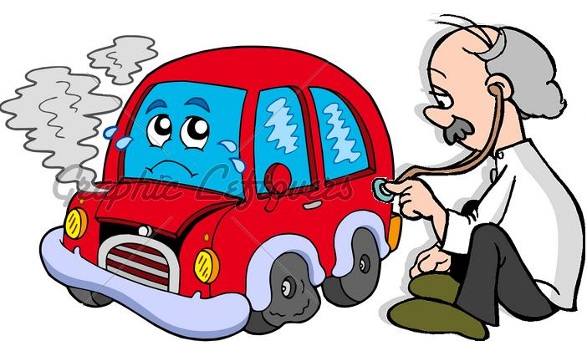

Basics of Diagnostics
Internal | Mary Thomas (RBEI/EEP1) | 13/1/2012 | © Robert Bosch India Ltd 2007. All rights reserved, also regarding any disposal, exploitation, reproduction, editing, distribution, as well as in the event of applications for industrial property rights.

Slide 2
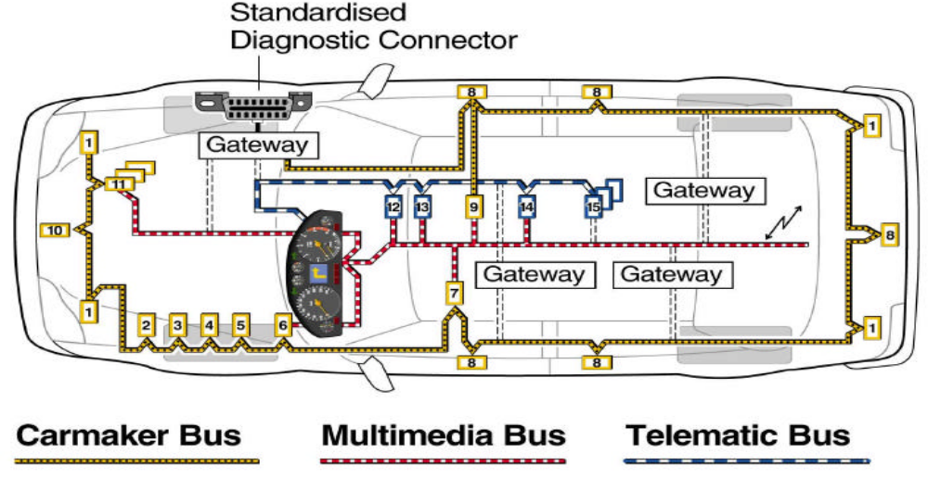
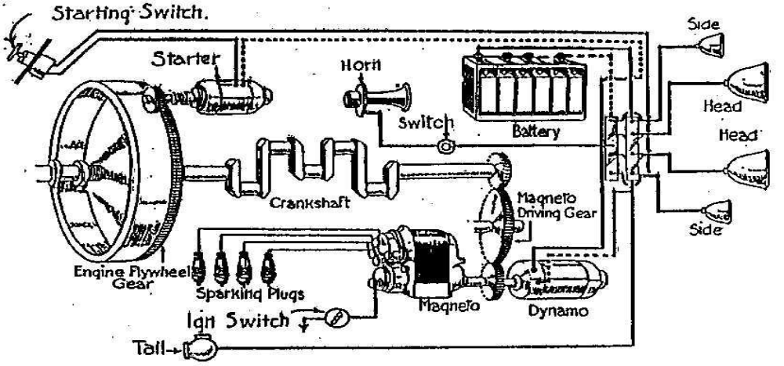
Basics of Diagnostics
Need for Protocols
Internal | Mary Thomas (RBEI/EEP1) | 13/1/2012 | © Robert Bosch India Ltd 2007. All rights reserved, also regarding any disposal, exploitation, reproduction, editing, distribution, as well as in the event of applications for industrial property rights.

Slide 3
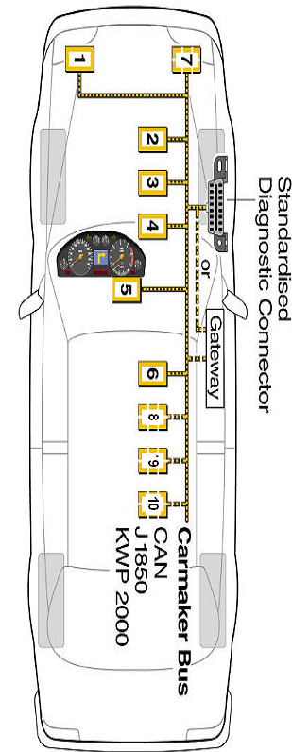
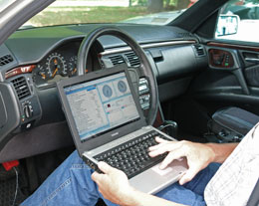
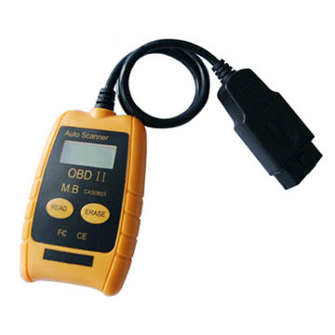
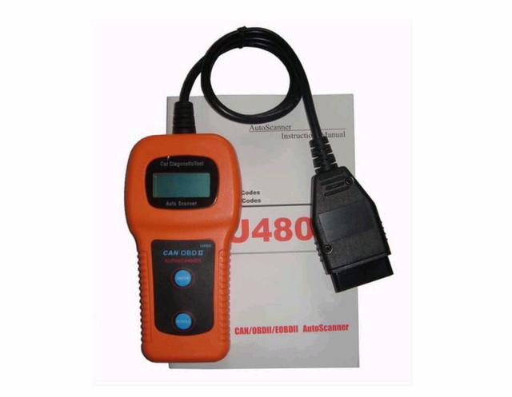
Basics of Diagnostics
Different Tester Tools:
Internal | Mary Thomas (RBEI/EEP1) | 13/1/2012 | © Robert Bosch India Ltd 2007. All rights reserved, also regarding any disposal, exploitation, reproduction, editing, distribution, as well as in the event of applications for industrial property rights.

Slide 4
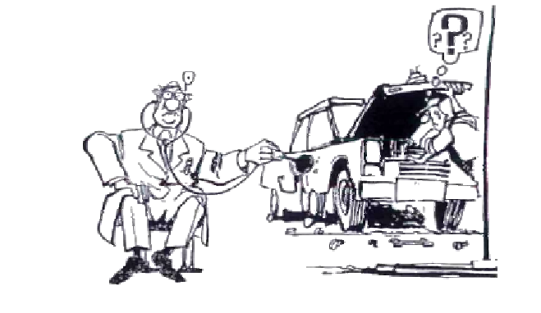
Basics of Diagnostics
Need for Diagnostics
Need
  To retrieve details of the Vehicle from the ECU (VIN, SW identification …)
  To retrieve detailed information on cause of a Fault
  To perform checks on actuators/sensors
  To update the SW or other configuration
  Component checks at service station through routines and tests
  Read values of certain memory locations
Internal | Mary Thomas (RBEI/EEP1) | 13/1/2012 | © Robert Bosch India Ltd 2007. All rights reserved, also regarding any disposal, exploitation, reproduction, editing, distribution, as well as in the event of applications for industrial property rights.

Slide 5
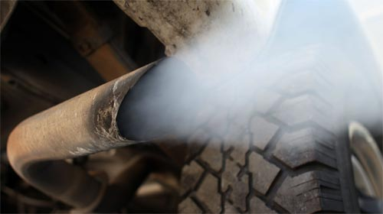
Basics of Diagnostics
Legislative Diagnostics (Emission)
Back in the 1970s, the newly established Environmental Protection Agency (EPA) issued standards for vehicle emissions that all American car manufacturers were required to meet.
On Board Diagnostics– ISO 15031
Internal | Mary Thomas (RBEI/EEP1) | 13/1/2012 | © Robert Bosch India Ltd 2007. All rights reserved, also regarding any disposal, exploitation, reproduction, editing, distribution, as well as in the event of applications for industrial property rights.

Slide 6
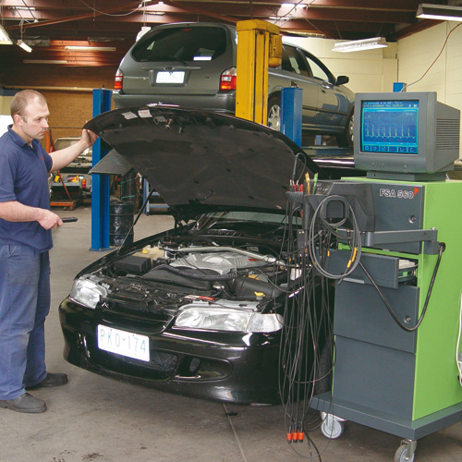
Basics of Diagnostics
Non-legislative Diagnostics (Enhanced diagnostics, OEM diagnostics)
e.g.
1) Key Word Protocol(KWP) – ISO 14230
2) Unified Diagnostic Services(UDS) – ISO 14229
Internal | Mary Thomas (RBEI/EEP1) | 13/1/2012 | © Robert Bosch India Ltd 2007. All rights reserved, also regarding any disposal, exploitation, reproduction, editing, distribution, as well as in the event of applications for industrial property rights.

Slide 7
Basics of Diagnostics
CAN IDs for Diagnostics
Every ECU in the system will have a dedicated CAN ID for communication with Tester and vice versa.
Tester
Request to ECU Receive signal
(eg 0x 7E0)
Engine
ECU
Respone from ECU Transmit signal
(eg 0x 7E8)
NOTE:
OBD diagnostics is done via different CAN ID!
Refer diag_prot_confdata.xml to get info on the CAN IDs for the given project.
Internal | Mary Thomas (RBEI/EEP1) | 13/1/2012 | © Robert Bosch India Ltd 2007. All rights reserved, also regarding any disposal, exploitation, reproduction, editing, distribution, as well as in the event of applications for industrial property rights.

Slide 8
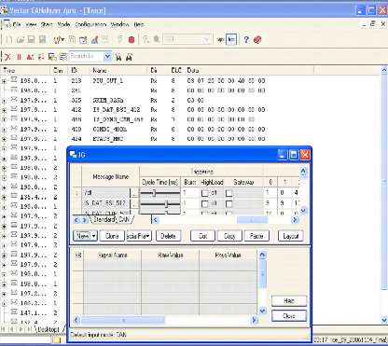
Basics of Diagnostics
Unit testing in Lab
CAN Analyser is used for testing Diagnostics.
Interactive generator (IG) of the CAN Analyser simulates the Tester.
The request to be transmitted to the ECU can be send via IG (through CAN ID eg: 0x7E0)
Response can be observed on the trace window! (through CAN ID eg: 0x7E8)
Internal | Mary Thomas (RBEI/EEP1) | 13/1/2012 | © Robert Bosch India Ltd 2007. All rights reserved, also regarding any disposal, exploitation, reproduction, editing, distribution, as well as in the event of applications for industrial property rights.

Slide 9
Addressing Methods
Basics of Diagnostics
1)Physical Addressing of ECU
0x7E0
ECU #1
0x7E8
Tester
Physical CAN IDRequest
(eg 7E0)
ECU #2
In the Physical Addressing Mode, unique Request and Response CAN IDs for each ECUs in the system.
Physical CAN IDResponse
(eg 7E8)
ECU #n-1
ECU #n
Internal | Mary Thomas (RBEI/EEP1) | 13/1/2012 | © Robert Bosch India Ltd 2007. All rights reserved, also regarding any disposal, exploitation, reproduction, editing, distribution, as well as in the event of applications for industrial property rights.

Slide 10
Addressing Methods
Basics of Diagnostics
2) Functional Addressing of ECU(optional)
0x7DF
ECU #1
0x7E8
For a given system, for functional addressing, the request CAN ID will be same for all the ECUs in a given system but response CAN IDs will be unique for each ECUs (Same as physical)
0x7DF
Tester
ECU #2
Funcational CAN IDRequest
(eg 7DF)
0x688
Physical CAN IDResponse of ECU #1
(eg 7E8)
0x7DF
Physical CAN IDResponse of ECU #2
(eg 688)
ECU #n-1
0x73F
Physical CAN IDResponse of ECU #n-1
(eg 73F)
0x7DF
ECU #n
0x2FF
Physical CAN IDResponse of ECU #n
(eg 2FF)
Suppose this ECU doesn’t support functional addressing
ECU remains silent
Internal | Mary Thomas (RBEI/EEP1) | 13/1/2012 | © Robert Bosch India Ltd 2007. All rights reserved, also regarding any disposal, exploitation, reproduction, editing, distribution, as well as in the event of applications for industrial property rights.

Slide 11
Request Format
Basics of Diagnostics
Eg: 0x7E0 02 11 01
Request Length | Service ID | Subservice ID | DATA 1 | DATA 2 | DATA 3 | DATA 4 | DATA 5
Positive Response Format
Response Length | Service ID + 0x40 | Subservice ID | DATA 1 | DATA 2 | DATA 3 | DATA 4 | DATA 5
Eg: 0x7E8 02 51 01
Internal | Mary Thomas (RBEI/EEP1) | 13/1/2012 | © Robert Bosch India Ltd 2007. All rights reserved, also regarding any disposal, exploitation, reproduction, editing, distribution, as well as in the event of applications for industrial property rights.

Slide 12
Basics of Diagnostics
Common Diagnostic Services
Internal | Mary Thomas (RBEI/EEP1) | 13/1/2012 | © Robert Bosch India Ltd 2007. All rights reserved, also regarding any disposal, exploitation, reproduction, editing, distribution, as well as in the event of applications for industrial property rights.

Slide 13
Diagnostic session control (i14229_dsc - $10)
Basics of Diagnostics
What is a diagnostic session?
diagnostic session is a defined ECU state which affects the level of diagnostic functionality by enabling a specific set of diagnostic services and/or functionality in the ECU.
Example: Defining a repair shop or development testing session selects different ECU functionality (e.g. access to all memory locations may only be allowed in the development testing session).
The vehicle manufacturer shall define the exact set of services and/or functionality enabled in each diagnostic session
Internal | Mary Thomas (RBEI/EEP1) | 13/1/2012 | © Robert Bosch India Ltd 2007. All rights reserved, also regarding any disposal, exploitation, reproduction, editing, distribution, as well as in the event of applications for industrial property rights.

Slide 14
Most commonly used session
Basics of Diagnostics
Default session $10 01
Programming session $ 10 02
  This diagnosticSession enables all diagnostic services required to support the memory programming of a ECU.
Extended session $10 03
  This diagnosticSession can be used for example to enable all diagnostic services required to support the adjustment of functions such as “Idle Speed”, “CO Value”, etc. in the ECU’s memory.
ECU always starts the default diagnostic session upon tester connection.
There shall always be exactly one diagnostic session active in a ECU upon connection of tester.
Internal | Mary Thomas (RBEI/EEP1) | 13/1/2012 | © Robert Bosch India Ltd 2007. All rights reserved, also regarding any disposal, exploitation, reproduction, editing, distribution, as well as in the event of applications for industrial property rights.

Slide 15
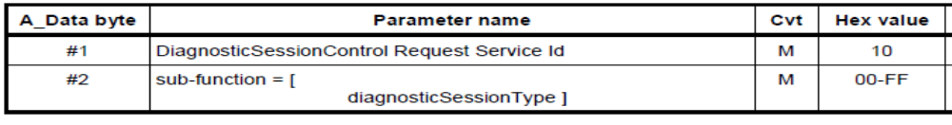
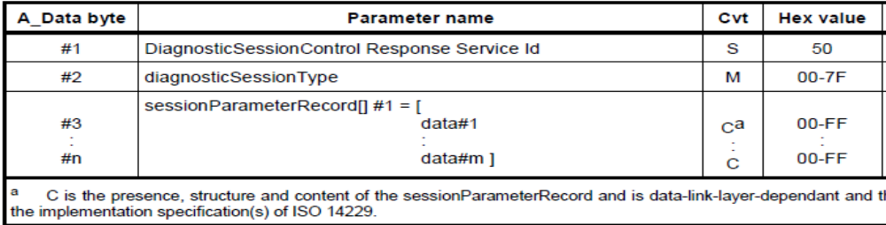
General Format
Basics of Diagnostics
Request
Response
Internal | Mary Thomas (RBEI/EEP1) | 13/1/2012 | © Robert Bosch India Ltd 2007. All rights reserved, also regarding any disposal, exploitation, reproduction, editing, distribution, as well as in the event of applications for industrial property rights.

Slide 16
Basics of Diagnostics
DefaultSession to DefaultSession (1)
  0000,7313 (Tx) 0x7E0 02 10 01 00 00 00 00 00 --- Request to Start Session 0x01 (Default Session)
  0000,7405 (Rx) 0x7E8 06 50 01 00 32 01 F4 00 --- Pos Resp to Start Session 0x01 (Default Session)
DefaultSession to any other session (2)
0002,3213 (Tx) 0x7E0 02 10 02 00 00 00 00 00 --- Request to Start Session 0x02 (Programming Session)
0002,3304 (Rx) 0x7E8 06 50 02 00 19 01 F4 00 --- Pos Resp to Start Session 0x02 (Programming Session)
Internal | Mary Thomas (RBEI/EEP1) | 13/1/2012 | © Robert Bosch India Ltd 2007. All rights reserved, also regarding any disposal, exploitation, reproduction, editing, distribution, as well as in the event of applications for industrial property rights.

Slide 17

Basics of Diagnostics
Security Access Issues
Internal | Mary Thomas (RBEI/EEP1) | 13/1/2012 | © Robert Bosch India Ltd 2007. All rights reserved, also regarding any disposal, exploitation, reproduction, editing, distribution, as well as in the event of applications for industrial property rights.

Slide 18
Seed and Key ( i14229_seca $27)
Basics of Diagnostics
What is security access and its need?
  Security is required to restrict access for sensitive information.
    Restrict access for data
    Restrict access for diagnostic services
  Diagnostic services for downloading/uploading routines or data into a ECU andreading specific memory locations from a ECU are situations where security access may be required
Internal | Mary Thomas (RBEI/EEP1) | 13/1/2012 | © Robert Bosch India Ltd 2007. All rights reserved, also regarding any disposal, exploitation, reproduction, editing, distribution, as well as in the event of applications for industrial property rights.

Slide 19
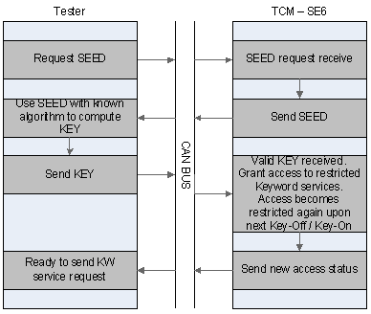
Basics of Diagnostics
Entering extended session
0x7E0 02 10 03 00 00 00 00 00 --- Request to Start Session 0x03 0x7E8 06 50 03 00 32 01 F4 00 --- Pos Resp to Start Session 0x03 (Extended Diag Session)
Requesting seed
0x7E0 02 27 01 00 00 00 00 00 --- Request Seed to Security Level 0x03
0x7E8 05 67 01 48 42 03 00 00 --- Pos Resp to Request Seed
Calculating key and sending
<<<<< Level: 01 Seed = 484203 Key = BB6446 >>>>>
0x7E0 05 27 02 BB 64 46 00 00 --- Key Submittal for Security Level 0x03
0x7E8 02 67 02 00 00 00 00 00 --- Pos Resp to Key (Access obtained)
Internal | Mary Thomas (RBEI/EEP1) | 13/1/2012 | © Robert Bosch India Ltd 2007. All rights reserved, also regarding any disposal, exploitation, reproduction, editing, distribution, as well as in the event of applications for industrial property rights.

Slide 20
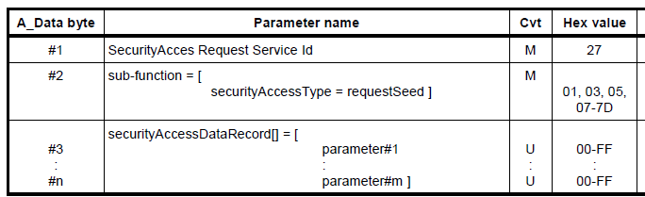
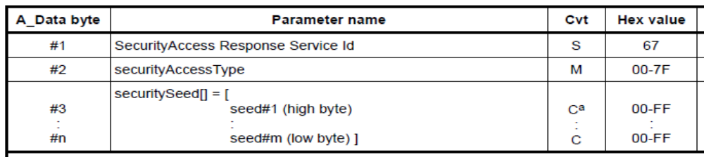
General Format
Basics of Diagnostics
Seed request - Always an odd sub service ID
Seed Response
Internal | Mary Thomas (RBEI/EEP1) | 13/1/2012 | © Robert Bosch India Ltd 2007. All rights reserved, also regarding any disposal, exploitation, reproduction, editing, distribution, as well as in the event of applications for industrial property rights.

Slide 21
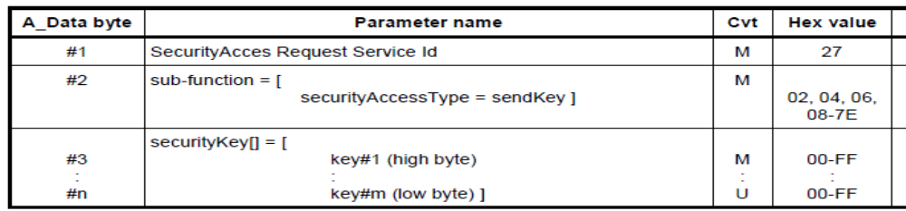
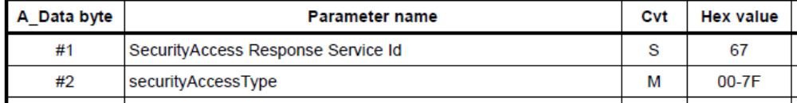
General Format
Basics of Diagnostics
Key request - Always an even Subservice ID
Validation of Key
Internal | Mary Thomas (RBEI/EEP1) | 13/1/2012 | © Robert Bosch India Ltd 2007. All rights reserved, also regarding any disposal, exploitation, reproduction, editing, distribution, as well as in the event of applications for industrial property rights.

Slide 22
Read Data By Identifier (i14229_rdbi $22)
Basics of Diagnostics
To read information Data from the ECU
DIDs (2 byte) are assigned to read a predefined value
Eg: DID 0x0303 - To read engine speed
DID 0xD100 - Current ECU session
03 | 22 | DID (High Byte) | DID (Low Byte) | 00 | 00 | 00 | 00
Internal | Mary Thomas (RBEI/EEP1) | 13/1/2012 | © Robert Bosch India Ltd 2007. All rights reserved, also regarding any disposal, exploitation, reproduction, editing, distribution, as well as in the event of applications for industrial property rights.

Slide 23
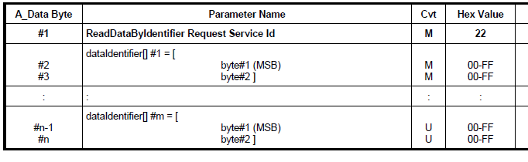
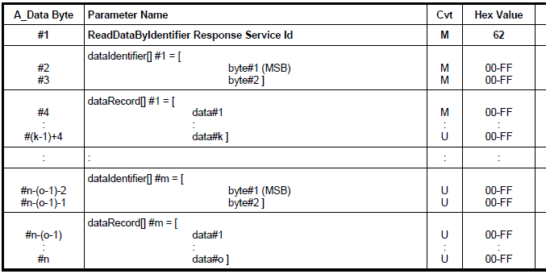
General Format
Basics of Diagnostics
Request Format
Response Format
Internal | Mary Thomas (RBEI/EEP1) | 13/1/2012 | © Robert Bosch India Ltd 2007. All rights reserved, also regarding any disposal, exploitation, reproduction, editing, distribution, as well as in the event of applications for industrial property rights.

Slide 24
Basics of Diagnostics
Requesting DID 0xD100
<<<<< Testing DID 0xD100 - Size = 1, Readable = Yes, Writeable = No, Write Data Present = No >>>>>
0x7E0 03 22 D1 00 00 00 00 00 --- Request to Read DataIdentifier 0xD100
0x7E8 04 62 D1 00 01 00 00 00 --- Pos Resp to Read DataIdentifier 0xD100
  The response indicates ECU is currently in Default session!
Requesting DID 0x0303
<<<<< Testing DID 0x0303 - Size = 2, Readable = Yes, Writeable = No, Write Data Present = No >>>>>
0001.7313 (Tx) 0x7E0 03 22 03 03 00 00 00 00 --- Request to Read DataIdentifier 0x0303
0001.7386 (Rx) 0x7E8 05 62 03 03 00 00 00 00 --- Pos Resp to Read DataIdentifier 0x0303
  The response indicates currently the engine speed is Zero!
Internal | Mary Thomas (RBEI/EEP1) | 13/1/2012 | © Robert Bosch India Ltd 2007. All rights reserved, also regarding any disposal, exploitation, reproduction, editing, distribution, as well as in the event of applications for industrial property rights.

Slide 25
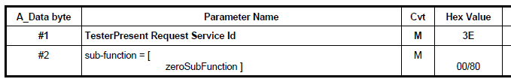

Tester Present (i14229_tpr - $3E)
Basics of Diagnostics
For all non default session, The session resets to default after a given period of time.
To avoid session reset Tester Present can be sent out periodically over CAN
Request Format
Response Format
Internal | Mary Thomas (RBEI/EEP1) | 13/1/2012 | © Robert Bosch India Ltd 2007. All rights reserved, also regarding any disposal, exploitation, reproduction, editing, distribution, as well as in the event of applications for industrial property rights.

Slide 26
InputOutputControlByIdentifier
(i14229_iocbi - $2F)
Basics of Diagnostics
Diagnostic service used to actuate and test the peripherals of an ECU during development /maintenance phase.
Basic use case is to test for the correct integration of ECU peripherals, e.g to check if MIL blinks correctly.
Also used for ‘fine-tuning’ of ECU behavior, without the need for removing ECU or its peripherals from the car
Internal | Mary Thomas (RBEI/EEP1) | 13/1/2012 | © Robert Bosch India Ltd 2007. All rights reserved, also regarding any disposal, exploitation, reproduction, editing, distribution, as well as in the event of applications for industrial property rights.

Slide 27
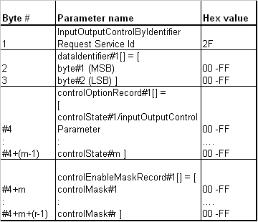


Request Format:
Basics of Diagnostics
Internal | Mary Thomas (RBEI/EEP1) | 13/1/2012 | © Robert Bosch India Ltd 2007. All rights reserved, also regarding any disposal, exploitation, reproduction, editing, distribution, as well as in the event of applications for industrial property rights.

Slide 28
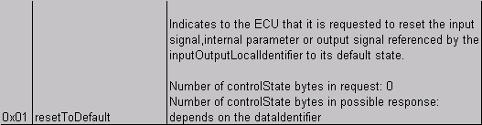
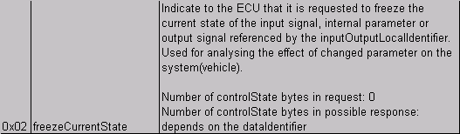
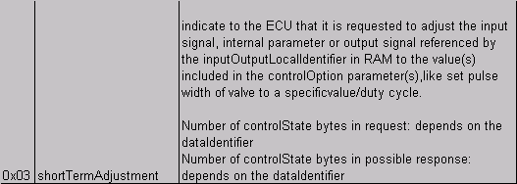
Control Option Record (3rd Parameter)
Basics of Diagnostics
0x7E0: 2F 01 32 01
0x7E8: 6F 01 32 01 4B
0x7E0: 2F 01 32 02
0x7E8: 6F 01 32 02 4B
0x7E0: 2F 01 32 03 64
0x7E8: 6F 01 32 03 64
Internal | Mary Thomas (RBEI/EEP1) | 13/1/2012 | © Robert Bosch India Ltd 2007. All rights reserved, also regarding any disposal, exploitation, reproduction, editing, distribution, as well as in the event of applications for industrial property rights.

Slide 29
Other Diagnostic services:
Basics of Diagnostics
Ecu Reset (11 hex) service
Communication Control (28 hex) service
Control DTC Setting (85 hex) service
ResponseOnEvent (86 hex) service
Read Memory By Address (23 hex) service
Read Data By Periodic Identifier (2A hex) service
Dynamically Define Data Identifier (2C hex) service
Write Data By Identifier (2E hex) service
Write Memory By Address (3D hex) service
Clear Diagnostic Information (14 hex) Service
Read DTC Information (19 hex) Service
Routine Control (31 hex) service
For more information refer PPT: \\Cob2fs01\NE1_Info_C\PROJECTS\EDC16C39_SW_GMI700\13_Info_Share\03_Diagnostics\UDS_Services_presentation.ppt
Internal | Mary Thomas (RBEI/EEP1) | 13/1/2012 | © Robert Bosch India Ltd 2007. All rights reserved, also regarding any disposal, exploitation, reproduction, editing, distribution, as well as in the event of applications for industrial property rights.

Slide 30
Suppress positive Response (Customer Specific)
Basics of Diagnostics
Positive response from an ECU can be suppressed by setting the MSB of subservice to 1
0x7E0 02 10 01
0x7E8 02 50 01
0x7E0 02 10 81 → MSB of Subservice byte is set
No response
0
0
0
0
0
0
0
1
1
0
0
0
0
0
0
1
Internal | Mary Thomas (RBEI/EEP1) | 13/1/2012 | © Robert Bosch India Ltd 2007. All rights reserved, also regarding any disposal, exploitation, reproduction, editing, distribution, as well as in the event of applications for industrial property rights.

Slide 31
Basics of Diagnostics
Negative Response Format
If the request transmitted to the ECU is incorrect:
Eg: 0x7E0 03 10 02 00
0x7E0 01 10
Response
length
7F
Service
ID
Negative
Response
Code (NRC)
Eg: 0x7E8 03 7F 10 13 → 13 indicating incorrect length
Commonly received NRCs:
0x11: Service not supported
0x12: SubService not supported
0x22: Precondition incorrect
0x31: Request Out of Range
Internal | Mary Thomas (RBEI/EEP1) | 13/1/2012 | © Robert Bosch India Ltd 2007. All rights reserved, also regarding any disposal, exploitation, reproduction, editing, distribution, as well as in the event of applications for industrial property rights.

Slide 32
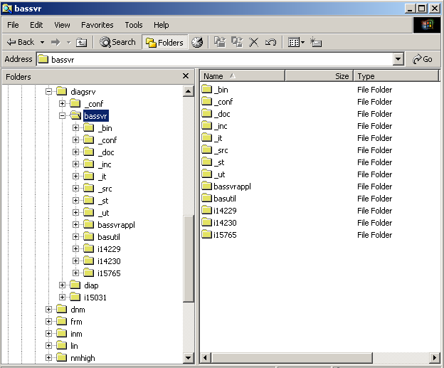
Services supported by the project
Basics of Diagnostics
Available in \\ComPtc\DComPtc\DiagCom_Distrib\diagcom_distrib_confdata.xml in SDOM
Available in \\com\diagsrv\_conf\diagcom_distrib_confdata.xml in Clearcase
Service implementation
Available in \\com\diagsrv\bassrv\i14229\ in Clearcase
Sub services supported
Present in the each service _conf folder in confdata file.
Internal | Mary Thomas (RBEI/EEP1) | 13/1/2012 | © Robert Bosch India Ltd 2007. All rights reserved, also regarding any disposal, exploitation, reproduction, editing, distribution, as well as in the event of applications for industrial property rights.

Slide 33
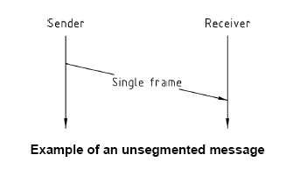
Single Frame Response
Occupant Safety
0x7DF | 3 | 22 | D1 | 0 | 0 | 0 | 0 | 0 | Request to Read DataIdentifier 0xD100
0x73F | 4 | 62 | D1 | 0 | 1 | 0 | 0 | 0 | Single Frame
Chassis Systems Control
Internal | CC-OS/EPM2 Wolff | 31/03/2010 | © Robert Bosch GmbH 2008. All rights reserved, also regarding any disposal, exploitation, reproduction, editing, distribution, as well as in the event of applications for industrial property rights.

Slide 34
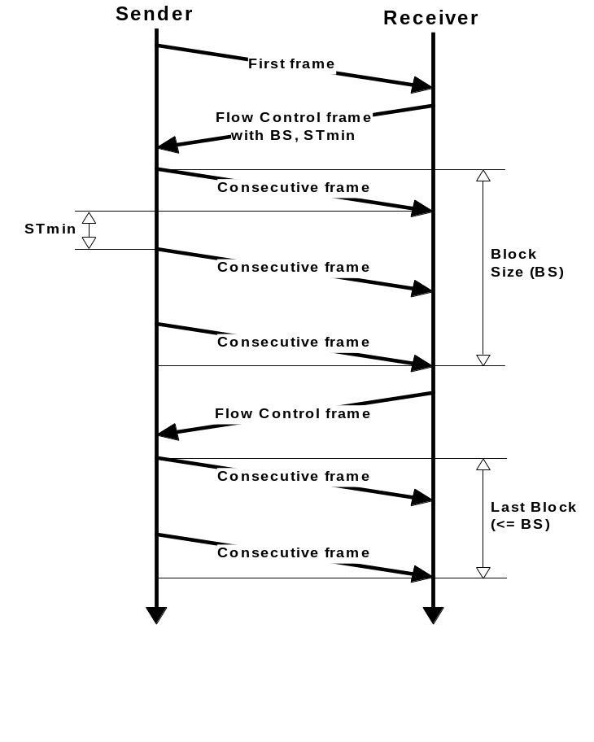
Multiple Frame Response
Occupant Safety
The response cannot be fitted into a single frame
Response length. (Max:0xFFF)
0x7DF | 3 | 22 | 58 | 18 | 0 | 0 | 0 | 0
0x7E8 | 1F | FF | 62 | 58 | 18 | FF | FF | FF
0x7E0 | 30 | 0 | 0 | 0 | 0 | 0 | 0 | 0
0x7E8 | 21 | FF | FF | FF | FF | FF | FF | FF
0x7E8 | 22 | FF | FF | FF | FF | FF | FF | FF
0x7E8 | 23 | FF | FF | FF | FF | FF | 1 | FF
0x7E8 | 24 | FF | FF | FF | FF | FF | FF | FF
First Frame
The first nibble 3 indicates it is flow control
Flow Control
Frame
Consecutive
Frames
For re-organisation of the frames at the receiver end.
Chassis Systems Control
Internal | CC-OS/EPM2 Wolff | 31/03/2010 | © Robert Bosch GmbH 2008. All rights reserved, also regarding any disposal, exploitation, reproduction, editing, distribution, as well as in the event of applications for industrial property rights.

Slide 35
Doubts??
Basics of Diagnostics
Internal | Mary Thomas (RBEI/EEP1) | 13/1/2012 | © Robert Bosch India Ltd 2007. All rights reserved, also regarding any disposal, exploitation, reproduction, editing, distribution, as well as in the event of applications for industrial property rights.

Slide 36
Thank You!
Basics of Diagnostics
Internal | Mary Thomas (RBEI/EEP1) | 13/1/2012 | © Robert Bosch India Ltd 2007. All rights reserved, also regarding any disposal, exploitation, reproduction, editing, distribution, as well as in the event of applications for industrial property rights.

