Slide 1

HOW TO READ HEXDUMP – Introduction

Slide 2
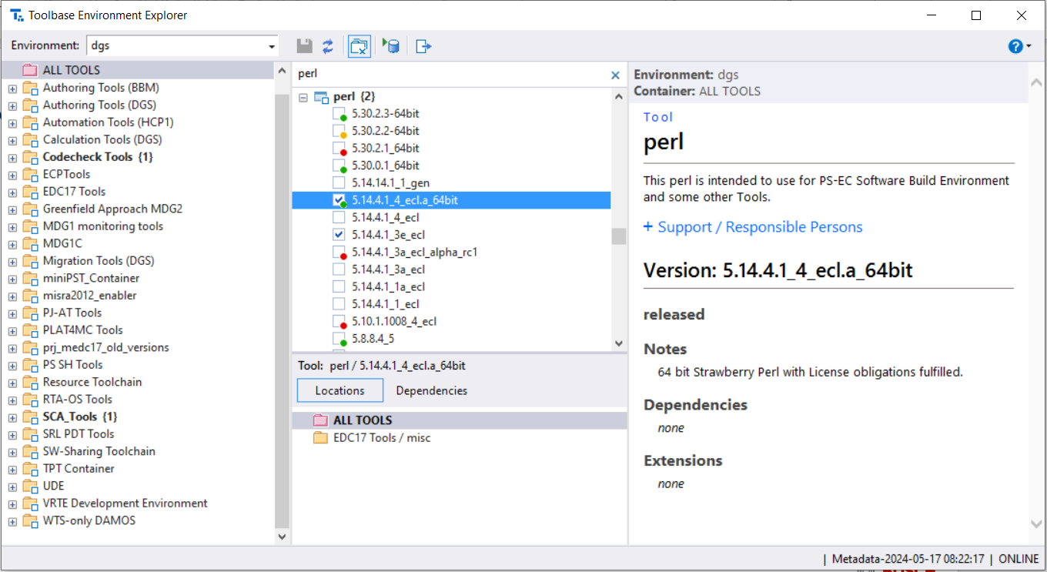
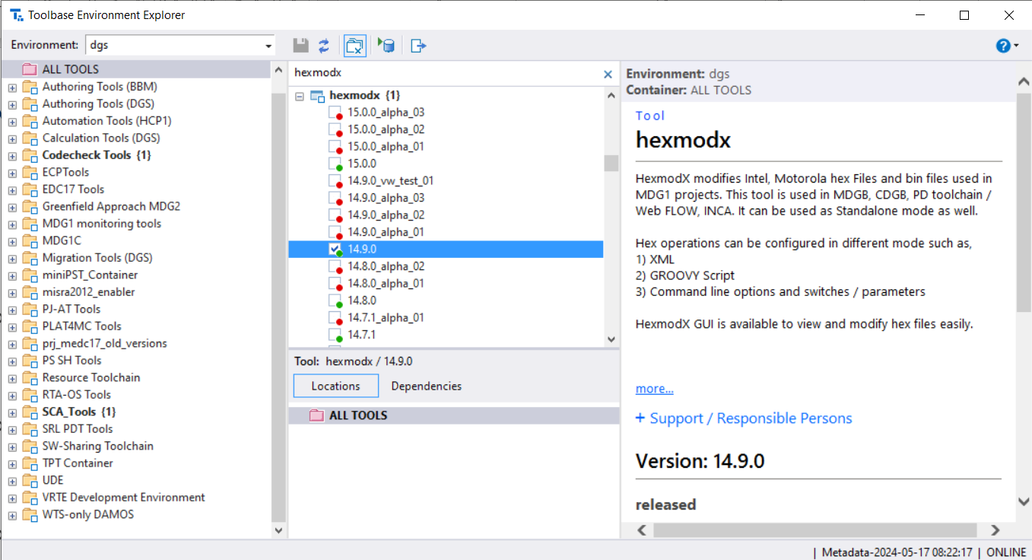
INSTALLATION
Flash Programming - Introduction
Perl (toolbase)
Hexmodx (toolbase)
rba_FeeFs2_Dump (local)
2
Internal | RBEI/NE3-EC-CoE-COM | 2018-05-31
© Robert Bosch Engineering and Business Solutions Private Limited 2018. All rights reserved, also regarding any disposal, exploitation, reproduction, editing, distribution, as well as in the event of applications for industrial property rights.
Notes:
(*) Processor core local SRAM available for MDG1 controllers

Slide 3
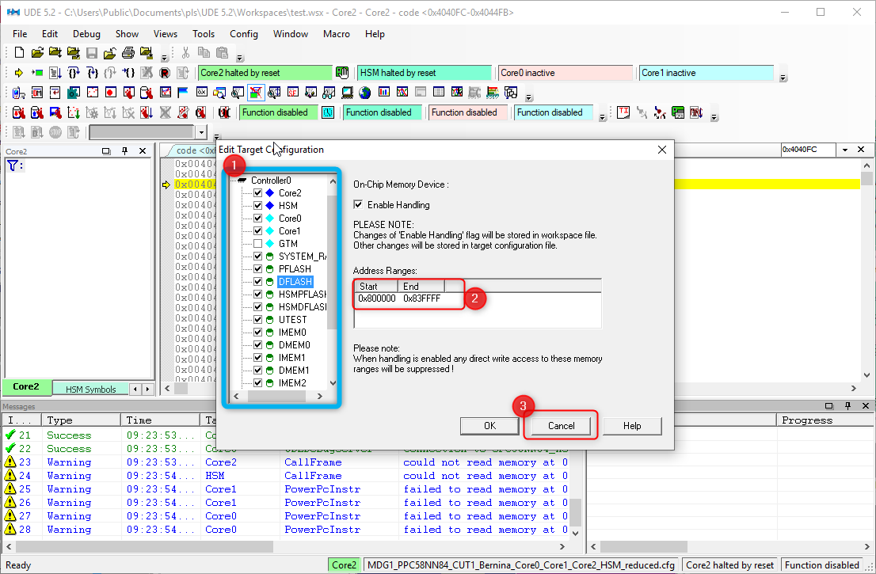
1) Create HEX file from D-Flash
Flash Programming - Introduction
3
Internal | RBEI/NE3-EC-CoE-COM | 2018-05-31
© Robert Bosch Engineering and Business Solutions Private Limited 2018. All rights reserved, also regarding any disposal, exploitation, reproduction, editing, distribution, as well as in the event of applications for industrial property rights.

Slide 4
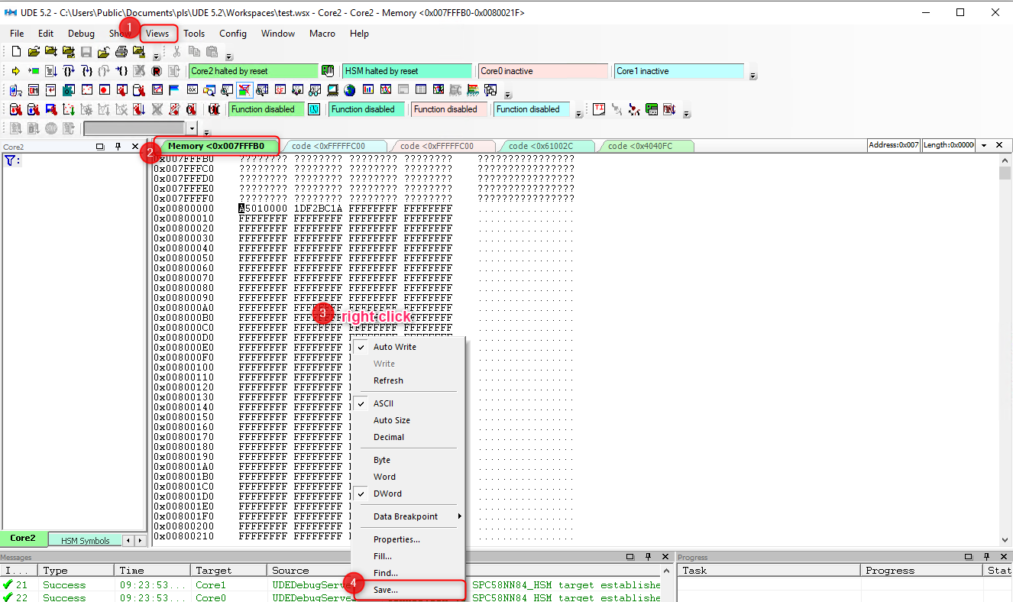
1) Create HEX file from D-Flash
Flash Programming - Introduction
3
Internal | RBEI/NE3-EC-CoE-COM | 2018-05-31
© Robert Bosch Engineering and Business Solutions Private Limited 2018. All rights reserved, also regarding any disposal, exploitation, reproduction, editing, distribution, as well as in the event of applications for industrial property rights.

Slide 5
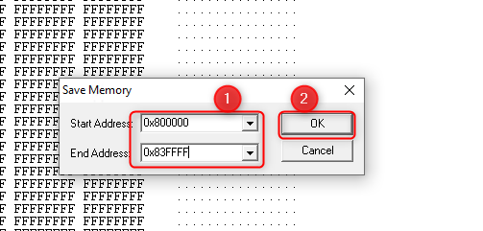
1) Create HEX file from D-Flash
Flash Programming - Introduction
3
Internal | RBEI/NE3-EC-CoE-COM | 2018-05-31
© Robert Bosch Engineering and Business Solutions Private Limited 2018. All rights reserved, also regarding any disposal, exploitation, reproduction, editing, distribution, as well as in the event of applications for industrial property rights.

Slide 6
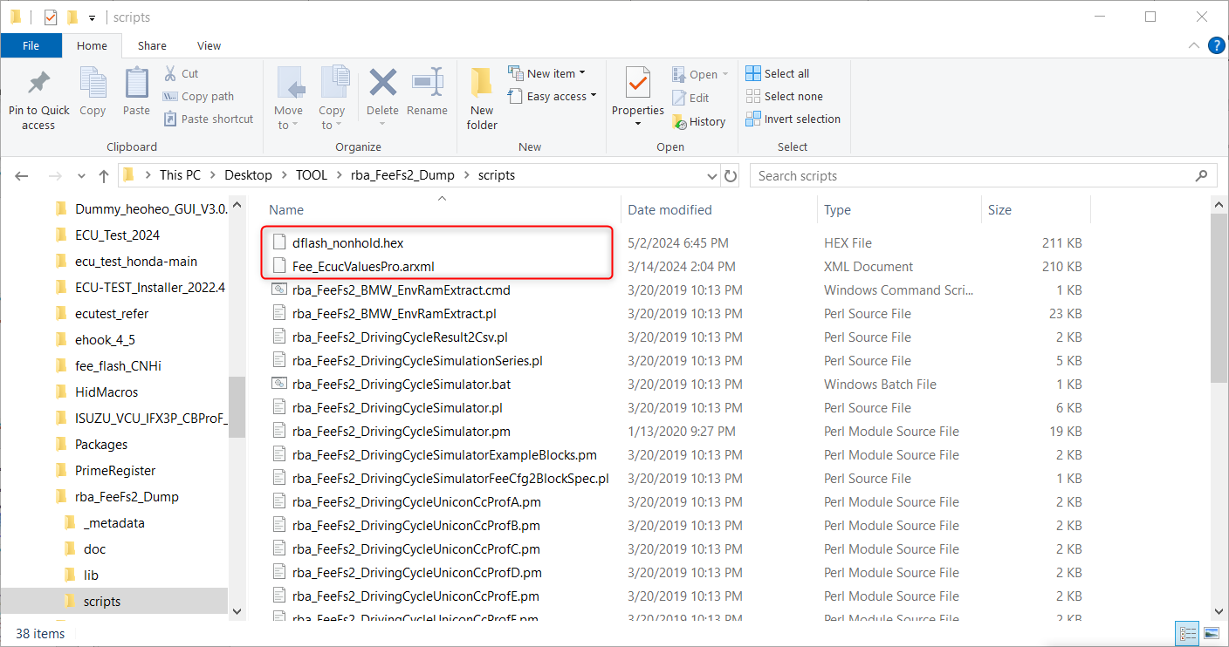
2) Analysing Hex file
Flash Programming - Introduction
Copy Hex file into rba_FeeFs2_Dump\scripts folder
Copy Fee_ecuValuesPro.arxml from PVER
4
Internal | RBEI/NE3-EC-CoE-COM | 2018-05-31
© Robert Bosch Engineering and Business Solutions Private Limited 2018. All rights reserved, also regarding any disposal, exploitation, reproduction, editing, distribution, as well as in the event of applications for industrial property rights.

Slide 7
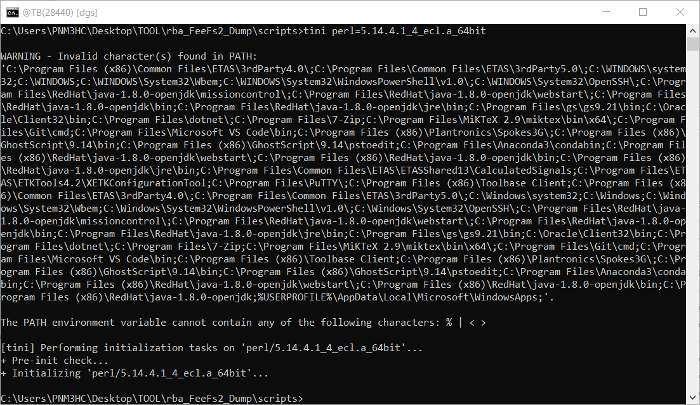
2) Analysing Hex file
Flash Programming - Introduction
Open cmd at current path
Run command: tini perl=5.14.4.1_4_ecl.a_64bit
4
Internal | RBEI/NE3-EC-CoE-COM | 2018-05-31
© Robert Bosch Engineering and Business Solutions Private Limited 2018. All rights reserved, also regarding any disposal, exploitation, reproduction, editing, distribution, as well as in the event of applications for industrial property rights.

Slide 8
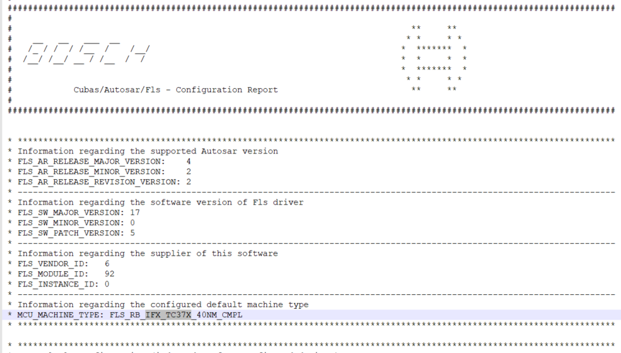
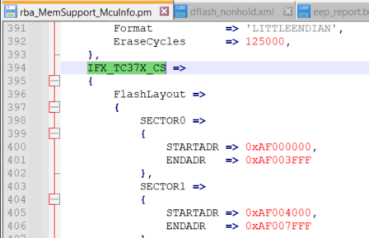
2) Analysing Hex file
Flash Programming - Introduction
Find MCU type info in Fls_Report.txt (PVER) and rba_MemSupport_McuInfo.pm (scripts)
4
Internal | RBEI/NE3-EC-CoE-COM | 2018-05-31
© Robert Bosch Engineering and Business Solutions Private Limited 2018. All rights reserved, also regarding any disposal, exploitation, reproduction, editing, distribution, as well as in the event of applications for industrial property rights.

Slide 9
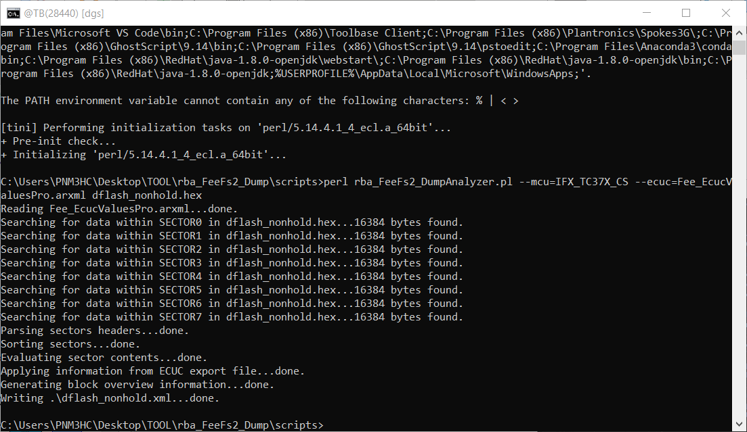
2) Analysing Hex file
Flash Programming - Introduction
Run command: perl rba_FeeFs2_DumpAnalyzer.pl –-mcu=IFX_TC37X_CS --ecuc=Fee_EcucValuesPro.arxml dflash_nonhold.hex (Change name of mcu and hex file)
4
Internal | RBEI/NE3-EC-CoE-COM | 2018-05-31
© Robert Bosch Engineering and Business Solutions Private Limited 2018. All rights reserved, also regarding any disposal, exploitation, reproduction, editing, distribution, as well as in the event of applications for industrial property rights.

Slide 10
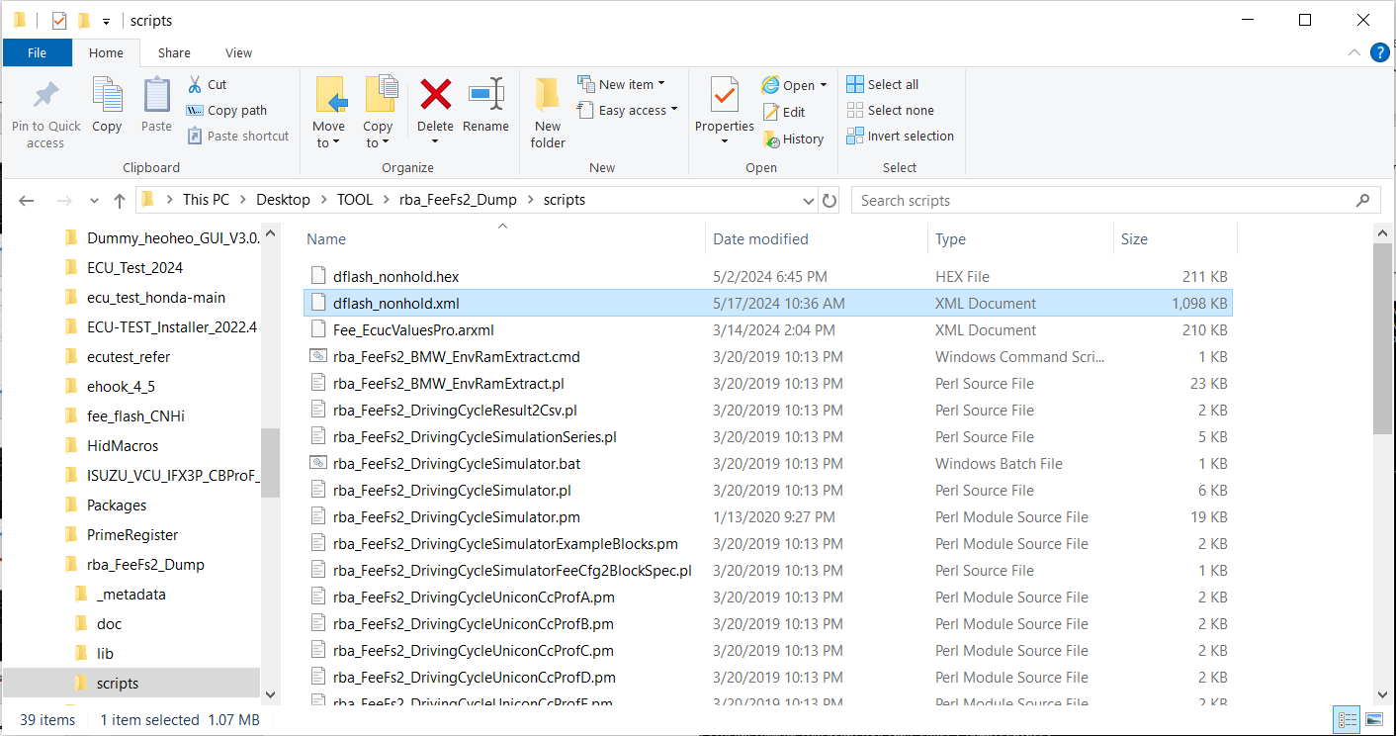
2) Analysing Hex file
Flash Programming - Introduction
Output file
4
Internal | RBEI/NE3-EC-CoE-COM | 2018-05-31
© Robert Bosch Engineering and Business Solutions Private Limited 2018. All rights reserved, also regarding any disposal, exploitation, reproduction, editing, distribution, as well as in the event of applications for industrial property rights.

Slide 11
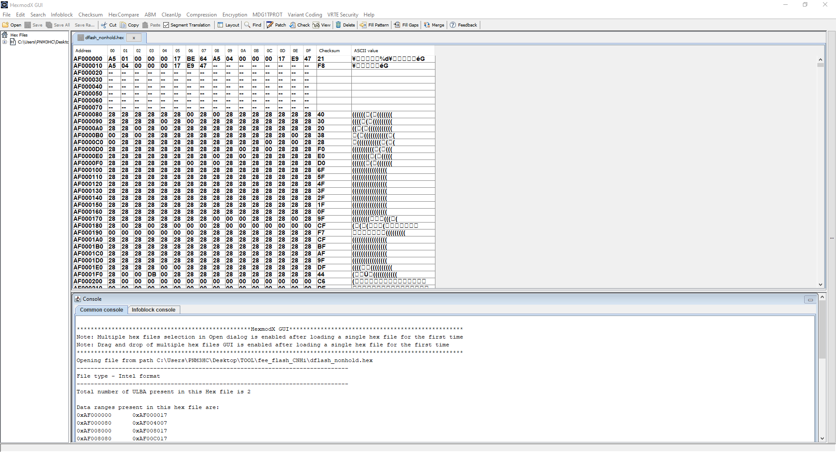
3) Hexdump
Flash Programming - Introduction
Run GUI.bat in
C:\toolbase\hexmodx\14.9.0\HexmodXGUI
Open hex file in HexmodX tool.
4
Internal | RBEI/NE3-EC-CoE-COM | 2018-05-31
© Robert Bosch Engineering and Business Solutions Private Limited 2018. All rights reserved, also regarding any disposal, exploitation, reproduction, editing, distribution, as well as in the event of applications for industrial property rights.

Slide 12
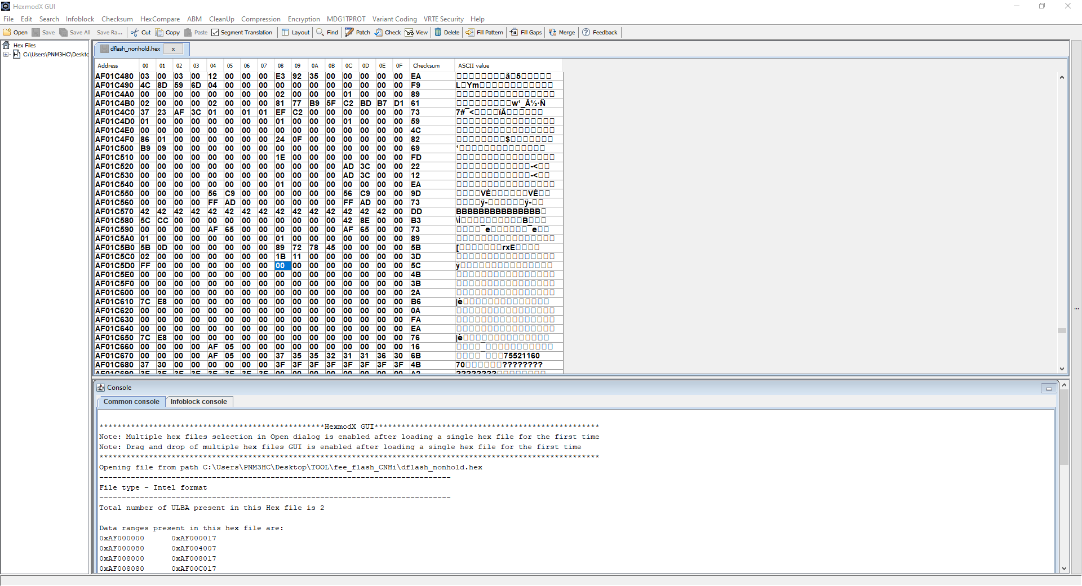
3) Hexdump
Flash Programming - Introduction
Search the Block name in rba_EepAdaptDGS_Report.txt
Search the Block’s address in output xml file.
Replace data in destination address and surrounding address.
Save the new hex file.
4
Internal | RBEI/NE3-EC-CoE-COM | 2018-05-31
© Robert Bosch Engineering and Business Solutions Private Limited 2018. All rights reserved, also regarding any disposal, exploitation, reproduction, editing, distribution, as well as in the event of applications for industrial property rights.

Slide 13

Thank you

