Slide 1

Agenda
Message Implementation
SIO overview
Software flow of RX/TX message
Working flow for adding new messages
Conversion
Huynh Mai Phuoc Loc | 21/07/2014 | © Robert Bosch Engineering and Business Solutions Limited 2014. All rights reserved, also regarding any disposal, exploitation, reproduction, editing, distribution, as well as in the event of applications for industrial property rights.

Slide 2
SIO
SIO Overview
Application
avi
CSP
SMI
SMO
Application
Layer
Netlib
SIO
hrz
Monitoring
Diagnostics
CSPL
Pdu mon
COM
XCP
dec
pgc
Interaction
Layer
I-PDU
I-PDUM
PDUR
DCM
ComM
NM
ISOTP15765 -2
Network Layer
N-PDU
<C> TP
<C> SM
CAN/FLEXRAY
<C IF >
Data link layer
L-PDU
C- Driver
C-Controller
Department | 21/07/2014 | © Robert Bosch Engineering and Business Solutions Limited 2014. All rights reserved, also regarding any disposal, exploitation, reproduction, editing, distribution, as well as in the event of applications for industrial property rights.

Slide 3
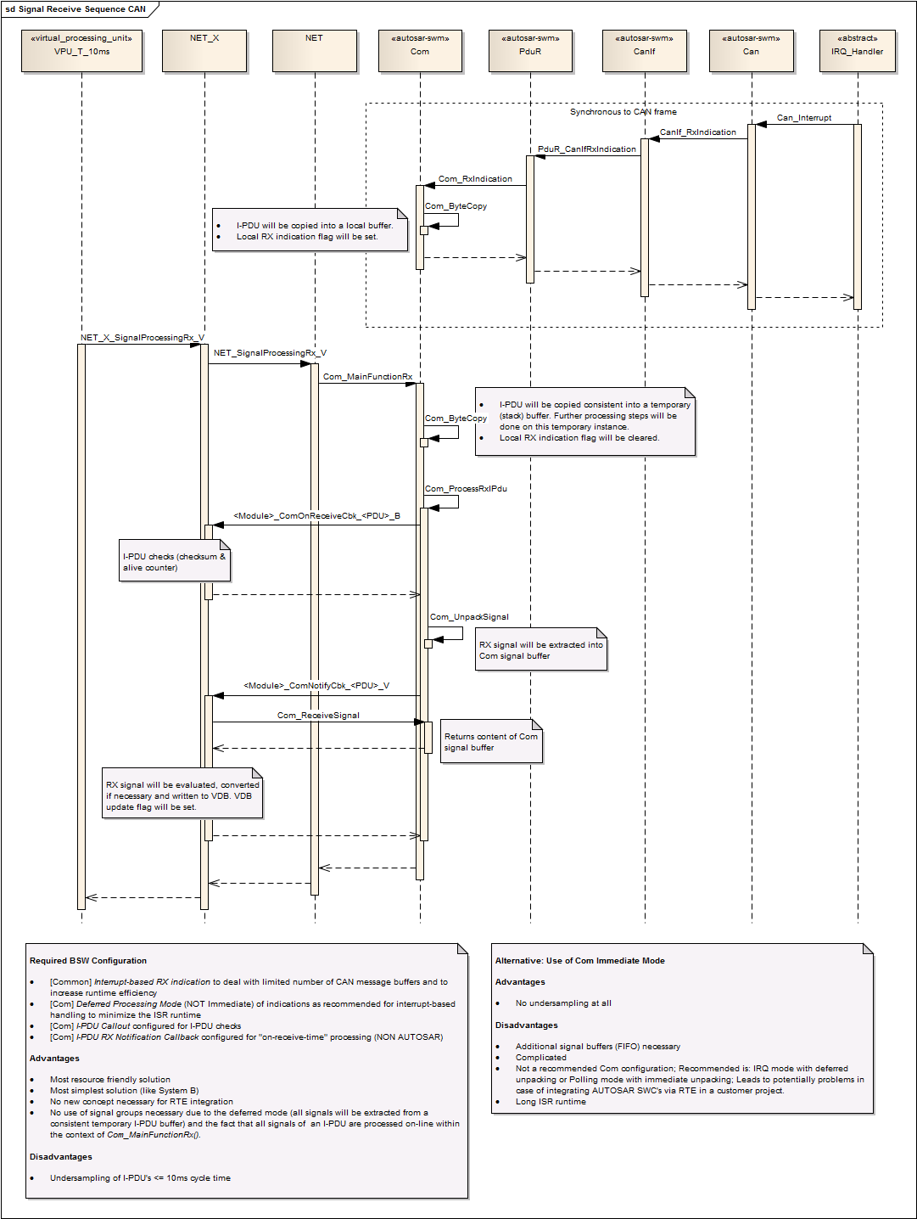
Flow of RX message
Huynh Mai Phuoc Loc | 21/07/2014 | © Robert Bosch Engineering and Business Solutions Limited 2014. All rights reserved, also regarding any disposal, exploitation, reproduction, editing, distribution, as well as in the event of applications for industrial property rights.

Slide 4
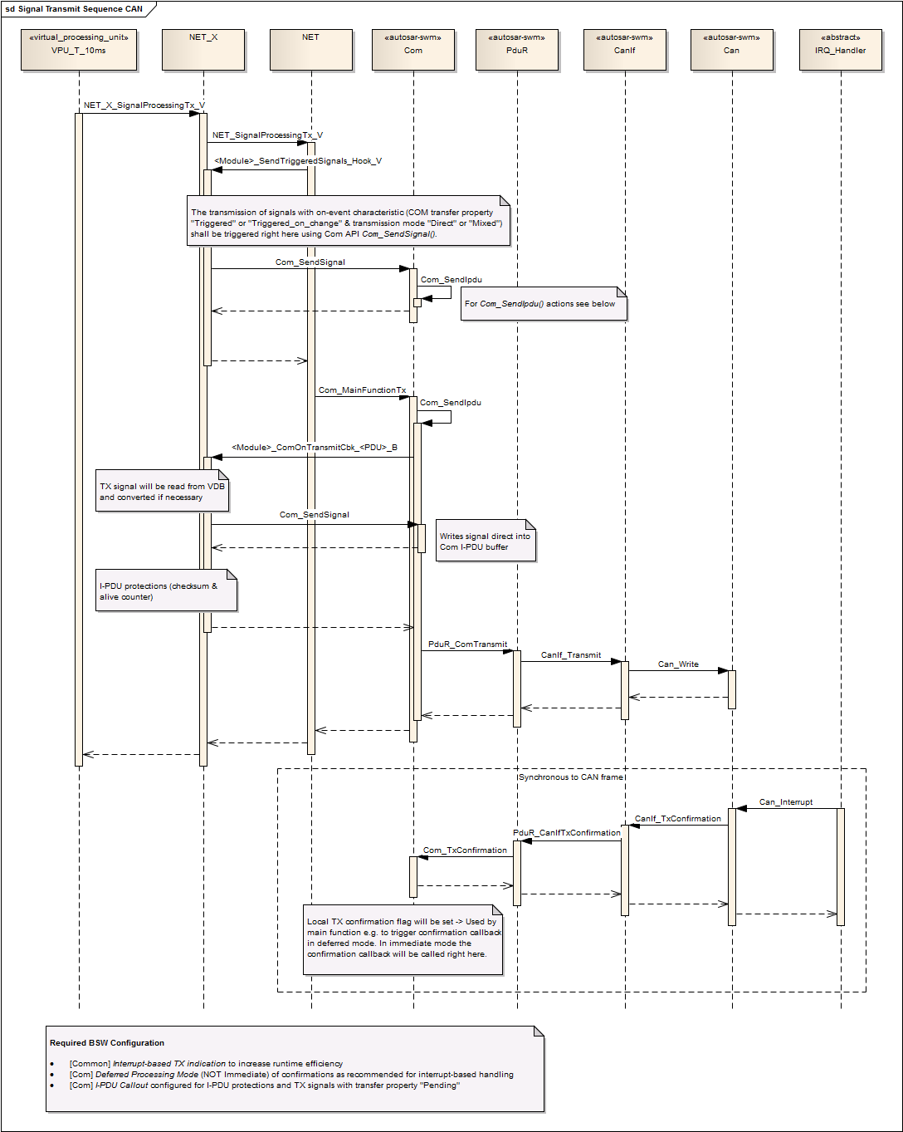
Flow of TX message
Huynh Mai Phuoc Loc | 21/07/2014 | © Robert Bosch Engineering and Business Solutions Limited 2014. All rights reserved, also regarding any disposal, exploitation, reproduction, editing, distribution, as well as in the event of applications for industrial property rights.

Slide 5
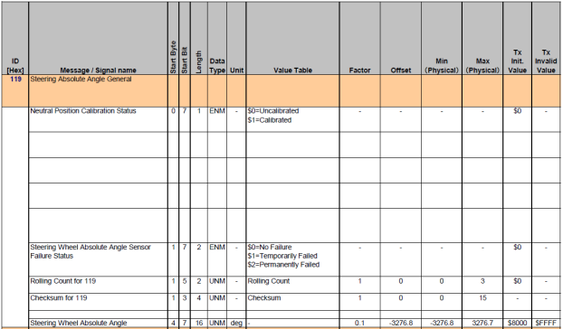
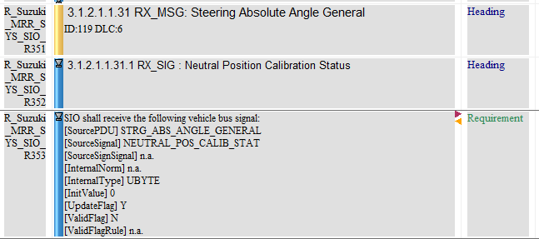
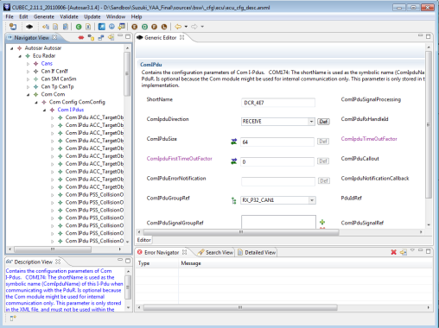
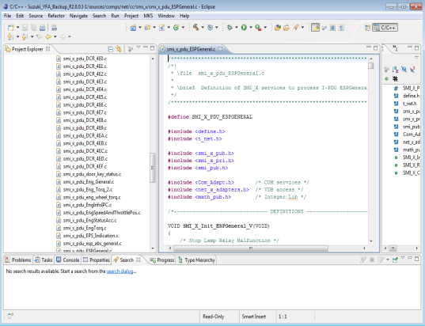
Working flow for adding new messages
Huynh Mai Phuoc Loc
1. Requirement gathering
2. Update product requirement
3. CUBEC configuration
4. Coding
Department | 21/07/2014 | © Robert Bosch Engineering and Business Solutions Limited 2014. All rights reserved, also regarding any disposal, exploitation, reproduction, editing, distribution, as well as in the event of applications for industrial property rights.

Slide 6
Raw value to physical value
Conversion
Physical value = Raw value * Bus factor + Offset
?
Ego velocity: min = -50km/h; max = 150km/h
Can signal: 10 bits
→ Appropriate Bus factor, Offset ?
Huynh Mai Phuoc Loc | 21/07/2014 | © Robert Bosch Engineering and Business Solutions Limited 2014. All rights reserved, also regarding any disposal, exploitation, reproduction, editing, distribution, as well as in the event of applications for industrial property rights.

Slide 7
Physical value to VDB value
Conversion
For RX message:
VDB value = (Physical value * Norm) * Conversion Factor
For TX message:
VDB value = (Physical value * Norm) / Conversion Factor
Ego velocity: min = -50km/h; max = 150km/h
VDB type: SWORD,
Conversion factor: 0.625 (miles/h)
→ Appropriate Norm ?
?

Slide 8
Q & A
Thank you

