Slide 1

PDU Monitoring overview pol1hc

Slide 2
Agenda: 1. OVERVIEW 2. Time out 3. DLc 4. alive counter 5. Checksum 6. Bus-off

Slide 3
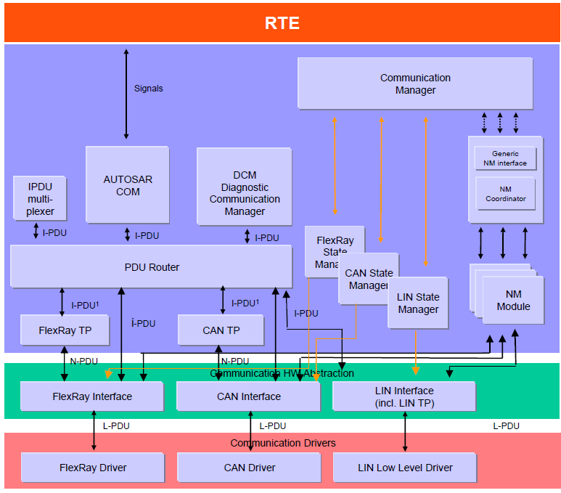
1. OVERVIEW
PDU MONITORING
Monitoring is a part of Communication.
Make sure for Communication
Failure shall be detected.
Failure handling for Communication shall be
triggered.
Why is required?
Monitoring whether Each RX/TX Message is received within specified cycle time and report to DEM (Diagnostic Error Management) for fault logging.
Checking for Checksum and Message Counter as per the algorithm defined by OEM.
3
Phan Hai Long RBVH/ESS1 | 2018-04-17
© Robert Bosch GmbH 2018. All rights reserved, also regarding any disposal, exploitation, reproduction, editing, distribution, as well as in the event of applications for industrial property rights.

Slide 4
2. Time out
PDU MONITORING
The communication concept for application data shall support RX timeout monitoring.
It shall be monitored whether an Cyclic Event PDU is received within the specific cycle time.
In case of Request & Response concept: It shall be monitored whether an Response PDU is received within the specific response time.
An RX timeout failure shall be reported to the error management.
The communication concept for application data shall support TX timeout monitoring.
It shall be monitored whether vehicle bus resources can be allocated during the next possible transmission slot after a TX request.
It shall be monitored whether vehicle bus resources can be allocated within 50ms after a TX request at the latest, respectively until the subsequent request (if < 50ms).
TX timeout failure shall be reported to the error management.
4
Phan Hai Long RBVH/ESS1 | 2018-04-17
© Robert Bosch GmbH 2018. All rights reserved, also regarding any disposal, exploitation, reproduction, editing, distribution, as well as in the event of applications for industrial property rights.

Slide 5
2. Time out
Radar
Node
Radar
Node
Rx
Tx
Estimated time Radar will receive message
Cycle time of message
Cycle time of message
Rx
Tx
Estimated time Radar will send message
Rx
Tx
If Radar don’t receive message after estimated time, RX timeout failure shall be reported to the error management
If Radar don’t send the message after estimated time, TX timeout failure shall be reported to the error management

Slide 6
3. DLC check
PDU MONITORING
The DLC of the received L-PDU is compared with the expected, statically configured DLC for the received L-PDU. All CAN L-PDUs with a DLC equal or greater then the expected DLC will be accepted.
5
Phan Hai Long RBVH/ESS1 | 2018-04-17
© Robert Bosch GmbH 2018. All rights reserved, also regarding any disposal, exploitation, reproduction, editing, distribution, as well as in the event of applications for industrial property rights.

Slide 7
4. Alive Counter
PDU MONITORING
Use for Validity of PDUs classified as ASIL A or higher
In case of Cyclic Events communication concept a sequence counter mechanism shall be applied.
A receiver shall check for the expected counter value.
A receiver shall not check the first received counter value after startup, RX timeout- or CRC failure. The received counter value shall just be stored in this case.
If a sequence counter fails on receiver side the payload data shall be discarded.
A sequence counter failure shall be reported to the error management.
6
Phan Hai Long RBVH/ESS1 | 2018-04-17
© Robert Bosch GmbH 2018. All rights reserved, also regarding any disposal, exploitation, reproduction, editing, distribution, as well as in the event of applications for industrial property rights.

Slide 8
4. Alive Counter
Example: 4 bit sequence counter, jump width shall be 1( if the first value is 0, the next expected value is 1)
Radar
Node A
Rx
Don’t check the first value → 0
First sequence counter (this value is 0)
Rx
1
1
=!2
Rx
2
A sequence counter failure shall be reported to the error management and the payload data shall be discarded

Slide 9
5. Checksum
PDU MONITORING
Application CRC (Valid for PDUs classified as ASIL A or higher)
A PDU based cyclic redundancy check shall be applied.
If a CRC fails on receiver side the payload data shall be discarded (signal values will not be updated to VDB).
A CRC failure shall be reported to the error management.
The CRC failure shall be qualified with respect to the required error detection time of 150ms.
7
Phan Hai Long RBVH/ESS1 | 2018-04-17
© Robert Bosch GmbH 2018. All rights reserved, also regarding any disposal, exploitation, reproduction, editing, distribution, as well as in the event of applications for industrial property rights.

Slide 10
5. Checksum
Radar
Node A
Rx
RX will calculate the CRC value from the PDU received and compare with CRC value packaged.
Sender calculate CRC value from PDU data and package this value inside the CRC byte
Rx
A CRC failure shall be reported if the value CRC calculated in Radar don’t map with CRC calculated in TX

Slide 11
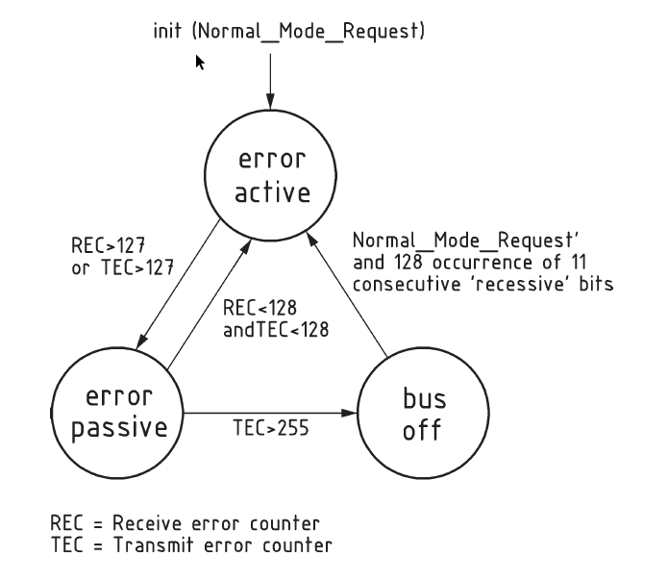
6. Bus-off
Transmitter Error Counter
Receiver Error Counter
ECU will be Bus-off If TEC > 255. Then Transmission will be disable. A Bus-off failure shall be reported
to the error management

Slide 12
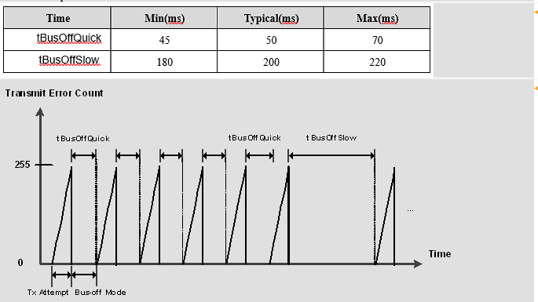
6. Bus-off Recovery
When Bus-Off occur a time L1,CAN controller shall be reset communication to try send out message. This behaviour shall be performed in specific times. It’s called Bus-off Quick recovery After that, Bus-off Slow Recovery happened will time L2 > L1 until Bus-off recovery,

Slide 13
Error Detection Time, Error Healing Time
Error Detection Time is the time from Radar receive the latest message to at the time event fault triggered
Error Healing Time is the time when the event fault triggered to the time the fault be heal

