Slide 1

SDU topic
Agenda:
Overview: SDU sub-system, CDE component and DAL component
DEM
Filtering
De-bouncing
RBVH/ESS1 | 15/05/2015 | © Robert Bosch Engineering and Business Solutions Vietnam Company Limited 2015. All rights reserved, also regarding any disposal, exploitation, reproduction, editing, distribution, as well as in the event of applications for industrial property rights.

Slide 2
Overview
SDU topic
Veh. Bus
(e.g. CAN)
Radar
Sensor
HW
Information Condensation
object model
ego veh. model
env. model
raw meas. data
(time signals)
locations
traffic situation
RP-trigger
internal
„set point values“
veh. bus
output msg
DSP
EHY
SIT
FCT
RPM
SIO
radar control
*
*
*
*
*
*
FSI subsystems (SIO, SDU, SMU, SRU)
* = e.g. veh. bus input, error mgmt data, diagnostic data, unavailability data, system resources access
RBVH/ESS1 | 15/05/2015 | © Robert Bosch Engineering and Business Solutions Vietnam Company Limited 2015. All rights reserved, also regarding any disposal, exploitation, reproduction, editing, distribution, as well as in the event of applications for industrial property rights.

Slide 3
Overview
SDU topic
Potential Failures in all parts of System
Veh. Bus
(e.g. CAN)
Radar
Sensor
HW
object model
ego veh. model
env. model
raw meas. data
(time signals)
locations
traffic situation
RP-trigger
internal
„set point values“
veh. bus
output msg
DSP
EHY
SIT
FCT
RPM
SIO
radar control
*
*
*
*
*
*
FSI subsystems (SIO, SDU, SMU, SRU)
* = e.g. veh. bus input, error mgmt data, diagnostic data, unavailability data, system resources access
RBVH/ESS1 | 15/05/2015 | © Robert Bosch Engineering and Business Solutions Vietnam Company Limited 2015. All rights reserved, also regarding any disposal, exploitation, reproduction, editing, distribution, as well as in the event of applications for industrial property rights.

Slide 4
Overview
SDU topic
A fault is an abnormal condition in a component
Faults can cause errors, which are anomalies in the internal state of a system.
Errors lead to failures when the erroneous state becomes exposed externally as erroneous output
A failure is an event that occurs when a system does not behave according to its specification. Failures result from faults and errors
RBVH/ESS1 | 15/05/2015 | © Robert Bosch Engineering and Business Solutions Vietnam Company Limited 2015. All rights reserved, also regarding any disposal, exploitation, reproduction, editing, distribution, as well as in the event of applications for industrial property rights.

Slide 5
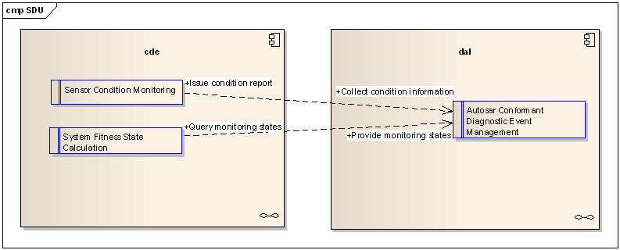
Overview
SDU topic
SDU (Self Diagnostic Unit):
Condition and Degradation Evaluation (CDE)
Dem Adaption Layer (DAL)
RBVH/ESS1 | 15/05/2015 | © Robert Bosch Engineering and Business Solutions Vietnam Company Limited 2015. All rights reserved, also regarding any disposal, exploitation, reproduction, editing, distribution, as well as in the event of applications for industrial property rights.

Slide 6
Overview
SDU topic
CDE:
Responsible for evaluation and monitoring of system condition and system degradation states/levels
System Fitness State: mapping between Diagnostic events, Function IDs, Failure Classes and System Fitness State.
Sensor Condition Monitoring:
Provide monitoring of the following sensor conditions: visibility (Blindness/free sight) and unavailability.
RBVH/ESS1 | 15/05/2015 | © Robert Bosch Engineering and Business Solutions Vietnam Company Limited 2015. All rights reserved, also regarding any disposal, exploitation, reproduction, editing, distribution, as well as in the event of applications for industrial property rights.

Slide 7
Overview
SDU topic
CDE
CDE
BldEval
Blindness Evaluation
UAEval
Unavailability Evaluation
SFS Cal
System Fitness Calculation
DriveTestLog
Drive Test Log
RBVH/ESS1 | 15/05/2015 | © Robert Bosch Engineering and Business Solutions Vietnam Company Limited 2015. All rights reserved, also regarding any disposal, exploitation, reproduction, editing, distribution, as well as in the event of applications for industrial property rights.

Slide 8
Overview
SDU topic
DAL:
Responsible for the integration and appropriate abstraction necessary to provide a diagnostic event management.
AutoSAR conformant diagnostic event management.
Dealing with the event monitoring are provided to the system by the Diagnostic Event Management itself:
- Sensor Condition Monitoring
- Other Event Monitorings
to report the result of the monitoring towards the DEM
RBVH/ESS1 | 15/05/2015 | © Robert Bosch Engineering and Business Solutions Vietnam Company Limited 2015. All rights reserved, also regarding any disposal, exploitation, reproduction, editing, distribution, as well as in the event of applications for industrial property rights.

Slide 9
Overview
SDU topic
DAL
DAL
DemAdapt
Interface functions for fault reporting
DiaAdapt
Collection of Environment Data
Ecal
Evaluation of Enable Condition
FmhAdapt
Interface to Customer Failure memory
DSWAdapt
Interface to RB memory
RBVH/ESS1 | 15/05/2015 | © Robert Bosch Engineering and Business Solutions Vietnam Company Limited 2015. All rights reserved, also regarding any disposal, exploitation, reproduction, editing, distribution, as well as in the event of applications for industrial property rights.

Slide 10
DEM
SDU topic
Diagnostic Event Management
NVM
DEM
System
Coordinator
SCO
Customer
Storage
DTC
DTC
Mapper
SFS
Mapper
ITC
System
Reaction
Requests
Debouncing Stage
Bosch
Storage
FCT
Sub-
system
RPM
Sub-
system
Filter Stage
Failure Reports
Absent/Present
Subsystem
A
Subsystem
B
Monitoring
A
Monitoring
B
RBVH/ESS1 | 15/05/2015 | © Robert Bosch Engineering and Business Solutions Vietnam Company Limited 2015. All rights reserved, also regarding any disposal, exploitation, reproduction, editing, distribution, as well as in the event of applications for industrial property rights.

Slide 11
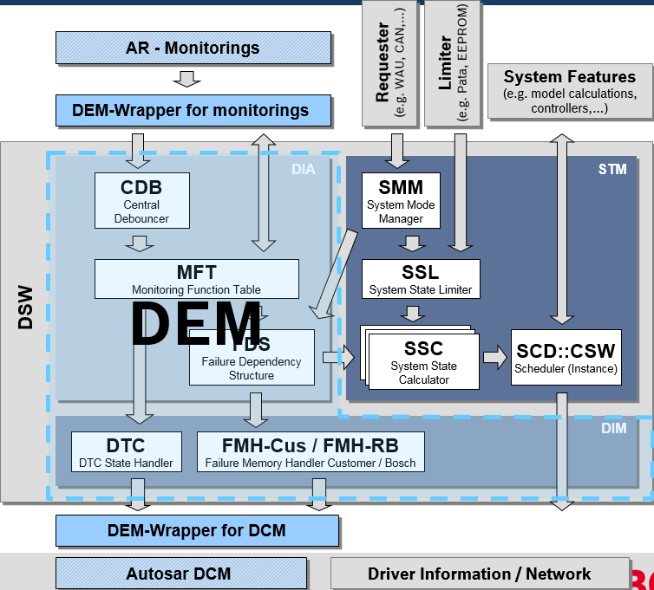
DEM
SDU topic
RBVH/ESS1 | 15/05/2015 | © Robert Bosch Engineering and Business Solutions Vietnam Company Limited 2015. All rights reserved, also regarding any disposal, exploitation, reproduction, editing, distribution, as well as in the event of applications for industrial property rights.
Notes:
- DEM is a functionality which is defined within the AutoSAR standards (version 3.1)
- Belong to BSW
BOSCH UBK use CUBAS BSW within all UBK products => DEM functionality is used as provided within CUBAS
Diagnosis (DIA) Make the diagnosis which problem has occurred
Diag. Inform. Man. (DIM) Putting information about diagnosis and treatment to archive.
State Management (STM) Treatment of the system according to the diagnosis.

Slide 12
DEM
SDU topic
Monitorings are used to detect failures in the System
e.g. Voltage Level Monitoring or PDU Timeout Check
Distributed throughout the system based on requirements for safety and system robustness
Failure Reports are sent towards the central error management DEM Diagnostic Event Manager
Failure Reports Status is either Absent or Present
Monitoring can run periodically or only at certain system states, e.g. startup
Activation of monitorings can be dependent on conditions
Three Categories
HW Monitoring
PDU and Signal Check
Environmental Condition Check, e.g. Blindness Detection
RBVH/ESS1 | 15/05/2015 | © Robert Bosch Engineering and Business Solutions Vietnam Company Limited 2015. All rights reserved, also regarding any disposal, exploitation, reproduction, editing, distribution, as well as in the event of applications for industrial property rights.

Slide 13
Filtering
SDU topic
To avoid unjustified reporting of the error to the logging facility and/or reaction of the system and therefore visibility to the outside.
Diagnostic Event Filtering can be implemented in two ways:
1. using Enable Conditions (specified within AutoSAR)
2. using Situation Filtering (used within some area of BOSCH)
RBVH/ESS1 | 15/05/2015 | © Robert Bosch Engineering and Business Solutions Vietnam Company Limited 2015. All rights reserved, also regarding any disposal, exploitation, reproduction, editing, distribution, as well as in the event of applications for industrial property rights.
Notes:
Under certain system conditions the result of certain monitorings can only be the failed state. Therefore the Event Filtering is desired to filter those monitorings to avoid unjustified reporting of the error to the logging facility and/or reaction of the system and therefore visibility to the outside.

Slide 14
Filtering
SDU topic
Filter works on failure reports
Filter State = Passive -> failure report is processed (FW can be set)
Filter State = Active -> failure report is ignored (FW cannot be set)
One failure report can be assigned to one or more filters
Filter state depends on continuously calculated filter criteria, i.e. defined system conditions (e.g. voltage level or error information in bus signals)
RBVH/ESS1 | 15/05/2015 | © Robert Bosch Engineering and Business Solutions Vietnam Company Limited 2015. All rights reserved, also regarding any disposal, exploitation, reproduction, editing, distribution, as well as in the event of applications for industrial property rights.

Slide 15
Filtering
SDU topic
Example:
EC_ACC_active is fulfilled (TRUE) : the DEM starts immediately evaluation of Diagnostic Event reports if ACC is in active control mode EC_ACC_active is not fulfilled (FALSE): the DEM stops immediately evaluation of Diagnostic Event reports if ACC is not in active control mode
RBVH/ESS1 | 15/05/2015 | © Robert Bosch Engineering and Business Solutions Vietnam Company Limited 2015. All rights reserved, also regarding any disposal, exploitation, reproduction, editing, distribution, as well as in the event of applications for industrial property rights.

Slide 16
Filtering
SDU topic
Logic for EnableCondition (detection & activation)
Enable Condition
Set Active (B)
MFT
static
definition
 | FaultLevel
Monitoring A
Monitoring B
Monitoring C
Monitoring D
…
Monitoring X
EnableC A
EnableC B
EnableC C
Report failure (C)
currently
active
Monitoring
Monitoring
A
A
Failure-
Memory
EnableC A
EnableC B
Monitoring
EnableC C
Monitoring
B
Monitoring
B
Monitoring
Monitoring
Monitoring
C
Monitoring
C
X
X
Monitoring
Monitoring
D
D
X
X
X
…
…
(C) Blocked
Monitoring
Monitoring
X
X
X
X
X
X
X
X
Monitoring
CDB
Monitoring
Monitoring
STM
RBVH/ESS1 | 15/05/2015 | © Robert Bosch Engineering and Business Solutions Vietnam Company Limited 2015. All rights reserved, also regarding any disposal, exploitation, reproduction, editing, distribution, as well as in the event of applications for industrial property rights.

Slide 17
Filtering
SDU topic
Situation Logic (detection & reporting)
Situation filter
Set Active (B)
MFT
static
definition
 | FaultLevel | Filtered
Monitoring A
Monitoring B
Monitoring C
Monitoring D
…
Monitoring X
Situation A
Situation A
Situation B
Situation B
Situation C
Situation C
Report failure (C)
currently
active
Monitoring
Monitoring
A
A
Failure-
Memory
Situation A
Situation A
Situation B
Situation B
Situation C
Monitoring
Situation C
Monitoring
B
Monitoring
B
Monitoring
Monitoring
X
X
Monitoring
C
Monitoring
C
X
X
Monitoring
Monitoring
D
D
X
X
X
…
…
Store
(substitute)
Monitoring
Monitoring
X
X
X
X
X
X
X
X
System reaction based on (C)
STM
RBVH/ESS1 | 15/05/2015 | © Robert Bosch Engineering and Business Solutions Vietnam Company Limited 2015. All rights reserved, also regarding any disposal, exploitation, reproduction, editing, distribution, as well as in the event of applications for industrial property rights.

Slide 18
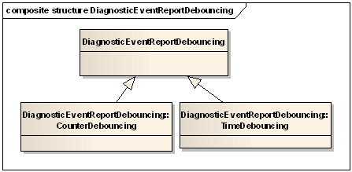
Debouncing
SDU topic
RBVH/ESS1 | 15/05/2015 | © Robert Bosch Engineering and Business Solutions Vietnam Company Limited 2015. All rights reserved, also regarding any disposal, exploitation, reproduction, editing, distribution, as well as in the event of applications for industrial property rights.
Notes:
Immediate use of the status delivered by a monitoring can sometimes be critical as the input to the monitoring is likely to be subject to bounce effects.
Therefore debouncing of all monitoring notifications has to take place.
Different monitorings require different debouncing methods.
Debouncing can additionally be used to simply delay reaching a failure situation inside the system.

Slide 19
Debouncing
SDU topic
One debouncing counter is assigned to each each failure report
Start value of zero is increased upon a present failure reports
When debounce counter is increased to the assigned value the failure is taken as persistent and further processed
Debounce counter is decreased upon an absent failure report
Steps for increments and decrements can be configured
RBVH/ESS1 | 15/05/2015 | © Robert Bosch Engineering and Business Solutions Vietnam Company Limited 2015. All rights reserved, also regarding any disposal, exploitation, reproduction, editing, distribution, as well as in the event of applications for industrial property rights.

Slide 20
Debouncing
SDU topic
Has two parameters (deviation (fail), active) which modulate the failure filter counter
The failure filter provides 5 different methods. Which describe the behavior of the counter dependent on deviation and active parameter. (active&devation==True)-(deviation==False)-(active==false)
Increase-Decrease-Decrease
Increase-Decrease-Reset
Increase-Reset-Reset
Increase-Reset-Hold
Increase-Hold-Hold
RBVH/ESS1 | 15/05/2015 | © Robert Bosch Engineering and Business Solutions Vietnam Company Limited 2015. All rights reserved, also regarding any disposal, exploitation, reproduction, editing, distribution, as well as in the event of applications for industrial property rights.

Slide 21
Debouncing
SDU topic
Increment-Reset-Reset behavior
With every failed notification the debounce counter is incremented by the defined step width
With every passed notification the debounce counter is decremented by the defined step width
Once the debounce counter reaches the specified fault level, no further increment takes place
If the debounce counter was counting up a single passed notification will reset the debounce counter
If the debounce counter was counting down from fault level a single failed notification will set the debounce counter back to fault level
RBVH/ESS1 | 15/05/2015 | © Robert Bosch Engineering and Business Solutions Vietnam Company Limited 2015. All rights reserved, also regarding any disposal, exploitation, reproduction, editing, distribution, as well as in the event of applications for industrial property rights.

Slide 22
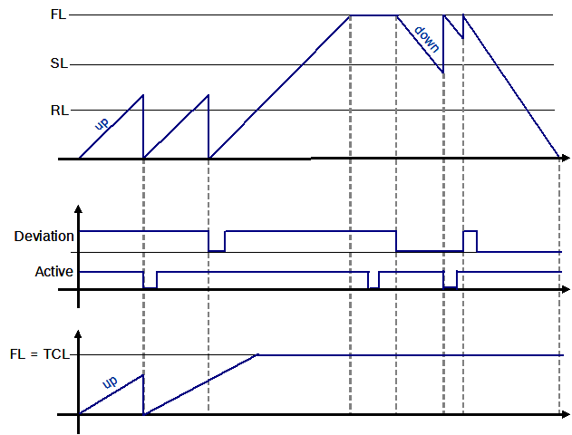
Debouncing
SDU topic
Increment-Reset-Reset
RBVH/ESS1 | 15/05/2015 | © Robert Bosch Engineering and Business Solutions Vietnam Company Limited 2015. All rights reserved, also regarding any disposal, exploitation, reproduction, editing, distribution, as well as in the event of applications for industrial property rights.

Slide 23
Debouncing
SDU topic
Increment-Decrement-Reset behavior
With every failed notification the debounce counter is incremented by the defined step width
With every passed notification the debounce counter is decremented by the defined step width
Once the debounce counter reaches the specified fault level, no further increment takes place
RBVH/ESS1 | 15/05/2015 | © Robert Bosch Engineering and Business Solutions Vietnam Company Limited 2015. All rights reserved, also regarding any disposal, exploitation, reproduction, editing, distribution, as well as in the event of applications for industrial property rights.

Slide 24
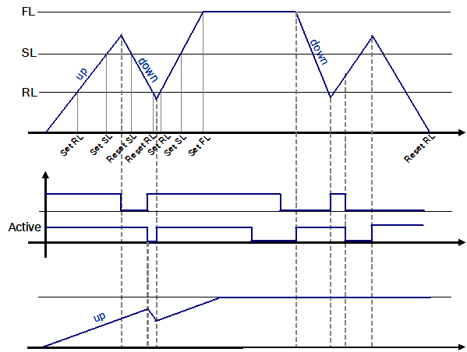
Debouncing
SDU topic
Increment-Decrement-Reset
RBVH/ESS1 | 15/05/2015 | © Robert Bosch Engineering and Business Solutions Vietnam Company Limited 2015. All rights reserved, also regarding any disposal, exploitation, reproduction, editing, distribution, as well as in the event of applications for industrial property rights.

Slide 25
System Fitness State and System Reactions
SDU topic
Each ITC is assigned to a System Fitness State SFS
n-to-1 assignment
SFS determines reaction of the system
System reaction can be reversible
if problem heals (Passive) within KL15 (Ignition) cycle system reaction is taken back (Reversible)
System reaction can be irreversible
even if problem heals (Passive) within KL15 (Ignition) cycle system reaction is maintained until the end of the KL15 cycle
System reactions are coordinated by central SCO System Coordinator by usage of coordination messages
RBVH/ESS1 | 15/05/2015 | © Robert Bosch Engineering and Business Solutions Vietnam Company Limited 2015. All rights reserved, also regarding any disposal, exploitation, reproduction, editing, distribution, as well as in the event of applications for industrial property rights.

Slide 26
Failure Storages
SDU topic
NVRAM Concept:
Parallel Emulation of Internal EEPROM or E2PROM
Customer Storage CST:
stores DTCs (10 DTC can be stored)
customer-specific environmental data for first and last occurrence
priority based overwriting
Bosch Storage BST:
stores ITCs
used by Bosch for development purposes
RBVH/ESS1 | 15/05/2015 | © Robert Bosch Engineering and Business Solutions Vietnam Company Limited 2015. All rights reserved, also regarding any disposal, exploitation, reproduction, editing, distribution, as well as in the event of applications for industrial property rights.

Slide 27
Referent documents:
SDU topic
01_DSM_overview_2013_07_08.ppt
02_DSM_Introduction_MFT_2011_10_07.ppt
07_DSM_Introduction_SituationFilter_2011_10_10.ppt
SDU_Anand_New.ppt
/System Bplus/Subsystem SDU/FW_SYSRS_SDU_SYSBplus
/System Bplus/Subsystem SDU/FW_SYSSD_SDU_SYSBplus
RBVH/ESS1 | 15/05/2015 | © Robert Bosch Engineering and Business Solutions Vietnam Company Limited 2015. All rights reserved, also regarding any disposal, exploitation, reproduction, editing, distribution, as well as in the event of applications for industrial property rights.

