Slide 1
SYC AND failsafe

Slide 2
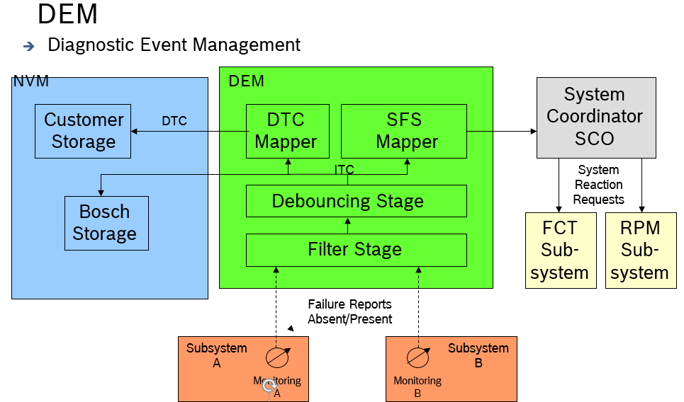

Slide 3
FID A
SFS A
SR A
System coordination message A
FAULT A
VDB PACKET A
FID B
SFS B
SR B
System coordination message B
FID C
SFS C
SR C
System coordination message C
FAULT B
VDB PACKET B
FID D
SFS D
SR D
System coordination message D
DEM
FIM
CDE
SYC

Slide 4
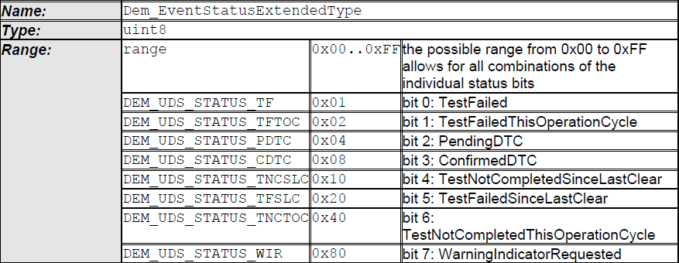
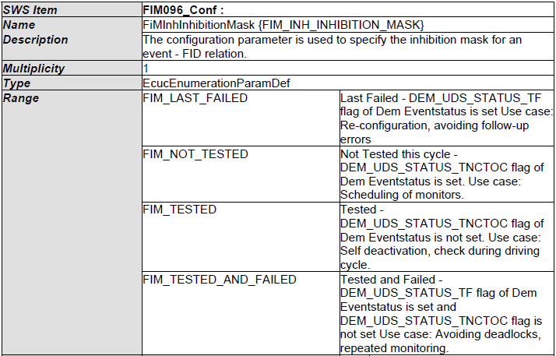
Dem Event Status
FID A
Mask
FID A permission state
FAULT A
FID B
Mask
FID B permission state
FID C
Mask
FID C permission state
FAULT B
FID D
Mask
FID D permission state
DEM
FIM
1 : n
FiMInhibitionMask
Interface:
From DEM
Std_ReturnType Dem_GetEventStatus( Dem_EventIdType EventId Dem_EventStatusExtendedType* EventStatusExtended );
To DEM
FiM_DemTriggerOnEventStatus( Dem_EventIdType EventId,
uint8 EventStatusOld, uint8 EventStatusNew );
To SW-C
Std_ReturnType FiM_GetFunctionPermission( FiM_FunctionIdType FID, boolean *Permission );

Slide 5
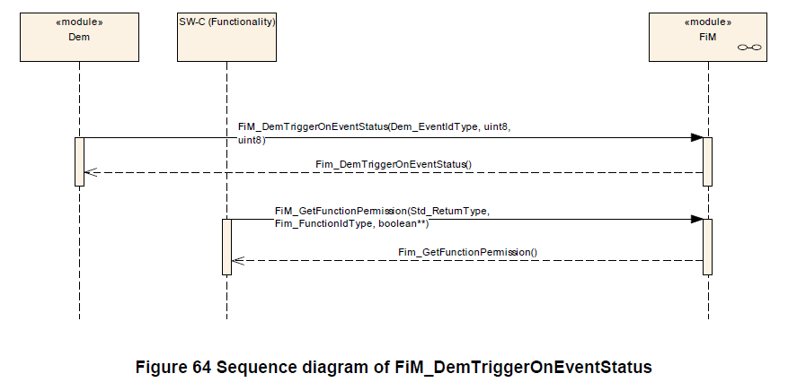

Slide 6
Interface:
FID A
SFS A
From FiM
Std_ReturnType FiM_GetFunctionPermission( FiM_FunctionIdType FID, boolean *Permission );
FID B
SFS B
FID C
SFS C
CDE service
UBYTE SFSC_GetFailureClassState_UB(const CDE_FAILURE_CLASS p_FailureClass_t, const struct CDE_FAILURE_CLASSES_PACKET_ST *p_FailureClasses_pst)
FID D
SFS D
FIM
CDE
- CDE failure class state array
[ ,
,
…
]
- Max number of SFS: 256
- Array size: 256/8 = 32
1 : 1

Slide 7
SFS A
SR A
System coordination message A
VDB PACKET A
SFS B
SR B
System coordination message B
SFS C
SR C
System coordination message C
VDB PACKET B
SFS D
SR D
System coordination message D
1 : 1
1 : n
CDE
SYC
From CDE
UBYTE SFSC_GetFailureClassState_UB(const CDE_FAILURE_CLASS p_FailureClass_t, const struct CDE_FAILURE_CLASSES_PACKET_ST *p_FailureClasses_pst)

Slide 8
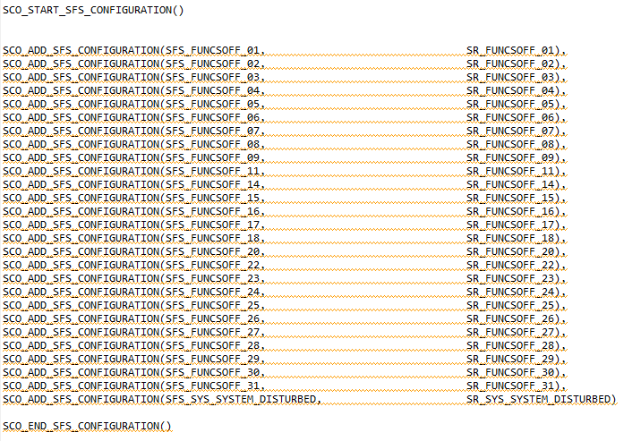
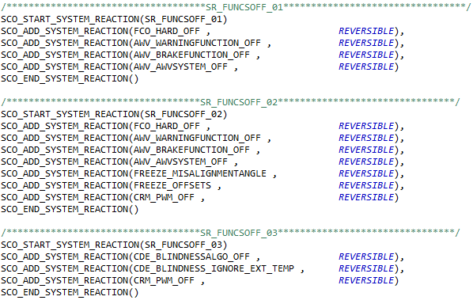
SFS – SR mapping
SR – Coordination message name mapping

Slide 9
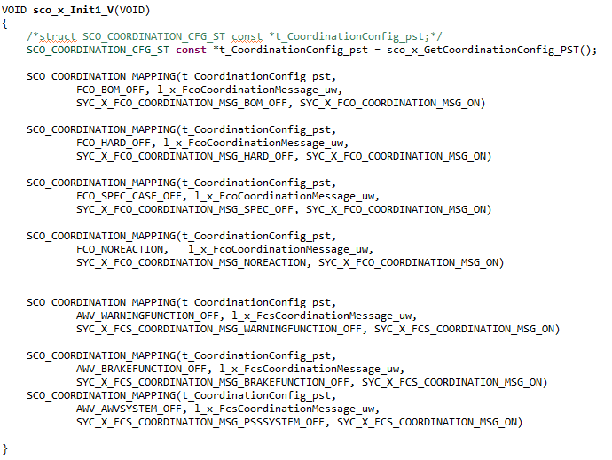
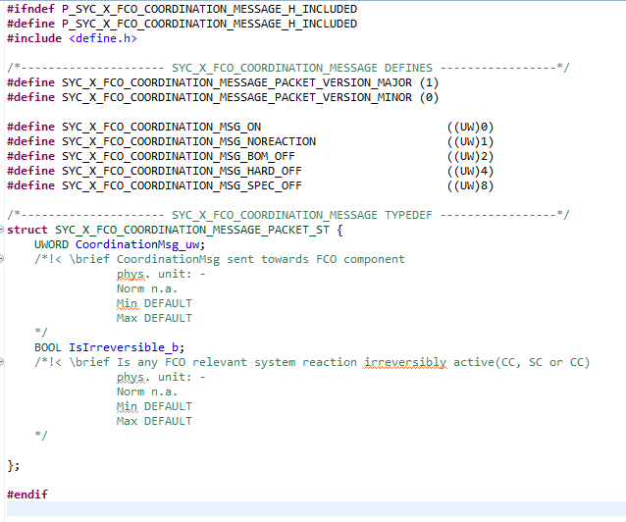
Coordination message name – value – VDB packet mapping
SYC packet interface

