Slide 1
UDS Protocol Overview
DGS-EC / ECG1-JP
2016/07/07
TechMemo_3609(Draft)
1
Confidential | Bosch Corporation (DGS-EC/ECG1-JP) | 07/07/2016
© Robert Bosch Engineering and Business Solutions Private Limited 2016. All rights reserved, also regarding any disposal, exploitation, reproduction, editing, distribution, as well as in the event of applications for industrial property rights.

Slide 2
Agenda
UDS Protocol Overview
What is UDS and Why
UDS on Different Mediums
Trend of UDS in Automotive sector
Advantages of UDS Protocol
OSI Model in UDS
Service Classifications based on Functionality
Detailed explanation of each Advantage
2
Confidential | Bosch Corporation (DGS-EC/ECG1-JP) | 07/07/2016
© Robert Bosch Engineering and Business Solutions Private Limited 2016. All rights reserved, also regarding any disposal, exploitation, reproduction, editing, distribution, as well as in the event of applications for industrial property rights.

Slide 3
UDS Means : Unified diagnostic Services
UDS Protocol Overview
OBD
KWP2000 (I14230-3)
Diagnostics on CAN I15765-3
UDS (ISO 14229 )
Which supports for WWH OBD & Enhanced Diagnostics
UDS Protocol was created by combining the ISO Standards 14230-3 (KWP 2000) and 15765-3 (Diagnostics on CAN).
Supports for all kind of Vehicles
UDS Protocol has been introduced to full fill common Requirements.
This standard defines unified set of diagnostic services, with which the cost and effort can be reduced.
UDS Tester can communicate any ECUs and Vehicles as UDS standard has derived by considering different Mediums and different ISO standards.
Follows the Standards of ISO 14229
Defined based on ISO and SAE
WWH : World wide Harmonised On board diagnostics
ISO : International Organisation for standardisation
SAE : Society of Automotive Engineers
3
Confidential | Bosch Corporation (DGS-EC/ECG1-JP) | 07/07/2016
© Robert Bosch Engineering and Business Solutions Private Limited 2016. All rights reserved, also regarding any disposal, exploitation, reproduction, editing, distribution, as well as in the event of applications for industrial property rights.

Slide 4
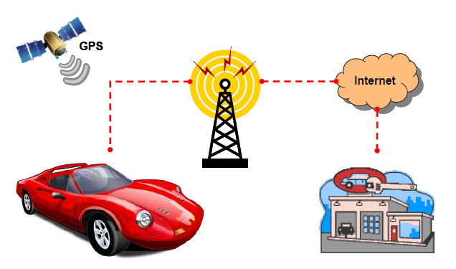
Works Independent of BUS system (Supports for LIN ,CAN, Ethernet and Flex ray protocols)
UDS Protocol Overview
UDS Diagnostics
I14229-1
CAN
I14229-3
UDSonCAN
Ethernet
I14229-5
UDSonIP
Future Enhancement
LIN
I14229-7
UDSonLIN
Flex Ray
I14229-4
UDSonFR
K-Line
I14229-6
UdsonK-Line
Designed for Remote diagnostics ( IOT )
IOT : Internet of Things
ISO 14229-1 is the application layer in UDS , which is common for all Mediums
4
Confidential | Bosch Corporation (DGS-EC/ECG1-JP) | 07/07/2016
© Robert Bosch Engineering and Business Solutions Private Limited 2016. All rights reserved, also regarding any disposal, exploitation, reproduction, editing, distribution, as well as in the event of applications for industrial property rights.

Slide 5
Trend of Usage on Diagnostic Protocol
UDS Protocol Overview
Many J-OEMS are also moved
towards UDS.
AUTOSAR supports only UDS
5
Confidential | Bosch Corporation (DGS-EC/ECG1-JP) | 07/07/2016
© Robert Bosch Engineering and Business Solutions Private Limited 2016. All rights reserved, also regarding any disposal, exploitation, reproduction, editing, distribution, as well as in the event of applications for industrial property rights.

Slide 6
Advantages over KWP
UDS Protocol Overview
Reduces the Flash Time by changing the CAN Baud rate
Control the DTCs settings by Tester
Request ECU to send Data periodically to Tester
Request ECU to send Data based on Events to Tester
Diagnosed for advanced Trouble Codes by enhancing the Read DTC service with more Sub-functions
Same DID number can be used for multiple Services ( only one Number to Read, Write and Control )
Wide Range of DATA Identifiers ( 2 Bytes DID )
Get to Know the Session Timings parameters while jumping to new Session
Flexible Number of Bytes to represent Memory address and Data Bytes in the Memory access service
Indicate ECU to suppress the unnecessary Positive responses, which influences CAN bus load.
6
Confidential | Bosch Corporation (DGS-EC/ECG1-JP) | 07/07/2016
© Robert Bosch Engineering and Business Solutions Private Limited 2016. All rights reserved, also regarding any disposal, exploitation, reproduction, editing, distribution, as well as in the event of applications for industrial property rights.

Slide 7
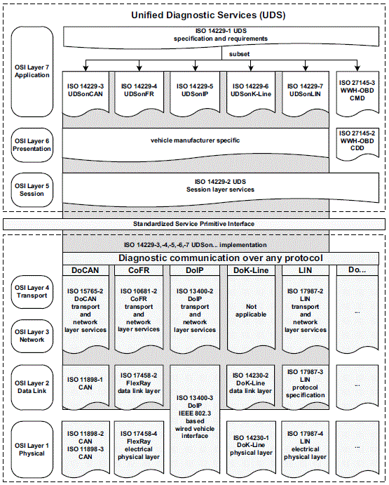

UDS Protocol Overview
OSI Model for UDS
Path for the
diagnosis on CAN
Communication
This part is already being
used with KWP I14230-3 on CAN
7
Confidential | Bosch Corporation (DGS-EC/ECG1-JP) | 07/07/2016
© Robert Bosch Engineering and Business Solutions Private Limited 2016. All rights reserved, also regarding any disposal, exploitation, reproduction, editing, distribution, as well as in the event of applications for industrial property rights.

Slide 8
OBD Diagnostics
UDS protocol Overview
Currently I15031-5 is being used in the SMC , which can be continued even with UDS.
I15031-5 Application Layer
ISO 15765-4 CAN Network Layer
ISO 11898-1, 11898-2, 11898-3
CAN Physical & Data link Layers are part of I15765-4
UDS services are broadly classified as below
Function Type | Functionality
Communication Management | Session control , ECU Reset , Communication Control , Security
Data Transmission | Read Identifier or Memory Data Write Identifier or Memory Data
Stored Data | Read Diagnostic information Clear Diagnostic information
Input, Output Control | Controlling Input and Output
Reprogramming | Download / Upload the data
8
Confidential | Bosch Corporation (DGS-EC/ECG1-JP) | 07/07/2016
© Robert Bosch Engineering and Business Solutions Private Limited 2016. All rights reserved, also regarding any disposal, exploitation, reproduction, editing, distribution, as well as in the event of applications for industrial property rights.

Slide 9
Services from Each Functional Type
UDS protocol Overview
Function Type | Supported Services
Communication Management | Diagnostic Session Control (0x10) , ECU Reset (0x11) , Security Access (0x27), Tester Present (0x3E) Communication Control (0x28), Access Timing parameters (0x83), Link Control(0x87), Response on Event (0x86), Control DTC setting (0x85), Secured Data Transmission ( 0x84)
Data Transmission | Read Data By Identifier (0x22), Read Memory By Address ( 0x23), Read Scaling Data by Identifier (0x24), Read Data By Periodic Identifier (0x2A) , Dynamically Defined by Identifier (0x2C) , Write Data by Identifier (0x2E) , Write Memory By Address (0x3D)
Stored Data Transmission | Clear Diagnostic Information(0x14), Read DTC Information(0x19)
Input Output Control | Input Output Control By Identifier (0x2F)
Routine Control | Routine Control (0x31)
Upload Download | Request Download ( 0x34) , Request Upload(0x35) , Transfer Data(0x36), Request Transfer Exit(0x37), Request File Transfer(0x38)
9
Confidential | Bosch Corporation (DGS-EC/ECG1-JP) | 07/07/2016
© Robert Bosch Engineering and Business Solutions Private Limited 2016. All rights reserved, also regarding any disposal, exploitation, reproduction, editing, distribution, as well as in the event of applications for industrial property rights.

Slide 10
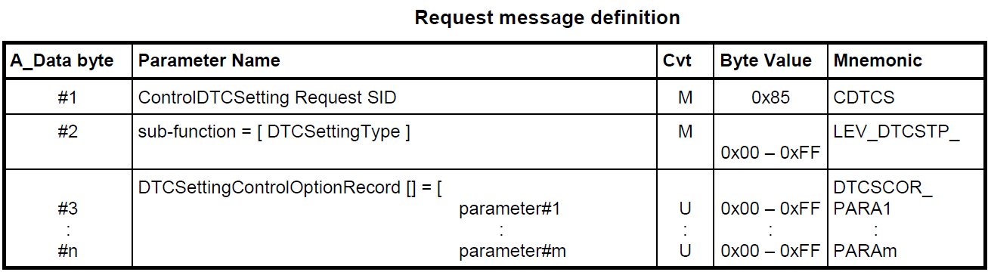
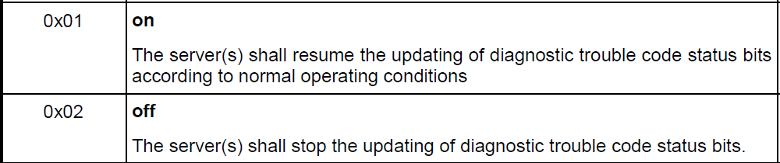
Controlling the DTCs in the ECU by Tester
UDS Protocol Overview
With KWP I14230-3 | With UDS I14229-1
Not possible to control the DTCs in the ECU by the Tester | Separate service 0x85 available to stop or resume DTCs setting in the ECU by the Tester
Here U Means User Option
10
Confidential | Bosch Corporation (DGS-EC/ECG1-JP) | 07/07/2016
© Robert Bosch Engineering and Business Solutions Private Limited 2016. All rights reserved, also regarding any disposal, exploitation, reproduction, editing, distribution, as well as in the event of applications for industrial property rights.

Slide 11
Reduces the Flashing Time by Changing CAN Baud Rate
UDS Protocol Overview
With KWP I14230-3 | With UDS I14229-1
No Option to switch Baud rate | With Service Link Control Service ( 0x87 ) , Baud rate switching is possible during Flash Programming
Link Control Service is used to Control the Communication between Tester and ECU ,
in order to gain BUS band width possible to change the Data Link layer parameters.
By Changing the CAN Baud rate Flashing time can be reduced.
Here Baud rate transition is possible in TWO steps.
Step 1 : Tester verifies whether Transition can be performed and informs to ECU about Transition Mechanism
Step 2 : Tester requests the mode transition ( Eg : Higher Baud Rate ) . Step 2 will be requested only if Step 1 is performed successfully
Sub Function Type 0x01 or 0x02 uses for the Step 1 . 0x01 is for the transition with fixed parameters in the ECU
0x02 is for the transition by providing Transition parameters to ECU
Sub function type 0x03 is for the Step 2 , which is for the actual Transition.
11
Confidential | Bosch Corporation (DGS-EC/ECG1-JP) | 07/07/2016
© Robert Bosch Engineering and Business Solutions Private Limited 2016. All rights reserved, also regarding any disposal, exploitation, reproduction, editing, distribution, as well as in the event of applications for industrial property rights.

Slide 12
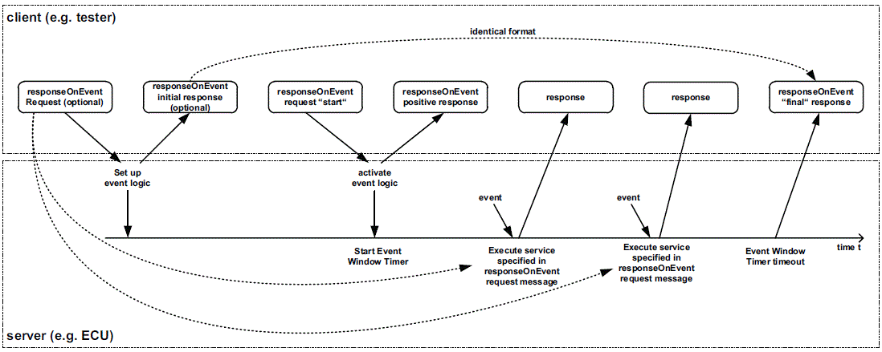
Prepare ECU in Advance, to Provide Details Based on EVENT
UDS Protocol Overview
With KWP I14230-3 | With UDS I14229-1
Always Request is needed to get response from ECU. It is difficult to get Data from ECU on special EVENTS that Tester can’t anticipate for the events to send the Read Request. | Special service 0x86 , with which Tester can request to ECU in advance with Event type , that tester is expecting response based on this particular Event with out any request at the time of Event.
12
Confidential | Bosch Corporation (DGS-EC/ECG1-JP) | 07/07/2016
© Robert Bosch Engineering and Business Solutions Private Limited 2016. All rights reserved, also regarding any disposal, exploitation, reproduction, editing, distribution, as well as in the event of applications for industrial property rights.

Slide 13
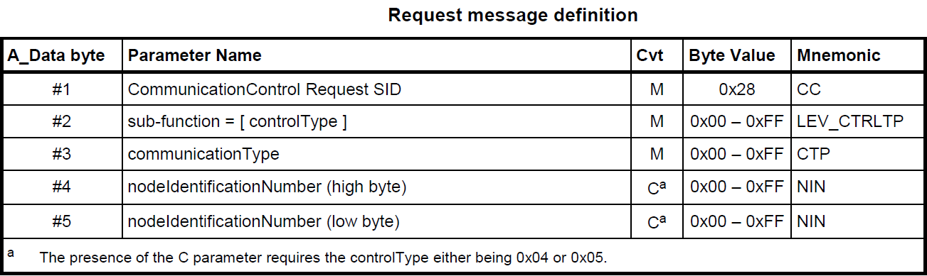
Dedicated Service, to Disable Normal Communication During Flash Programming
UDS Protocol Overview
With KWP I14230-3 | With UDS I14229-1
Deviation in the service flow to implement Disable Normal Communication and diagnosis | There is separate service “Communication Control 0x28” which can handles disable Normal communication and diagnostics
Purpose of Communication Control 0x28 Service : Possible to Switch ON/OFF Transmission AND/OR Reception Messages
Control Type | Description
0x00 | Enable RX And TX
0x01 | Enable RX and Disable TX
0x02 | Disable RX ad Enable TX
0x03 | Disable Rx and TX
Control Type 0x40 – 0x5F are reserved for
Vehicle Manufacture Specific, Which can be
used to disable diagnosis or combination of DNC DCD
Communication Type could be Normal Messages or Network Messages
Conditional
13
Confidential | Bosch Corporation (DGS-EC/ECG1-JP) | 07/07/2016
© Robert Bosch Engineering and Business Solutions Private Limited 2016. All rights reserved, also regarding any disposal, exploitation, reproduction, editing, distribution, as well as in the event of applications for industrial property rights.

Slide 14
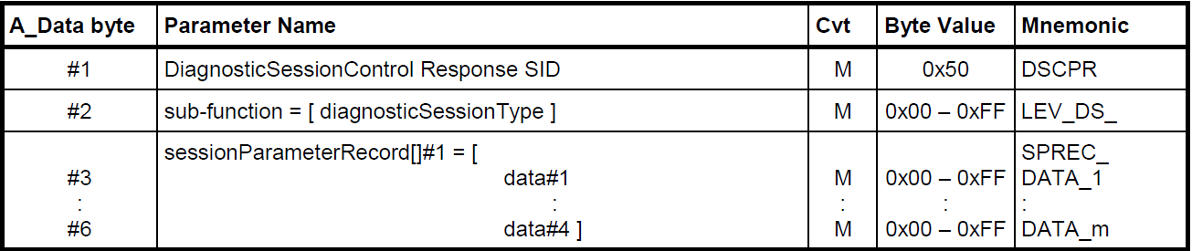
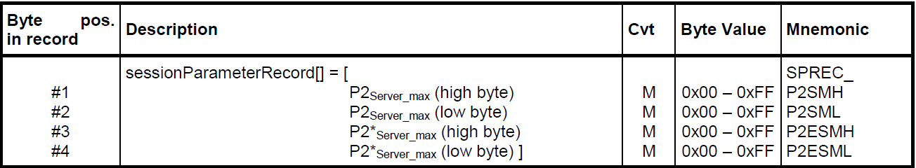
ECU Provides New Session Timing Parameters to Tester before Jumping to New Session
UDS Protocol Overview
With KWP I14230-3 | With UDS I14229-1
Separate Request is required to access Respective session Timing parameters. | Session Timing parameters are part of Diagnostic Session Control Response ( 0x50 ).
Format of diagnostic Session Control Response in UDS
Here M Means: Mandatory
14
Confidential | Bosch Corporation (DGS-EC/ECG1-JP) | 07/07/2016
© Robert Bosch Engineering and Business Solutions Private Limited 2016. All rights reserved, also regarding any disposal, exploitation, reproduction, editing, distribution, as well as in the event of applications for industrial property rights.

Slide 15
Wide Range of Data Identifiers & Single DID for Both Read and Write
UDS Protocol Overview
Advantages in Data Transmission function
With KWP I14230-3 | With UDS I14229-1
Number of Identifiers are limited to 255 , As protocol suggests 1 Byte for the DID | Wide Range of Identifiers are possible , as 2 Bytes have been allocated to the DID.
Separate DID numbers are required for each Service . Example: For VIN Writing one DID number and another number for Reading | One DID number can be used among Services . Example: one DID number used for both VIN Writing and reading
15
Confidential | Bosch Corporation (DGS-EC/ECG1-JP) | 07/07/2016
© Robert Bosch Engineering and Business Solutions Private Limited 2016. All rights reserved, also regarding any disposal, exploitation, reproduction, editing, distribution, as well as in the event of applications for industrial property rights.

Slide 16
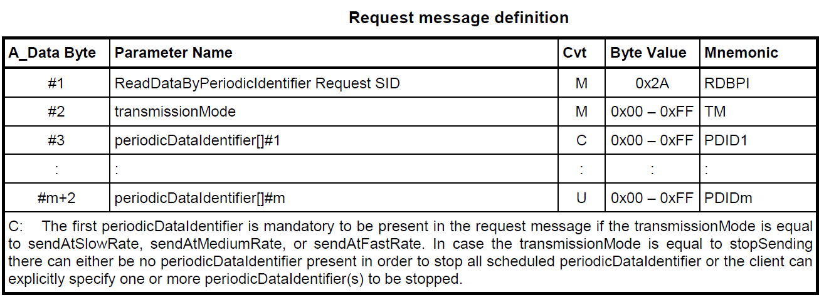
Read the Identifier Data Periodically by Triggering on Time Request to ECU
UDS Protocol Overview
With KWP I14230-3 | With UDS I14229-1
It is not possible to read Data periodically with one request from Tester | Service 0x2A , it is possible to send the Data by the ECU periodically with one Request message to Start ( to Stop another Request )
Transmission Mode | Description
0x01 | Send at Slow Rate
0x02 | Send at Medium Rate
0x03 | Send at Fast Rate
0x04 | Stop Sending
Slow, Medium & Fast Rates will be defined by Vehicle manufacturer , which are fixed in the ECU
16
Confidential | Bosch Corporation (DGS-EC/ECG1-JP) | 07/07/2016
© Robert Bosch Engineering and Business Solutions Private Limited 2016. All rights reserved, also regarding any disposal, exploitation, reproduction, editing, distribution, as well as in the event of applications for industrial property rights.

Slide 17
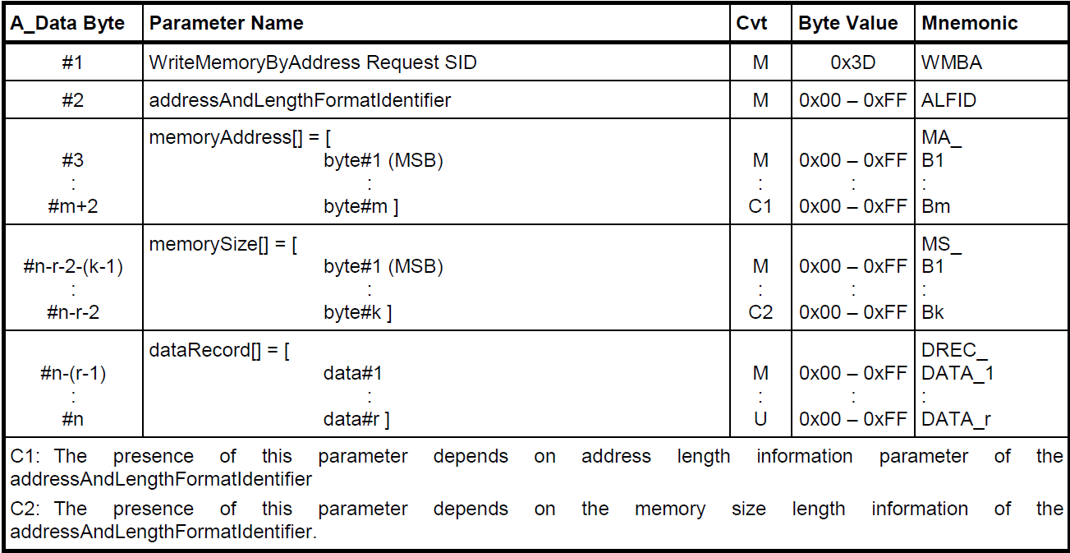
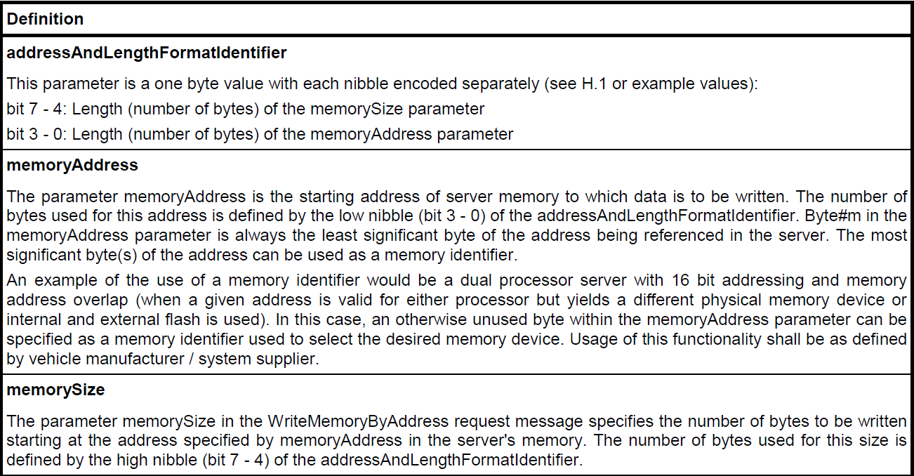
Flexible Number of Bytes for the Memory Address & Memory Size
UDS Protocol Overview
With KWP I14230-3 | With UDS I14229-1
Number of Bytes for the Memory Address and Memory Size is limited in the Request ( 3 Byte Memory Address & 1 Byte for the Memory size ) | No Limit in number of bytes in the Request for the Memory Address and Memory Size.
17
Confidential | Bosch Corporation (DGS-EC/ECG1-JP) | 07/07/2016
© Robert Bosch Engineering and Business Solutions Private Limited 2016. All rights reserved, also regarding any disposal, exploitation, reproduction, editing, distribution, as well as in the event of applications for industrial property rights.

Slide 18
Stored Data Function ( Read DTC Information )
UDS Protocol Overview
KWP I14230-3 | UDS
4 Services are available to read DTC related information | 1 Service with many sub-functions
Limited Number of Features. Due to Limited Features additional Calculations should be performed by Tester. Some of the features are not possible | More features are supported with many sub functions
Sub Function Details in the Read DTC Information (0x19) [1]
Sub – Function ID & Name |  | Short Overview
0x01 | Report Number Of DTC By Status Mask | ECU sends the count of Number of DTCs based on Tester Requested Status mask
0x02 | Report DTC By Status Mask | ECU sends list of DTCs and respective Status based on Tester requested status mask
0x0F | Report Mirror Memory DTC By Status Mask | Same as Sub function 0x02, Difference is that ECU reads from Mirror Memory
0x11 | Report Number Of Mirror Memory DTC By Status Mask | Same as Sub function 0x01, Difference is that ECU reads from Mirror Memory
0x12 | Report Number Of Emissions OBD DTC By Status Mask | ECU sends the count of Number of “Emission Related OBD” DTCs based on Tester Requested Status mask
0x13 | Report Emissions OBD DTC By Status Mask | ECU Sends list of Emission Related OBD DTCs and respective status based on Tester requested status mask
0x03 | Report DTC Snapshot Identification | Get the list of triggered snap shot record numbers with respective DTC numbers
Mirror Memory is an Optional error memory in the ECU , that can’t be erased by CDTC ( 0x14 ) service.
Continued ….
18
Confidential | Bosch Corporation (DGS-EC/ECG1-JP) | 07/07/2016
© Robert Bosch Engineering and Business Solutions Private Limited 2016. All rights reserved, also regarding any disposal, exploitation, reproduction, editing, distribution, as well as in the event of applications for industrial property rights.

Slide 19
Sub Function Details in the Read DTC Information (0x19) [2]
UDS Protocol Overview
Sub – Function ID & Name
0x0A | Report Supported DTC
0x0B | Report First Test Failed DTC
0x0C | Report First Confirmed DTC
0x0D | Report Most Recent Test Failed DTC
0x0E | Report Most Recent Confirmed DTC
0x14 | Report DTC Fault Detection Counter
0x15 | Report DTC With Permanent Status
0x42 | Report WWH OBD DTC By Mask Record
0x55 | Report WWH OBD DTC With Permanent Status
Sub – Function ID & Name
0x04 | Report DTC Snapshot Record By DTC Number
0x05 | Report DTC Stored Data By Record Number
0x06 | Report DTC Extended Data Record By DTC Number
0x10 | Report Mirror Memory DTC Extended Data Record By DTC
0x07 | Report Number Of DTC By Severity Mask Record
0x08 | Report DTC By Severity Mask Record
0x09 | Report Severity Information Of DTC
0x16 | Report DTC Extended Data Record By Record Number
0x17 | Report User Defined Memory DTC By Status Mask
0x18 | Report User Defined Memory DTC Snapshot Record By DTC Number
0x19 | Report User Defined Memory DTC Extended Data Record By DTC Number
19
Confidential | Bosch Corporation (DGS-EC/ECG1-JP) | 07/07/2016
© Robert Bosch Engineering and Business Solutions Private Limited 2016. All rights reserved, also regarding any disposal, exploitation, reproduction, editing, distribution, as well as in the event of applications for industrial property rights.

Slide 20
Additional Advantages of UDS
UDS Protocol Overview
In UDS Routine Control service has the functionality of Start Routine, Stop Routine and Request routine results in one service with different sub functions IDs.
Block Sequence counter “1 Byte” in the Transfer Data service , which is useful to identify the Block missing in the ECU side.
20
Confidential | Bosch Corporation (DGS-EC/ECG1-JP) | 07/07/2016
© Robert Bosch Engineering and Business Solutions Private Limited 2016. All rights reserved, also regarding any disposal, exploitation, reproduction, editing, distribution, as well as in the event of applications for industrial property rights.

