Slide 1
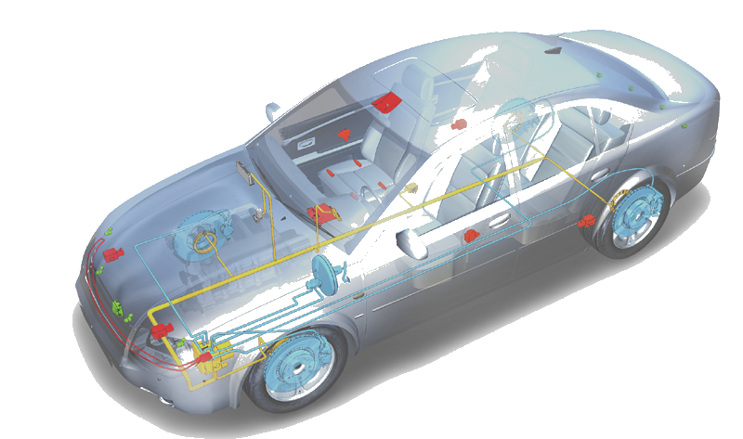
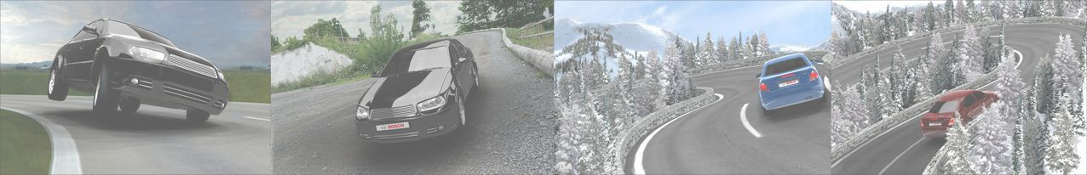

UDS/DCM Sharing
UDS/DCM Sharing
UDS/DCM Sharing
Chassis Systems Control
Internal | Phan Hai Long | 10.12.15 | © Robert Bosch GmbH 2015. All rights reserved, also regarding any disposal, exploitation, reproduction, editing, distribution, as well as in the event of applications for industrial property rights.

Slide 2

Agenda
UDS/DCM Sharing
UDS Overview
DCM Overview
Example of implementation of DCM according to UDS
Chassis Systems Control
Internal | Phan Hai Long | 10.12.15 | © Robert Bosch GmbH 2015. All rights reserved, also regarding any disposal, exploitation, reproduction, editing, distribution, as well as in the event of applications for industrial property rights.

Slide 3
UDS Overview
UDS/DCM Sharing
Definition of UDS
Diagnostic Communication protocol
Classify services
Chassis Systems Control
Internal | Phan Hai Long | 10.12.15 | © Robert Bosch GmbH 2015. All rights reserved, also regarding any disposal, exploitation, reproduction, editing, distribution, as well as in the event of applications for industrial property rights.

Slide 4
UDS Overview
UDS/DCM Sharing
Definition of UDS
Diagnostic Communication protocol
Classify services
Chassis Systems Control
Internal | Phan Hai Long | 10.12.15 | © Robert Bosch GmbH 2015. All rights reserved, also regarding any disposal, exploitation, reproduction, editing, distribution, as well as in the event of applications for industrial property rights.

Slide 5
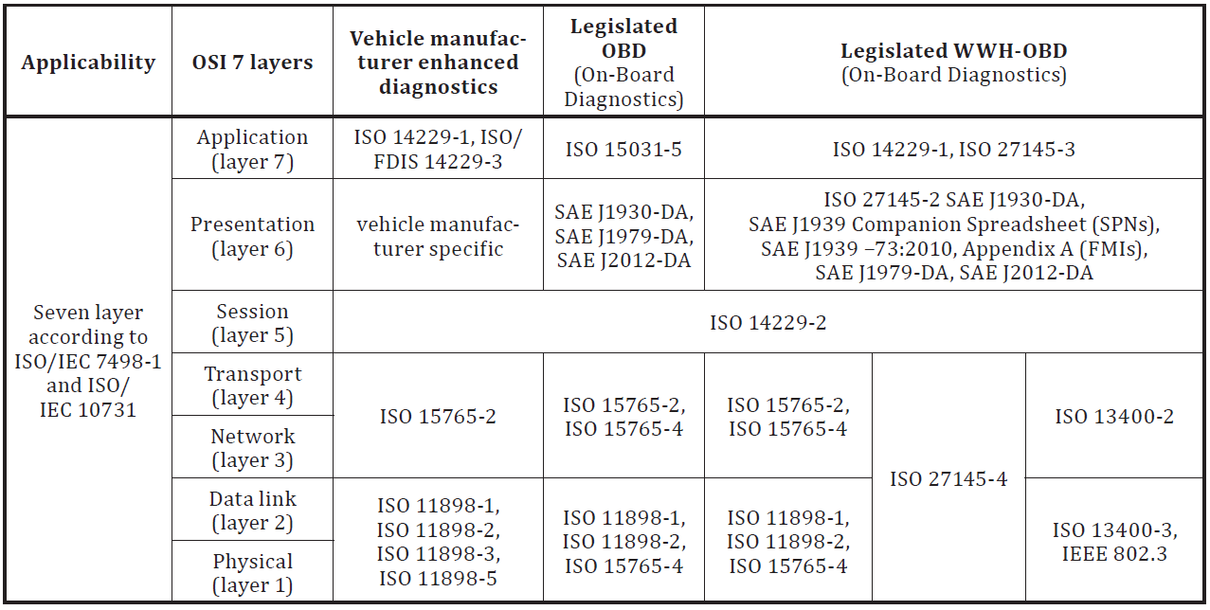
Definition of UDS: reference to OSI model
UDS protocol principles
UDS: Unified Diagnostic Service
Chassis Systems Control
Internal | Phan Hai Long | 10.12.15 | © Robert Bosch GmbH 2015. All rights reserved, also regarding any disposal, exploitation, reproduction, editing, distribution, as well as in the event of applications for industrial property rights.

Slide 6
UDS Overview
UDS/DCM Sharing
Definition of UDS
Diagnostic Communication protocol
Classify services
Chassis Systems Control
Internal | Phan Hai Long | 10.12.15 | © Robert Bosch GmbH 2015. All rights reserved, also regarding any disposal, exploitation, reproduction, editing, distribution, as well as in the event of applications for industrial property rights.

Slide 7
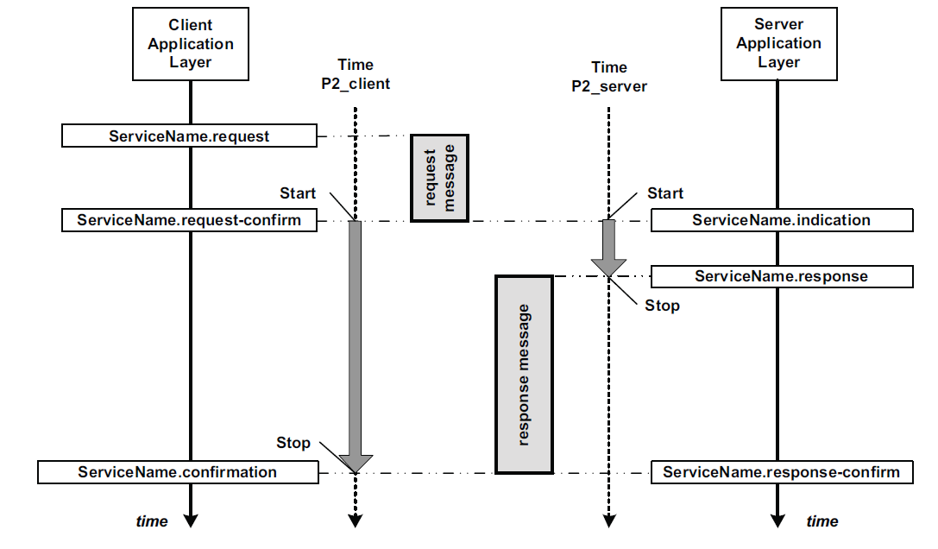
Diagnostic Communication protocol:Request/Response Behavior
UDS/DCM Sharing
  Diagnostic communication is Client - Server communication.
  Client is tester and Server is ECU. Client initiates the communication.
Chassis Systems Control
Internal | Phan Hai Long | 10.12.15 | © Robert Bosch GmbH 2015. All rights reserved, also regarding any disposal, exploitation, reproduction, editing, distribution, as well as in the event of applications for industrial property rights.

Slide 8




Diagnostic Communication protocol: UDS request/response formats
UDS/DCM Sharing
There is 4 different types of UDS request
  Request with Service ID only
  Request with Service ID and Sub-function
  Request with Service ID and Data ID
  Request with Service ID, Sub-function and Data ID
Chassis Systems Control
Internal | Phan Hai Long | 10.12.15 | © Robert Bosch GmbH 2015. All rights reserved, also regarding any disposal, exploitation, reproduction, editing, distribution, as well as in the event of applications for industrial property rights.

Slide 9
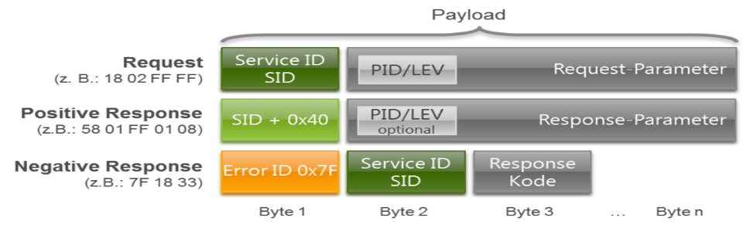
UDS/DCM Sharing
Diagnostic Communication protocol: UDS request/response formats
There is 2 types of UDS response: positive and negative response
Chassis Systems Control
Internal | Phan Hai Long | 10.12.15 | © Robert Bosch GmbH 2015. All rights reserved, also regarding any disposal, exploitation, reproduction, editing, distribution, as well as in the event of applications for industrial property rights.

Slide 10
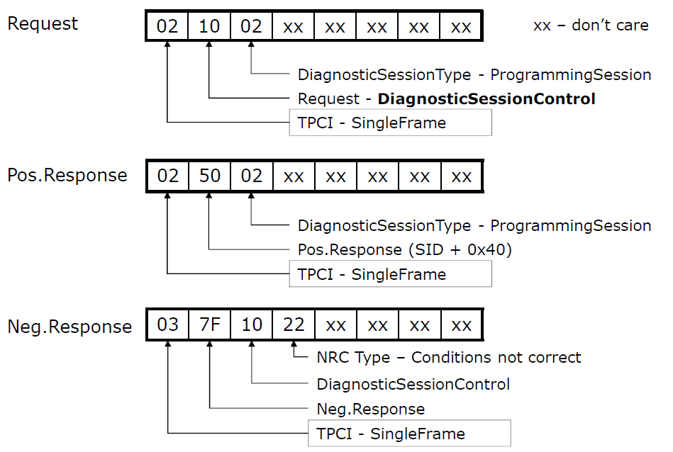
Diagnostic Service Example
UDS/DCM Sharing
Diagnostic Session Control: SID 0x10
Chassis Systems Control
Internal | Phan Hai Long | 10.12.15 | © Robert Bosch GmbH 2015. All rights reserved, also regarding any disposal, exploitation, reproduction, editing, distribution, as well as in the event of applications for industrial property rights.

Slide 11
UDS Overview
UDS/DCM Sharing
Definition of UDS
Diagnostic Communication protocol
Classify services
Chassis Systems Control
Internal | Phan Hai Long | 10.12.15 | © Robert Bosch GmbH 2015. All rights reserved, also regarding any disposal, exploitation, reproduction, editing, distribution, as well as in the event of applications for industrial property rights.

Slide 12
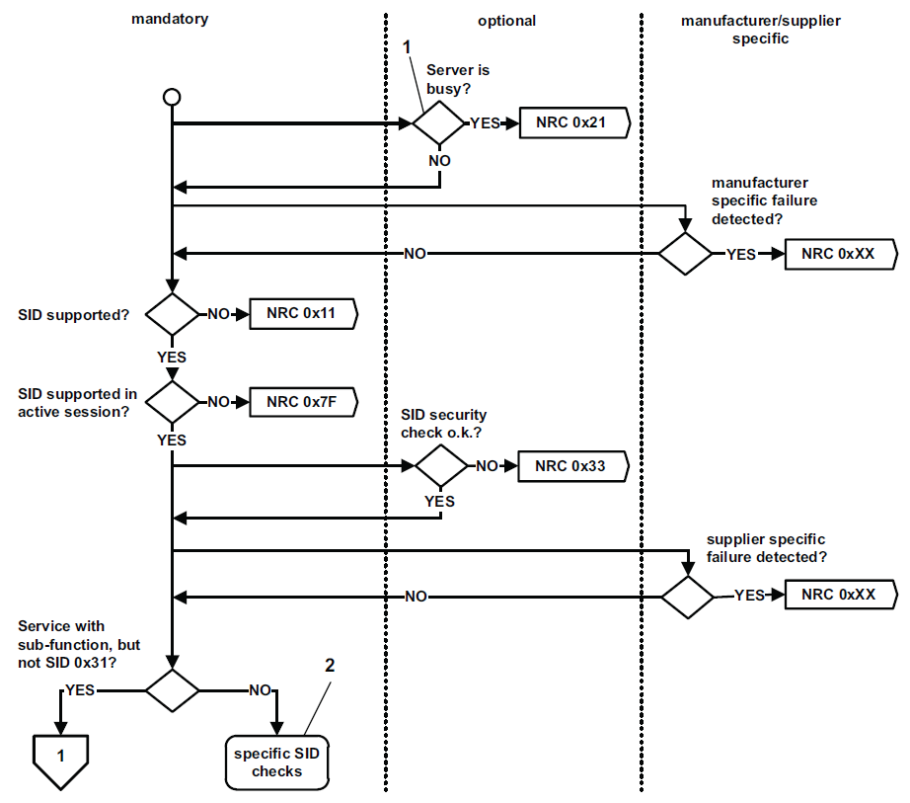
Request handling
UDS/DCM Sharing
Chassis Systems Control
Internal | Phan Hai Long | 10.12.15 | © Robert Bosch GmbH 2015. All rights reserved, also regarding any disposal, exploitation, reproduction, editing, distribution, as well as in the event of applications for industrial property rights.

Slide 13
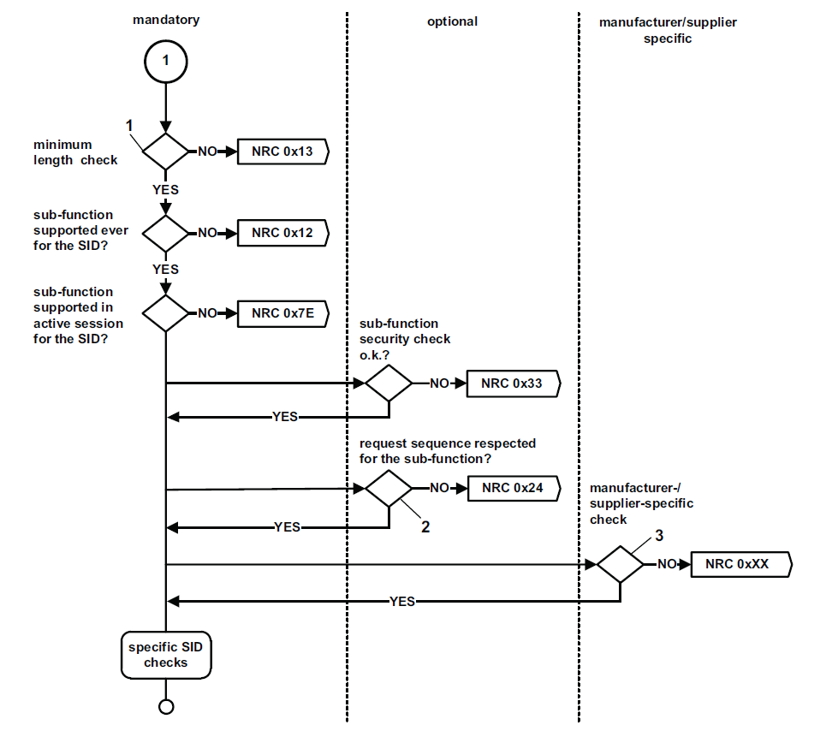
Request handling
UDS/DCM Sharing
Chassis Systems Control
Internal | Phan Hai Long | 10.12.15 | © Robert Bosch GmbH 2015. All rights reserved, also regarding any disposal, exploitation, reproduction, editing, distribution, as well as in the event of applications for industrial property rights.

Slide 14
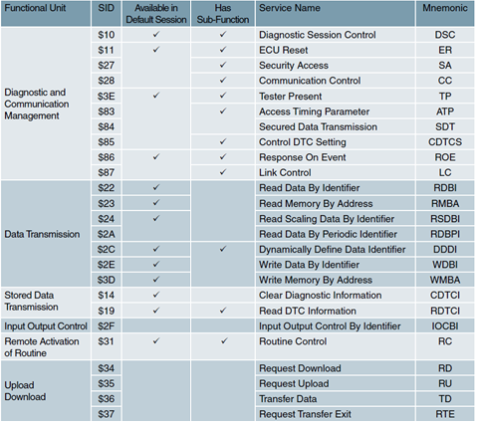
Classify services
UDS/DCM Sharing
Chassis Systems Control
Internal | Phan Hai Long | 10.12.15 | © Robert Bosch GmbH 2015. All rights reserved, also regarding any disposal, exploitation, reproduction, editing, distribution, as well as in the event of applications for industrial property rights.

Slide 15
DCM Overview
UDS/DCM Sharing
Overview: SW Context
Features
Design Aspects
Interfaces
Chassis Systems Control
Internal | Phan Hai Long | 10.12.15 | © Robert Bosch GmbH 2015. All rights reserved, also regarding any disposal, exploitation, reproduction, editing, distribution, as well as in the event of applications for industrial property rights.

Slide 16
DCM Overview
UDS/DCM Sharing
Overview: SW Context
Features
Design Aspects
Interfaces
Chassis Systems Control
Internal | Phan Hai Long | 10.12.15 | © Robert Bosch GmbH 2015. All rights reserved, also regarding any disposal, exploitation, reproduction, editing, distribution, as well as in the event of applications for industrial property rights.

Slide 17
DCM Definition
UDS/DCM Sharing
  DCM stands for Diagnostic Communication Manager.
  A module belong to AUTOSAR architecture.
  Responsible for all Diagnostic service.
  Data transfer size can be more than single N-PDU size. Hence
  DCM stack needs a separate module called Transport protocol
  Pdu Router (PduR) provides the medium encapsulation to DCM module.
Chassis Systems Control
Internal | Phan Hai Long | 10.12.15 | © Robert Bosch GmbH 2015. All rights reserved, also regarding any disposal, exploitation, reproduction, editing, distribution, as well as in the event of applications for industrial property rights.

Slide 18
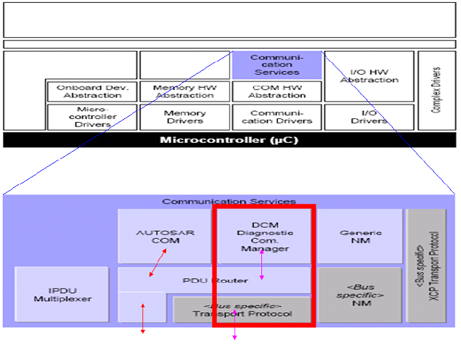
Position of the DCM module in AUTOSAR Architecture
UDS/DCM Sharing
Chassis Systems Control
Internal | Phan Hai Long | 10.12.15 | © Robert Bosch GmbH 2015. All rights reserved, also regarding any disposal, exploitation, reproduction, editing, distribution, as well as in the event of applications for industrial property rights.

Slide 19
DCM Overview
UDS/DCM Sharing
Overview: SW Context
Features
Design Aspects
Interfaces
Chassis Systems Control
Internal | Phan Hai Long | 10.12.15 | © Robert Bosch GmbH 2015. All rights reserved, also regarding any disposal, exploitation, reproduction, editing, distribution, as well as in the event of applications for industrial property rights.

Slide 20
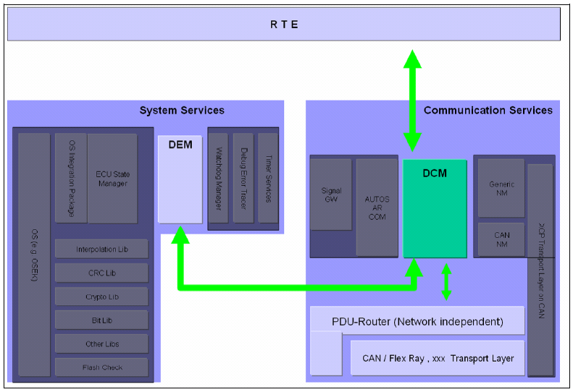
Connect with other modules
UDS/DCM Sharing
Chassis Systems Control
Internal | Phan Hai Long | 10.12.15 | © Robert Bosch GmbH 2015. All rights reserved, also regarding any disposal, exploitation, reproduction, editing, distribution, as well as in the event of applications for industrial property rights.

Slide 21
Features of Dcm
UDS/DCM Sharing
Handles UDS (ISO 14229) and OBD (ISO 15031-5) protocol
Diagnostic multi-channel capabilities not supported by Dcm
Network Independent Design (taken care by PduR)
Ensures flow of diagnostic data
Manages diagnostic states especially diagnostic sessions and security states
Provides all diagnostic services interfaces to the AUTOSAR-RTE
Dcm is part of the ComStack.
Chassis Systems Control
Internal | Phan Hai Long | 10.12.15 | © Robert Bosch GmbH 2015. All rights reserved, also regarding any disposal, exploitation, reproduction, editing, distribution, as well as in the event of applications for industrial property rights.

Slide 22
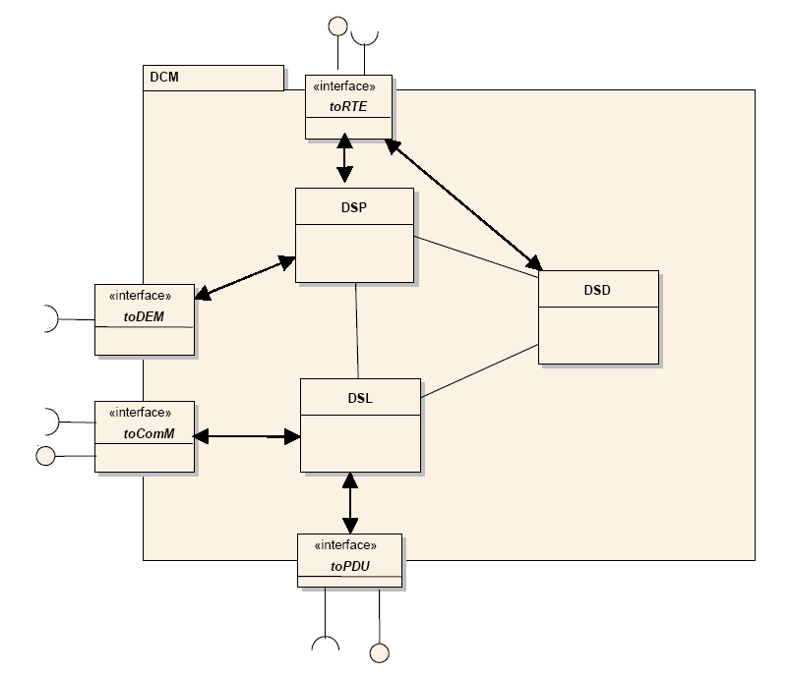
Dcm Features: Architecture Overview
UDS/DCM Sharing
Dcm internally consists of 3 building blocks:
Diagnostic Session Layer DSL
This part is responsible to receive the request, start the protocol, monitor the timings (P2max, S3max etc) and transmit the response.
Diagnostic Service Dispatcher DSD
This part DCM will verify the diagnostic data partially (verification of SID, allowed session and security). DSD will call the service function.
Diagnostic Service Processing DSP
This part of DCM contains the implemented standard services.
Chassis Systems Control
Internal | Phan Hai Long | 10.12.15 | © Robert Bosch GmbH 2015. All rights reserved, also regarding any disposal, exploitation, reproduction, editing, distribution, as well as in the event of applications for industrial property rights.

Slide 23
Dcm Features: Diagnostic Session Layer DSL
UDS/DCM Sharing
Request Handling
Forward requests from PDU Router to DSD
Concurrent functional “TesterPresent” (“keep alive logic”)
Response Handling
Forward responses from DSD to PDU Router
Guarantee response timing to tester by ResponsePending transmission
Support of periodic transmission (0x2A) and ResponseOnEvent (ROE) transmission (0x86)
Support of “Paged Buffer” concept for long responses
Security Level Handling
Manage security level
Session State Handling
Manage session state
Keep track of active non-default sessions
Informs depending modules on session change
Diagnostic Protocol Handling
  Handling of different diagnostic protocols (UDS on CAN, OBD on CAN, UDS on FlexRay)
Communication Mode Handling
Handling of communication requirements (Full- / Silent- / No Communication)
Indicating of active / inactive diagnostic
Enable / Disable all kinds of transmissions
Chassis Systems Control
Internal | Phan Hai Long | 10.12.15 | © Robert Bosch GmbH 2015. All rights reserved, also regarding any disposal, exploitation, reproduction, editing, distribution, as well as in the event of applications for industrial property rights.

Slide 24
Dcm Features: Diagnostic Service Dispatcher DSD
UDS/DCM Sharing
Service Dispatching
Support check of diagnostic service identifier and adaptation of the diagnostic message
Distribution of diagnostic message to service function (DSP or diagnostic application)
Service Verification
Verification functionality (session, security level, environment permission)
Response Assembling
Handling of “suppressPosRspMsgIndicationBit“
Assemble positive or negative response
Initiate transmission
Chassis Systems Control
Internal | Phan Hai Long | 10.12.15 | © Robert Bosch GmbH 2015. All rights reserved, also regarding any disposal, exploitation, reproduction, editing, distribution, as well as in the event of applications for industrial property rights.

Slide 25
Dcm Features: Diagnostic Service Processing DSP
UDS/DCM Sharing
According to AUTOSAR, Dcm implements several OBD and UDS services.
Emissions-Related Diagnostic Services
As CC ECUs are not OBD-relevant, none of those services are required.
AUTOSAR Dcm portfolio:
  Reading freeze-frame data (service 0x02)
  Accessing the fault data (service 0x03 and 0x07)
  Clearing fault data (service 0x04)
Unified Diagnostic Services
Error memory interface:
  Clear Diagnostic Information (service 0x14)
  Read DTC Information (service 0x19)
  Control DTC Setting (service 0x85)
Diagnostic communication and security:
  Diagnostic Session Control (service 0x10)
  Tester Present (service 0x3E)
  Security Access (service 0x27)
Chassis Systems Control
Internal | Phan Hai Long | 10.12.15 | © Robert Bosch GmbH 2015. All rights reserved, also regarding any disposal, exploitation, reproduction, editing, distribution, as well as in the event of applications for industrial property rights.

Slide 26
Agenda
UDS/DCM Sharing
Overview: SW Context
Features
Design Aspects
Interfaces
Chassis Systems Control
Internal | Phan Hai Long | 10.12.15 | © Robert Bosch GmbH 2015. All rights reserved, also regarding any disposal, exploitation, reproduction, editing, distribution, as well as in the event of applications for industrial property rights.

Slide 27
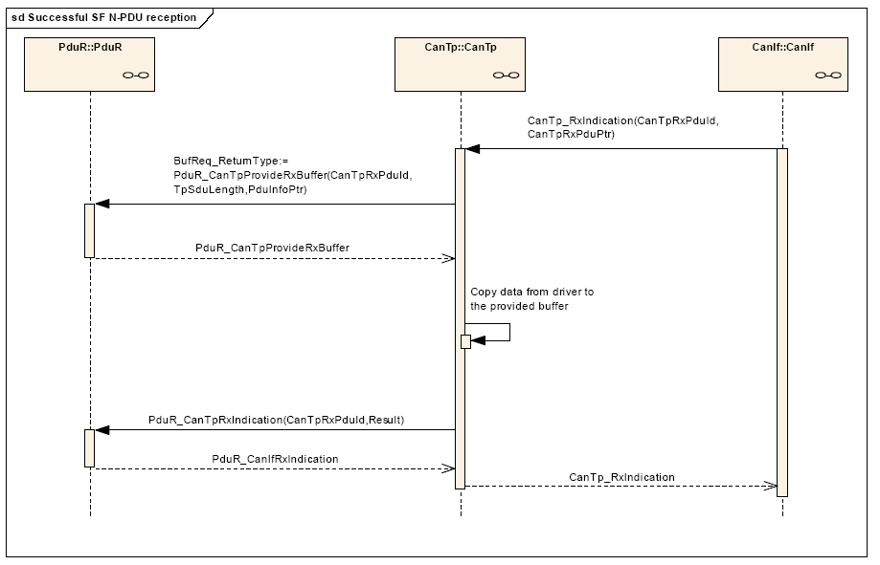
Design Aspects: Reception from TP
UDS/DCM Sharing
Chassis Systems Control
Internal | Phan Hai Long | 10.12.15 | © Robert Bosch GmbH 2015. All rights reserved, also regarding any disposal, exploitation, reproduction, editing, distribution, as well as in the event of applications for industrial property rights.

Slide 28
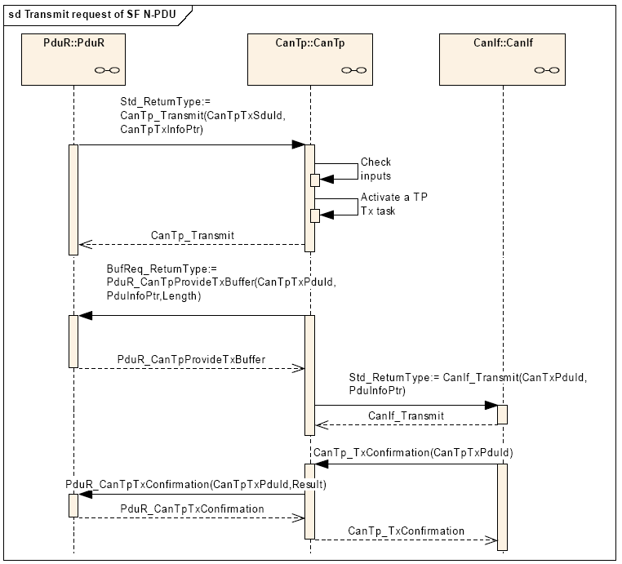
Design Aspects: Transmission to TP
UDS/DCM Sharing
Chassis Systems Control
Internal | Phan Hai Long | 10.12.15 | © Robert Bosch GmbH 2015. All rights reserved, also regarding any disposal, exploitation, reproduction, editing, distribution, as well as in the event of applications for industrial property rights.

Slide 29
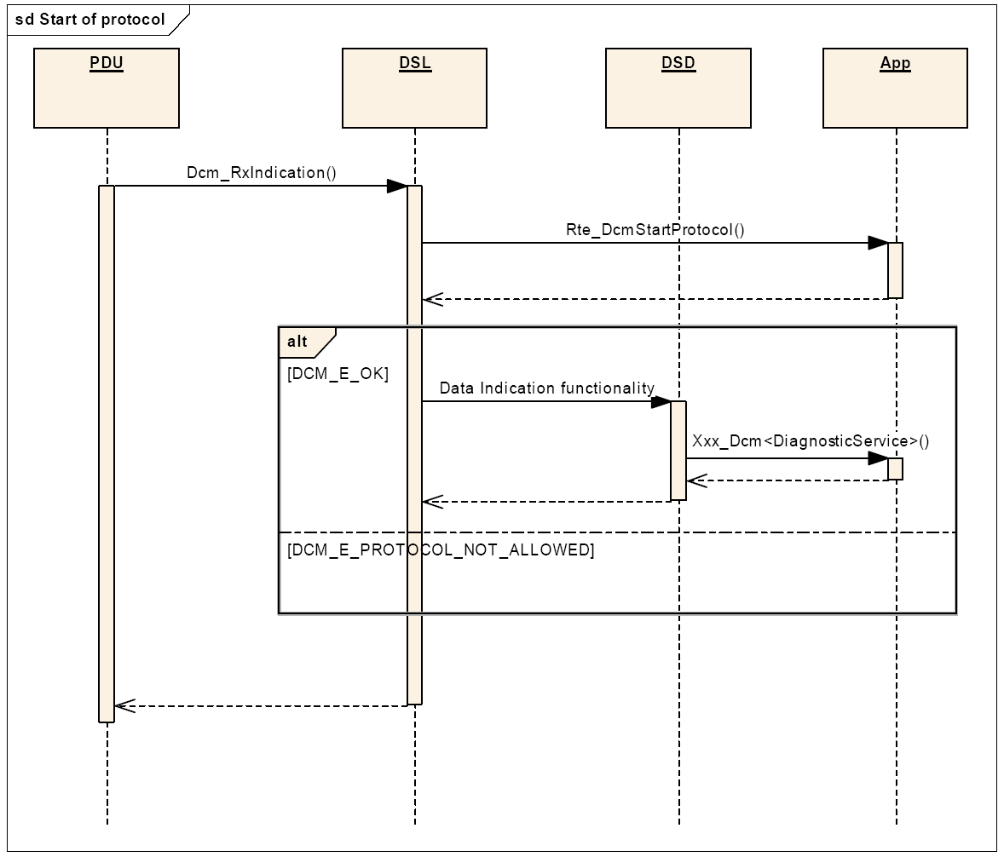
Design Aspects: Protocol Start
UDS/DCM Sharing
Chassis Systems Control
Internal | Phan Hai Long | 10.12.15 | © Robert Bosch GmbH 2015. All rights reserved, also regarding any disposal, exploitation, reproduction, editing, distribution, as well as in the event of applications for industrial property rights.

Slide 30
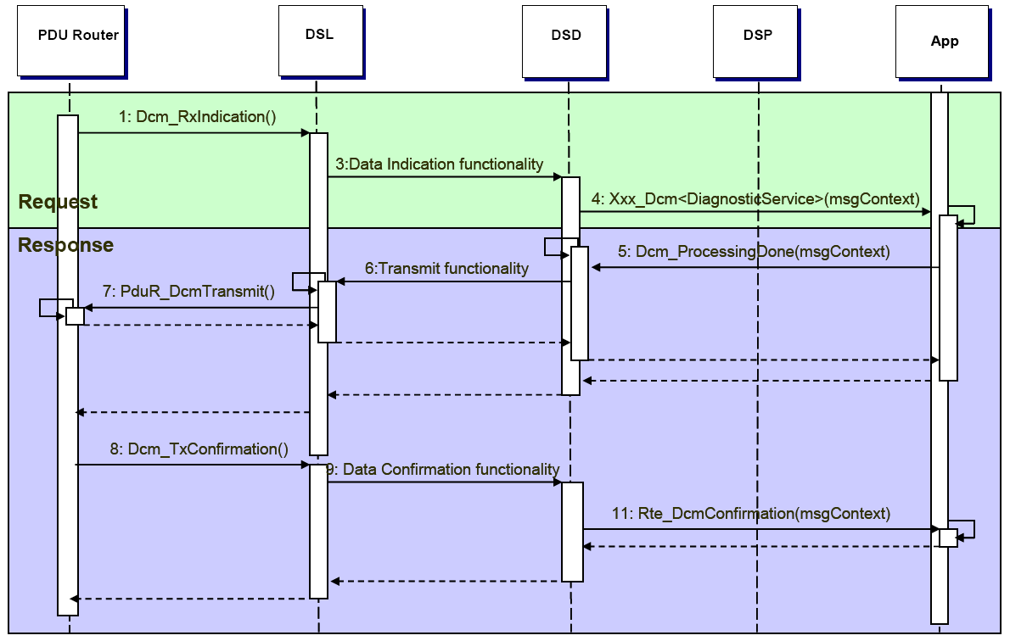
Design Aspects: Request Handling (1/4)
UDS/DCM Sharing
Request and Positive Response
Chassis Systems Control
Internal | Phan Hai Long | 10.12.15 | © Robert Bosch GmbH 2015. All rights reserved, also regarding any disposal, exploitation, reproduction, editing, distribution, as well as in the event of applications for industrial property rights.

Slide 31
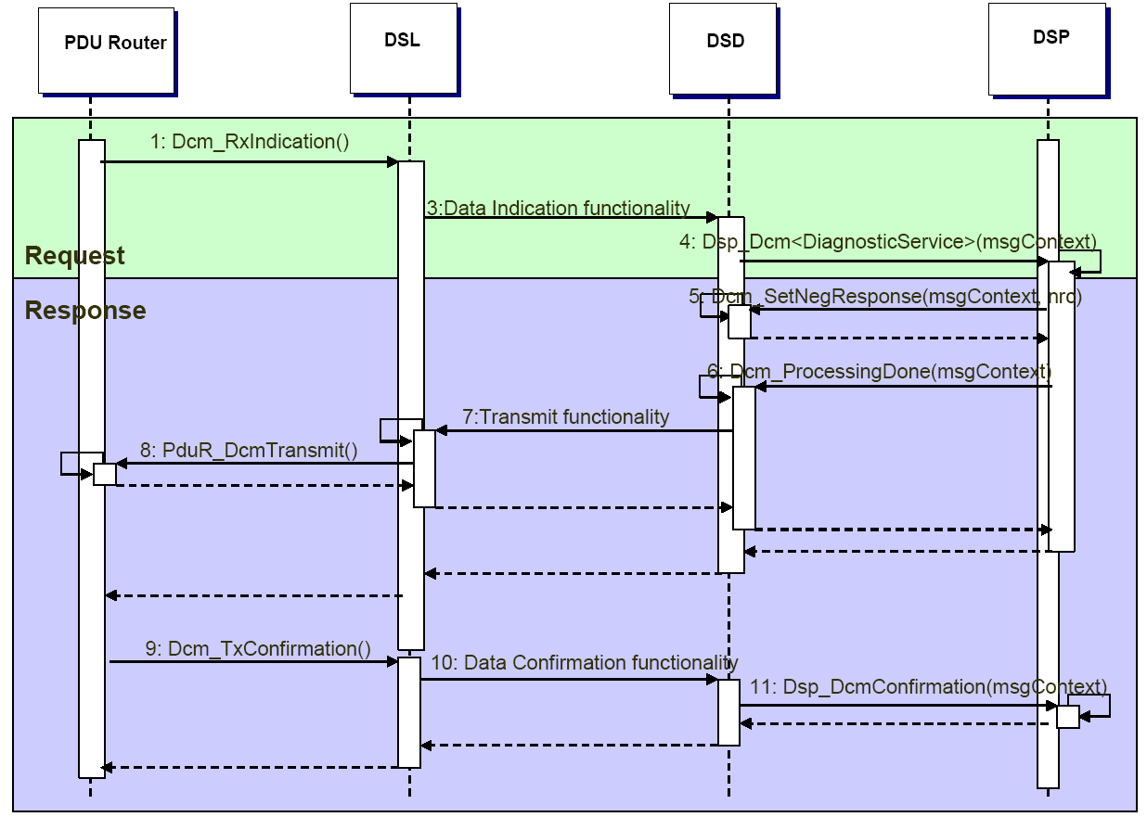
Design Aspects: Request Handling (2/4)
UDS/DCM Sharing
Request and Negative Response
Chassis Systems Control
Internal | Phan Hai Long | 10.12.15 | © Robert Bosch GmbH 2015. All rights reserved, also regarding any disposal, exploitation, reproduction, editing, distribution, as well as in the event of applications for industrial property rights.

Slide 32
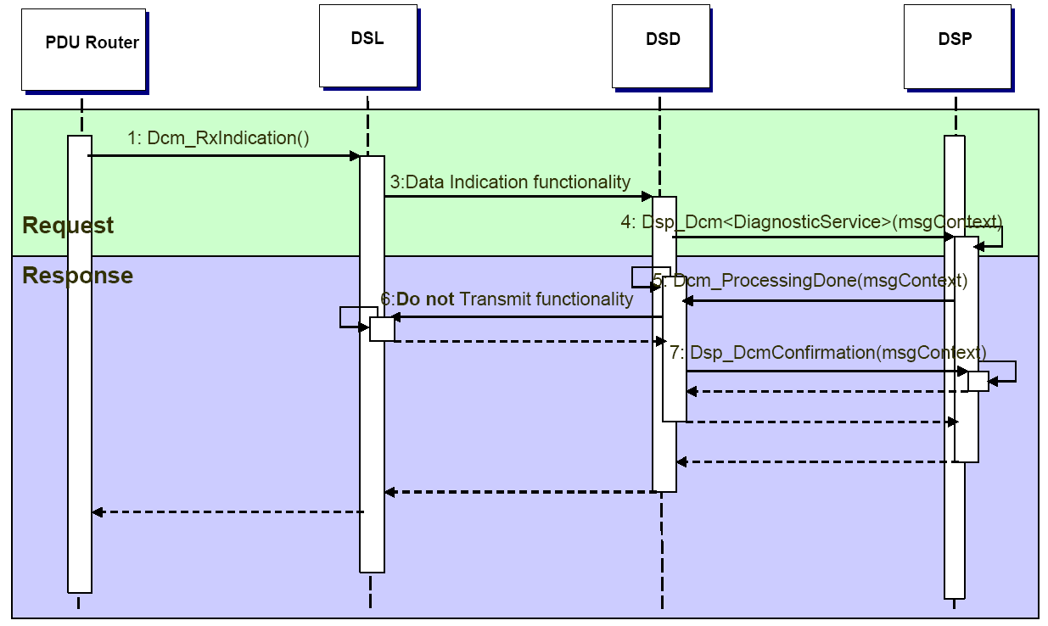
Design Aspects: Request Handling (3/4)
UDS/DCM Sharing
Request and no Response
Request no response from Dcm
Chassis Systems Control
Internal | Phan Hai Long | 10.12.15 | © Robert Bosch GmbH 2015. All rights reserved, also regarding any disposal, exploitation, reproduction, editing, distribution, as well as in the event of applications for industrial property rights.

Slide 33
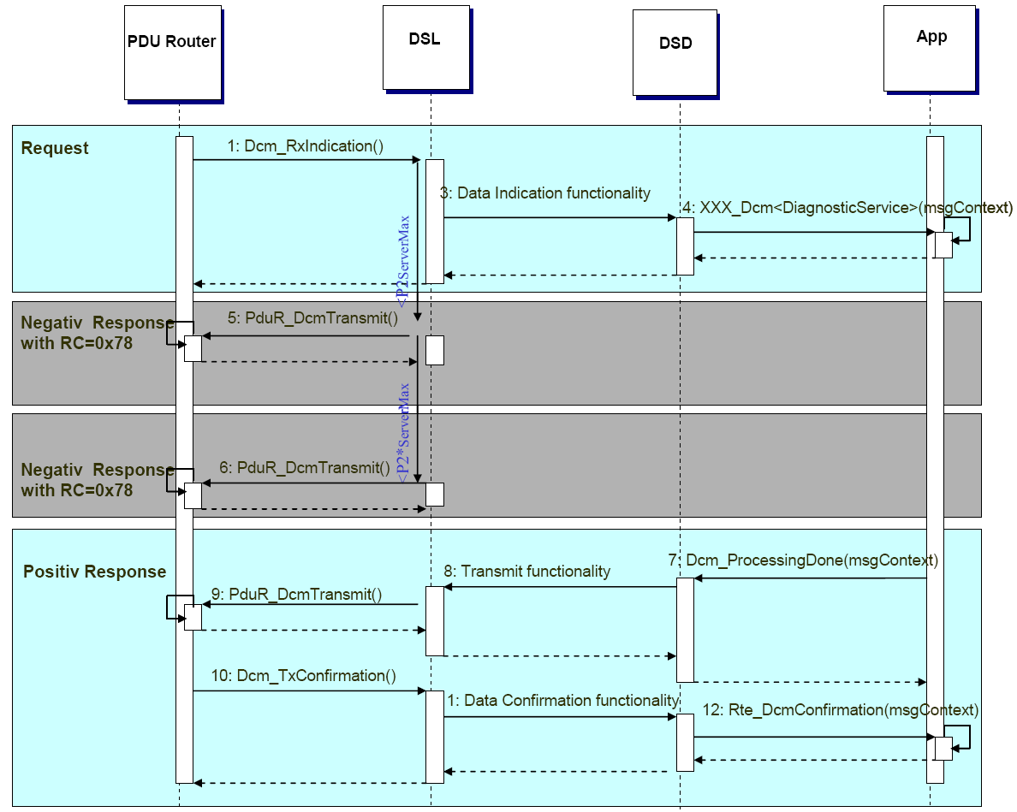
Design Aspects: Request Handling (4/4)
UDS/DCM Sharing
Request, ResponsePending and Positive Response
Chassis Systems Control
Internal | Phan Hai Long | 10.12.15 | © Robert Bosch GmbH 2015. All rights reserved, also regarding any disposal, exploitation, reproduction, editing, distribution, as well as in the event of applications for industrial property rights.

Slide 34
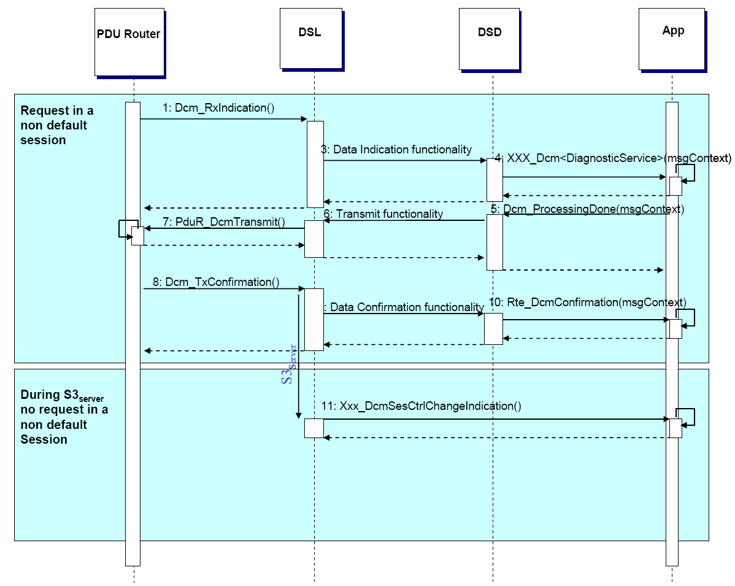
Design Aspects: S3max Timeout
UDS/DCM Sharing
Chassis Systems Control
Internal | Phan Hai Long | 10.12.15 | © Robert Bosch GmbH 2015. All rights reserved, also regarding any disposal, exploitation, reproduction, editing, distribution, as well as in the event of applications for industrial property rights.

Slide 35
DCM Overview
UDS/DCM Sharing
Overview: SW Context
Features
Design Aspects
Interfaces
Chassis Systems Control
Internal | Phan Hai Long | 10.12.15 | © Robert Bosch GmbH 2015. All rights reserved, also regarding any disposal, exploitation, reproduction, editing, distribution, as well as in the event of applications for industrial property rights.

Slide 36
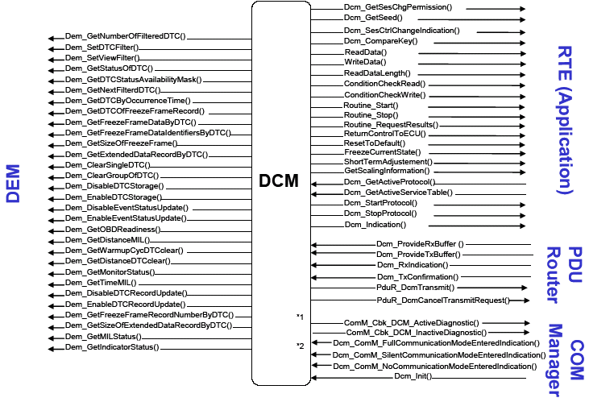
Interface between DCM and other modules
UDS/DCM Sharing
Chassis Systems Control
Internal | Phan Hai Long | 10.12.15 | © Robert Bosch GmbH 2015. All rights reserved, also regarding any disposal, exploitation, reproduction, editing, distribution, as well as in the event of applications for industrial property rights.

Slide 37
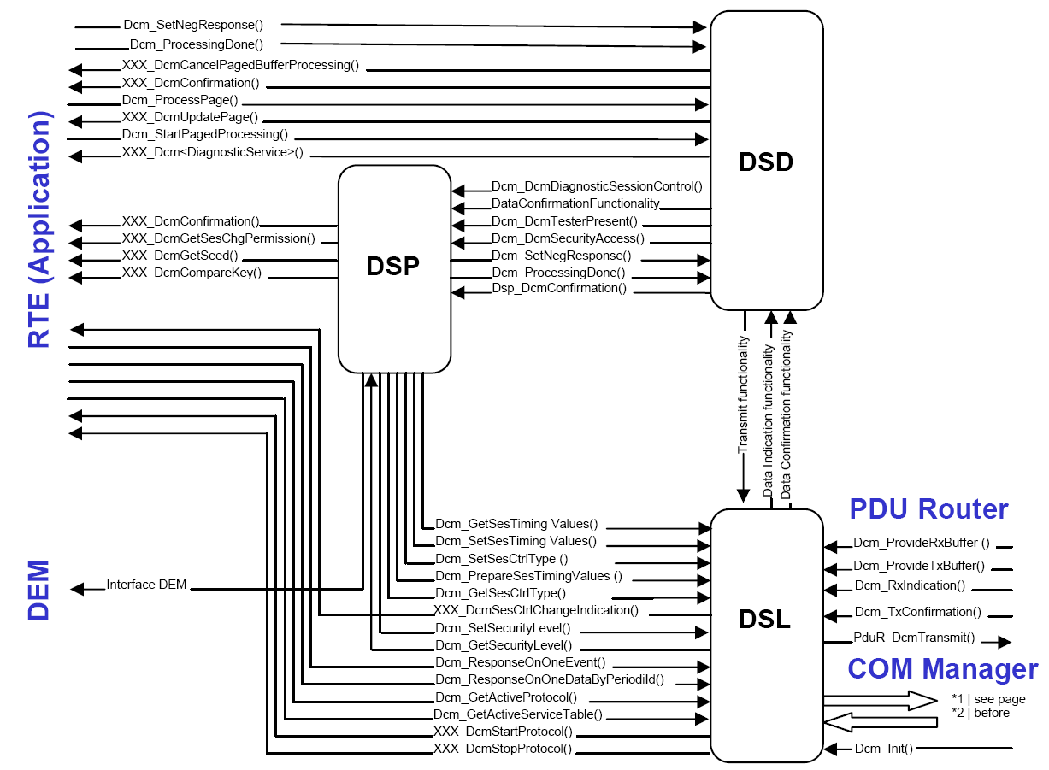
Interfaces within DCM
UDS/DCM Sharing
Chassis Systems Control
Internal | Phan Hai Long | 10.12.15 | © Robert Bosch GmbH 2015. All rights reserved, also regarding any disposal, exploitation, reproduction, editing, distribution, as well as in the event of applications for industrial property rights.

Slide 38
Example of implementation of DCM according to UDS
UDS/DCM Sharing
Change Diagnostic Session (0x10) Service
Security Access (0x27) Service
Chassis Systems Control
Internal | Phan Hai Long | 10.12.15 | © Robert Bosch GmbH 2015. All rights reserved, also regarding any disposal, exploitation, reproduction, editing, distribution, as well as in the event of applications for industrial property rights.

Slide 39
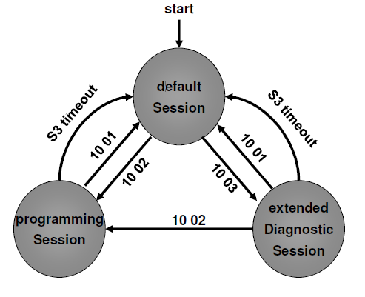
Example of implementation of DCM according to UDS
UDS/DCM Sharing
Change Diagnostic Session (0x10) Service
Chassis Systems Control
Internal | Phan Hai Long | 10.12.15 | © Robert Bosch GmbH 2015. All rights reserved, also regarding any disposal, exploitation, reproduction, editing, distribution, as well as in the event of applications for industrial property rights.

Slide 40
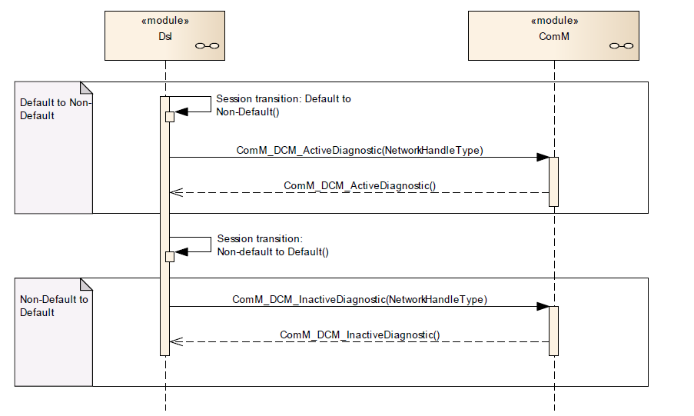
Example of implementation of DCM according to UDS
UDS/DCM Sharing
Change Diagnostic Session (0x10) Service
Chassis Systems Control
Internal | Phan Hai Long | 10.12.15 | © Robert Bosch GmbH 2015. All rights reserved, also regarding any disposal, exploitation, reproduction, editing, distribution, as well as in the event of applications for industrial property rights.

Slide 41
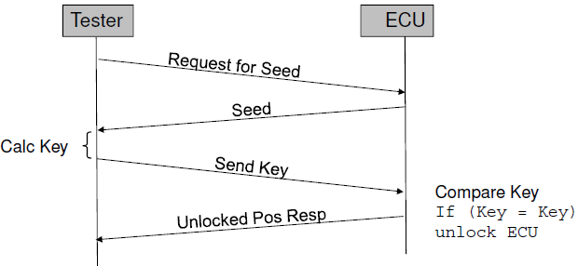
Example of implementation of DCM according to UDS
UDS/DCM Sharing
Security Access (0x27) Service
Chassis Systems Control
Internal | Phan Hai Long | 10.12.15 | © Robert Bosch GmbH 2015. All rights reserved, also regarding any disposal, exploitation, reproduction, editing, distribution, as well as in the event of applications for industrial property rights.

Slide 42
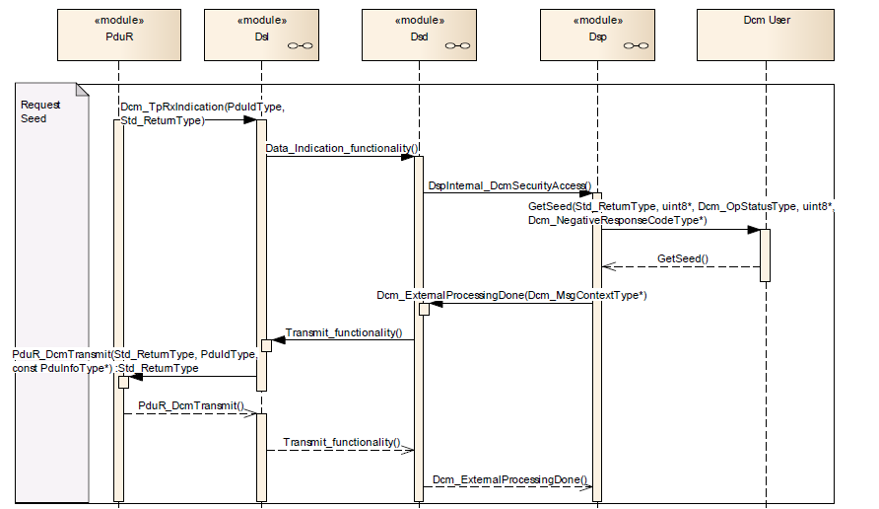
Example of implementation of DCM according to UDS
UDS/DCM Sharing
Security Access (0x27) Service: Request Seed
Chassis Systems Control
Internal | Phan Hai Long | 10.12.15 | © Robert Bosch GmbH 2015. All rights reserved, also regarding any disposal, exploitation, reproduction, editing, distribution, as well as in the event of applications for industrial property rights.

Slide 43
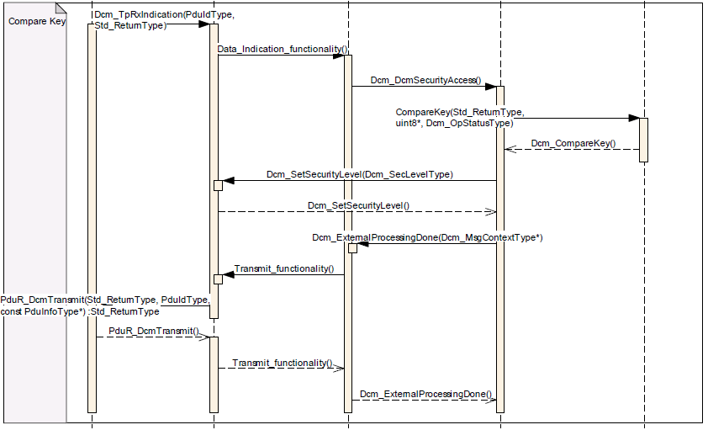
Example of implementation of DCM according to UDS
UDS/DCM Sharing
Security Access (0x27) Service: Compare Key
Chassis Systems Control
Internal | Phan Hai Long | 10.12.15 | © Robert Bosch GmbH 2015. All rights reserved, also regarding any disposal, exploitation, reproduction, editing, distribution, as well as in the event of applications for industrial property rights.

Slide 44
UDS/DCM Sharing
- Q & A -
Chassis Systems Control
Internal | Phan Hai Long | 10.12.15 | © Robert Bosch GmbH 2015. All rights reserved, also regarding any disposal, exploitation, reproduction, editing, distribution, as well as in the event of applications for industrial property rights.

Slide 45
UDS/DCM Sharing
- END -
Chassis Systems Control
Internal | Phan Hai Long | 10.12.15 | © Robert Bosch GmbH 2015. All rights reserved, also regarding any disposal, exploitation, reproduction, editing, distribution, as well as in the event of applications for industrial property rights.

