Slide 1


Slide 2
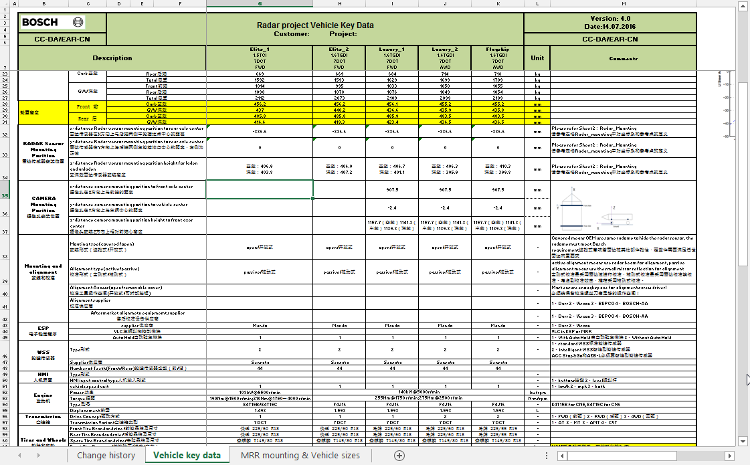
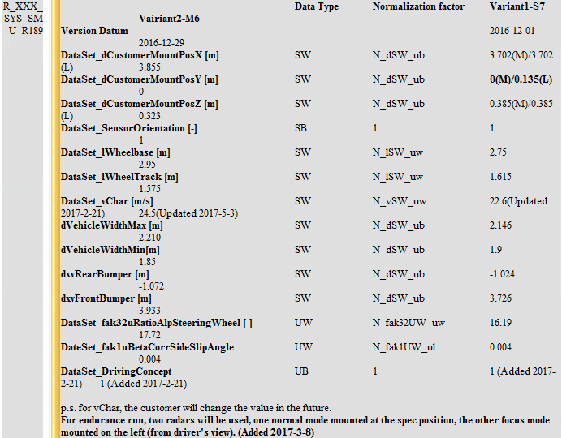
Background
Variant coding
Vehicle key parameter sheet
Requirement from EHY to SMU
Normal requirements:
+ During variant coding, a “Variant code” is written in to NVM
+ Vehicle parameters is updated depending on the “Variant code”
+ Variant coding is not required after reprogramming
2
RBVH/ESS13 | 8/9/2017
© Robert Bosch Engineering and Business Solutions Vietnam Company Limited 2017. All rights reserved, also regarding any disposal, exploitation, reproduction, editing, distribution, as well as in the event of applications for industrial property rights.

Slide 3
Relevant topics
Variant coding
How to identify “Variant not done”?
How to ensure the matching between “Variant code” and vehicle parameters?
What happens if customer change the default parameter value?
What happens if customer change the parameter value of some variants?
What happens if customer/EHY add/remove some parameters?
What happen if customer change the default variant in default packet?
3
RBVH/ESS13 | 8/9/2017
© Robert Bosch Engineering and Business Solutions Vietnam Company Limited 2017. All rights reserved, also regarding any disposal, exploitation, reproduction, editing, distribution, as well as in the event of applications for industrial property rights.

Slide 4
Method 1
Variant coding
DIA_X_NVM_DATASET_DOWNLOAD_PACKET_ST
UBYTE Version_ub;
UBYTE VariantCode_ub;
<vehicle parameter>
= x
Write request
Variant data array
< Dataset 1 >
< Dataset x >
…
< Dataset n >
Write NVM
4
RBVH/ESS13 | 8/9/2017
© Robert Bosch Engineering and Business Solutions Vietnam Company Limited 2017. All rights reserved, also regarding any disposal, exploitation, reproduction, editing, distribution, as well as in the event of applications for industrial property rights.

Slide 5
Method 1
Variant coding
Advantage
Simple way to implement variant coding.
Reduce NVM writing process (only 1 NVM packet need to be written in variant coding)
Disadvantage
“Variant code” will be lost when Version_ub in default packet is changed due to customer request.
5
RBVH/ESS13 | 8/9/2017
© Robert Bosch Engineering and Business Solutions Vietnam Company Limited 2017. All rights reserved, also regarding any disposal, exploitation, reproduction, editing, distribution, as well as in the event of applications for industrial property rights.

Slide 6
Method 2
Variant coding
DIA_X_NVM_CODING_DATA_PACKET_ST
UBYTE Version_ub;
UBYTE VariantCode_ub;
…….
[UBYTE VariantDone_ub;]
= x
Write request
Variant data array
DIA_X_NVM_DATASET_DOWNLOAD_PACKET_ST
< Dataset 1 >
< Dataset x >
…
< Dataset n >
UBYTE Version_ub;
<vehicle parameter>
Write NVM
6
RBVH/ESS13 | 8/9/2017
© Robert Bosch Engineering and Business Solutions Vietnam Company Limited 2017. All rights reserved, also regarding any disposal, exploitation, reproduction, editing, distribution, as well as in the event of applications for industrial property rights.

Slide 7
Method 2
Variant coding
Advantage
“Variant code” is in independent NVM packet with vehicle parameter
Disadvantage
May need a mechanism to ensure the matching between “Variant code” and vehicle parameters.
7
RBVH/ESS13 | 8/9/2017
© Robert Bosch Engineering and Business Solutions Vietnam Company Limited 2017. All rights reserved, also regarding any disposal, exploitation, reproduction, editing, distribution, as well as in the event of applications for industrial property rights.

Slide 8
Method 3
Variant coding
DIA_X_NVM_CODING_DATA_PACKET_ST
UBYTE Version_ub;
UBYTE VariantCode_ub;
…….
[UBYTE VariantDone_ub;]
= x
Write request
DIA_X_NVM_DATASET_DOWNLOAD_PACKET_ST
Variant data array
UBYTE Version_ub;
UBYTE VariantCode_ub;
<vehicle parameter>
< Dataset 1 >
< Dataset x >
…
< Dataset n >
Write NVM
8
RBVH/ESS13 | 8/9/2017
© Robert Bosch Engineering and Business Solutions Vietnam Company Limited 2017. All rights reserved, also regarding any disposal, exploitation, reproduction, editing, distribution, as well as in the event of applications for industrial property rights.

Slide 9
Method 3
Variant coding
Advantage
Have a field for easy checking the matching between “Variant code” and vehicle parameters.
Disadvantage
The “variant code” information is duplicated in 2 NVM packet
Still need to check the matching of 2 “variant code”
9
RBVH/ESS13 | 8/9/2017
© Robert Bosch Engineering and Business Solutions Vietnam Company Limited 2017. All rights reserved, also regarding any disposal, exploitation, reproduction, editing, distribution, as well as in the event of applications for industrial property rights.

Slide 10
Relevant topics – Some solutions
Variant coding
How to identify “Variant not done”?
S1: set invalid value for default packet, if NVM value equals default packet -> Coding not done
S2: Use an extra NVM field “Variant done”. This NVM field shall be in “rarely modified” packet.
How to ensure the matching between “Variant code” and vehicle parameters?
For M1: We can assume they are matched. Further check may be optional.
For M2: Call a function in Task Init to compare the data set in “Variant data array” and data in NVM
For M3: Call a function in Task Init to compare “Variant code”
10
RBVH/ESS13 | 8/9/2017
© Robert Bosch Engineering and Business Solutions Vietnam Company Limited 2017. All rights reserved, also regarding any disposal, exploitation, reproduction, editing, distribution, as well as in the event of applications for industrial property rights.

Slide 11
Relevant topics – Some solutions
Variant coding
What happens if customer change the default parameter value?
For M1: If the default value is changed and “Version_ub” is updated, then “Variant code” value will be lost after reprogramming → Have to perform variant coding again. Possible solution: update default packet without changing “Version_ub”.
For M2: The function in Task Init will copy relevant parameter value from “Variant data array” to NVM packet in case of mismatch in vehicle parameter.
For M3: The function in Task Init will copy relevant parameter value from “Variant data array” to NVM packet in case of mismatch in “variant code”.
What happens if customer change the parameter value of some variants?
For M1,M2: The function in Task Init will copy relevant parameter value from “Variant data array” to NVM packet in case of mismatch in vehicle parameter
For M3: The function in Task Init will copy relevant parameter value from “Variant data array” to NVM packet in case of mismatch in “variant code”
11
RBVH/ESS13 | 8/9/2017
© Robert Bosch Engineering and Business Solutions Vietnam Company Limited 2017. All rights reserved, also regarding any disposal, exploitation, reproduction, editing, distribution, as well as in the event of applications for industrial property rights.

Slide 12
Relevant topics – Some solutions
Variant coding
What happens if customer/EHY add/remove some parameters?
For M1: If the default value is changed and “Version_ub” is updated, then “Variant code” value will be lost after reprogramming → Have to perform variant coding again.
Possible solution: Reserve some field in NVM in advance. Update default packet without changing “Version_ub”.
For M2: The function in Task Init will copy relevant parameter value from “Variant data array” to NVM packet in case of mismatch in vehicle parameter.
For M3: The function in Task Init will copy relevant parameter value from “Variant data array” to NVM packet in case of mismatch in “variant code”.
What happen if customer change the default variant in default packet?
Shall clarify the use case with customer, confirm whether customer want to keep the “variant code” in new default packet or in current ECU.
Note: If “variant code” and “variant done” are in same NVM packet, the change in default packet of “variant code” may lead to resetting the value of “variant done”
12
RBVH/ESS13 | 8/9/2017
© Robert Bosch Engineering and Business Solutions Vietnam Company Limited 2017. All rights reserved, also regarding any disposal, exploitation, reproduction, editing, distribution, as well as in the event of applications for industrial property rights.

Slide 13
Awareness
Variant coding
Some recommended requirement:
Should clear variant before rewrite variant code → set alignment not done fault
In “variant data array”, every parameter set can contain variant code information to ensure the consistency of parameter set and variant code.
Customer may have different models which use the same sandbox. In some model variant coding is required while some others do not need variant coding → need a NVM field to check whether the current parameter value is relevant to current model.
Can have a NVM field to indicate whether default packet should be updated in NVM Ram or not
13
RBVH/ESS13 | 8/9/2017
© Robert Bosch Engineering and Business Solutions Vietnam Company Limited 2017. All rights reserved, also regarding any disposal, exploitation, reproduction, editing, distribution, as well as in the event of applications for industrial property rights.

