Slide 1

AJAX /On-Demand JavaScript:
A New Vision for Web-Based Chemistry Applications
Robert M. Hanson
St. Olaf College
19th BCCE
Purdue University
West Lafayette, Indiana
August 1, 2006

Slide 2
The plan…
Identify the problem
briefly introduce two of the latest
buzzwords in web technology:
  AJAX
  On-Demand JavaScript
provide some examples:
  Google Suggests
  AJAX Hyperglossary
  GoogleIndex
  Jmol Crystal Explorer
  On-Demand JavaScript Chemistry Toolkit

Slide 3

CAUTION!
This presentation includes content that may not be appropriate for all audiences. Its bleeding edge examples have not been approved by the Code Writer’s Guild of America.
Many of these examples were written last night.
Your results may differ.

Slide 4


Slide 5


Slide 6
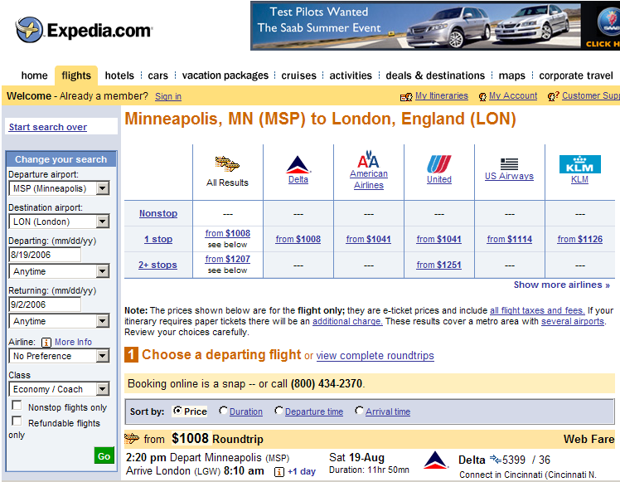

Slide 8
http://labs.google.com/suggest

Slide 9
AJAX
Shorthand for Asynchronous JavaScript and XML, AJAX is a web development technique for creating interactive web applications.
The intent is to make web pages feel more responsive by exchanging small amounts of data with the server behind the scenes, so that the entire web page does not have to be reloaded each time the user makes a change.
This is meant to increase the web page's interactivity, speed, and usability.
http://en.wikipedia.org/wiki/AJAX

Slide 10
AJAX
Asynchronous JavaScript and XML
User can keep working.
Behind the scenes.
Doesn’t open a new page.
NOT form-based.

Slide 11
AJAX
Asynchronous JavaScript and XML
Original implementation based on a JavaScript function introduced by Microsoft in 2000, XMLHttpRequest().
“Behind-the-scenes” communication with a server – no <form> submission involved.
Basically a miniature Java applet.

Slide 12
AJAX
Asynchronous JavaScript and XML
Originally envisioned as a way to deliver XML data to a web page.

Slide 13
AJAX
Asynchronous JavaScript and XML
eXtensible Markup Language - an extension of HTML
<molecule>
<atomArray>
<atom id="a1" elementType="O" x3="1.38329439136044"
y3="3.33065066870283" z3="7.66923161156146">
</atom>
<atom id="a2" elementType="C" x3="1.65759755962943"
y3="3.50573042198838" z3="6.34487662670248">
</atom>
…
</atomArray>
</molecule>

Slide 14
AJAX
Asynchronous JavaScript and XML
More commonly used to deliver JavaScript instead, which can be evaluated in the browser.

Slide 15
http://www.ualr.edu/rebelford/

Slide 16
AJAX
Asynchronous JavaScript and XML
Problem: XMLHttpRequest() can only be used to get new data from the page’s host computer. This is a built-in security feature.
What if we want to get data from a different host?
…

Slide 17
http://www.stolaf.edu/people/hansonr/ajax/ajax.htm?

Slide 18
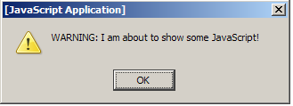
On-Demand JavaScript
<script type="text/javascript" id="scriptnode"></script>

Slide 19
On-Demand JavaScript
<script type="text/javascript" id="scriptnode"></script>
document.getElementById(“scriptnode”).src= “http://www.google.com/complete/search? js=true & qu=ethanol”
sendRPCDone(…, "ethanol",
new Array("ethanol", "ethanol msds", …, new Array("4,630,000 results", "60,600 results", …);
…

Slide 20
http://www.stolaf.edu/people/hansonr/ajax/ajax.htm?

Slide 21
http://fusion.stolaf.edu/chemistry/jmol/xtalx

Slide 22
http://www.stolaf.edu/people/hansonr/test/proto/poly.htm

Slide 23
On-Demand JavaScript
Allows for asynchronous data transfer between browser and server.
Allows for a more interactive browser session – no page reloading; no waiting until the SUBMIT button is pressed.
Allows for essentially immediate feedback.
Allows data transfer from multiple hosts.

Slide 24
On-Demand JavaScript
Three possible uses:
multiple-choice testing/quiz feedback
seamless dictionary/glossary tie-ins
user activity logging

Slide 25
Click JavaScript
An idea involving modular components
Wouldn’t it be great if, at the click of the mouse, we could call in a fully functional interactive periodic table or a molecular visualization or an equation-solving calculator or … what else?
…

Slide 26

A proposal: On-Demand JavaScript Chemistry Toolkit
Many thanks to: Bob Belford, Jon Holmes, Miguel Howard, Egon Willighagen, Nico Vervelle, Jmol user group, and the GoogleLabs team.
http://www.stolaf.edu/people/hansonr/ajax/click.htm

