Slide 1
The Challenge of Web-Based Molecular Visualization
Robert M. Hanson
St. Olaf College
NOTE: THIS PRESENTATION REQUIRES A WINDOWS PC WITH THE LiveWeb POWERPOINT ADD-IN.

Slide 2
The Challenge of Web-Based Molecular Visualization
Robert M. Hanson
St. Olaf College
Cologne University
August 21, 2006

Slide 3
The Challenge of Web-Based Molecular Visualization
Robert M. Hanson
St. Olaf College
Radboud University, Nijmegen
August 23, 2006

Slide 4
The Challenge of Web-Based Molecular Visualization
Robert M. Hanson
St. Olaf College
Cambridge University
August 25, 2006

Slide 5
This talk is about visualization – but not just any kind. It is about my favorite kind of visualization – molecular visualization.
But first, let’s think about visualization in general…. Why visualize?

Slide 6
Graphical visualization
0,1.00
0.500,1.04
1.000,1.09
1.500,1.13
2.000,1.18
2.500,1.22
3.000,1.27
3.500,1.32
4.000,1.37
4.500,1.42
5.000,1.48
5.500,1.54
6.000,1.60
6.500,1.67
7.000,1.75
7.500,1.85
8.000,1.95
8.500,2.09
9.000,2.28
9.500,2.59
10.000,7.00
10.500,11.39
11.000,11.68
11.500,11.84
12.000,11.96
12.500,12.05
13.000,12.12
13.500,12.17
14.000,12.22
14.500,12.26
15.000,12.30
15.500,12.33
16.000,12.36
16.500,12.39
17.000,12.41
17.500,12.44
18.000,12.46
18.500,12.47
19.000,12.49
19.500,12.51
20.000,12.52
What are we looking at?

Slide 7
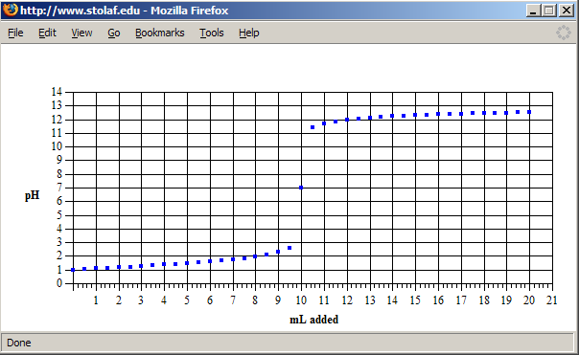
Graphical visualization
A titration curve.

Slide 8
Graphical visualization
time(sec) [NO2]
0 0.0100
50 0.0079
0.0065
0.0048
300 0.0038
What have we here?

Slide 9
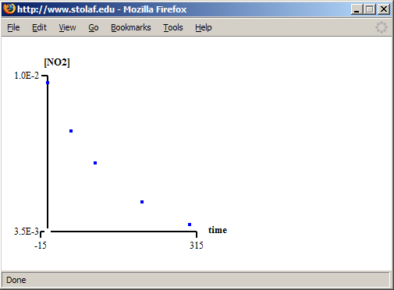
Graphical visualization
Ah, yes, but what kind of reaction kinetics?

Slide 10
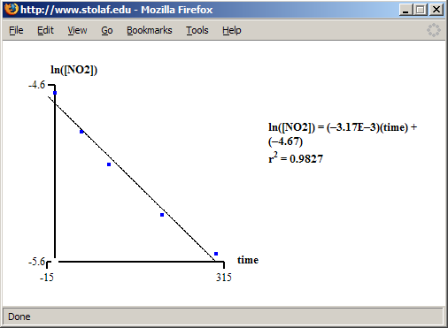
Graphical visualization
Not first order…

Slide 11
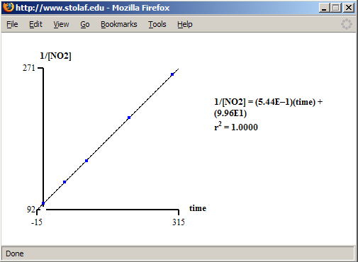
Graphical visualization
Second order, it is!

Slide 12


Slide 13
Graphical visualization
J. Willard Gibbs:
“To fix our ideas, let the axes of ν, η, and ε have the directions usually given to the axes of X, Y, and Z (ν increasing to the right, η forward, and ε upward). The pressure and temperature of the state represented by any point of the surface are equal to the tangents of the inclinations of the surface to the horizon at that point, as measured in planes perpendicular to the axes of η and of ν, respectively….“
A Method of Geometrical Representation of the Thermodynamic Properties of Substances by Means of Surfaces Transactions of the Connecticut Academy, II, pp 382-404, Dec. 1873.

Slide 14
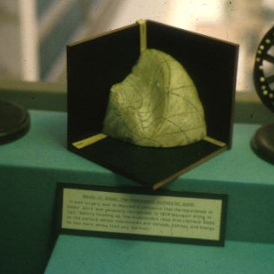
Graphical visualization
Maxwell’s plaster model of Gibbs’s surface
Photo: Thomas G. West
http://krasnow.gmu.edu/twest/maxwell_visual.html
http://old.siggraph.org/publications/newsletter/v33n1/index.html

Slide 15
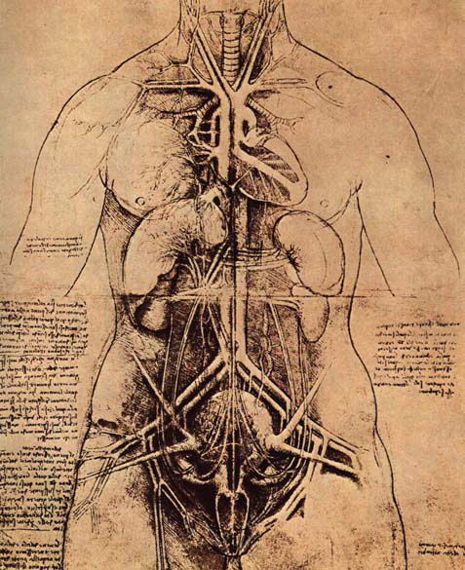
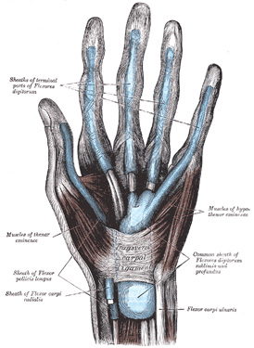
Medical visualization

Slide 16
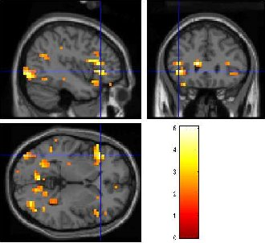
Medical visualization

Slide 18

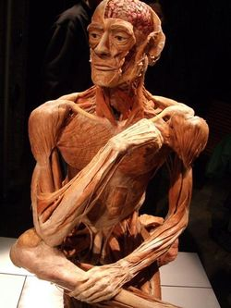
Körperwelten

Slide 19
The point?
Visualization takes many forms.
Sometimes getting the right visualization is critical.
Many amazing forms of visualization are appearing.
Visualization doesn’t have to be perfectly “realistic” – and in fact sometimes should not be photorealistic.

Slide 20
Molecular visualization
Friedrich August Kekulé concludes that the structure of benzene is a closed, hexagonal, six-membered ring after a visionary dream.
"...I was sitting writing on my textbook, but the work did not progress; my thoughts were elsewhere. I turned my chair to the fire and dozed. Again the atoms were gamboling before my eyes. This time the smaller groups kept modestly in the background. My mental eye, rendered more acute by the repeated visions of the kind, could now distinguish larger structures of manifold conformation; long rows sometimes more closely fitted together all twining and twisting in snake-like motion. But look! What was that? One of the snakes had seized hold of its own tail, and the form whirled mockingly before my eyes. As if by a flash of lightning I awoke; and this time also I spent the rest of the night in working out the consequences of the hypothesis."
Royston M. Roberts, Serendipidty, Accidental Discoveries in Science , John Wiley and Sons, New York, NY,1989, pp. 75-81.
http://www.chemsoc.org/timeline/pages/1864_benzene.html

Slide 21
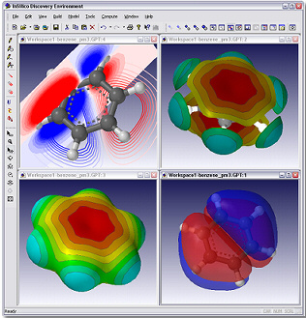
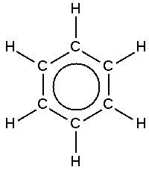
Molecular visualization

Slide 22

Molecular visualization
Bob, turn on the sound now.

Slide 24
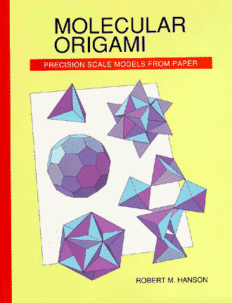
Molecular visualization
http://www.uscibooks.com/hansonnb.htm

Slide 25
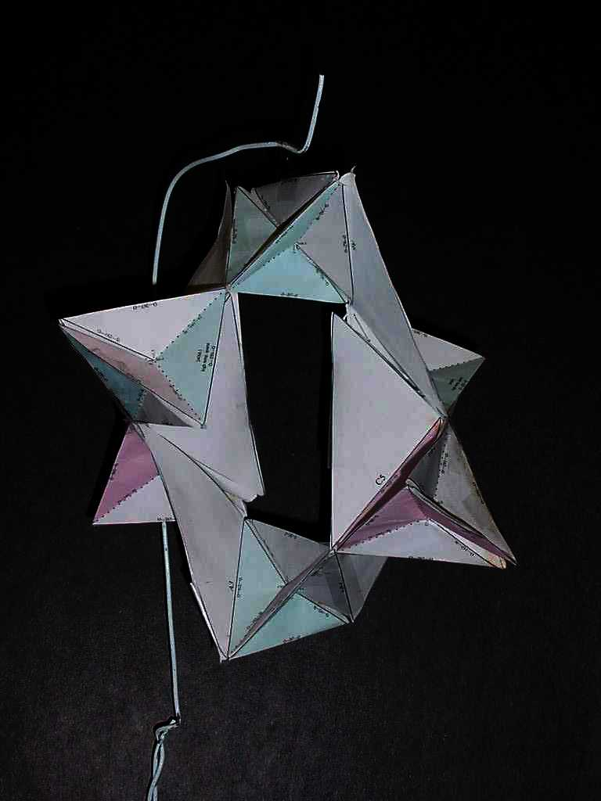
Molecular visualization
quartz helix

Slide 26
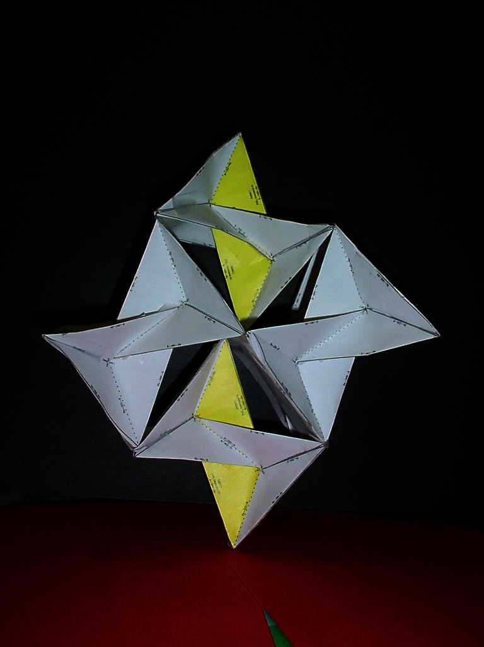
Molecular visualization
marcasite

Slide 27
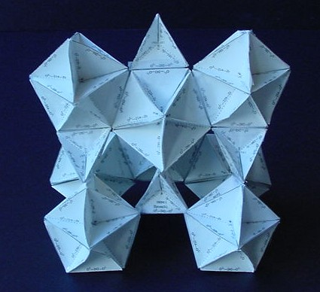
Molecular visualization
zircon

Slide 28
http://www.stolaf.edu/academics/chemapps/jmol/docs/examples-11/zircon.htm

Slide 29
http://www.stolaf.edu/academics/chemapps/jmol/docs/misc/bob.htm

Slide 30
http://www.stolaf.edu/depts/chemistry/mo/struc

Slide 31
Web-base molecular visualization
Challenges include:
Realistic rendering
Speed
Scalability
Surface rendering

Slide 32
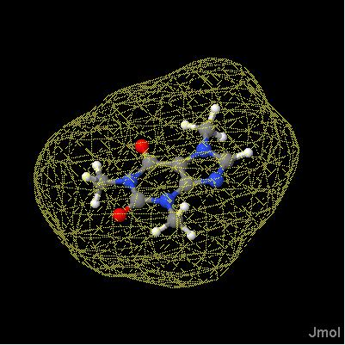
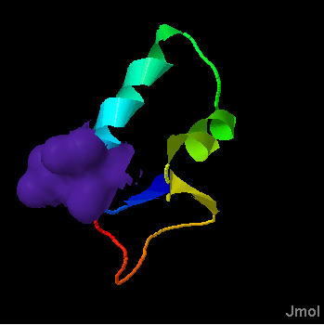
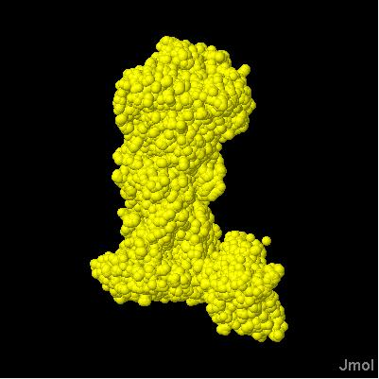
Web-base molecular visualization
Applications of isosurfaces:
molecular/solvent surfaces

Slide 33
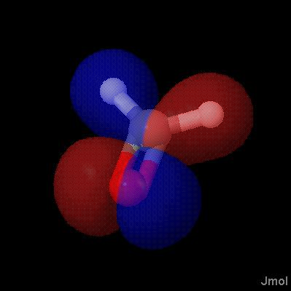
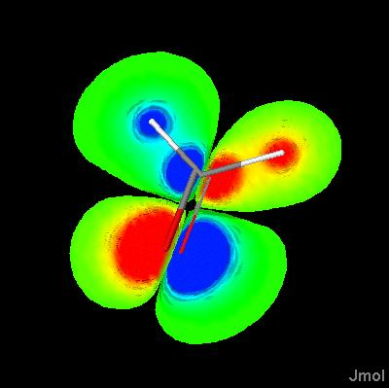
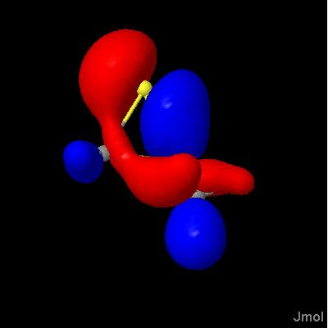
Web-base molecular visualization
Applications of isosurfaces:
molecular orbitals

Slide 34
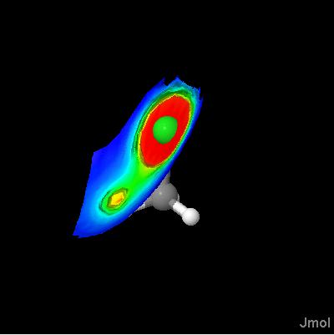
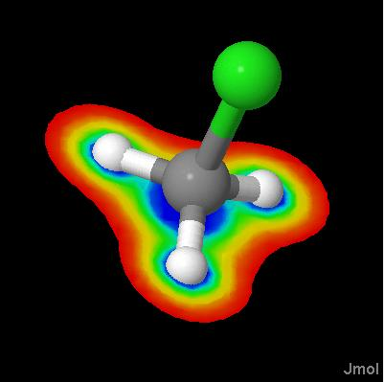
Web-base molecular visualization
Applications of isosurfaces:
electrostatic potentials

Slide 35
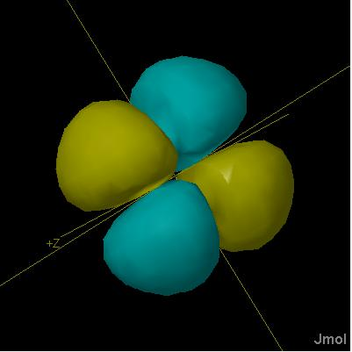
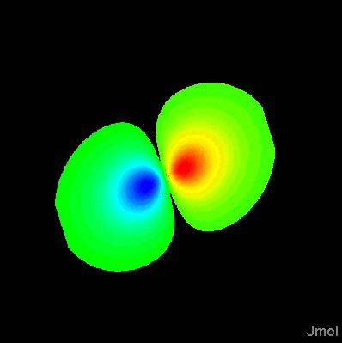
Web-base molecular visualization
Applications of isosurfaces:
atomic orbitals

Slide 36
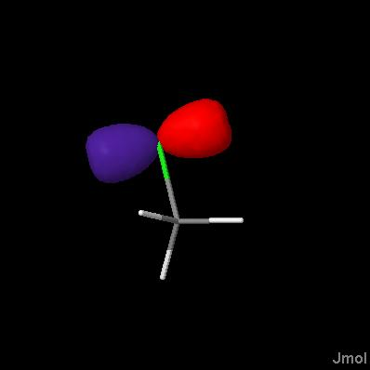
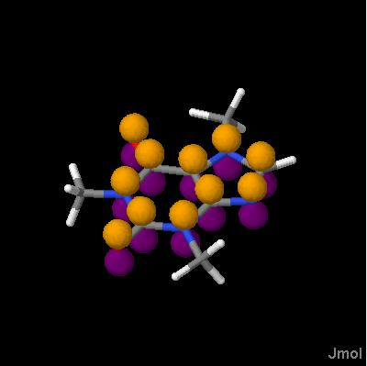
Web-base molecular visualization
Applications of isosurfaces:
LCAO “cartoons”

Slide 37
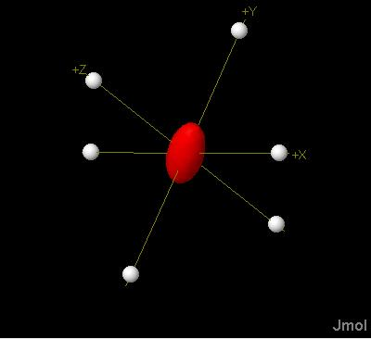
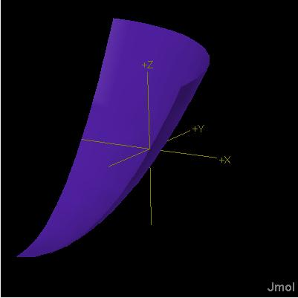
Web-base molecular visualization
Applications of isosurfaces:
ellipsoids and
user-defined functions

Slide 38
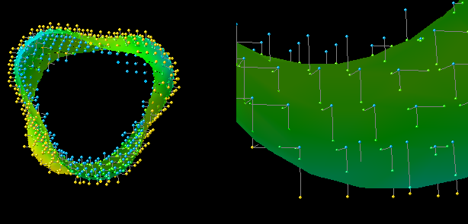
Web-base molecular visualization
Isosurface Implementation in Jmol:
Adapted Marching Cubes algorithm

Slide 39
Web-base molecular visualization
Isosurface Implementation in Jmol:
Adapted Marching Cubes algorithm
Marching Squares algorithm

Slide 40
Web-base molecular visualization
Isosurface Implementation in Jmol:
Adapted Marching Cubes algorithm
Marching Squares algorithm
Dynamic cube generation

Slide 41
Web-base molecular visualization
Isosurface Implementation in Jmol:
Adapted Marching Cubes algorithm
Marching Squares algorithm
Dynamic cube generation
Read/Write JVXL file format

Slide 42
Web-base molecular visualization
Typical JVXL compression statistics:
compound | type | Cube size/Kb | JVXL size/Kb | Compression ratio
CH3Cl | Electron density | 1813 | 3.5 | 518
CH3Cl | Electrostatic Potential | 1813 | 4.8 | 377
CH3Cl | ESP-mapped electron density | 3626 | 6.1 | 594
ethene | MO | 1015 | 5.5 | 184
1crn | Solvent surface | ??? | 3.4 | ???

Slide 43
http://www.stolaf.edu/academics/chemapps/jmol/docs/examples-11/data/ethene.jvxl

Slide 44

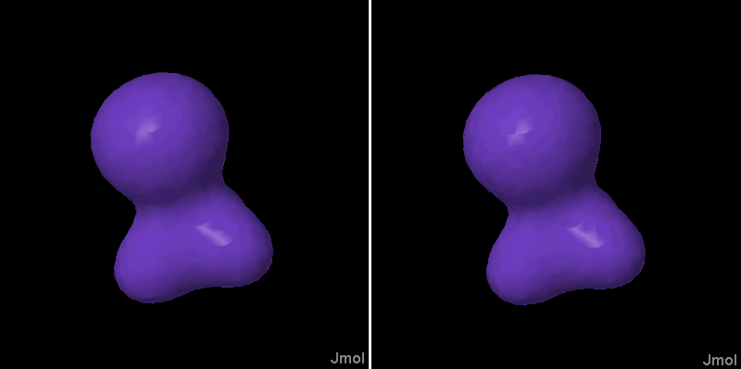
CUBE/JVXL Comparisons

Slide 45
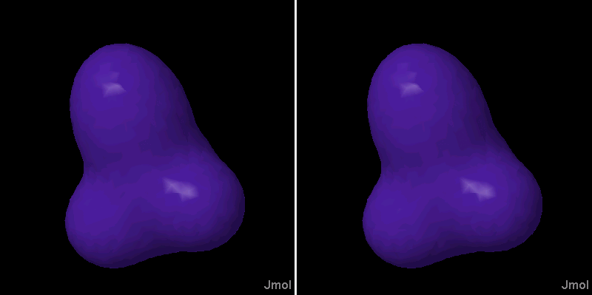
CUBE/JVXL Comparisons

Slide 46
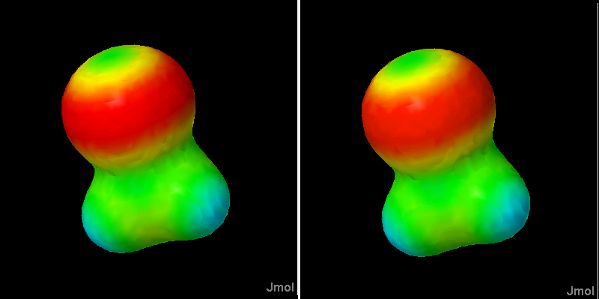
CUBE/JVXL Comparisons

Slide 47
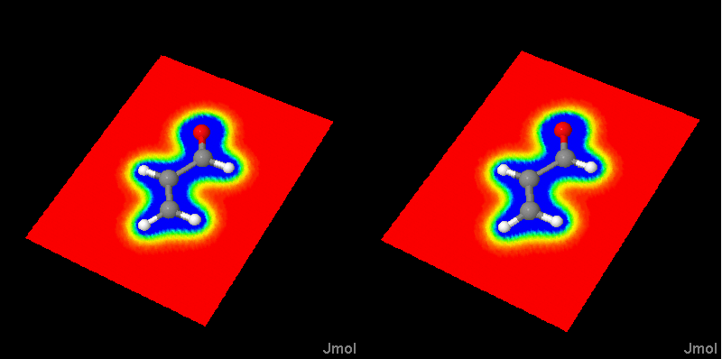
CUBE/JVXL Comparisons

Slide 48
Summary
Visualization is important both in teaching and research.
Sometimes getting the right visualization is critical.
Jmol can now render a wide variety of objects using isosurfaces. See http://www.stolaf.edu/academics/chemapps/jmol
The Jmol Voxel (JVXL) format efficiently and accurately delivers a single surface with roughly 150-600 fold compression over using CUBE files.

Slide 49
Future Plans
Add to Jmol a space-group translator and support for thermal ellipsoids with the help of the crystallographic community.
Add electrostatic potential display for files already having charges specified. (No plans to generate charges quantum mechanically.)
Provide a better implementation of XML and CML.
Specify the JVXL format better and publish this.
Integrate/demonstrate more AJAX functionality in relation to Jmol.

Slide 50
Acknowledgments
Miguel Howard wrote the original isosurface code using the Marching Cube algorithm. I adapted it and used that as a basis for the Marching Squares algorithm, which was kindly suggested to me by Olaf Hall-Holt. Fast gaussian molecular orbital calculations are based on algorithms by Daniel Severance and Bill Jorgensen. I thank Won Kyu Park for pointing me to this work.
Many thanks to Chris Steinbeck, Egon Willighagen, Hens Borkent, and Peter Murray-Rust for the kind invitations that allowed me to speak to you today.

