Slide 1
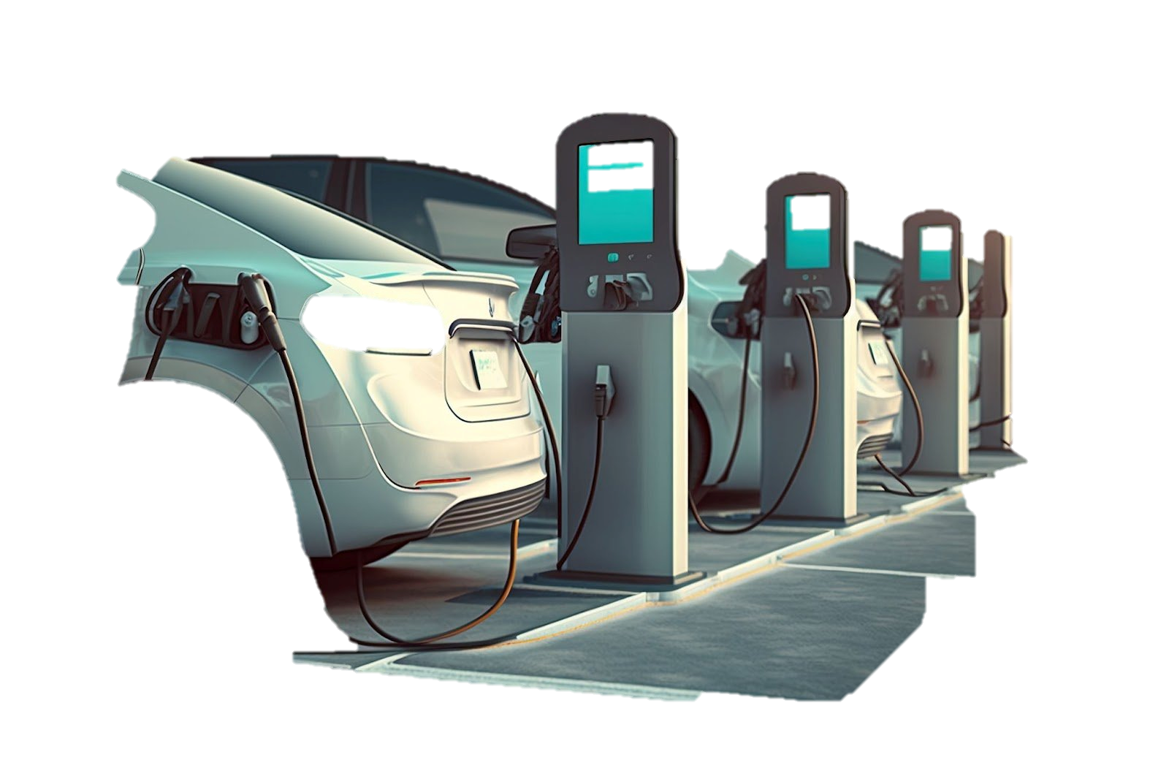
Integration of collaborative filtering to predict the demand of electricity in EV charging grids
Presentation
Huang Xiao (Team Leader)
Tian Jun Jie

Slide 2
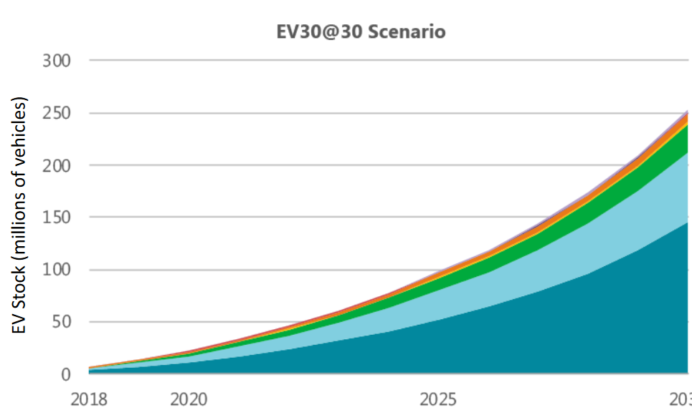
Charging of EVs is becoming one of the major load type in the grids
Scheduling of the charging becomes crucial in power managing system
By understanding the behaviors of the users in advance, we can better schedule or predict the demand of the grids.

Slide 3
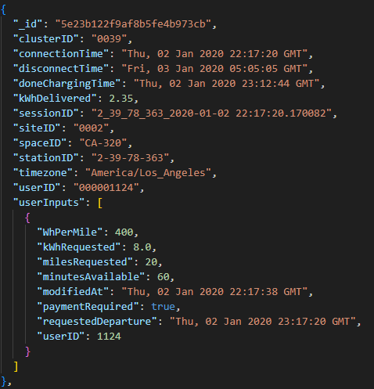
ACN-Data
ACN-Data exists to help researchers access real data around electric vehicle charging. The dataset is made possible by a close collaboration with PowerFlex Systems which operates Adaptive Charging Networks around the United States.
Web Interface - A simple way to download data as JSON files.
REST API - A more flexible way to access data.
Python API Client - A simple client for using the API in Python.
https://colab.research.google.com/drive/1c1KbwFUPUm0e_uEy5DE-nOcowX-sfuRp
https://ev.caltech.edu/dataset

Slide 4
Potential Questions
[1] Y. Tao, X. Cheng, H. Zheng, and J. Liu, “Research on location and capacity optimization method for electric vehicle charging stations considering user’s comprehensive satisfaction,” Energies, vol. 12, no. 10, p. 1915, May 2019, doi: 10.3390/en12101915.
[2] Z. J. Lee, T. Li, and S. H. Low, “ACN-Data,” ACN-Data, Jun. 2019, doi: 10.1145/3307772.3328313.
[3] X. Wang, X. Zheng, and X. Liang, “Charging station recommendation for electric vehicle based on federated learning,” Journal of Physics, vol. 1792, p. 012055, Feb. 2021, doi: 10.1088/1742-6596/1792/1/012055.
[4] C. Zhang, C. Huang, Y. Wang, W. Shi, Y. Xie, and W. Chen, “Clustering Analysis of User Load Characteristics under New Power System Based on Improved k-Means Clustering Algorithm,” 2022 5th World Conference on Mechanical Engineering and Intelligent Manufacturing (WCMEIM), Nov. 2022, doi: 10.1109/wcmeim56910.2022.10021391.
[5] F. Luo, G. Ranzi, W. Kong, G. Liang, and D. Zhang, “Personalized Residential Energy Usage recommendation system based on load monitoring and collaborative filtering,” IEEE Transactions on Industrial Informatics, vol. 17, no. 2, pp. 1253–1262, Feb. 2021, doi: 10.1109/tii.2020.2983212.
[6] J. Zhang, X. Tong, H. Song, Y. Xi, and S. Zhang, “Hierarchical classification method of electricity consumption behaviour of power users based on combination model,” Soft Computing, 2023. doi:10.1007/s00500-023-08765-x
[7] S. Ai, A. Chakravorty, and C. Rong, “Household EV charging demand prediction using machine and Ensemble Learning,” 2018 IEEE International Conference on Energy Internet (ICEI), 2018. doi:10.1109/icei.2018.00037
[8] S. Wang et al., “Short-term electric vehicle charging demand prediction: A deep learning approach,” Applied Energy, vol. 340, p. 121032, 2023. doi:10.1016/j.apenergy.2023.121032
what are some factors to build up the matrices to predict the demand of the EV charging grids?
what are some potential impacts to the current EV charging grid?
what are proper algorithms for user segmentation and collaborative filtering, will the result affect the user behaviors?

Slide 5
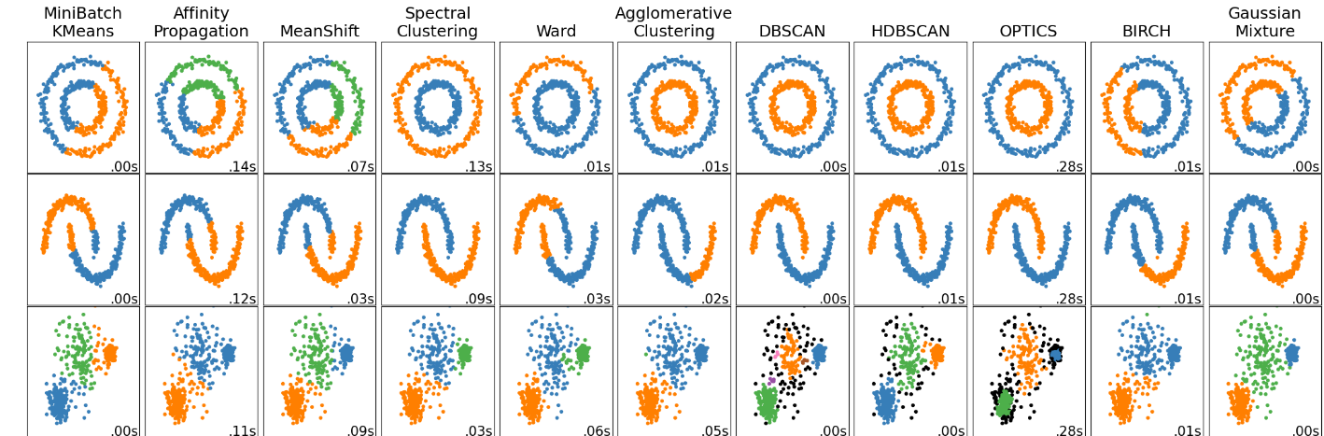
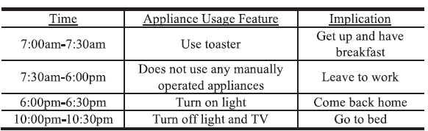
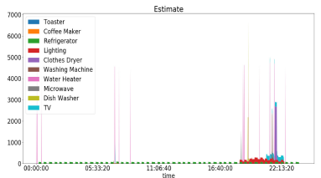
Clustering algorithms applied in user segmentation
Based on high-dimensional user data, the users’ behaviors can be clustered/classified: Fuzzy-C means (FCM)
Partition based clustering: Kmeans, DBSCAN
Model-based clustering: GMM
F. Luo, G. Ranzi, W. Kong, G. Liang, and D. Zhang, “Personalized Residential Energy Usage recommendation system based on load monitoring and collaborative filtering,” IEEE Transactions on Industrial Informatics, vol. 17, no. 2, pp. 1253–1262, Feb. 2021, doi: 10.1109/tii.2020.2983212.

Slide 6
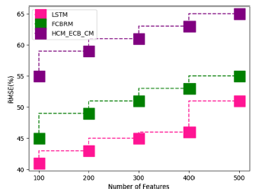
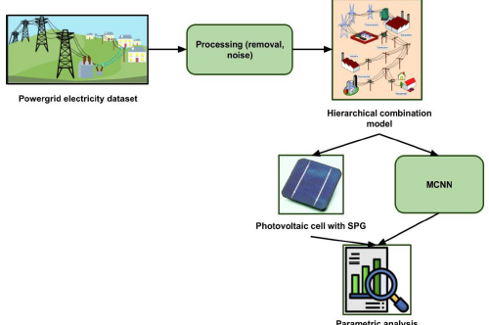
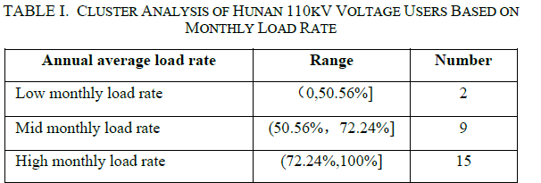
Other Literatures focusing on clustering
analysing power
grid electricity consumption based on a classification
model and deep learning techniques [1].
achieved 95% energy efficiency, 83% power analysis, 93% accuracy,
81% MAPE, 65% RMSE, and 93% specificity
Application of K-means to do cluster analysis of high voltage user profile [2]
[1] J. Zhang, X. Tong, H. Song, Y. Xi, and S. Zhang, “Hierarchical classification method of electricity consumption behaviour of power users based on combination model,” Soft Computing, 2023. doi:10.1007/s00500-023-08765-x
[2] C. Zhang, C. Huang, Y. Wang, W. Shi, Y. Xie, and W. Chen, “Clustering Analysis of User Load Characteristics under New Power System Based on Improved k-Means Clustering Algorithm,” 2022 5th World Conference on Mechanical Engineering and Intelligent Manufacturing (WCMEIM), Nov. 2022, doi: 10.1109/wcmeim56910.2022.10021391.

Slide 7
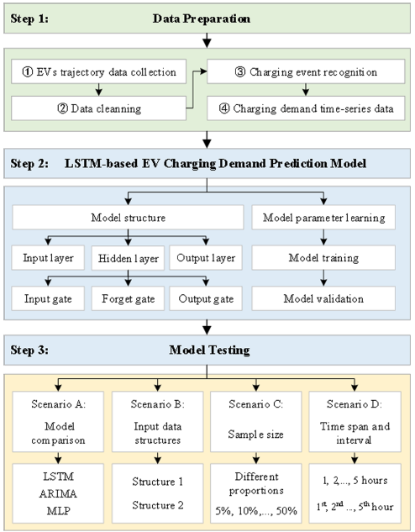
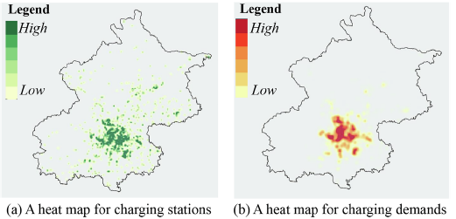
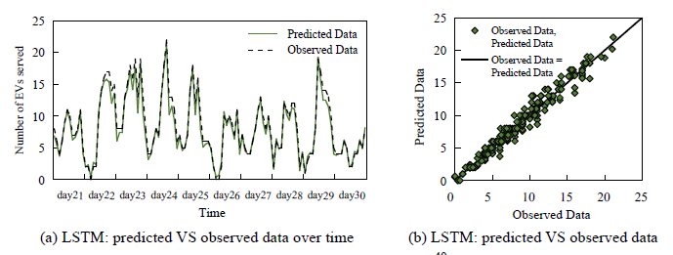
Demand prediction
S. Wang et al., “Short-term electric vehicle charging demand prediction: A deep learning approach,” Applied Energy, vol. 340, p. 121032, 2023. doi:10.1016/j.apenergy.2023.121032

Slide 8
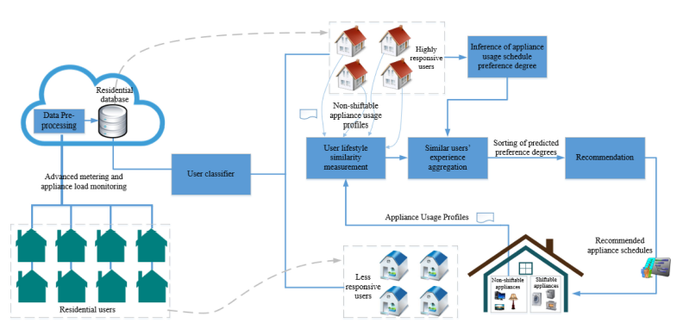
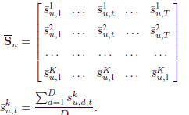
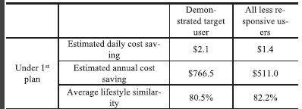
Recommendation and Collaborative filtering
The CF-based recommendation techniques can be further classified into two kinds: memory-based and model-based
methods.
F. Luo, G. Ranzi, W. Kong, G. Liang, and D. Zhang, “Personalized Residential Energy Usage recommendation system based on load monitoring and collaborative filtering,” IEEE Transactions on Industrial Informatics, vol. 17, no. 2, pp. 1253–1262, Feb. 2021, doi: 10.1109/tii.2020.2983212.

Slide 9
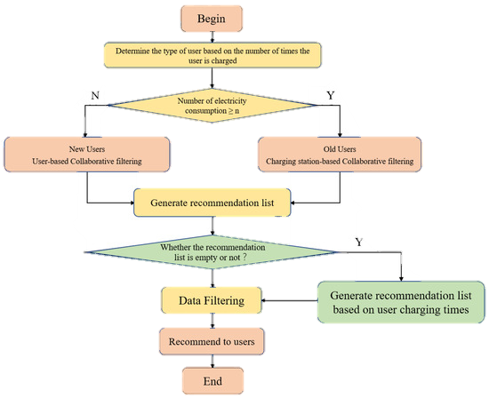
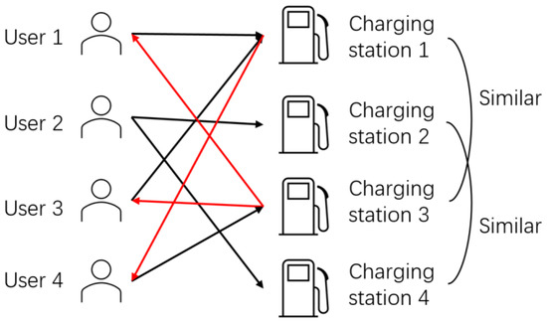
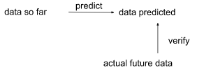
Evaluation Matrices

Slide 10
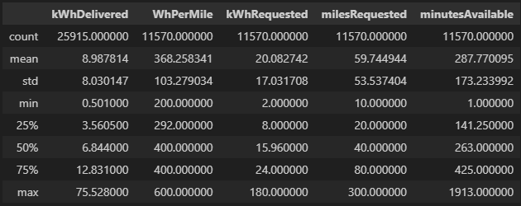
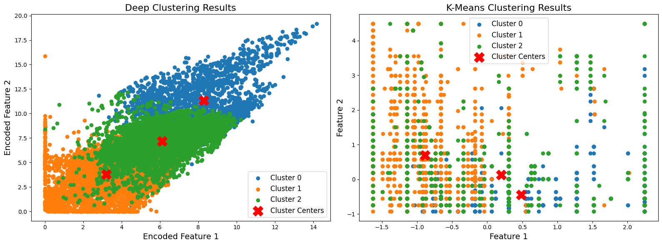
Current Work and summation of our process
Previous work
Refresh the dataset -> convert to before-covid data (2018-Dec 2019)
Clustering based on user/session behaviors
Testing of clustering algorithms
Classification of users and sessions
Collaborative filtering building
Cold start
Recommendation
User GUI

Slide 11
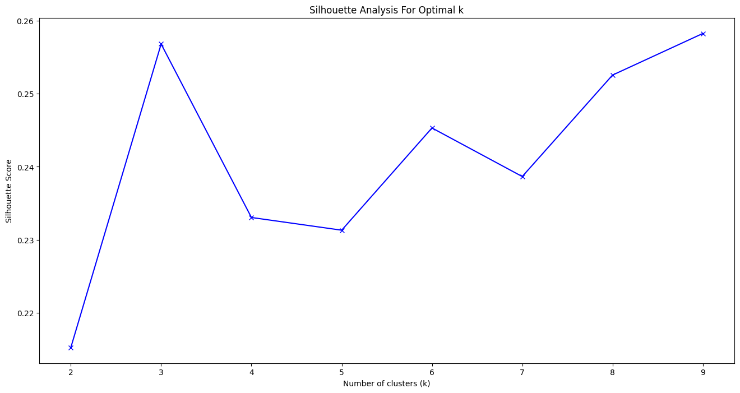
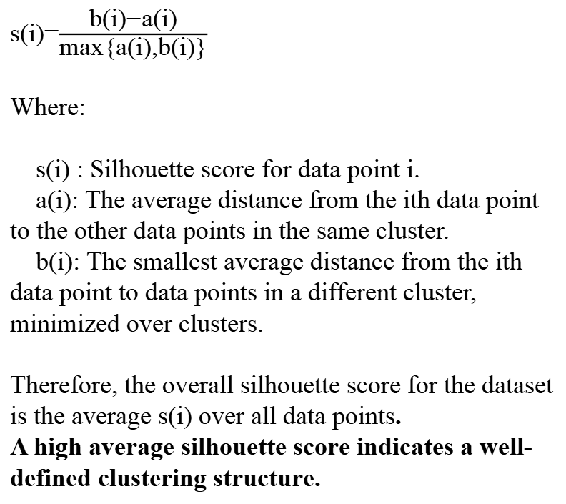
Determination for the number of clusters
s(i)=$\frac{\text{b}\text{(}\text{i}\text{)−}\text{a}\text{(}\text{i}\text{)​}}{\text{max}\text{\{}\text{a}\text{(}\text{i}\text{),}\text{b}\text{(}\text{i}\text{)\}}}$
Where:
s(i) : Silhouette score for data point i.
a(i): The average distance from the ith data point to the other data points in the same cluster.
b(i): The smallest average distance from the ith data point to data points in a different cluster, minimized over clusters.
Therefore, the overall silhouette score for the dataset is the average s(i) over all data points.
A high average silhouette score indicates a well-defined clustering structure.

Slide 12
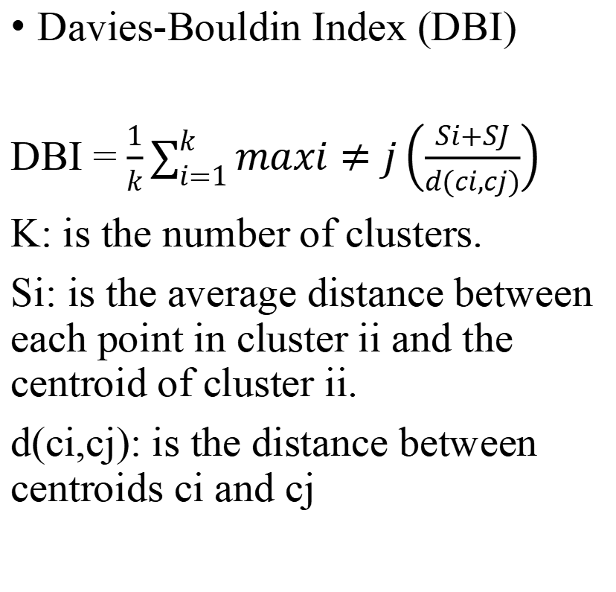
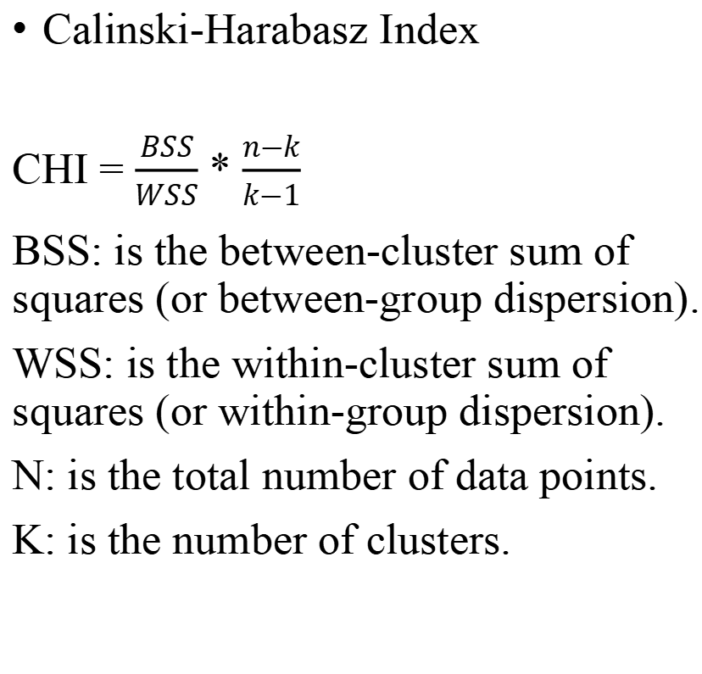
CHI and DBI
Calinski-Harabasz Index
CHI = $\frac{BSS}{WSS}$ * $\frac{n−k}{k−1}$
BSS: is the between-cluster sum of squares (or between-group dispersion).
WSS: is the within-cluster sum of squares (or within-group dispersion).
N: is the total number of data points.
K: is the number of clusters.
Davies-Bouldin Index (DBI)
DBI = $\frac{1}{k}\sum_{i=1}^{k}{maxi≠j}\left(\frac{Si+SJ}{d(ci,cj)}\right)$
K: is the number of clusters.
Si​: is the average distance between each point in cluster ii and the centroid of cluster ii.
d(ci,cj): is the distance between centroids ci​ and cj

Slide 13
Clustering based on user/session behaviors
K-means
Parameters: n_clusters = 3, random state = 0, max_iter = 15000, init = k-means++
Scaled: No
SI Score: 0.2329409844742252
Calinski Harabasz Score: 2866.7334549962293
Davies Bouldin Score: 1.3640193557882327
Fuzzy C-means (FCM)
parameters: m=2, error=0.00005, maxiter=15000
Scaled: no
SI Score: 0.10110115766005662
Calinski Harabasz Score: 1364.2143551582044
Davies Bouldin Score: 2.3803425324518086
Deep clustering
parameters: epochs=100, batch_size=256, shuffle=True, validation_split=0.2
Scaled: yes
SI Score: 0.30155012011528015
Calinski Harabasz Score: 11807.596925114321
Davies Bouldin Score: 1.1739936960817805

Slide 14
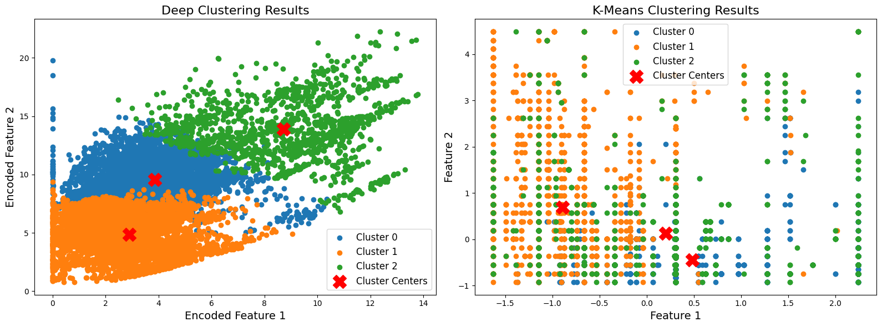
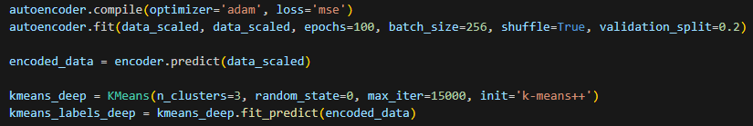
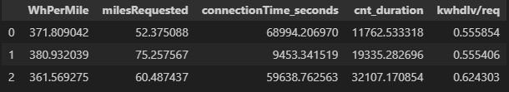
Result
Unit and scale of the features:
connectionTime_seconds: seconds after 0:00
Cnt_durations: seconds
Kwhdlv/req: kwh delivered (actual)/requested energy
WhPerMile, milesRequested: can be used to identified the types of cars
Clusters:
Connect at 11am, for 3 hours. Delivered energy is half of the requested energy
Connect at 19 pm for 5 hours. Delivered energy is half of the requested energy
Connect at 8 am for 9 hours Delivered energy is 62.4% of the requested energy
The time are all in GMT (California+8)

Slide 15
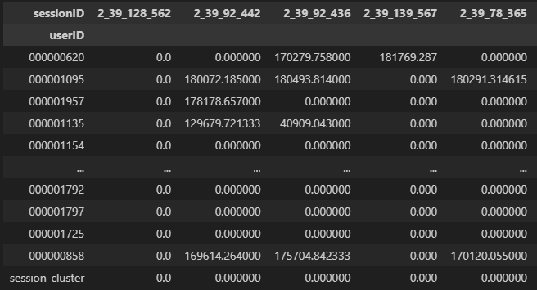
Collaborative filtering
1. Matrix Creation
Row: users
Columns: sessions
2. User similarity calculation
Cosine similarity
3. Session recommendation
4. Evaluation
5. Iterative refinement

Slide 16
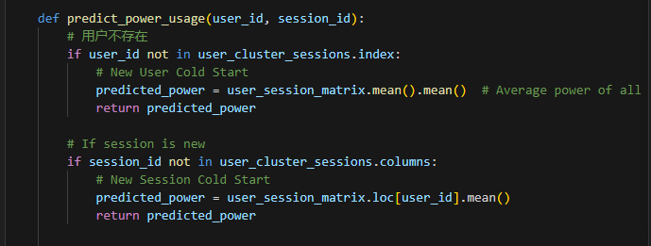
Cold start
Cold start: for a new user or charger, we don't have previous usage data, so it's hard to make predictions
random recommendation
locate the nearest charging station based on the user's location
set an initial value based on the average of the existing data.

Slide 17
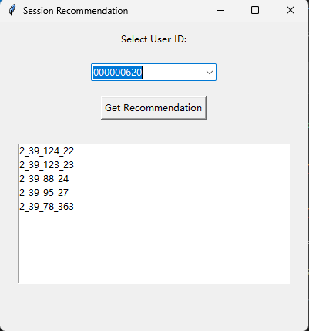
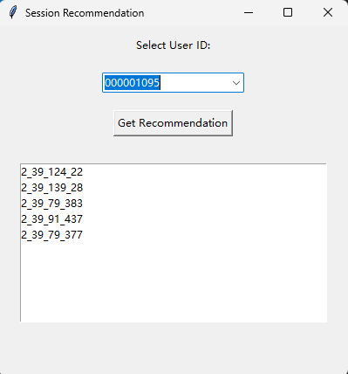
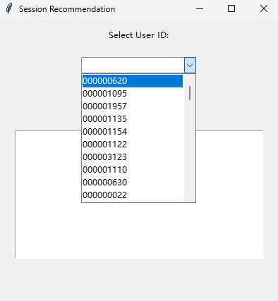

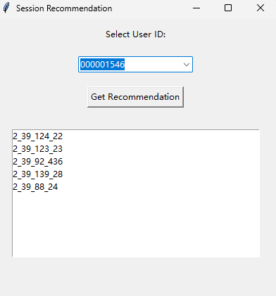
Result

Slide 18
Discrepancies of the recommender system
Testing
Iterations
GUI
Algorithm
Lack of user feedback, currenly cannot use testing/evaluation matrices to evaluate
Currently, the algorithm is built with the current dataset, and the algorithm will improve iteratively as users are using
Only created a GUI for target users, not for business and generation end (source end)
Convolutional neural network can be used in this case, whereas, it requires daily trainings

Slide 19
Power prediction
CNN Bi-LSTM (RNN)
SVM
XGBoost
Use a Convolutional Neural Network (CNN) to extract spatial or structural features from the data.
Apply a Bidirectional Long Short-Term Memory (Bi-LSTM) network to capture temporal dependencies and sequential patterns within the data.
Train the combined CNN Bi-LSTM model using the historical data.
During training, the model learns the patterns and relationships within the data to create an optimal decision boundary or hyperplane that best fits the training data.
Once trained, the SVM model is used to make predictions on new or unseen data. The model applies the learned patterns to the test dataset, predicting the target values based on the input features.
During training, XGBoost constructs an ensemble of decision trees iteratively to capture and refine patterns within the data by correcting the errors made by previous trees. This process aims to minimize prediction errors and improve overall accuracy.
Once trained, XGBoost utilizes the ensemble of trees to predict target values on new or unseen data.
Train: test split rate: 0.9 with respect with time. Used the latest 10% of data for testing and computation of MAE

Slide 20
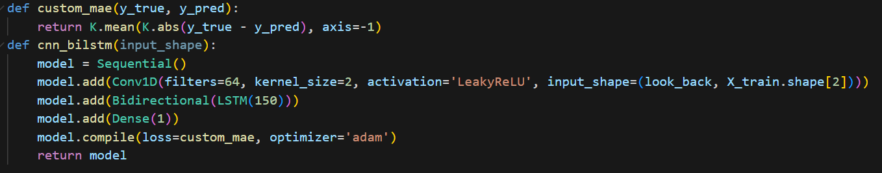
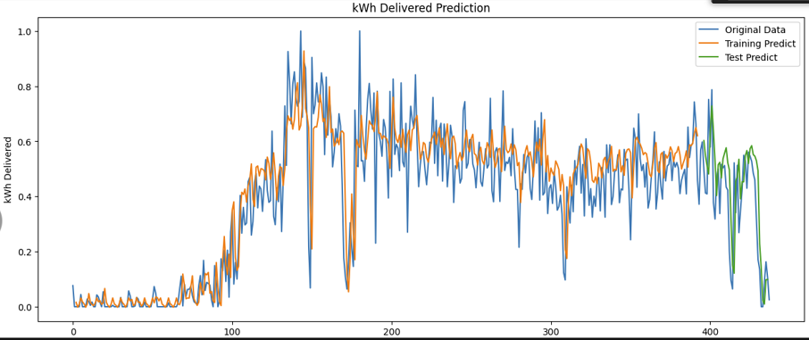
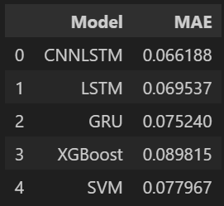
Results
1. Algorithm comparison
complexity:
LSTM/ CNN-Bi LSTM (purposed by us)/ GRU
SVM
XGBoost
Discussion
The CNN-Bi LSTM shows better results in the energy prediction.
The training of the algorithm requires further more data to see more obvious advantages compared with other algorithms
RNN algorithms are costly in complexity, layers can be deduced as per problems
further feature engineering can be made (identify seasonaility, filter out holidays, use hourly trends (currenly semi-daily)
the result in our data set is seemingly larger than some of the literatures (which has MAE at around 0.04). Since their dataset is different and our dataset is much smaller in size
CNN-Bi LSTM has better results

Slide 21
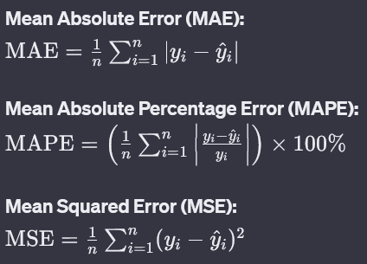


Feature engineering and loss functions
Feature engineering:
the seasonality and cyclic trends can be used for training: - cluster results can be used (data size was too small in our case), therefore, we used semi-daily as a training feature
- regularization: it is identified that using 175 epochs instead of 200 epochs results in better predictions
Loss function:
it is identified that using custom MAE instead of MSE or MAPE will result in better prediction results
Cyclic trend engineering, using sinusoidal functions. Drop weekends (lower charging demand)
Grouped the data by half day, and sum up the data for each day with respect of ‘connectionTime’.

Slide 22
Future Work
Recommender system
As the recommender system delivered to our target users, iterative refinement of the algorithm will be made (especially when we are using RNN-based algorithms)
GUI for generation end will be developed to monitor the demand
Other recommender systems can be tried, such as LS-PLM, Logistics regressions, GBDT-LR
Predictions
In further analysis, data with larger sets can be used to fully utilize the strengths of LSTM and other RNN models
Algorithms that adapt to data with complex trend with small size should be taken in to consideration, since it is crucial in the initial few steps of recommender system development (transformer)
Hyperparameter tunings can be done to improve the performances (grid search)
Feature engineering, and other manipulations on the training data can be make to adapt to the usages of the users
Residual can be taken into the layers of RNN (ARIMA-LSTM)

