Slide 1
Team 5
BURRA Sri Haritha LIN Albert
HABERLING Alexander MOREAU Christian
KAENDLER Jonas THIETKE Jonas
LEI Ya-Chu IE 672 Data Mining II
CHANDRASHEGARAN AYYASAMY Shangeetha

Slide 2
Summary
1 |  | Dataset Insight
2 |  | Feature Generation
3 |  | Further Approaches

Slide 3
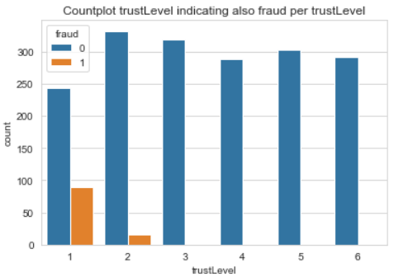
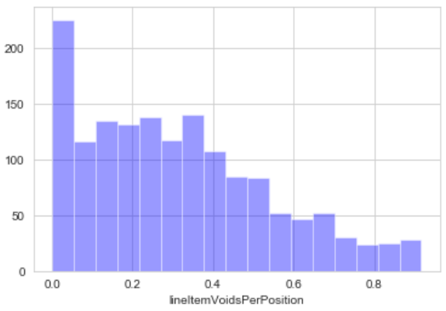
Dataset Insight
fraud & trustLevel
1775 cases of „non-fraud“
104 cases of „fraud“ (~5,54%)
Distributions
e.g. lineItemVoidsperPosition <1

Slide 4
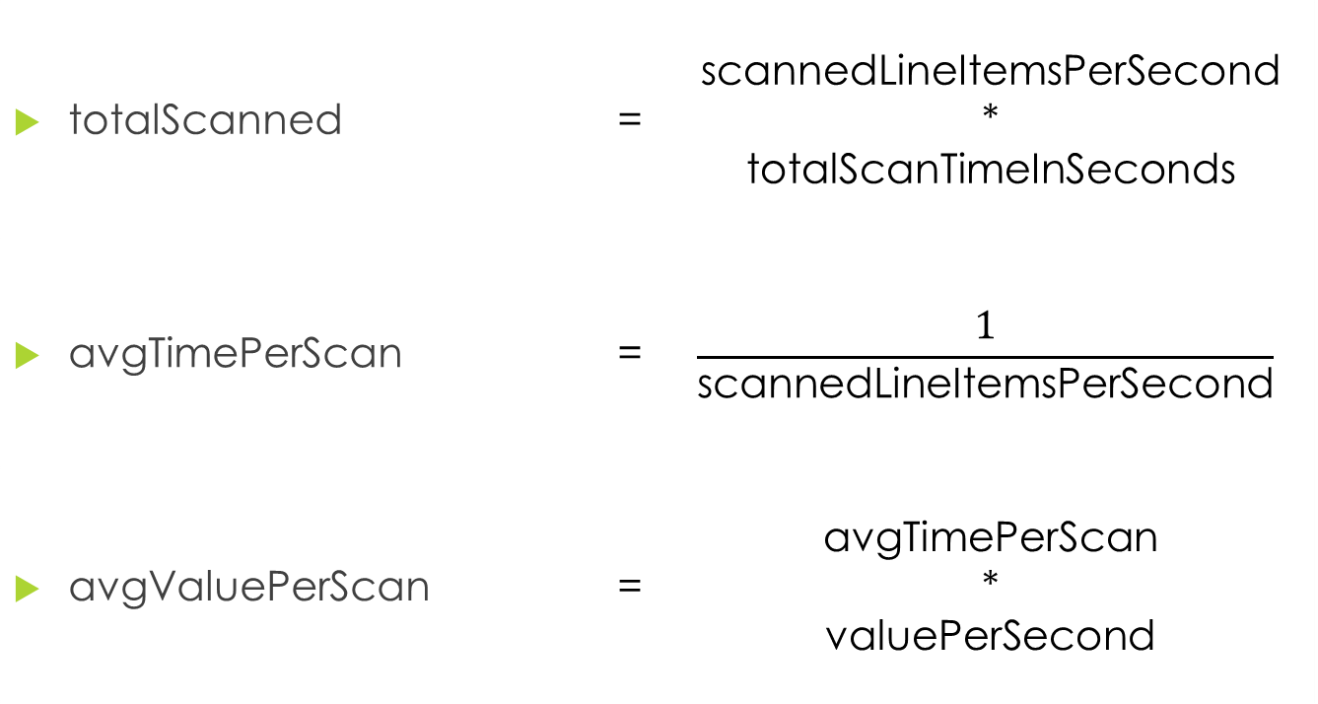
Feature Generation
totalScanned | = | scannedLineItemsPerSecond * totalScanTimeInSeconds
$\text{avgTimePerScan}$ | = | $$\frac{1}{\text{scannedLineItemsPerSecond}}$$
avgValuePerScan | = | avgTimePerScan * valuePerSecond

Slide 5
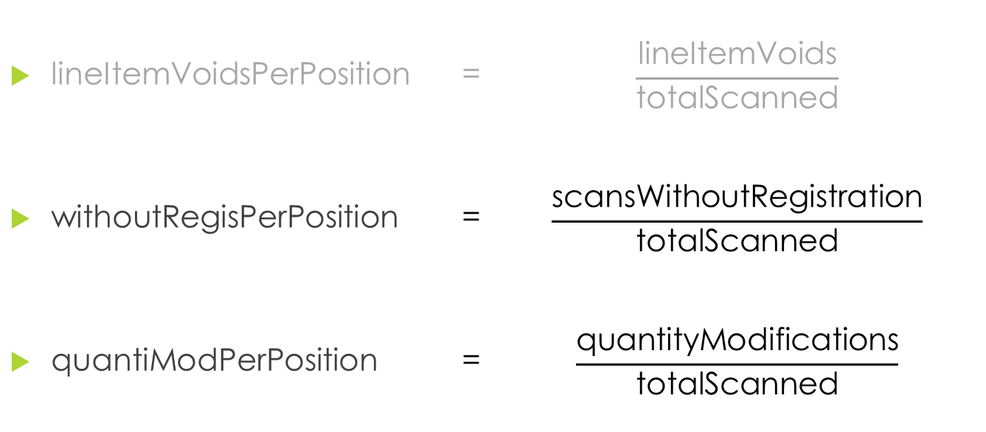
Feature Generation
lineItemVoidsPerPosition | = | $$\frac{\text{lineItemVoids}}{\text{totalScanned}}$$
$\text{withoutRegisPerPosition}$ | = | $$\frac{\text{scansWithoutRegistration}}{\text{totalScanned}}$$
quantiModPerPosition | = | $$\frac{\text{quantityModifications}}{\text{totalScanned}}$$

Slide 6
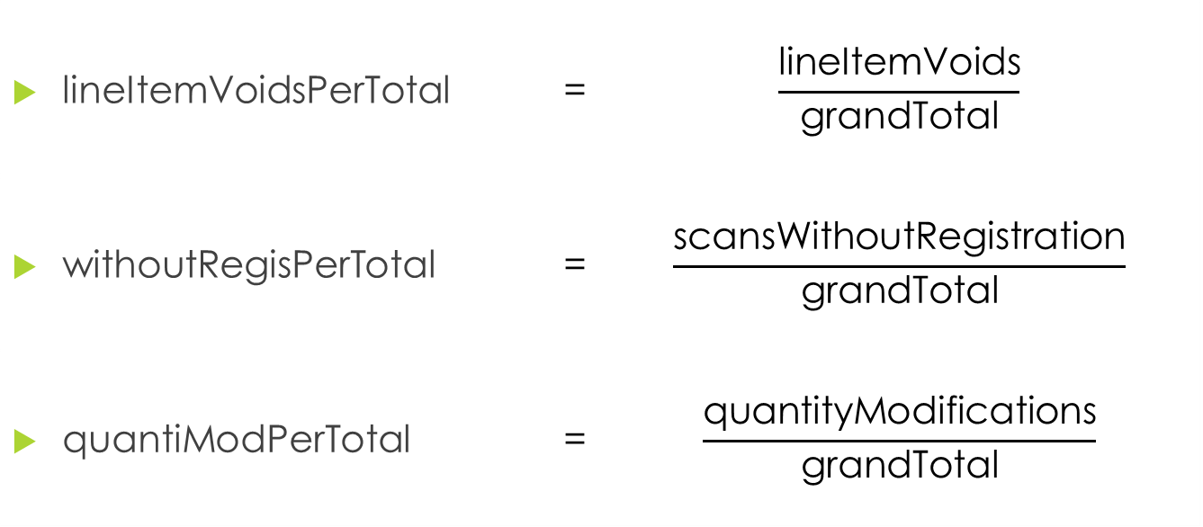
Feature Generation
lineItemVoidsPerTotal | = | $$\frac{\text{lineItemVoids}}{\text{grandTotal}}$$
$\text{withoutRegisPerT}$otal | = | $$\frac{\text{scansWithoutRegistration}}{\text{grandTotal}}$$
quantiModPerTotal | = | $$\frac{\text{quantityModifications}}{\text{grandTotal}}$$

Slide 7
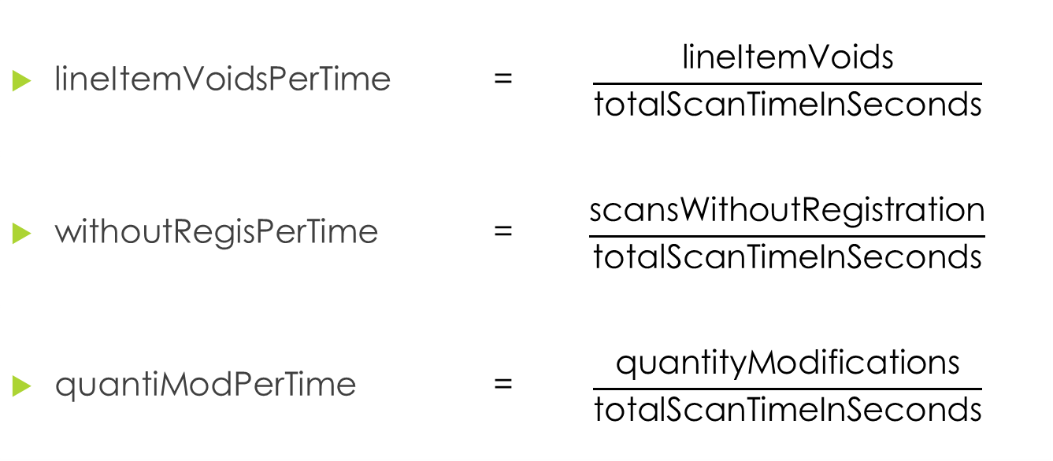
Feature Generation
lineItemVoidsPerTime | = | $$\frac{\text{lineItemVoids}}{\text{totalScanTimeInSeconds}}$$
$\text{withoutRegisPerTime}$ | = | $$\frac{\text{scansWithoutRegistration}}{\text{totalScanTimeInSeconds}}$$
quantiModPerTime | = | $$\frac{\text{quantityModifications}}{\text{totalScanTimeInSeconds}}$$

Slide 8
Further Approaches
Finishing basic pre-processing (Up-sampling, Scaling, etc.)
Applying first simple models like Naive Bayes, Logistic Regression, etc.
Fancying out our feature generation and selection via e.g. PCA
Outlier detection with e.g. Isolation Trees
Applying more sophisticated models and ensembles e.g. Random Forests
Left aside for now: Neural Networks

