Slide 1

Data-driven Marketing Strategies for the Bellabeat App
Presented by: Albert Hunduza
Last Updated: September 4th, 2023

Slide 2
Table of Contents
Data Sources…………………………………………………………………………………. | 3
Trends in Usage Data………………………………………………………………………... | 4
Application to Bellabeat Customers………………………………………………………... | 9
Marketing Strategy Recommendations……………………………………………………. | 11
Conclusion…………………………………………………………………………………….. | 12

Slide 3
Data Sources
Collected via Amazon Mechanical Turk in 2016. | Fitbit users consented to to the submission of their personal tracker data | Minute-level output for physical activity, heart rate and sleep monitoring | Variations between outputs caused by use of different types of Fitbit Trackers and individual tracking behaviors/preferences

Slide 4
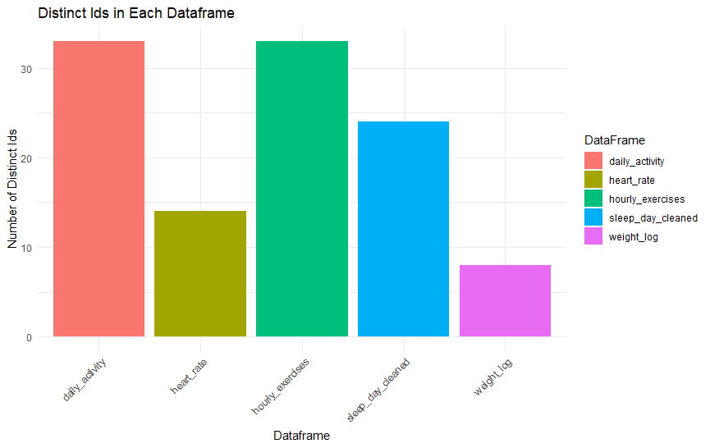
Trends in Usage Data
All 33 participants recorded their hourly and daily activity
The majority monitored their sleep
Less than half monitored their heart rate and only a handful recorded their weight

Slide 5
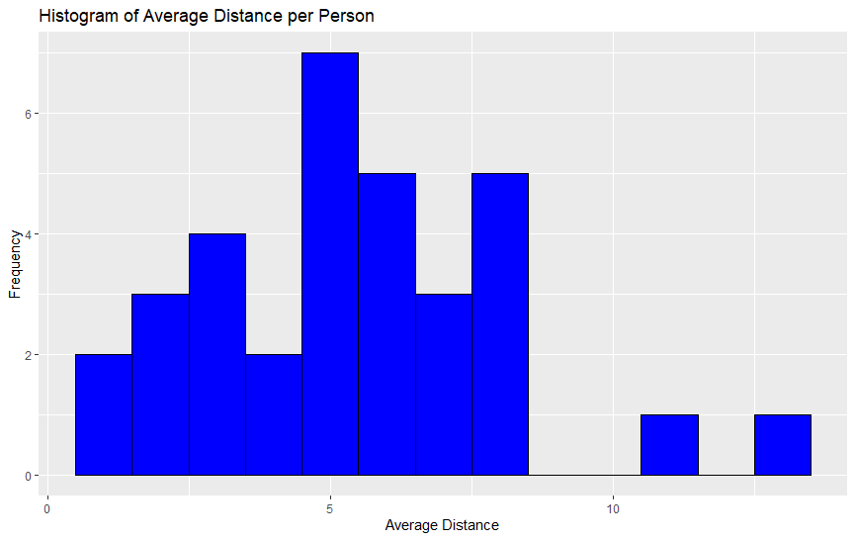
Trends in Usage Data
The average distance covered by the participants was about 6km

Slide 6
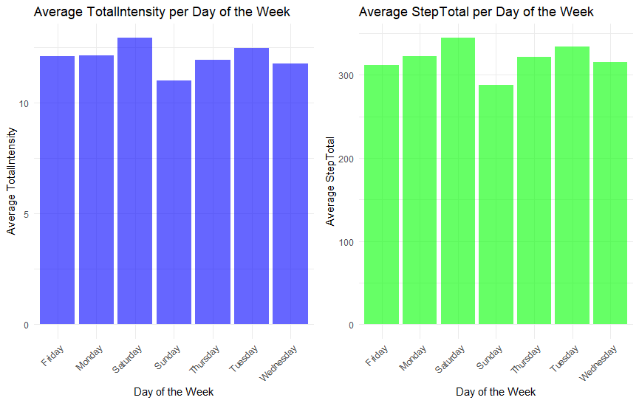
Trends in Usage Data
Activity was mostly constant across all days of the week
Participants were slightly more active on Saturdays than on other days
On Sundays participants were slightly less active

Slide 7
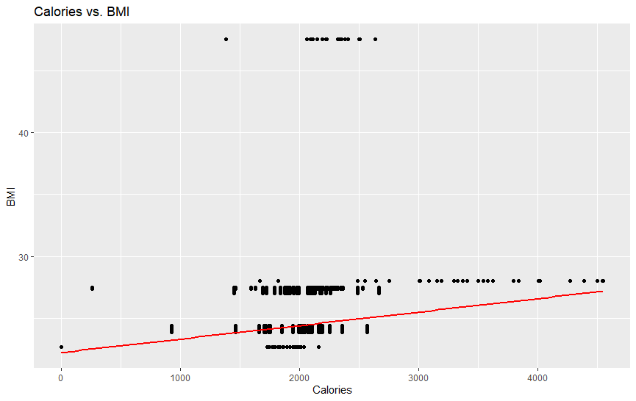
Trends in Usage Data
Participants with a higher BMI tended to exercise more, burning more calories

Slide 8
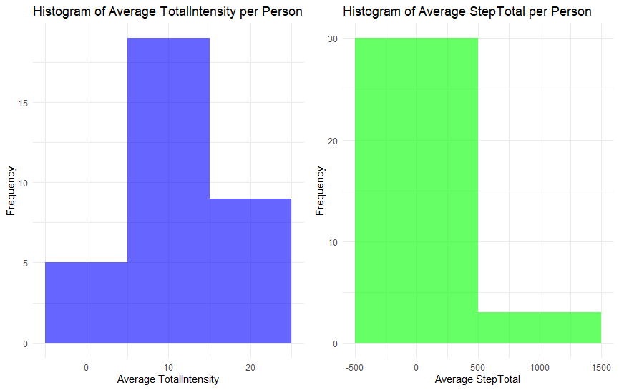
Trends in Usage Data
During exercise, participants favored high intensity activity over a short distances

Slide 9
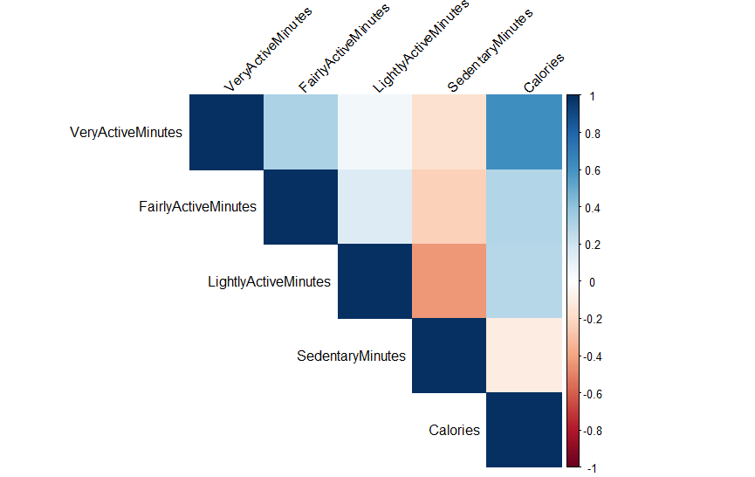
Application to Bellabeat Customers
Very active minutes burn the most amount of calories
Sedentary minutes decrease the amount of calories burned

Slide 10
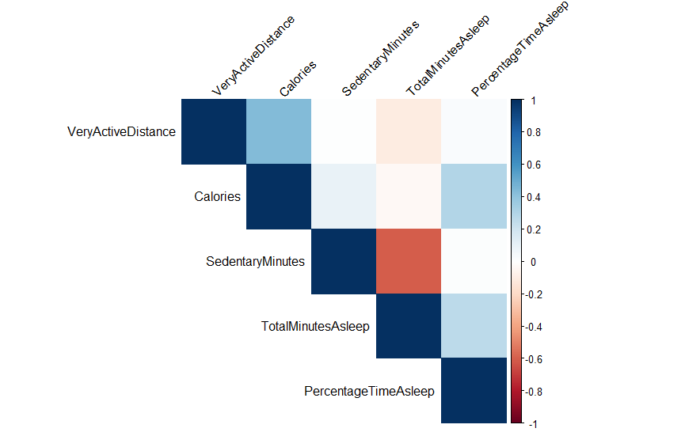
Application to Bellabeat Customers
Burning more calories makes it easier to fall asleep
Sedentary minutes reduce the total minutes spent asleep

Slide 11
Marketing Strategy Recommendations
Users are very interested tracking their daily and hourly activity There’s a lot of friction making it difficult to monitor sleep heart rate and weight data | The fitbit app should be compatible with many different devices to appeal more to users already using different Fitbit trackers | Fitbit app should be compatible with smart weights and heart rate monitors Fitbit app should be able to put together all this information | Integrate machine learning to be able to predict weight data and calories burned etc for users without all the necessary tracking devices

Slide 12
Conclusion
We can only make high level recommendations since our data is out of date and less reliable
The recommendations can help the Bellabeat app appeal to users with different fitbit trackers
This can help Bellabeat gain market share

