Slide 1

ANM PROJECT MAFIA TEAM
MATTHIEU LIN & ANDREI GLINSKII & ALBERT MILLAN
2019280208 & 2019280807 & 2019280366

Slide 2

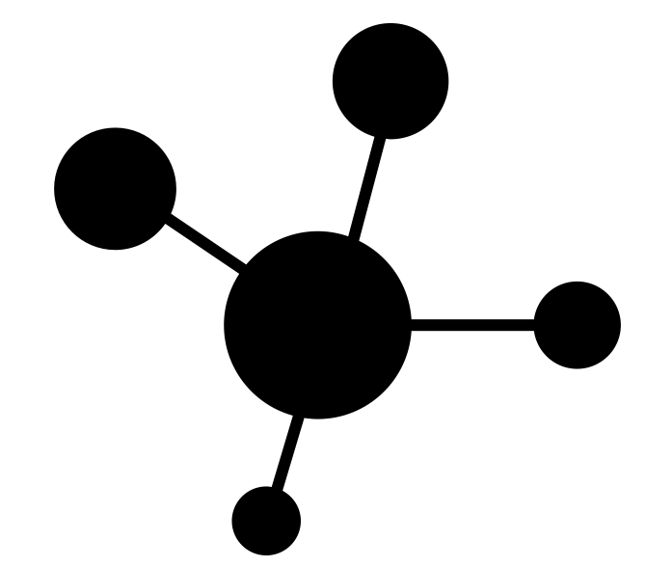

Data Visualization
Models Implemented
Conclusion

Slide 3
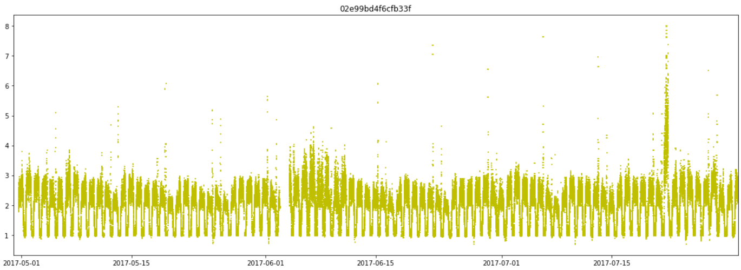
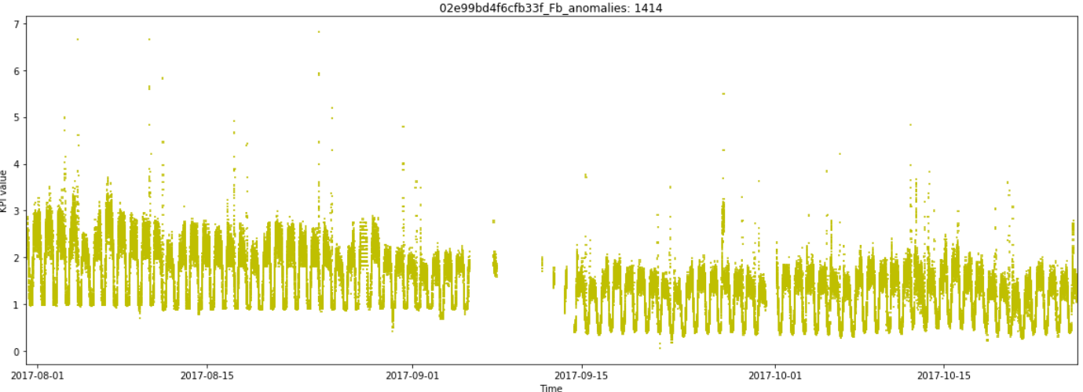
Data Visualization
Training vs Testing Data
Proportion of Anomalies
Recurrent Cyclical Nature
Varying Scale
Notes:
Training Data can differ significantly from the testing data. For instance, in the images provided the range of values were the data lies is between 1-3, while in the test data there is a shift from 0.5-2.3 approximately, with all else being anomalies.

Slide 4
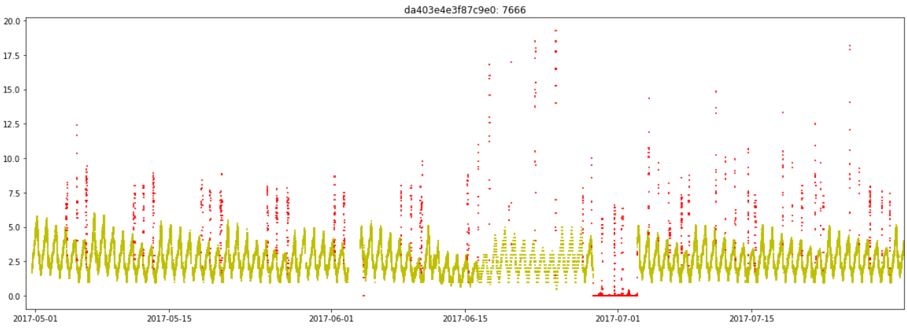
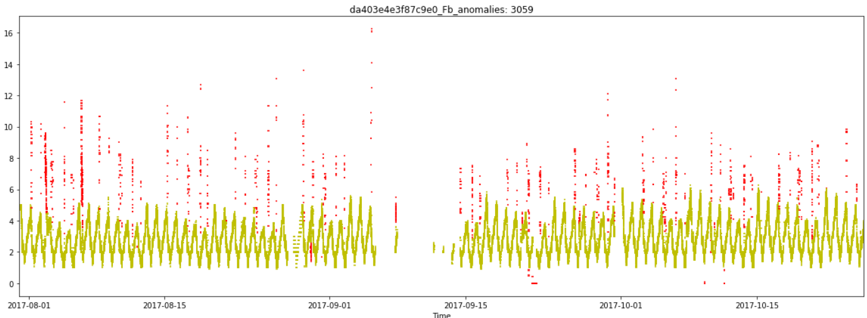
Data Visualization
Training vs Testing Data
Proportion of Anomalies
Recurrent Cyclical Nature
Varying Scale

Slide 5
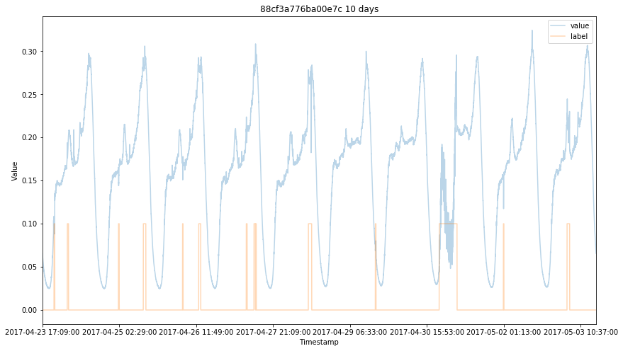
Data Visualization
Training vs Testing Data
Proportion of Anomalies
Recurrent Cyclical Nature
Varying Scale
What is an anomaly?
Notes:
It is clear that anomalies are completely KPI dependent. It appears that data points that preceed and succeed this data play a significant role in classifying a given data point as anomaly. Huge gaps and spikes are clear indicators of anomaly.

Slide 6
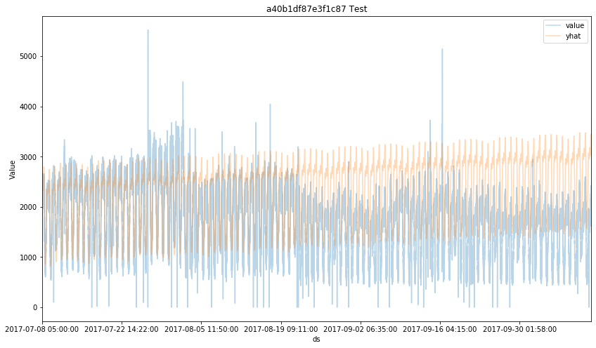
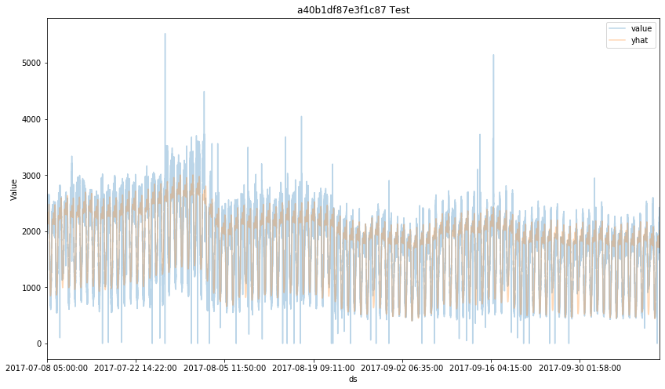
Model: Time Series
Rolling Mean/STD
Optimal window size varies per KPI
ARIMAX
Complex
High Training Time
Prophet
Threshold Selection
Notes:
Rolling Mean: Window size(5)
Threshold Selection: Visualize KPIs and manually set values. Plot them, if they seem anomalies we test it.

Slide 7
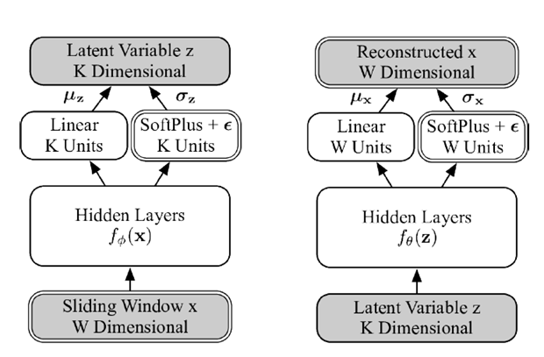
Model
Donut:

Slide 8
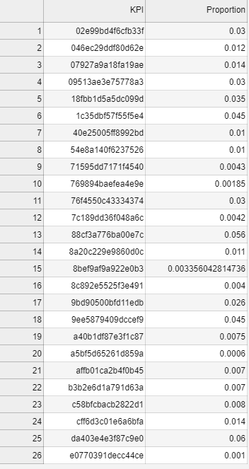
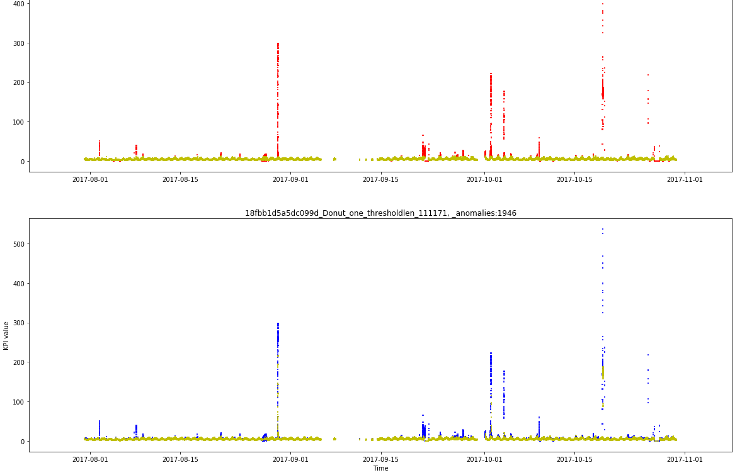
Model
Donut:

Slide 9
Models Implemented
Donut Threshold Selection
1 | 2 | 3 | 4 | 5 | 6 | 7 | 8 | 9 | 10
1
0
Notes:
Thresholds depend on the proportion of anomalies. The starting values/proportions were those predicted by the Donut model.

Slide 10
Conclusion
Data Visualization is paramount to Optimize thresholds
Could lead to overfitting with new test data...
DONUT!

Slide 11
Some models we tried
Models | Accuracy
Model mixtures | 0.78358663615
Donut | 0.719681122659
Facebook Prophet | 0.540883458647
LSTM | 0.390138920193
DecisionTreeClassifier | 0.371066345961
ExtraTreesClassifier | 0.378509865903
RandomForestClassifier | 0.366923398412
BaggingClassifier | 0.367623623433
GradientBoostingClassifier | 0.319460637705

