Slide 1
C# 8

Slide 2
.NET framework?
When Microsoft released the first version of .NET framework in 2002, the applications developed on it could only run on Windows machines with the .NET Framework installed. This has not changed until today. Applications developed using the full .NET framework will still run only on Windows.

Slide 3
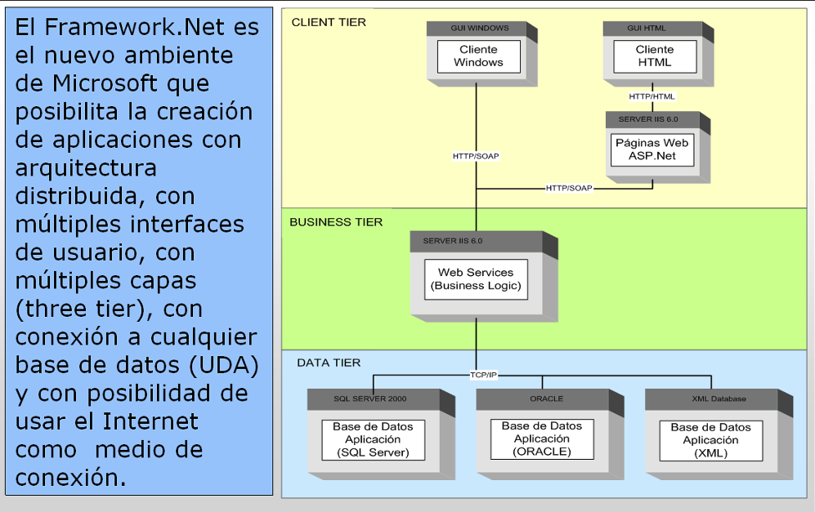
.Net Framework

Slide 4
.Net Core
The latest .NET implementation by Microsoft is .NET Core, first released in 2016.
.NET Core is an open source re-implementation of the full .NET framework, available for Windows, macOS and Linux. It provides a subset of the .NET class libraries.
It supports development of console applications, Entity Framework Core and ASP.NET Core based web applications for all supported operating systems.

Slide 5
.Net Core 3.1
.NET Core Version 3.1 (released in 2019) add support for Windows Forms and WPF based Windows desktop applications and Entity Framework 6.0.

Slide 6
Xamarin
Independent of Microsoft, programmer Miguel de Icaza developed an open source implementation of the .NET framework for Linux, named Mono.
Xamarin is a .NET implementation based on Mono, which supports the development for iOS, Android and macOS. Microsoft acquired Xamarin in 2016. Its development model is based on a subset of .NET class libraries, combined with the ability to invoke native APIs of each supported platform.
Additionally, Xamarin.Forms, a XAML based user interface framework can be used for development of common user interfaces for iOS, Android and Windows Mobile applications.

Slide 7
Unity
Mono is also used in Unity, a cross platform game development engine, which currently supports over 25 different platforms, including mobile, desktop, gaming consoles, virtual reality and augmented reality platforms. Although the game development mostly takes advantage of the proprietary Unity game engine, the recommended scripting language is C# and takes advantage of a subset of .NET class libraries.

Slide 8
Tizen.NET
The latest .NET runtime is Tizen.NET. It is developed by Samsung and runs on their Linux based Tizen operating system for smartphones, smart TVs, wearable devices and other types of devices. It is based on .NET Core, but also takes advantage of Xamarin.Forms as the user interface framework.

Slide 9
Blazor

Slide 10
Azure

Slide 11
Runtimes .Net and Platforms
Taking into account all of the listed implementations, .NET framework can be used
today to develop at least some types of applications for most of the actively developed
platforms and operating systems.

Slide 12
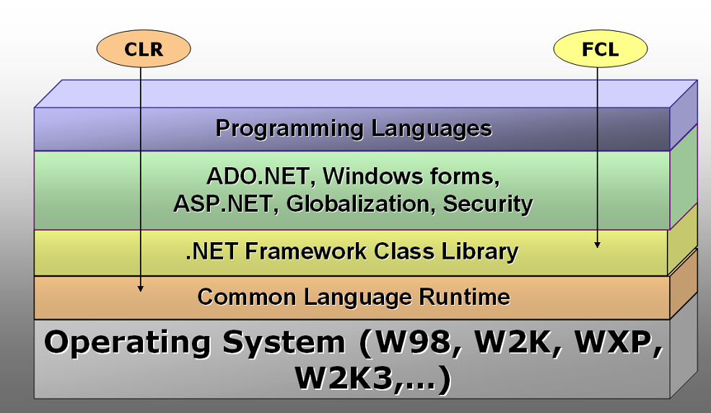
.NET framework: CLR and FCL

