Slide 1
C# 8

Slide 2
.NET framework?
When Microsoft released the first version of .NET framework in 2002, the applications developed on it could only run on Windows machines with the .NET Framework installed. This has not changed until today. Applications developed using the full .NET framework will still run only on Windows.

Slide 3
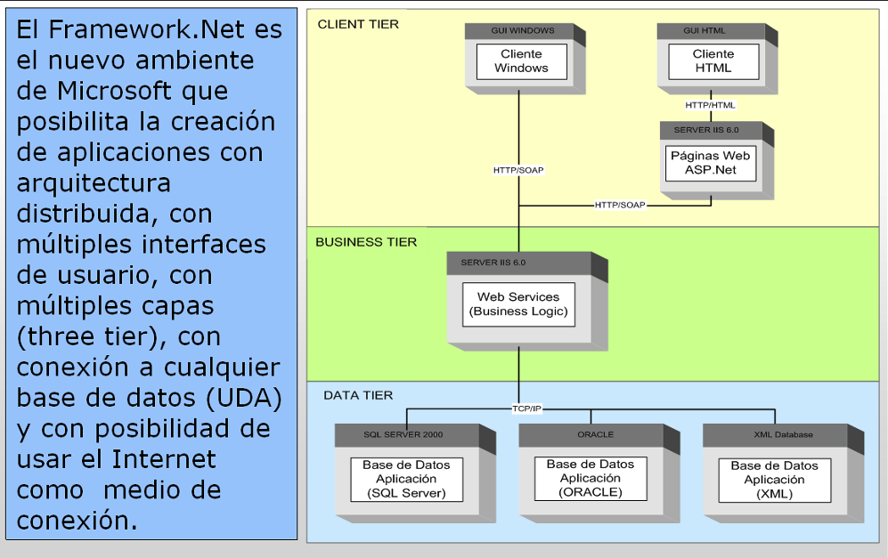
.Net Framework

Slide 4
.Net Core
The latest .NET implementation by Microsoft is .NET Core, first released in 2016.
.NET Core is an open source re-implementation of the full .NET framework, available for Windows, macOS and Linux. It provides a subset of the .NET class libraries.
It supports development of console applications, Entity Framework Core and ASP.NET Core based web applications for all supported operating systems.

Slide 5
Xamarin
Independent of Microsoft, programmer Miguel de Icaza developed an open source implementation of the .NET framework for Linux, named Mono.
Xamarin is a .NET implementation based on Mono, which supports the development for iOS, Android and macOS. Microsoft acquired Xamarin in 2016. Its development model is based on a subset of .NET class libraries, combined with the ability to invoke native APIs of each supported platform.
Additionally, Xamarin.Forms, a XAML based user interface framework can be used for development of common user interfaces for iOS, Android and Windows Mobile applications.

Slide 6
Unity
Mono is also used in Unity, a cross platform game development engine, which currently supports over 25 different platforms, including mobile, desktop, gaming consoles, virtual reality and augmented reality platforms. Although the game development mostly takes advantage of the proprietary Unity game engine, the recommended scripting language is C# and takes advantage of a subset of .NET class libraries.

Slide 7
Tizen.NET
The latest .NET runtime is Tizen.NET. It is developed by Samsung and runs on their Linux based Tizen operating system for smartphones, smart TVs, wearable devices and other types of devices. It is based on .NET Core, but also takes advantage of Xamarin.Forms as the user interface framework.

Slide 8
Blazor

Slide 9
Azure

Slide 10
Runtimes .Net and Platforms
Taking into account all of the listed implementations, .NET framework can be used
today to develop at least some types of applications for most of the actively developed
platforms and operating systems.

Slide 11
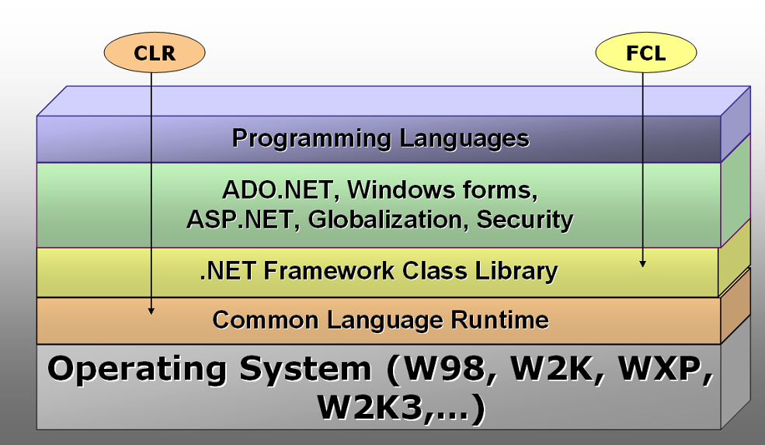
.NET framework: CLR and FCL

Slide 12
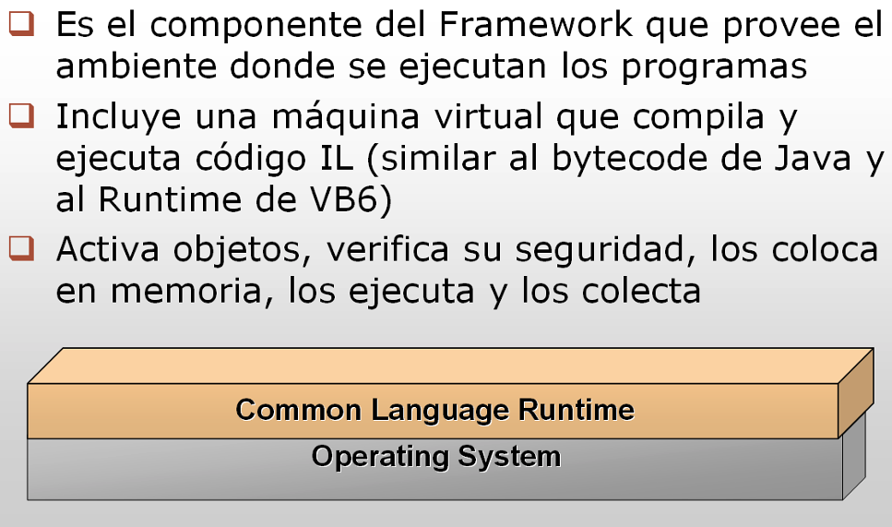
CLR

Slide 13
CLR Services
The Common Language Runtime is the virtual machine part of the .NET framework, responsible for running applications. It provides multiple services which make the following possible:
The just-in-time (JIT) compiler converts the compiled IL (intermediate language) code from .NET application binaries packaged as assemblies, into machine code for the CPU on which it is currently running.
The garbage collector (GC) handles memory management. .NET applications need not allocate and release memory themselves. The garbage collector automatically releases all the unused objects from memory.
Thread management allows applications to use multiple threads to improve their scalability and performance.
Exception handling provides the structure required for throwing exceptions as well as the hierarchical handling of exceptions in applications.

Slide 14
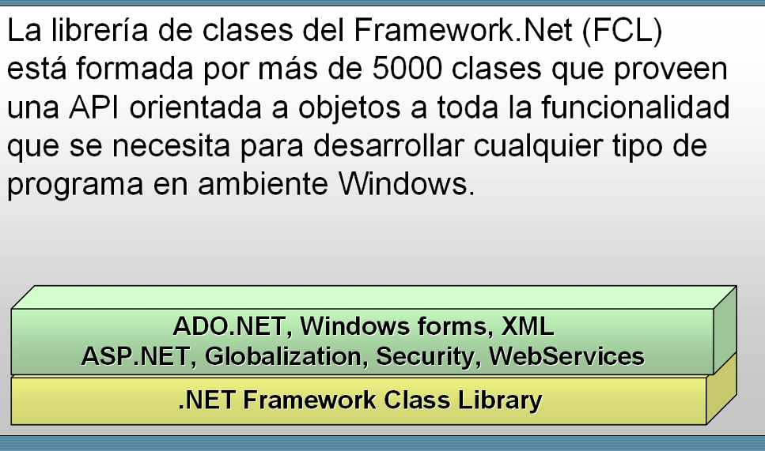
FCL

Slide 15
FCL toolset
The Framework Class Library is the toolset for effectively building .NET applications.
At its core is the Base Class Library (BCL) – a set of low-level classes for common operations, such as math, string manipulation, I/O operations etc.
On top of it are other frameworks, specific to building different types of applications: Windows Forms and Windows Presentation Foundation (WPF) for desktop applications, ASP.NET Web Forms and ASP.NET MVC for building web applications, Windows Communication Foundation (WCF) and ASP.NET Web API for building web services, etc.

Slide 16
.Net Core 3.1
.NET Core is a complete reimplementation of the .NET framework. Microsoft designed it with several differences compared to the .NET framework.
Unlike the .NET framework, which was only built for the Windows operating system, .NET Core CLR is cross-platform, with implementations available for Windows, Linux and macOS.
It is fully open source, licensed under MIT and Apache 2 licenses.
.NET Core can be deployed as a part of the application itself. This allows different versions of .NET Core to be installed side-by-side, making it possible for an application to keep running on the same version of the runtime, even if the runtime is updated for other applications.
The development tools for .NET Core are not tightly bound to Visual Studio. All operations can be performed using command line tools.
A lot of attention is given to performance characteristics of the runtime.
.NET Core includes only a subset of the .NET framework’s Framework Class Library. Although the class library size has more than doubled in .NET Core 2.0, it is still mostly limited to the BCL only.
.NET Core Version 3.1 (released in 2019) add support for Windows Forms and WPF based Windows desktop applications and Entity Framework 6.0.

Slide 17
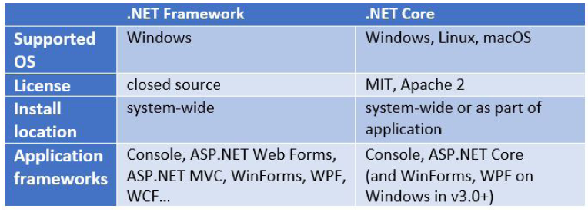
.NET Framework vs .NET Core

Slide 18
.NET Standard
Since the original release of the .NET framework in 2002, the .NET ecosystem expanded with many alternative .NET runtimes: .NET Core, Universal Windows Platform (UWP), Xamarin, Unity Game Engine and others. Although the runtimes are similar to each other, there are some differences between their base class libraries (BCL), which makes it difficult to share code between projects targeting different runtimes.
Microsoft introduced .NET Standard as an alternative for easier cross-platform development. .NET Standard takes a reversed approach to determining the available set of APIs, it explicitly specifies the APIs which must be supported by a compatible runtime.
Several different versions of .NET Standard are defined, each with an increasing number of supported APIs.

Slide 19
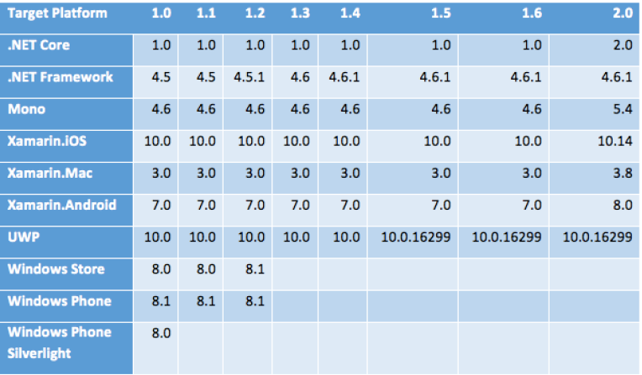
Runtimes an .NET Standard
.NET Standard
The last version is .NET Standard 2.1

Slide 20
.Net Standard 2.1
Compared to .NET Standard 1.6, .NET Standard 2.1 includes over 30,000 APIs.
Since .NET Standard is focused on cross-platform compatibility, it still doesn’t include all the .NET framework APIs, and it never will. By design, it excludes all application model APIs, such as WPF, Windows Forms, ASP.NET and others. It also excludes all Windows specific APIs that were included in the .NET framework, e.g. APIs for working with the registry and event logs. Most of the .NET framework APIs that do not fall in these two categories are included in .NET Standard 2.1.

Slide 21
.NET Standard and System.Drawing
There’s also a namespace that’s not in .NET Standard, but is worth mentioning as it might come as a surprise to most developers: System.Drawing.
Although the System.Drawing APIs can’t be used on all .NET Standard compliant runtime, they are made available to .NET Core as part of the Windows Compatibility Pack. Despite the name of this pack, many of its APIs aren’t just supported on Windows, but on other platforms too. APIs from the System.Drawing namespace count among them and can also be used on Linux and macOS since .NET Core 2.1.

