Slide 1
Creating Slide Decks With R
A short demo

Slide 2
Add data-driven content like tables...
species | mean_bill_length_mm | mean_bill_depth_mm | mean_body_mass_g
Adelie | 38.79 | 18.35 | 3,700.66
Gentoo | 47.50 | 14.98 | 5,076.02
Chinstrap | 48.83 | 18.42 | 3,733.09

Slide 3
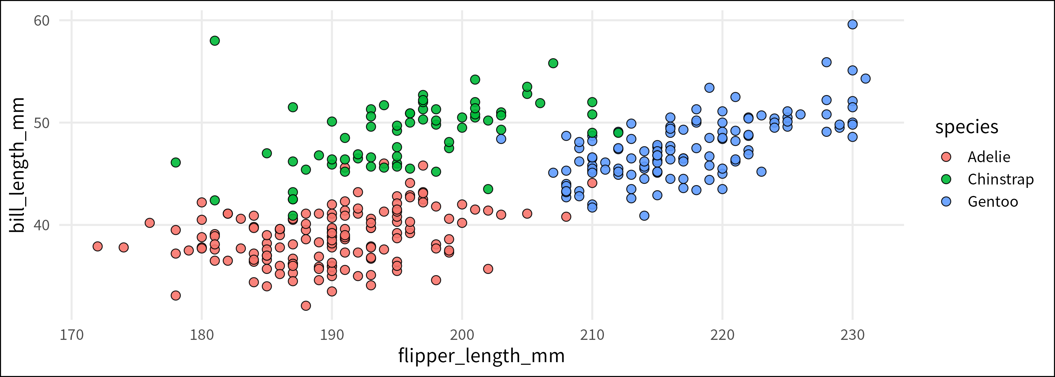
... or ggplots

