Slide 1
A practical review of math and coding Class #6: Statistics

Slide 2
References
Fundamentals: J. Taylor, (1997), Introduction to Error Analysis, 2nd ed, University Science Books (PDF)
Advanced texts: course notes by Dennis Hartmann, University of Washington (website)

Slide 3
population and sample
Objective: We use statistics is to estimate the characteristics of the population
Data is often reported as X ± ∆X. How do we determine X and ∆X ?
What are the meanings of uncertainty?
How do they combine through additive and multiplicative operations?

Slide 4
Measurements and uncertainty
One of the best ways to understand the characteristics of the uncertainty is to measure several times and evaluate the differences in measurements
Systematic error: this type of error cannot be treated with statistics. Calibration with known standard is required to reduce the level of systematic error to an acceptable level.
Random error: random uncertainty is revealed by repeat sampling, and can be treated with statistics. Most of today’s discussion deals with this type of error.

Slide 5
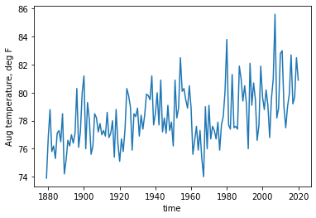
A quick look at the monthly (August) temperature of Atlanta
National weather service, w2.weather.gov

Slide 6
What is the representative value?

Slide 7
What is the representative value?
Mean
Median (50 percentile)

Slide 8
What is the representative value?
In MATLAB >> Tmean = mean(T) >> Tmedian = prctile(T,50)
In Python (numpy) >>> Tmean = np.mean(T) >>> Tmedian = np.percentile(T,50)

Slide 9
How much does the data vary?

Slide 10
How much does the data vary?
Standard deviation
IQR (Inter-Quartile Range) = (75 percentile) – (25 percentile)

Slide 11
How much does the data vary?
In MATLAB >> Tstd = std(T) >> Tiqr = prctile(T,75)-prctile(T,25)
In Python (numpy) >>> Tstd = np.std(T) >>> Tiqr = np.percentile(T,75)-np.percentile(T,25)

Slide 12
Mean vs median
Mean and Median: which one should you choose?

Slide 13
Mean vs median
Mean and Median: which one should you choose?
Atlanta annual mean temperature
Mean = 78.33521126760563 °F
Median = 78.2 °F

Slide 14
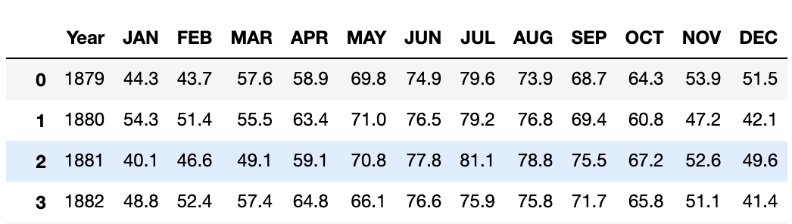
Mean vs median
Mean and Median: which one should you choose?
Atlanta annual mean temperature
Mean = 78.33521126760563 °F
Median = 78.2 °F
Significant figure should reflect the precision of the measurements

Slide 15
Mean vs median
Mean and Median: which one should you choose?
Atlanta mean August temperature
Mean = 78.3 °F
Median = 78.2 °F

Slide 16
Mean vs median
Mean and Median: which one should you choose?
9 people makes $50K and 1 person make $1M
Mean = $145K
Median = $50K
The answer depends on the statistical distribution of the data. Mean and variance are impacted by outliers.

Slide 17
Mean vs median
Mean and Median: which one should you choose?
9 people makes $50K and 1 person make $1M
Remove outlier ($1M) and re-calculate the mean and median
Mean (w/o outlier): $50K
Median: $50K
Data quality control (flagging outliers) may be necessary before taking the mean and standard deviation

Slide 18
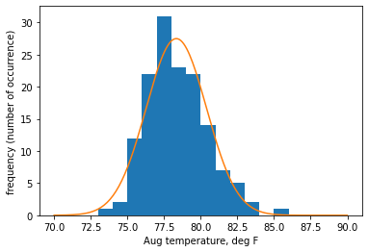
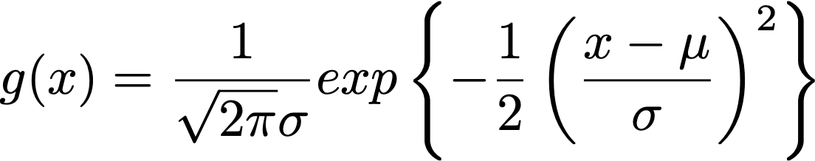
Statistical distribution
Statistical distribution of data: Histogram
Orange line is the Gaussian, g(x), multiplied by the sample size

Slide 19
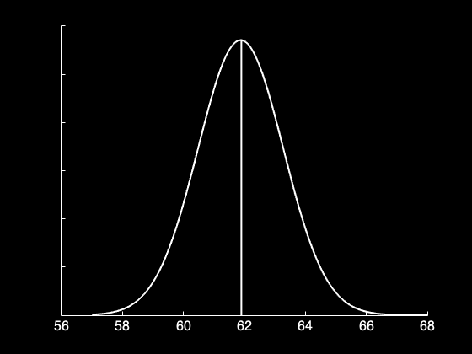
Gaussian (normal distribution)
Atlanta’s monthly mean temperature ≃ Gaussian
Properties of Gaussian (normal distribution)
Symmetric
Mean = Median
μ ±1σ contains 68% of data
μ ±2σ contains 95% of data
Median/mean

Slide 20
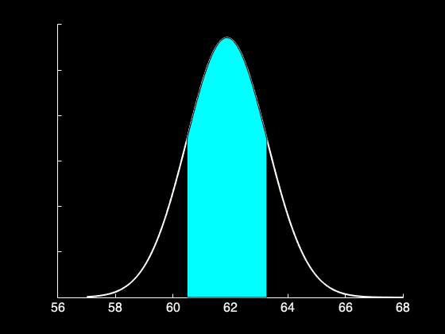
Gaussian (normal distribution)
Atlanta’s annual mean temperature ≃ Gaussian
Properties of Gaussian (normal distribution)
Symmetric
Mean = Median = Mode
μ ±1σ contains 68% of data
μ ±2σ contains 95% of data
±1σ

Slide 21
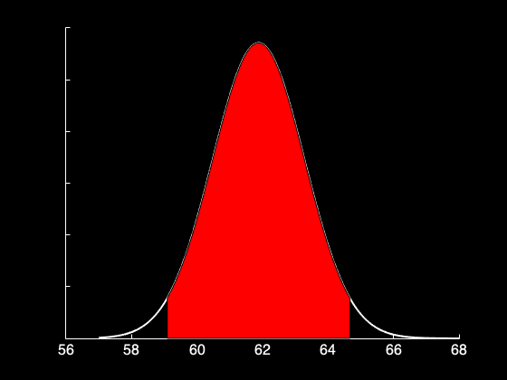
Gaussian (normal distribution)
Atlanta’s annual mean temperature ≃ Gaussian
Properties of Gaussian (normal distribution)
Symmetric
Mean = Median = Mode
μ ±1σ contains 68% of data
μ ±2σ contains 95% of data
±2σ

Slide 22
Statistical distribution
Uncertainty of single measurement:
IF the data is normally distributed, there is 95% probability that a single measurement (x) lies within the range of 2 standard deviation (σ) from the population mean (μ).
x = μ ± 2σ

Slide 23
Confidence interval
We can also write μ = x ± 2σ
This is a statement of estimation: true mean lies within 2σ of the single measurement
“95% confidence interval”

Slide 24
Statistical distribution and uncertainty
Population has a distribution
Example. Rolling a dice. You have equal chance of getting 1 through 6. It’s distribution is flat with 1/6 probability.

Slide 25
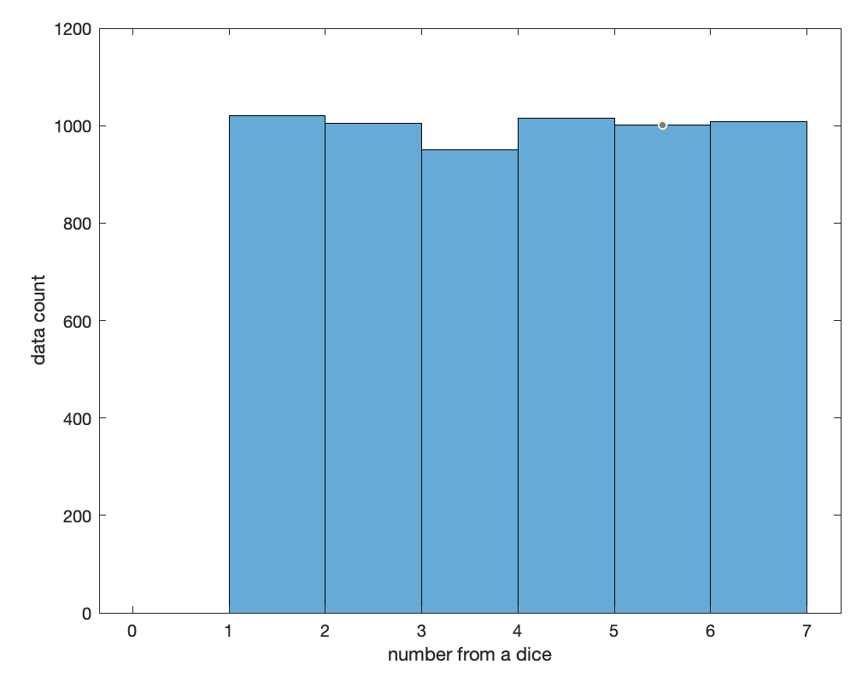
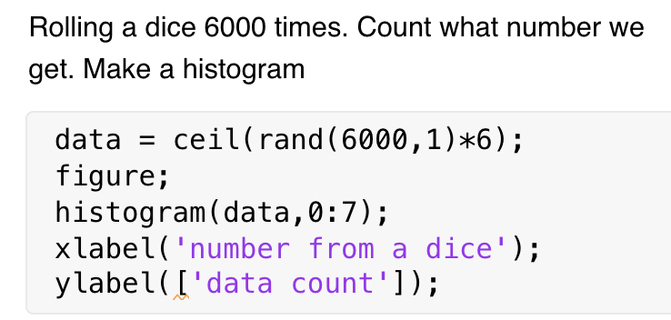
Statistical distribution
Histogram visualizes the distribution

Slide 26
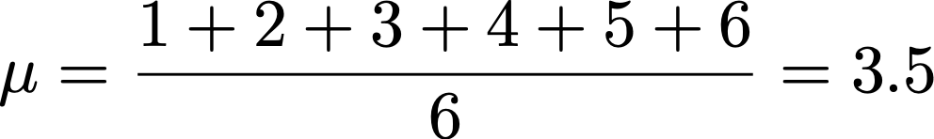
Statistical distribution
What is the expected value of rolling a dice many times and take an average?
Let’s say P(x) is the probability of having the value, x. In this case, P(x) is constant, 1/6, for the range from 1 to 6. If N is very large, you will get roughly equal occurrence from 1 to 6, i.e. with the equal probability of 1/6. Then you expect to get the mean of 3.5 as the sum of xP(x).

Slide 27
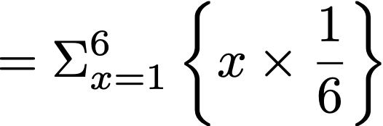

Statistical distribution
What is the expected value of sample mean (i.e. population mean) from rolling a dice for many times?

Slide 28
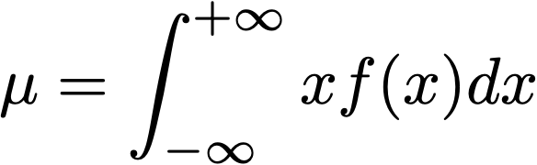
Statistical distribution
What is the expected value of sample mean (i.e. population mean) from rolling a dice for many times?
For continuous problem

Slide 29
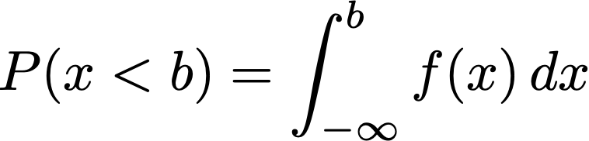
f(x) = PDF = Probability Density Function
PDF is a function that describes statistical distribution
Its area (integral) measures the probability
Graph of f(x) is different from the histogram that PDF integrates out to 1. The area covered by the histogram is equal to NΔx where N is the sample size and Δx is the bin size.

Slide 30


Statistical distribution
What about the standard deviation?

Slide 31
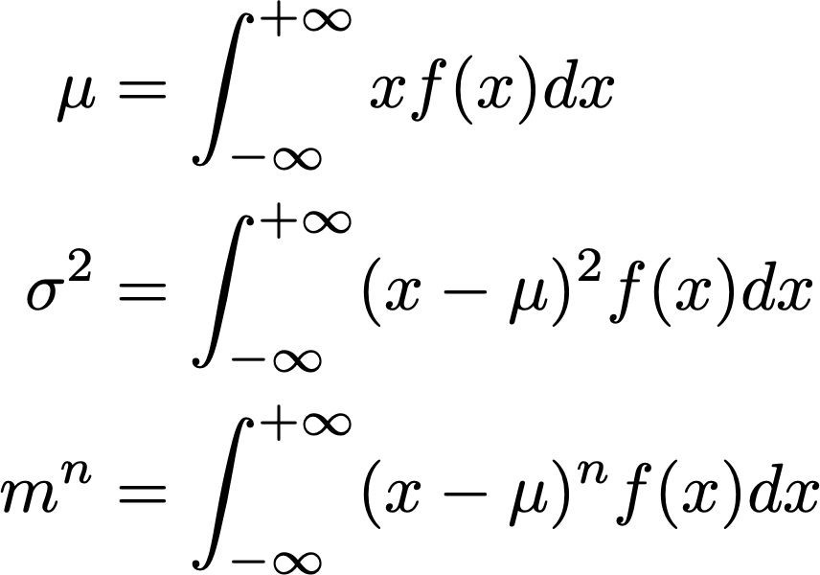
PDF and its moments
1st moment = mean
2nd moment = variance
n-th moment

Slide 32

Central Limit Theorem
1. Mean of sample mean (M) is equal to the population mean (μ)
2. Standard error measures the average distance between sample mean (M) and the true mean (μ)
3. Sample mean (M) follows the normal distribution (Gaussian) regardless of the parent population.

Slide 33
Statistical distribution
Roll a dice 10 times and take the mean (M). Repeat this many times.
What type of distribution will the sample means form?

Slide 34
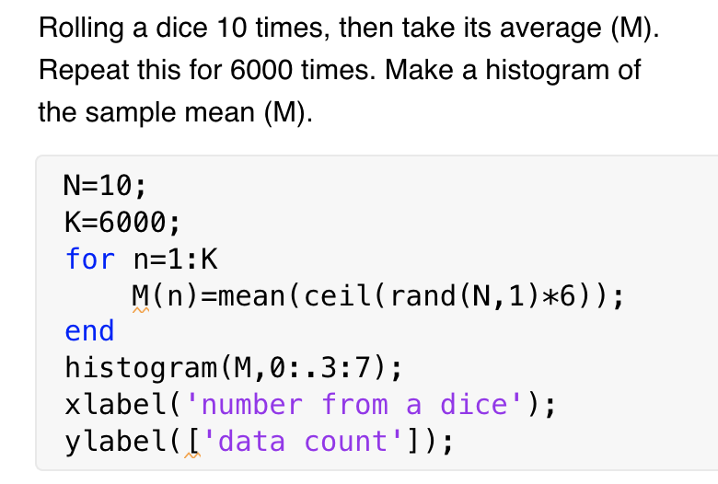
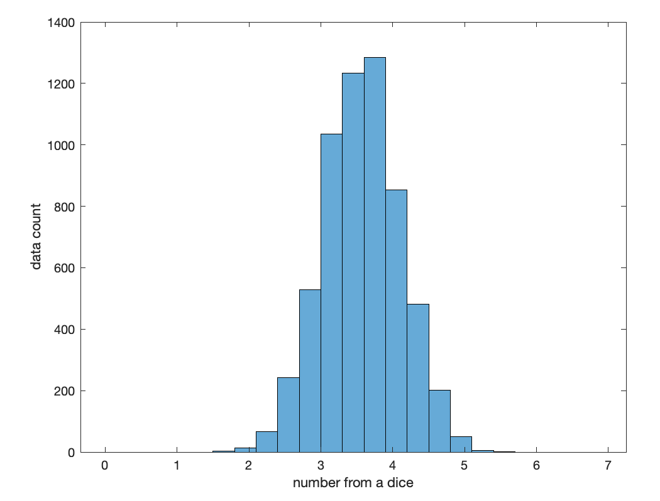
Statistical distribution
Histogram visualizes the distribution

Slide 35
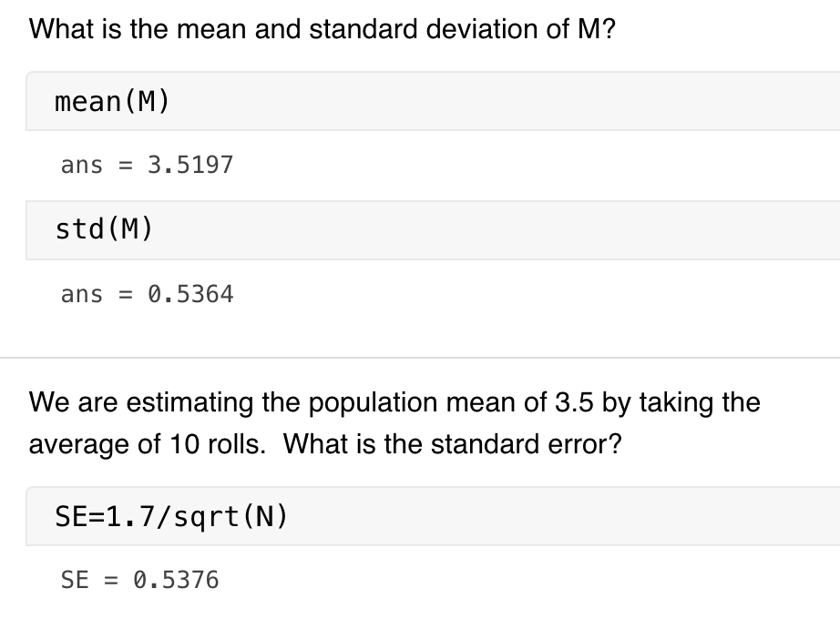
Statistical distribution
Histogram visualizes the distribution

Slide 36
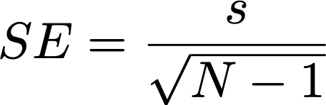

Uncertainty from multiple (N) measurements
Consider taking N samples randomly from a population
What is the 95% confidence interval on the true mean?
Sample mean (M) is the average of N samples
Uncertainty scales with SE.
If N > 30, 95% confidence interval is

Slide 37

Uncertainty from multiple (N) measurements
Consider taking N samples randomly from a population
What is the 95% confidence interval on the true mean?
Sample mean (M) is the average of N samples
Uncertainty scales with SE.
If N < 30, use Student’s t-distribution instead of Gaussian.
The 95% confidence interval is

Slide 38
Useful functions
For the 95% confidence interval, α = 1 - 0.95
α value is set equal to the 1 – (confidence level)
In MATLAB,
>> tcrit = tinv(1-a/2,df) returns the critical t-value (df = N-1).
In python, from scipy import stats
>>> tcrit = stats.t.ppf (1-a/2,df) does the same.

Slide 39

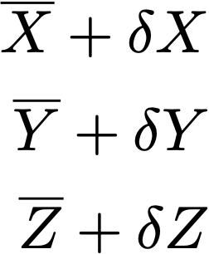


Propagation of uncertainty
Additive problem
D = X + 2Y – 3Z
Given the best estimates and uncertainties in (X, Y, Z), estimate the range of D

Slide 40
Propagation of uncertainty
Additive problem
D = X + 2Y – 3Z
Given the best estimates and uncertainties in (X, Y, Z), estimate the range of D
The most conservative uncertainty estimate:

Slide 41
Propagation of uncertainty
Additive problem
D = X + 2Y – 3Z
Given the best estimates and uncertainties in (X, Y, Z), estimate the range of D
If the uncertainty is independent and random:

Slide 42
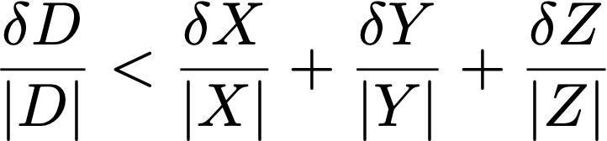
Propagation of uncertainty
Multiplicative problem
D = X * Y / Z
Given the best estimates and uncertainties in (X, Y, Z), estimate the range of D
The most conservative uncertainty estimate:

Slide 43
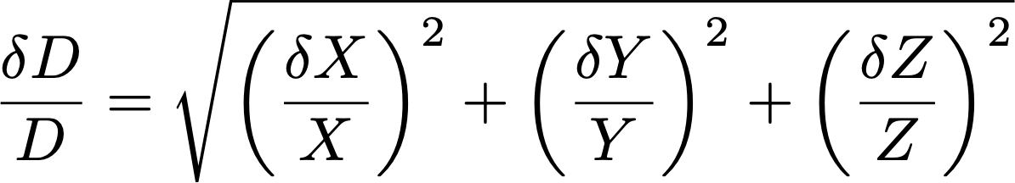
Propagation of uncertainty
Multiplicative problem
D = X * Y / Z
Given the best estimates and uncertainties in (X, Y, Z), estimate the range of D
If the uncertainty is independent and random:

Slide 44
Propagation of uncertainty
Additive problem
D = X + 2Y – 3Z
Given the best estimates and uncertainties in (X, Y, Z), estimate the range of D

Slide 45
Hypothesis testing
The 5 steps
State your confidence level
State your null hypothesis and its alternative
State the statistics used
Determine the critical region
Evaluate whether the data is within or outside of the critical region

Slide 46
1. State your confidence level
It is important to set your confidence level first. This sets how extreme the data should be in order to reject the null hypothesis.
Example
95% confidence level means we reject null hypothesis if data is extreme beyond 95% of expected range.

Slide 47
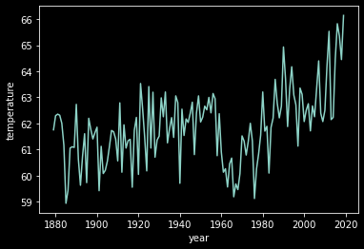
2. State the null hypothesis and its alternative
Example
H₀: Annual mean temperature from the last 10 years is NOT significantly warmer than the long-term mean.
H₁: Annual mean temperature from the last 10 years is significantly warmer than the long-term mean.

Slide 48
3. State the statistics used.
Example
We use Student’s t-distribution with one-tail test.
Student’s t-distribution: In general when the sample number is small (N<30) we use t-distribution.
One-tail test: Since we already know that some warming has occurred, we focus on the positive side of the distribution.

Slide 49
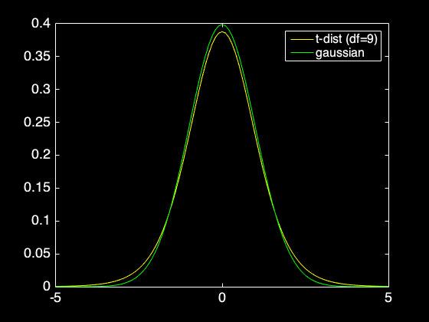
Student’s t-distribution

Slide 50
4. Determine the critical region
Critical region is related to the percentile value.
For one-tail test, the critical region with the 95% confidence level is 95% percentile value
Look for the t-value at 0.95 = CDF(t,d.f.=9) where CDF is the cumulative distribution function.
This can be done using MATLAB/python
>> a = 1-.95
>> tcrit = tinv(1-a,df) (for one tail)
>> tcrit = tinv(1-a/2,df) (for two tail)

Slide 51

5. Evaluate whether data is within the critical region
Calculate the t-value of the data:
x: Mean temperature from the last 10 years
μ: Long term mean temperature
t-value is (signal)/(standard error)

Slide 52
5. Evaluate whether data is within the critical region
x = 64.2°F (from last 10 years)
μ = 61.9°F (long-term mean)
s = 1.5 °F (std from last 10 years)
t-value is 4.8, which is much larger than the critical value of 1.8.

Slide 53
5. Evaluate whether data is within the critical region
If the null hypothesis is correct, the t-value will be t<t_{crit} for the confidence level (95%)
t>t_{crit}: we reject the null hypothesis
Random sampling cannot explain the warm temperature from the last 10 years!
(p-value) What’s the probability of getting the observed signal by random sampling: p=1-CDF(tvalue,df) p=0.0005 (0.05%).

Slide 54
Type I vs II errors
There are 4 possible outcomes of the hypothesis testing
1. Null hypothesis is NOT true, and the t-test rejects the null hypothesis (true positive)
2. Null hypothesis is true, and the t-test does not reject the null hypothesis (true negative)
3. Null hypothesis is true, and the the t-test rejects the null hypothesis (false positive = Type I error)
4. Null hypothesis is NOT true, and the t-test does not reject the null hypothesis (false negative = Type II error)

Slide 55
Type I error
False positive
Random sampling can sometimes create a strong signal.
If confidence level is 95%, this happens at 5% probability (the “α” value is the probability of committing Type I error)
To reduce the Type I error, increase the confidence level (i.e. lower the α value). Higher level of confidence requires a stronger t-value in order to reject H₀.

Slide 56
Type II error
False negative
The signal is not very strong and/or sample size is small.
If the confidence level is very high, type II error can occur.
To reduce the Type II error while keeping certain confidence level, it is necessary to collect more data. You should not just lower the confidence level to get the result you want.

Slide 57
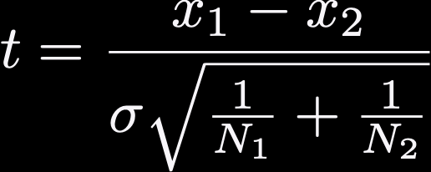
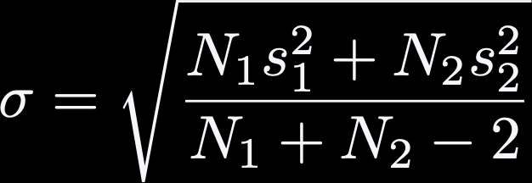
Comparing two sample statistics
Assume you want to compare 2 groups of samples
Sample size N₁ and N₂, means x₁ and x₂, standard deviation s₁ and s₂
Null hypothesis: the two samples are coming from the same population (x₁ = x₂)

Slide 58
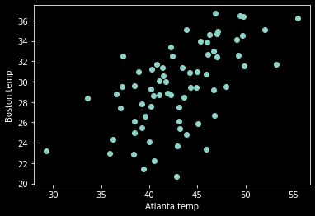
Significance of correlation
You have a pair of N observations, x and y, with a correlation coefficient of r.
Temperature of Atlanta and Boston
r=0.6
Is this statistically significant?

Slide 59
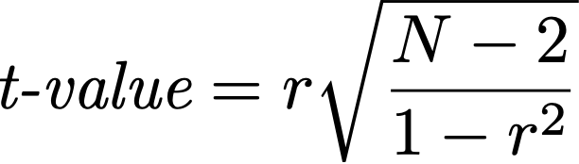
Significance of correlation
You have a pair of N observations, x and y, with a correlation coefficient of r.
N=140, r=0.6
t=8.8 >> 2
Atlanta and Boston are significantly correlated at 95% confidence interval

