Slide 1
A practical review of math and coding Class #5: Interpolation & smoothing

Slide 2
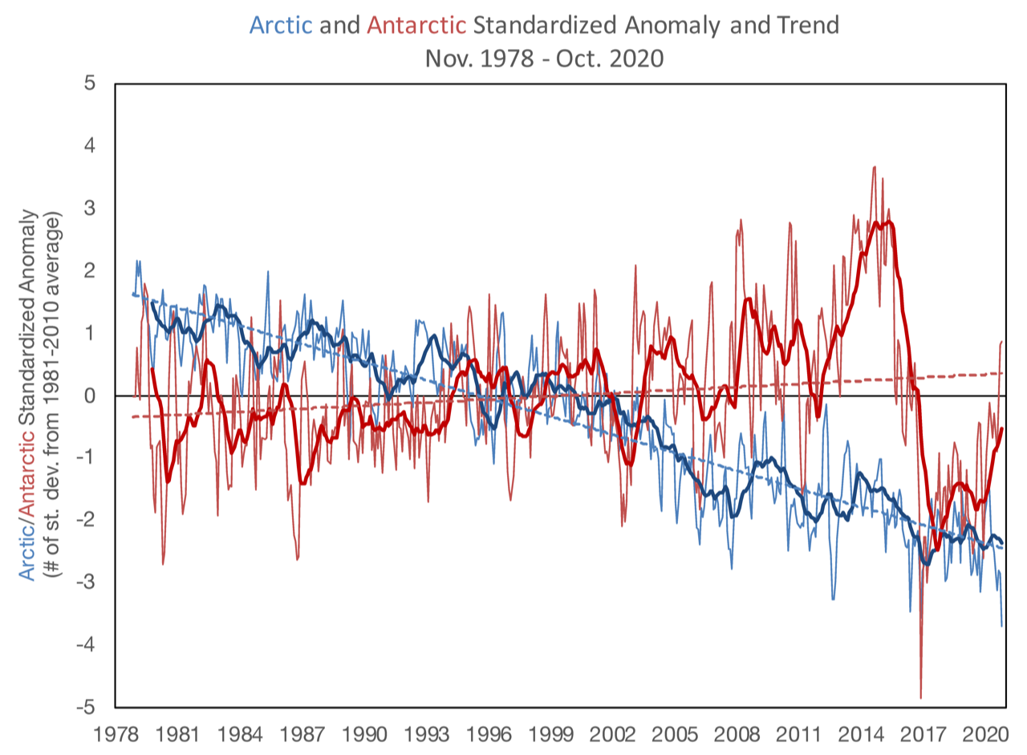
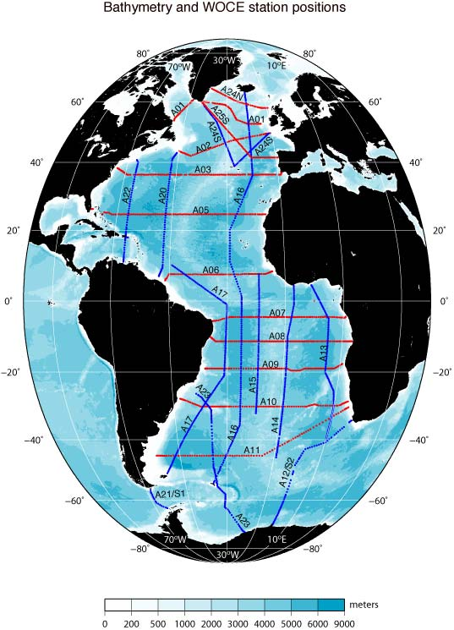
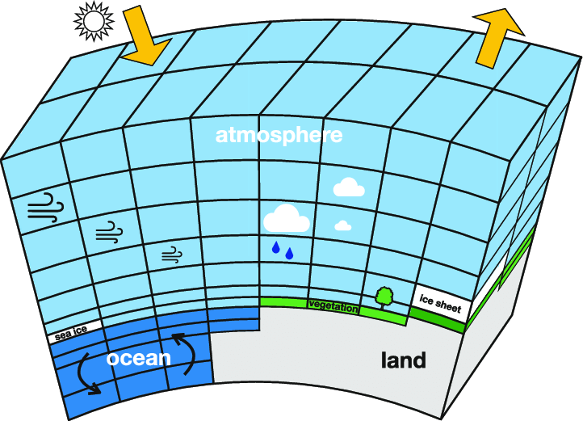
Why interpolate?

Slide 3
We may need to interpolate data when…
Comparing datasets that are defined in different grid system in space and/or in time
Data points are sparse and/or irregular, and it needs to be placed on regular grid before data analysis/interpretation
There is a data gap (missing data) that needs to be filled
Preparing inputs (e.g. boundary conditions) for a model that are continuous, smooth and without gaps

Slide 4

Interpolation as a linear operator
Mathematically,

Slide 5
Interpolation as a linear operator
Mathematically,
Output, e.g. estimated temperature on regular grid
Input, e.g. observed temperature on irregular grid

Slide 6
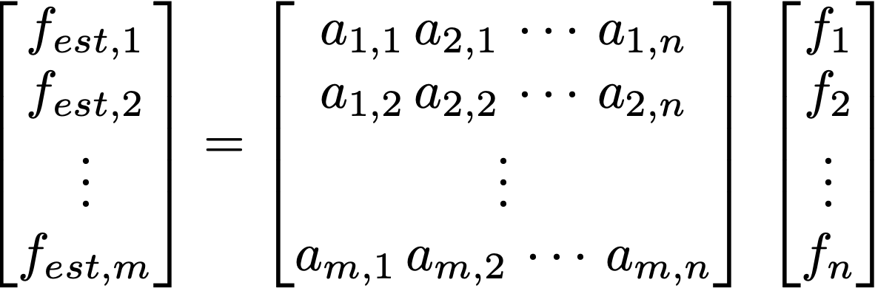
Interpolation as a linear operator
Mathematically,
Output, e.g. estimated temperature on regular grid
Input, e.g. observed temperature on irregular grid

Slide 7
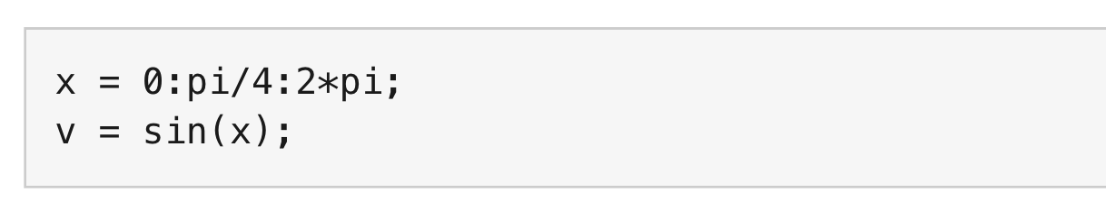
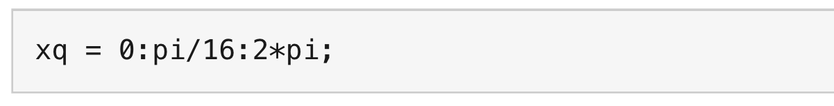
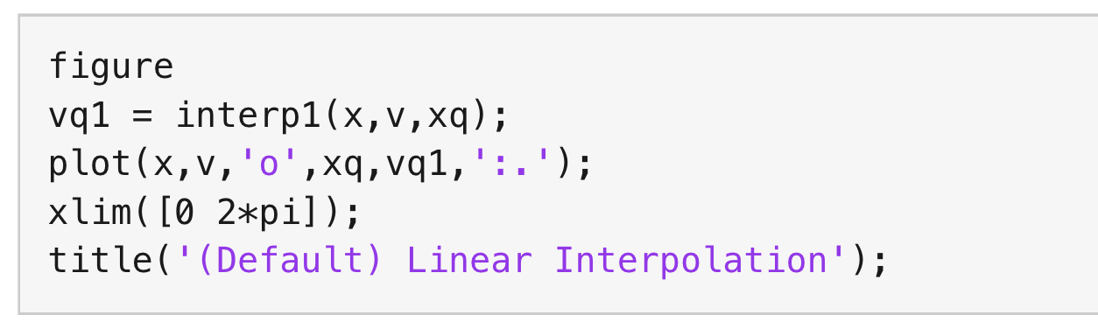
1. piecewise linear (MATLAB)
The input is a sine function subsampled at every π/4
The interpolation output is desired at every π/16
The MATLAB function, interp1, by default give you the piecewise linear interpolation

Slide 8
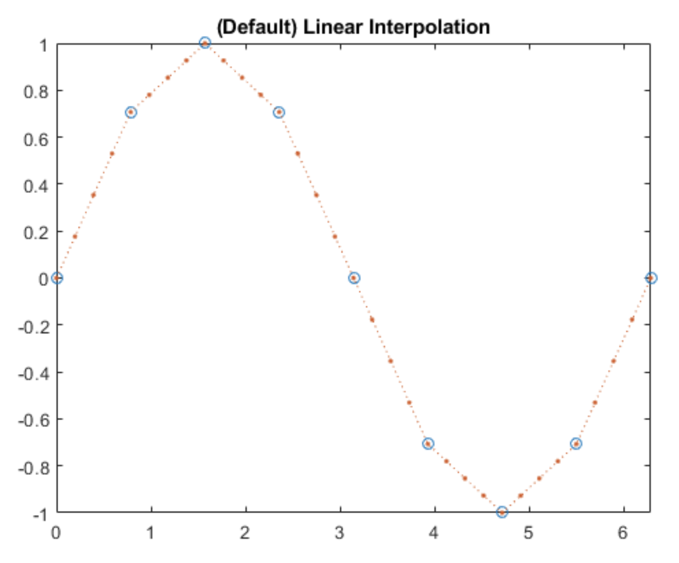
1. piecewise linear (MATLAB)
The input is a sine function subsampled at every π/4
The interpolation output is desired at every π/16
The MATLAB function, interp1, by default give you the piecewise linear interpolation

Slide 9
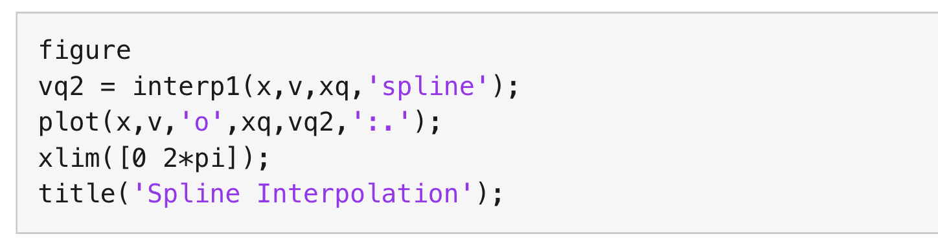
2. spline (MATLAB)
The input is a sine function subsampled at every π/4
The interpolation output is desired at every π/16
See the option ‘spline’ for the input of interp1 function

Slide 10
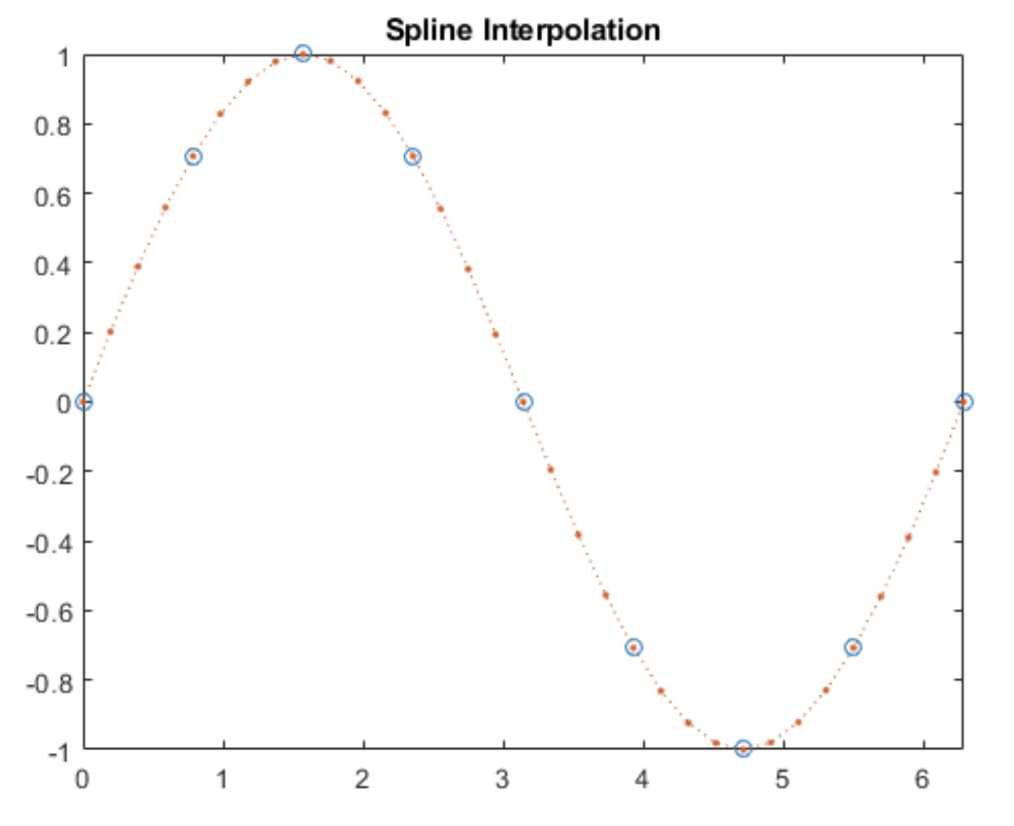
2. spline (MATLAB)
The input is a sine function subsampled at every π/4
The interpolation output is desired at every π/16
See the option ‘spline’ for the input of interp1 function

Slide 11
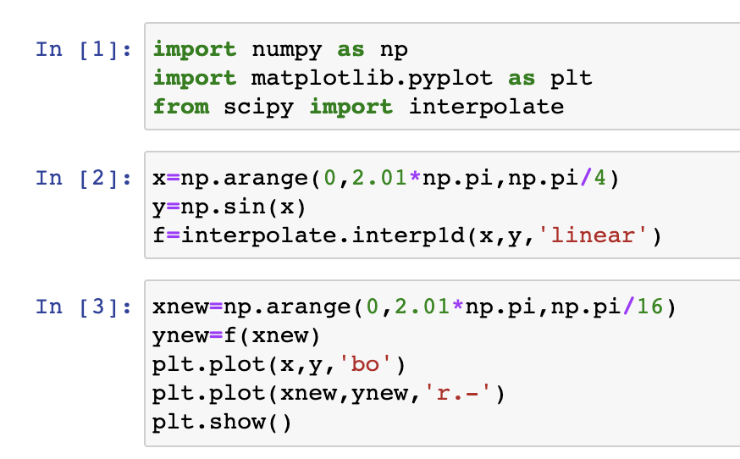
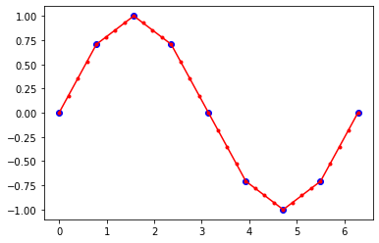
Python: scipy.interpolate.interp1d (linear)

Slide 12
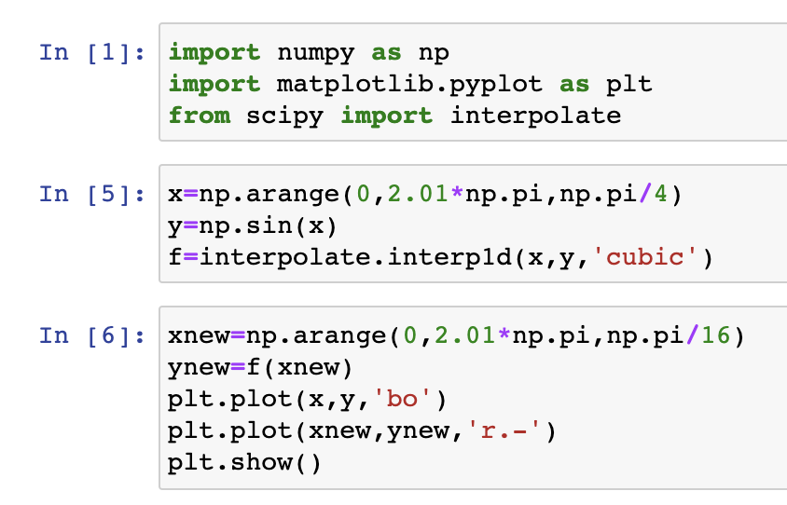
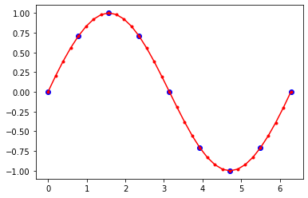
Python: scipy.interpolate.interp1d (spline)

Slide 13
Python: scipy.interpolate.interp1d (spline)

Slide 14
Two dimensional interpolation
Input and output are in 2 dimensions: f(x,y)
Example: Input is a temperature on 2° x 2° longitude-latitude grid and the desired output is on 1° x 1° grid.
Bilinear interpolation → this is what I use for the first try. First, linearly interpolate in one direction, and then linearly interpolate again in the other direction
Other options would be nearest neighbor and cubic spline

Slide 15
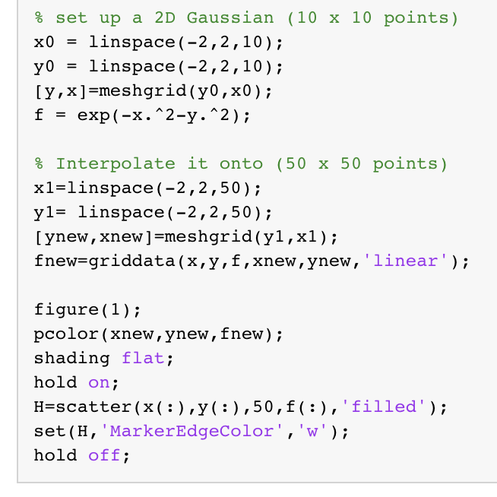
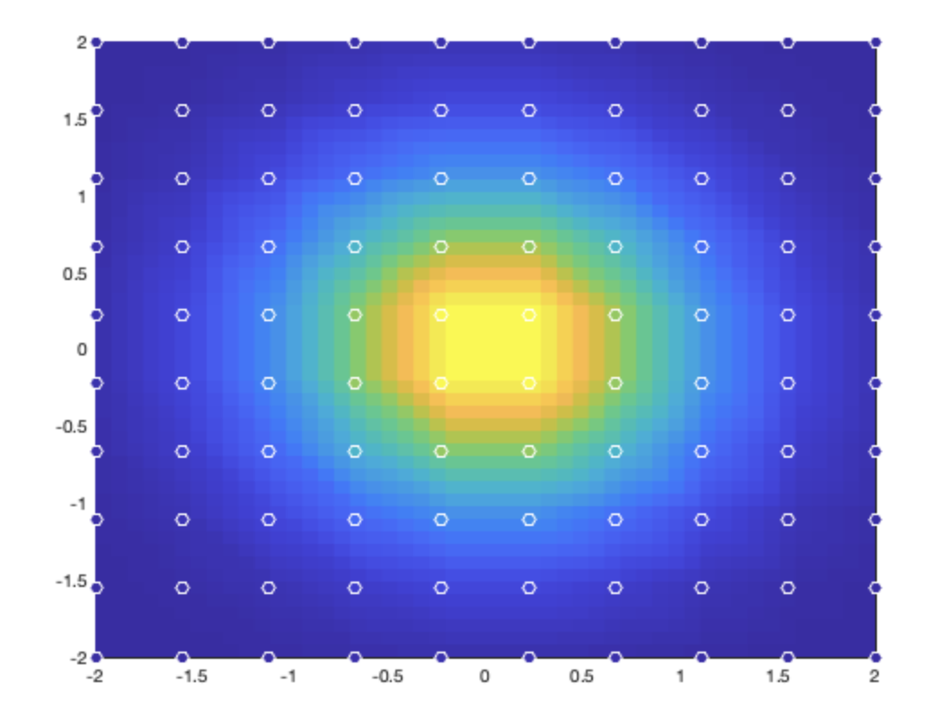
MATLAB: fnew = griddata(x,y,f,xnew,ynew)
Bilinear interpolation

Slide 16
MATLAB: fnew = griddata(x,y,f,xnew,ynew)
Bilinear interpolation

Slide 17
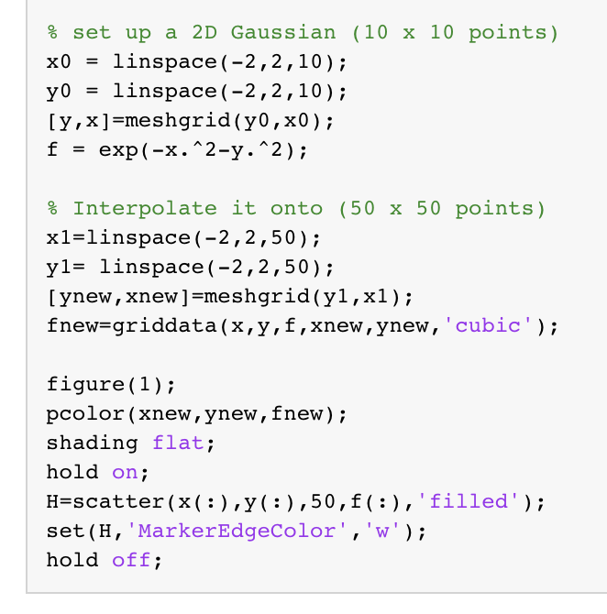
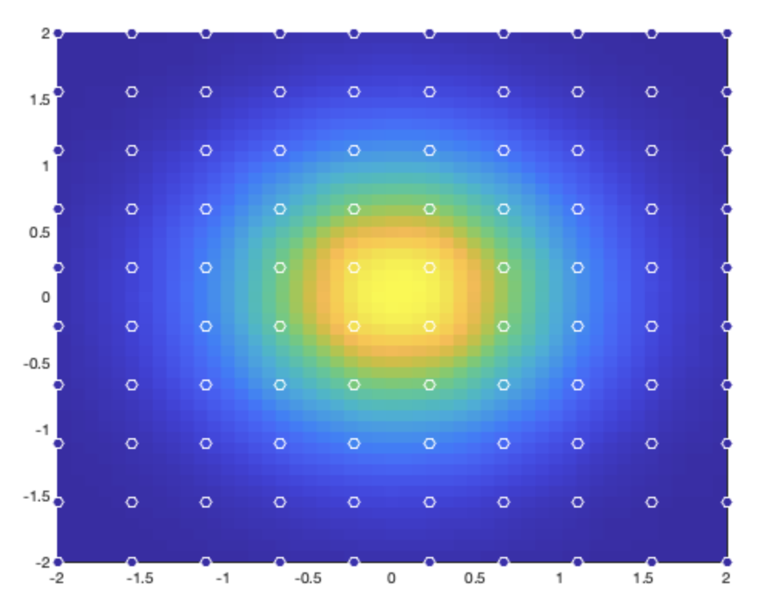
MATLAB: fnew = griddata(x,y,f,xnew,ynew)
Cubic interpolation

Slide 18
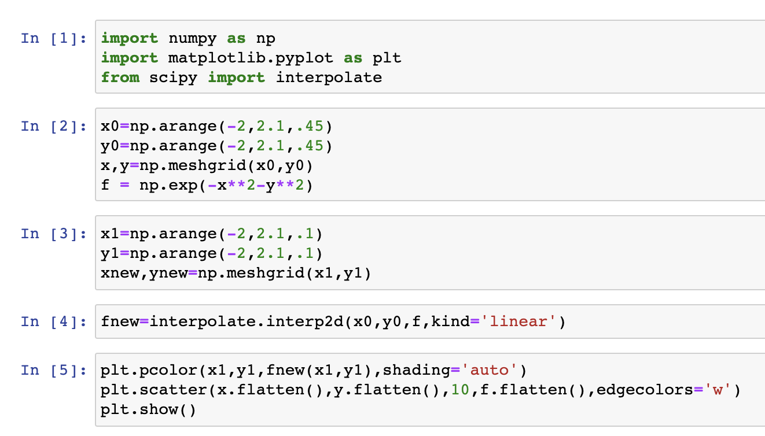
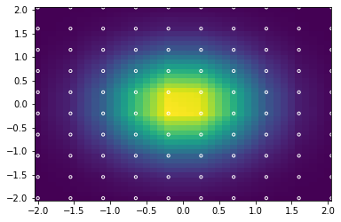
Python: interpolate.interp2d

Slide 19
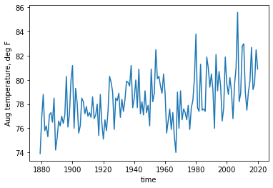
Least square and interpolation
Looking at the August temperature (T) of Atlanta, I expect an increasing trend with time (t). The expected relationship is:
where a₀ and a₁ are constants.
T(t)

Slide 20
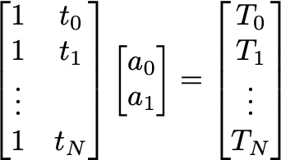
Least square and pseudoinverse
Looking at the August temperature (T) of Atlanta, I expect an increasing trend with time (t). The expected relationship is:
where a₀ and a₁ are constants.
T(t)
A x ~ b

Slide 21
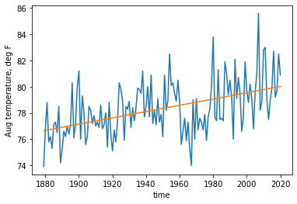


An example
Trend = Ax = a₀ + a₁ t
A x = b

Slide 22
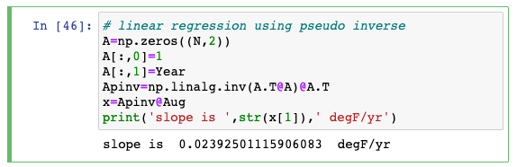
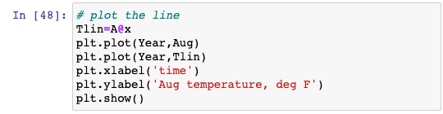
A python example
Trend = Ax = a₀ + a₁ t

Slide 23
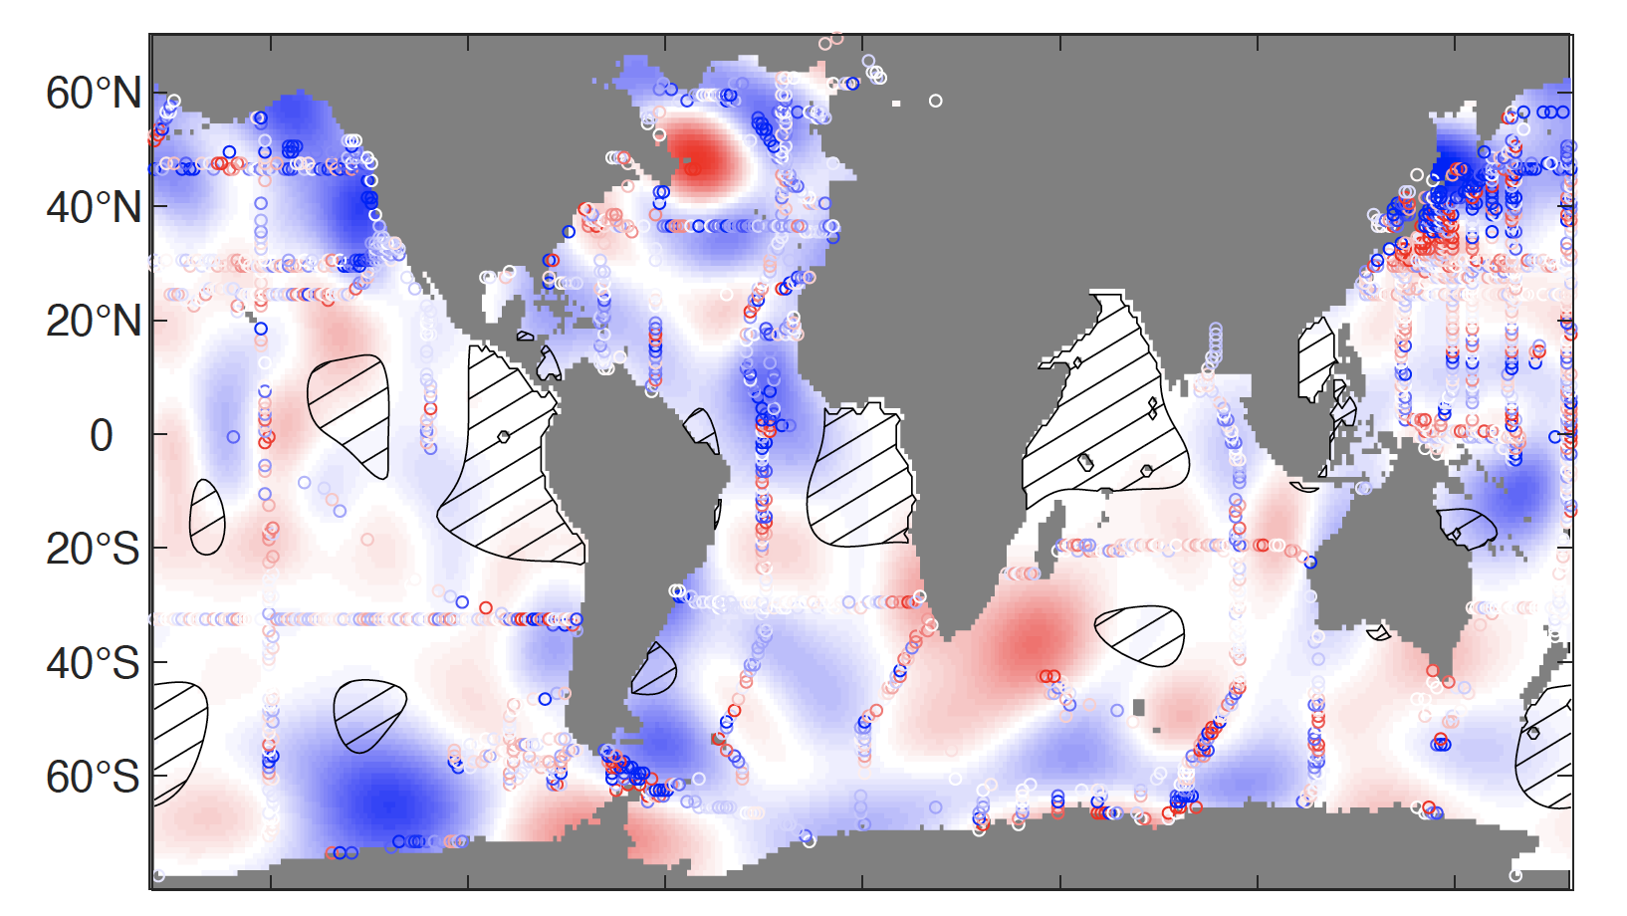
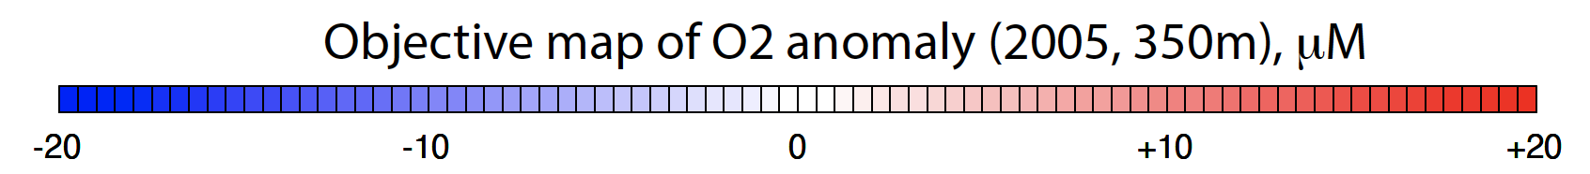
Objective mapping (optimal interpolation)
Objective mapping is a least square fit to the irregular, noisy observations, commonly used in meteorology and oceanography

Slide 24
Smoothing
Real data often contains noises.
For example, atmospheric data contains high-frequency weather events on top of slowly varying climate signals. Ocean data can contain the effects of tides, waves, eddies, seasonal cycles, El-Nino events, etc… Sometimes, we want to remove the high-frequency “noises” so that we can focus on the slow climate signals.
Smoothing (filtering) is almost necessary step in data analysis

Slide 25
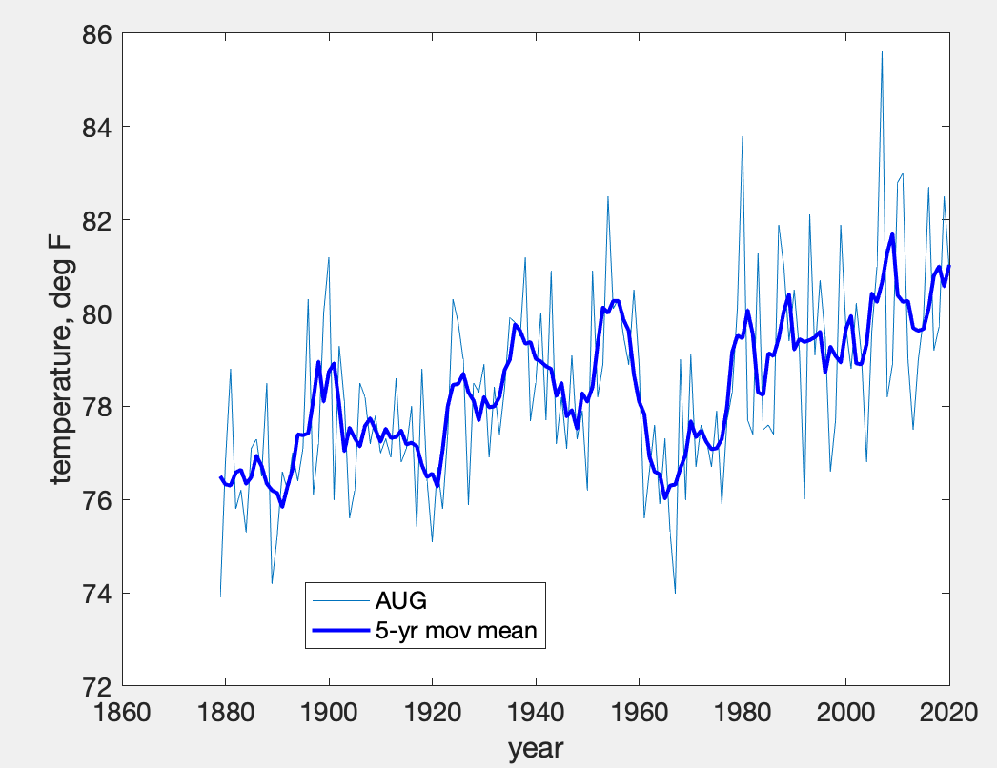
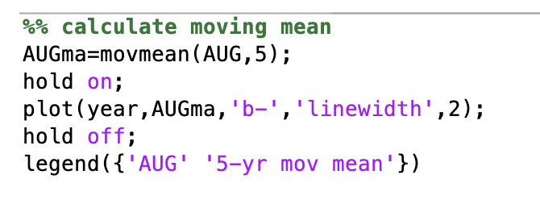
Moving window averages (running mean)
The data is smoothed by averaging over a given time window. For example, we can look at the August temperature of Atlanta, and apply 5-year moving window averaging.

Slide 26
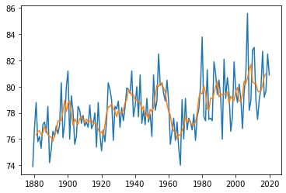
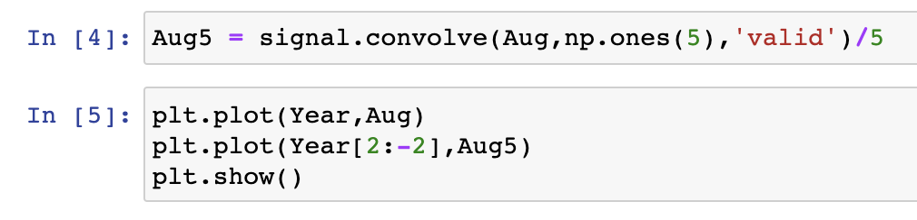
Moving window averages (running mean)
The data is smoothed by averaging over a given time window. For example, we can look at the August temperature of Atlanta, and apply 5-year moving window averaging
(from scipy import signal)

Slide 27
Moving window averages (running mean)
In MATLAB, use movmean
In Python, use scipy.signal.convolve
Running mean can be calculated as a discrete convolution with ones of window size (N) divided by N

