Slide 1
Drugs of Abuse

Slide 2
Question
How do we know which recreational drug is going to be popular in the future?
Use word embeddings to correlate past drug popularity with public sentiments about the drugs

Slide 3
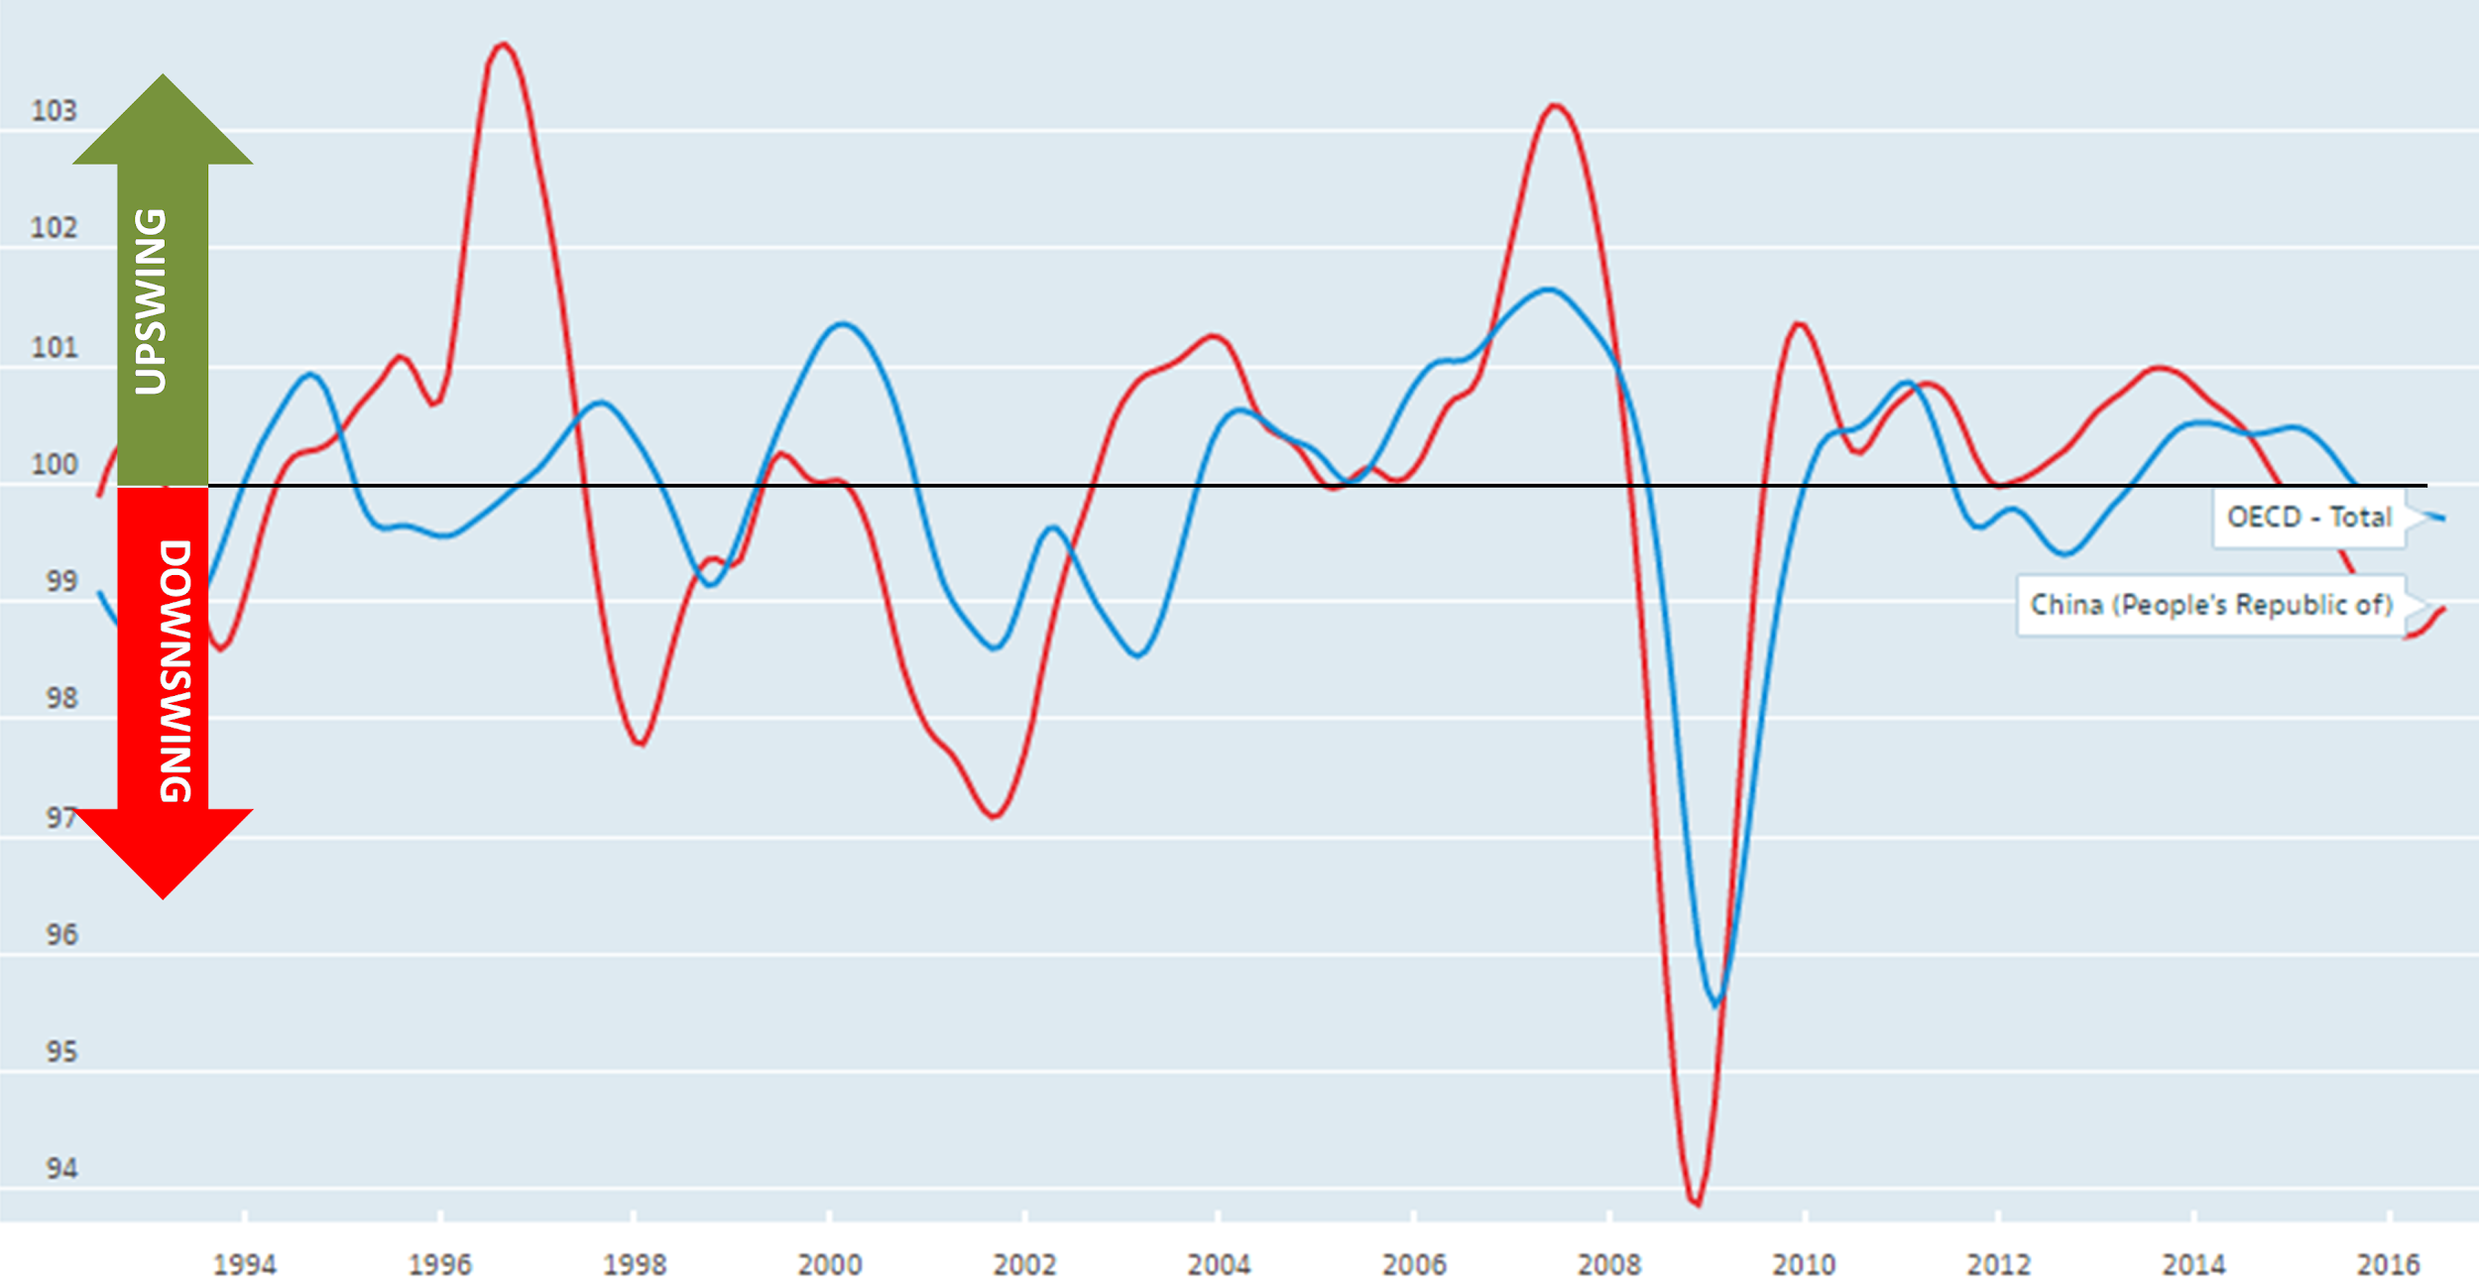
Leading Indicators

Slide 4
Possible Indicators for Popularity
Semantic similarity to a list of words (ie lit, cool, sell, etc.)
Specific linear combination of semantic features derived from word embeddings
Principal component (similar to Wenhan’s initial experiment)

Slide 5
List of Drugs
Created from Substance Abuse and Mental Health Services Administration(SAMHSA)
- U.S. Department of Health and Human Services
Marijuana, Cocaine, Crack, Heroin, Hallucinogens, LSD, PCP, Ecstasy, Inhalants, Methamphetamine, Stimulants, Tranquilizers, Sedatives, Benzodiazepines, Opioids

Slide 6
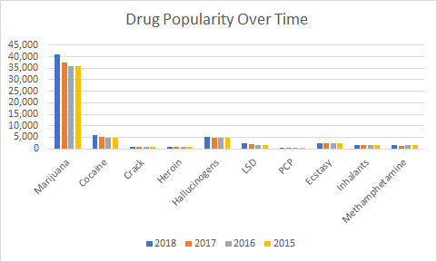
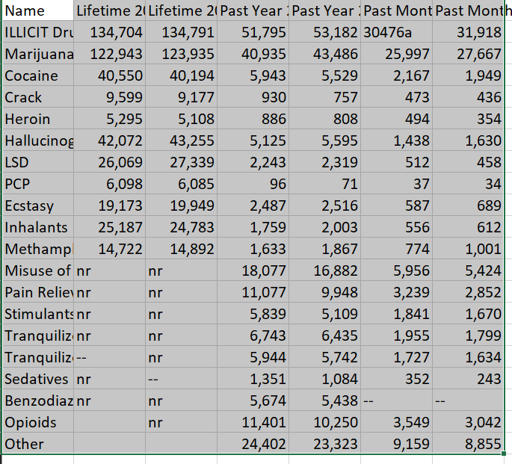
Popularity Data

Slide 7
Embeddings
Reddit
Twitter
Wikipedia
Gensim (includes Twitter, Wikipedia, training implementation)
Notes:
Number of words
Size
Date
Method
Window Size

Slide 8
Twitter(word2vec)
Number of Words: 400 Million Tweets
Size: 4.89GB
Date March 2013 - March 2014
Method: word2vec
Are all Drugs Present: Yes
Notes:
Number of words
Size
Date
Method
Window Size

Slide 9
Reddit Comment Data
Number of Words: 1.7 billion comments
Size: 250GB compressed, 1TB uncompressed
Date March 2005 - March 2015
Method: To be trained
Are all Drugs Present: Unknown(most likely yes)
Notes:
Number of words
Size
Date
Method
Window Size

Slide 10
Initial Investigations
Given lack of word embeddings across time...
How is semantic similarity to a list of words related to “level of abuse”?
“Level of abuse” in terms of
Drug popularity (eg. monthly users)
DSM criteria (eg. Schedule VI)
Category (eg. stimulants)
Meng et. al.

Slide 11
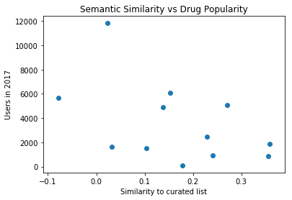
Initial Investigations
Notes:
Future curiosities:
Meng et. al “get high” “smoke”

Slide 12
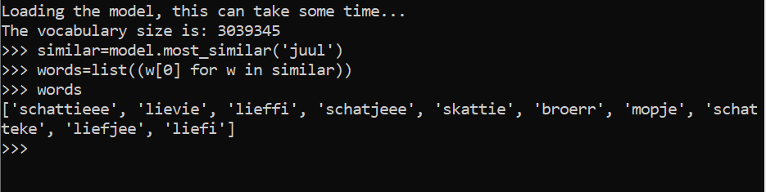
Questions
What drugs would you have wished to predict the popularity of?
Do we want to keep “garbage words”?

Slide 13
Next steps-Finding Leading Indicators for Drug Popularity
Train data that is timestamped
Reddit data
GloVe, Haas computing cluster
Correlate with drug popularity data from SAMHSA

Slide 14
Next steps-Identify new and upcoming drugs
Use word embeddings to identify if a word is a drug(ie juul, bath salts, prescription opioids)

Slide 15
Next steps-Predicting which drugs will be popular
Use leading indicators on new drugs to see which ones will be most popular in the future

Slide 16
Other
This technique could also be applied to other market segments besides drugs
Ie which diet will be the most popular in the future
Ie what clothing style will be “in style”

