Slide 1
Drugs of Abuse

Slide 2
Question
How do we know which recreational drug is going to be popular in the future?
Use word embeddings to correlate past drug popularity with public sentiments about the drugs

Slide 3
Description of Corpus
Song Database, songs influence culture?
Size: 250,473 songs, 50,094,600 words
Genre: Rock(36%), Pop(14%), Other(50%)
Dates: 1960-2000(18,070) 2000-(344,161)
https://www.kaggle.com/gyani95/380000-lyrics-from-metrolyrics

Slide 4
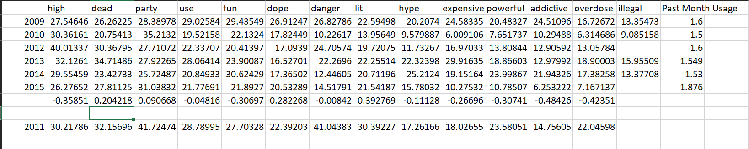
Cocaine

Slide 5
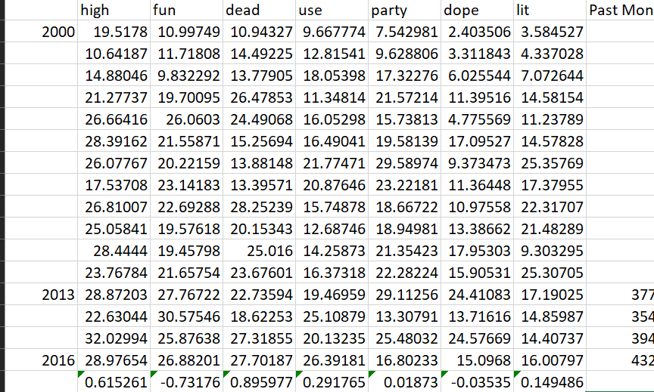
Crack Cocaine
Crack

Slide 6
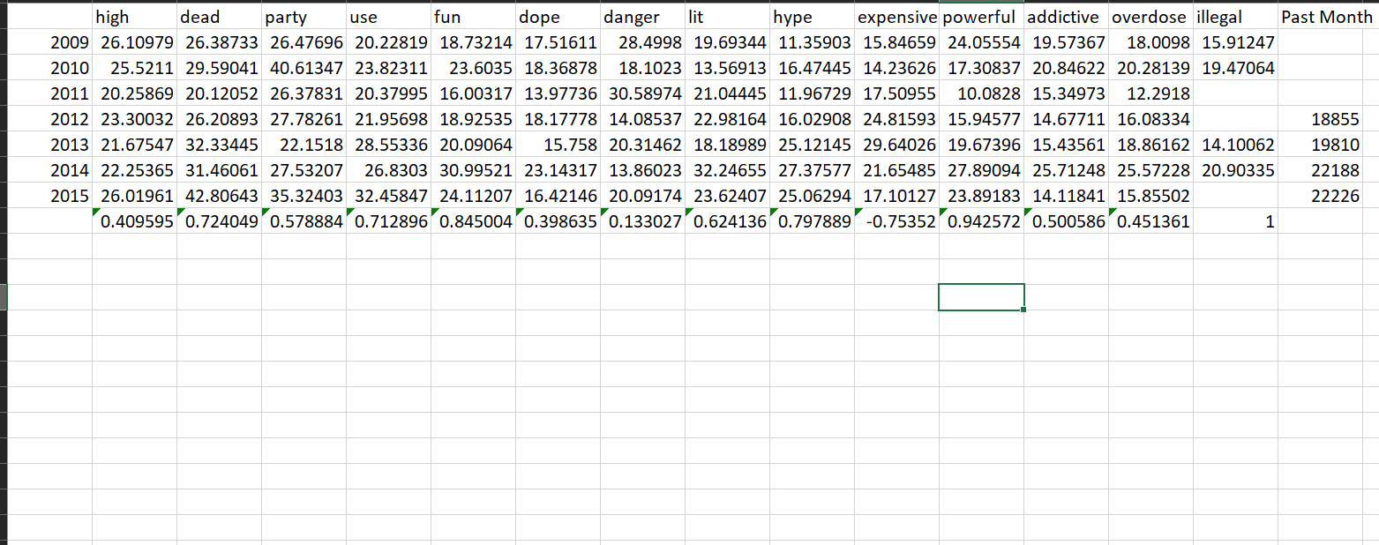
Marijuana

Slide 7
Next Steps
Expand size of corpus
PCA on different words that describe experiences/associations of drugs

