Slide 1
Drugs of Abuse
Trends in Pop Culture and Music

Slide 2
Overview
How did music change between 1950s to present

Slide 3
Qualitative Trends
-1950s: Rock and Roll, civil rights movement
-1960s: British Invasion, R&B, Folk Music - Social activism
-1970s: Punk, Disco
-1980s: Hip Hop - disenfranchised African American Youth
-1990s: Grunge → Pop music - Mainstream marketing, commercialization
-2000s: Pop, Hip Hop - continuation of commercialization
Notes:
1960s vietnam war, environmentalism
1980s - similar to british youths and punk
https://open.lib.umn.edu/mediaandculture/chapter/6-2-the-evolution-of-popular-music/

Slide 4
Sentiment Analysis
Sentiment Analysis by Napier, Shamir
-Dataset 6150 songs from 1951-2016
-Calculated from the choice of words used: psycholinguistics
-Scores range from 0-1, with .5 indicating presence of tone
- “Young man, there’s no need to feel down” Y.M.C.A by Village People
Joy: 0.65
Anger: 0.11
Fear: 0.09
Disgust: 0.07
Notes:
IBM Watson Tone Analyzer

Slide 5
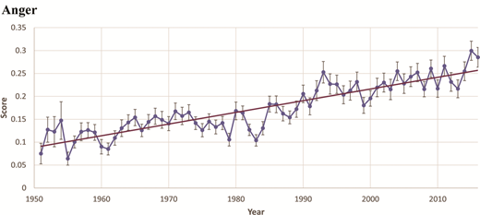
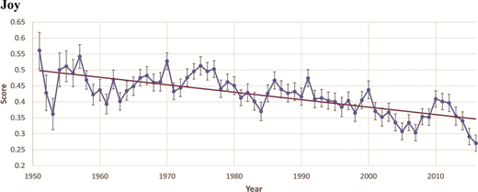
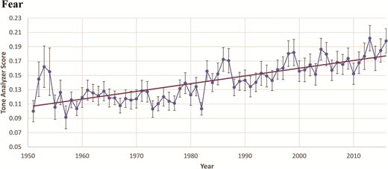
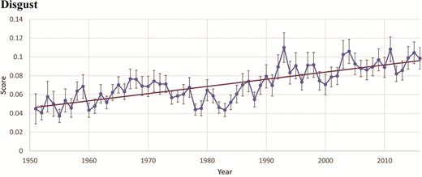
Sentiment Analysis - Results
Correlation coefficient: .8897
Correlation coefficient: -.7293
Correlation coefficient: .7790
Correlation coefficient: .7817
All p-values less than 0.0001

Slide 6
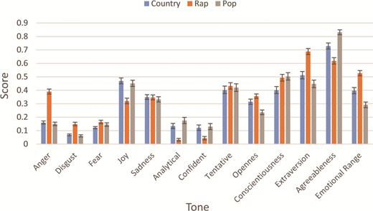
Sentiment Analysis-By Genre

Slide 7
Sentiment Analysis Conclusions
Music became more negative between 1950-2020
Rap is more negative than Pop or Country, which are about equal
Notes:
https://online.ucpress.edu/jpms/article/30/4/161/106385/Quantitative-Sentiment-Analysis-of-Lyrics-in

Slide 8
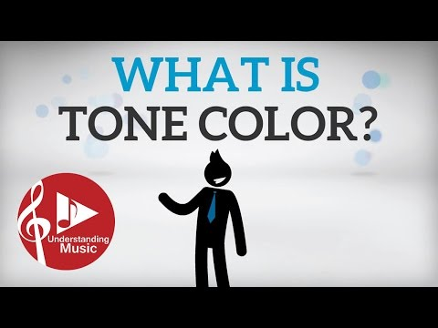
Feature Extraction from Audio
Dataset: 17094 songs, US Billboard Hot 100, 1960-2010
Model built using timbre(T-lexicon) and harmony(H-lexicon)
Harmony: 12 Chord changes, Chord progessions
Timbre: 14 Timbre clusters
https://www.musical-u.com/learn/introduction-to-chord-progressions/
Notes:
Go to https://www.musical-u.com/learn/introduction-to-chord-progressions/ and play the three chord progessions
https://royalsocietypublishing.org/doi/10.1098/rsos.150081

Slide 9
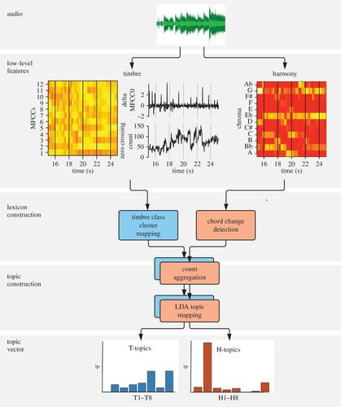
Feature Extraction from Audio
H-lexicon and T-lexicon combined into
Topics using latent dirichlet allocation(LDA)
Each song is then given a distribution of topics
See last section of graphic

Slide 10
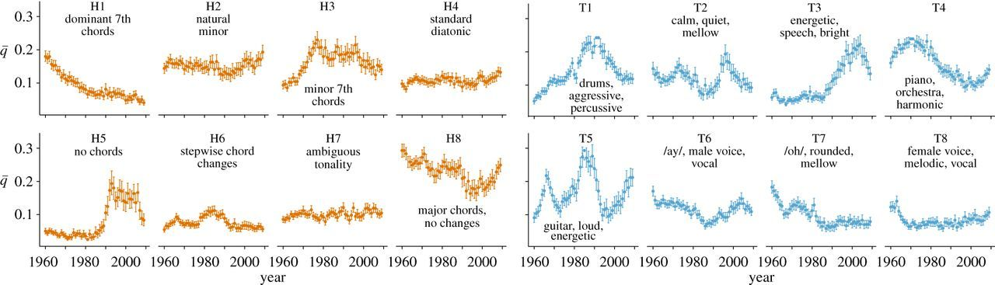
Feature Extraction from Audio
H1 chords used in Jazz, Blues
H3 chords used in Funk, Disco, Soul
H5 chords used in Hip Hop, Rap
T1 came from percussive technology: ie drum machine

Slide 11
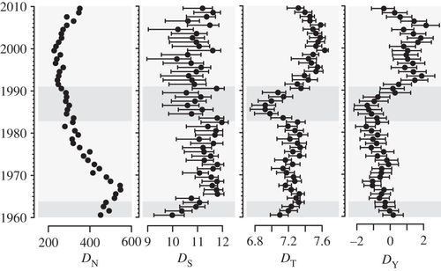
Feature Extraction from Audio
Dn- Number of unique songs
Ds- Number of styles
Dt - Number of different timbral and harmonic topics
Dy - Total standard deviation?

Slide 12
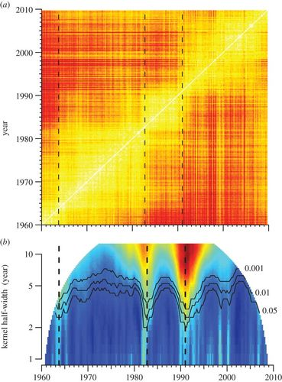
Feature Extraction from Audio
Major stylistic changes occurred 1964, 1983, 1991
1964: soul, rock and roll
1983: Disco, hard rock
1991: Rap

Slide 13
Feature Extraction from Audio Conclusions
Music diversity has not declined
Genre popularity can be capture from timbre and harmonic changes
Major Genre changes happened in 1964, 1983, 1991
Predict: Next Genre, then run Sentiment Analysis to see positivity vs negativity
Notes:
Even with oligopoly on music industry
Probably not a research focus for the lab

Slide 14
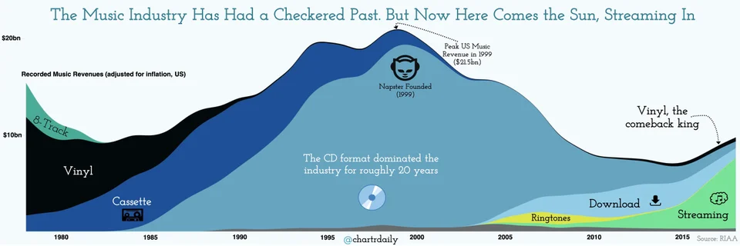
Music Industry

Slide 15
Next Steps
-Correlation between negative music trend and mental health

