Slide 1
Drugs of Abuse

Slide 2
Overview
How do we know which recreational drug is going to be popular in the future?
Use word embeddings to correlate past drug popularity with public sentiments about the drugs

Slide 3
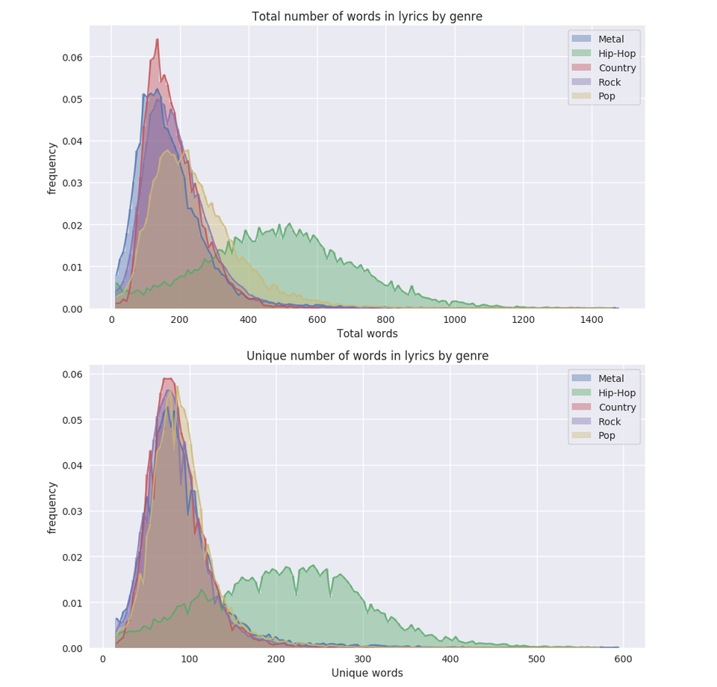
Description of Corpus
Billboard Charts Top 100
Lyrics Genius API
Start Date: August 1958
100 songs per week, 5200 per year
Size: 320,496 songs
Realistic Size: 288,446 songs-90%
Total words: 57,689,200 - 115,378,560
Unique words: 14,422,300 - 43,266,900
Metadata: Song Name, Date, Author

Slide 4
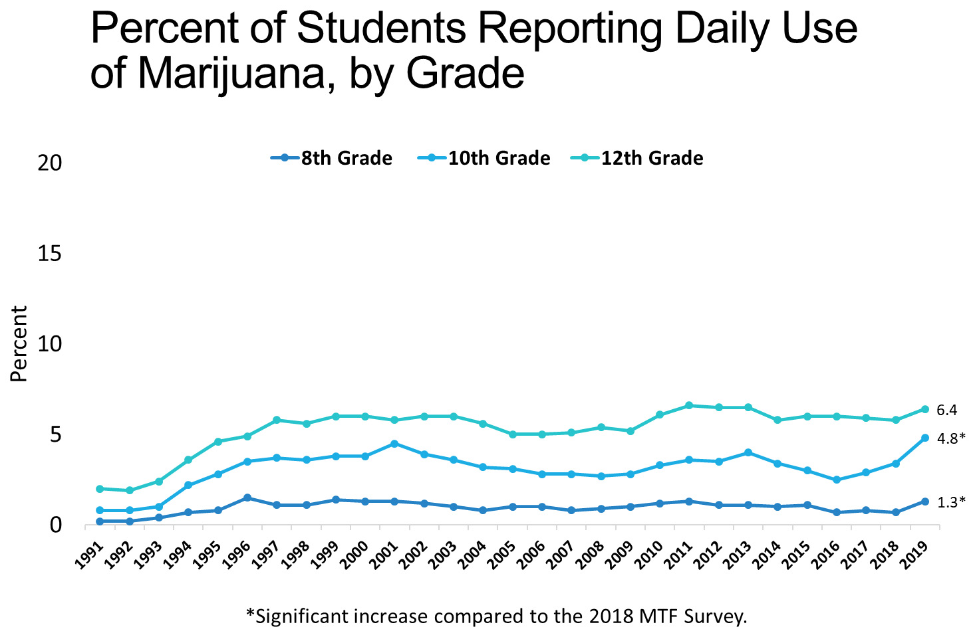
Cocaine/Coke

Slide 5
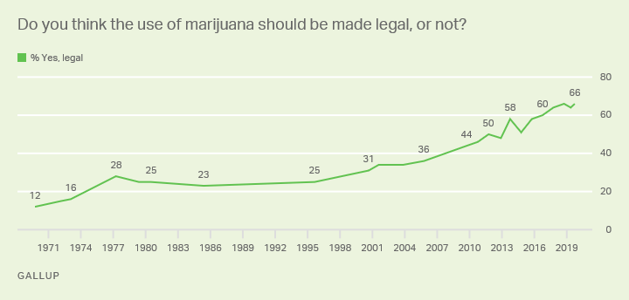
Marijuana

Slide 6
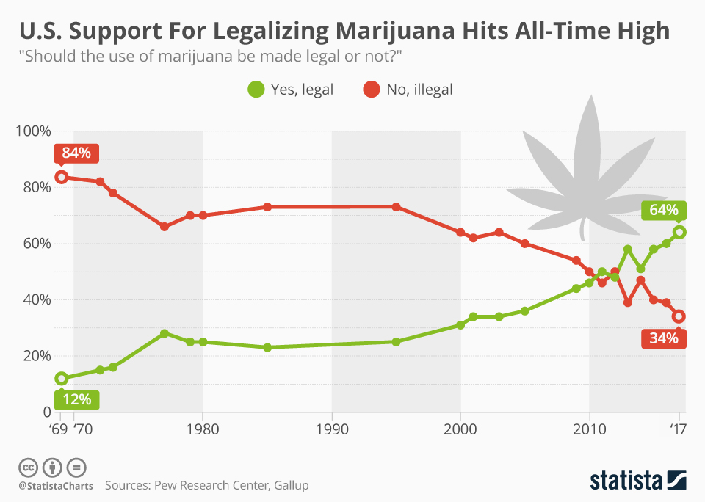

Slide 7
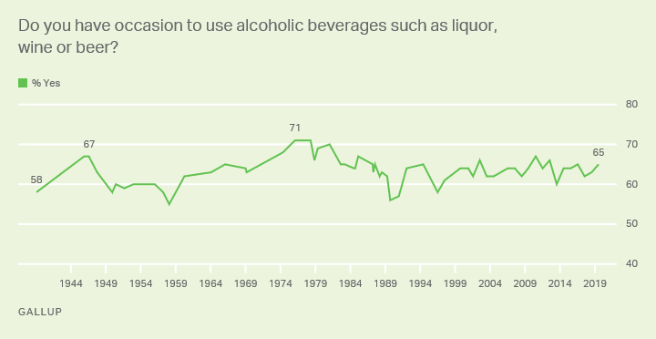
Alcohol

