Slide 1
Songs Word Embeddings
Billboard Top 100, 1958-2019

Slide 2
Overview
4. What are the targets of specific emotions?
2. What emotions do billboard songs in general have? Angry, Happy, Sad? Are they stronger emotions or weaker emotions?
6. How has the love song changed over time? What is the object of love?

Slide 3
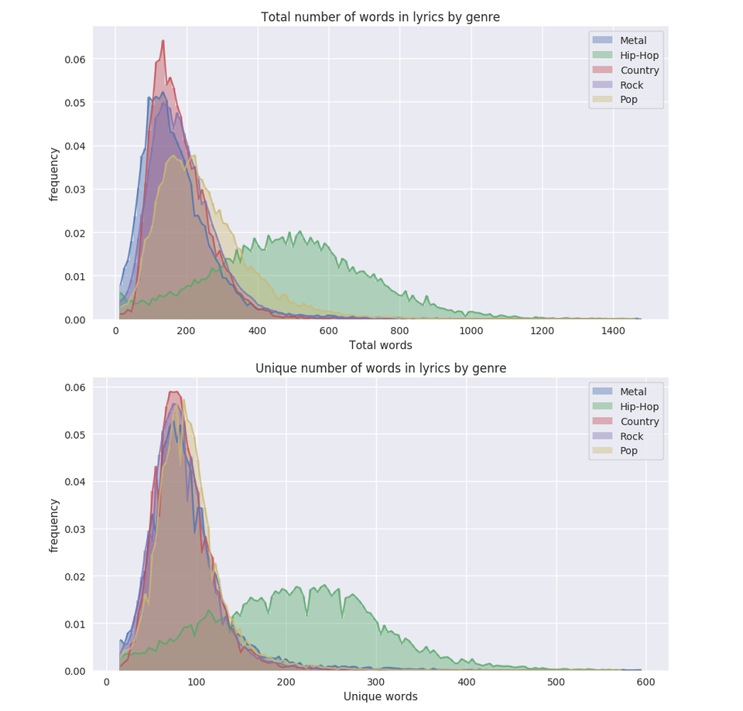
Description of Corpus
Billboard Charts Top 100
Lyrics Genius API
Start Date: August 1958
100 songs per week, 5200 per year
Size: 320,496 songs
Realistic Size: 288,446 songs-90%
Total words: 57,689,200 - 115,378,560
Unique words: 14,422,300 - 43,266,900
Metadata: Song Name, Date, Author

Slide 4
Glove Vector Specifications
Used cleaned song files
Split by decade from 1960 to 2010
Vocab min count = 5 (songs have fewer words)
Vector size = 50
Window size = 15
Iterations = 15
Min corpus size = 1,331,973 lines

Slide 5

Object of [emotion] methods
Used best word analogy to find other objects
Ie somebody : love | ____ : anger
Somebody is the closest noun to love
Use Euclidean distance to find the closest words

Slide 6
Objects of Love
1960s:
somebody(3.85)
found(3.95)
his(4.09)
Barbara(4.09)
belonged(4.10)
1970s
bone(3.99)
love(3.99)
vehicle(4.05)
last(4.07)
fur(4.11)
1980s:
Japanese(4.67)
picture(4.90)
sun(5.023)
time(5.06)
Jay(5.07)
1990s
precious(3.98)
lasts(4.28)
around(4.30)
Chance(4.34)
sky-rocket(4.39)
2000s:
Janis
inspires(4.59)
unconditional(4.67)
replace(4.67)
rust(4.76)
2010s
nightlife(4.60)
spunk(4.85)
spark(4.88)
amazin(4.92)
near(4.96)

Slide 7
Objects of Anger
1960s: somebody:love | _:angry
family(6.76)
vixen(6.83)
runway(6.86)
1979(6.86)
dolores(6.88)
1970s bone:love | _:angry
student(8.24)
undaground(8.61)
windmill(8.61)
Gutenberg(8.65)
literary(8.67)
1980s: picture:love | _:angry
portfolio(7.84)
gorgon(7.94)
ousel(7.96): bird
old(7.96)
AI(7.97)
1990s: precious:love | _:angry
afternoon(6.26)
do(6.31)
ward(6.34)
lyrical(6.35)
what(6.36)
2000s: Janis:love | _:angry
shop(6.01)
Luther(6.11)
sea(6.14)
fields(6.15)
races(6.16)
2010s: nightlife:love | _:angry
lessons(7.39)
shots(7.52)
selling(7.59)
I(7.62)
adolescent(7.66)

Slide 8
Objects of Sadness
1960s: somebody:love | _:sad
Astrid(6.86)
S(6.87)
family(6.91)
pristine(6.95)
Kiyoko(7.023)
1970s bone:love | _:sad
admire(8.26)
dad(8.66)
lawyer(8.66)
resurrection(8.68)
vicious(8.70)
1980s: picture:love | _:sad
scared(8.41)
possibly(8.45)
decomposing(8.46)
male(8.46)
he(8.48)
1990s: precious:love | _:sad
sister(6.73)
mirror(6.75)
Jesus(6.76)
Dum(6.79)
lifts(6.85)
2000s: Janis:love | _:sad
Dr. (7.66)
rock(7.92)
fields(8.04)
often(8.15)
dropping(8.18)
2010s: nightlife:love | _:sad
road(7.32)
counting(7.36)
like(7.38)
drop(7.40)
outside(7.40)

Slide 9
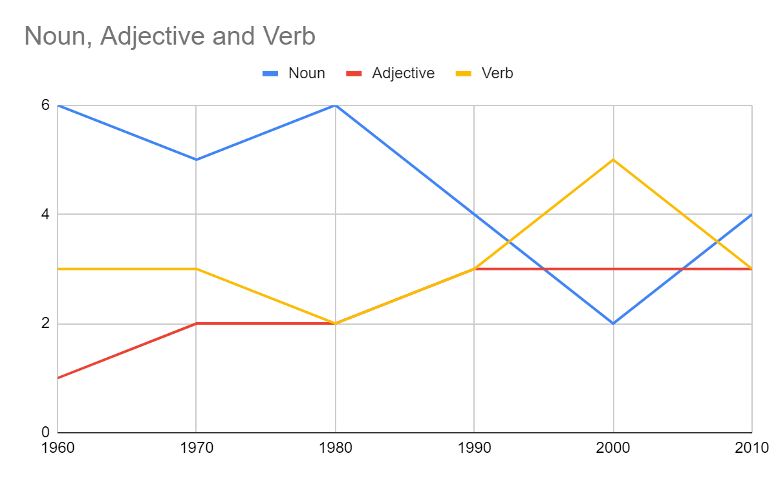
Conclusion for Object Finding
Need more data for better answers:
Ie Janis(Love 2000), Chance(1990s), Barbara(1960s)
Technique has promise: Student:anger(1970)
Get rid of non-noun words?

Slide 10
What emotions do billboard songs have?
Angry words: 52,240
Fear: 77,900
Sadness: 658,500
Joy: 610,350

Slide 11
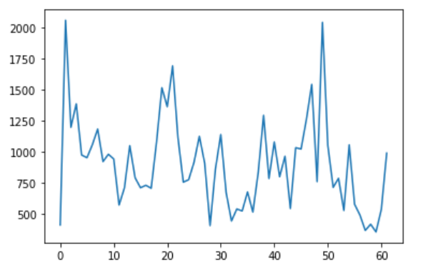
Anger

Slide 12
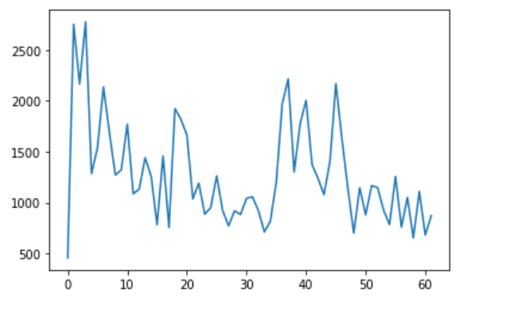
Fear

Slide 13
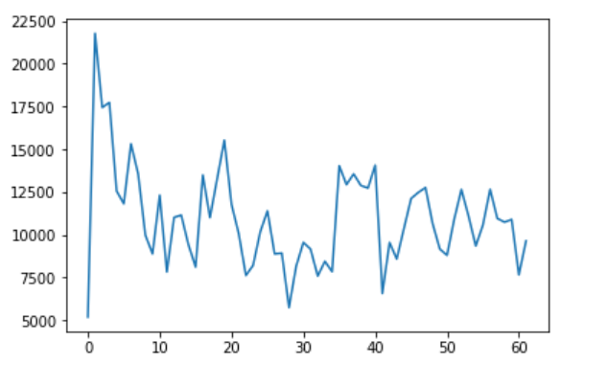
Sadness

Slide 14
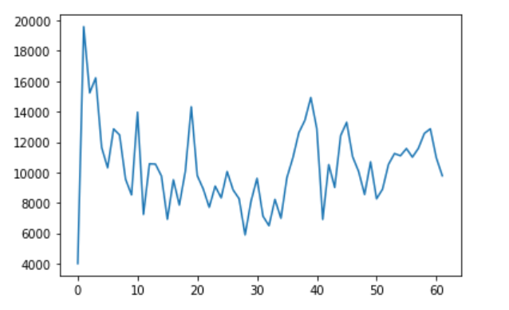
Joy

Slide 15
Conclusions for Song Emotions
All emotions besides fear are incresing

