Slide 1
Drugs of Abuse
Trends in Pop Culture and Music

Slide 2
Overview
See what words are associated with emotions using some analysis tool

Slide 3
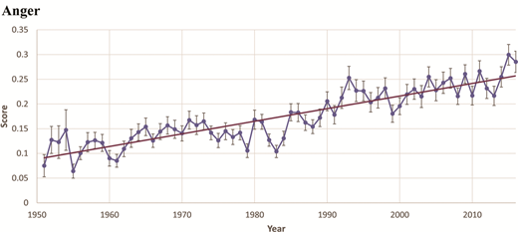
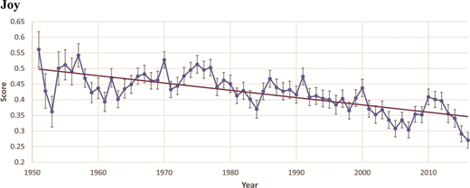
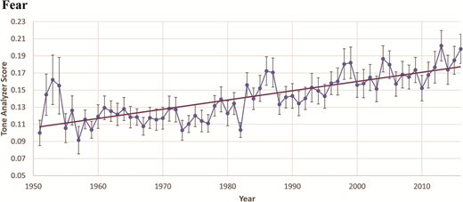
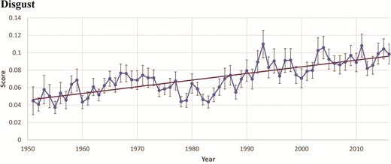
Sentiment Analysis - Results
Correlation coefficient: .8897
Correlation coefficient: -.7293
Correlation coefficient: .7790
Correlation coefficient: .7817
All p-values less than 0.0001

Slide 4
Quantitative Sentiment Analysis Conclusions
Conclusions:
Personal nostalgia = joyful lyrics, Historical nostalgia = Sad lyrics
Knobloch and Zillman
1995-2003 Greater presence of comforting music during difficult economic/social times
Pettijohn and Sacco Jr.
Rap lyrics have more anger + disgust
Ballard et al

Slide 5
Watson Tone Analyzer
Emotional Tone
Ekman: 4 main emotions: Happiness, Sadness, Fear/Surprise, Anger/Disgust
Uses Punctuation, Emoticons, Curse Words, Greetings, Sentiment Polarity
Trained off of ISEAR(7666 examples), SEMEVAL
Verified with humans
Figure 8(appen.com)
5 annotators per sentence

Slide 6
Anger
Came: 8
Fuck: 6
My: 5
Loving: 3
Blame: 3
Down: 3

Slide 7
Joy
Ooh: 32
Love: 30
Like: 30
Kiss: 27
God: 20
Good: 19

Slide 8
Fear
Worry: 2
Devil: 1
Driveway: 1
Scare: 1
Strange: 1
Church: 1

Slide 9
Sadness
Nigga: 17
Like: 16
Wanna: 12
Break: 7
What: 7
Stand:7

Slide 10
Costs
Parallel Dots - 399 per month or 29 per month
Projected 1-2 months with 399
Watson Tone Analyzer - .0088 per API call
Projected $2000
Use free tiers/free trials
Usually 10k calls per month
Notes:
https://medium.com/sifium/top-five-emotional-sentiment-analysis-apis-116cd8d42055

