Slide 1
Qualtrics Spell Checker
Albert Su

Slide 2
The Problem
People forget how to spell
How do we know if it is a misspelling or a new word?
The Stimulus Based Choice Menu should not contain duplicates
Input: Rebock Expected Output: Reebok
Input: ChikfilA Expected Output: Chick-fil-A

Slide 3
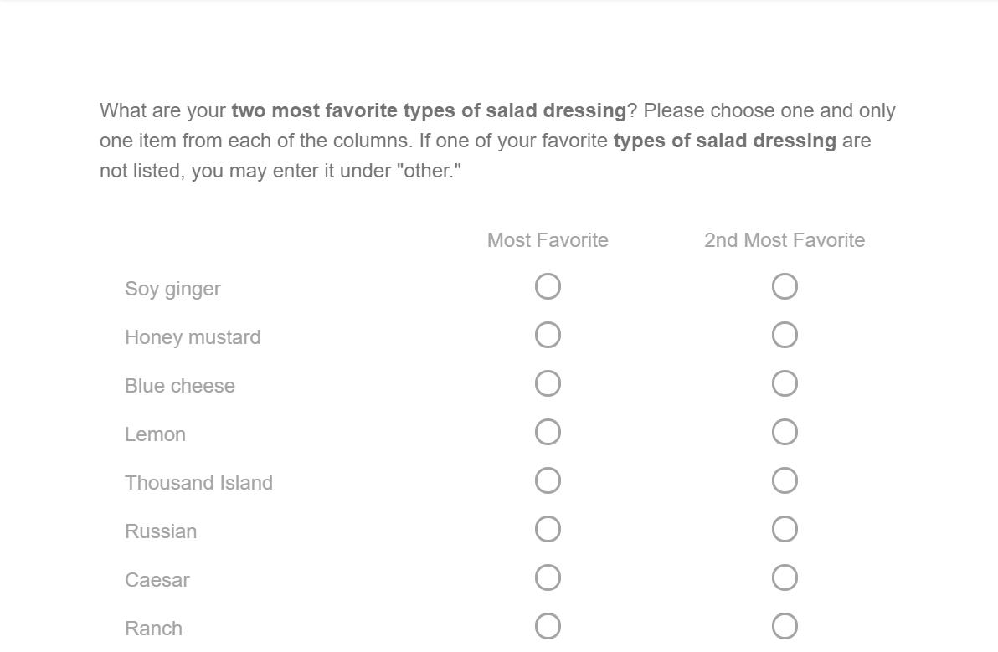
The Problem

Slide 4
The Solution
Step 1: Find which words are closest related
Step 2: Determine whether the word to correct is a misspelling or a new entry to the list
Step 3: Decide to correct the word or not

Slide 5





Find Closely related words
Gestalt Pattern Matching
Longest Common Substring: WIKIM
Other common substring: IA
Km = len of all substrings S1= len of S1(WIKIMEDIA)
How do we generate all possibilities for S2?

Slide 6
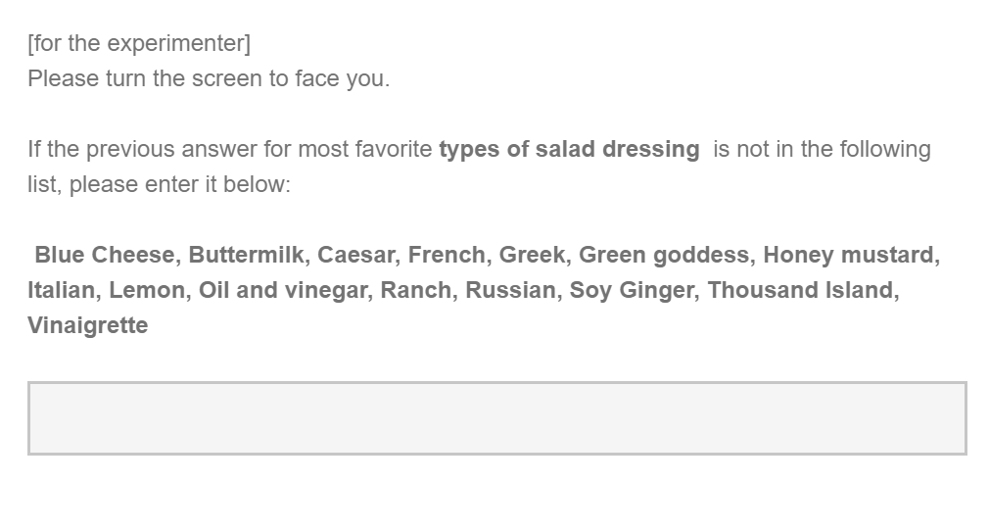
SBC Menu

Slide 7
Step 2: Check if it is a misspelling
The input may be a different brand or it could be a misspelling of a current brand
Category: Pizza
Word 1: Domminoes
Word 2: Little Caesars
List of brands: Dominos, Pizza hut, Papa Johns
Choose whether to spellcheck or not
Parameter for % closeness is set to be 50%

Slide 8
Step 3(Optional): Correct the word
Step 1: Select the current response using Qualtrics API
Step 2: Modify it with the word from getCloseMatches
Or
Step 1: Keep the current response unmodified

Slide 9
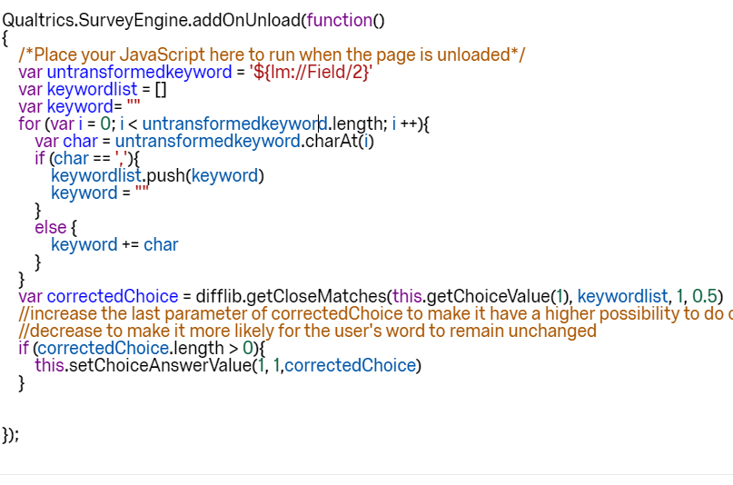
Step 3(Optional): Correct the word

Slide 10
Room for improvement
Step 1: Test what value to use when deciding whether to replace a word or not
Currently using 0.5

