Slide 1
Impacts of Healthcare Shortages on Los Angeles Community Development
Code for America [Hack for LA]
Mina Moe

Slide 2
Intro & Problem Statement
This project explores
Quality and Quantity of Healthcare Services in LA County
Impacts of Healthcare Shortages in different cities, zip codes, services category
Poverty Level vs Severity of Healthcare Shortages
Data + Statistical Analysis
Deep Learning + Machine Learning Models

Slide 3
Data Sources
To obtain DATA QUALITY for both LA and California:
Merging,
Extraction,
Cleaning
Please refer to the links for
Project Introduction:
https://github.com/hackforla/311-data/blob/dev/dataAnalysis/LAHealthcareProject/1.%20Introduction_LACountyHealthcare.ipynb
Data Sources:
https://github.com/hackforla/311-data/blob/dev/dataAnalysis/LAHealthcareProject/2.%20Healthcare_DataMiningResearch.ipynb

Slide 4
Workflow
Part1: Data Analysis + Visualization (slide 6-19)
Part2: Statistical Analysis (slide 20-21)
Library: Python (Numpy, Pandas, Scipy)
: Visualization (Python: Matplotlib, Seaborn)
Link: https://github.com/hackforla/311-data/tree/dev/dataAnalysis/LAHealthcareProject/LAHealthcare_UnderservedAreas_DataAnalysis
Part3: Predictive Modeling (Deep Learning + ML, slide 22-end)
Library: Keras (CNN), sklearn, LGBM, CatBoost
Link: https://github.com/hackforla/311-data/tree/dev/dataAnalysis/LAHealthcareProject/DLmodels_CNN_OLC

Slide 5
Other ML Works for Code for America (Los Angeles)
Machine Learning Works:
https://github.com/hackforla/311-data/blob/dev/dataAnalysis/mina_MultiClass_LGBM_MachineLearning.ipynb
Geospatial Timeseries Project (Deep Learning + ML Works)
https://github.com/hackforla/lucky-parking/blob/master/notebooks/Binary_Classification_LGBM_bymina.ipynb
https://github.com/hackforla/lucky-parking/blob/master/notebooks/CNN%2BNN_GeodataTimeseries_bymina.ipynb

Slide 6
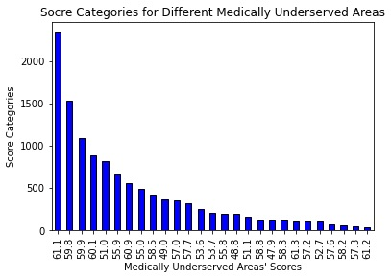
Part1: Counts of Medically Underserved Scores
Medically Underserved Scores (0-100)
The lower the score, the higher the severity of shortages
b) Minimum Score: 47.9
c) Maximum Score: 61.3
d) Score with Highest Counts: 61.1 (over 2000)
Conclusion:
Most areas fall between 51.0 and 61.1
Medium Healthcare Shortage Risk
Do not reach upper percentile (< 75.0)
Significant Healthcare Improvement needed

Slide 7
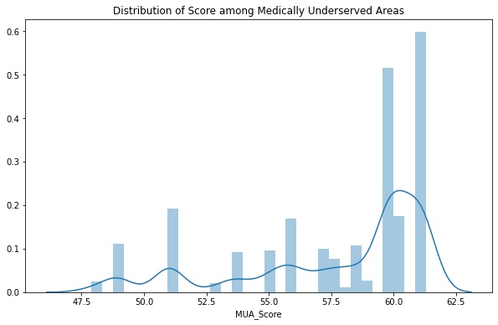
Distribution of Medically Underserved Scores

Slide 8
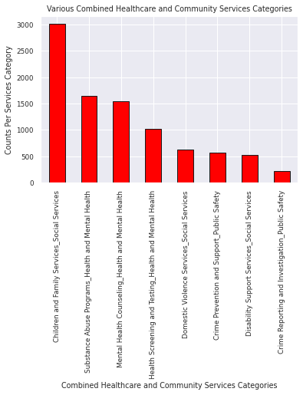
Demand for Healthcare + Community Services
Top Services Demand:
(In Descending Order)
Children + Family Service
Substance Abuse
Mental Health + Counseling
Screening + Testing
Domestic Violence

Slide 9
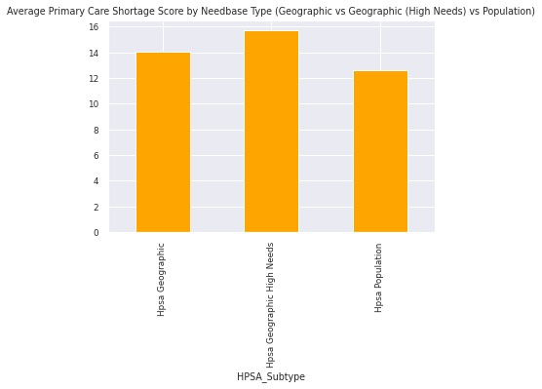
Average Primary Care Shortage Score
Primary Care Shortage
(descending order):
1. Geographic (High Needs)
2. Geographic
3. Population

Slide 10
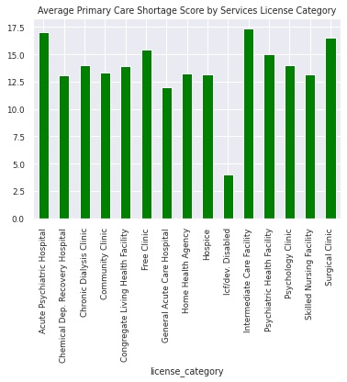
Primary Care Shortage Scores by Services Category
Top 3 Highest Shortages: (Descending Order)
Intermediate Care Facility
Acute Psychiatric Hospital
Surgical Clinic

Slide 11
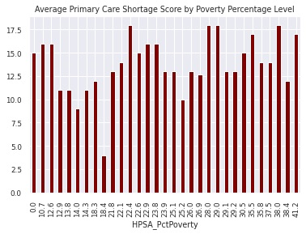
Huge Impacts of Poverty Level on Healthcare Shortages
Poverty Rises, Shortage goes Up
Poverty Range: 0.0-41.2
Spikes: 22.4, 28.0, 29.0, 35.5, 38.0, 41,2
Most Spikes fall in Right tail (at higher poverty zones)

Slide 12
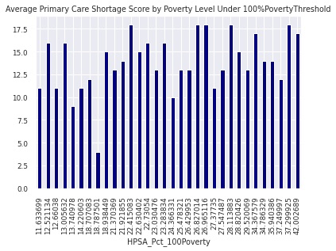
Further Proof of Poverty Impacts (100% Level)
Poverty Rises, Shortage goes Up
Poverty Range: 11.633699 – 42.002689
Spikes: 26.0 < Poverty (100% level) < 43.0
Most Spikes fall in Right tail (at higher poverty zones)

Slide 13
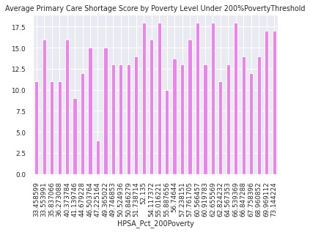
Further Proof of Poverty Impacts (at 200% Level)
Poverty Range: 33.458599 – 73.144224
Spikes: 52.0 < Poverty (200% level) < 74.0 (Poverty Rises, Shortage goes Up)
Most Spikes fall in Right tail (at higher poverty zones)

Slide 14
Comparison of Average MUA Scores (by City)
Average Medically Underserved Area Scores (MUA) by 5 Most Frequent Cities:
(in Ascending Order)
The lower average MUA score, the higher severity of shortage
LA has the lowest average -> LA has highest shortage severity
Van Nuys has the highest average -> Van Nuys has lowest shortage severity)
City (round up) | MUA Score Mean (by City) | MUA Score Min (by City)
Los Angeles | 55.24 | 47.90
Pomona | 57.02 | 57.00
North Hollywood | 57.21 | 55.90
Long Beach | 59.83 | 48.80
Van Nuys | 61.10 | 61.10

Slide 15
Comparison of Average MUA Scores (by Zip Codes)
Average Medically Underserved Area Scores (MUA) by 10 Most Frequent Zip Codes:
(in Ascending Order)
The Lower Average MUA score, the Higher Severity of Overall Healthcare Shortage
Highest Severity Areas: 90015, 90010, 90057, 90033, 91606
Zip Code | MUA Score Mean (by Zip Code) | MUA Score Count (by Zip Code
90015 | 53.833333 | 420
90010 | 53.873684 | 570
90057 | 56.352941 | 408
90033 | 57.241176 | 646
91606 | 57.200000 | 660
91205 | 58.500000 | 300
90813 | 59.792308 | 507
90806 | 59.900000 | 396
91401 | 61.100000 | 1127
91405 | 61.100000 | 510

Slide 16
Comparison Primary Care Shortage (7 Major Cities)
Long Beach, Los Angeles -> Top 2 Highest Primary Care Shortage
Santa Monica, Pomona -> 2 Lowest Primary Care Shortage
Hollywood, Glendale, Pasadena -> Same Shortage Level
Los Angeles : 2nd Highest PC Shortage
: Highest Overall Healthcare Shortage (slide #14)
City (round up) | Average Primary Care Shortage (Descending Order)
Long Beach | 14.283495
Los Angeles | 14.064622
Hollywood | 13.000000
Glendale | 13.000000
Pasadena | 13.000000
Santa Monica | 11.833333
Pomona | 10.016854

Slide 17
Top 5 Services Shortage in 2 Highest Risk Cities
LOS ANGELES Top 5 Services Shortage (round up) | Avg Shortage (in Descending) | LONG BEACH Top 5 Services Shortage | Avg Shortage (in Descending)
Surgical Clinic | 18.00 | Community Clinic | 14.5468
Intermediate Care Facility | 17.00 | General Acute Care Hospital | 14.00
Acute Psychiatric Hospital | 17.00 | Psychology Clinic | 14.00
Skilled Nursing Facility | 14.6125 | Skilled Nursing Facility | 14.00
Chronic Dialysis Clinic | 14.6011 | Chronic Dialysis Clinic | 14.00

Slide 18
Avg. Poverty (by10 Most Frequent Zip Codes)
Zip Code | Average Poverty Level (Ascending Order)
90706 | 0.000000
90640 | 16.981818
90262 | 19.000000
91331 | 22.212500
91606 | 23.900000
93550 | 24.620000
90022 | 26.423077
93534 | 30.500000
90813 | 34.811111
90011 | 37.510000
Average Poverty by 10 Most Frequent ZipCodes:
(in Ascending Order)
The Lower the Score, the Higher the PovertyLevel
Highest Poverty: 90706,
: 90640,
: 90262,
: 91331,
: 91606
in BOTH MUA and Poverty Severity: 91606, 90813
91606 and 90813 need better improvement

Slide 19
Avg. Poverty 100% Level (by10 Most Frequent Zip Codes)
Zip Code | Average Poverty 100% Level (Ascending Order)
90640 | 16.040570
90706 | 18.938449
90262 | 19.298602
91331 | 21.880433
91606 | 23.030476
93550 | 23.991426
90022 | 26.747578
93534 | 28.820426
90813 | 33.901961
90011 | 36.759326
Average Poverty at 100% Level
(in Ascending Order)
The Lower the Score, the Higher the PovertyLevel
Highest Poverty: 90640,
: 90706,
: 90262,
: 91331,
: 91606
in BOTH MUA + Poverty Severity 100%: 91606, 90813
91606 and 90813 need better improvement

Slide 20
Part2: Descriptive Statistics (Continuous Variables)
Variable (round up) | STDEV | STD ERROR | MEAN | MAX | MIN | LOWER 95% CL for Mean | UPPER 95% CL for Mean
MUA Poverty | 0.5675 | 0.0055 | 0.2093 | 2.00 | 0.00 | 0.1985 | 0.2202
MUA Score | 3.9308 | 0.0384 | 57.4685 | 61.30 | 47.90 | 57.3934 | 57.5437
Date Difference | 1686.850 | 16.4580 | 677.5655 | 7820.00 | 0.00 | 645.3047 | 709.8264

Slide 21
Proc Univariate, Normality, P-Value (Avg MUA Score by Category Services)
Category Services (round up) | Mean | Stdev | Variance | Skewness | Kurtosis | Std Error | P-Value
Children + Family Services | 57.0698 | 3.9753 | 15.8031 | -0.7972 | -0.6165 | 0.0732 | <.0001
Crime Prevention + Support | 57.9316 | 4.0389 | 16.3130 | -1.1365 | 0.0034 | 0.1363 | <.0001
Crime Report’ + Investigate | 58.2649 | 3.6918 | 13.6293 | -1.3067 | 0.7035 | 0.1762 | <.0001
Disability Support Services | 57.0718 | 3.9231 | 15.3909 | -0.6268 | -1.0693 | 0.1615 | <.0001
Domestic Violence Services | 58.0256 | 3.5612 | 12.6821 | -1.2046 | 0.3848 | 0.1269 | <.0001
Health Screening + Testing | 57.4741 | 3.8606 | 14.9042 | -0.8677 | -0.5116 | 0.1108 | <.0001
Mental Health Counseling | 57.6814 | 3.9640 | 15.7132 | -0.9919 | -0.2871 | 0.0907 | <.0001
Substance Abuse Programs | 57.3680 | 3.9375 | 15.5036 | -0.9834 | -0.3413 | 0.0945 | <.0001
Hkhnl;m,’l;lkbj

Slide 22
Part3: Predictive Modeling (Multi-Class Classification)
Healthcare Shortage Classification based on:
1. Location (Zip Code area)
2. Services Category
Location Multi-Class Classification Models:
1. CNN (Neural Networks: Convolutional Neural Networks, DL)
2. CatBoost (simple split vs 6-Kfold, ML)
3. LGBM (simple split vs 6-Kfold, ML)
Services Category Multi-Class Classification Models:
1. CNN (Neural Networks: Convolutional Neural Networks, DL)
2. LGBM (simple split vs 6-Kfold, ML)

Slide 23
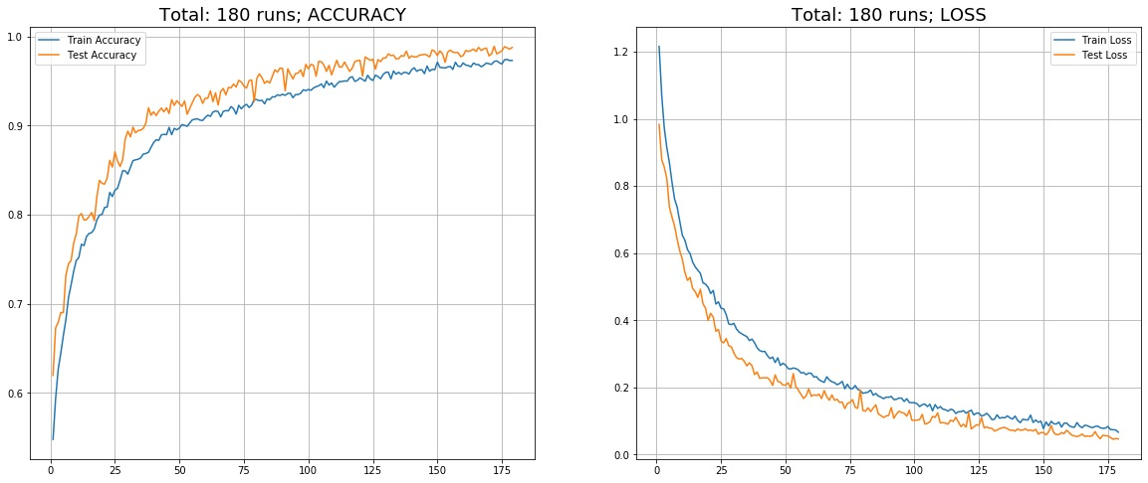
DL Model: Zip Code Multi-Class (CNN)
Best Iteration-> Train Loss: 0.0799 – Train Accuracy: 0.9719,
-> Test Loss: 0.047 – Test Accuracy: 0.989
NO Overfitting
In both graphs, the curves go smooth & stable (NO sudden spikes)

Slide 24
ML Model: Zip Code Multi-Class CatBoost + LGBM
RESULTS
CatBoost:
1. simple split: Test Accuracy = 0.9889
2. 6-Kfold: Test Accuracy = 0.992
LGBMClassifier:
1. simple split: Test Multi Log-loss = 0.012
2. 6-StratifiedKfold: Test Multi Log-loss = 0.009
Both DL & ML models product similar results ~ 0.99

Slide 25
Service Shortage Multi-Class: CNN + LGBM
RESULTS
CNN (DL):
Train Loss: 0.060 – Train Accuracy: 0.976,
Test Loss: 0.019 – Test Accuracy: 0.997
LGBMClassifier (ML):
1. simple split: Test Multi Log-loss = 0.001
2. 6-StratifiedKfold: Test Multi Log-loss = 0.0009

Slide 26
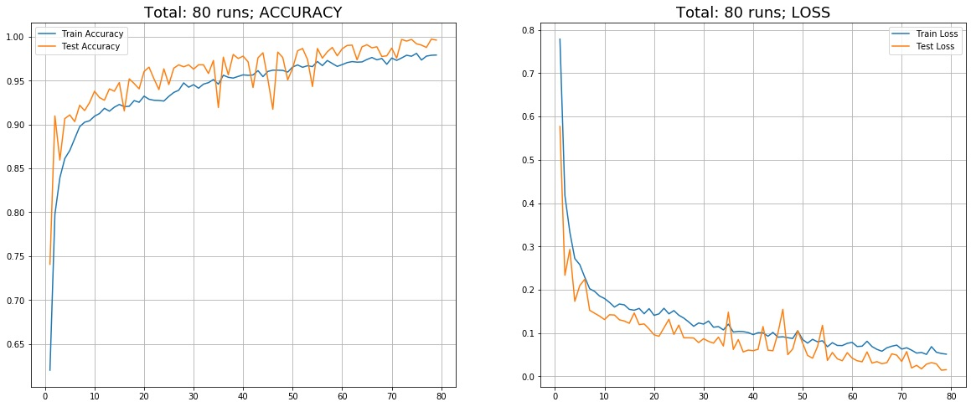
DL Model: Services Shortage Multi-Class (CNN)
Best Iteration-> Train Loss: 0.060 – Train Accuracy: 0.976,
-> Test Loss: 0.019 – Test Accuracy: 0.997
NO Overfitting
In both graphs, the curves go smooth & stable (NO sudden spikes)

Slide 27
Predictive Modeling (DL+ML): Conclusions
Zip Codes Multi-Class Shortage Classification:
NO Overfitting issues
CNN (DL) | CatBoost (ML) : ~0.989 scored on Test dataset
CNN (DL) | LGBM (ML) : < 0.05 multi log-loss on Test dataset
CNN curves have NO sudden spikes
Services Category Multi-Class Shortage Classification:
NO Overfitting issues
CNN (DL) | LGBM (ML) : < 0.02 multi log-loss on Test dataset
CNN curves have NO sudden spikes

Slide 28
Predictive Modeling (DL+ML): Conclusions
Both Zip Codes + Services Shortage Classification
All individual models perform very well
Can try out Ensembling | Stacking for more robustness
Can also experiment with different algorithms
(XGBoost, random forest, decision trees, DNN, …)

Slide 29
Thank you!!

