Slide 1
Rain in Australia: A Data Story for Executives
What drives tomorrow’s rain? Trends, signals, and an action plan

Slide 2
Executive Questions We Answered
When and where is rainfall most intense across major cities?
Which signals best predict rain tomorrow (e.g., humidity, pressure, wind)?
What seasonal patterns matter for planning operations?
How well can a simple model predict rain tomorrow?

Slide 3
Dataset & Method
Synthetic 2023 daily weather signals for 8 cities (executive illustration).
Variables: TempMax/TempMin, Humidity3pm, Pressure9am, WindGust, Cloud3pm, RainToday, RainfallMM, RainTomorrow.
We explore trends and fit a simple logistic regression to predict RainTomorrow.
Use this deck as a template—swap in your real Australian weather data for production.

Slide 4
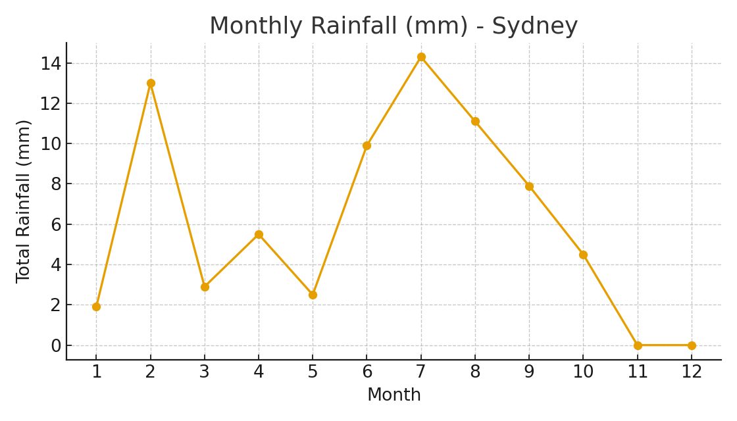
Seasonality: Sydney

Slide 5
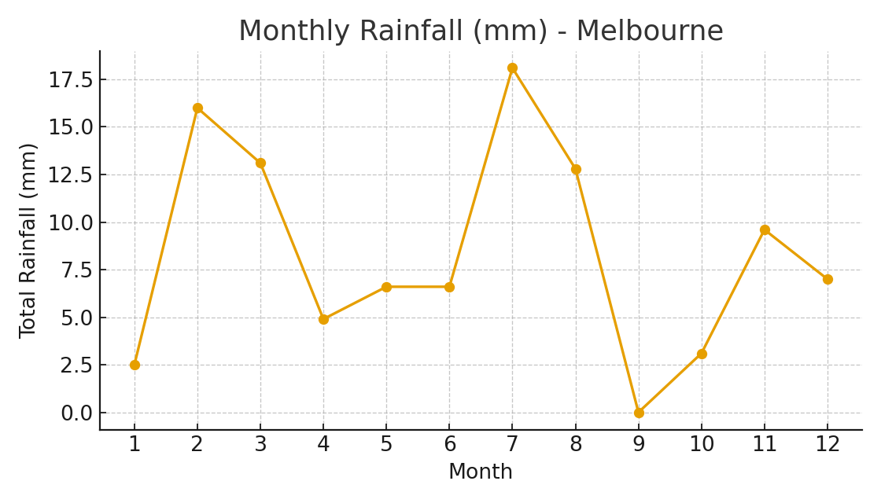
Seasonality: Melbourne

Slide 6
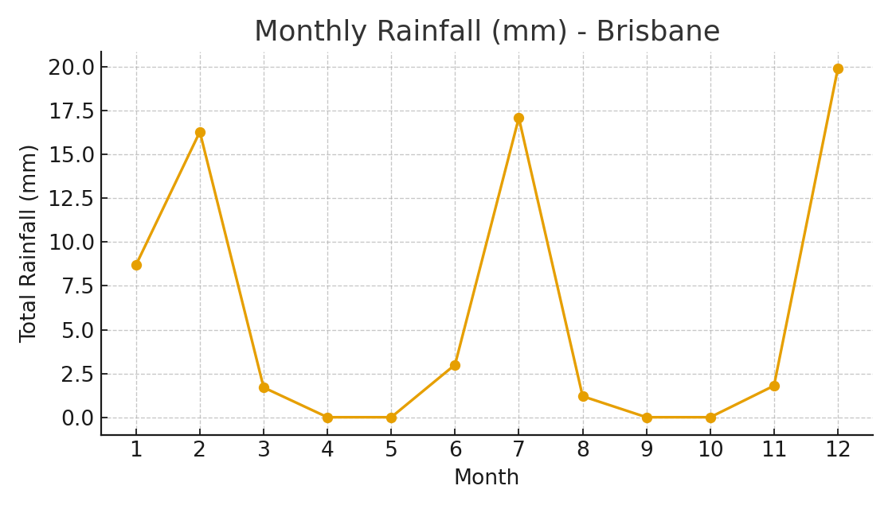
Seasonality: Brisbane

Slide 7
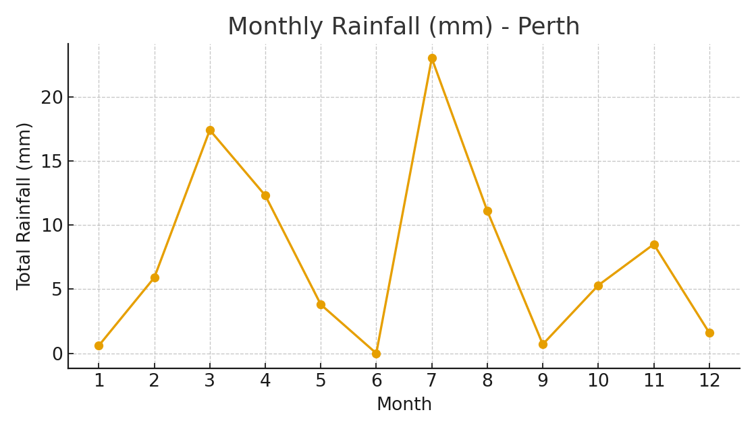
Seasonality: Perth

Slide 8
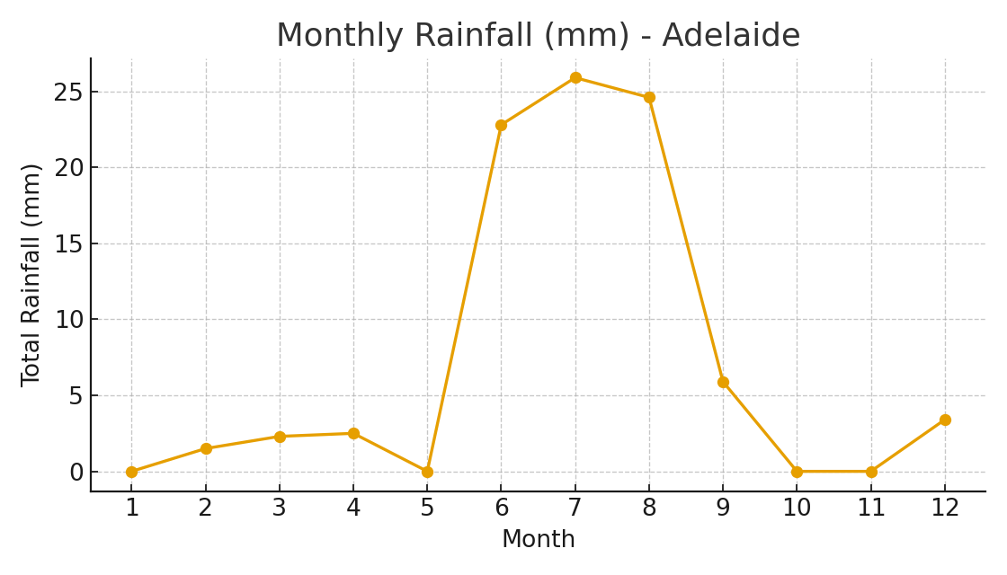
Seasonality: Adelaide

Slide 9
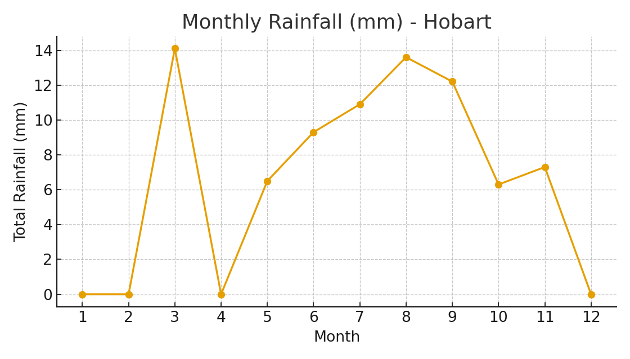
Seasonality: Hobart

Slide 10
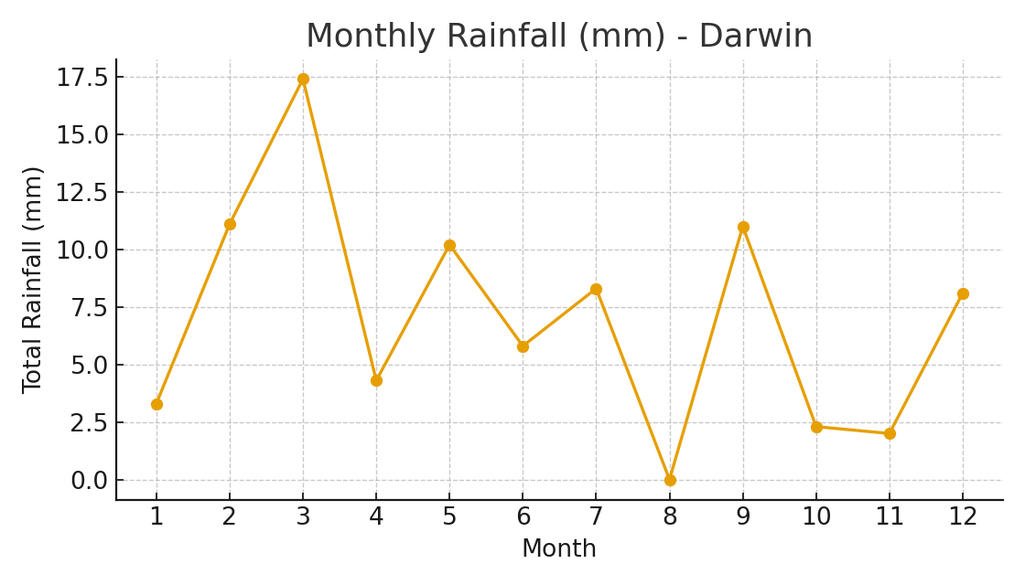
Seasonality: Darwin

Slide 11
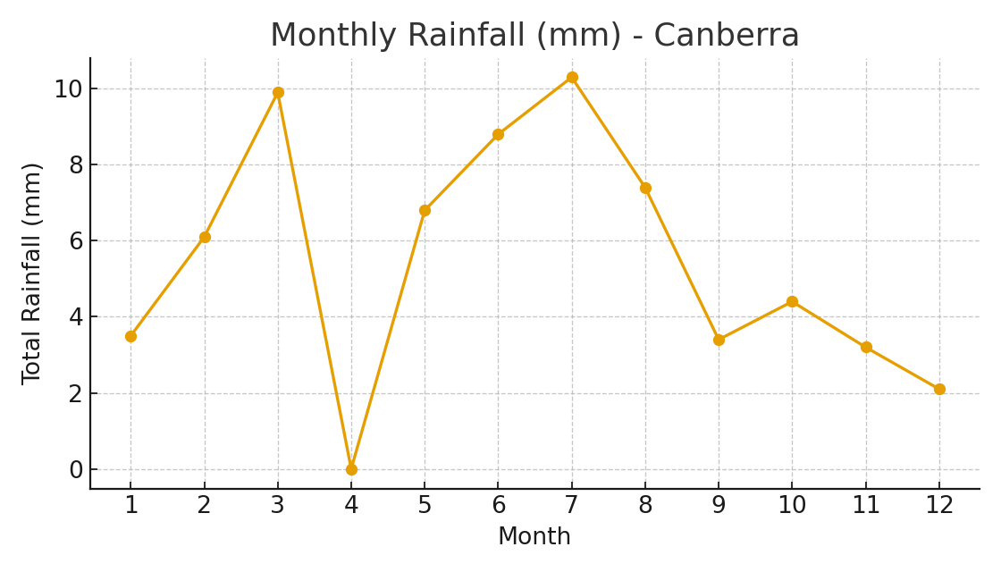
Seasonality: Canberra

Slide 12
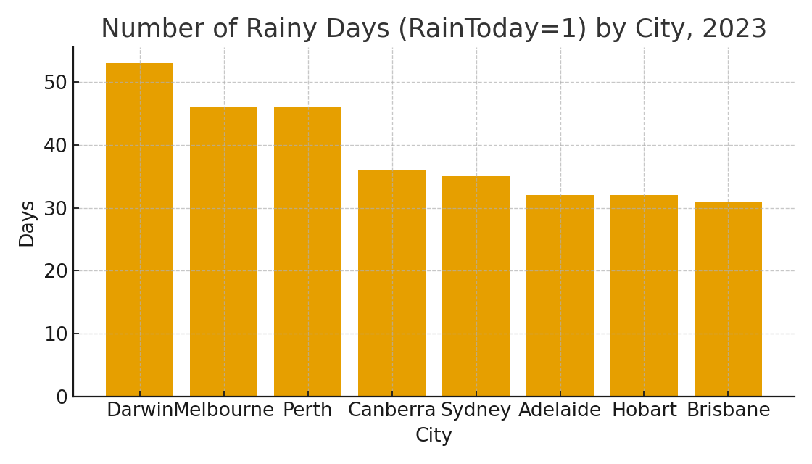
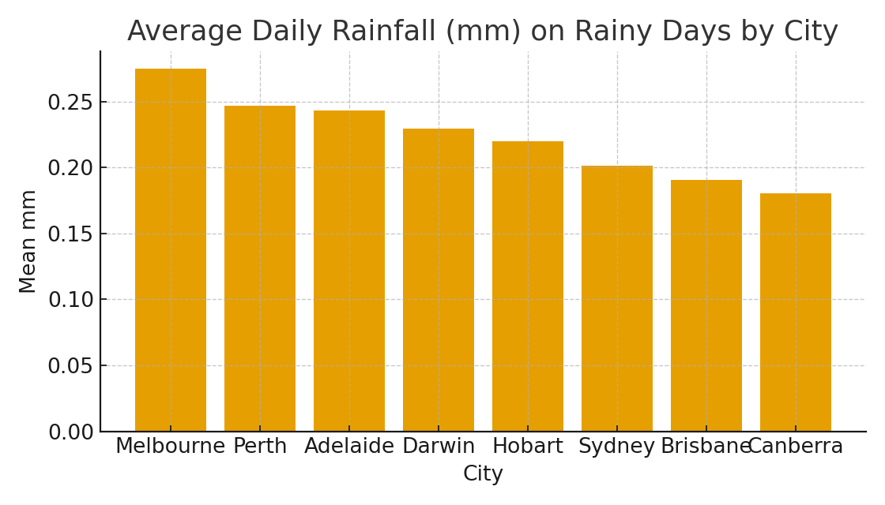
City Comparisons (2023)

Slide 13
What Drives Rain Tomorrow?
Top signals (Pearson correlation with RainTomorrow):
  Humidity3pm: 0.25
  Cloud3pm: 0.12
  WindGust: 0.10
  TempMax: -0.05
  Pressure9am: -0.15

Slide 14
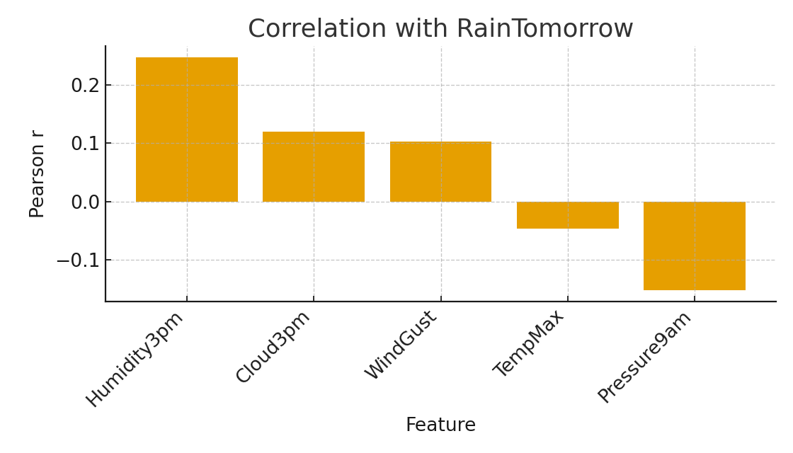
Signals vs RainTomorrow: Correlation View

Slide 15
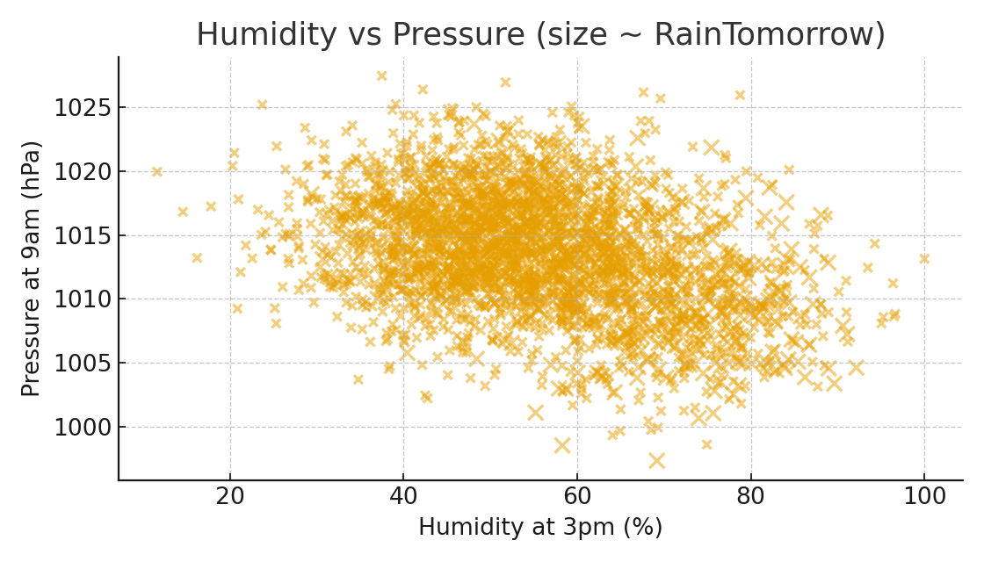
Storm Signal: High Humidity + Lower Pressure Clusters

Slide 16
How Predictable is Rain Tomorrow?
Simple logistic regression (5 features) achieves Accuracy = 0.88, ROC-AUC = 0.67.
Interpretation: Signals carry useful information; a lightweight model can prioritize field ops.
Next step: Validate with real bureau data per city and add lags (e.g., rolling humidity).

Slide 17
Actions for the Business
Staffing & Scheduling: Align maintenance and field crews with seasonal peaks by city.
Inventory: Pre-position rain-sensitive supplies before wet periods (e.g., Darwin Dec–Mar; South Jun–Aug).
Risk & Safety: Use humidity/pressure alerts to trigger ‘prepare’ workflows 24 hours ahead.
Data: Integrate live sensor feeds; monitor drift; revisit models quarterly.

Slide 18
Roadmap to Production
Week 1–2: Data audit & ingestion from Bureau of Meteorology; define SLAs.
Week 3–4: Feature engineering (lags, storms), city-specific models; backtesting.
Week 5–6: Deploy dashboards & alerts; measure precision/recall; calibrate thresholds.
Quarterly: Model monitoring for drift; seasonal recalibration.

Slide 19
Appendix: Method Notes
Pearson correlation computed on numeric features vs RainTomorrow (binary).
Logistic regression with train/test split (25% test), max_iter=1000.
All charts generated with matplotlib; no styling overrides.

