Slide 1
Generalizing the Goldschmidt tolerance factor beyond perovskites using symbolic learning Update #1 Andrew Lee, Albert Vong, Kyle Miller

Slide 2
Progress summary – Data Handling
Extracted AB₂ .cif files from the ICSD – 17171 total
Removed 2497 irrelevant theoretical entries
Filtered out unwanted CIFs– 8758 remaining
Some entries had 3 elements
Some entries had partial occupancies
Extracted prototype information from .cif files
Total of 418 unique prototypes
converted to numerical labels for “one-vs-all” (binary) classification
Identified the “A” and “B” elements for each .cif file
Featurized the A and B elements using Matminer w/ Magpie preset
22 types of features * 2 elements = 44 total features

Slide 3
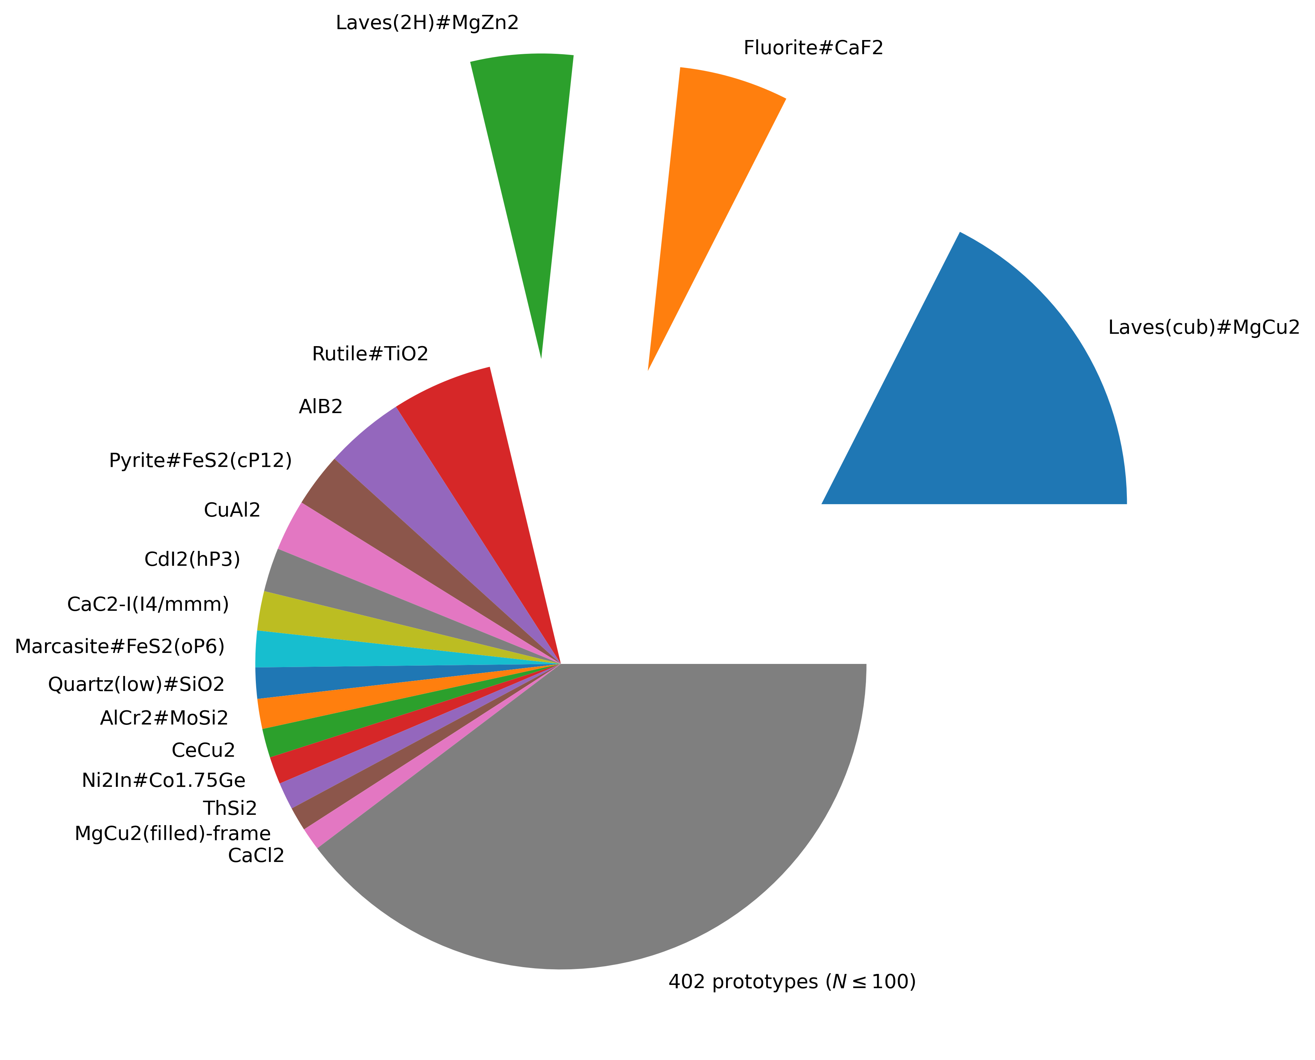
Class Representation

Slide 4
Progress summary – Modelling
Data Splitting: Subsample negative class for equal class balance (50/50)
Subsampling may affect model accuracy significantly (!)
Modeling: Gplearn, Symbolic Regression (SR) library with ”sci-kit learn” functionality
Several hyperparameters to optimize evolutionary algorithm
Initial symbolic expressions are non-physical
Model Benchmarking: use Random Forest to benchmark SR model
RF is one “classical” model to set an upper bound on potential SR performance
Symbolic Regression is expected to underfit due to functional simplicity

Slide 5
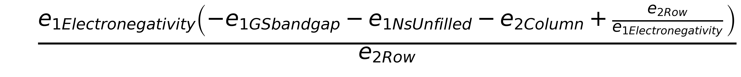
Challenges and next steps
Initial symbolic expressions are non-physical (1 = Element A, 2 = Element B for AB₂)
Data still needs cleaning
Remove infrequently represented classes(e.g. less than 10)
Trim features based on feature importance/cardinality
How to do k-fold validation with an inherently stochastic model?
I.e. “Best” expression may vary from fold to fold
How to subsample negative data to avoid bias?
Possibly pursue a “frequentist” approach and find SD on model performance over many different subsampled datasets

Slide 6
Summary of important findings
If the RF model cannot achieve high accuracy, symbolic regression can never perform well (due to simplicity)
Negative example subsampling needs to be handled carefully when examining model robustness
Getting symbolic expressions that make physical sense
AI Feynman?? (another symbolic regression library)

