Slide 1
Generalizing the Goldschmidt tolerance factor beyond perovskites using symbolic learning Final Presentation Andrew Lee, Albert Vong, Kyle Miller

Slide 2
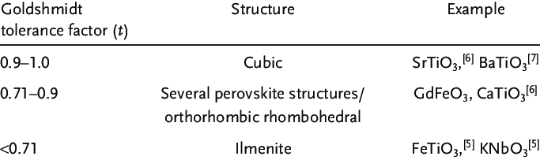
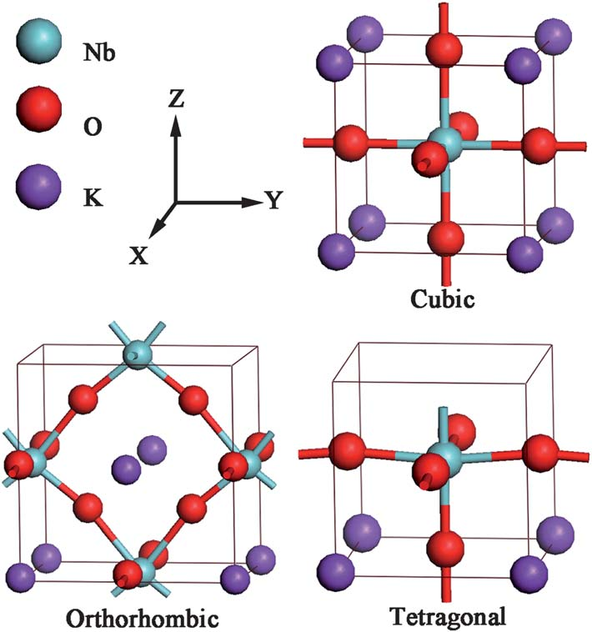
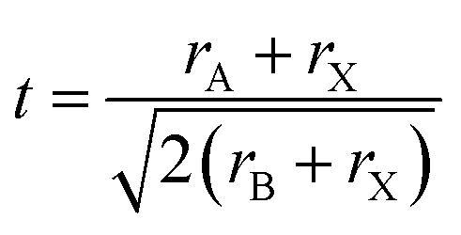
Problem Statement
Develop a “tolerance factor” to predict an AB₂ material’s stable structural prototype
Expression is simple,
Contains physical intuition
Easy to apply to high-throughput screening workflows
Low barrier to entry for experimentalists
Does not need modelling experience (i.e. this is simply a formula!)

Slide 3


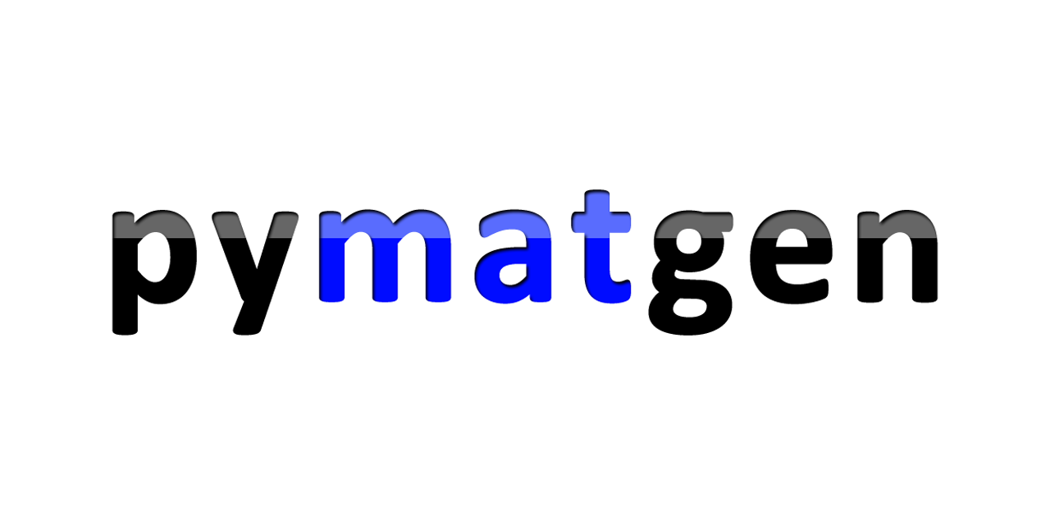
Data-intensive resources
Extracted AB₂ .cif files from the ICSD – 17171 total
Filtered out unwanted CIFs– 8758 remaining
3 elements, partial occupancies, theoretical files
Extracted prototype information from .cif files
Total of 418 unique prototypes
Featurized the A and B elements using Matminer w/ Magpie preset
22 types of features * 2 elements = 44 base features

Slide 4
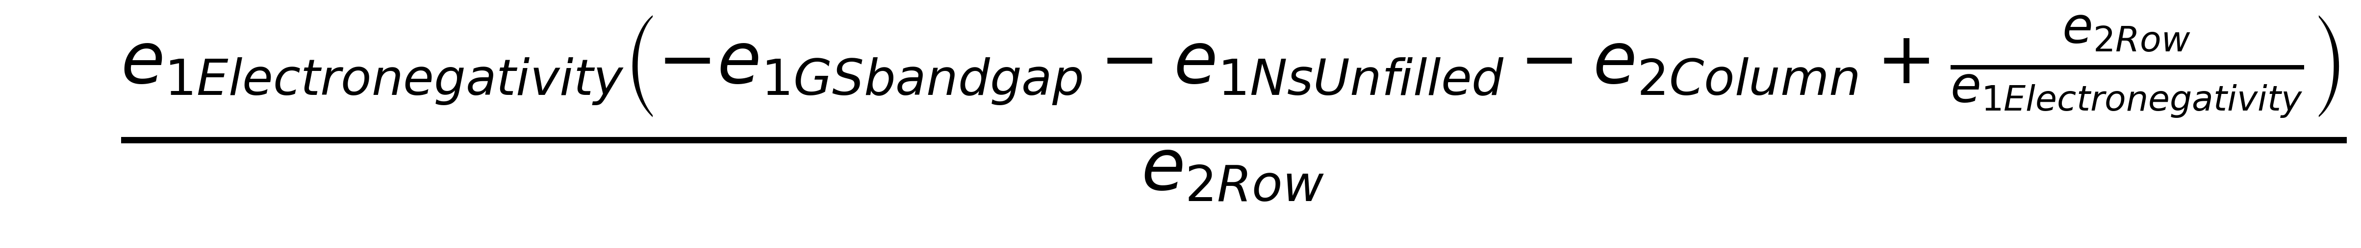
Approach - Featurization
Enforced dimensionless expressions via feature engineering
Convert all features to feature ratios (e.g. A/B, (A-B)/A)
44 absolute features
→ ~1200 dimensionless features
Pruned features using recursive feature reduction (Random Forest) to 9 features
Example expression with non-physical units

Slide 5
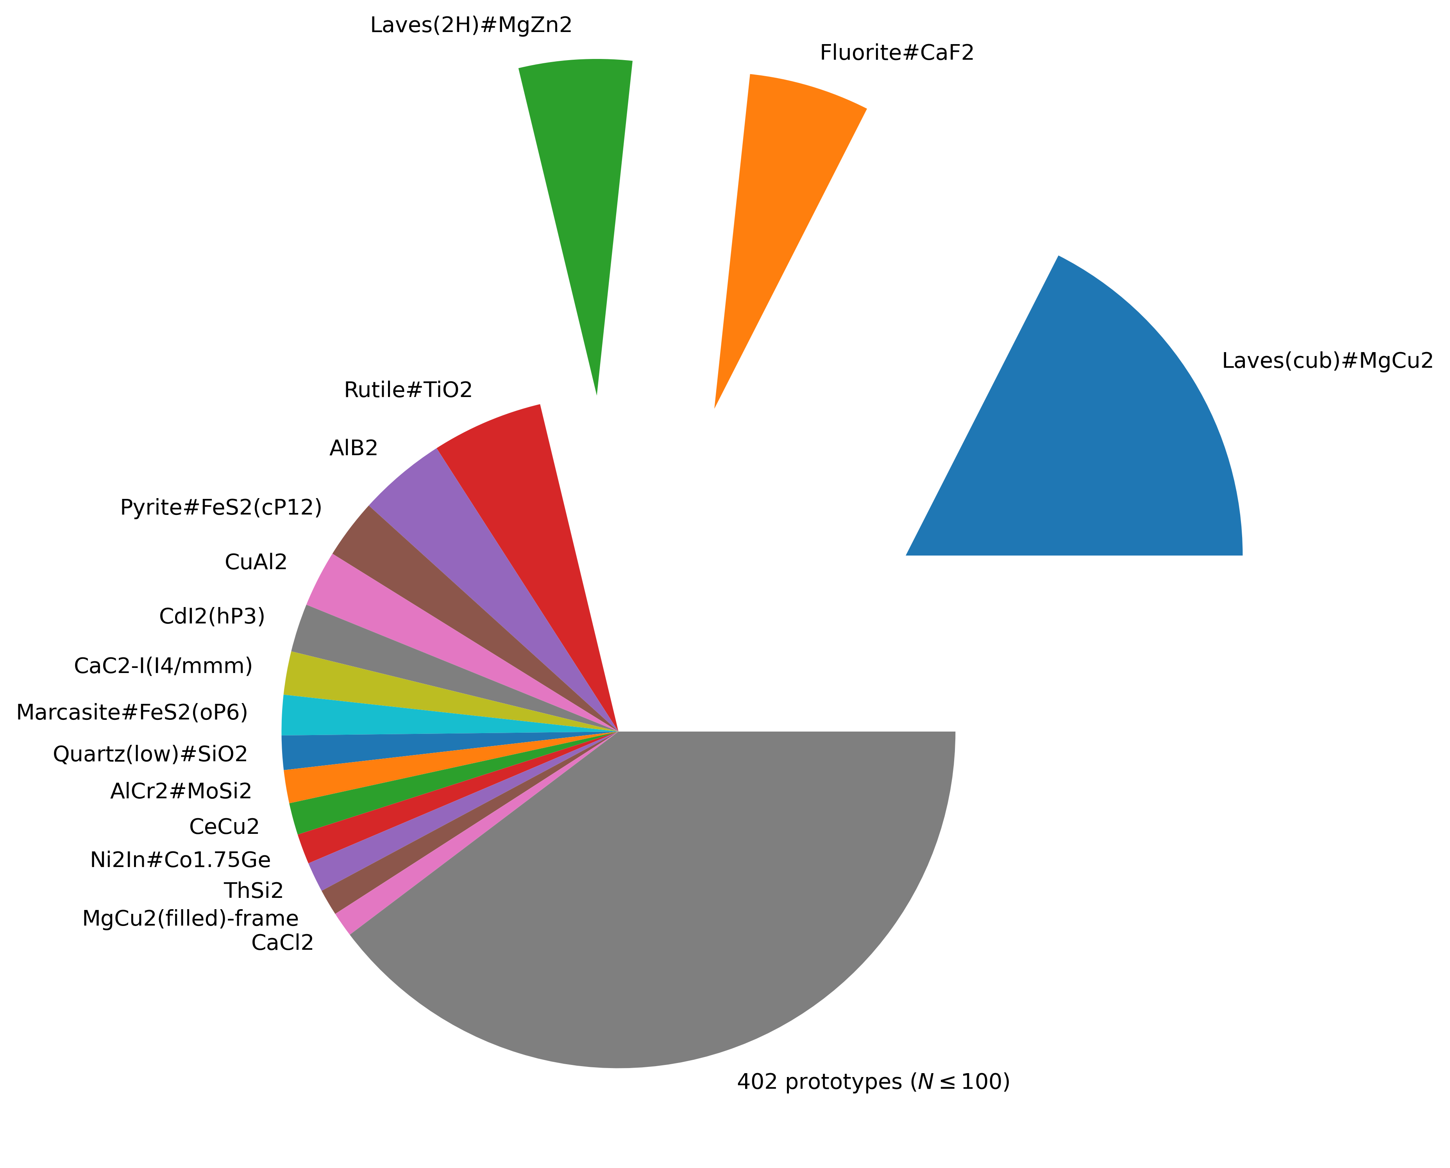
Approach - Subsampling
Labelled 8758 materials for “one-vs-all” classification
Positive: Cubic Laves phase (MgCu₂) ~1532 examples
Negative: Rest ~ 7226 examples
Balanced train/test datasets to have 50/50 representation
Subsample 1532 negative examples
80:20 train/test split
1532
1532
7226
Subsampling
Extracted prototype class distribution
Negative Examples
1225
1225
307
307
Train
Test

Slide 6
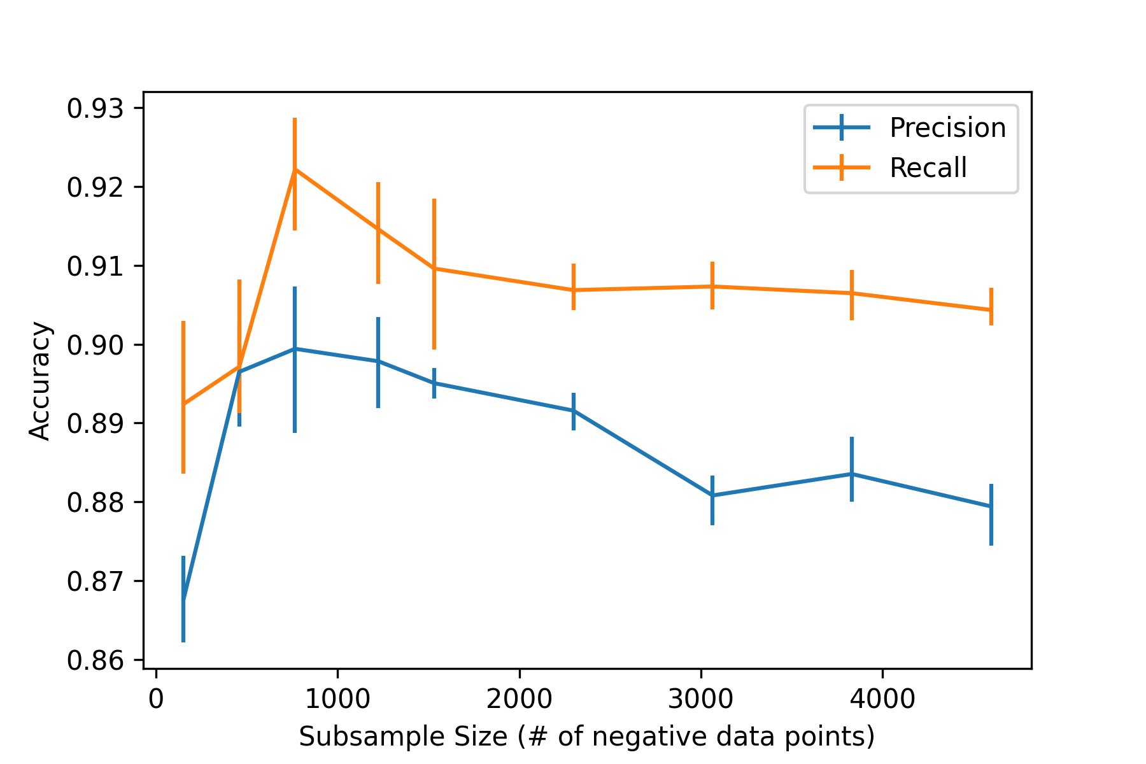
Accuracy ceiling is not sensitive to subsample size
Random forest model

Slide 7
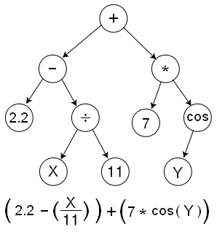
Approach – Modelling / Evaluation
Implemented symbolic classifier using gplearn to produce expression
Used default hyperparameters for evolutionary algorithm
Penalized expression length by tuning ”parsimony coefficient” (i.e. regularization)
Evaluated precision, recall on subsampled “50/50” set
Also tested predictive accuracy on negative-only set (i.e. unused for train/test)
Example expression tree (randomly generated)

Slide 8
Results – Baseline from RandomForest
Laves phase
Most important feature: (# p electrons/# unfilled valence states)
Precision | Recall: 0.82 | 0.93
Fluorite
Most important feature: Radius ratio
Precision | Recall: 0.90 | 0.96
RandomForest feature_importances confirm chemical intuition
We expect a well-tuned symbolic learner to achieve these accuracies

Slide 9
Results – Symbolic Expression
Predicting the Cubic Laves phase:
Precision | Recall: 0.82 | 0.96
Predicting Fluorite
Precision | Recall: 0.88 | 0.77
Symbolic learner is not well-tuned
but it’s looking in the right place

Slide 10
Impact (if successful)
Formulate a data-driven tolerance factor:
using a repeatable workflow
that is simple to use and interpretable
Identify new features important for prototype classification
Create design rules for novel materials discovery

Slide 11
Future work
Feature engineering to address the units-consistency problem
Identify common important features between various expressions
Tune symbolic learner
Output confidence metric (customize prec/recall balance)
Strike balance between accuracy & generality/simplicity
Apply workflow on stoichiometries beyond AB₂
Unify symbolic learners → beyond binary classification
Tradeoff between generality and interpretability

