Slide 1
Generalizing the Goldschmidt tolerance factor beyond perovskites using symbolic learning Final Presentation Andrew Lee, Albert Vong, Kyle Miller

Slide 2
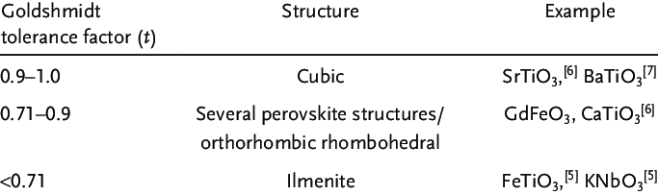
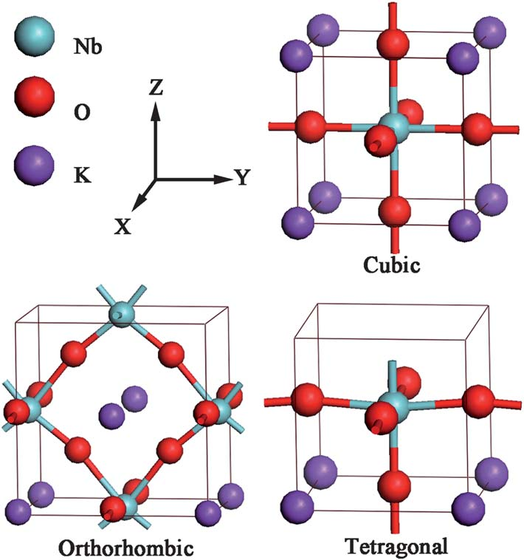
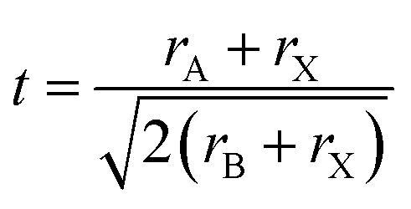
Problem Statement
Develop “tolerance factor” that predicts whether an AB₂ material is synthesized as a specific structural prototype
Expression is simple, with room for physical intuition
Low experimental barrier for high-throughput screening
Does not need modelling experience (i.e. this is simply a formula!)

Slide 3


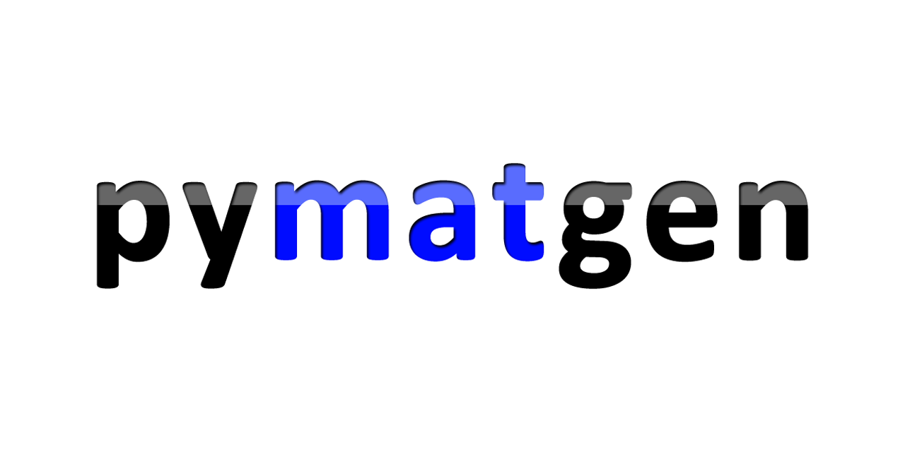
Data-intensive resources
Extracted AB₂ .cif files from the ICSD – 17171 total
Filtered out unwanted CIFs– 8758 remaining
3 elements, partial occupancies, theoretical files
Extracted prototype information from .cif files
Total of 418 unique prototypes
Featurized the A and B elements using Matminer w/ Magpie preset
22 types of features * 2 elements = 44 base features

Slide 4
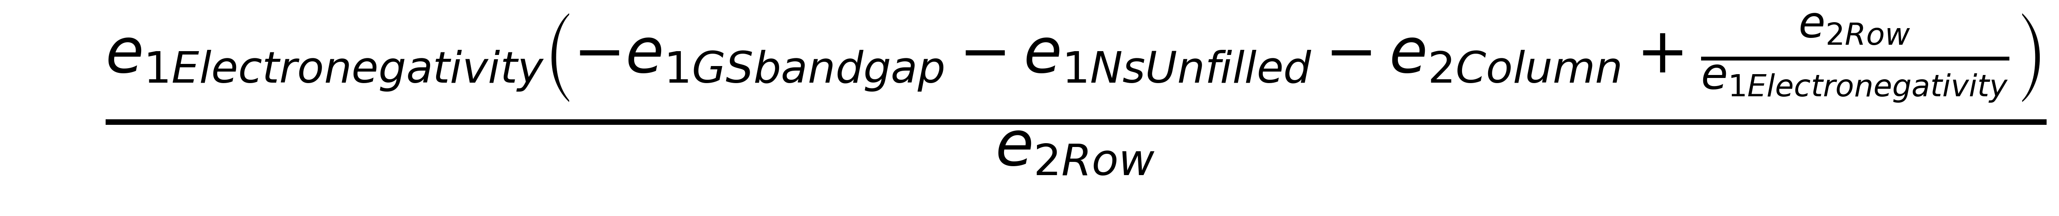
Approach - Featurization
Enforced dimensionless expressions via feature engineering
Convert all features to feature ratios (e.g. A/B instead of A and/or B)
44 features -> 1200 ratio features
Pruned features via Random Forest feature importance
Example expression with non-physical units

Slide 5
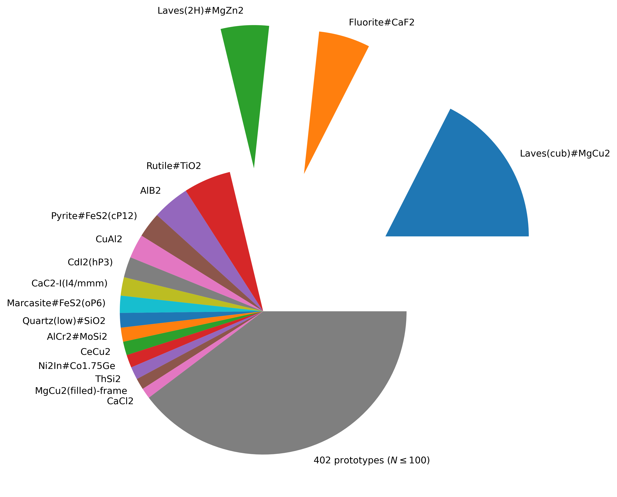
Approach - Subsampling
Labelled 8758 materials for “one-vs-all” classification
Positive: Laves (MgCu₂) ~1532 examples
Negative: Rest ~ 7226 examples
Balanced train/test datasets to have 50/50 representation
Subsample 1532 negative examples
80:20 train/test split
1532
1532
7226
Subsampling
Extracted prototype class distribution
Negative Examples
1225
1225
307
307
Train
Test

Slide 6
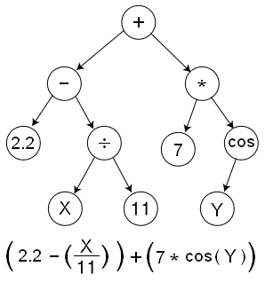
Approach – Modelling / Evaluation
Implemented symbolic classifier using gplearn to produce expression
“Evolves” randomized expressions to better classify training data
Penalized expression length by tuning ”parsimony coefficient” (i.e. regularization)
Evaluated precision, recall on subsampled “50/50” set
Also tested predictive accuracy on negative-only set (i.e. unused for train/test)
Example expression tree (randomly generated)

Slide 7
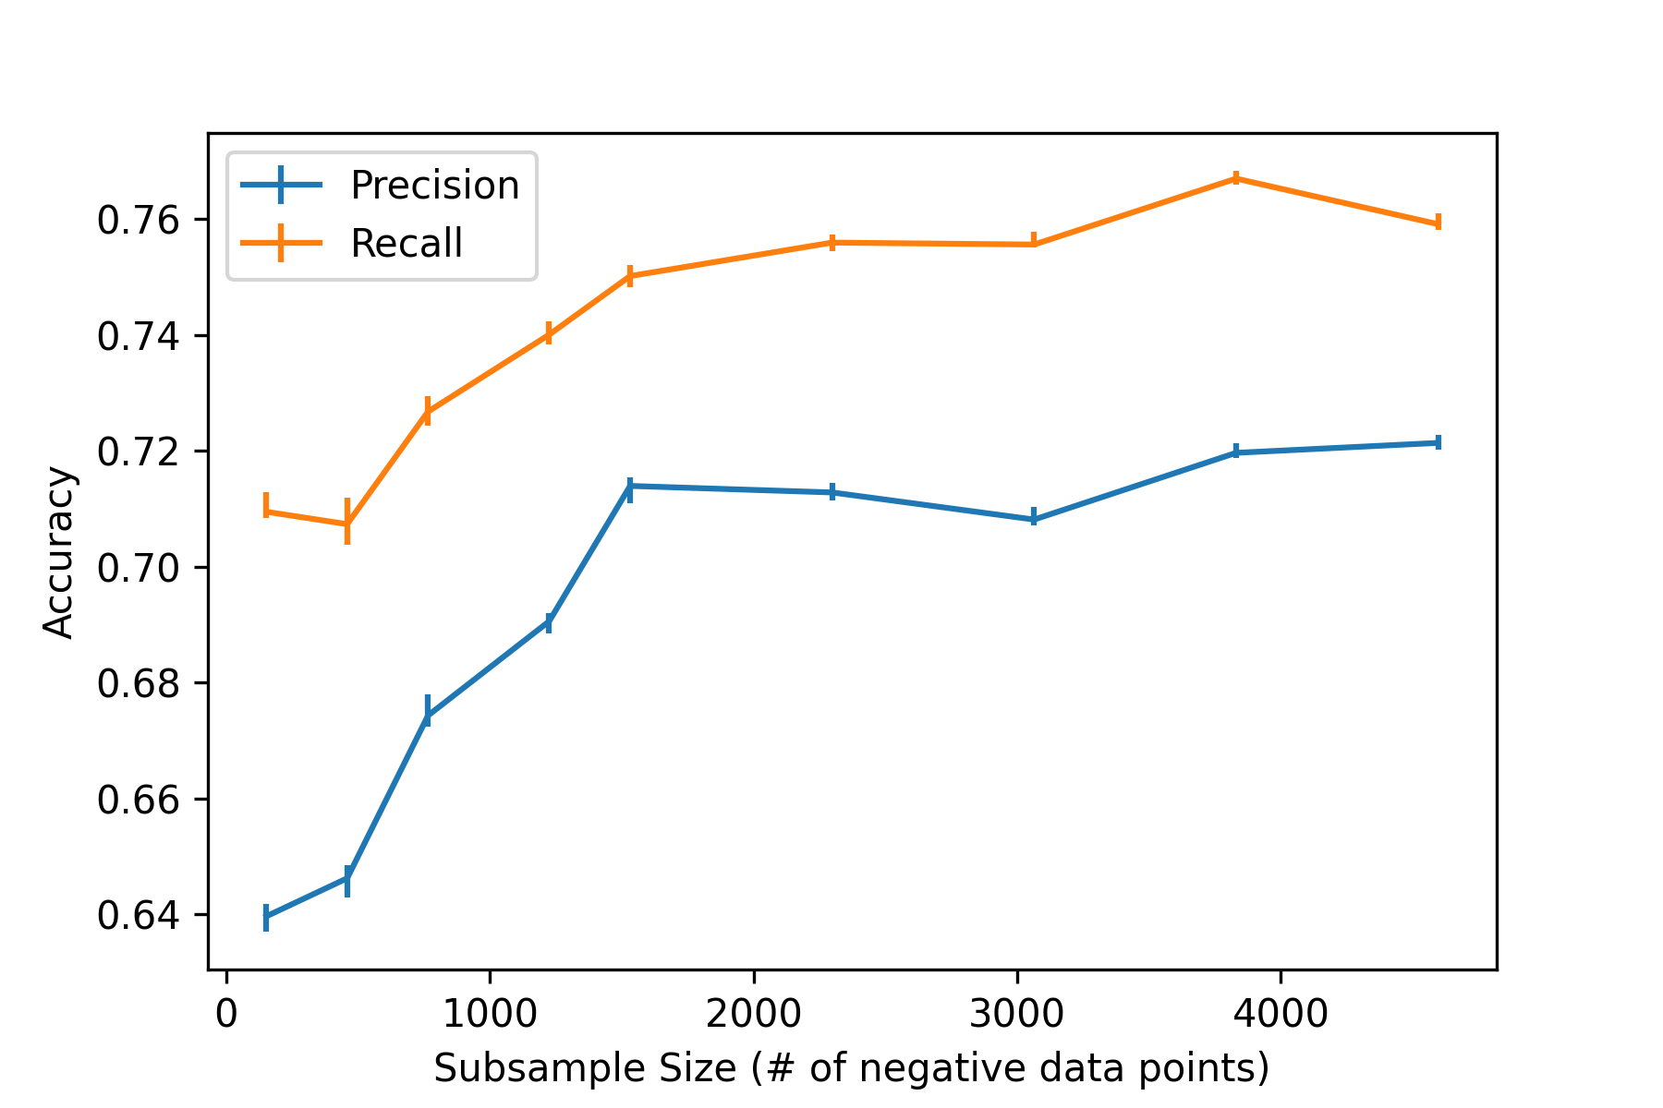
Results – Data Bias
Subsampling has minimal impact on data bias
Fit RF over many trials on different subsamples

Slide 8
Results – Symbolic Expression
Final expression is fairly simple
Precision ~
Recall ~

Slide 9
Impact (upon project completion)
Data-driven tolerance factor:
Replicable workflow
Simple to use and interpretable (plug and play)
Identify features important for prototype classification
Small list due to symbolic regression simplicity

Slide 10
Future work
Feature engineering to address the units-consistency problem
Apply workflow on stoichiometries beyond AB₂
Investigate other classes in AB₂
Identify common important features between various expressions
Expression similarity metrics (tree representation)

