Slide 1


YouTube Comment Spam Detection
DSP Project
By Albert Zihan Zeng
2023-11-04
Notes:
Hello everyone, welcome to my channel.

Slide 2

AGENDA
Objectives
Hypothesis
Data Preprocessing
Exploratory Analysis
Modeling
Model Evaluation
Recommendations

Slide 3
OBJECTIVES
Overview: The proliferation of online platforms, especially social media and video-sharing websites like YouTube, has brought forth the challenge of dealing with spam. YouTube, being one of the largest video-sharing platforms, relies heavily on user engagement through comments. However, this engagement feature is often exploited by spammers to spread malicious content, irrelevant links, or disruptive messages.
Problem Statement: The YouTube Comment Spam Detection Project addresses this issue by implementing machine learning and natural language processing (NLP) techniques to automatically identify and filter out spam comments. The primary goal of this project is to enhance user experience, maintain a healthy commenting environment, and ensure that viewers and creators can engage in meaningful conversations without being disturbed by spammy or harmful content.
Objectives:
Develop a machine learning model that correctly sorts YouTube comment into spam or ham (legitimate) groups.
Make sure the model can keep up with the changing nature of spam messages to keep its accuracy high over time.
Lowering the chance of wrongly labeling comments, to ensure that less legitimate comments are wrongly marked as spam.
Test different algorithms to find the best one for this job.
Help ongoing research in spam detection by offering a strong and scalable solution that could be used for other forms of digital communication too.

Slide 4
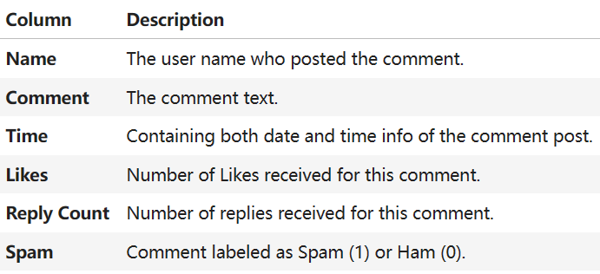
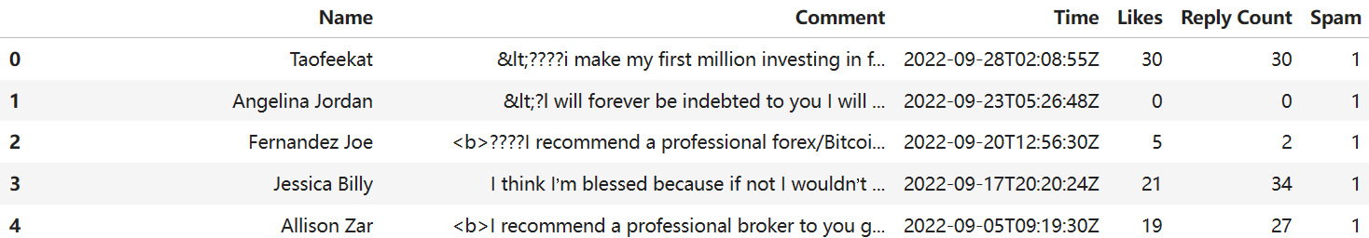
DATA SOURCE
The dataset used in this project consists 5000 comment consisting 2500 of each spam and not spam comments gathered from various YouTube videos.
The original dataset was downloaded from: https://www.kaggle.com/datasets/madhuragl/5000-youtube-spamnot-spam-dataset

Slide 5
HYPOTHESIS
Comments which are labeled as spam mostly have a positive sentiment
There are less spam comments generated in weekends
There are less spam comments generated at night times
Positive sentiment comments have more likes and replies
Spam comments are more likely to have longer comment length
There is a linear positive relationship between Likes and Reply Count
Duplicated comment post within the same day are highly likely to be spam

Slide 6
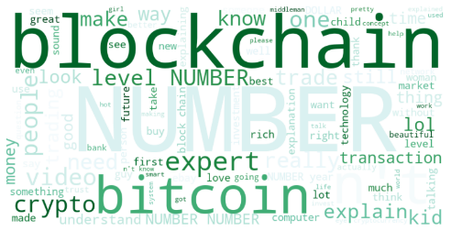

DATA PREPROCESSING
Text Cleaning
Read HTML Symbols
Combine Name and Comment
Tokenize
Regex Cleaning
Remove Stop Words
Lemmatize
Combine as Text
HAM:
SPAM:

Slide 7
Feature Engineering
Sentiment Analysis (Positive, Neutral, Negative)
Comment Length (number of characters in comment)
Log transformation on Likes and Reply Count
Extract and convert Datetime
Date
Year/Month/Day
Day of Year
Hour
Day of Week / Is Weekend
Day Part (Morning, Daytime, Night)
Duplicate Post (same comment and date)

Slide 8
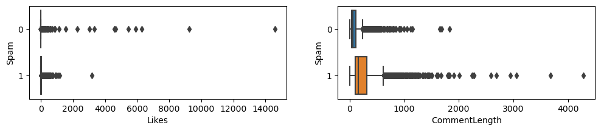
Outliers and Missing Values
Dropping extreme outliers in Likes > 2000
Dropping extreme outliers in CommentLength > .99 quantile and < 2
50 Missing values generated in Likes, filled with mode = 0
50 Missing values generated in CommentLength, removed

Slide 9
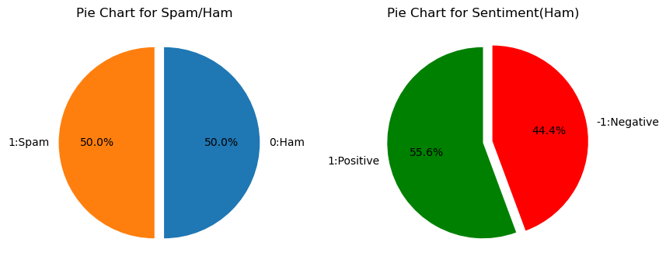
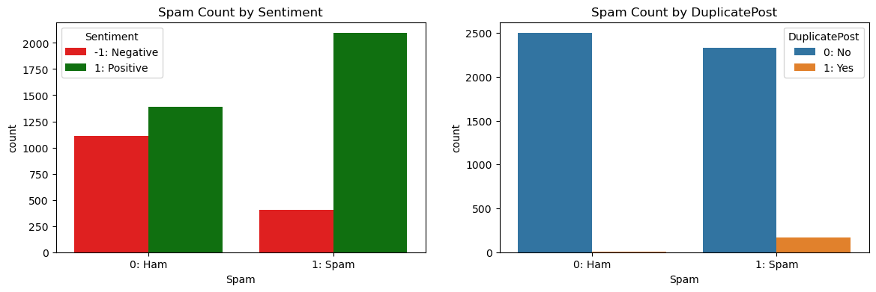
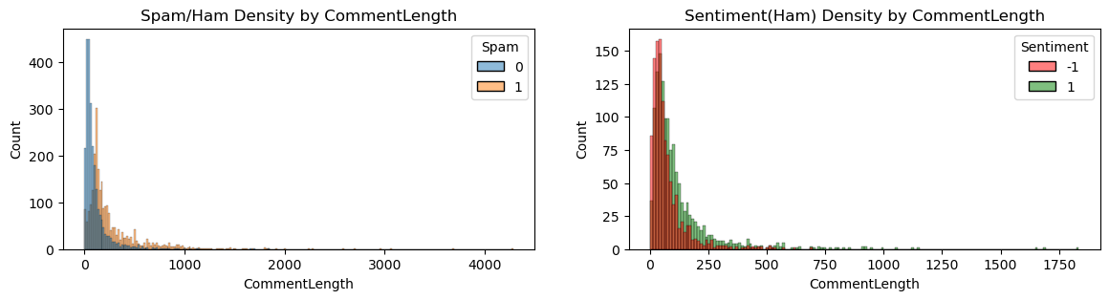
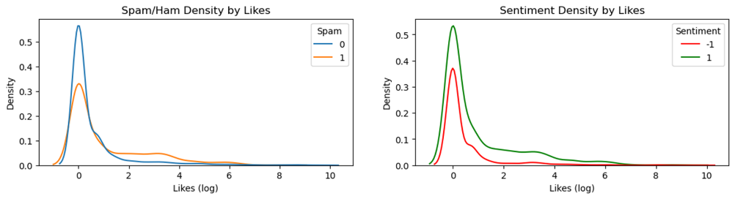
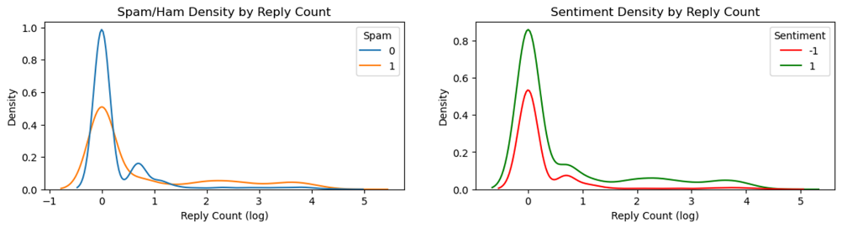
Exploratory Analysis

Slide 10
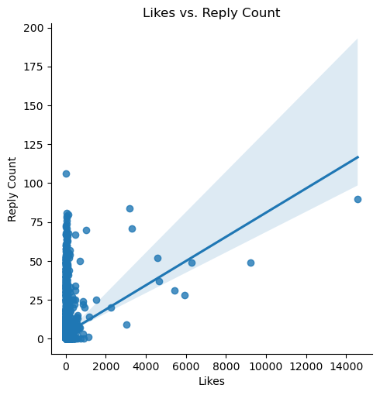
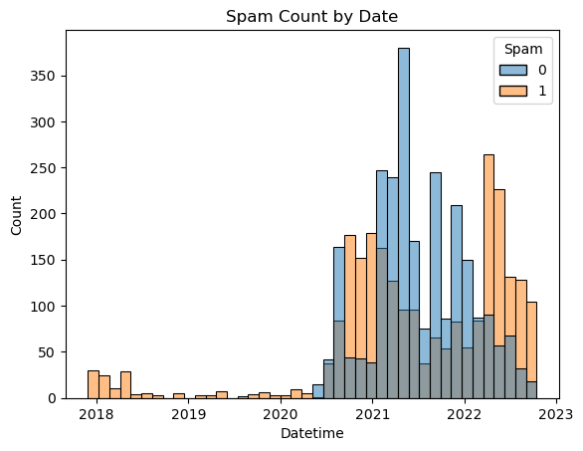
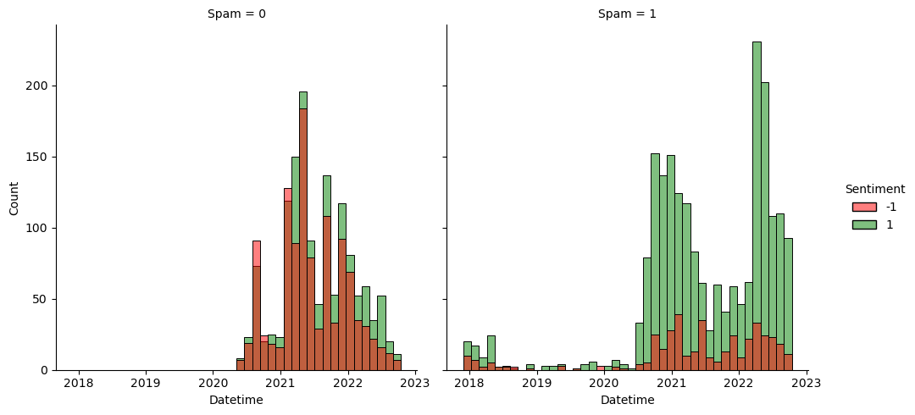
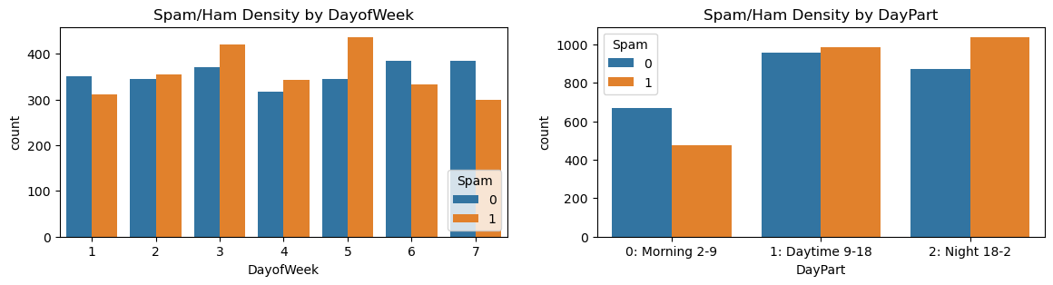
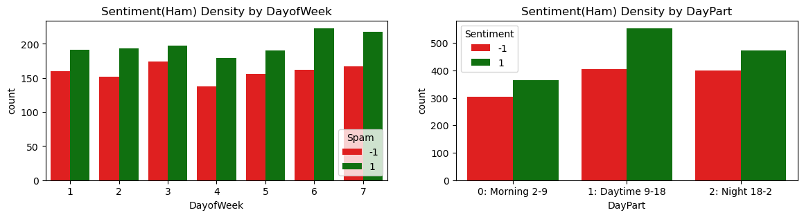
Exploratory Analysis

Slide 11
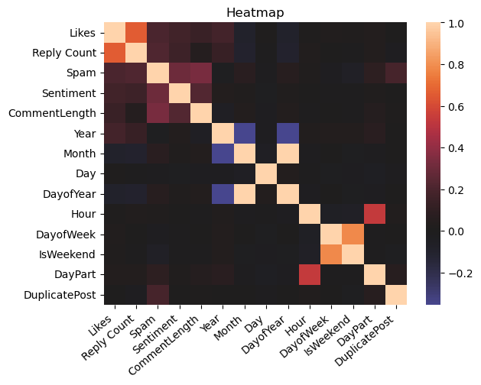
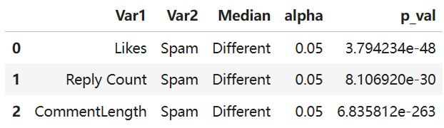
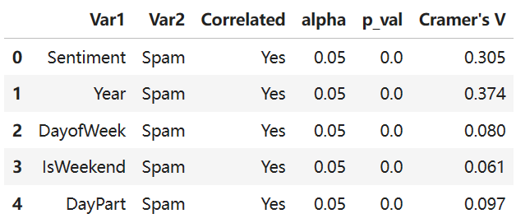
Correlations
Mann Whitney U Test:
Chi-Square Test:

Slide 12
MODELING
Two approaches for spam prediction will be tested.
Approach A: prediction models will be built based on NLP application on the name and comment text.
Approach B: prediction models will be built based on related attributes of the comment posts.
Split train/test sets by 0.2
X_train = 3940 x 3035 sparse matrix
Vectorize by TfidfVectorizer (min_df=3)
Split train/test sets by 0.2
X_train = 4000 x 13 array
MinMax Scaling

Slide 13
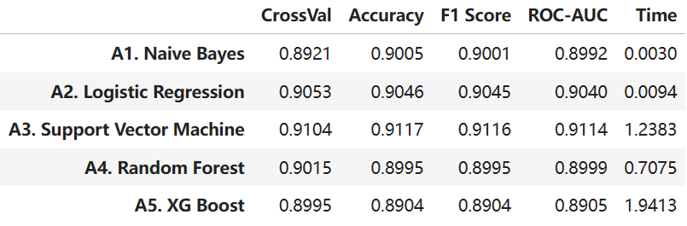
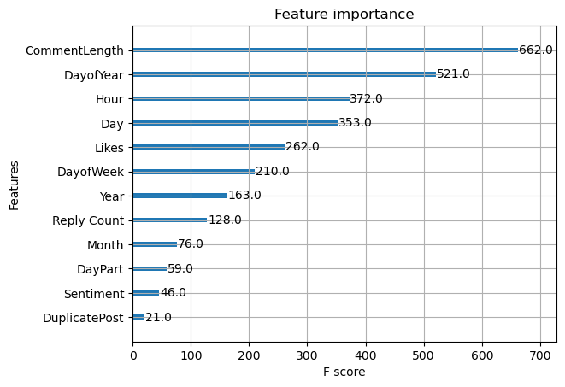
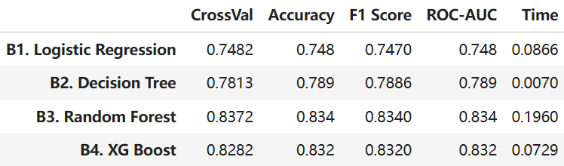
MODEL EVALUATION
Approach A - NLP
Approach A models generally give higher accuracy score (~0.90) than approach B models (0.7-0.8)
A3 model using SVM gives highest AUC and accuracy score 0.91
Approach B provides feature importance
Approach B - Attributes

Slide 14
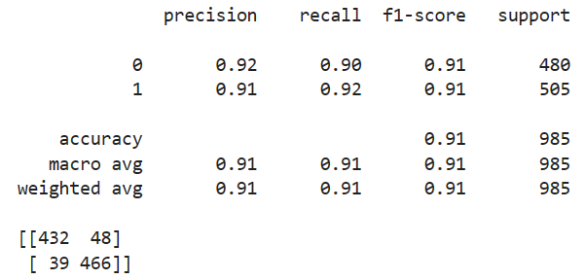
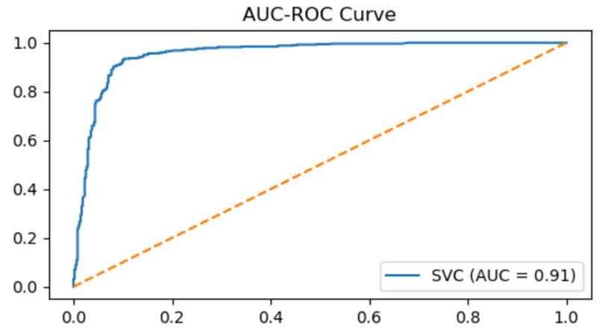
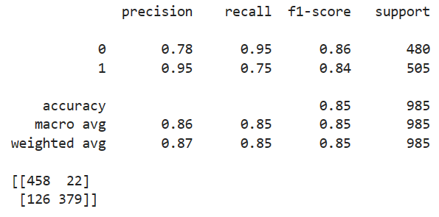
MODEL EVALUATION
The goal of this project is to predict spam comment while minimizing the error on the non-spam items.
Prediction threshold can be changed from 0.9 to achieve 0.95 recall score on class 0, meaning 95% of true ham will be correctly classified as ham.
Threshold 0.9

Slide 15
RECOMMENDATIONS
Deep Learning Models: Utilize deep learning techniques, such as recurrent neural networks (RNNs) or long short-term memory networks (LSTMs), to capture complex patterns in textual data.
Feature Engineering and Text Preprocessing: Invest time in careful feature engineering and text preprocessing. Extract relevant features from comments, such as the presence of hyperlinks, excessive capitalization, or the frequency of specific words.
Active Learning and User Feedback Integration: Implement an active learning system where the model can continuously learn from new, labeled data. Integrate user feedback mechanisms allowing users to report potential spam comments.

Slide 16

THANK YOU

